Slide 1
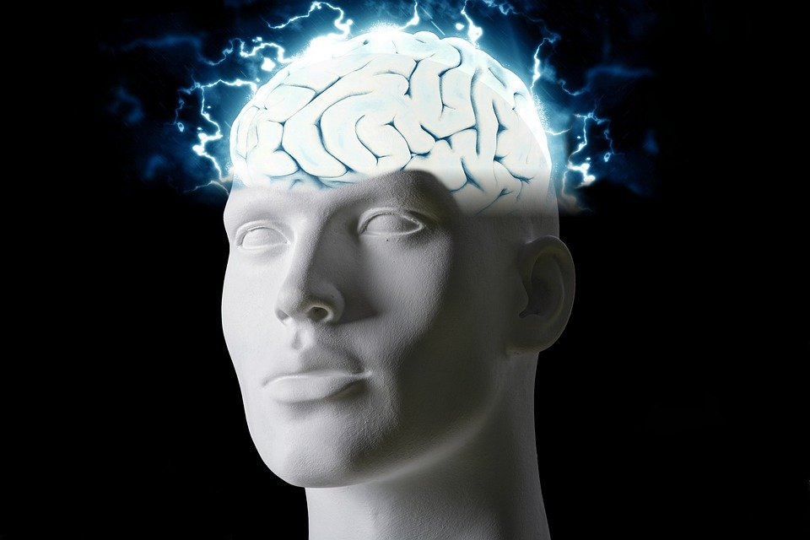
Regions of the Brain

Slide 2
For today’s assignment, you will create a Google Slides Presentation describing the 7 regions of the brain (Frontal Lobe, Motor Cortex, Sensory Cortex, Parietal Lobe, Temporal Lobe, Occipital Lobe and Cerebellum).
You must include the following on each slide:
Description of that region’s function
Example of how you use that region’s function in your daily life
Label the included brain photos with an arrow pointing to that particular region of the brain
Once you have fully completed all 7 slides, show me you are done to earn the opportunity to make the brain hat.

Slide 3
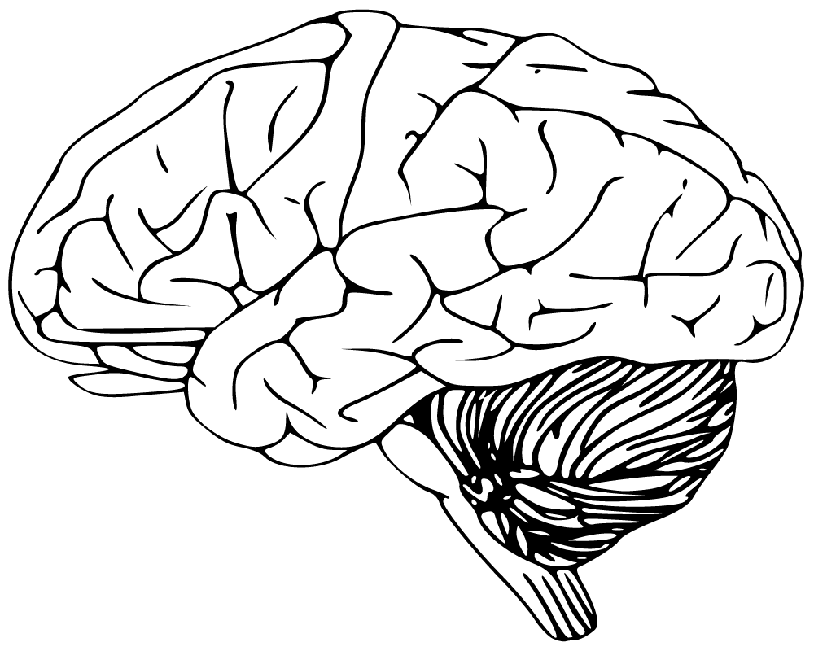
Frontal Lobe
The frontal lobes are important for voluntary movement, and expressive language
-I use this part of my brain when I speak in class.

Slide 4
Motor Cortex
This part of the brain has to do with movement.
I use this part of my brain when I move around.
This is the motor cortex

Slide 5
Sensory Cortex
This part of the brain has to do with processing somatic sensations
I use this part of my brain when I touch or feel something.

Slide 6
Parietal Lobe
This part of the rain helps process information.
I use this part of my brain when I am learning something new

Slide 7
Temporal Lobe
This part of the brain helps with processing affect/emotions, language, and certain aspects of visual perception.
I use this part of my brain when I feel emotions, when speak, and to see.

Slide 8
Occipital Lobe
The occipital lobes sit at the back of the head and are responsible for visual perception, including color, form and motion.
I use this part of my brain when I see things

Slide 9
Cerebellum
The cerebellum is important for making postural adjustments in order to maintain balance.
I use this part of my brain when I need to maintain my balance, or even when I am just walking.

