Slide 1
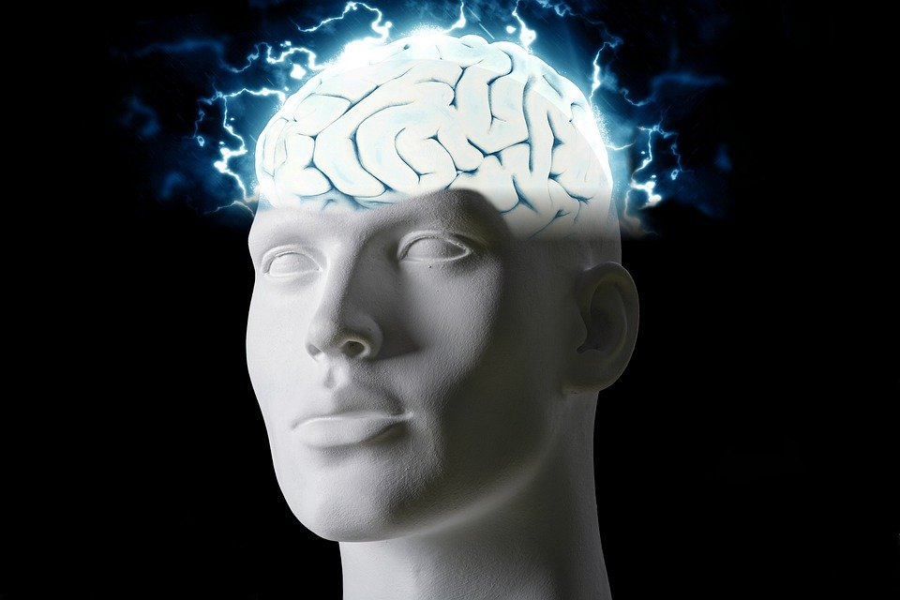
Regions of the Brain

Slide 2
For today’s assignment, you will create a Google Slides Presentation describing the 7 regions of the brain (Frontal Lobe, Motor Cortex, Sensory Cortex, Parietal Lobe, Temporal Lobe, Occipital Lobe and Cerebellum).
You must include the following on each slide:
Description of that region’s function
Example of how you use that region’s function in your daily life
Label the included brain photos with an arrow pointing to that particular region of the brain
Once you have fully completed all 7 slides, show me you are done to earn the opportunity to make the brain hat.

Slide 3
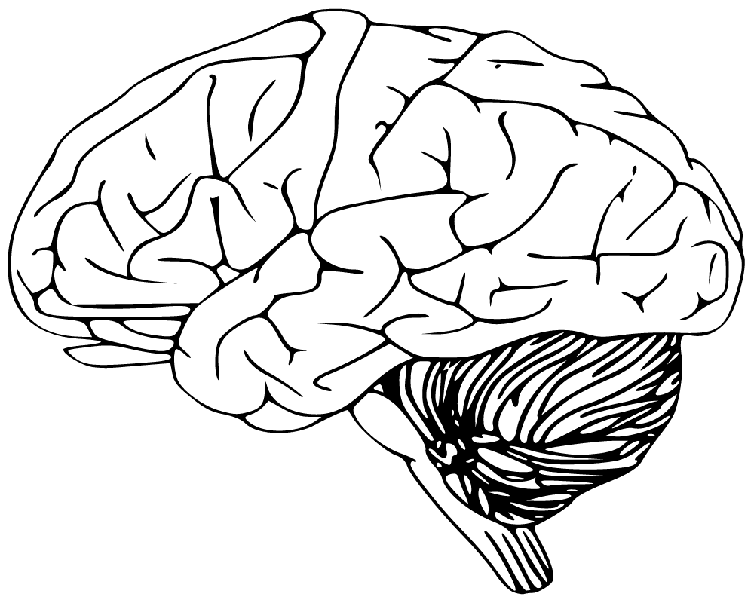
Cerebellum
Has to do with speaking and your balance
I use this part of my brain to walk.

Slide 4
Frontal lobe
Has to do with your voluntary movement,expressive language,and for managing higher level extensive function.
I use this part of my brain to organize, plan and respond.

Slide 5
Motor cortex
Has to do with generating signals to direct the movement of the body.
I use this part of my brain for planning, control, and execution of voluntary movements.

Slide 6
Sensory Cortex
The sensory cortex is responsible for processing somatic sensations.
I use this part of my brain for Vision,Sound,Smell,Taste and Touch.

Slide 7
Parietal Lobe
Has to do with telling you information about temperature, taste, touch, and movement.
I use this part of my body to touch, feel pain, temperature, and the sense of the limb position.

Slide 8
Temporal Lobe
The temporal lobe processes memories, sensation of taste, sound, and touch.
I use this part of my brain for processing affect/emotions, language , and certain aspects of visual perception

Slide 9
Occipital Lobe
The occipital Lobe is responsible for visual perception, including color form and motion.
I use this part of my brain for visuospatial processing, distance and depth perception, color determination object and face recognition and memory information

