Slide 1
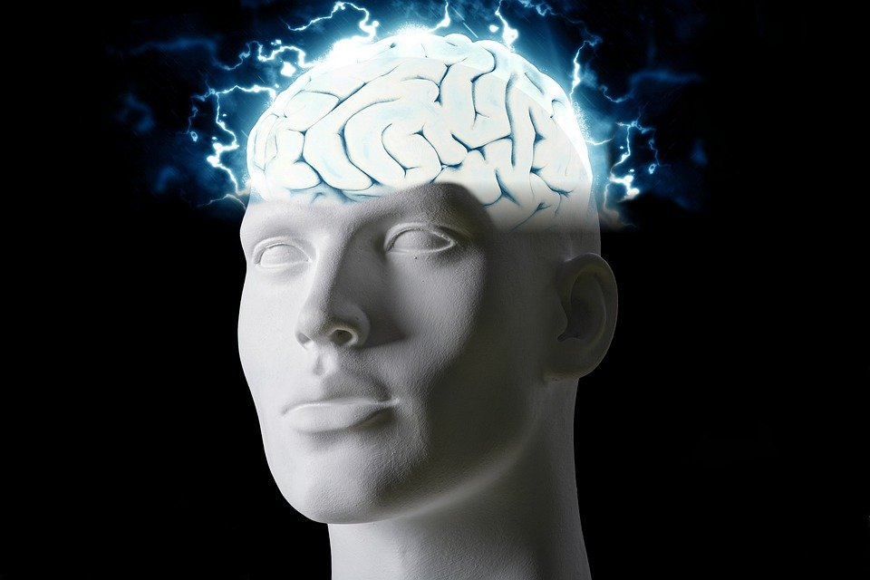
Regions of the Brain

Slide 2
For today’s assignment, you will create a Google Slides Presentation describing the 7 regions of the brain (Frontal Lobe, Motor Cortex, Sensory Cortex, Parietal Lobe, Temporal Lobe, Occipital Lobe and Cerebellum).
You must include the following on each slide:
Description of that region’s function
Example of how you use that region’s function in your daily life
Label the included brain photos with an arrow pointing to that particular region of the brain
Once you have fully completed all 7 slides, show me you are done to earn the opportunity to make the brain hat.

Slide 3
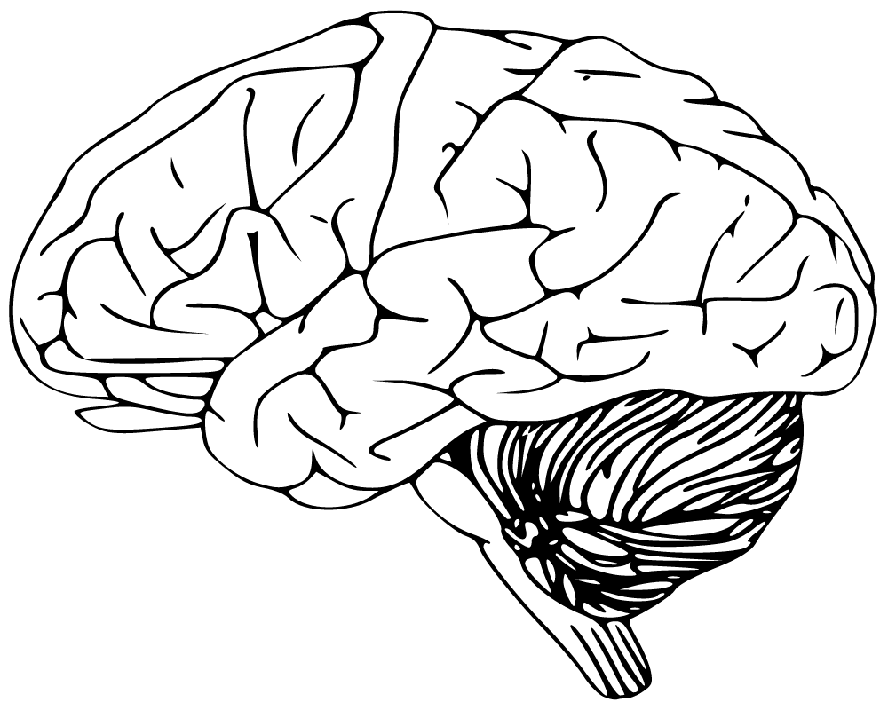
Frontal Lobe
-Has to do with voluntary movement
-I use this part of my brain when I want to move around

Slide 4
Motor Cortex
-Has to do with movement
-I use this part of my brain when I move around

Slide 5
Sensory Cortex
-Has to do with processing somatic sensations
-I use this part of my brain when I think things

Slide 6
Parietal Lobe
-Has to do with processing information
-I use this part of my brain when I get told something

Slide 7
Temporal Lobe
-Has to do with emotions and language
-I use this part of my brain when I talk

Slide 8
Occipital Lobe
-Has to do with vision and motion
-I use this part of my brain when I look at things

Slide 9
Cerebellum
-Has to do with speaking and your balance
-I use this part of my brain when I walk

