Slide 1
All About Me
By:Aidan Leo Berg

Slide 2
About me
My name is Aidan Leo Berg I am 12 years old and I was born on April 1st 2009 My nicknames are:Aidano,Zuckerberg.
I was born in Yuba city

Slide 3
My Family
I have 2 brothers and 1 sister,they are 24,22,14.My mom and dads names are Ami and Ryland and my siblings names are Robert,Kaleb,Kyia.My mom and dad are 44 and 41 years old.

Slide 4
My pets
So my pets names are Nala,Kimber and Murky there all dogs they are all german shepherds to I also have 4 cats Bootsie,Dillen,Ebine,and Sassy I also have a guinea pig named Nutmeg.

Slide 5
My hobbies
My hobbies are gaming,fishing,drawing,singing, and writing speeches I do these hobbies a lot and I enjoy them they make me happy and I know theres some people out there that have these hobbies too.

Slide 6
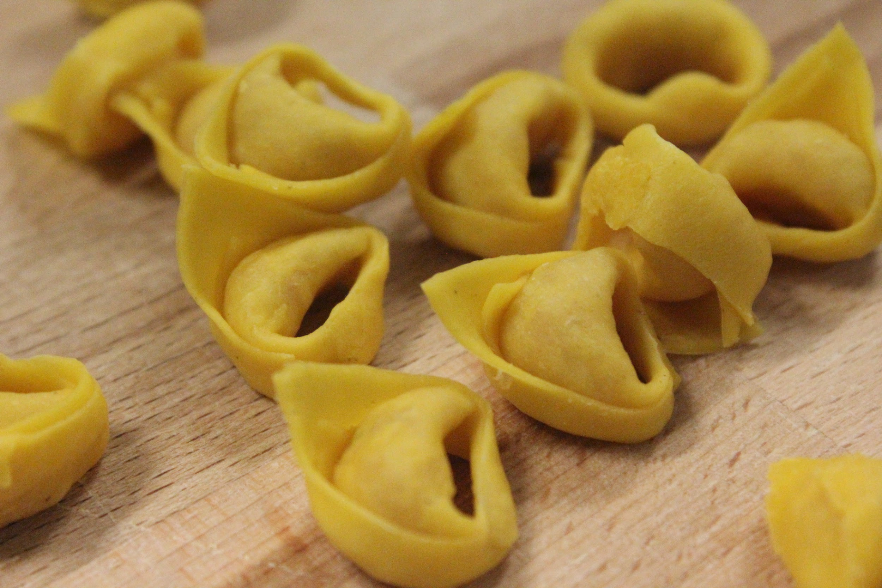
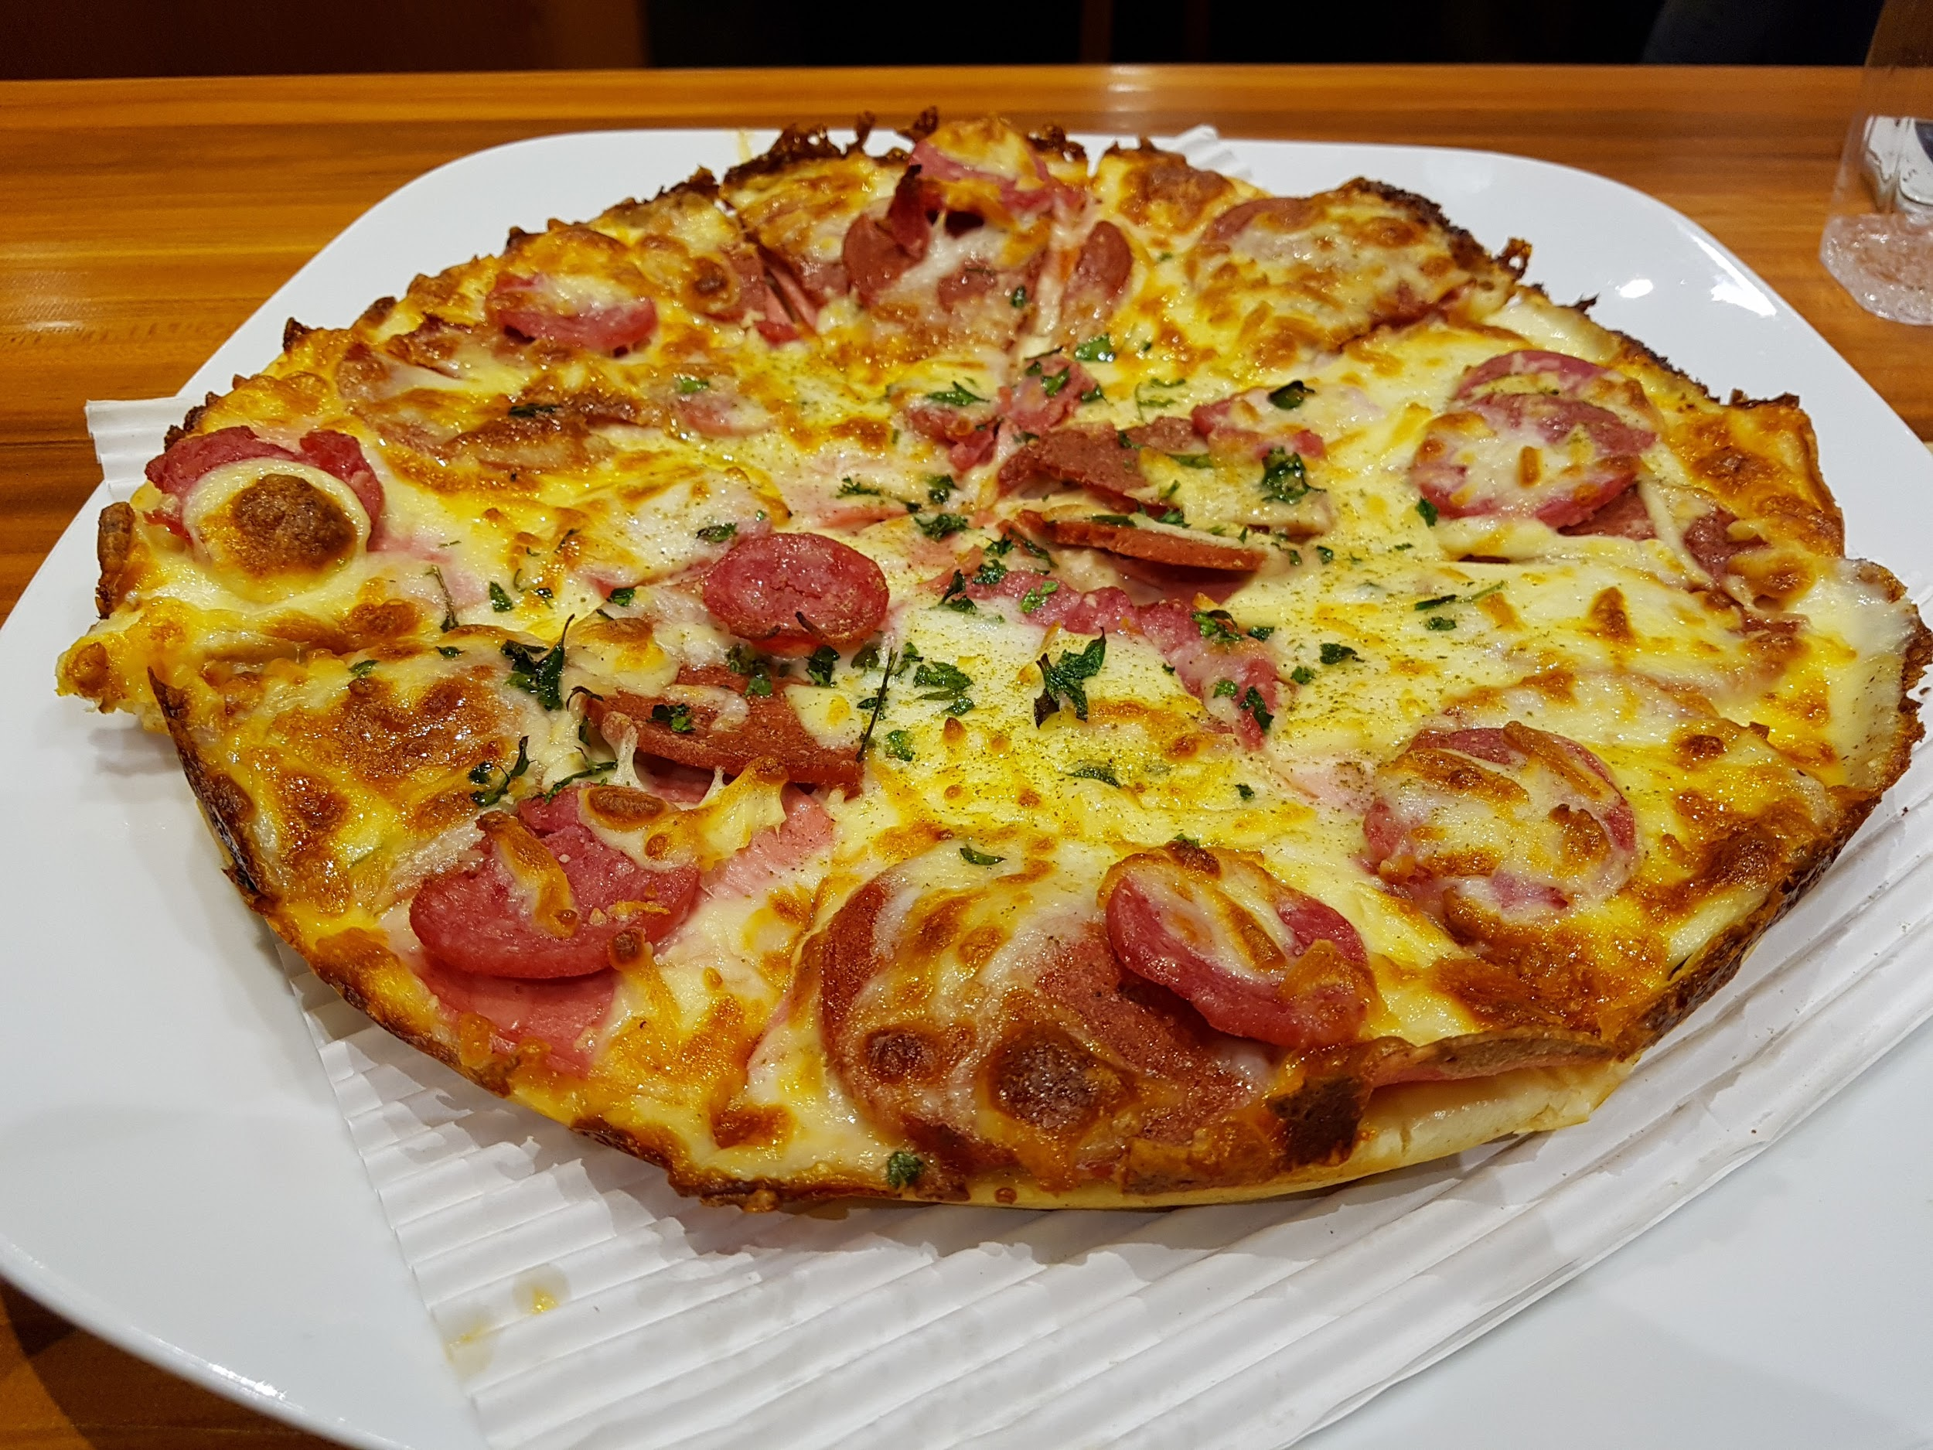
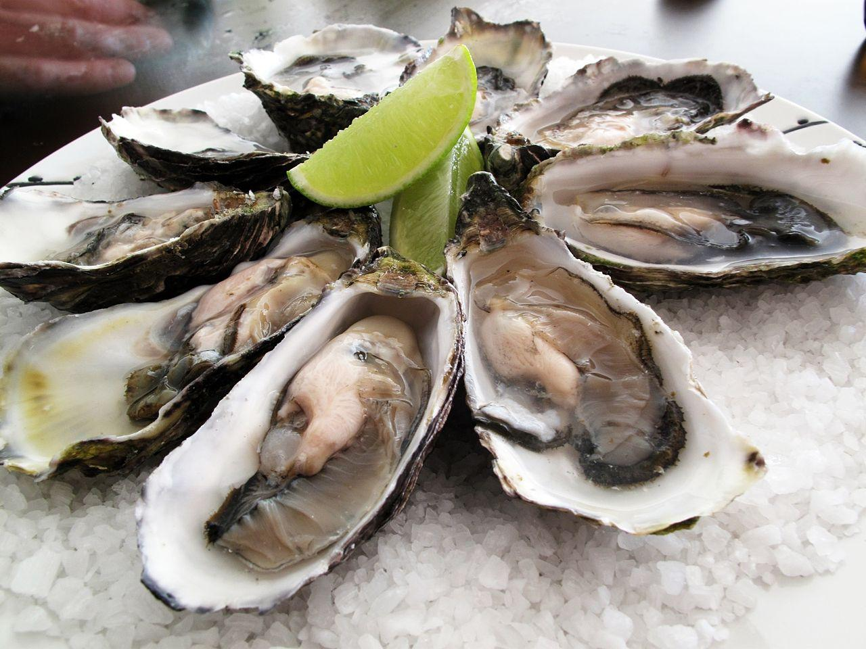
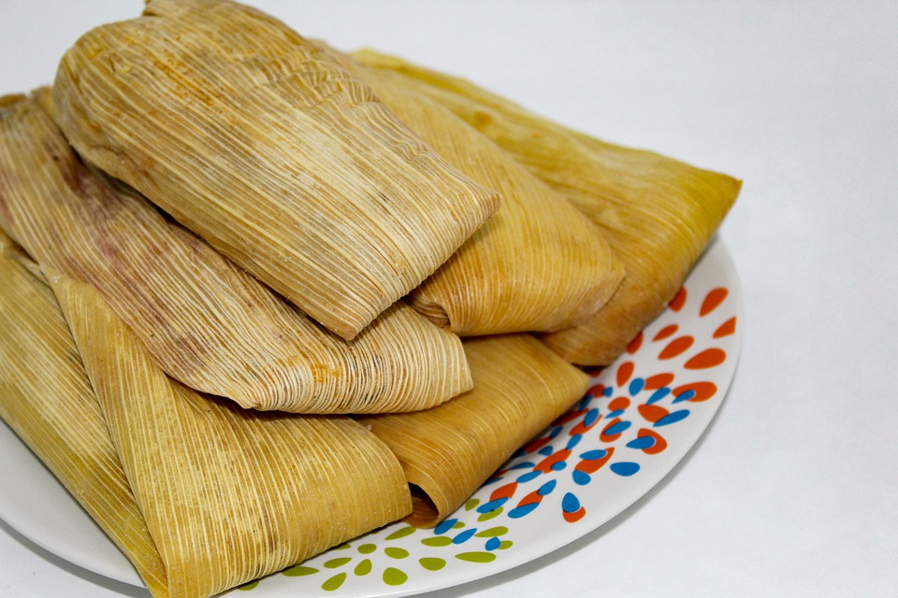
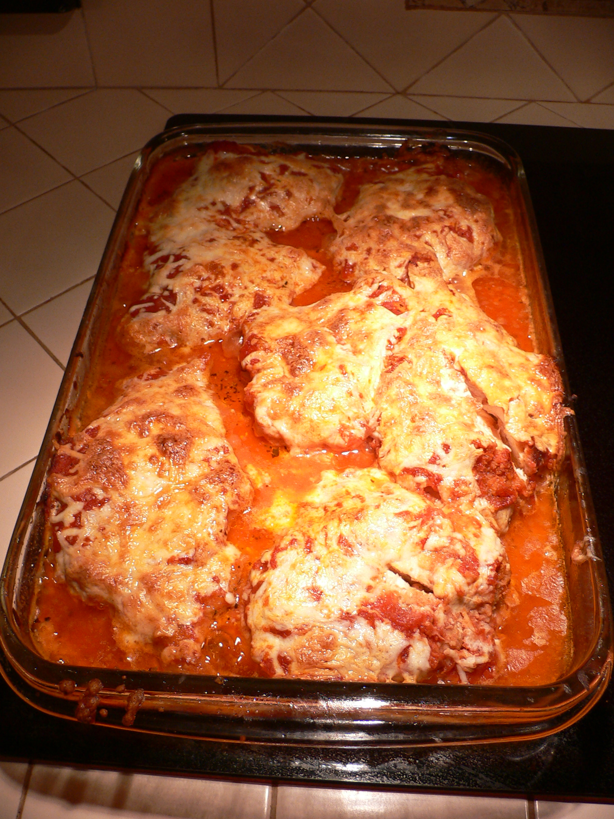
My favorite foods
Pizza
Tortellini
Oysters
Tamales
Parmesan Chicken

Slide 7


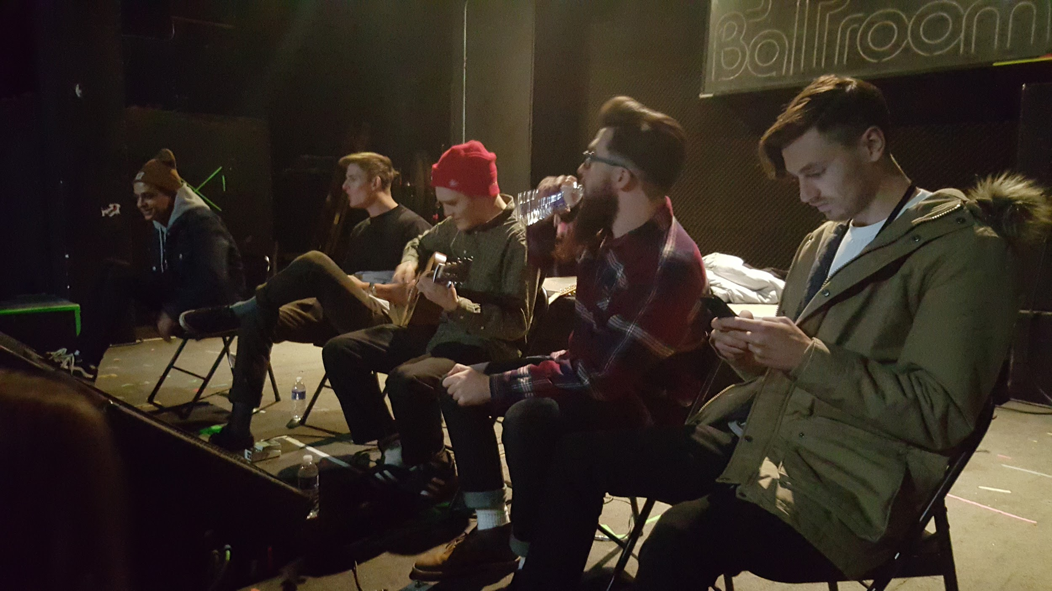
My favorite music
My favorite music group is The Living Tombstone and my favorite song is My Ordinary Life my second favorite artist Neck Deep and my favorite song is A Part Of Me.

Slide 8

My best friends
I have 5 best friends there names are felix,jalen,jullisa,briana and jovan. I also have bestie for the restie named Chapel. I enjoy hanging out with my friends.

Slide 9

Things I like about school
My favorite subject in school is math I love math. Some things i love about school is the kindness and welcomeness that it gives off I also love the teachers there all really nice.

Slide 10

My Personality
My personality is kind and respectful and outgoing. I am a generally good person to hang around with and to talk to. My friends think im super nice.

Slide 11
My goals for this year!
Become secretary for ASB
Become president for anime club
Get good grades this year
Get no referrals
Lose 30 pounds
Become more athletic

Slide 12
Conclusion slide
Those were my all about me slides I hope you enjoyed them and learned some more about me byeeeee!

