Slide 1
All About Me
By:
Allax Howarth

Slide 2
About Me
I was born on July 25th, 2009. My name is Allax James Howarth and I was born in Oroville, California.

Slide 3
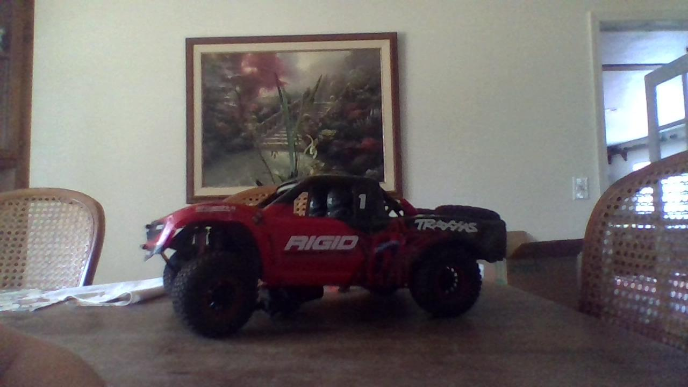
I Like RC Cars
I really like to drive RC cars. I have a Traxxas UDR, a Traxxas Slash VXL, and a Horizon Hobbies Axial SCX-24.

Slide 4
My Pets
I have 2 cats, a dog, 8 chickens, and 2 goats. My cats names are Snowball and Star, my dog’s name is Jake, and my goats’ names are Stella and Ruby.

Slide 5
My Goals For The School Year
My goals for the school year are to get good grades, have fun while doing it, and to hopefully do some fun projects like this in my classes!

Slide 6
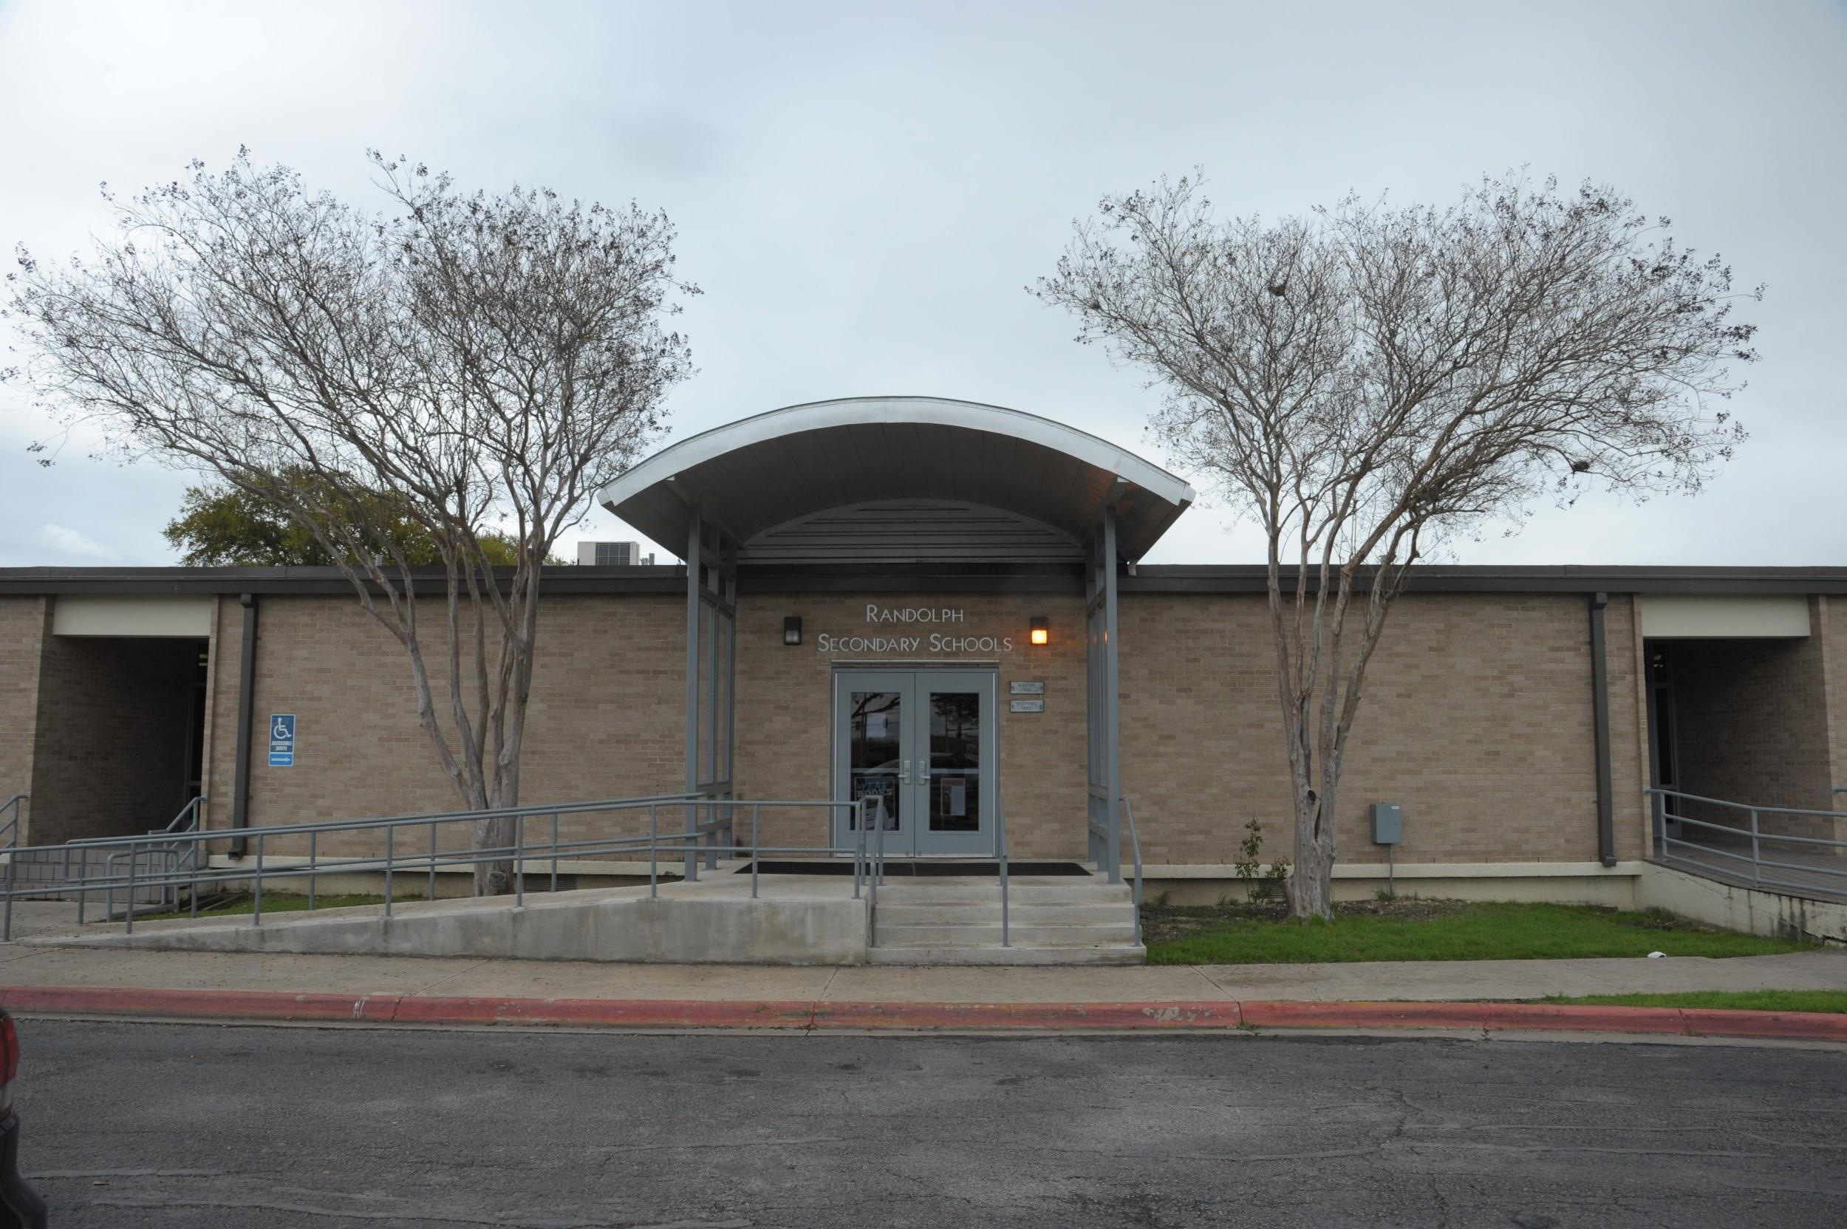
My Goals for High School
My goals for high school are to ace my tests, respect others, and just have a great time doing it.

Slide 7
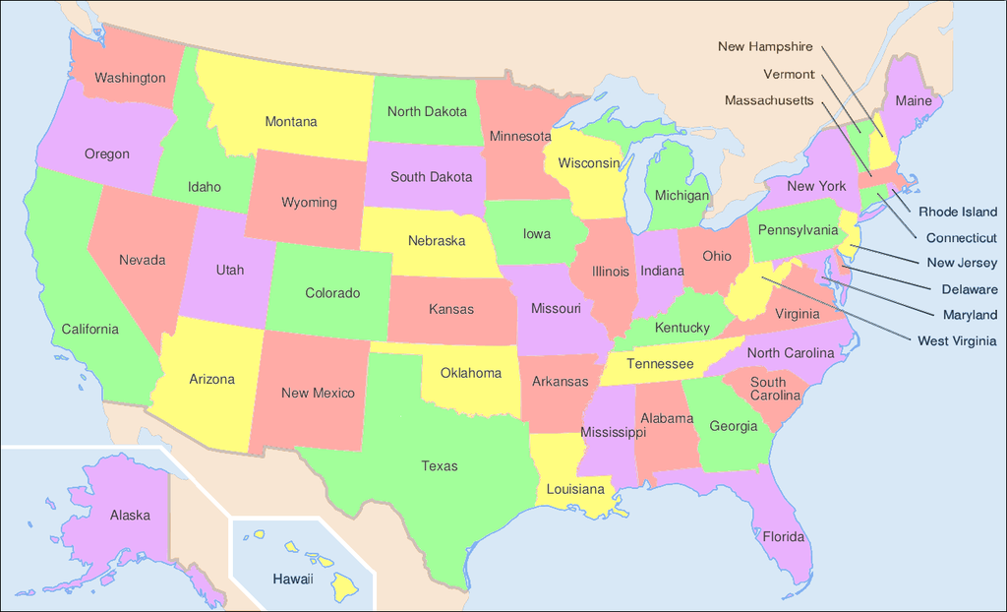
Places I Have Visited
I have visited Nevada, Oregon, Idaho, and Montana. In terms of towns/cities, I have visited Wise river, Montana, Cambridge, Idaho, Boomtown, Nevada, Reno, Nevada, and Medford, Oregon.

Slide 8
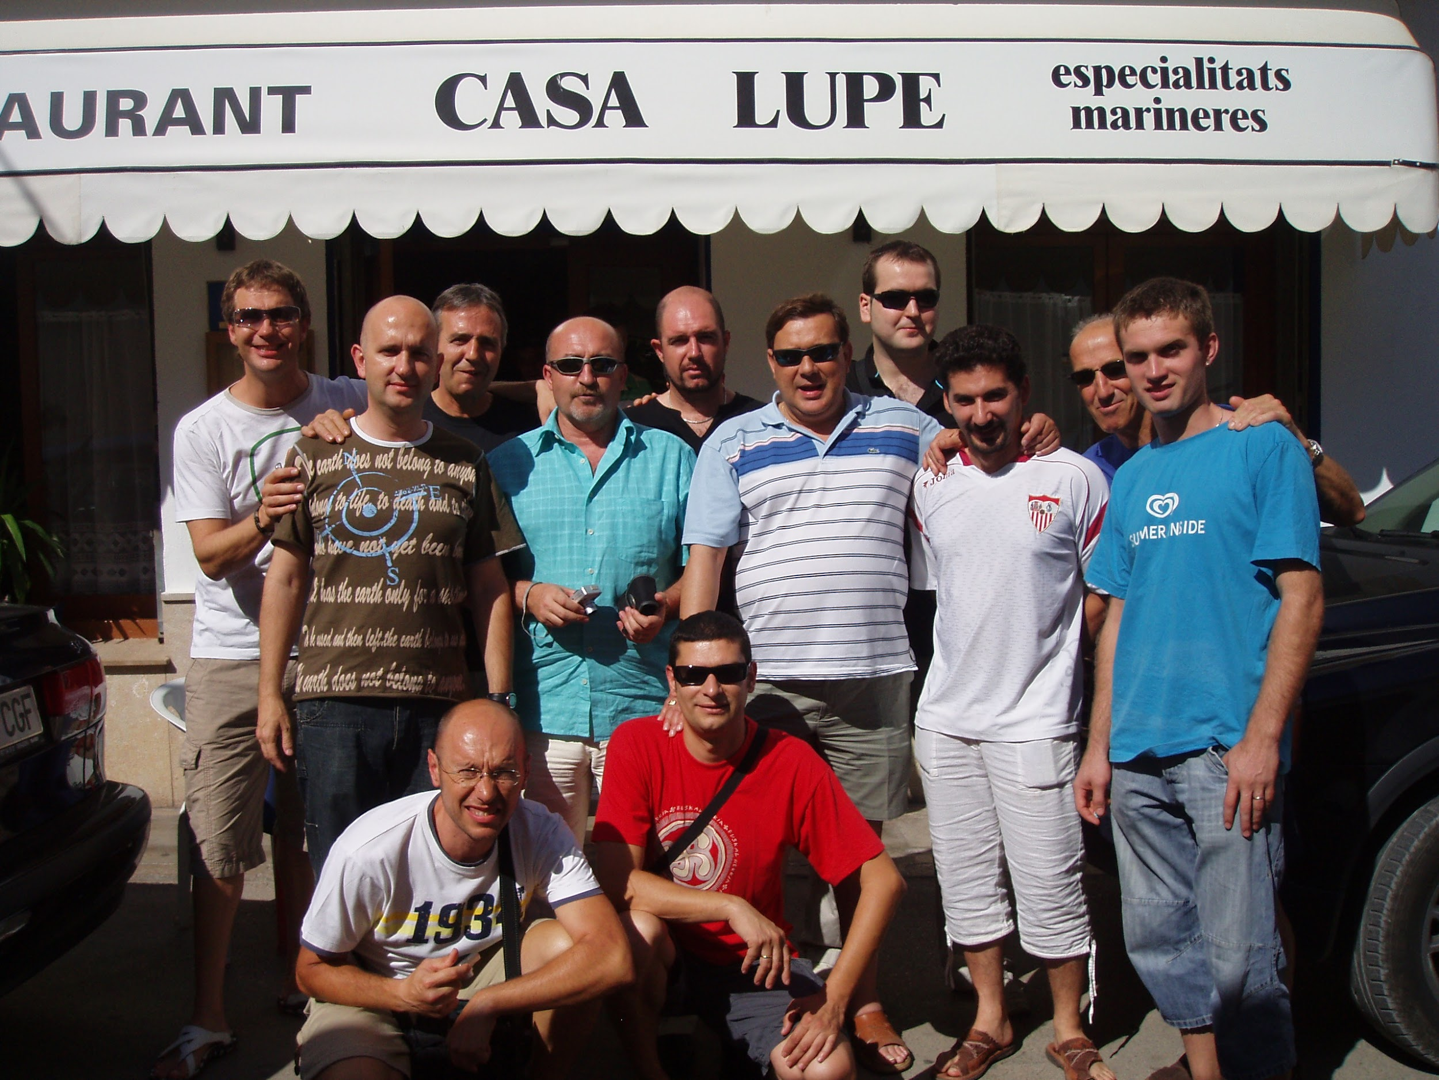
My Favorite Place To Eat
I like to eat at Casa Lupe, La Mexicana, and ABC. They all have great foods that you should try if you haven’t already.

Slide 9

My Favorite Subjects
My favorite subjects are History and Science. I love learning about the great wars, and ancient times in history. And I love learning about the organisms that make up the basic things in our lives.

Slide 10
My Personality
I think I am a quiet, hardworking, and shy person willing to try their best.

Slide 11
My Favorite Color
My favorite color is red. I really like the way its different shades reflect light and the way they look.

Slide 12
Conclusion Slide
In conclusion, my slideshow pretty much represents all the basics about me. I hope you enjoyed mine and will/enjoyed oter classmates slideshows.

