Slide 1
All About Me
By:Alyssa Barney

Slide 2
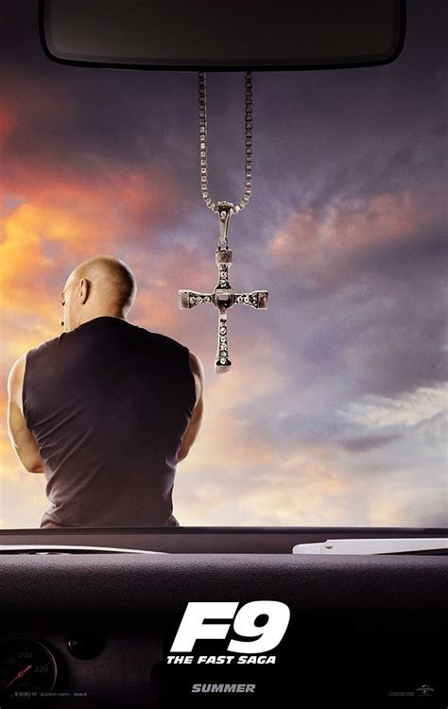
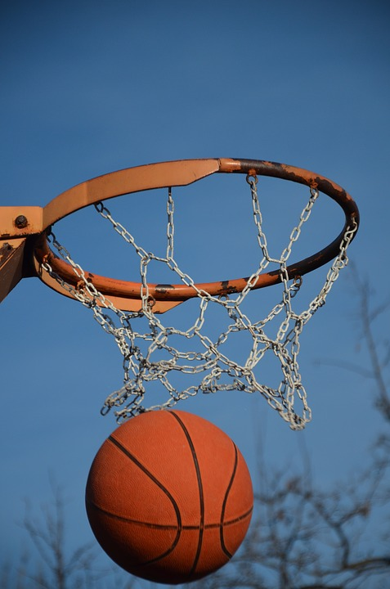
My name is Alyssa. My favorite colors are Red, Black and Blue.
Im 12 My favorite songs are :When Im gone ,2055.
07-20-2009 A movie that i like is F9. I like basketball.

Slide 3
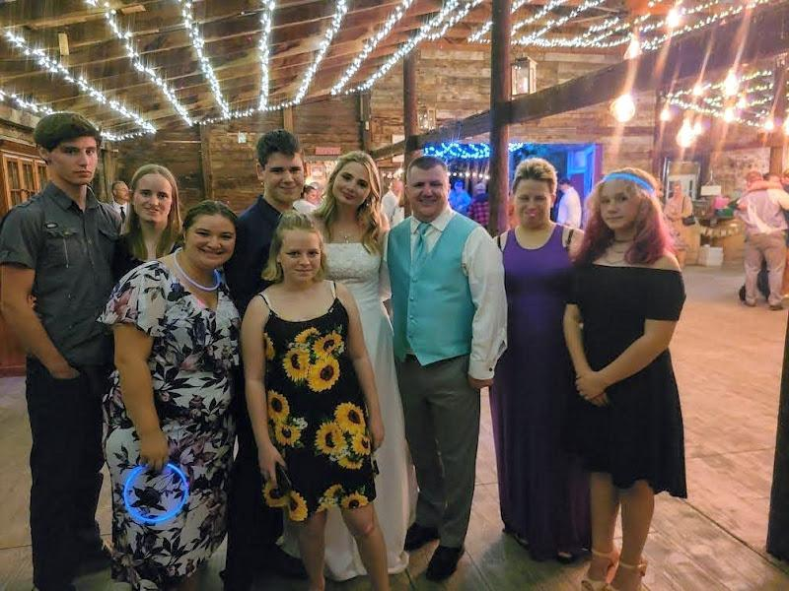
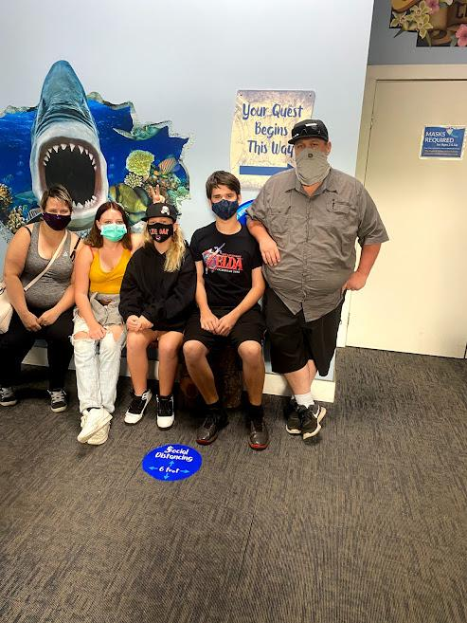
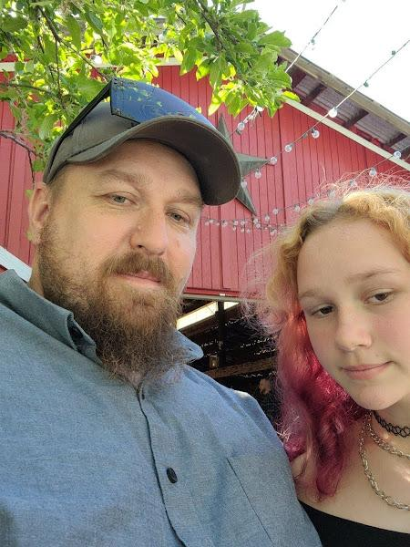
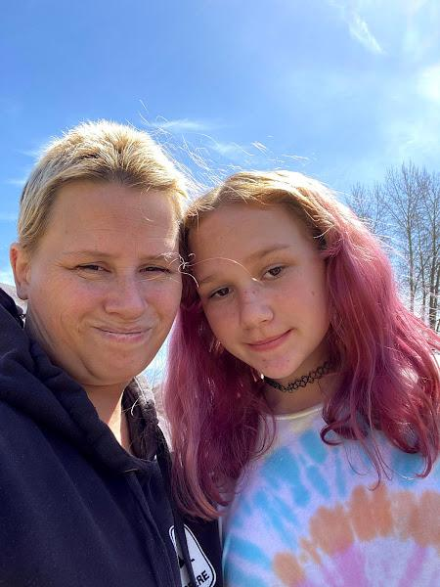
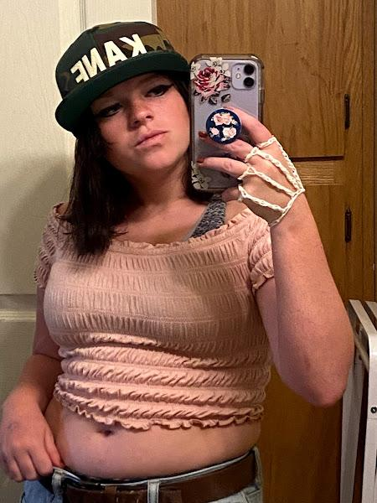
I have a cat, bird and hamsters.
I have a mom, dad, two sisters and one brother.

Slide 4
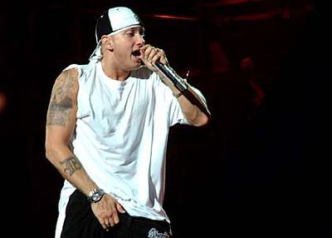
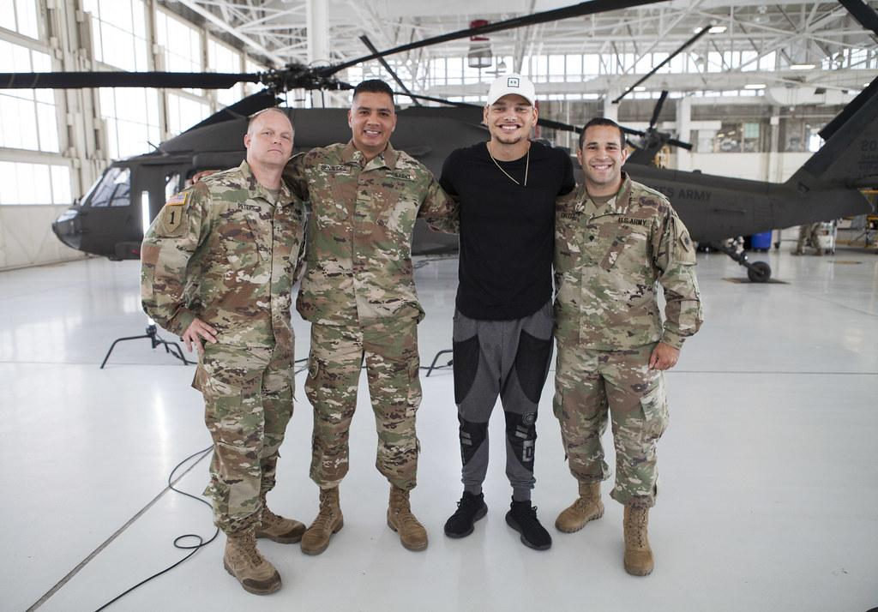
Try to get good grades this year.
My favorite singers are Eminem and kane brown
Hobbies i have are playing basketball, listening to music and SLEEPING

Slide 5
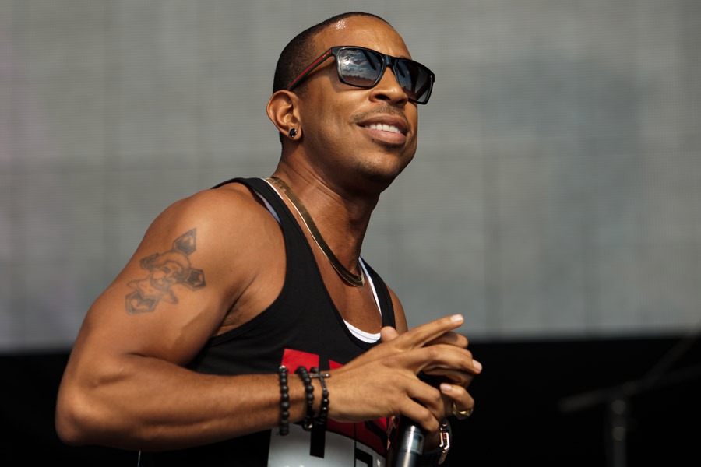
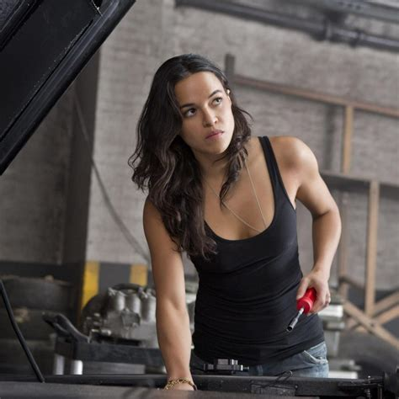
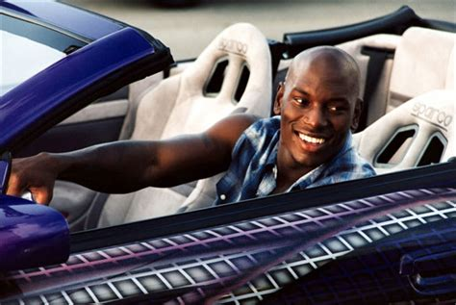
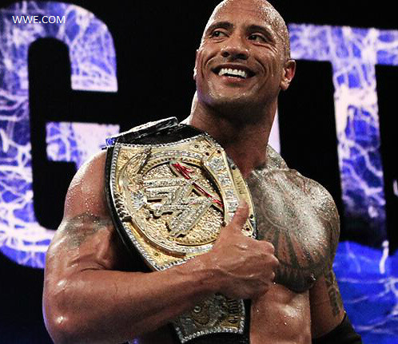
My personality is funny, a little shy, karing, friendly.
My favorite actors is Roman Pearce, Tej Parker.
My favorite actresses is Letty Ortiz

Slide 6

My plans for high school is to get good grades and graduate.
My best friends are Jade, Izabella, Jaelyn

Slide 7
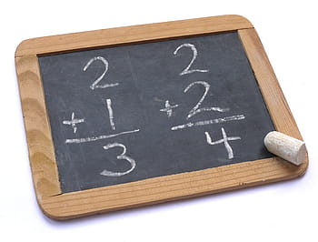

For fun i go to my friends house.
In school i like ELA, Math and Science

Slide 8
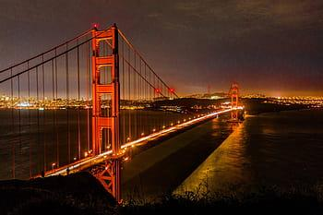
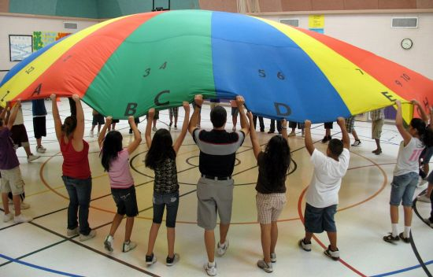
For school i do not like PE.
I have visited San Francisco

Slide 9
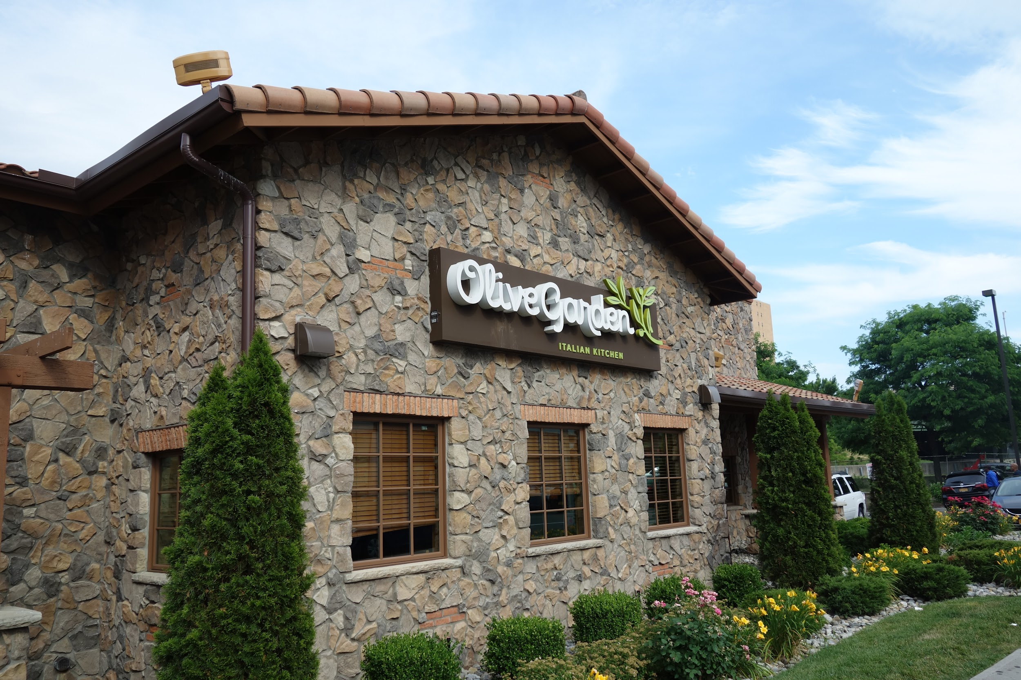
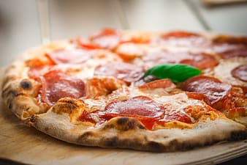
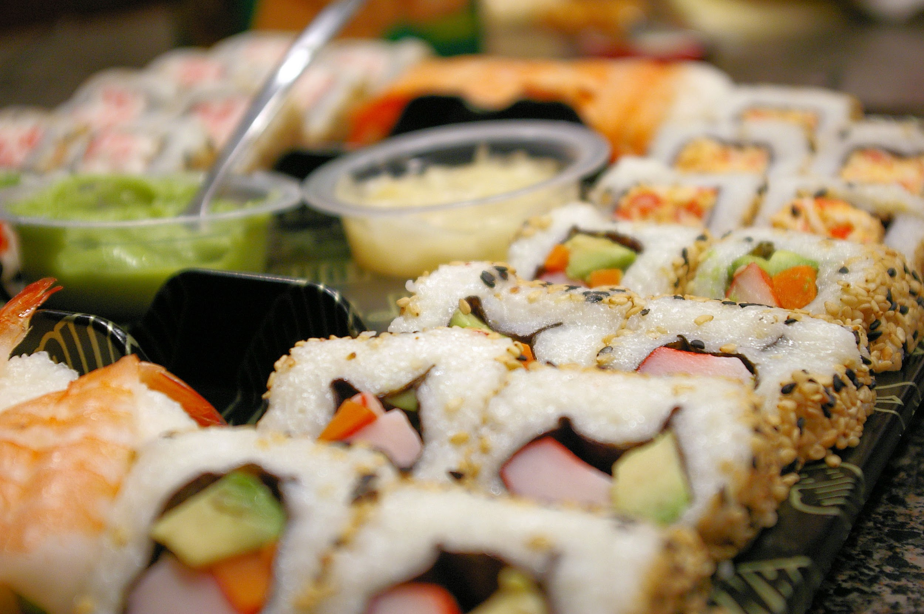
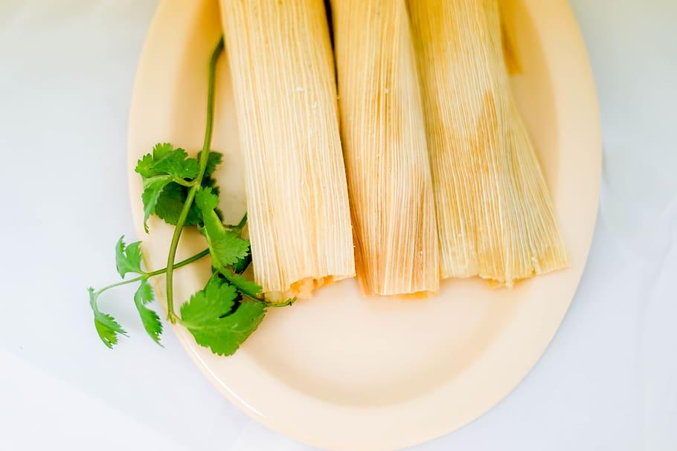
My favorite places to eat is Olive Garden.
My favorite food is Pizza, Sushi and Tamales

Slide 10
My favorite quotes is saying your momma lol

Slide 11
Conclusion Slide
Im all done with All About Me slides i hope you like it

