Slide 1


CCCCCCCCCCC
Science Notes
All about Me!
By:
Anna C Martinez Pureco

Slide 2
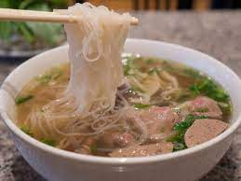
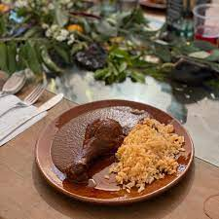
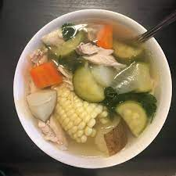
Favorite Foods
Pho- Pho is also one of my favorite. Pho is my favorite because I really like noodles and I like how many different variety of Pho there is.
Mole- Mole is one of my favorite foods because I love how you can both have spicy and sweet mole.
Caldo de Pollo- Last but not least, caldo de pollo. I like caldo de pollo because there is many good memories I have of caldo de pollo.
Some of my favorite foods are pho, mole, and caldo de pollo.

Slide 3
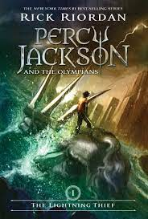

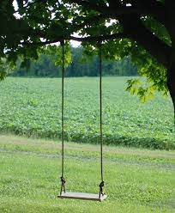
Favorite Hobbies
One of my favorite book I enjoy reading is Percy Jackson and the Lightning Thief. I enjoy this book because it discusses a lot of topics and lessons that I will need in the future.
My favorite hobbies are reading and going on my swing.
The Distance between us is also one of my favorite books because it talks about the real world and talks about many topics that my family can relate too.
I enjoy going on my swing because I get fresh air and get to listen to music freely.

Slide 4


Favorite Movies
“Boo York, Boo York!” is one iof my favorite movies because I loved how catchy the songs in the movie and overall how the movie was expressed.
My favorites movies are Monster High: “Boo York, Boo York!” and “To All The Boys I’ve loved before.
“To All The Boys I’ve Loved Before” is one of my favorite movies ie because how good Laura Jean’s character is expressed in the movie.

Slide 5
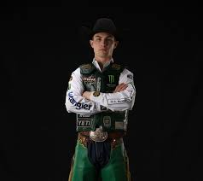
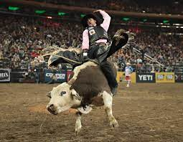
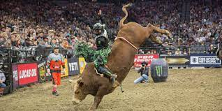
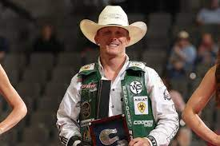
My Favorite Sport
Jess Lockwood is also one of my favorite bull riders. Jess Lockwood is one of my favorite bull riders is because he is very inspiring. Jess Lockwood is the youngest rider to ever win a PBR World Championship.
One of my most favorite sports in bull riding. I enjoy watching bull riding is on the PBR. One reason I like bull riding is the history behind the sport.
Cooper Davis is one of my all-time favorite bull riders. I like Cooper davis because of his skills and determination he has in the sport he does, bull riding.
v

Slide 6
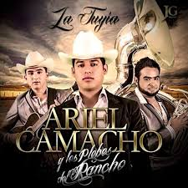
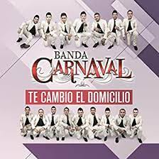

My Favorite Songs
La Fuga Del Dorian-Ariel Camacho y los PLebes del Rancho
My favorites songs are all of the mix and K-pop and Corriods and occasionally Banda.
Y Te Cambio El Domicilio- Banda Carnaval
Boy in Luv- BTS

Slide 7
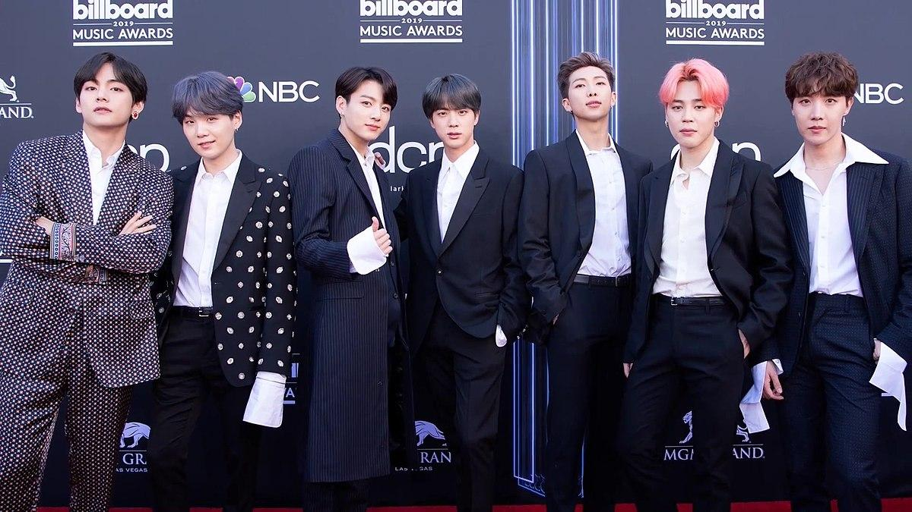
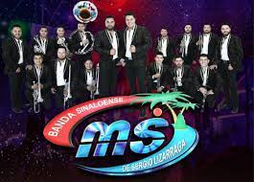
My Favorite Music genres
Corridos: example - Ariel Camacho
My favorite music genres are K-pop, Corridos and Banda.
K-pop: example- BTS
Banda: example- Banda MS

Slide 8
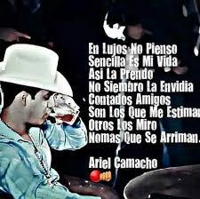
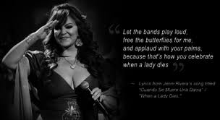
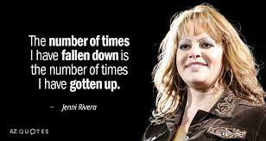
My Favorite quotes
My favorite quotes are usually about how to never give up and to always stay simple and humble. Some of my favorites are Ariel Camacho and Jenni RIvera quotes.

Slide 9
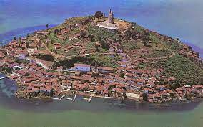
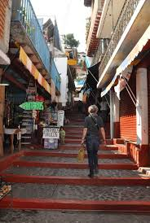
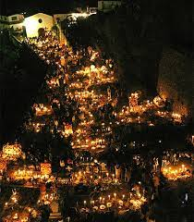
Favorite Place I have visited
Out of all places I have visited my favorite is Janitzio. Janitzio is my favorite place to visit is because one it is in my home state of Michoacan. Another reason I enjoy visiting Janitzio is because of the scenery. IN Janitzio you can see the whole lake and the small island of Janitzio from on top of the island.

Slide 10

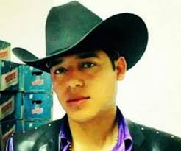



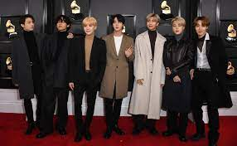
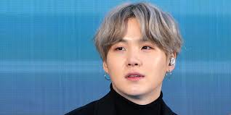
Music taste
Ariel Camacho is one of my favorite artists to listen too, He was the lead singer of his group ‘Ariel Camacho y los plebes del rancho’, and played the he requinto. His nicknames and “El Rey de Corazones” and “El Rey del Requinto”.
Last but not least is the K-pop group, BTS. They are my top favorite artists. My favorite album from BTS is “Skool Luv Affair.”
August D
August D is one of my most streamed and favorite artist that I listen to. His real name is MIn yoongi, and is a South Korean rapper. August D is also apart of BTS, just more known as Suga.

Slide 11

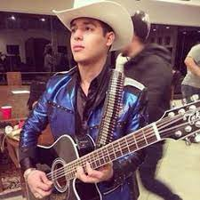


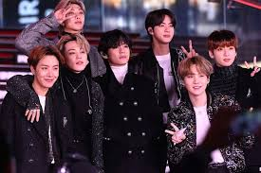
Basic Information
Birthday: May 5, 2009
Age-12
Full name: Anna Consuelo Martinez Pureco.
Favorite Subject in school: ELA
Favorite bands and groups: BTS, Banda MS, Ariel Camacho y los plebes del rancho
Favorite colors: Purple and Burgundy

Slide 12
The End! Thank you for your time and goodbye! :)

