Slide 1
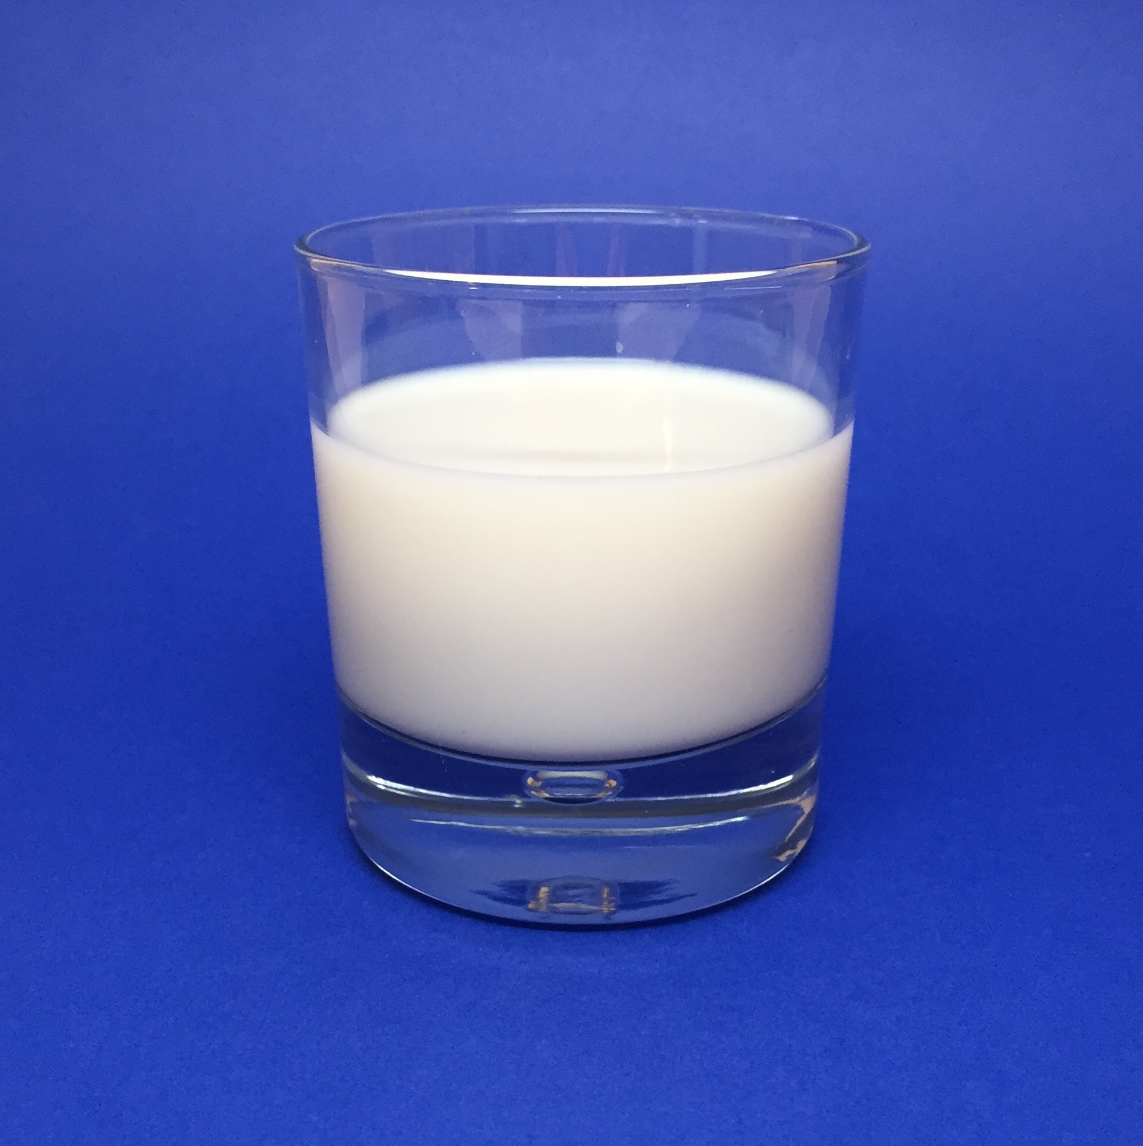
All About Me
By:
Ayden

Slide 2
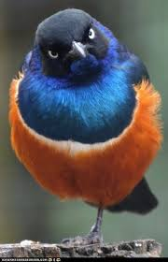
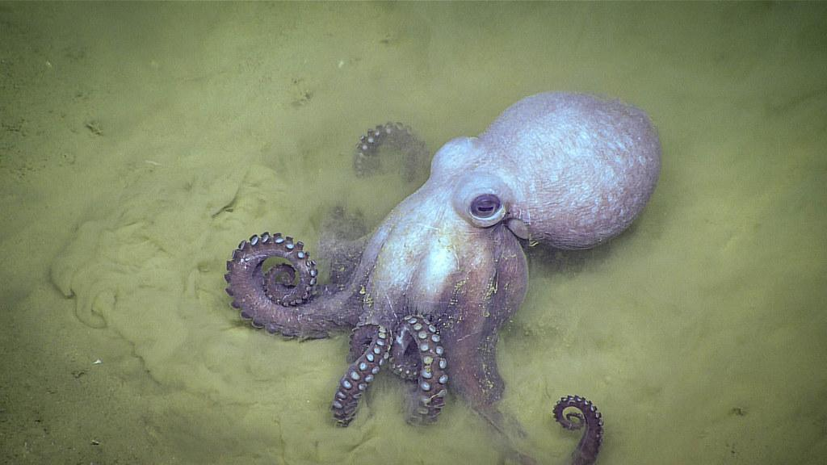
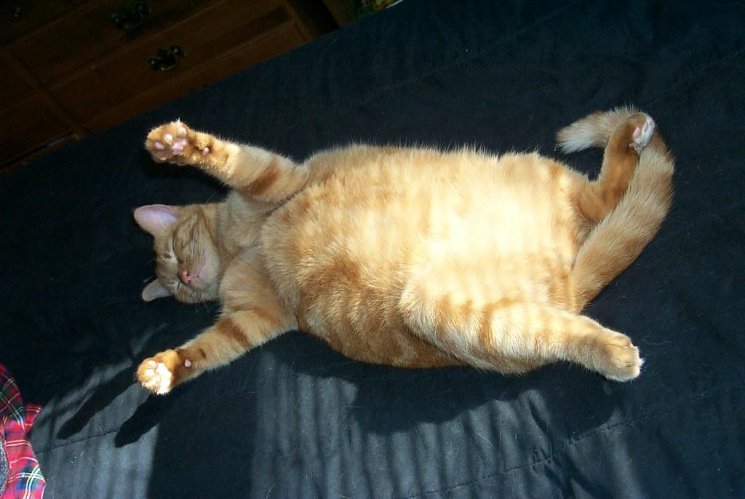
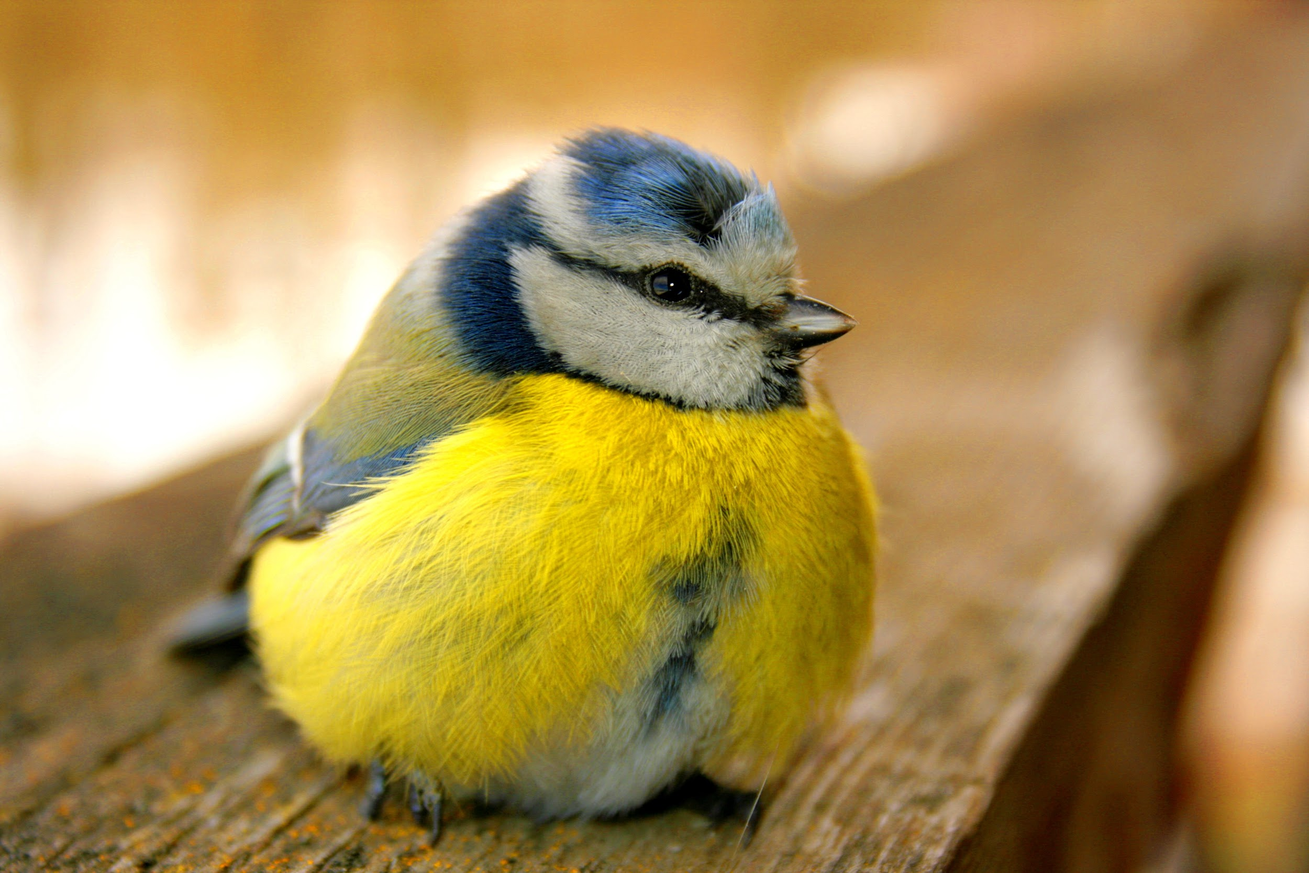
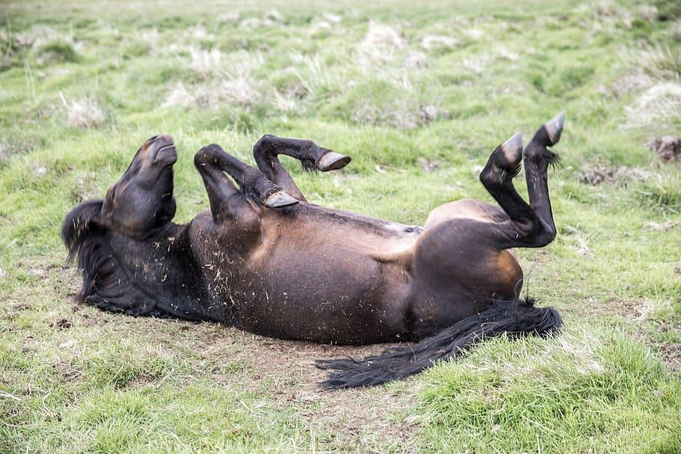
My favorite animals.
Some of my favorite
Animals are cats, birds,
Octopus’s, and horses
Sssdd

Slide 3

My favorite colors
My favorite colors are red, black, and blue

Slide 4
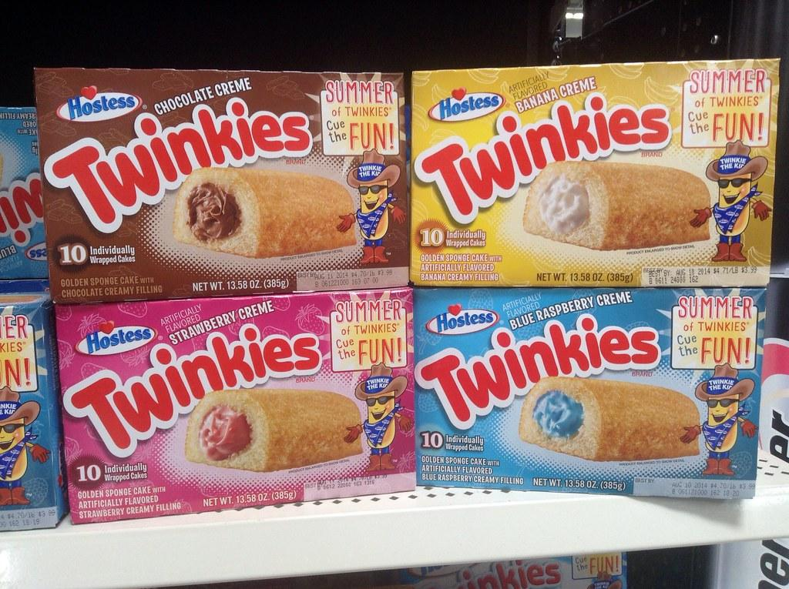
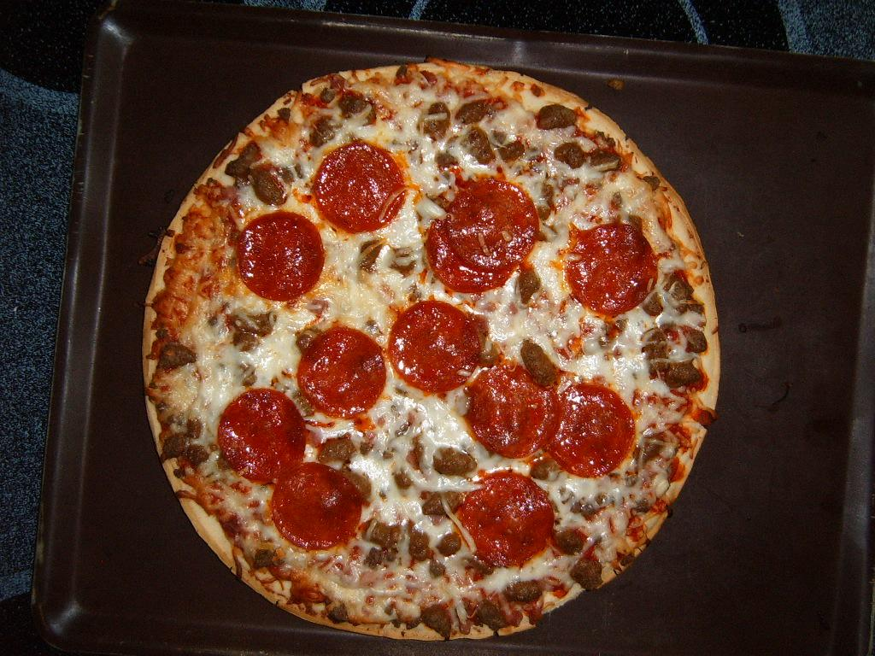
My favorite foods
Some of my favorite foods are pizza, twinkies, and almost anything sweet or salty

Slide 5
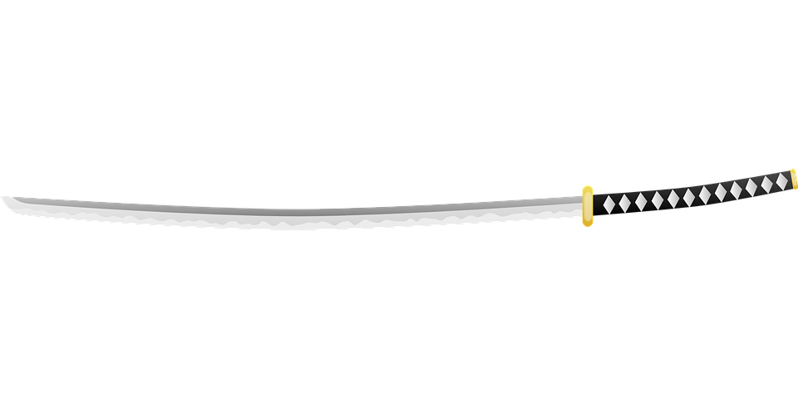
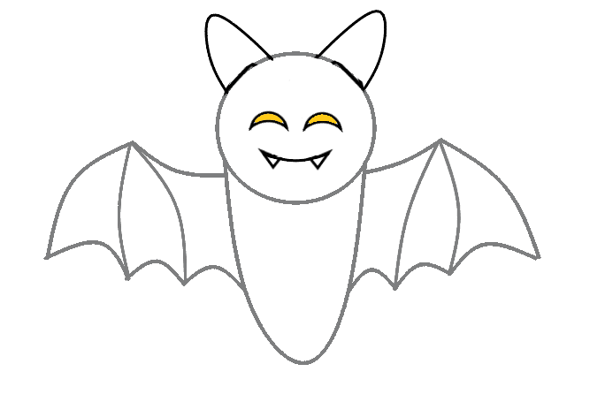

Some things im intrested in.
Some things im interested in is drawing, anime, katana’s, a japanese urban legend called Kuchisake Onna, and sleeping

Slide 6

My favorite games (board games and video games)
Some of my favorite games are dead by daylight, sorry, minecraft, dishonored 2, roblox, and the harry potter board game.

Slide 7

My facorite movie
My favorite movie is harry potter.

Slide 8
My dream job.
My dream job is to be a teacher or a actor

Slide 9

My favorite show.
My favorite show is the walking dead

Slide 10
Things about me
I like to dye my hair, play games, watch tv, hang out with friends and family, and try new foods

Slide 11
Conclusion Slide
And this is my all about me slide:)

