Slide 1
All About Me
By: Ian Moreno

Slide 2

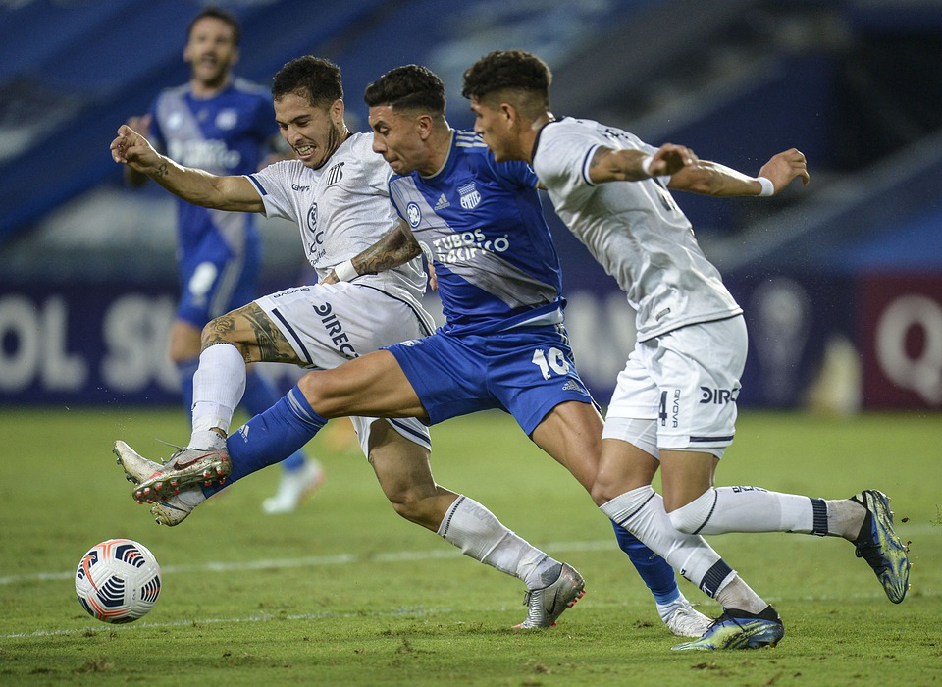
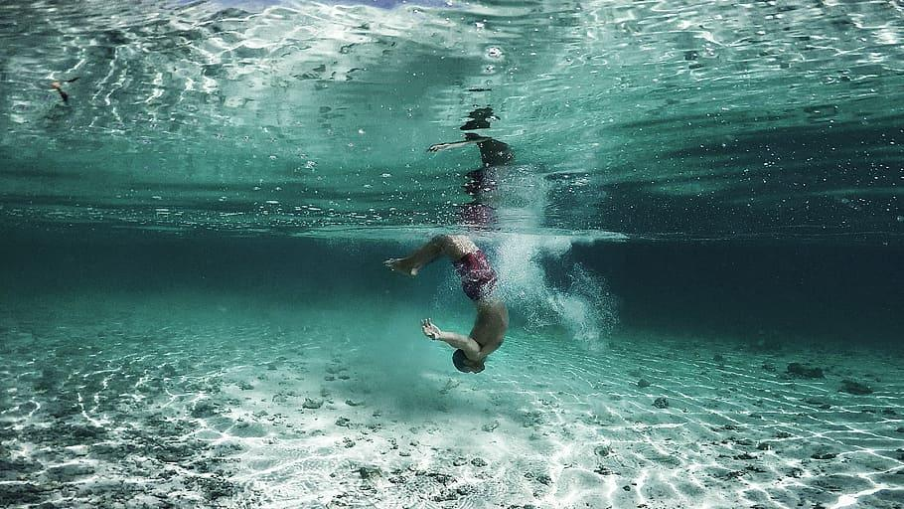
One of my favorite hobbies are playing soccer, swinging and running.

Slide 3


For my family I two sister and my mom and dad.
Random family

Slide 4
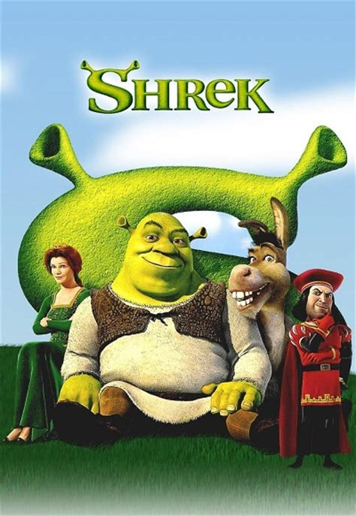
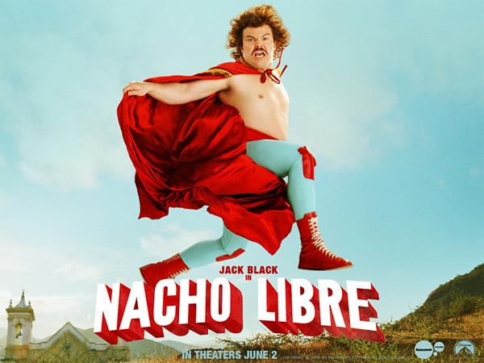
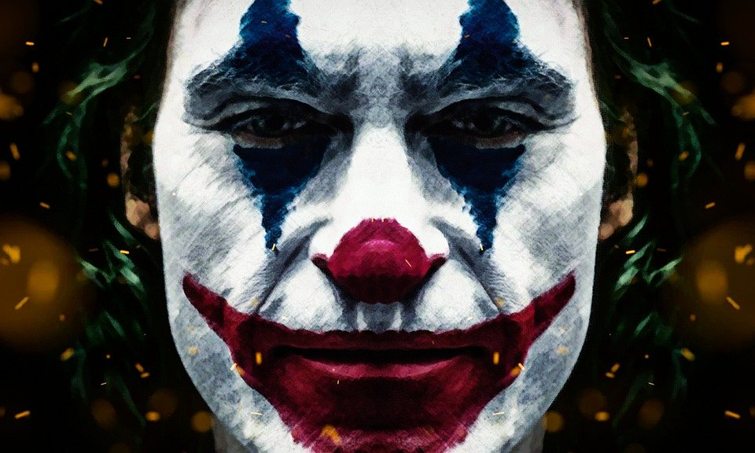
My top 3 favorite movies are shrek, Nacho libre, and the joker.

Slide 5

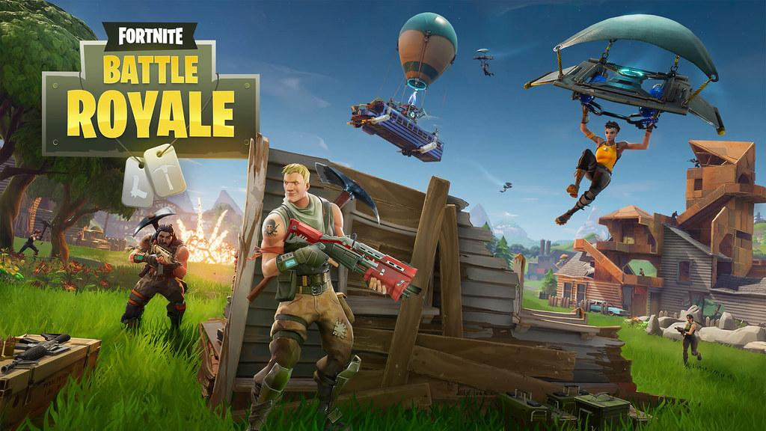


I like gaming I play on a ps4 saving up to get a two thousand dollar gaming pc.
My most play games are warzone,(old) fortnite, apex, minecraft and lot more.

Slide 6
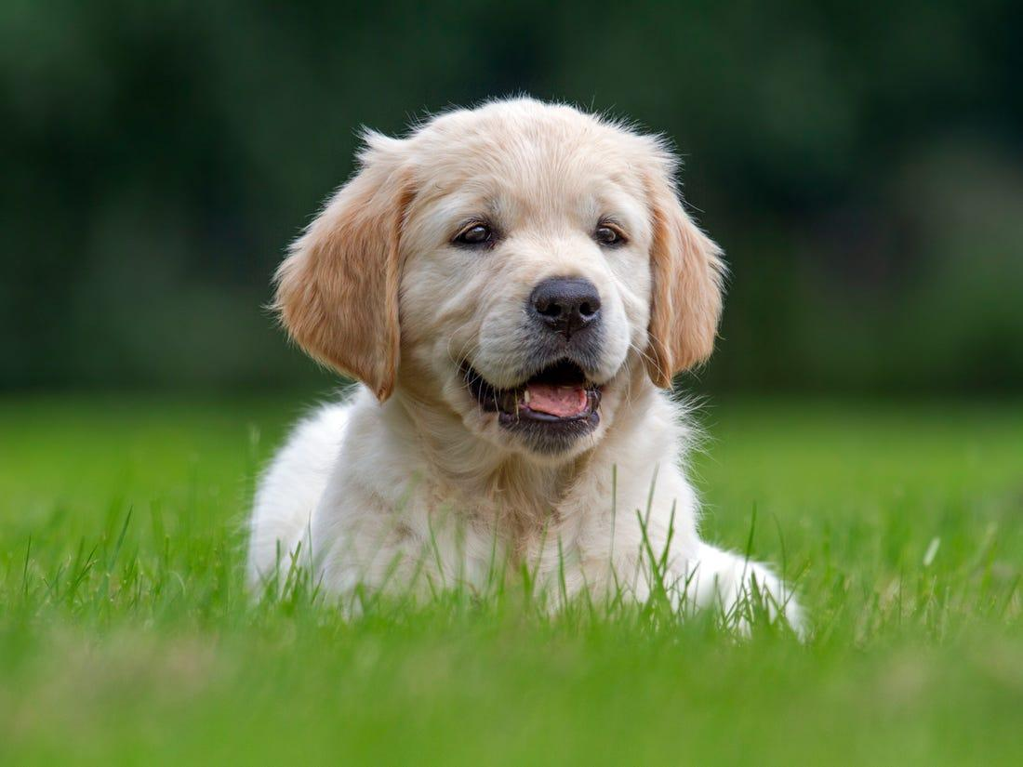
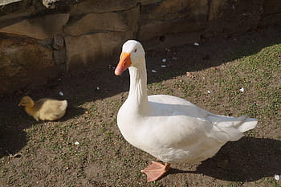
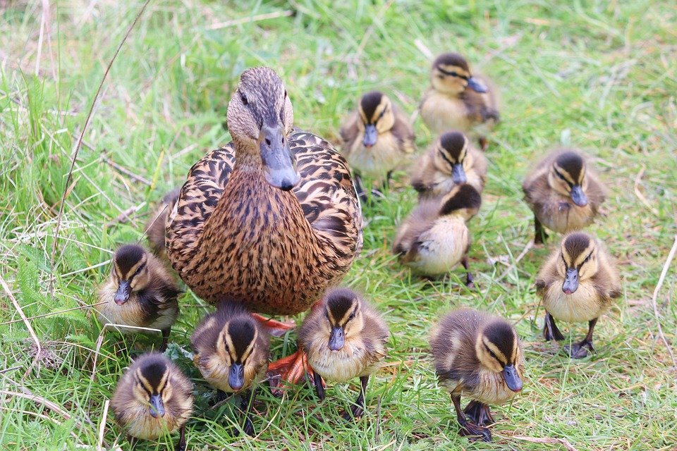
For pets I used to have A dog but he ran away then I had two ducks but after 2 years we let them free.
Not my real pet just look alike.

Slide 7
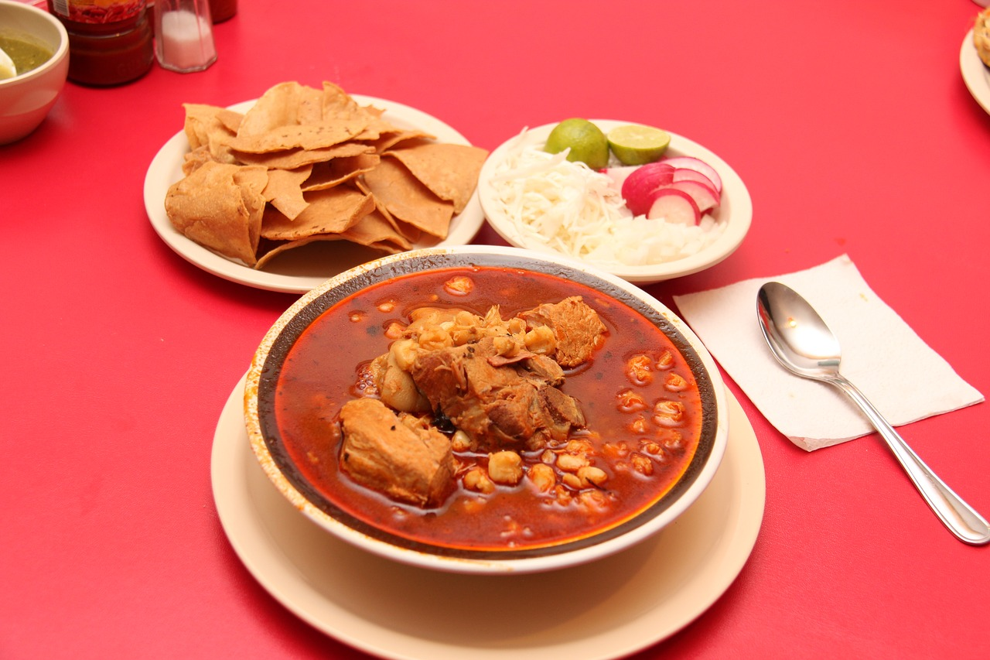
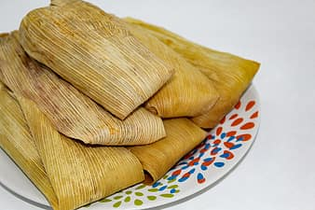
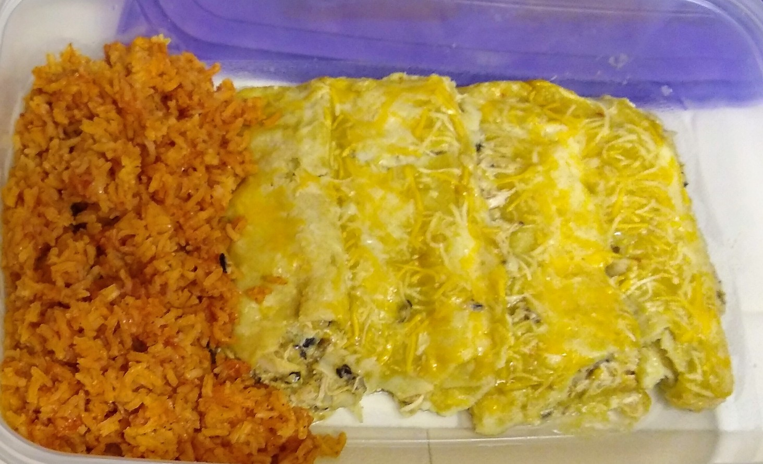
My top three favorite food are 1 pozole 2 tamales 3 encremadas.

Slide 8
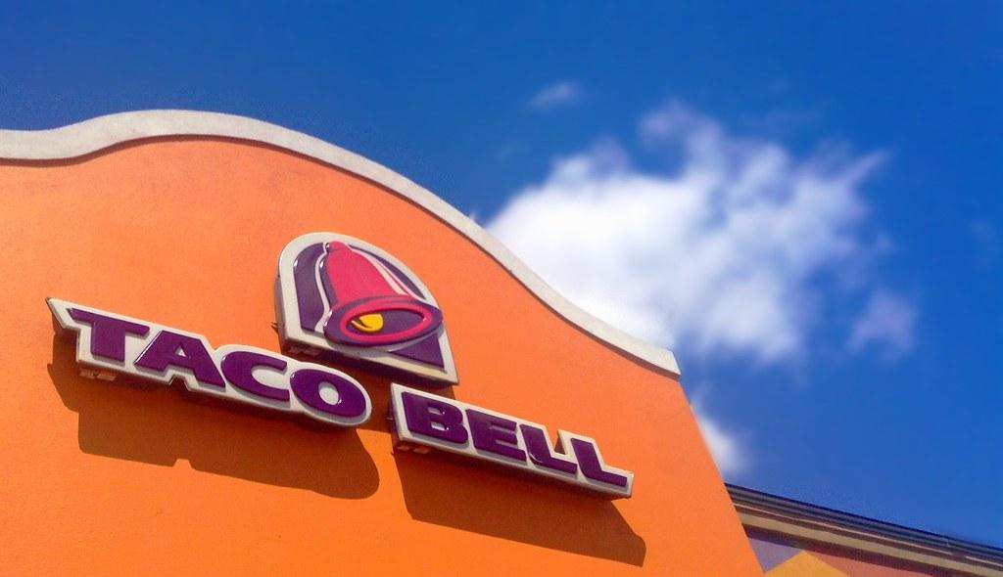

My favorite fast food restaurant is taco bell if it not taco bell it red robin

Slide 9
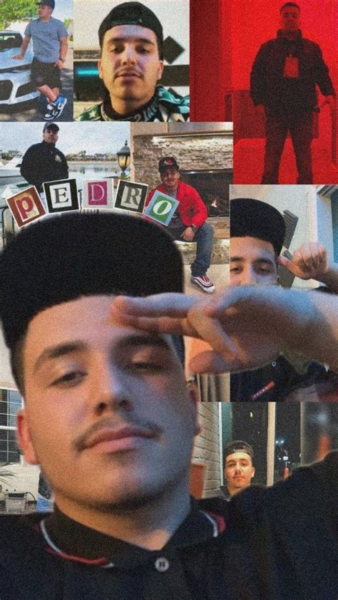
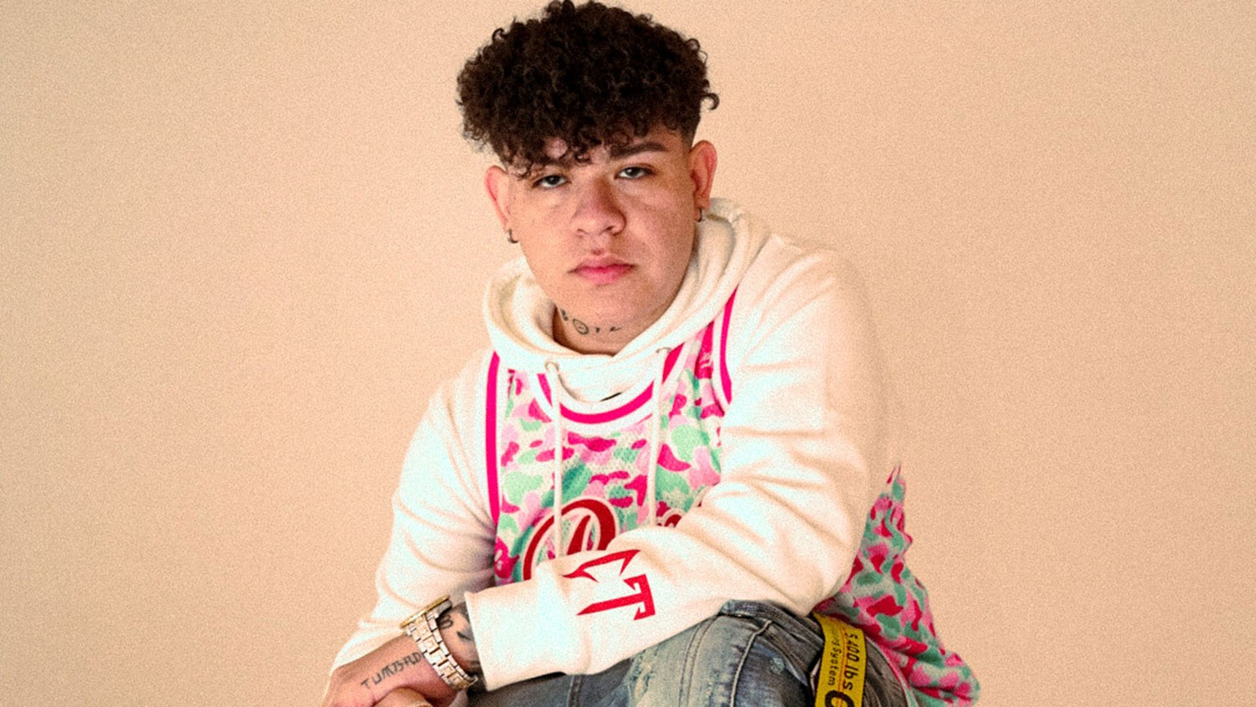

My favorite type of music is corridos tumbados
Junior h
Eslabon Armado
And for my artis is Eslabon Armado or junior h

Slide 10

My favorite class from this year science 1 because Mr perez is a great teacher and 2 it's we are going to do a lot of projects.

Slide 11
Conclusion Slide
This were some of my favorite thing about my life

