Slide 1

All About Me
By:
Julissa Fregoso

Slide 2

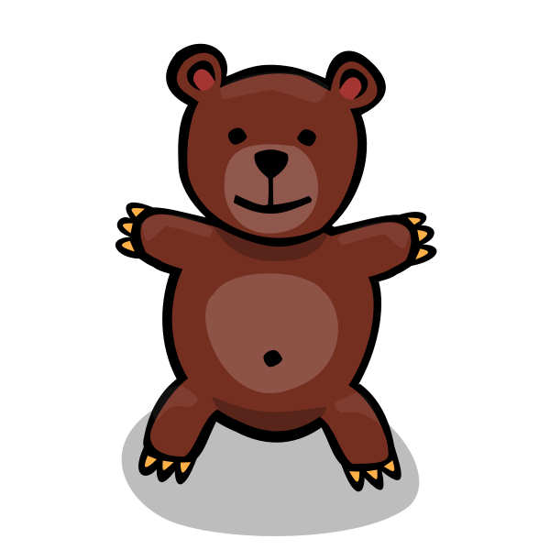
About me:
Name: Julissa Fregoso Favorite color: Light purple
Age: 11 (yes I’m still 11) Birthday: 08/21/2009
Birthplace: California Yuba City Favorite animal: Bears
Write: Right handed

Slide 3




I am not showing my family.
All I’m going to say about my family is that it’s crazy.

Slide 4



My pets:
I have a cat but sadly don’t have any pictures of her.
But her name is Crystal and I’ve had her for about 2-3
She’s white and grayish on her back
And she’s an old cat

Slide 5


My favorite sports team:
I don’t watch sports and I’m not interested in watching any sports teams
I don’t play sports much, the only sport that I used to play and actually enjoyed is probably tennis.
I used to play tennis with my dad cousin and sisters before online class started.

Slide 6

I don’t have a job :)
My only job is to do my chores and take care of my baby sister.
I usually only clean on the weekends now because when it’s school we don’t have time.
On the weekends my mom goes crazy about the mess we made throughout the week so it’s basically not even a weekend .

Slide 7
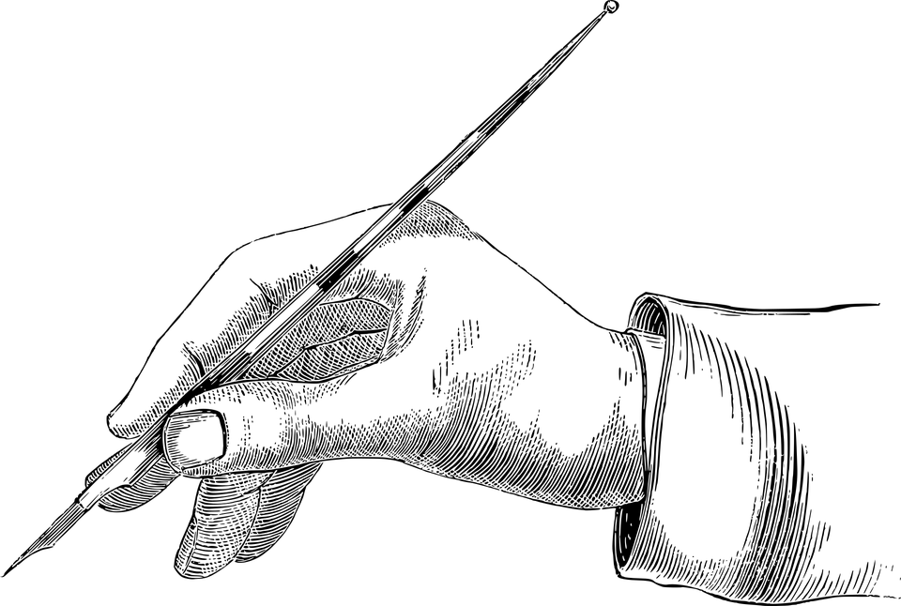
My hobbies
Drawing
Sleeping
Painting
I usually draw when I’m bored or feel like drawing same thing with painting. Sleeping, I’ll sleep whenever I can be tired I can be wide awake I will sleep either way.

Slide 8


My favorite subject:
My favorite subject is probably science because it’s fun and every other subject is boring. In science you can do experiments and learn new things. Some other subjects aren't that bad but if we’re talking about favorites then science only.

Slide 9


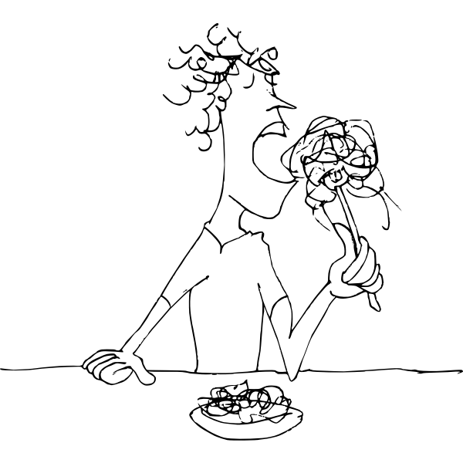
Favorite places to eat:
My favorite places to eat are:
Panda express
In-n-out
Overall I just like to eat
Food is life.

Slide 10

My goals this year:
My goals this year is probably to get at least A’s or B’s in all of my classes. Because 7th grade i when you have take everything seriously or you won’t go to 8th grade. I also want to make sure I get everything turned in.

Slide 11
Conclusion Slide
That’s all the things you need to know about me :)
- End

