Slide 1













All about me
By Olivia Renfrow

Slide 2

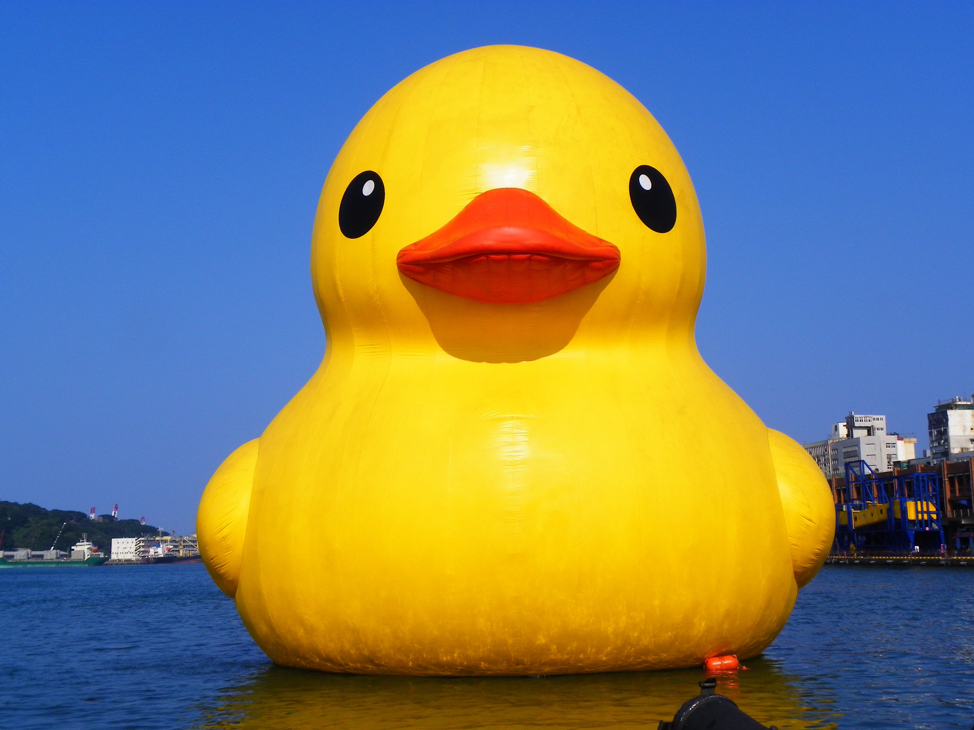
My Favorite quotes!
“Be who you are and say what you feel because those who mind don’t matter and those who matter don’t.. mind”- Dr Seuss
“.Hurting someone can be as easy as throwing .a stone into the sea. But do you have any idea. .how deep that stone can go?”

Slide 3


My Favorite colors!
Muted pinks, black and white

Slide 4


My hobbies
Art
Swimming
Reading
cooking/baking

Slide 5

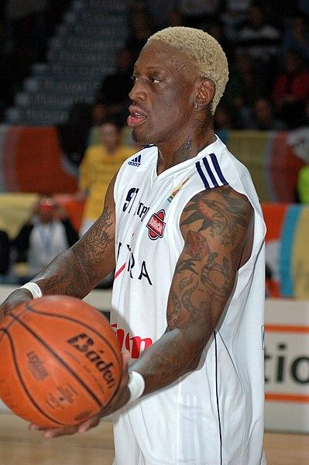
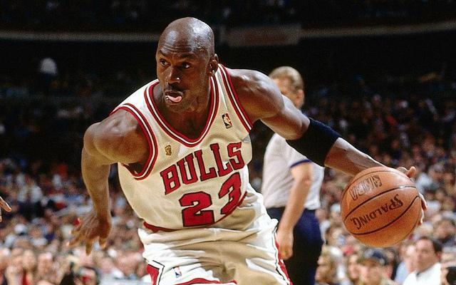
My favorite sport!!
basketball!!!!!

Slide 6
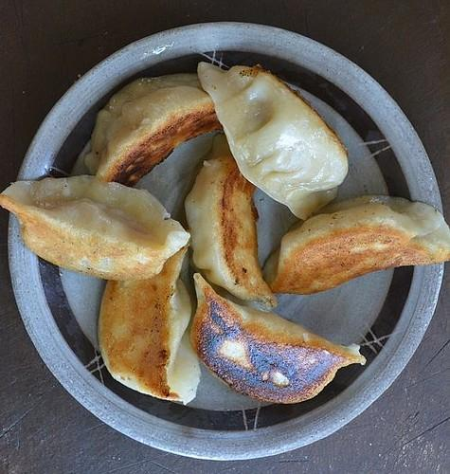
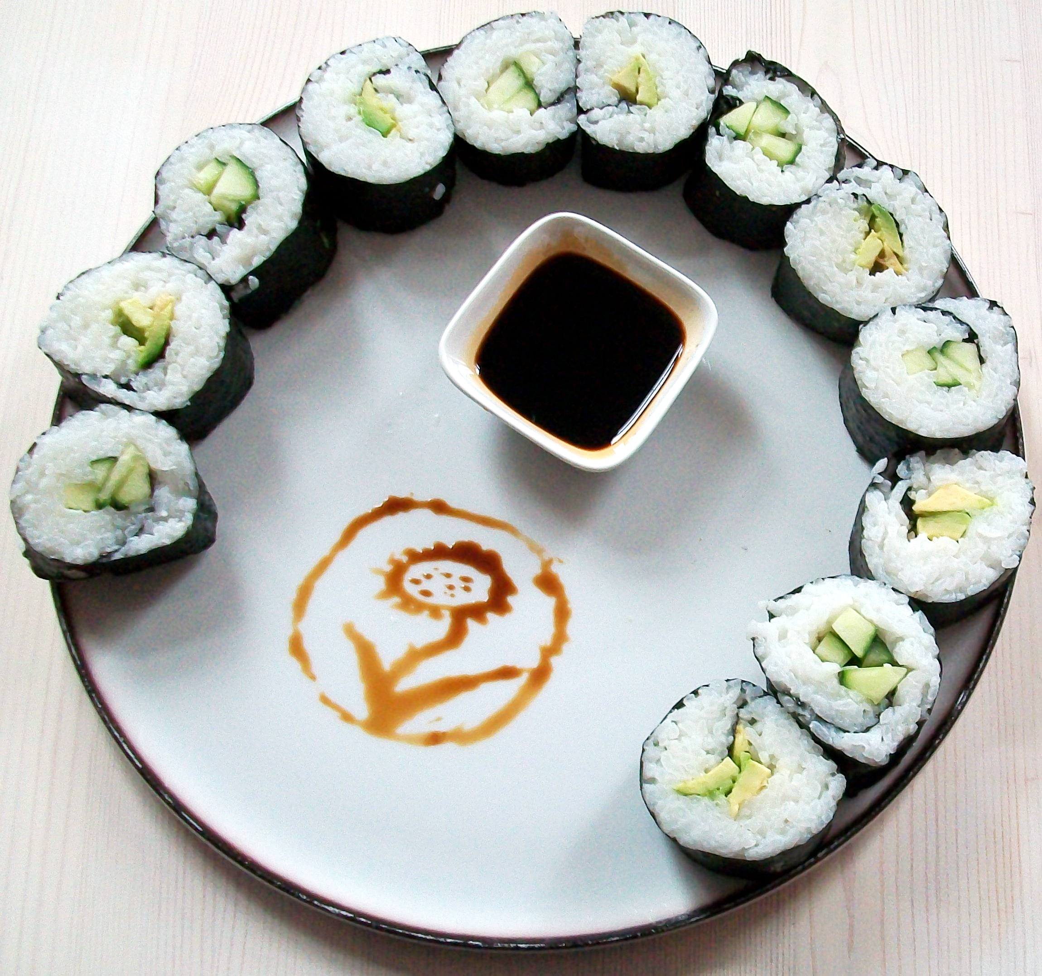
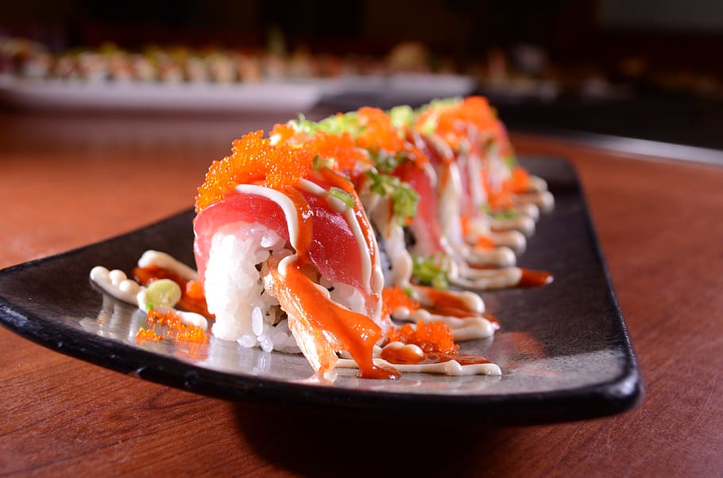
My
Favorite
Foods!!
POTSTICKERS!!!
SUSHIIII!!!! 🍣

Slide 7
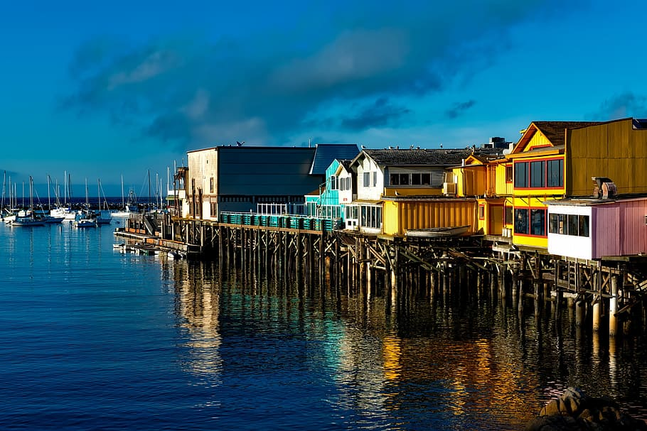
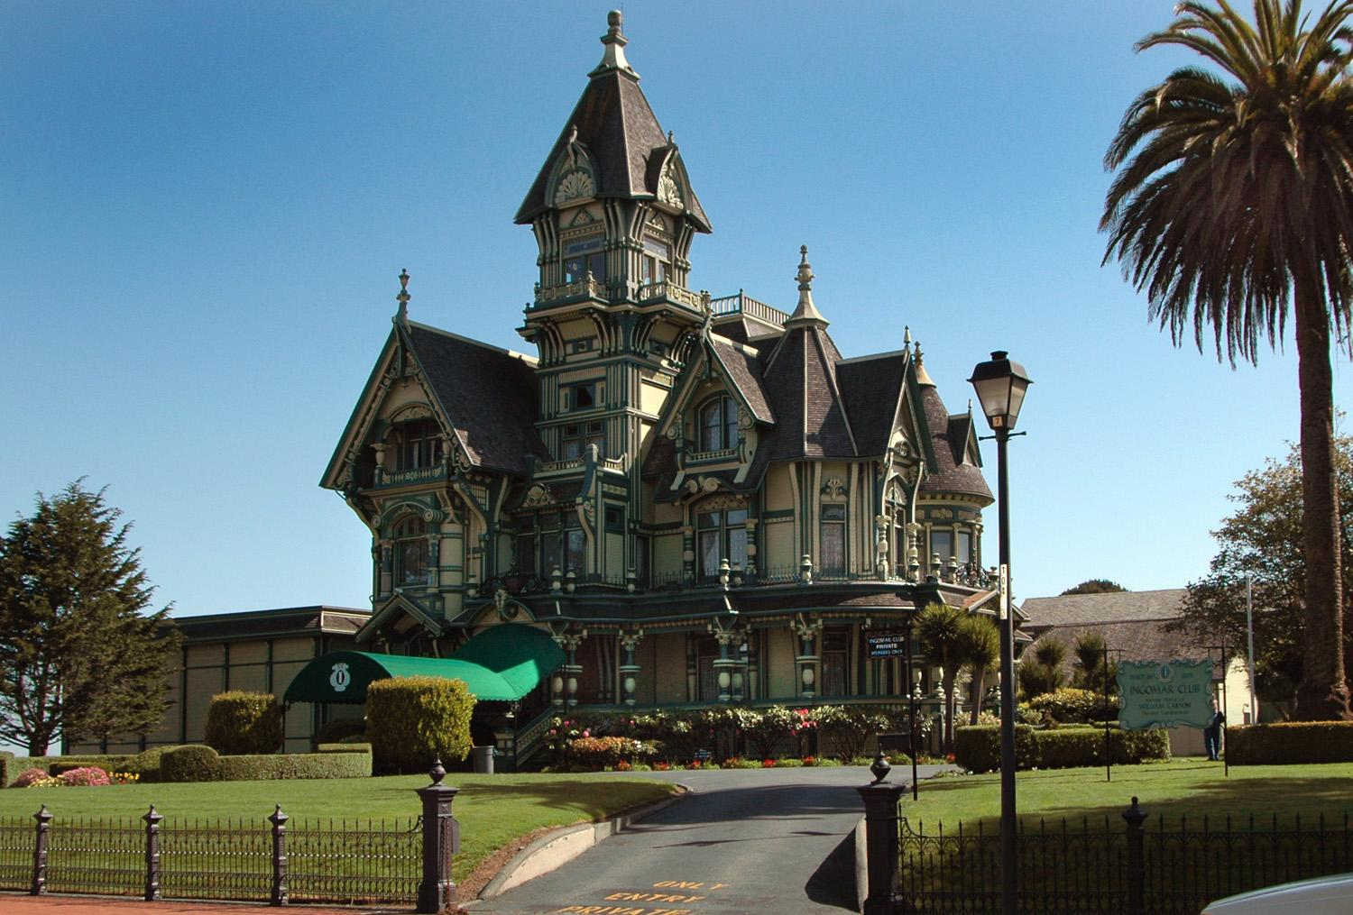
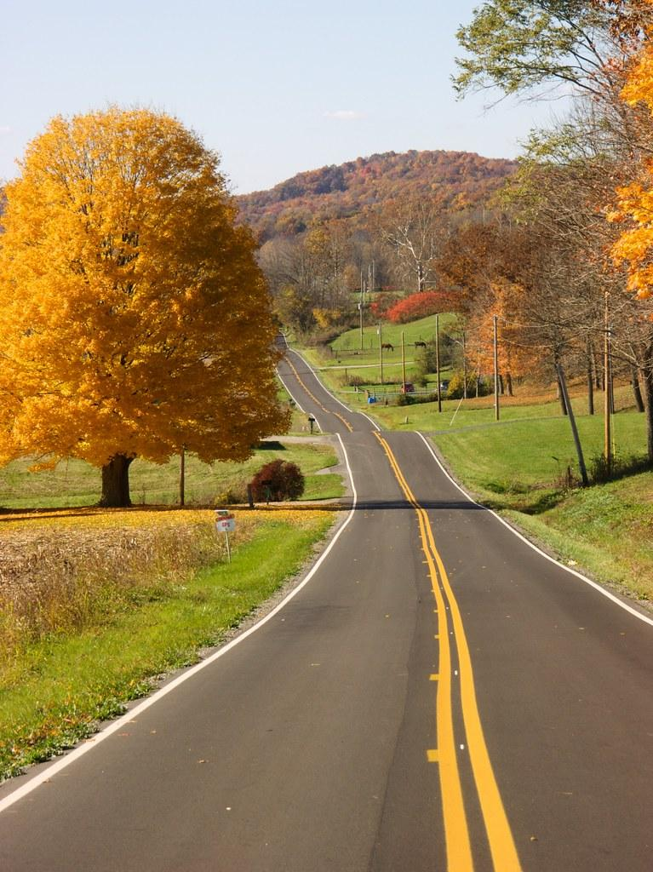
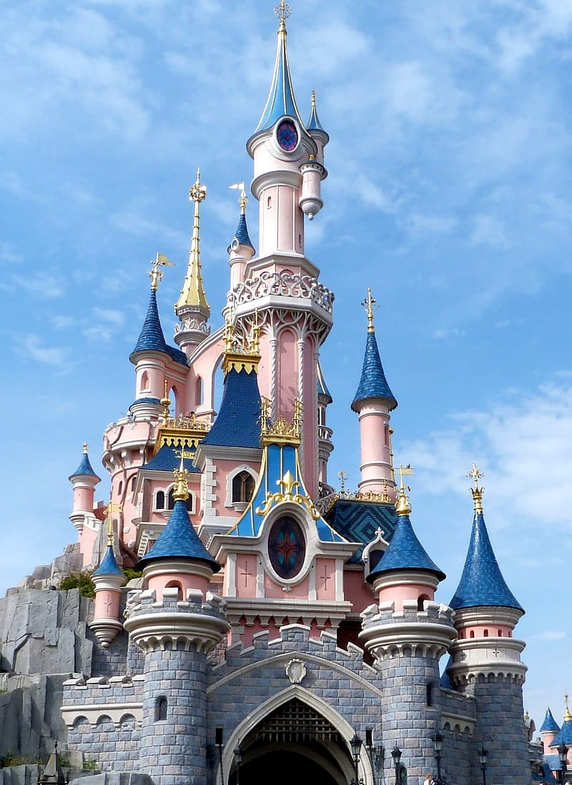
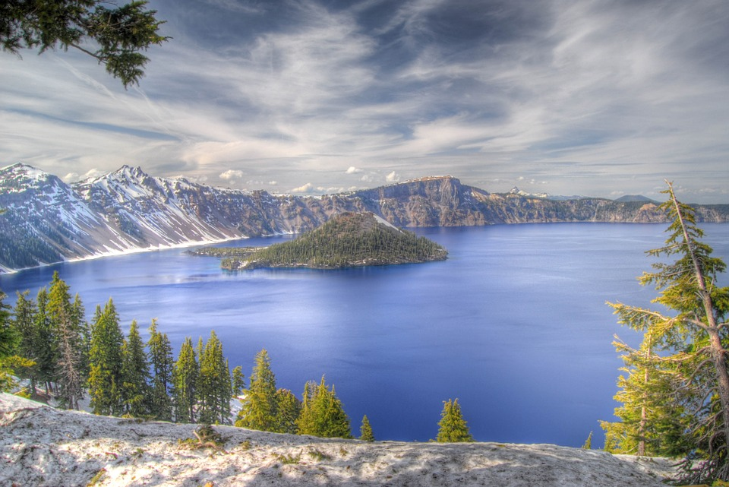
Monterey CA
(i couldn't fit everywhere i’ve been on one slide ) 🤣
Places i've visited
Eureka CA
Disneyland CA
ohio
Crater lake -oregon

Slide 8

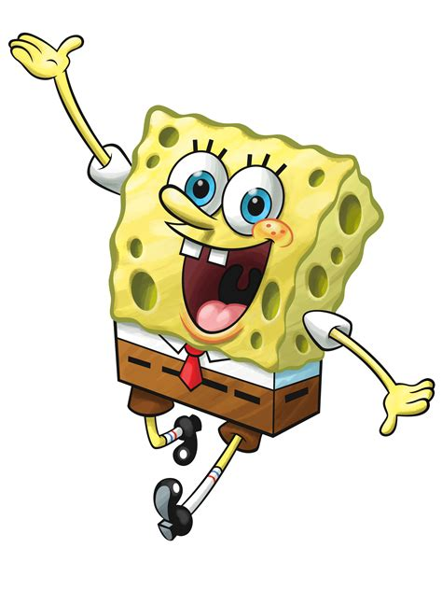
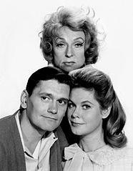
My favorite movies/shows
Bewitched ✨
Spongebob squarepants
The Great Gatsby

Slide 9
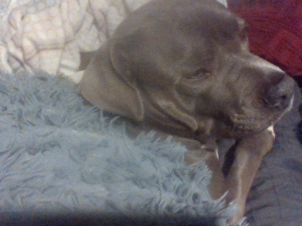
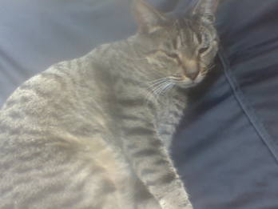
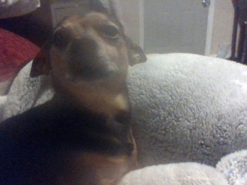
About my pets!
(I couldn't find a picture of my other cat)
I have four pets , 2 dogs 2 cats (Kai,Thrash,Molly and Griswood)
Molly✨
Kai ❤❤♡
Thrash boogie🐥✨

Slide 10


My favorite subjects
My current favorite subjects are science, ela and forensics
My second favorite subjects are history and math

Slide 11

My favorite musicians
Elton John
Pink
Imagine dragons
The beatles
Cage the elephant
(not in this order)

Slide 12

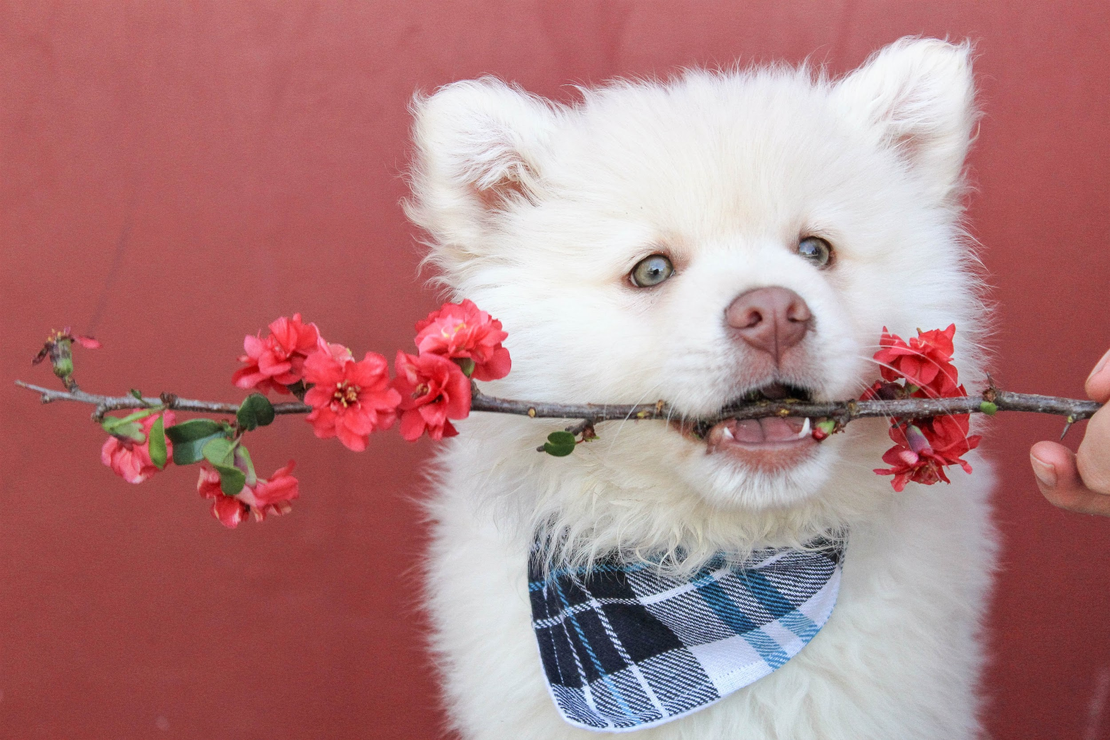
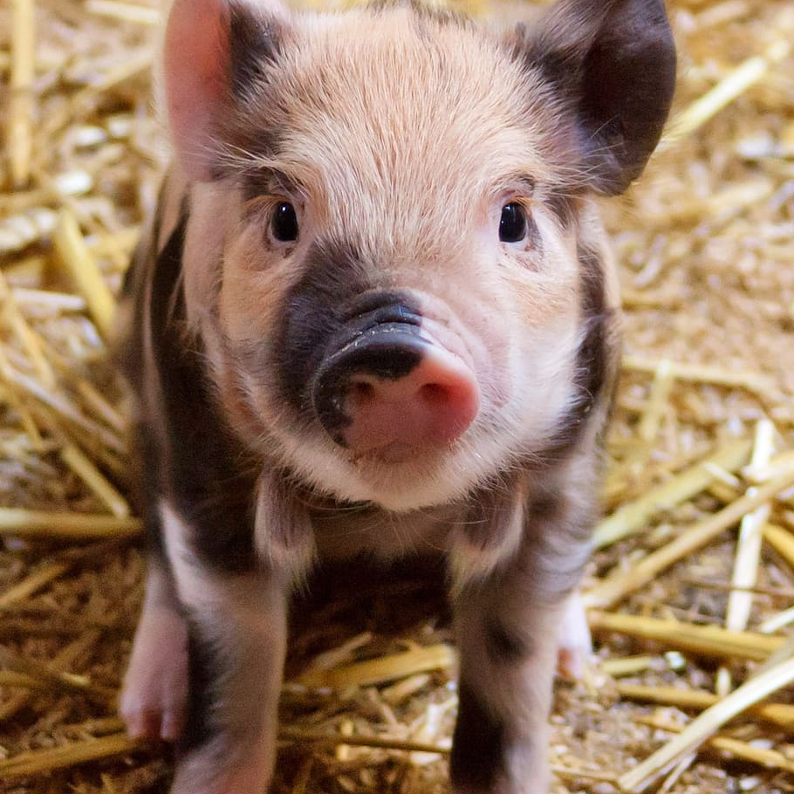
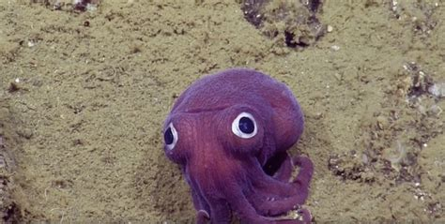
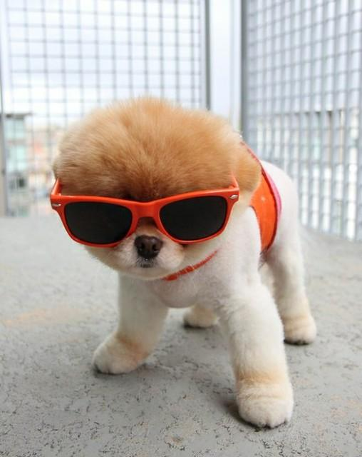
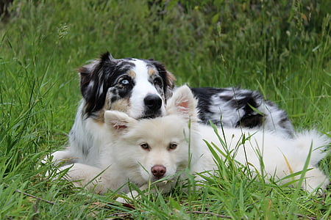
My Favorite Animals
Stubby Squid ✨
Puppies 🐶
Piglet s❤
https://youtu.be/QSpWpfecUQ0
https://youtu.be/B1CPE6WWsAQ
https://youtu.be/PBUebk9-LyQ

Slide 13

✨Im Olivia Renfrow and
this was all about my life ✨

