Slide 1
All About Me
By: Ramon Salazar

Slide 2
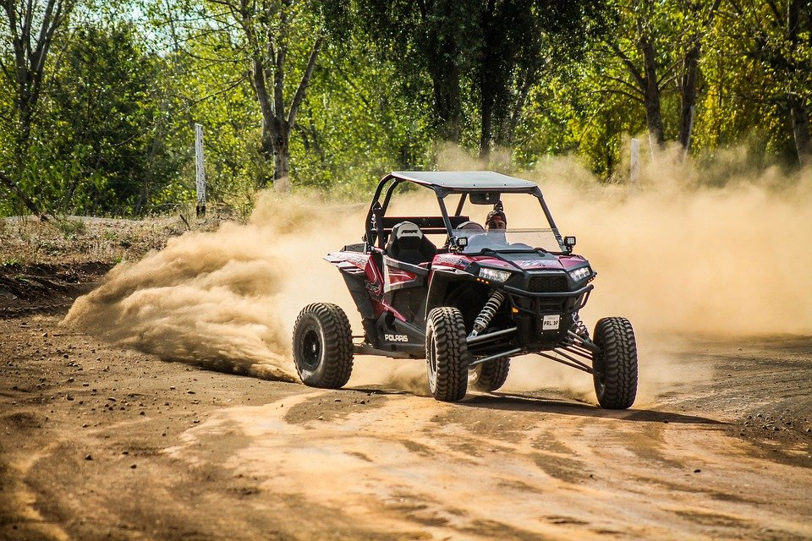
About me
Name: Ramon Salazar favorite color: red
Age: 12 birthday: 6-2-2009
Birthplace: marisvile

Slide 3
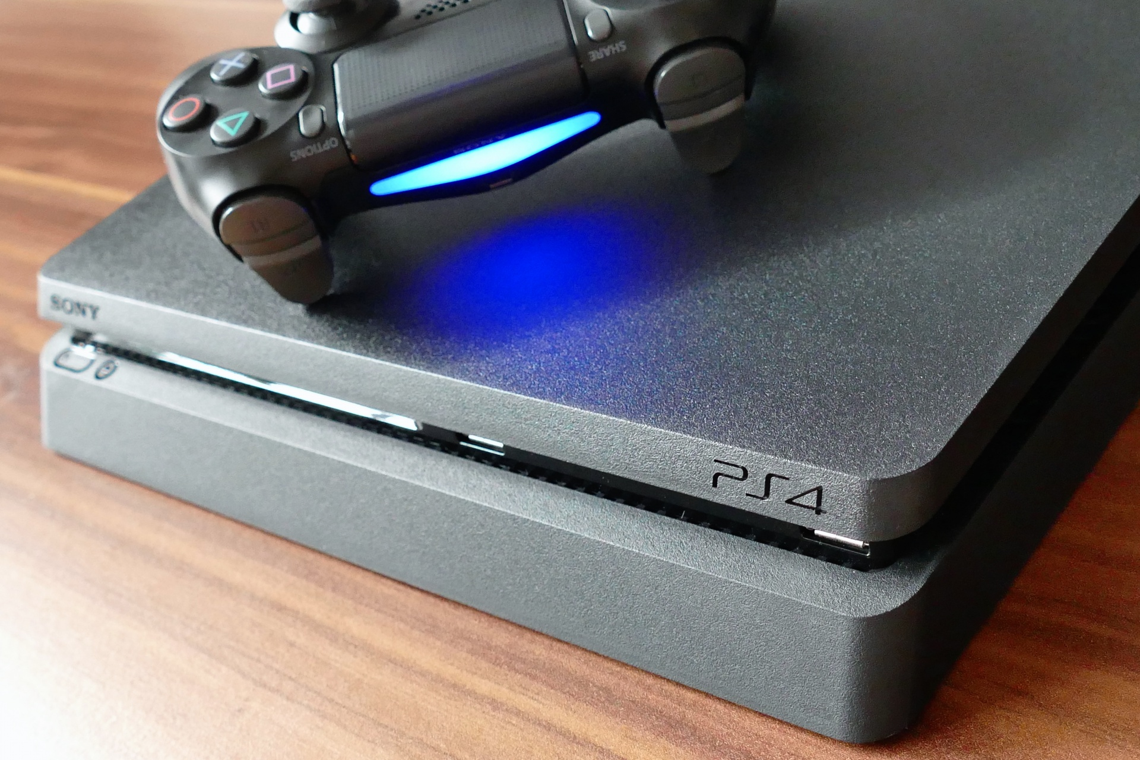
My hobbies
Soccer
Riding horses around in Mexico
Playing video games
Cleaning for my mom

Slide 4

Favorite sports teams
My favorite sports team are the san fran 49ers, sac kings and the a’s

Slide 5
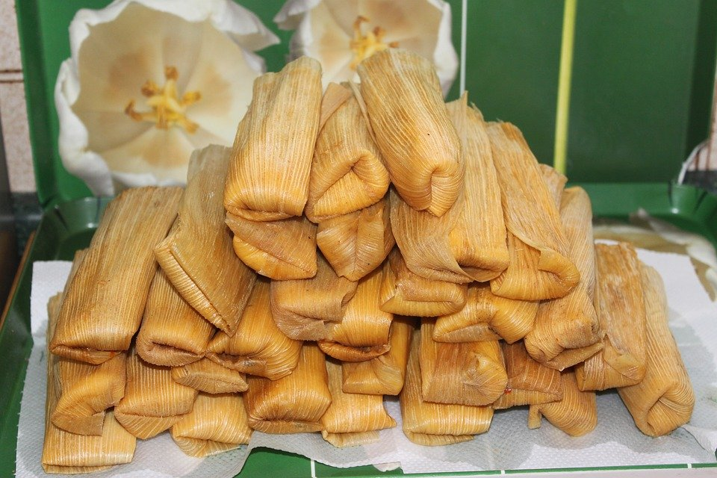
My fav foods
Tamales
Pizza
Beans

Slide 6
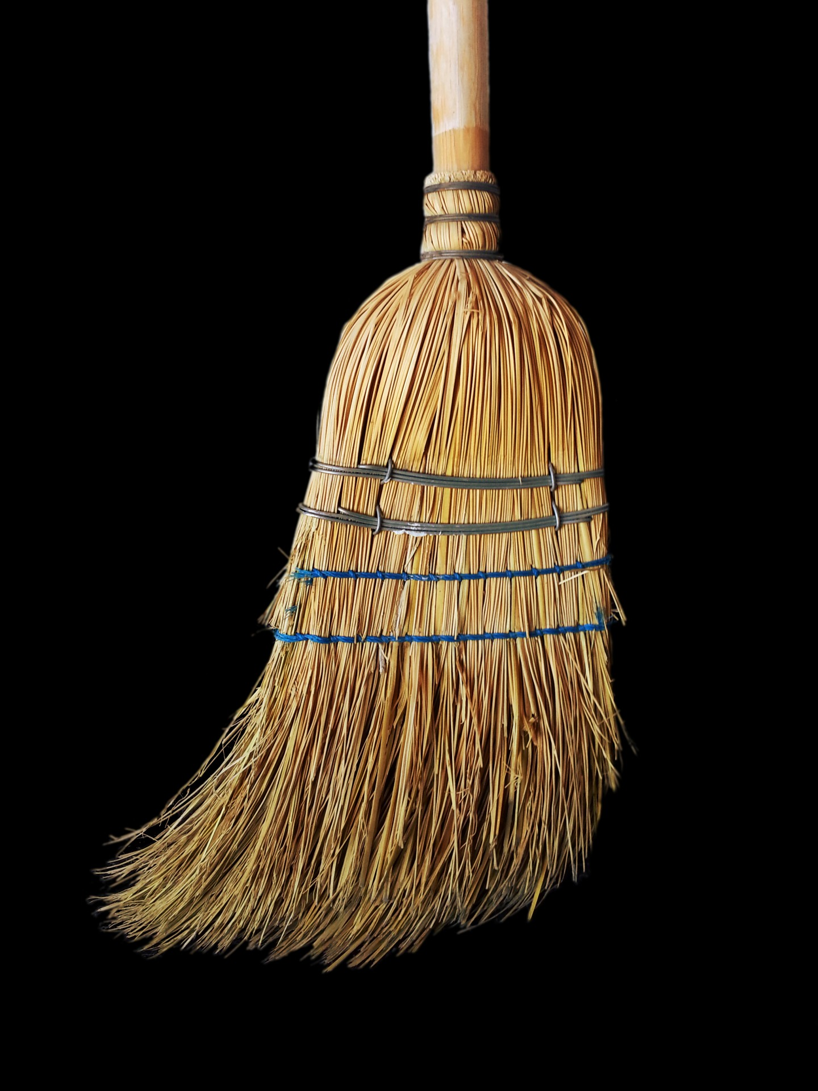
What i did this summer
I cleaned the whole house
Got yelled at by my mom
Went to parties
Yurr

Slide 7
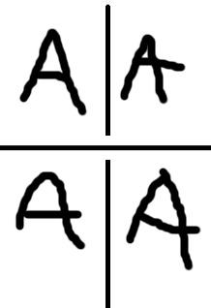
My goals for this year
Have good grades
Be on tasks
Listen to the teachers
And give it my all

Slide 8

My favorite singers
Junior h
Eslabon armando
Herencia de patrones
Rancho humilde

Slide 9
Family
I have 2 sisters karla and daisy and 1 brother i also have a dead cousin that died from called leukemia cancer.

Slide 10
The end
Thank u for reading

Slide 11
Conclusion Slide

