Slide 1
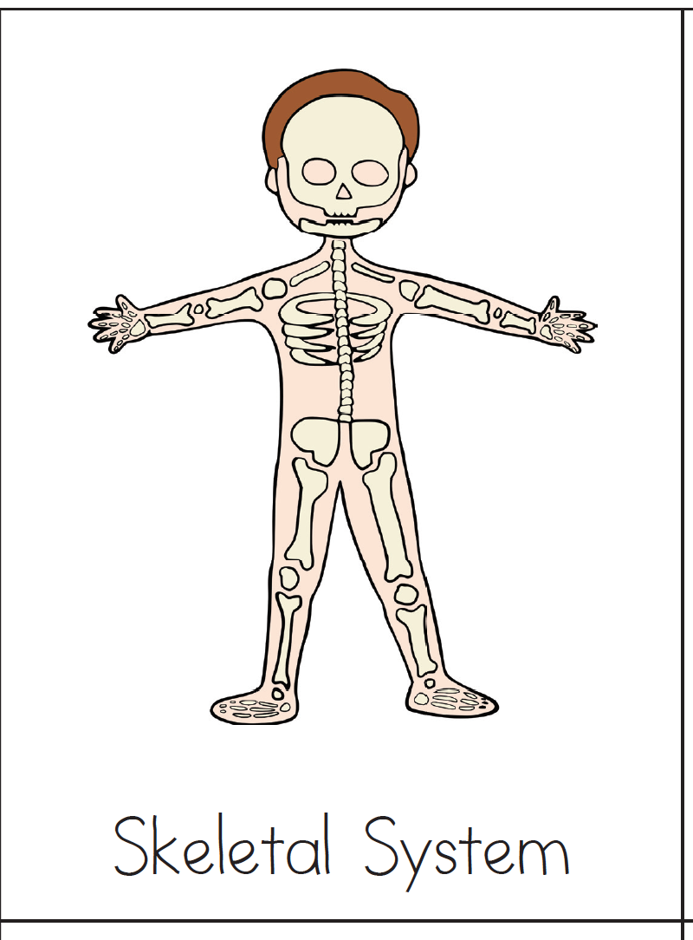
Body System
Description
Use this card to cover the side you want to study
Provides support for the body.

Slide 2
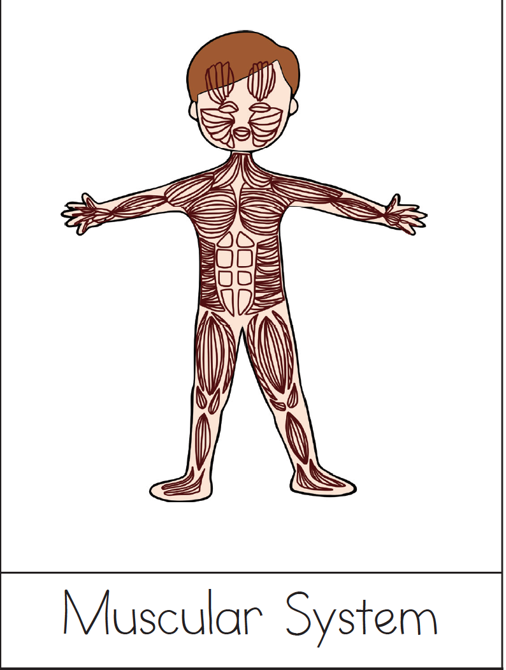
Body System
Description
Use this card to cover the side you want to study

Slide 3
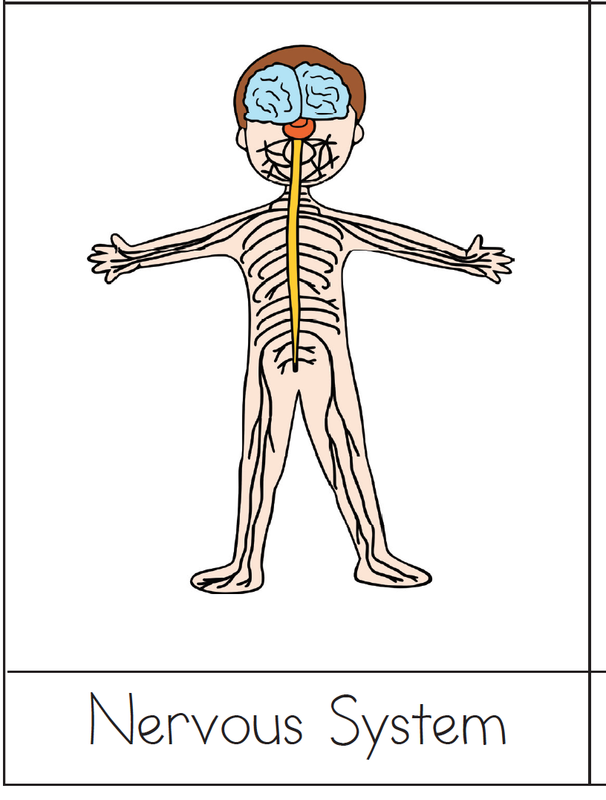
Body System
Description
Use this card to cover the side you want to study

Slide 4
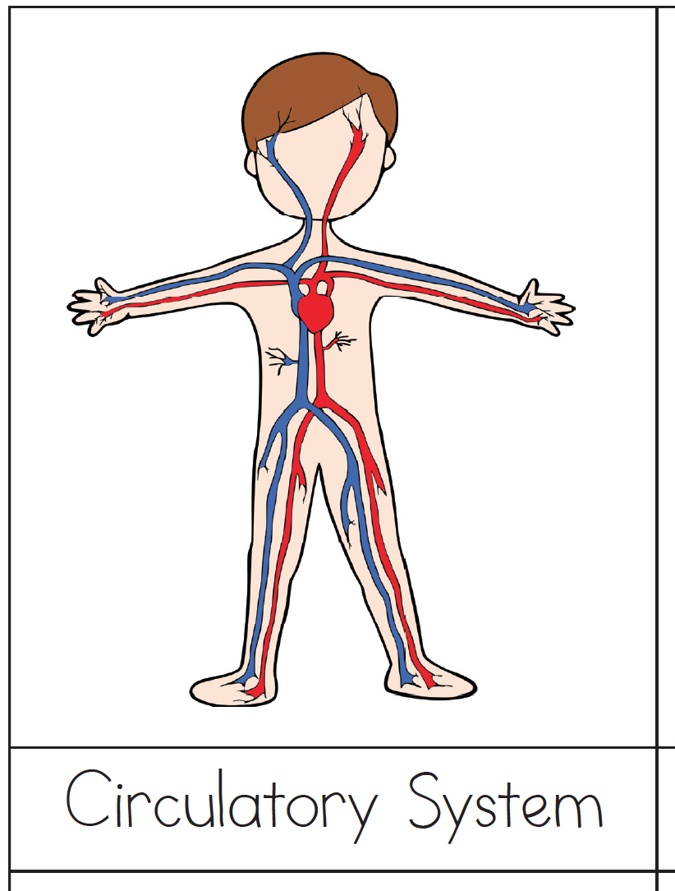
Body System
Description
Use this card to cover the side you want to study

Slide 5
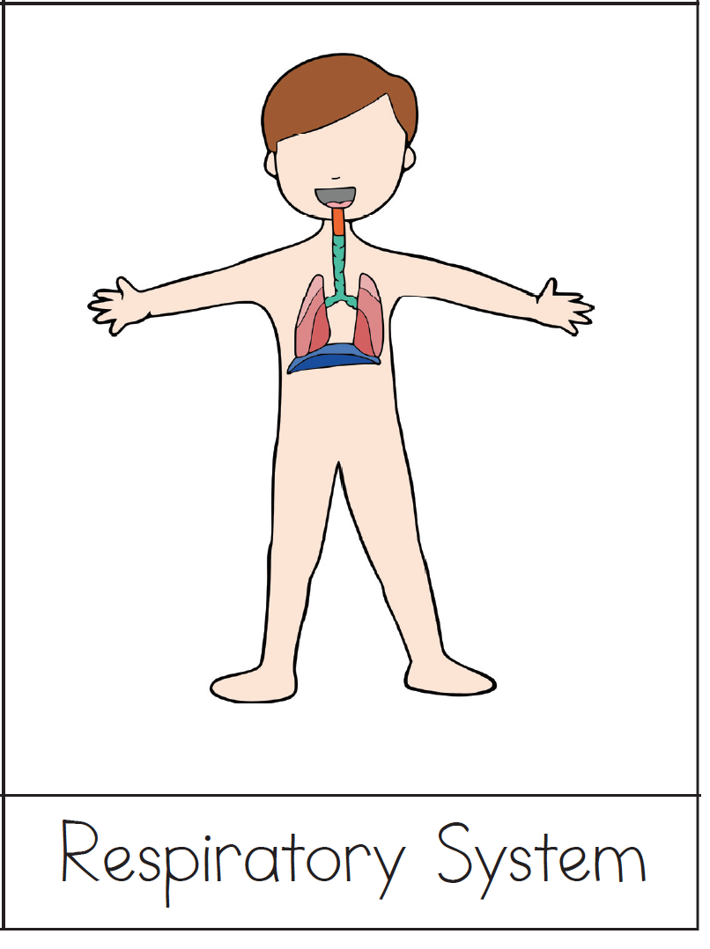
Body System
Description
Use this card to cover the side you want to study

Slide 6
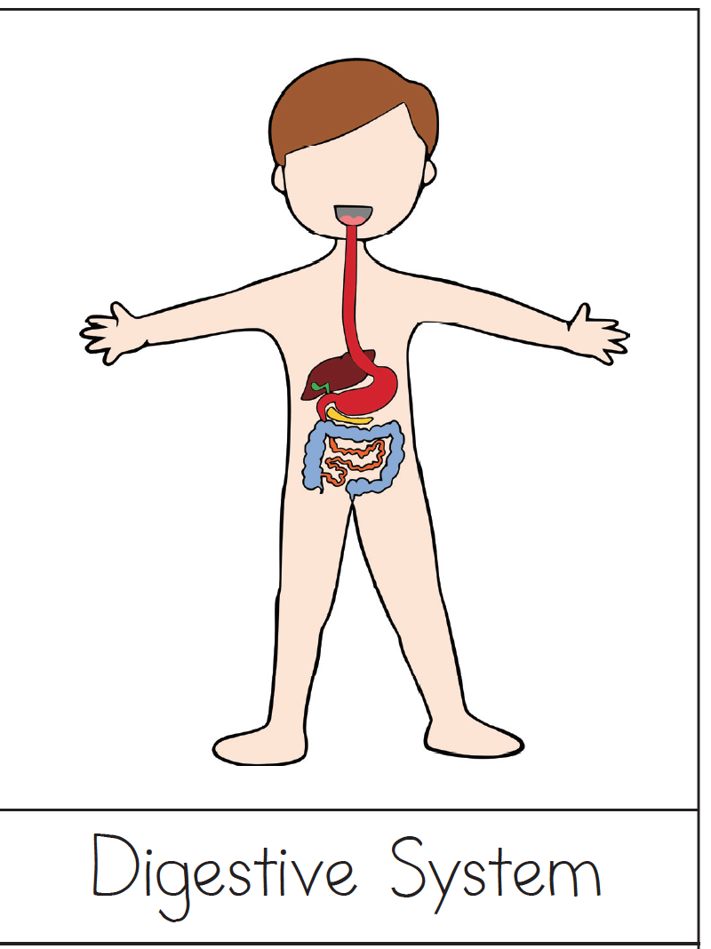
Body System
Description
Use this card to cover the side you want to study

Slide 7
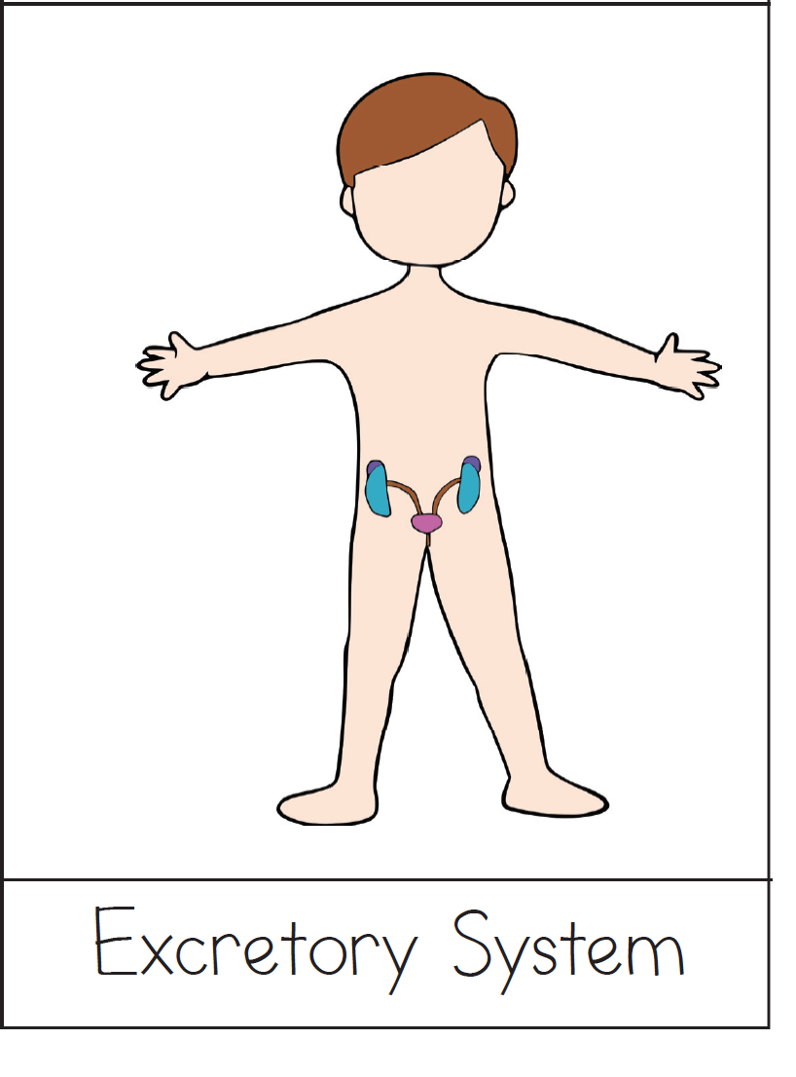
Body System
Description
Use this card to cover the side you want to study

Slide 8

Body System
Description
Use this card to cover the side you want to study

Slide 9
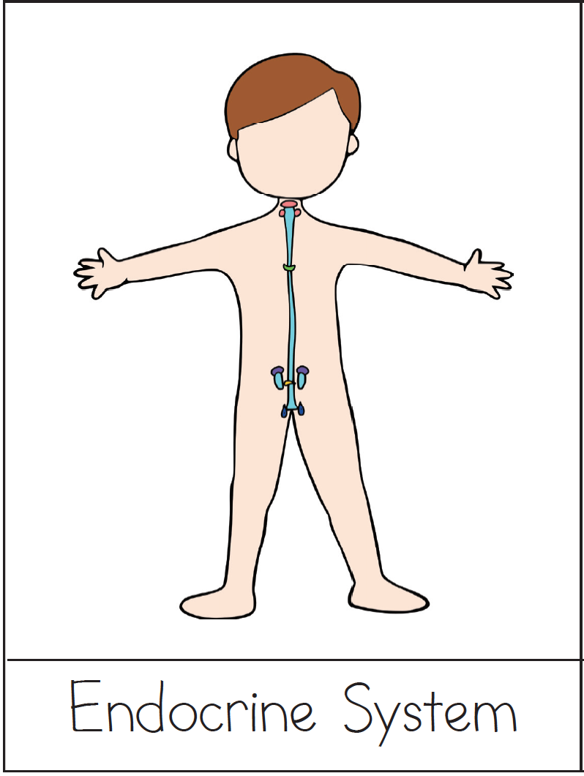
Body System
Description
Use this card to cover the side you want to study

Slide 10
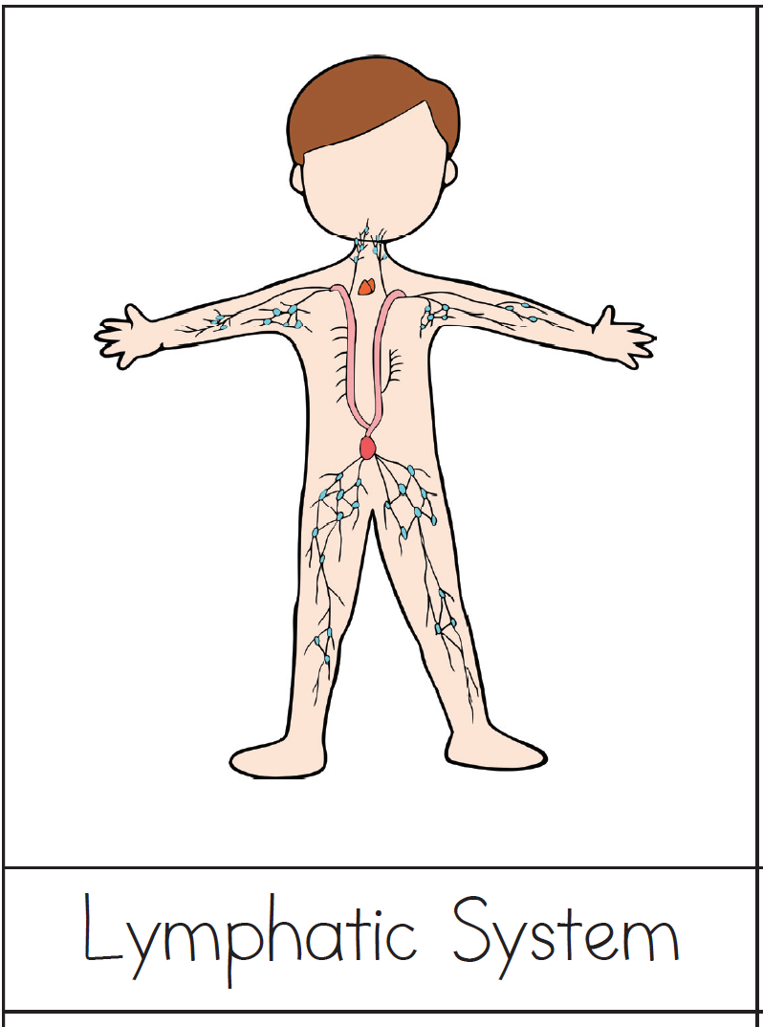
Body System
Description
Use this card to cover the side you want to study

Slide 11
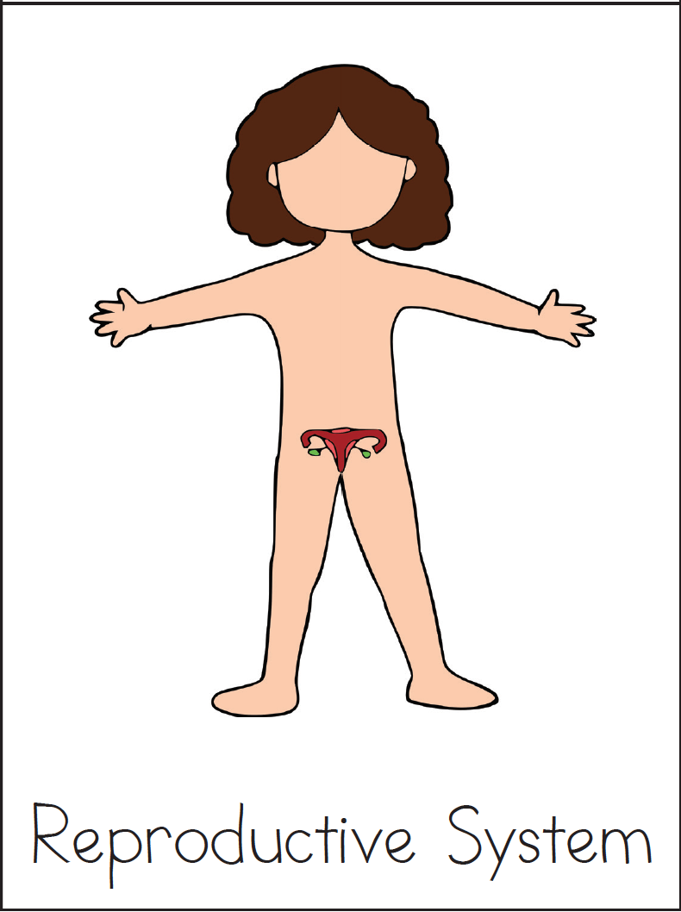
Body System
Description
Use this card to cover the side you want to study

