Slide 1
Disease Diagnosis

Slide 2
Directions
For the following three cases, please read each case carefully and extract as much information as you can from each case. Once you have extracted as much info as possible from each case, answer the questions on each slide about what disease you believe the patient has, what test can be run to check, how to treat the disease and see if the patient will make a full recovery.

Slide 3
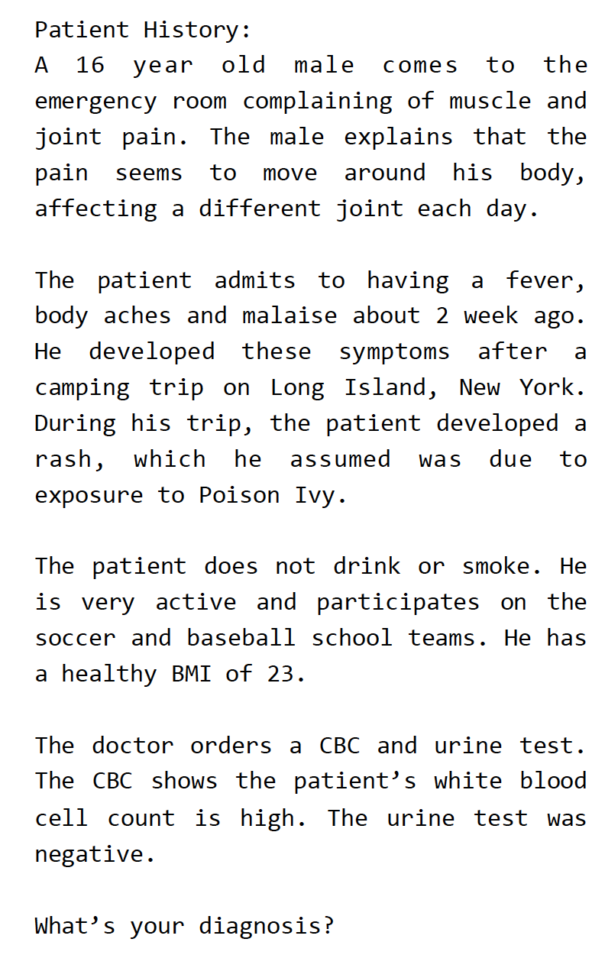
Case #1
Write down any important information about the patient.

Slide 4
Case #1
What possible diseases does your patient have?

Slide 5
Case #1
What disease do you believe your patient has?
What tests confirm your patients diagnosis?

Slide 6
Case #1
How does a doctor treat this disease?
Will they make a full recovery? What happens if they do not treat their disease?

Slide 7
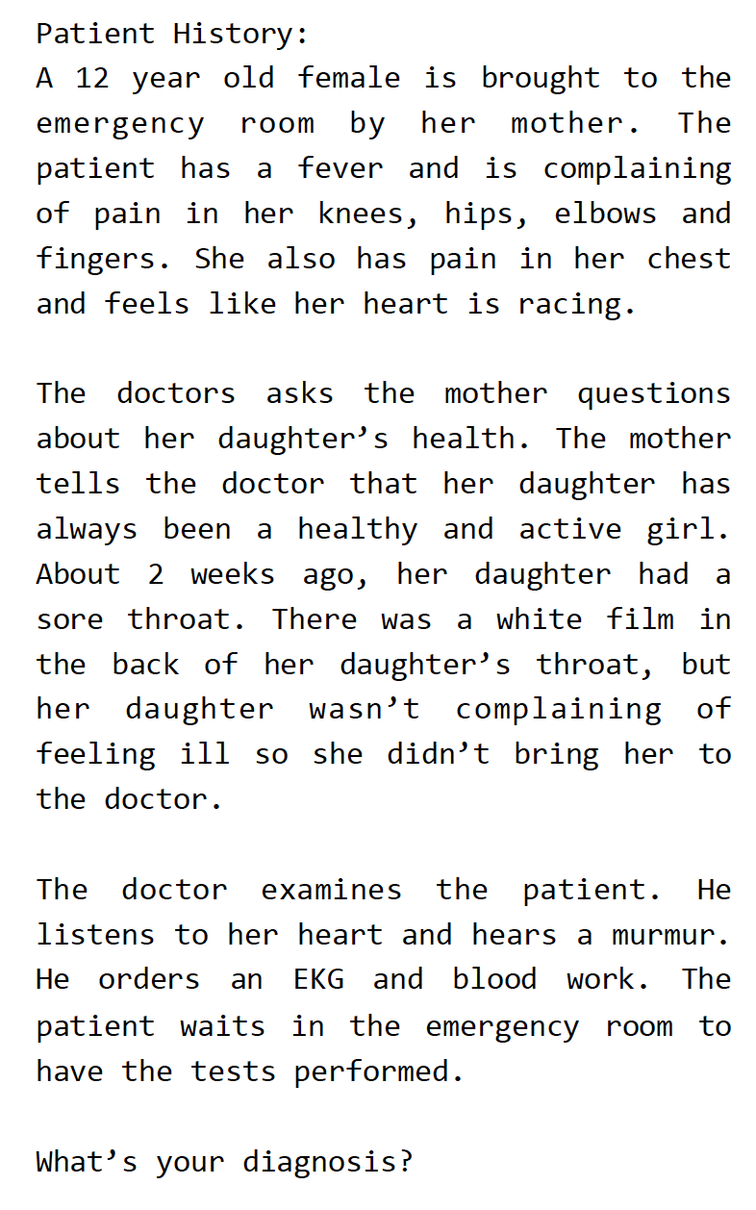
Case #2
Write down any important information about the patient.

Slide 8
Case #2
What possible diseases does your patient have?

Slide 9
Case #2
What disease do you believe your patient has?
What tests confirm your patients diagnosis?

Slide 10
Case #2
How does your patient treat their disease?
Will they make a full recovery? What happens if they do not treat their disease?

Slide 11
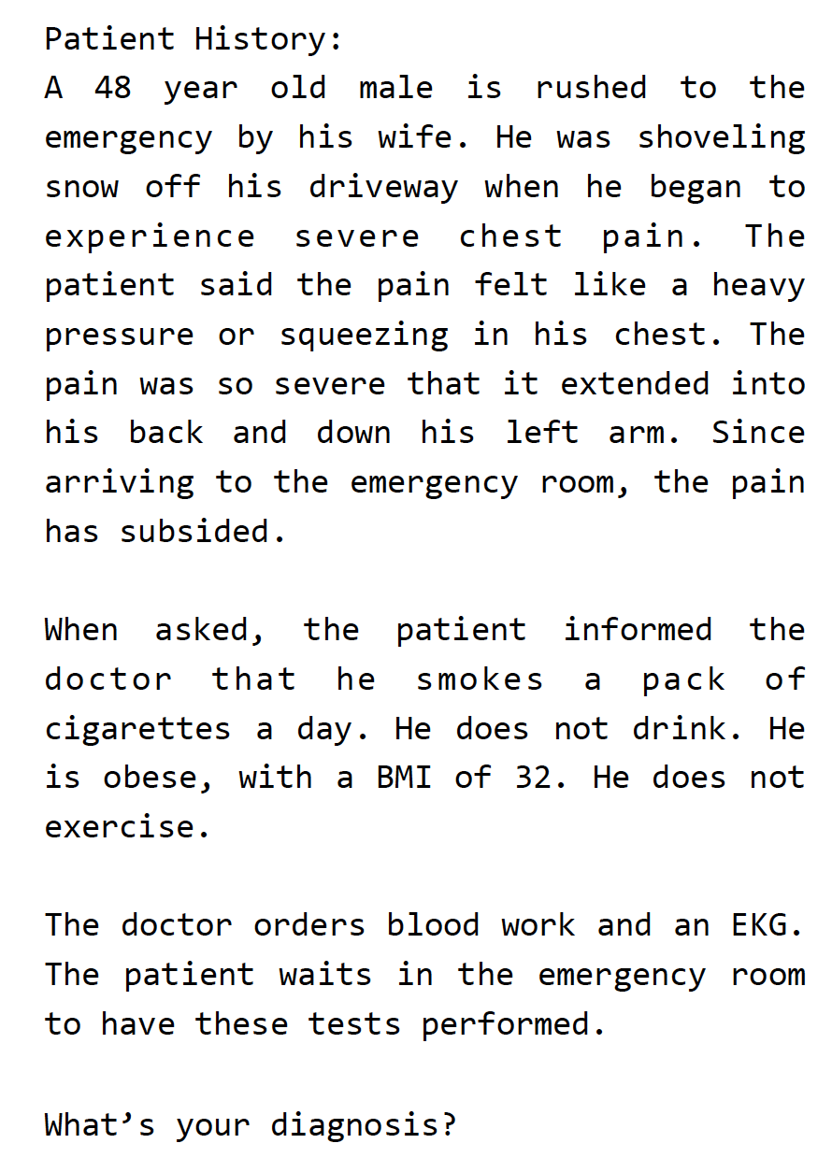
Case #3
Write down any important information about the patient.

Slide 12
Case #3
What possible diseases does your patient have?

Slide 13
Case #3
What disease do you believe your patient has?
What tests confirm your patients diagnosis?

Slide 14
Case #3
How does your patient treat their disease?
Will they make a full recovery? What happens if they do not treat their disease?

