Slide 1
Plate Tectonics Puzzle

Slide 2
Directions
On slide three, you will see tectonic plates spread around the slide. Please drag them to the correct location on the faded Earth map.
All of the pieces should fit together like puzzle. My goal is for you to see how all of the plates fit together. If you have difficulty clicking and dragging the plates, you can also click on the plate and use the arrow keys to move them around (however, this will take longer). You will likely need to scroll around the slide to find all of the plate puzzle pieces.
On slide 4, click the link at the top of the slide. This will take you to a BrainPop on plate tectonics. ONLY WATCH THE VIDEO, you are not responsible for anything else on BrainPop. The video will be a mix of review from this week, as well as items we will be learning about next week. When you are finished watching the video, write a six sentence summary (minimum, but may write more) about what you learned from the video. Please type your summary on slide 4 where indicated.

Slide 3
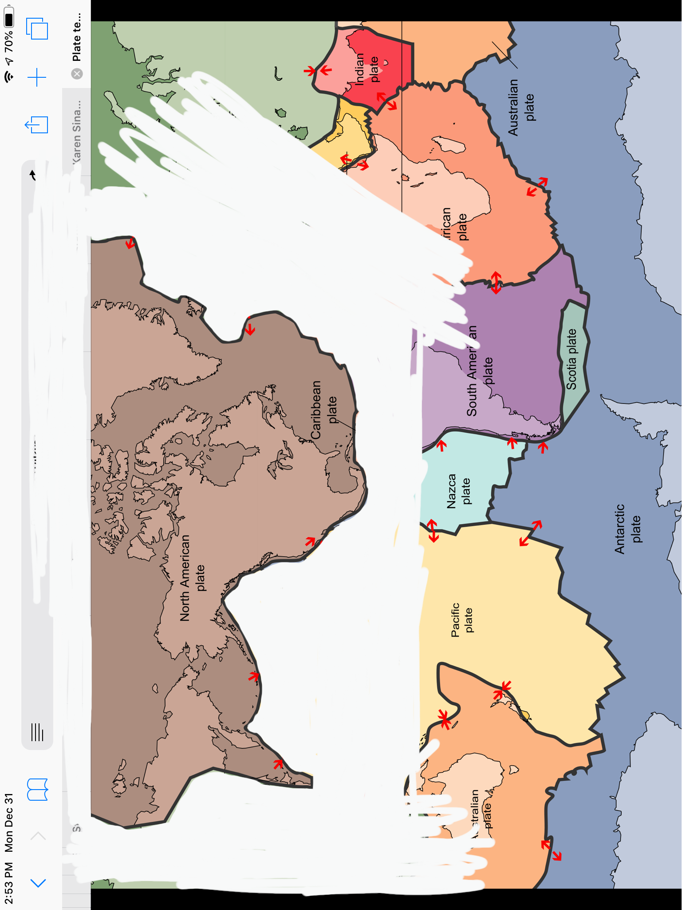
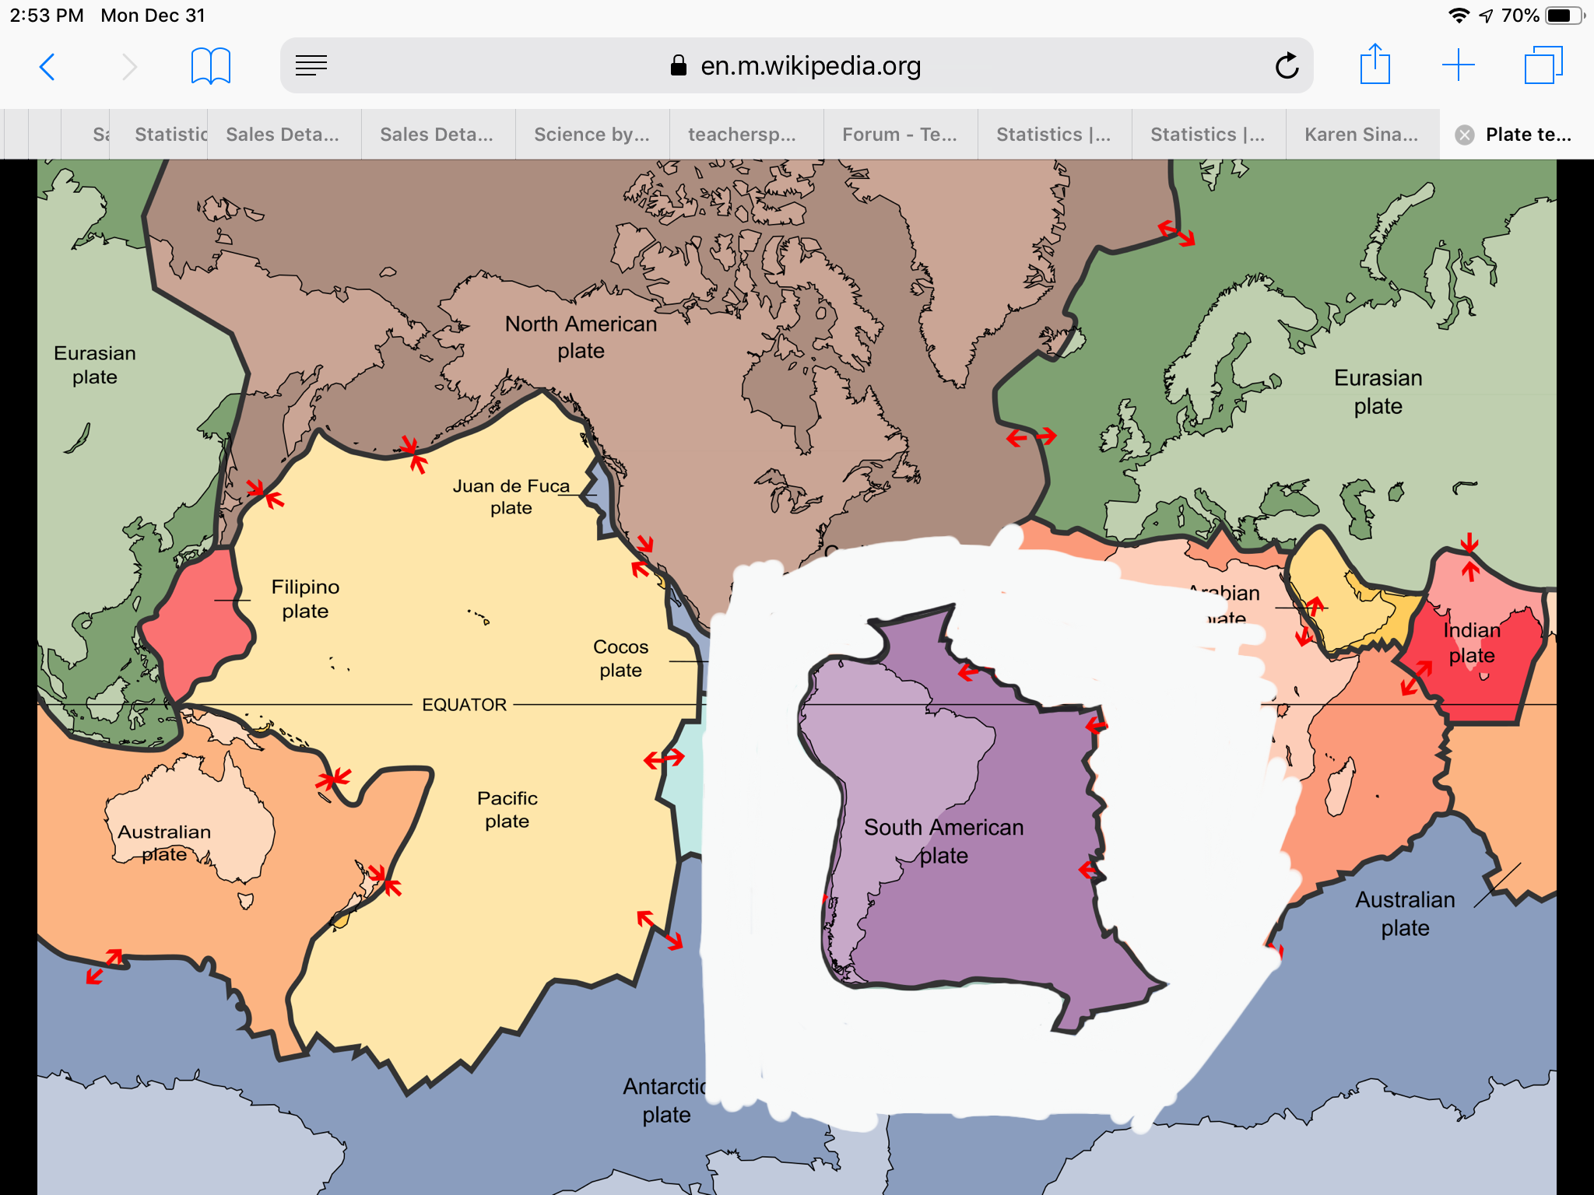
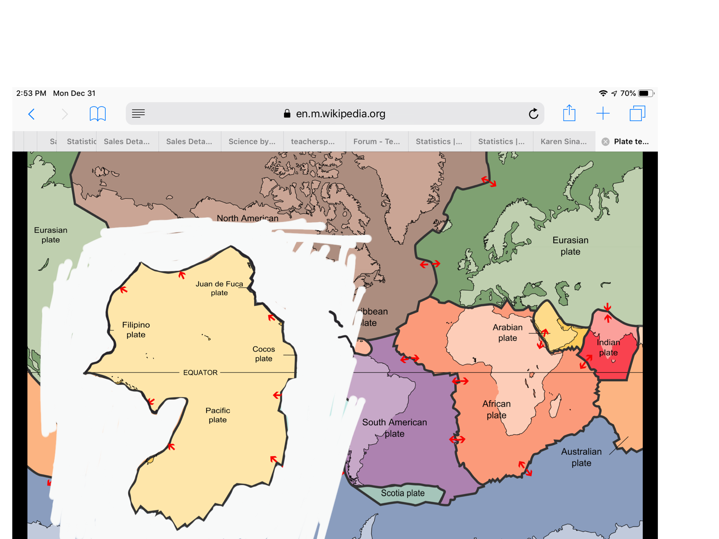
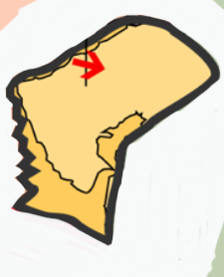
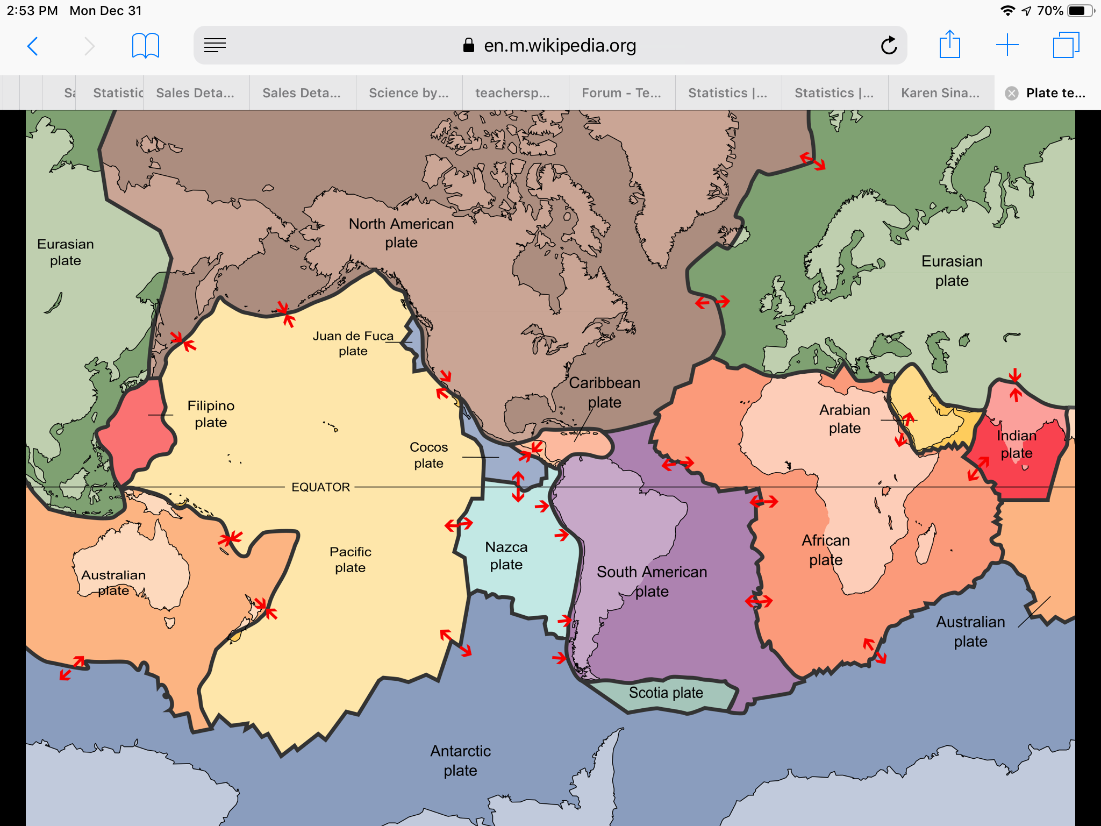
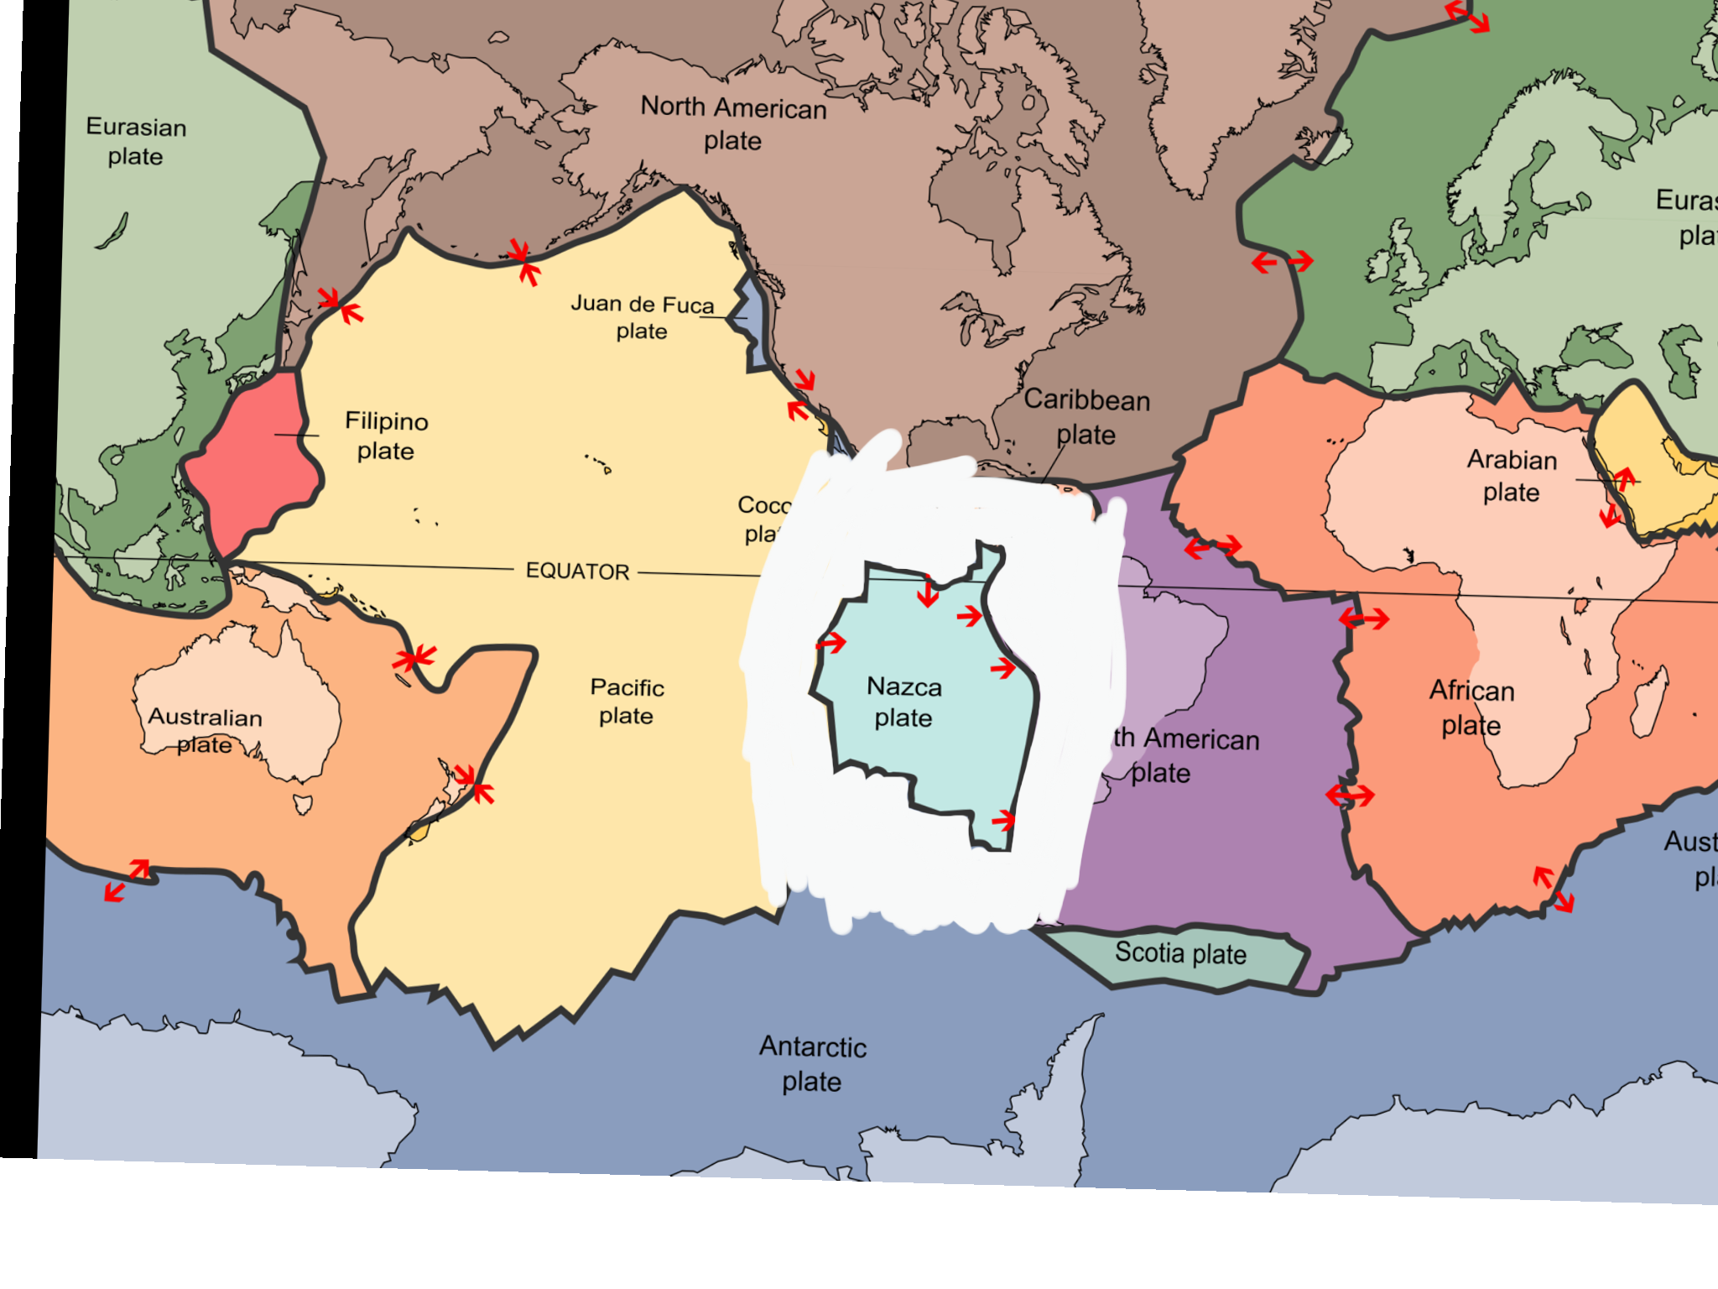
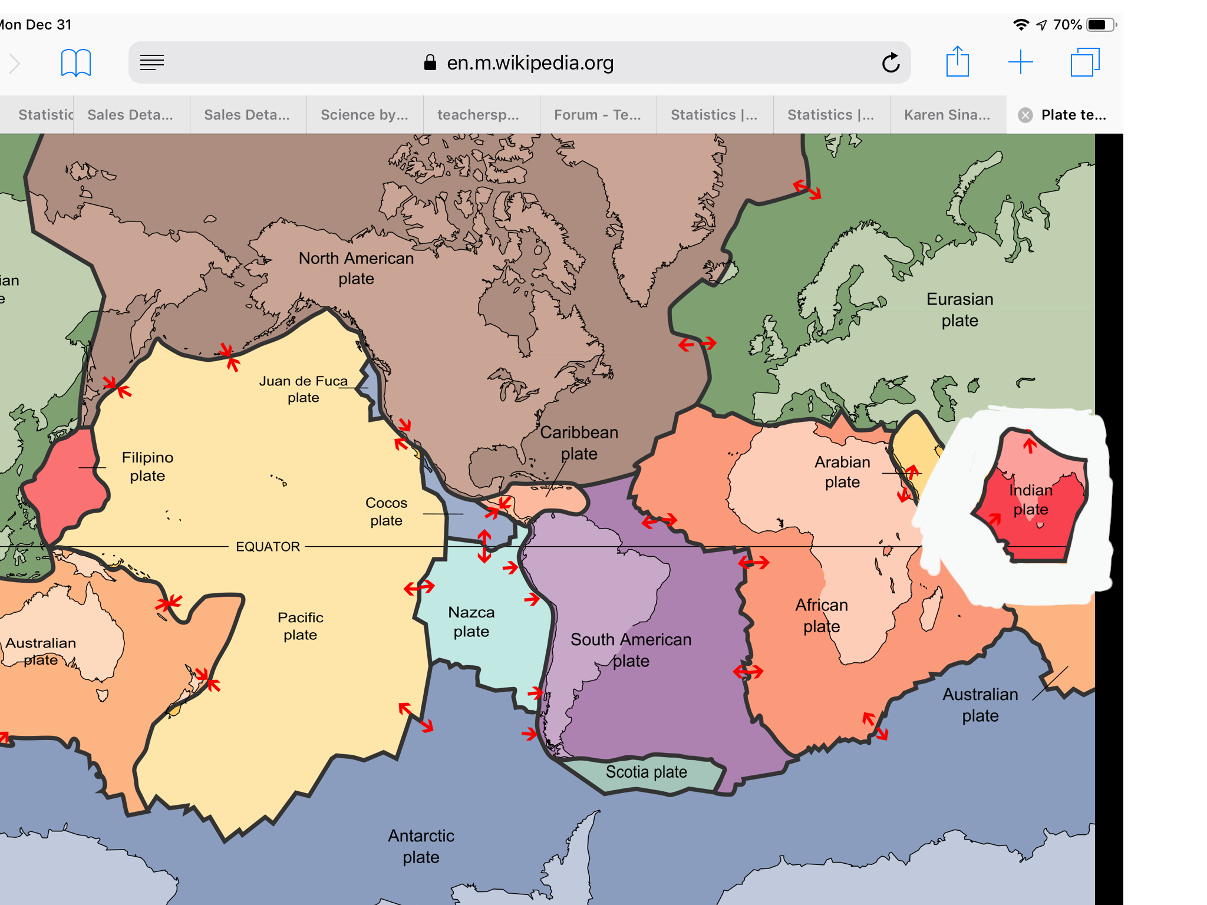
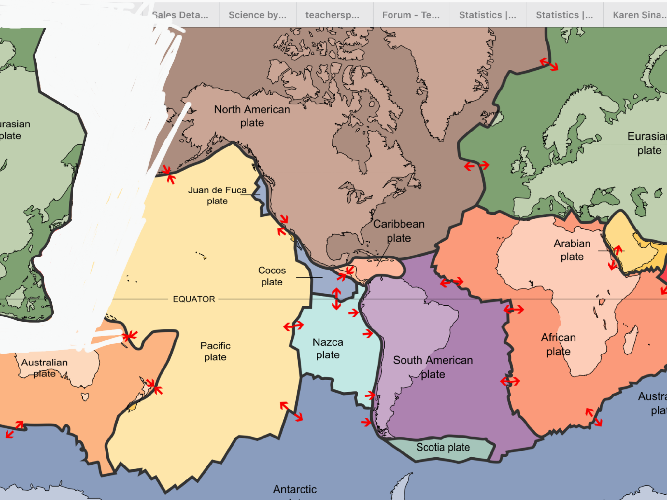
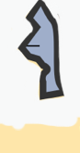
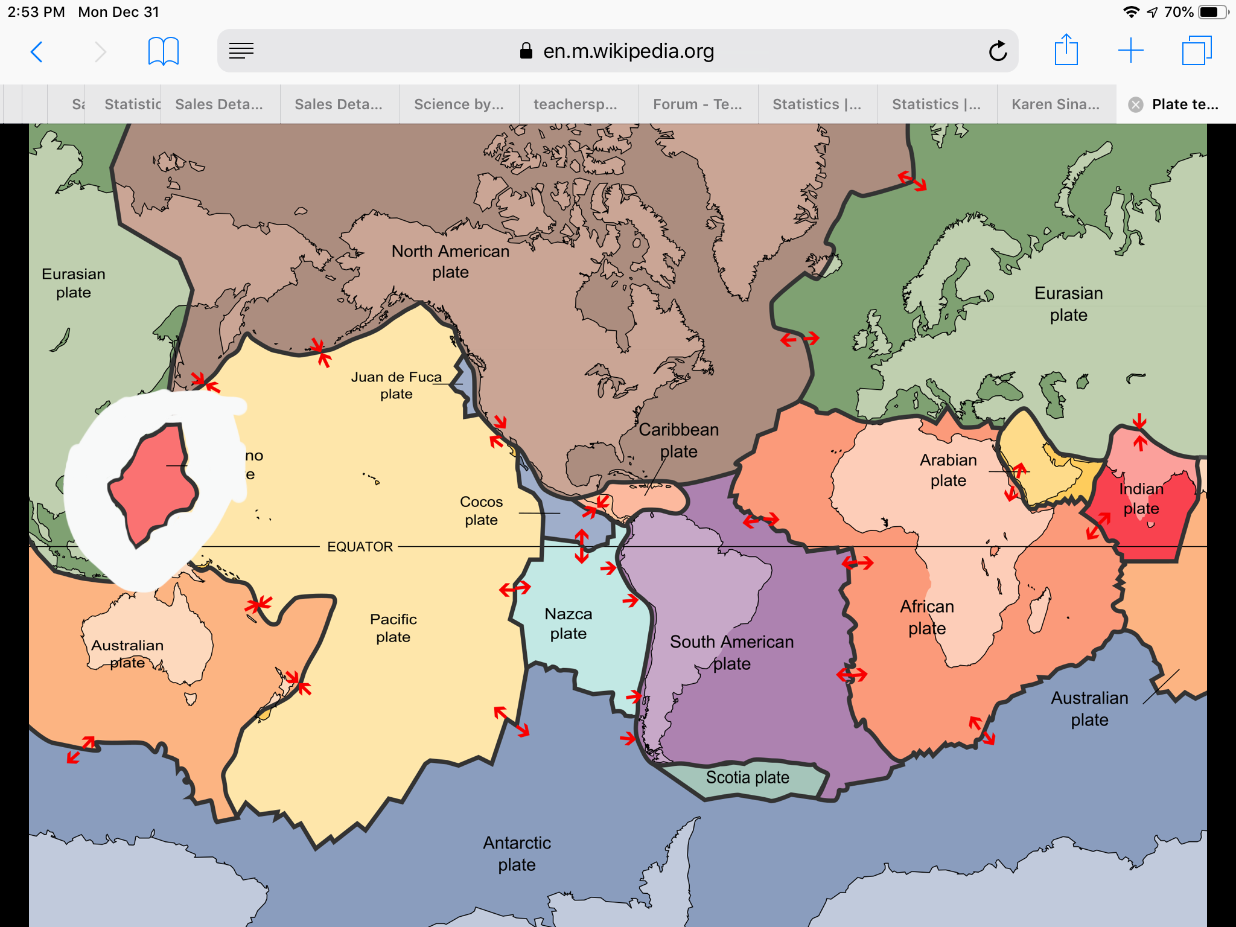
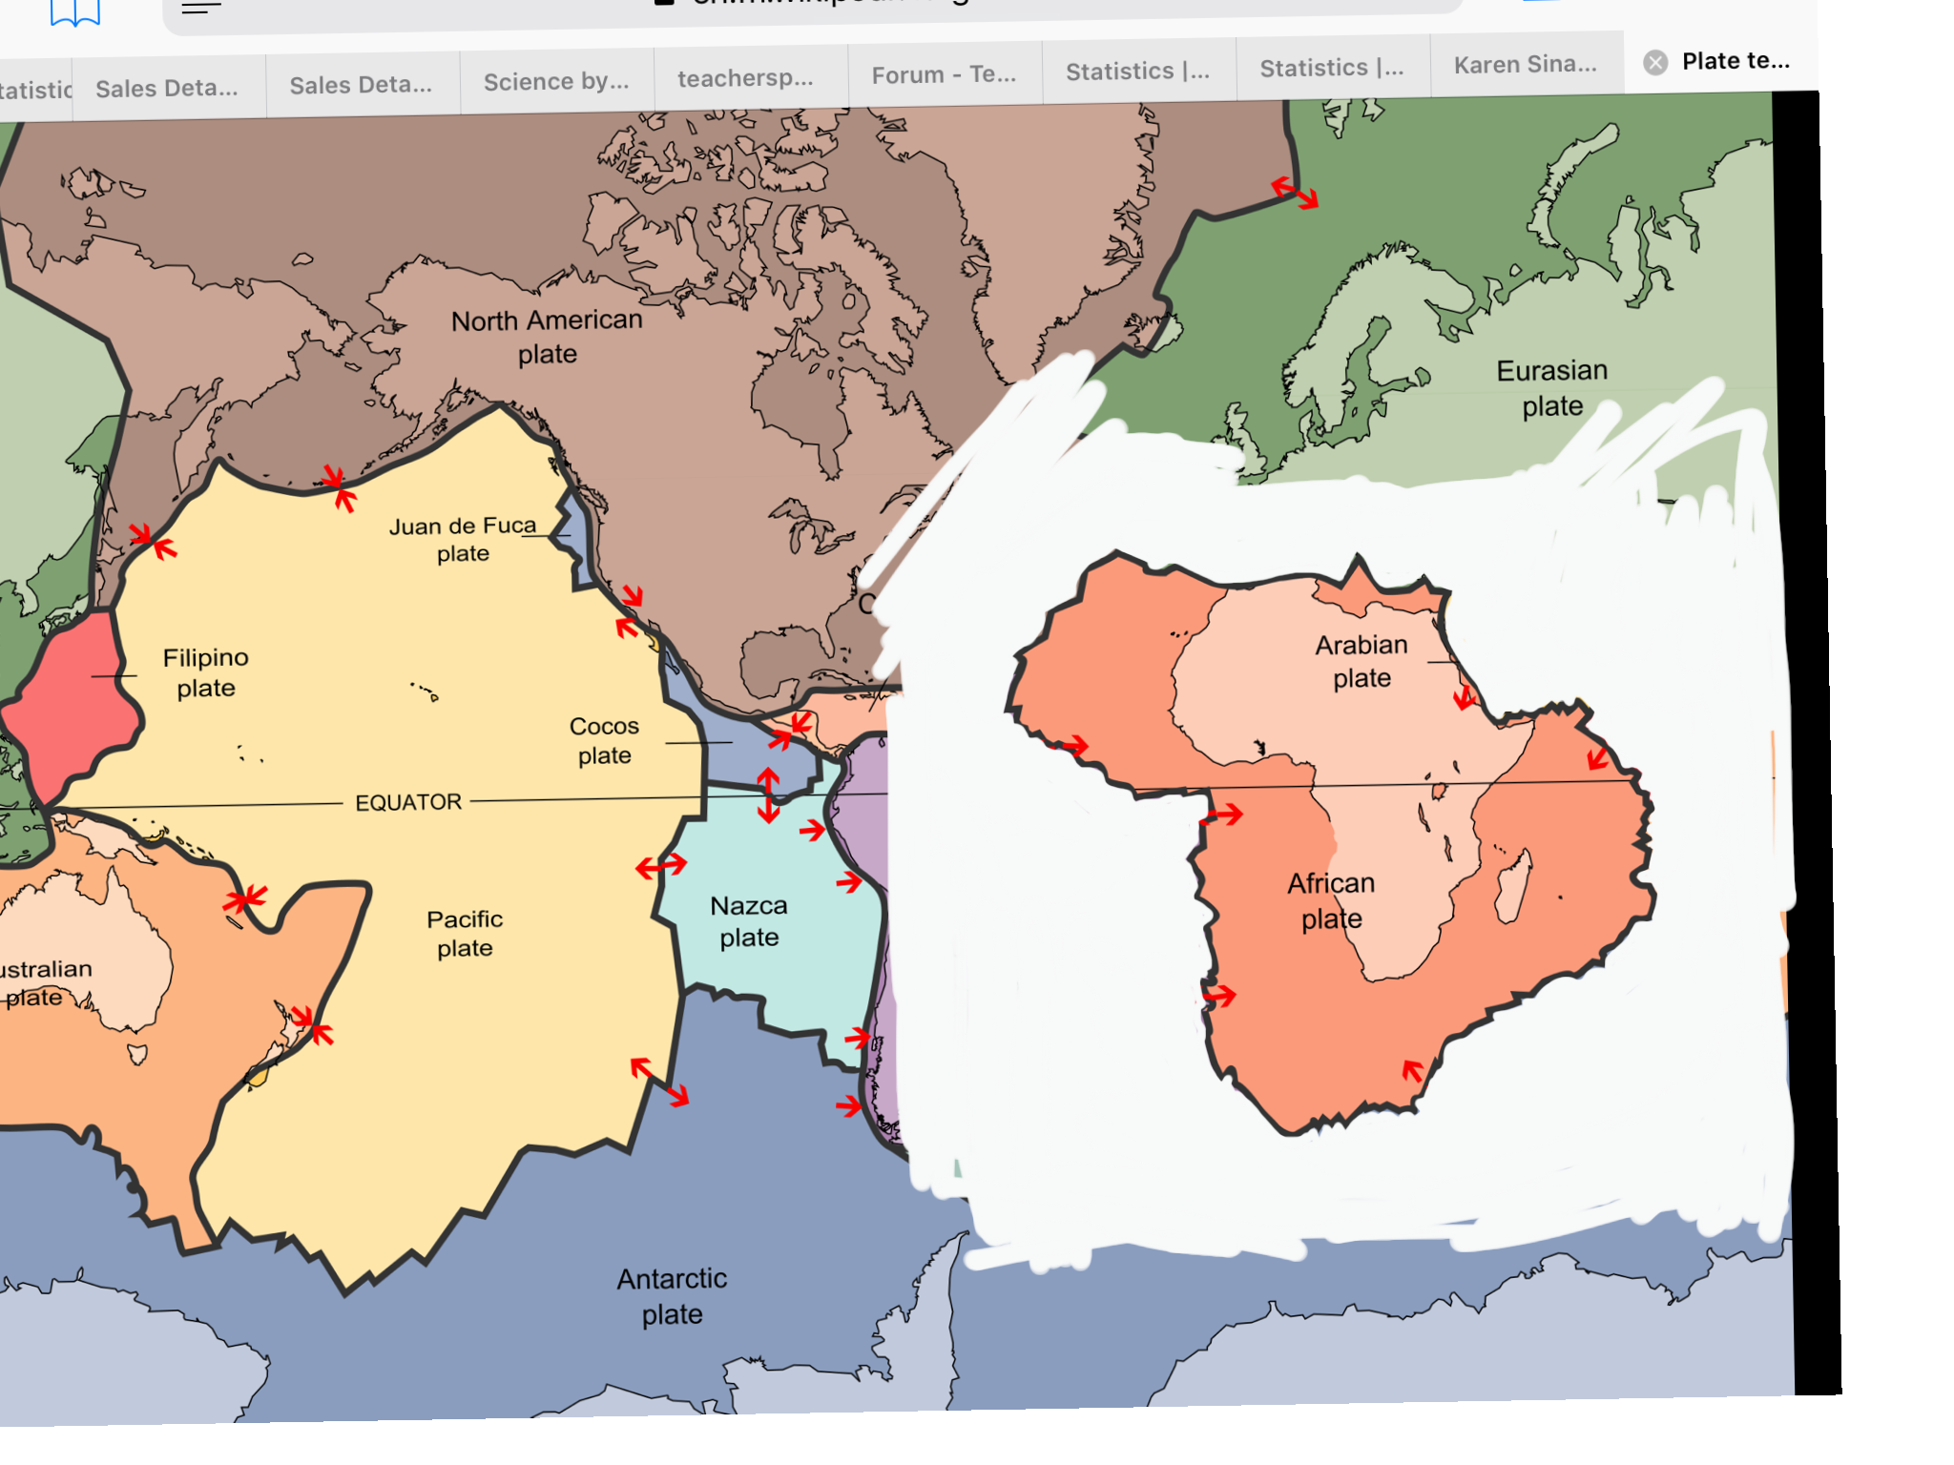
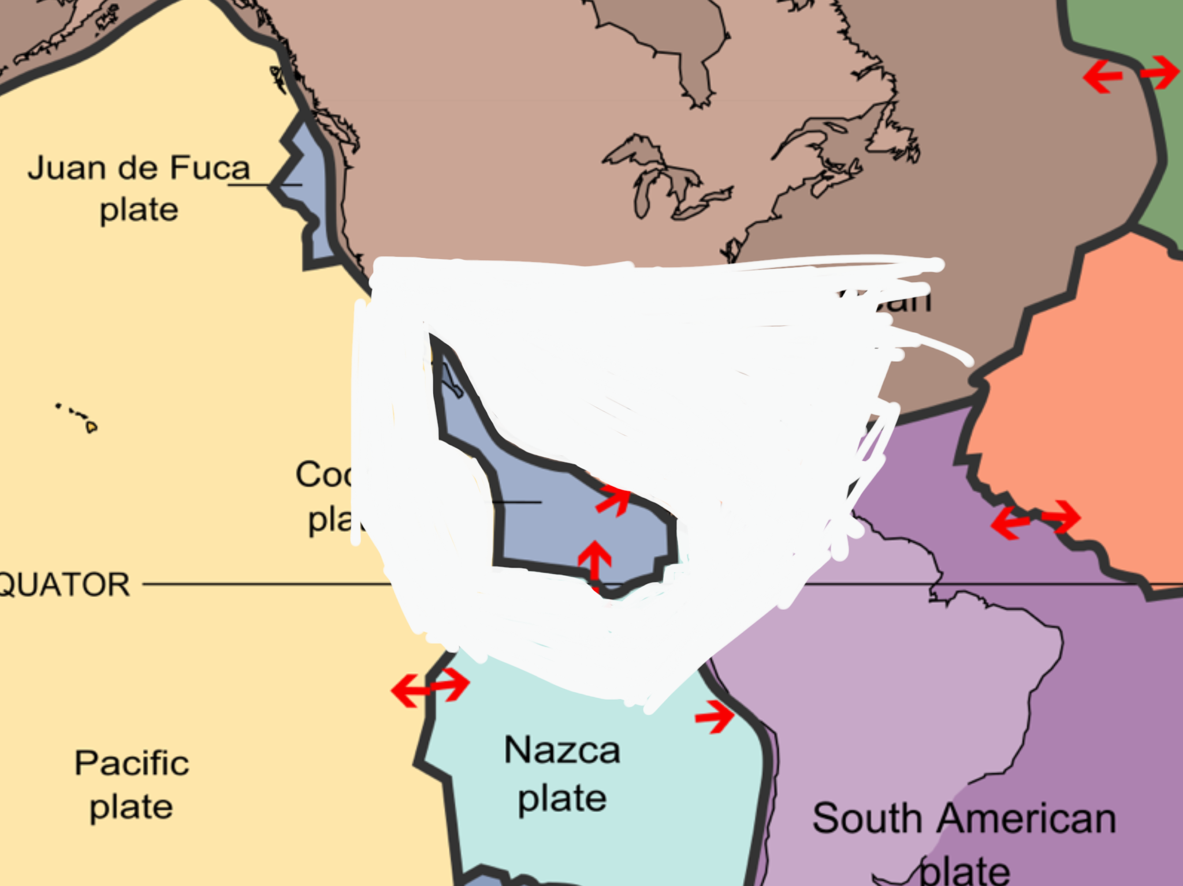
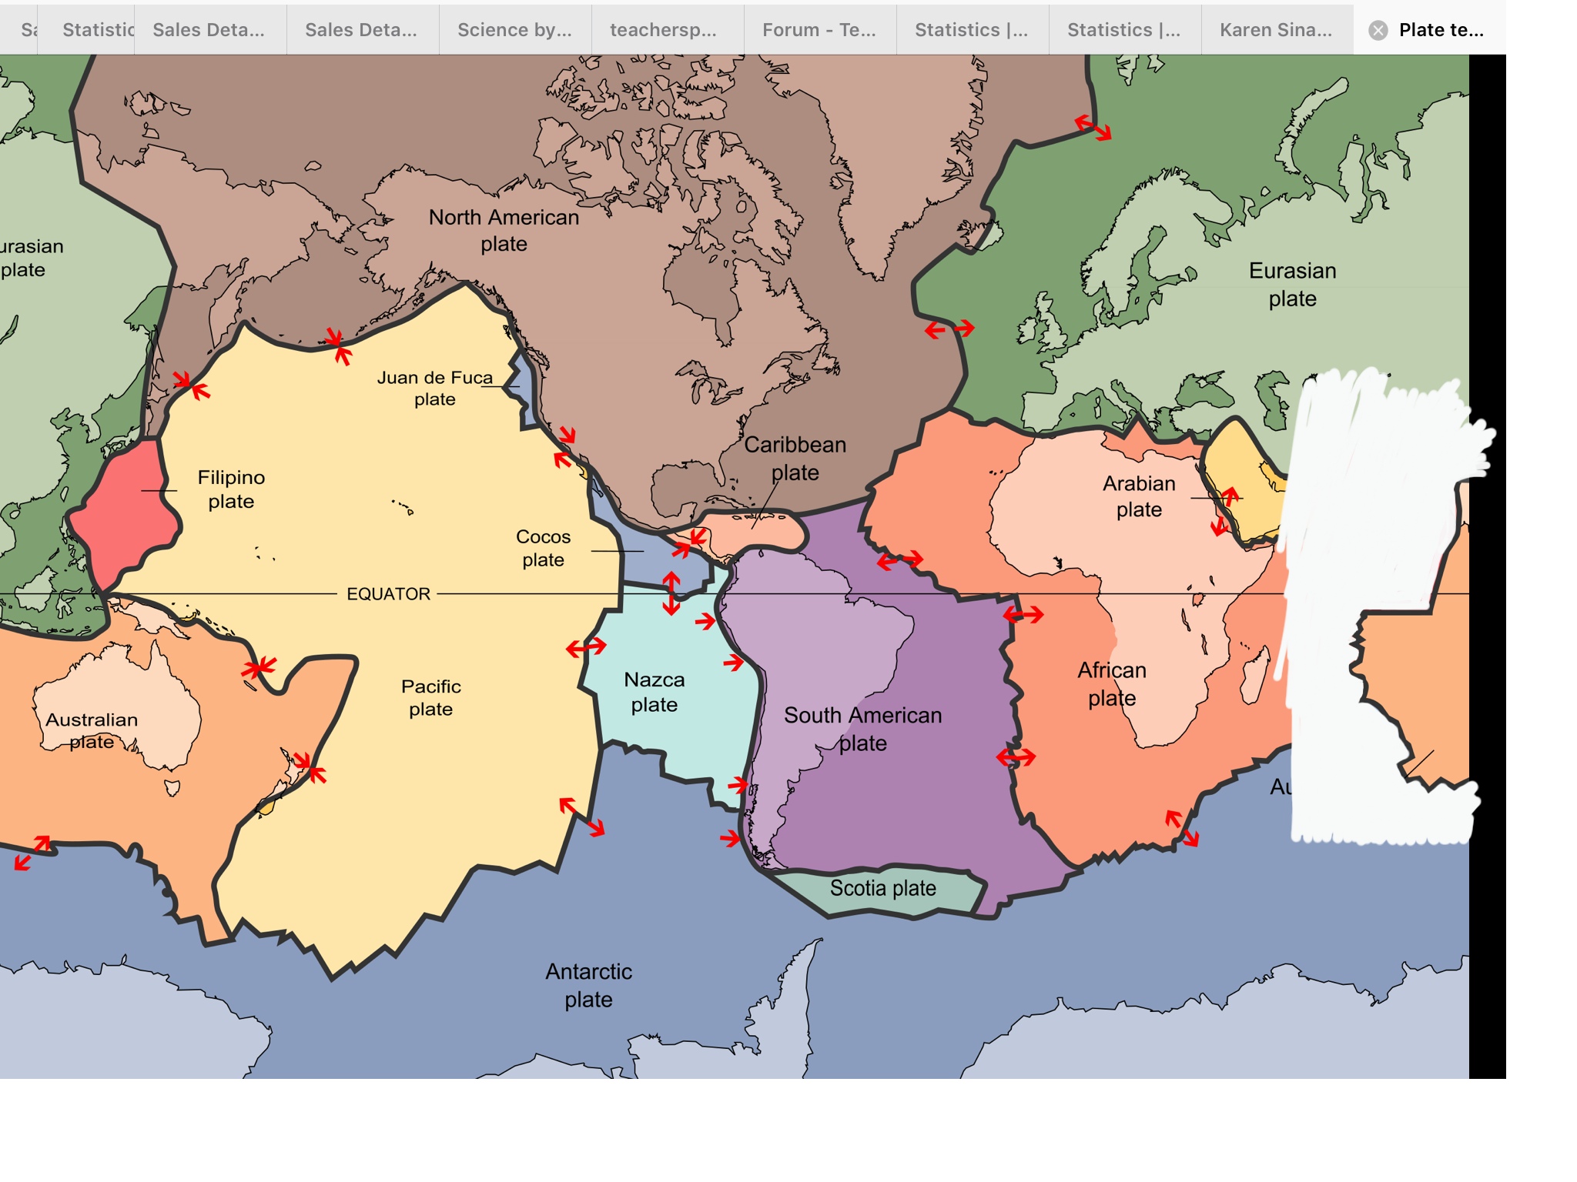
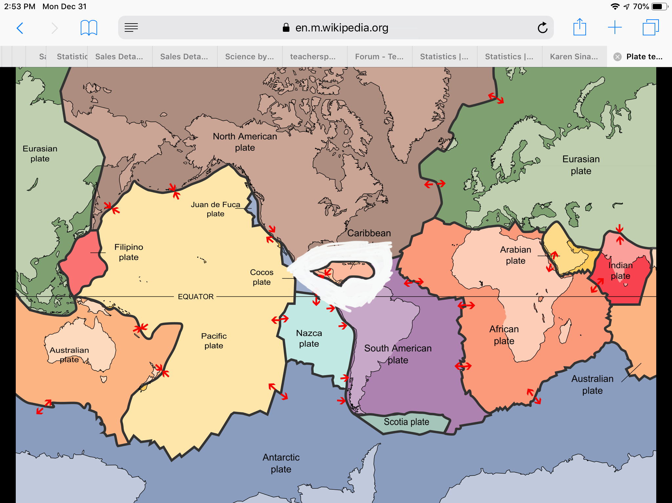
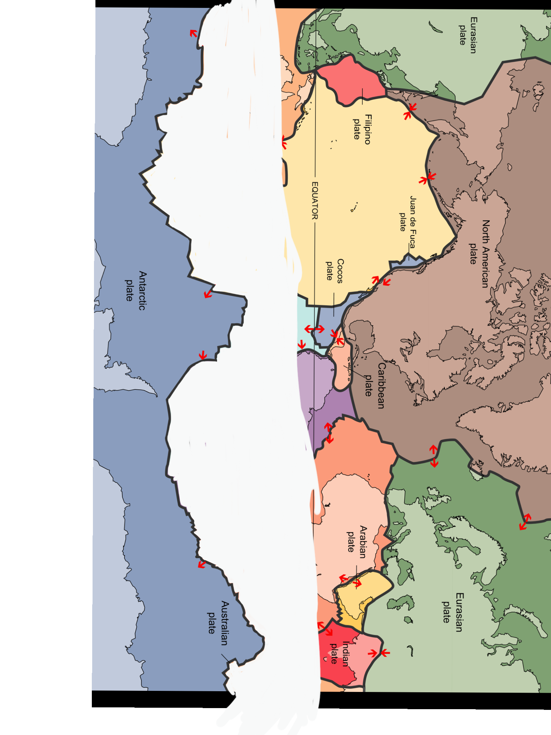
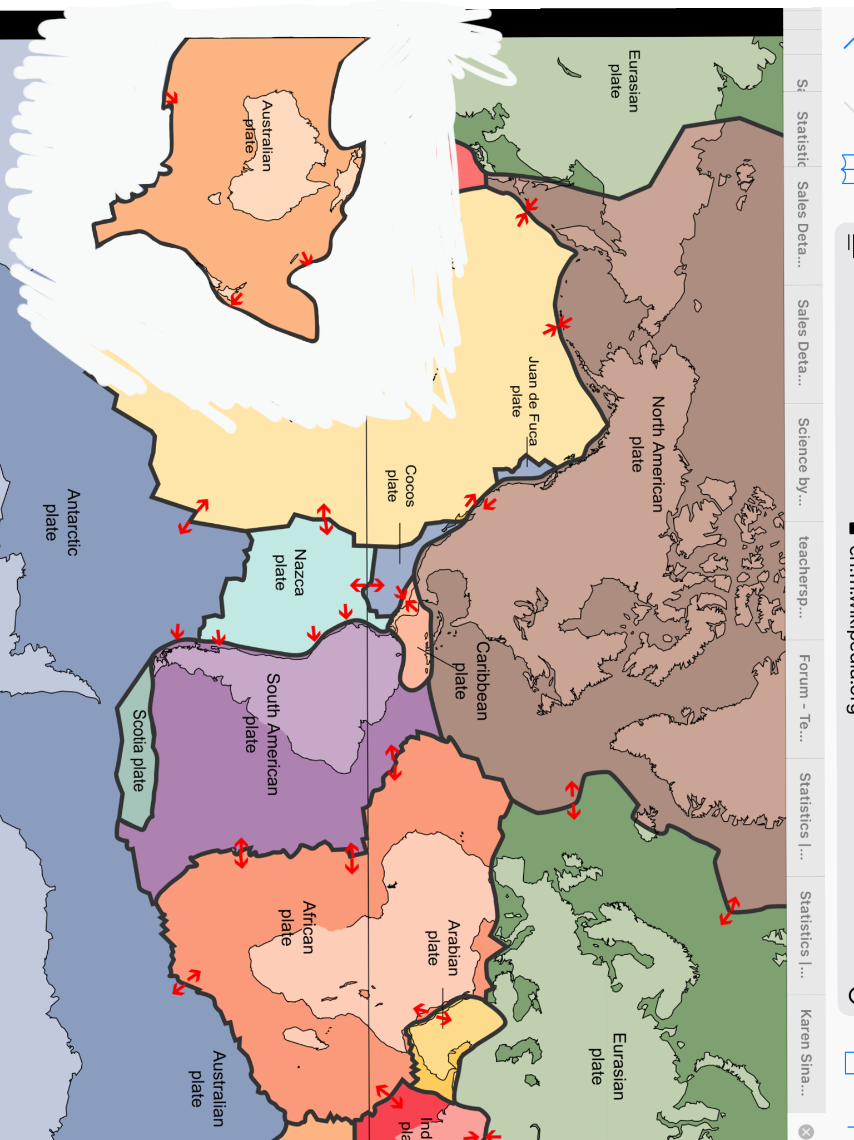
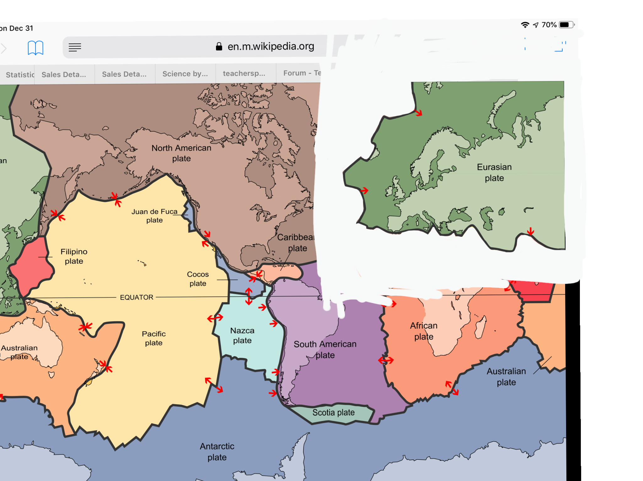
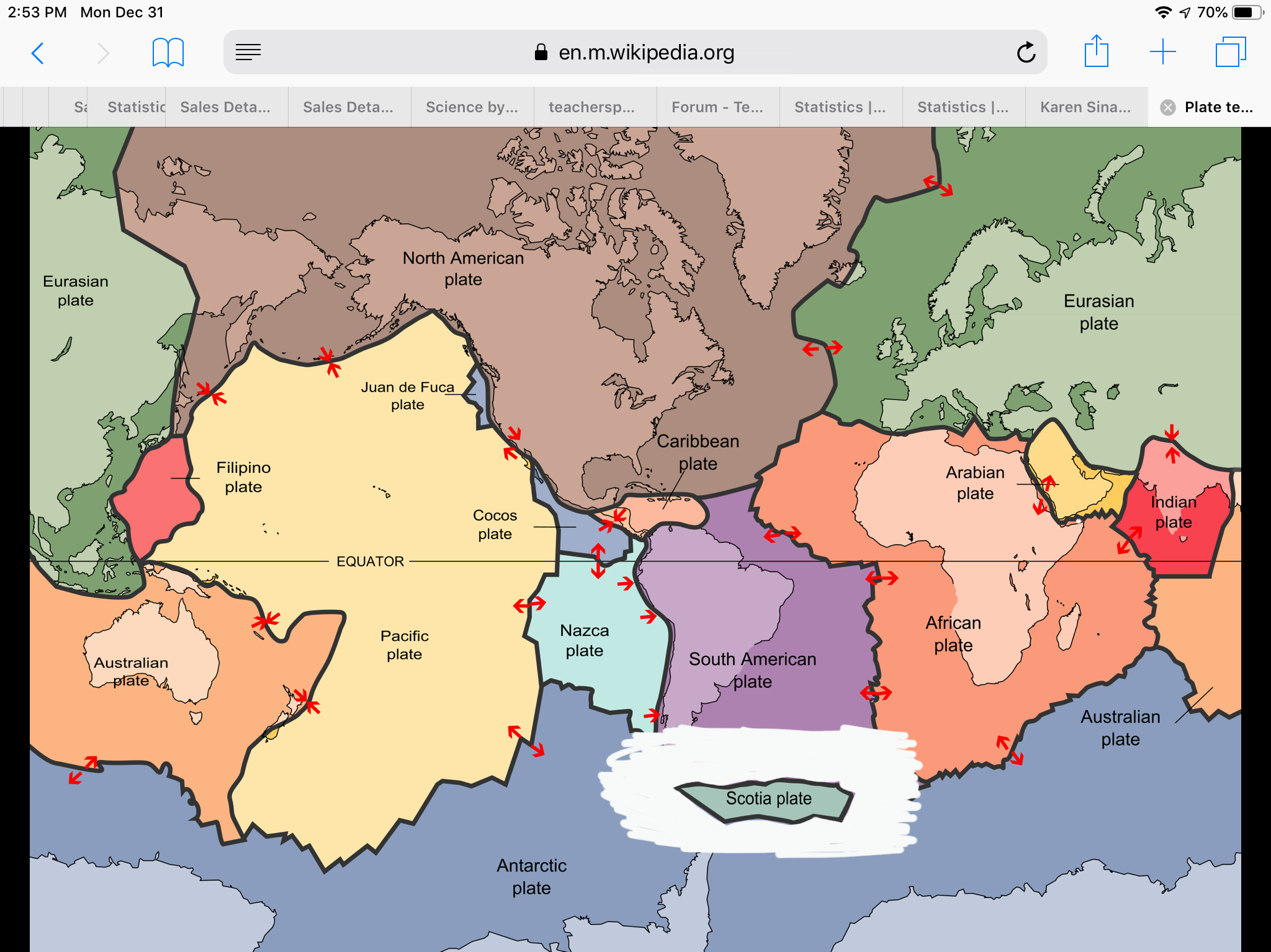
©️Karen Sinai 2019

Slide 4
Link to Brainpop on tectonic plates
Please write at least a 6 sentence summary on what you learned from the Brainpop video. The video will be review as well as things we will be learning about next week.
Summary:

