Slide 1
Biotic v Abiotic Review

Slide 2
Directions
For slides 3-11, look at each picture and list all the biotic and abiotics items in each picture. For any organism that you list as biotic, tell me whether they are a producer, consumer or decomposer.
For slide 12, click on the link to play the producer, consumer, decomposer game for review.
For slide 13, click on the link to take the quizziz review game.

Slide 3

Photo #1
Biotic: Kangaroo (C), rotting log(P), bacteria(C,D), algae(P), plankton(D), snail(C), insects(C), and trees(P).
Abiotic:Water, rock, sand, and dirt. sun.

Slide 4
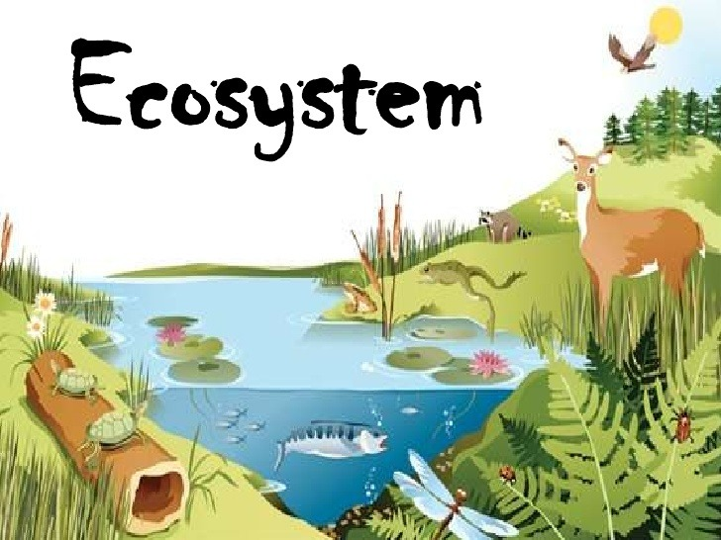
Photo #2
Biotic: Deer(C), frog(C), turtle(C), fish(C), racoon(C).
Abiotic: Water, dirt, hills.

Slide 5

Photo #3
Biotic: Fish(C), frog(C), snail(C), tadpoles(C).
Abiotic: Sun, water, ground

Slide 6

Photo #4
Biotic: Giraffe(C), elephant(C), lions(C), alligator(C), flamingo(C), hippo(C).
Abiotic: Sun, cloud, water, snow.

Slide 7

Photo #5
Biotic: Tree(P), Hippo(C), Fungi(D), Turtle(C).
Abiotic: Sun, water, cloud, ground/dirt.

Slide 8

Photo #6
Biotic: Fish(C), ducks(C), snail(C).
Abiotic: water, dirt and ground.

Slide 9

Photo #7
Biotic:
Bunny(C), wolf(C), ducks(C).
Abiotic: Water, cloud, rock

Slide 10
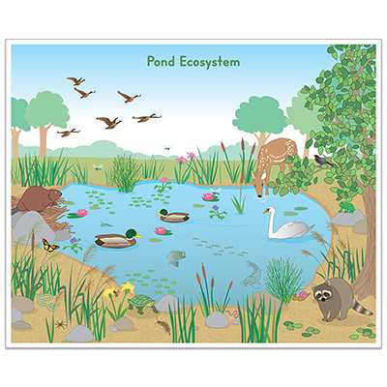
Photo #8
Biotic:
Ducks(C), Deer(C), Racoon(C), tree(P)
Abiotic:Mountain, dirt, rock.

Slide 11

Photo #9
Biotic: Dragonfly(C), Snapping turtle(C), Newt(P).
Abiotic:Water, dirt, sky.

Slide 12
Producer, Consumer, Decomposer Game
Click on the link below and play the producer, consumer, decomposer game. If the link tells you to adobe flash players does not work,click on the puzzle piece and click on the allow button to allow the puzzle piece to work.
Producer,Consumer,Decomposer Game I got 100% :)

Slide 13
Quizziz Review
Click on the link below to play a quizziz review game on Abiotic v. Biotic.
Quizziz review game I got 100% :]

