Slide 1
Biotic v Abiotic Review

Slide 2
Directions
For slides 3-11, look at each picture and list all the biotic and abiotics items in each picture. For any organism that you list as biotic, tell me whether they are a producer, consumer or decomposer.
For slide 12, click on the link to play the producer, consumer, decomposer game for review.
For slide 13, click on the link to take the quizziz review game.

Slide 3

Photo #1
Biotic: bird, mushroom, fish, kangaroo, weird crab thing in water, tree, frog, snail, termite, insects and bacteria
Abiotic: rocks, dirt, sun, log, bush, grass

Slide 4

Photo #2
Biotic: frog, raccoon, deer, fish, tortus’s, cockroaches, dragonflies, bird and trees
Abiotic: lilypad, water, log, bush, sun,grass and mountain in the back.

Slide 5

Photo #3
Biotic: flies, tadpoles, snail, fish and frog
Abiotic: lilypad, water weeds, sun, water log and bush

Slide 6

Photo #4
Biotic: tree, lion, hippo, giraffe, flamingo, aliater, elephant, tree
Abiotic: sun, clouds, mountain, grass and plants

Slide 7

Photo #5
Biotic: trees, hippos, mushrooms, turtle and bacteria
Abiotic: log, plants, clouds, sun and water

Slide 8

Photo #6
Biotic: fish, dragonfly, frog, duck and snail
Abiotic: Rocks, water, grass and bush

Slide 9

Photo #7
Biotic: ducks, fox\wolf, bunny, trees and beetle
Abiotic: Plants, rocks, water, bushes and sky

Slide 10
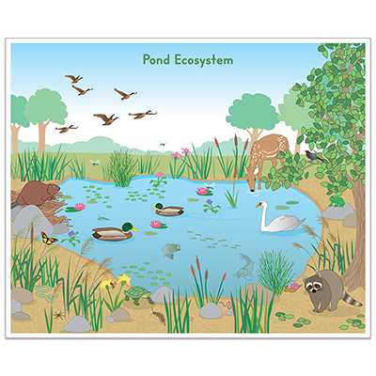
Photo #8
Biotic: deer, duck, beever, racoon, butterfly, turtles, swan, snake, worms, dragonflies, snail, fish, spider and birds
Abiotic: dirt, grass, flowers and rocks

Slide 11

Photo #9
Biotic: dragonfly, mosquito, tadpoles, snail, newt , leach, fish, backswimmer, water shrew, turtle and eartworm
Abiotic: Water, dirt plants, grass and sky

Slide 12
Producer, Consumer, Decomposer Game
Click on the link below and play the producer, consumer, decomposer game. If the link tells you to adobe flash players does not work,click on the puzzle piece and click on the allow button to allow the puzzle piece to work.
Producer,Consumer,Decomposer Game
( i finished it but got 1 wrong)

Slide 13
Quizziz Review
Click on the link below to play a quizziz review game on Abiotic v. Biotic.
Quizziz review game

