Slide 1
Biotic v Abiotic Review

Slide 2
Directions
For slides 3-11, look at each picture and list all the biotic and abiotics items in each picture. For any organism that you list as biotic, tell me whether they are a producer, consumer or decomposer.
For slide 12, click on the link to play the producer, consumer, decomposer game for review.
For slide 13, click on the link to take the quizziz review game.

Slide 3

Photo #1
Biotic:
Kangaroo C
Fish C
Algae P
Bird C
Bush P
Trees P
Abiotic: ; log
Rock
Sun
sand

Slide 4
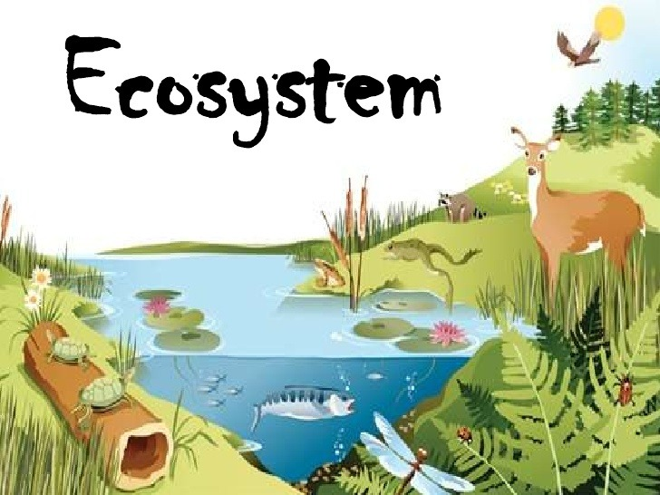
Photo #2
Biotic:
Deer C
Frog C
Water lily P
Turtle C
Abiotic: log
Clouds
dirt

Slide 5

Photo #4
Biotic: elephant C
Alligator C
Hippopotamus C
Giraffe C
Abiotic:
Sun
Clouds
Mountain.
snow

Slide 6

Photo #5
Biotic:
Hippopotamus C
Turtle C
Mushroom D
Flowers P
Abiotic: dirt
Hills
clouds

Slide 7

Photo #6
Biotic:
Abiotic:

Slide 8

Photo #7
Biotic:
Ducks C
Rabbit C
Trees P
Abiotic: pebbles
Clouds
sky

Slide 9
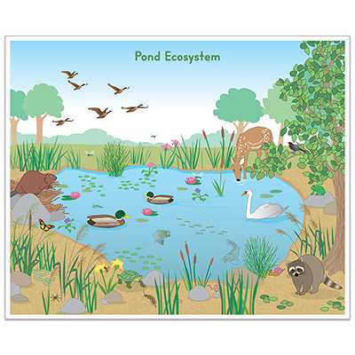
Photo #8
Biotic: beaver C
Swan C
Racoon C
Birds C
Deer C
Tree P
Abiotic:rocks
Mountains
water

Slide 10

Photo #3
Biotic: Tadpoles C
Water weeds P
Fish C
Snail C
Frog C
Abiotic: Water
Sun

Slide 11

Photo #9
Biotic:
Leach C
Dragonfly C
Newt C
Mosquito C
Earthworm D
Abiotic: dirt

Slide 12
Producer, Consumer, Decomposer Game
Click on the link below and play the producer, consumer, decomposer game. If the link tells you to adobe flash players does not work,click on the puzzle piece and click on the allow button to allow the puzzle piece to work.
Producer,Consumer,Decomposer Game

Slide 13
Quizziz Review
Click on the link below to play a quizziz review game on Abiotic v. Biotic.
Quizziz review game

