Slide 1
Biotic v Abiotic Review

Slide 2
Directions
For slides 3-11, look at each picture and list all the biotic and abiotics items in each picture. For any organism that you list as biotic, tell me whether they are a producer, consumer or decomposer.
For slide 12, click on the link to play the producer, consumer, decomposer game for review.
For slide 13, click on the link to take the quizziz review game.

Slide 3

Photo #1
Biotic:
Insect termite tree rotting log bacteria plankton protozoans kangro frog snail sombster and fish
consuemrers
Abiotic:
Leaf water sun cloud rock and bush produducers

Slide 4

Photo #2
Biotic:
Dear frog racoon turtle fish leafs insects bird trees
cunsumers
Abiotic:
Water sun ground hills
Sky producers

Slide 5

Photo #3
Biotic:
Frog glies water weeds snails fish tadpoles log bush
Consumers
Abisun ground skyotic:
producers

Slide 6

Photo #4
Biotic:
Crocodile elephant hippo lion flamingos graff leaves ground trees
con
Abiotic:
sun sky cloud hills
pro

Slide 7

Photo #5
Biotic:
Hippo bush leafs trees flower
bird
Turderal frog
con
Abiotic:
Water sun sky cloud
Mounteains
pro

Slide 8

Photo #6
Biotic:
Duck fish leafs snails fly bush
con
Abiotic:
Water rock dirt
pro

Slide 9

Photo #7
Biotic:
Fox bird ducks wabbit insect tree bush
Con pro
Abiotic:
Water rock sky clouds
Pro

Slide 10
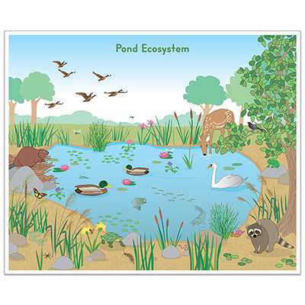
Photo #8
Biotic:
Dear birds duck racoon butterfly
Con
Abiotic:\water rocks sky clouds
Pro

Slide 11

Photo #9
Biotic:
Dragonfly mosquito pound skater turtle tadpools
Con
Abiotic:
Dirt water sky cloud
pro

Slide 12
Producer, Consumer, Decomposer Game
Click on the link below and play the producer, consumer, decomposer game. If the link tells you to adobe flash players does not work,click on the puzzle piece and click on the allow button to allow the puzzle piece to work.
Producer,Consumer,Decomposer Game

Slide 13
Quizziz Review
Click on the link below to play a quizziz review game on Abiotic v. Biotic.
Quizziz review game

