Slide 1
Biotic v Abiotic Review

Slide 2
Directions
For slides 3-11, look at each picture and list all the biotic and abiotics items in each picture. For any organism that you list as biotic, tell me whether they are a producer, consumer or decomposer.
For slide 12, click on the link to play the producer, consumer, decomposer game for review.
For slide 13, click on the link to take the quizizz review game.

Slide 3

Photo #1
Biotic: bird fish kangro frog scrawl
Abiotic: bush mountain sun rock

Slide 4

Photo #2
Biotic: deer bird fish ladybug frog raccoon turtle dragon fly
Abiotic: leafs water leap pads sun

Slide 5

Photo #3
Biotic: snail frog fish dragonfly
Abiotic: water weeds leappad bush

Slide 6

Photo #4
Biotic: alligator giraffe flamingo hippo cheetah lion
Abiotic: water sun mountains ground

Slide 7

Photo #5
Biotic: turtle hippo bird frog
Abiotic: bush water sun rocks

Slide 8

Photo #6
Biotic:
Frog fish dragonfly duck
Abiotic: sand water leappad rocks

Slide 9

Photo #7
Biotic: fox rabbit geese beetle
Abiotic: bush rocks water leappad

Slide 10
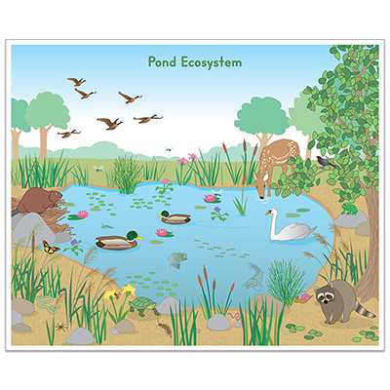
Photo #8
Biotic:
Swan deer geese hedgehog
Abiotic: rocks water leappad leafs

Slide 11

Photo #9
Biotic: snail dragonfly mosquito pond kater
Abiotic: dirt water air rock

Slide 12
Producer, Consumer, Decomposer Game
Click on the link below and play the producer, consumer, decomposer game. If the link tells you to adobe flash players does not work,click on the puzzle piece and click on the allow button to allow the puzzle piece to work.
Producer,Consumer,Decomposer Game

Slide 13
Quizizz Review
Click on the link below to play a quizizz review game on Abiotic v. Biotic.
Quizizz review game

