Slide 1
Biotic v Abiotic Review

Slide 2
Directions
For slides 3-11, look at each picture and list all the biotic and abiotics items in each picture. For any organism that you list as biotic, tell me whether they are a producer, consumer or decomposer.
For slide 12, click on the link to play the producer, consumer, decomposer game for review.
For slide 13, click on the link to take the quizziz review game.
Yellow=Consumer Red=Decomposer Green=Producer

Slide 3

Photo #1
Biotic: Insects, Kangaroo, Bacteria, Fungi, Algae, plankton, Fish, Termites, Lobster, Frogs/Toads (Can’t tell), bird, and Trees
Abiotic: The sun, Water, Clouds, Rocks, ground, termite mound (Not including termites), Temperature, Rotting log, and bushes.

Slide 4
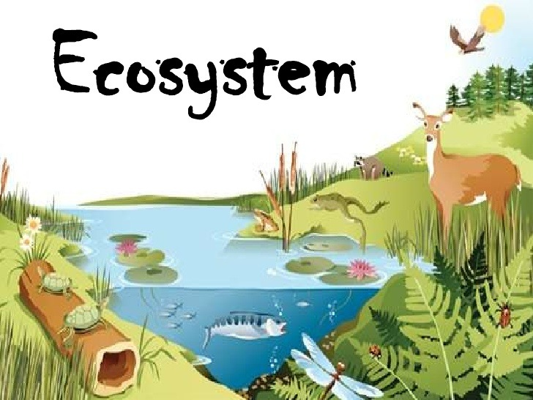
Photo #2
Biotic: Turtles, Hawk, Deer, Frog, fish, insects, racoon, trees, and plants
Abiotic: Sun, log, water, ground temperature, and air

Slide 5

Photo #3
Biotic: Frog, Tadpoles, Snail, Flies, Water weeds, bushes, and lillypad.
Abiotic:Log, Water, Sun, Air, and ground, and temperature.

Slide 6

Photo #4
Biotic: Lions, Elephants, Crocodile, Flamingo, Giraffes, Trees, and other plants
Abiotic: Ground, Water, Clouds, Sun, Air, temperature, and Mountains

Slide 7

Photo #5
Biotic: Pigs, Fungi, Turtle, Fungi, Frogs, Water weed, underwater plants, bushes, Trees, Lily Pads, plants,Bacteria.
Abiotic: Sun , Air, Clouds Mountains, hills, rocks, water and ground

Slide 8

Photo #6
Biotic: Frog, ducklings, dragonflies, bushes, plants, underwater plants, and lilly pads
Abiotic: Water, Air Grounds, and Rocks, and tempature

Slide 9

Photo #7
Biotic: Rabbit, Duck,s Fox, beetle, water weed, lily pads, trees, bushes
Abiotic: Air, clouds, water, and rocks, and temperature.

Slide 10
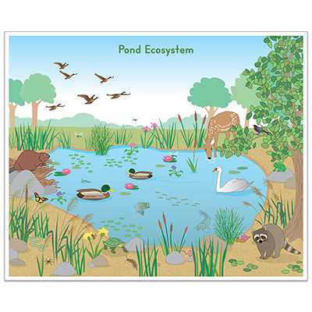
Photo #8
Biotic: , beaver,Geese, flies, deer, tiny bird, Swan, Racoon, Snail, insects, turtle, fish, ducks, butterfly trees, water weeds, plants, and lily pads
Abiotic: Air, rocks, ground, and temperature.

Slide 11

Photo #9
Biotic: Mosquito, Pond snail, Pond skater, Tadpoles, Earthworm, Backswimmer, Newt, 3-spined stickleback, leech, Water scorpion, Snapping turtle, Dragonfly, Water shrew, plants.
Abiotic: Water, Ground, Air, and temperature.

Slide 12
Producer, Consumer, Decomposer Game
Click on the link below and play the producer, consumer, decomposer game. If the link tells you to adobe flash players does not work,click on the puzzle piece and click on the allow button to allow the puzzle piece to work.
Producer,Consumer,Decomposer Game

Slide 13
Quizziz Review
Click on the link below to play a quizziz review game on Abiotic v. Biotic.
Quizziz review game

