Slide 1
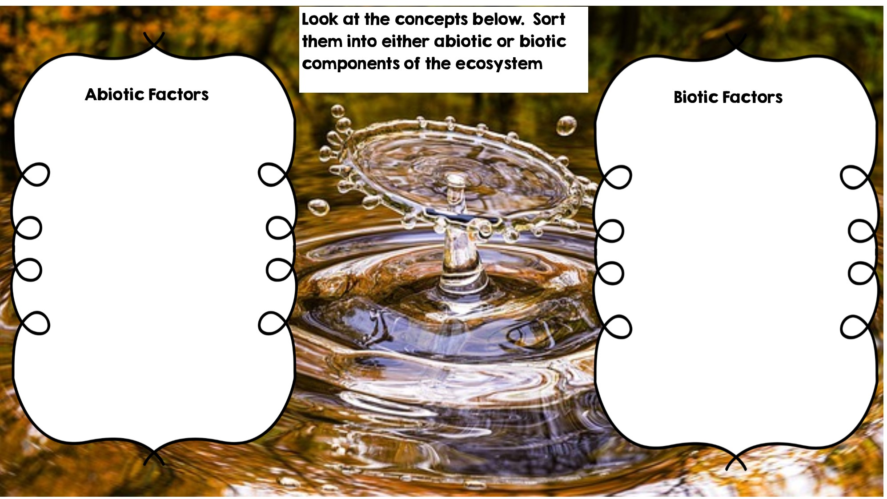
Deer
Rocks
Fox
Temperature
Grass
Flowers
Water
Dead Animal
Sunlight
Rotting Log
Frog

Slide 2
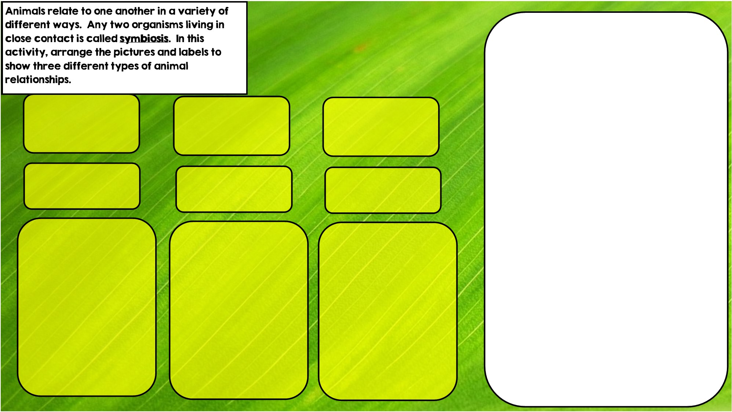
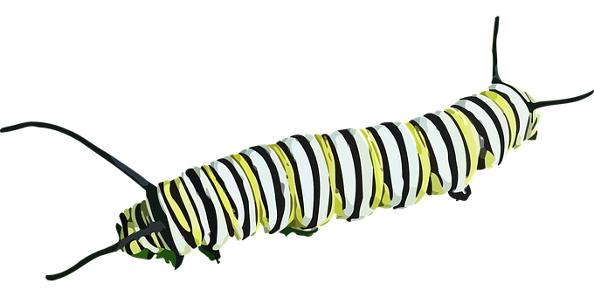


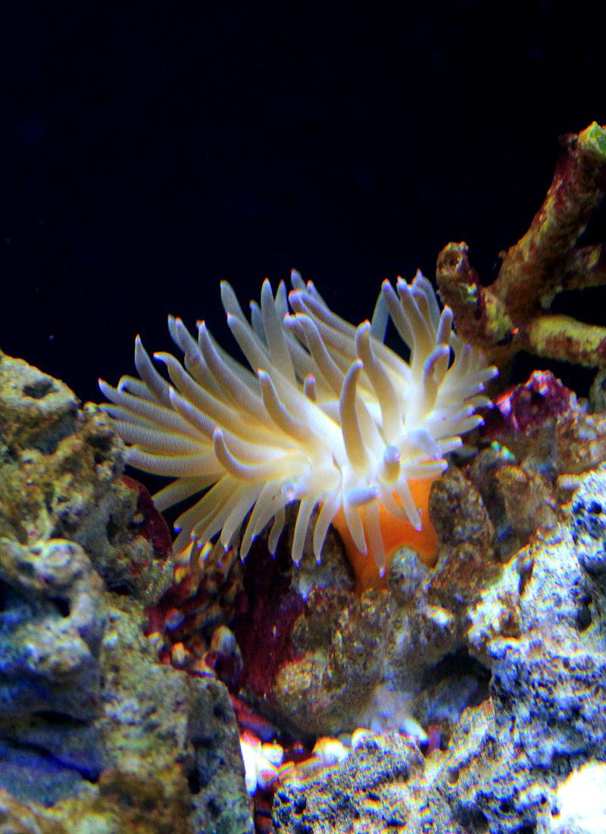
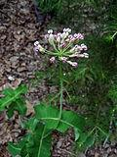

Commensalism is where one organism benefits and doesn’t hurt the other.
Parasitism is where one organisms benefits and the other is hurt
Mutualism is where both organisms benefit
Hint: I live in intestines
Hint: I live in stingers
Hint: I eat toxic leaves

Slide 3
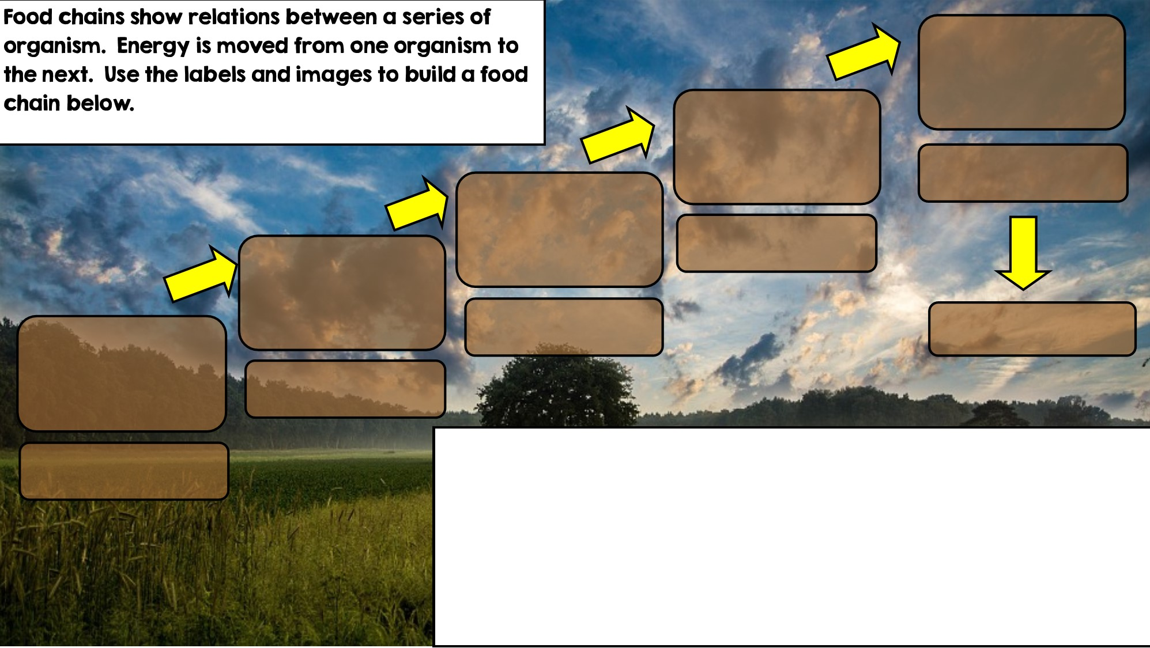

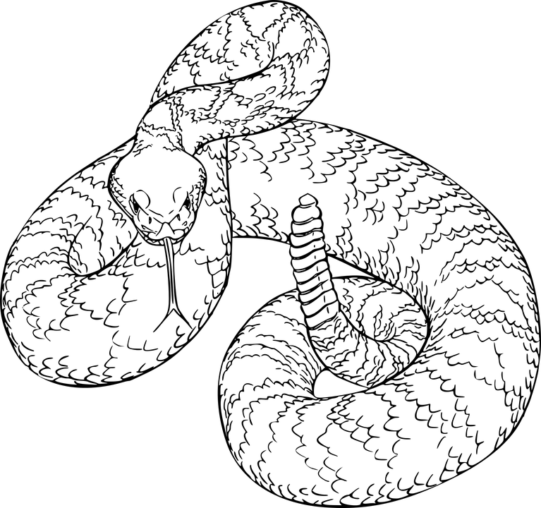
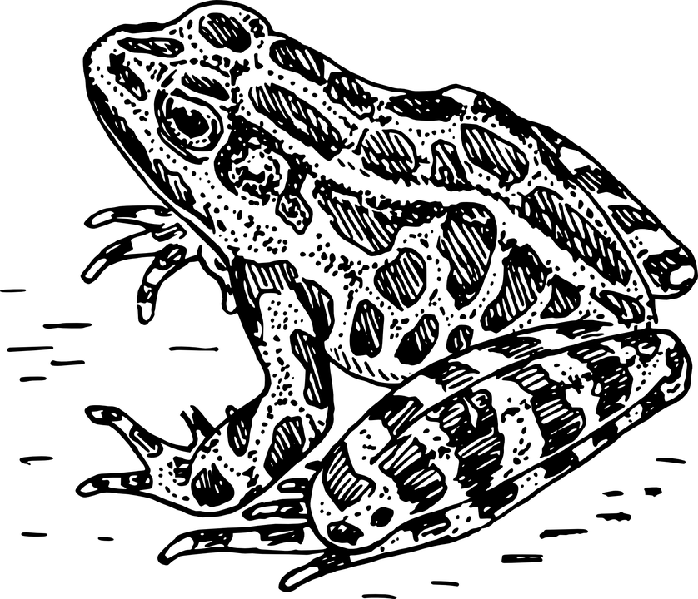
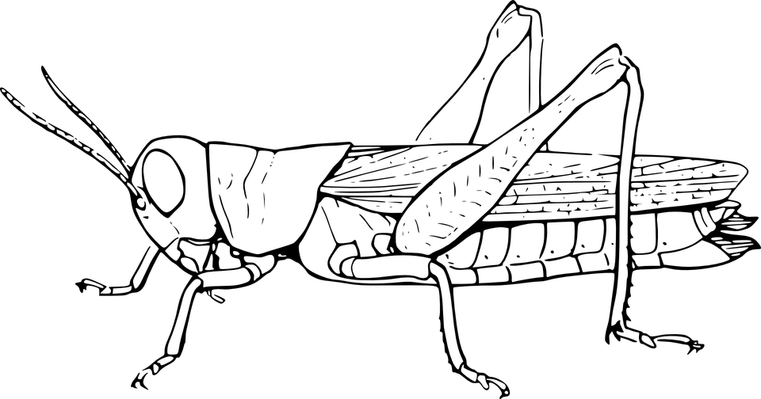

Apex Predator
Tertiary Consumer
Secondary Consumer
Decomposer
Primary Consumer: Heterotroph
Producer: Autotroph

Slide 4
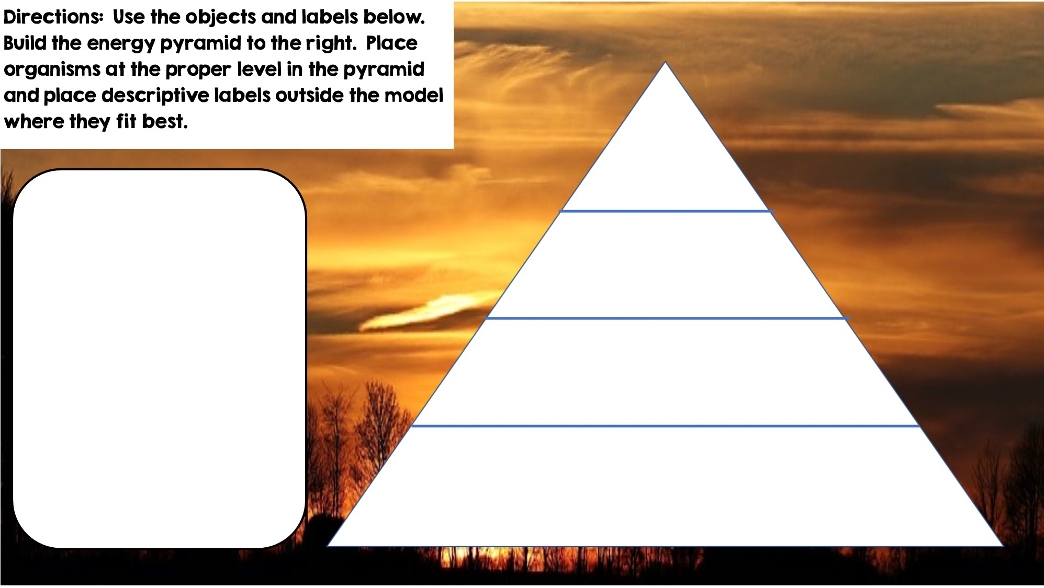

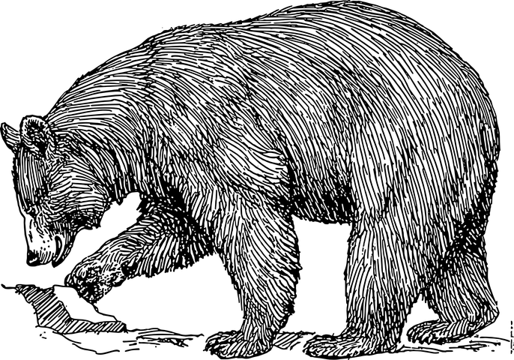



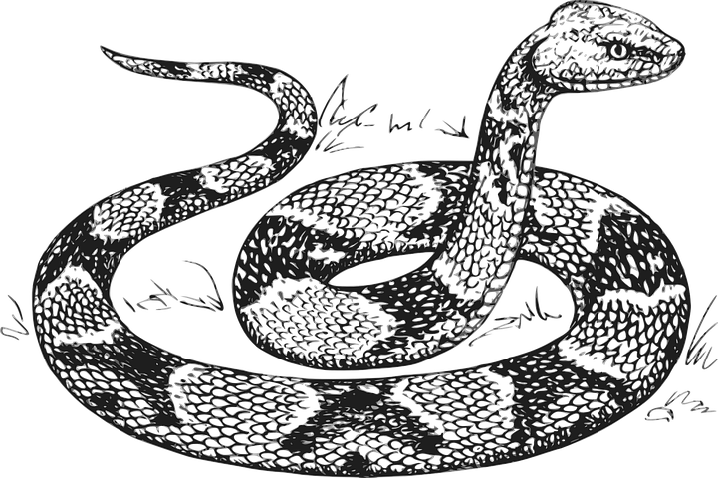


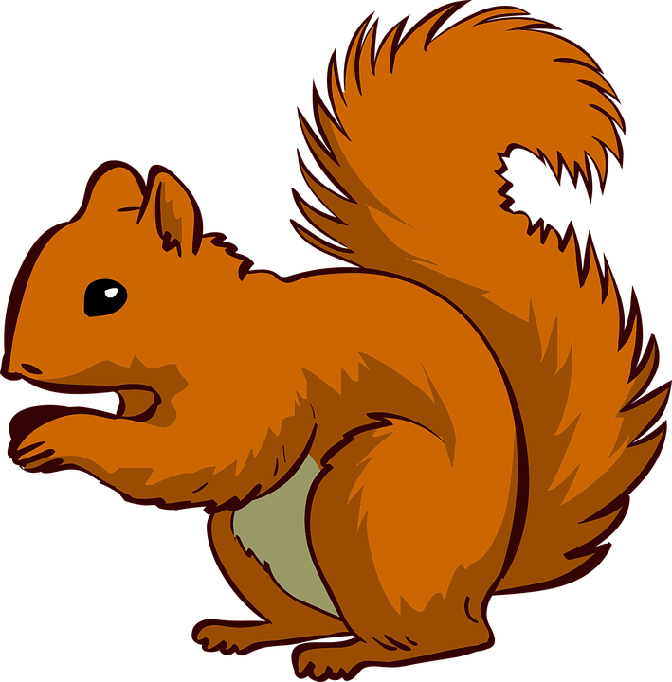


Only 10% of the energy from each tropic level is transferred
Heterotrophs
Tertiary Consumers
Secondary Consumers
Heterotrophs
Primary Consumers
Heterotrophs
Autotrophs
Producers

Slide 5
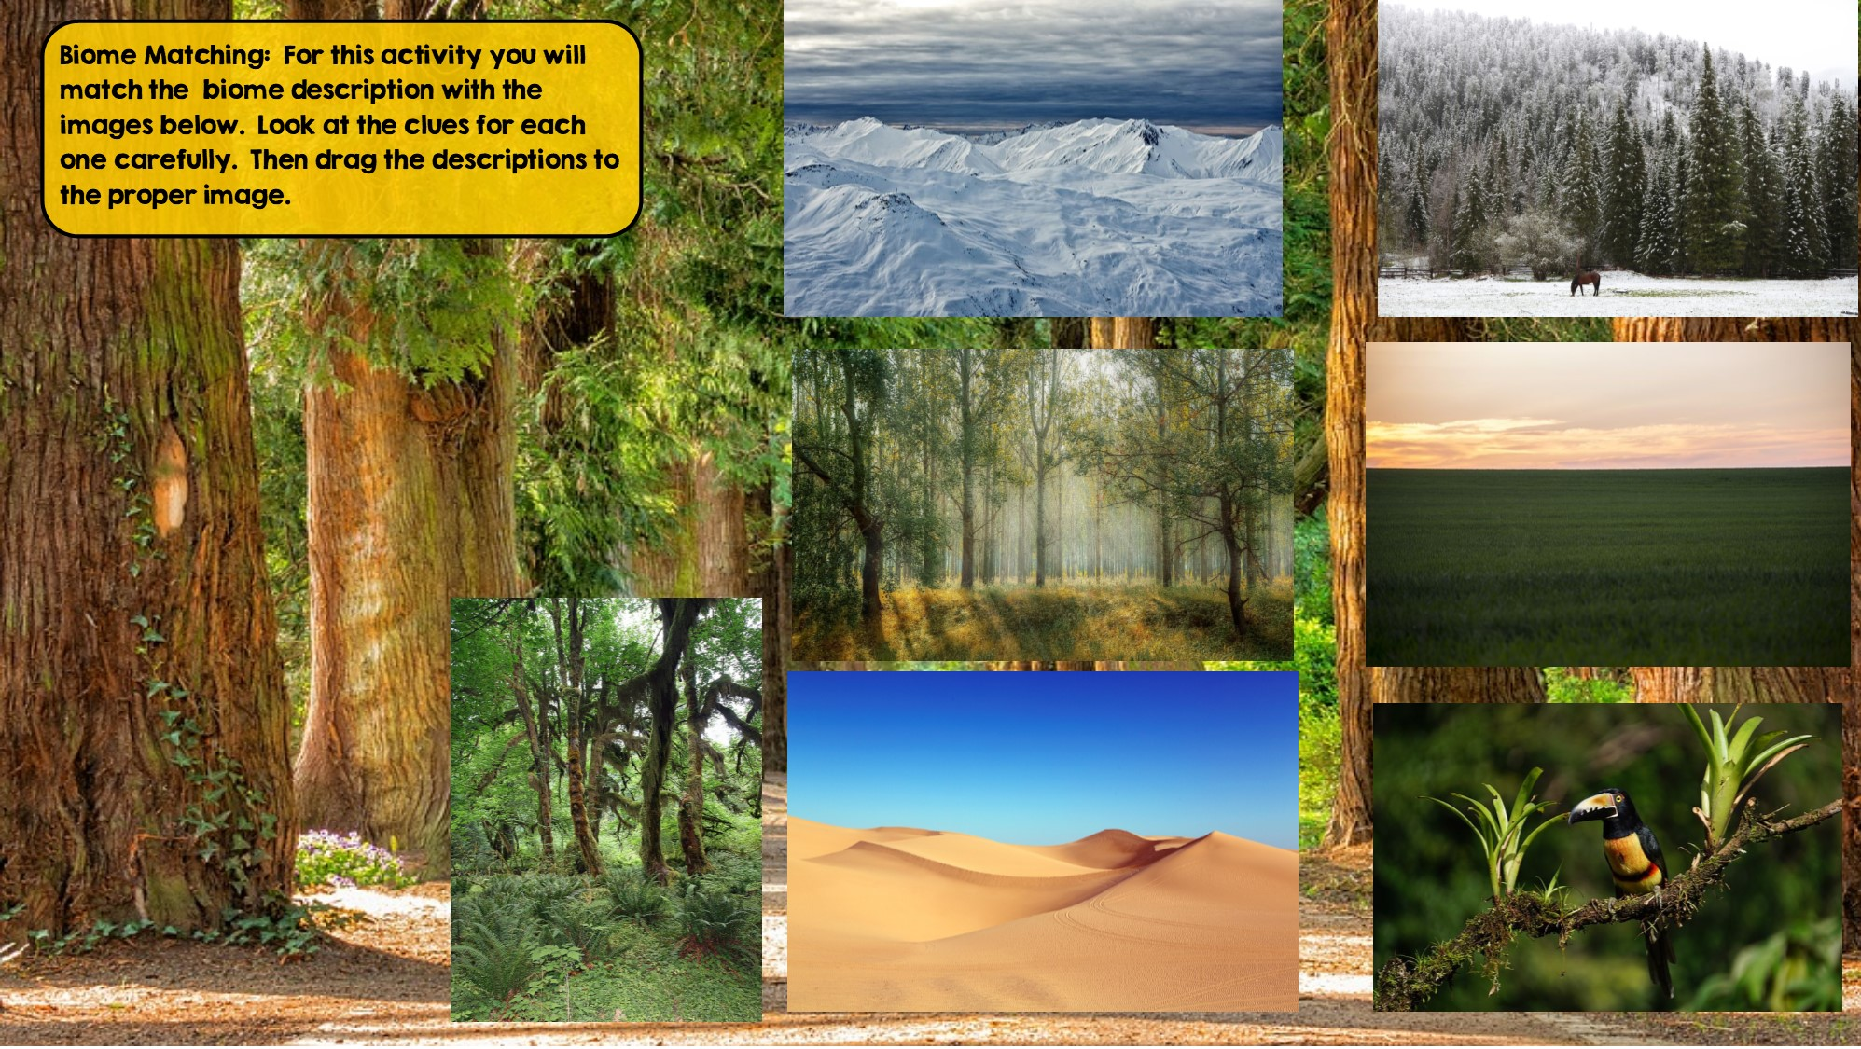
Tundra
Hint: Cold Desert
Taiga
Hint: Snowy Forest
Temperate Deciduous Forest Hint: Four distinct seasons
Grassland
Hint: Very few trees grow
Temperate Rainforest
Hint: Cool rainforest
Desert
Hint: little to no water
Tropical Rainforest:
Hint: Found near equator

Slide 6
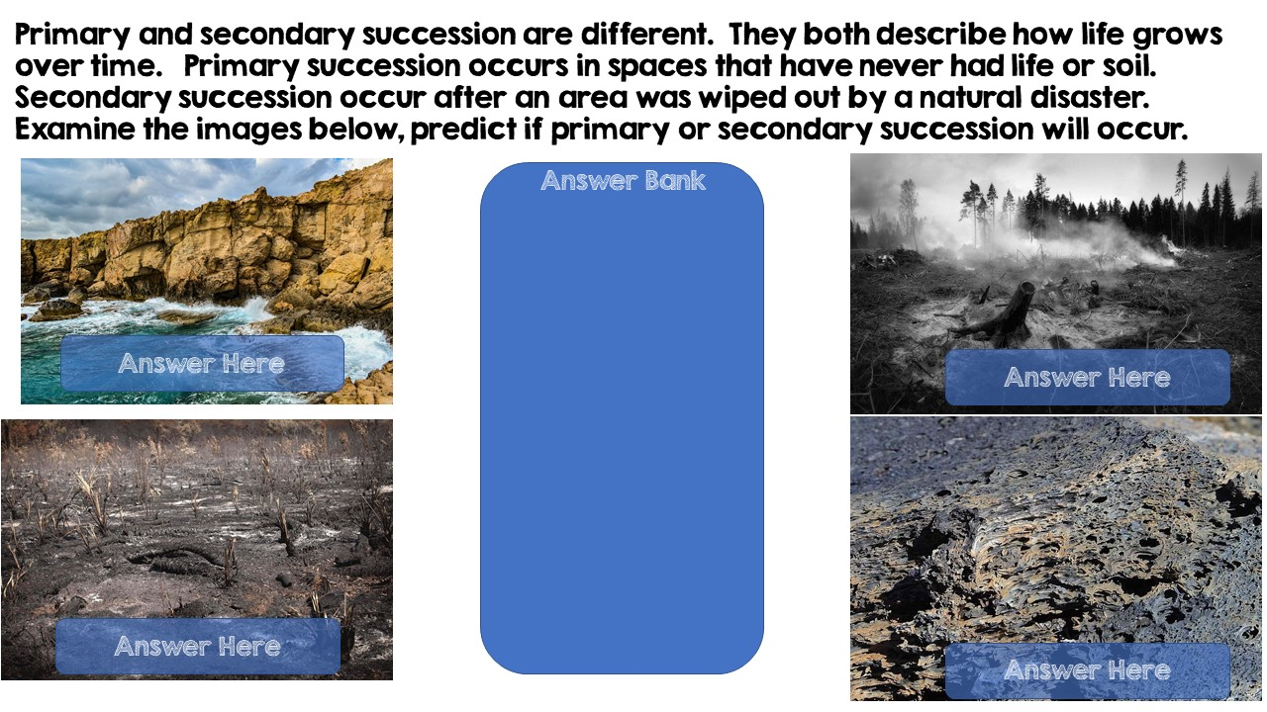
Secondary Succession
Primary Succession
Primary Succession
Secondary Succession

Slide 7
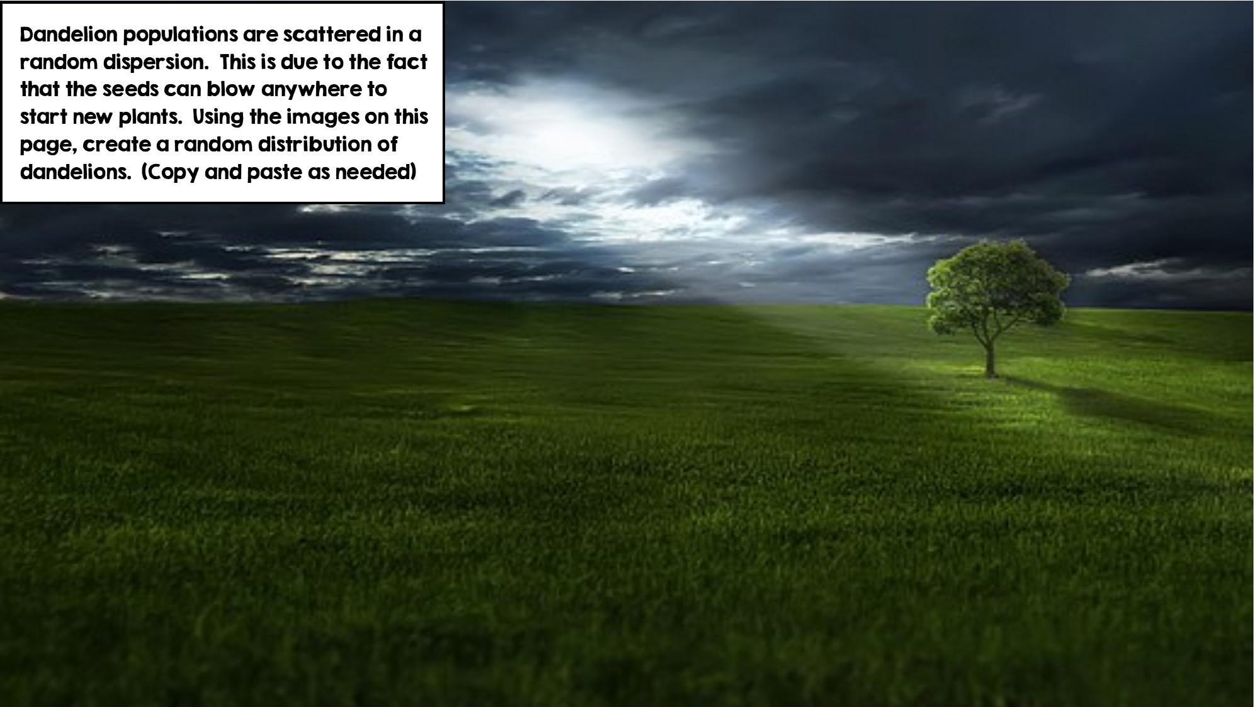
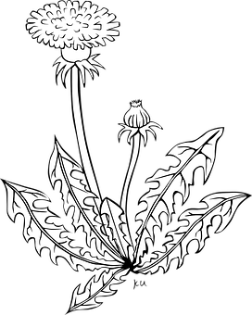

Slide 8
