Slide 1
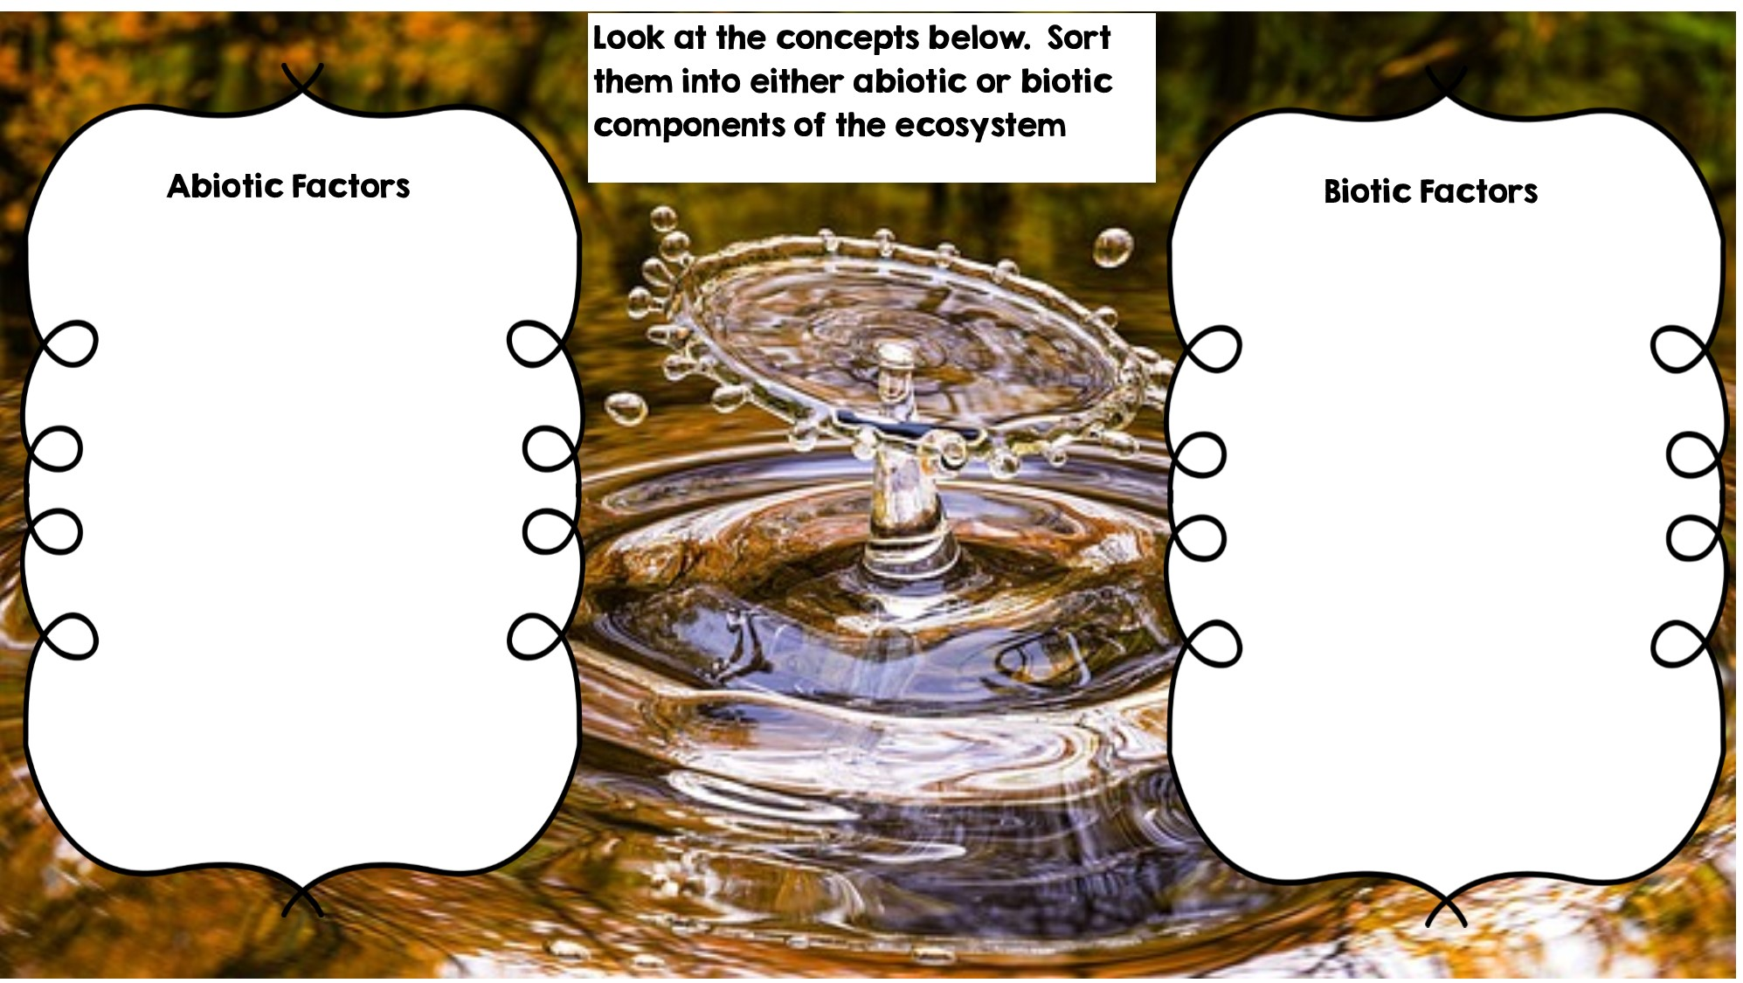
Rocks
Frog
Temperature
Fox
Water
Deer
Flowers
Dead Animal
Rotting Log
Grass
Sunlight

Slide 2
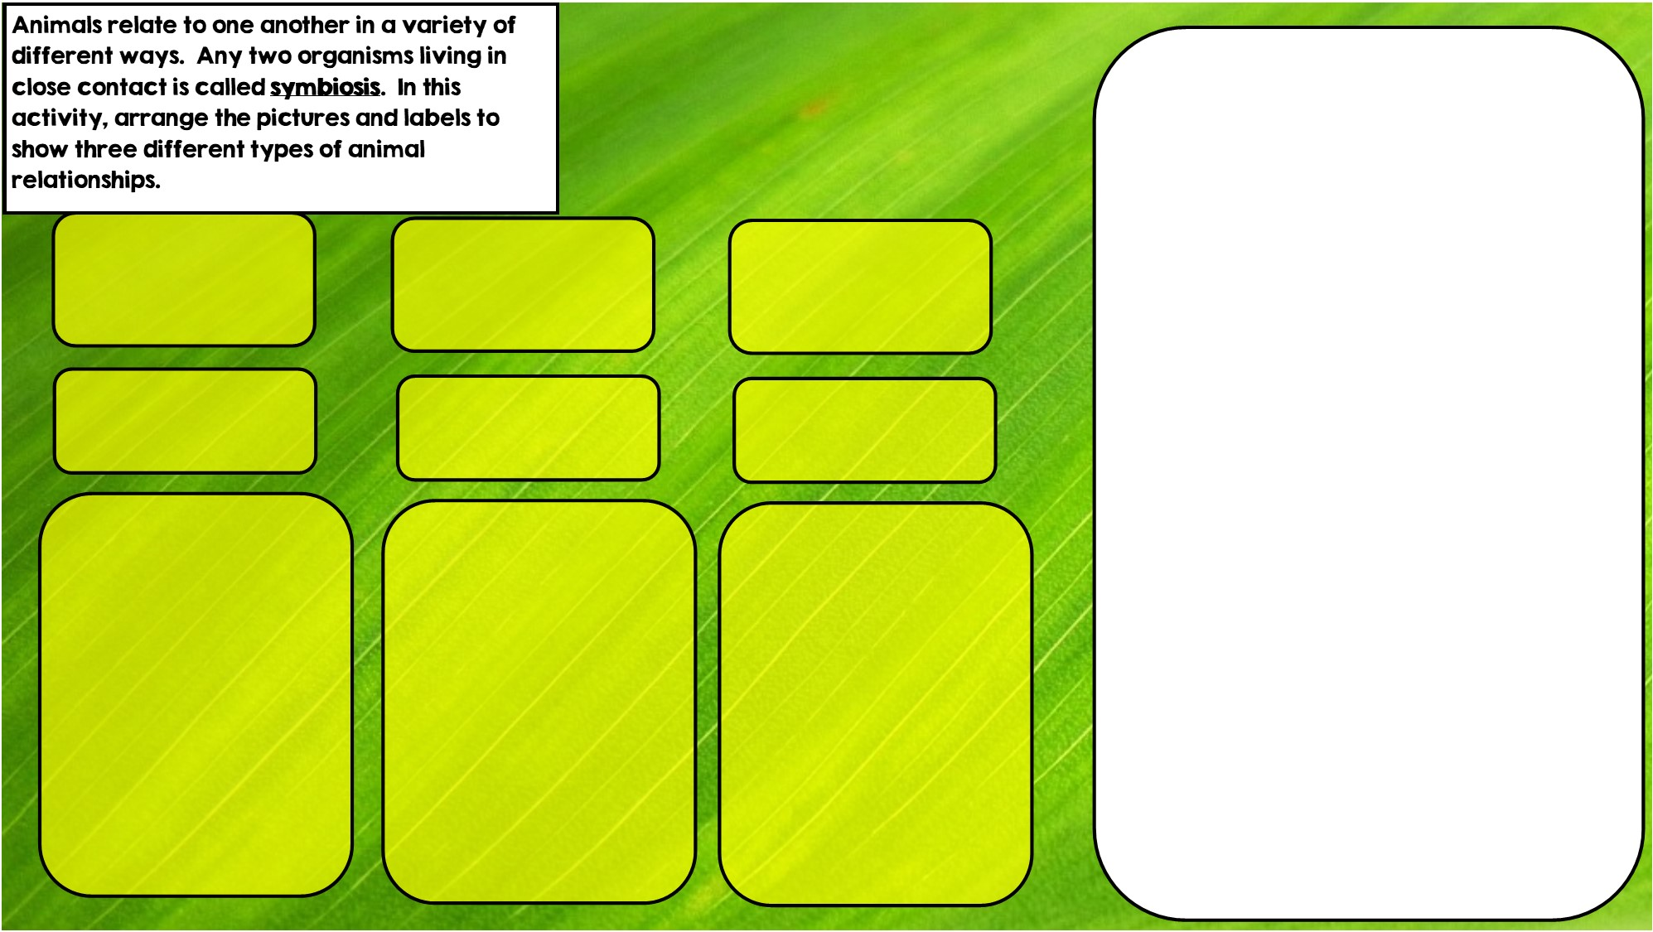

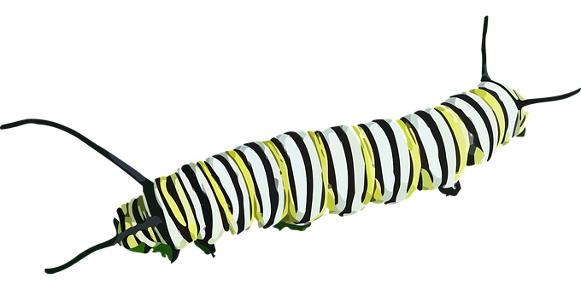

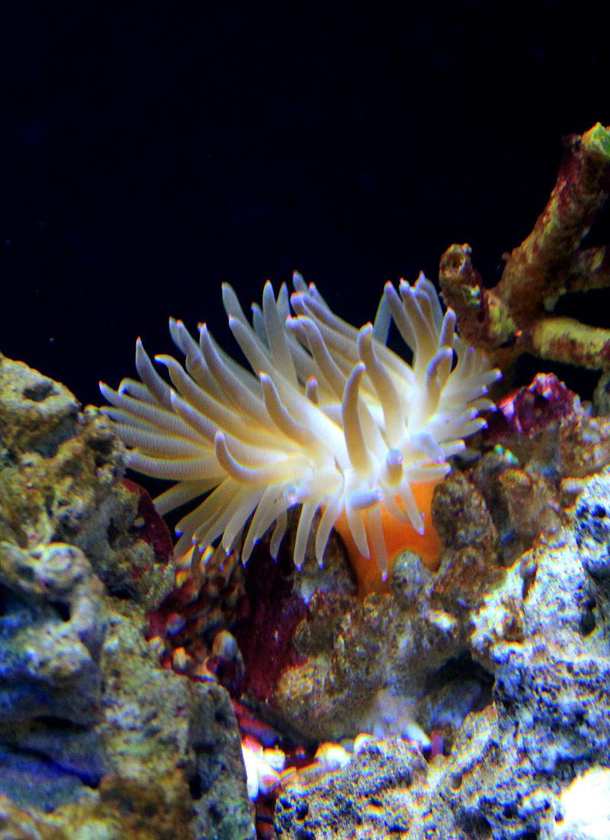

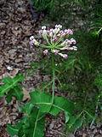
Commensalism is where one organism benefits and doesn’t hurt the other.
Hint: I live in intestines
Parasitism is where one organisms benefits and the other is hurt
Hint: I live in stingers
Mutualism is where both organisms benefit
Hint: I eat toxic leaves

Slide 3
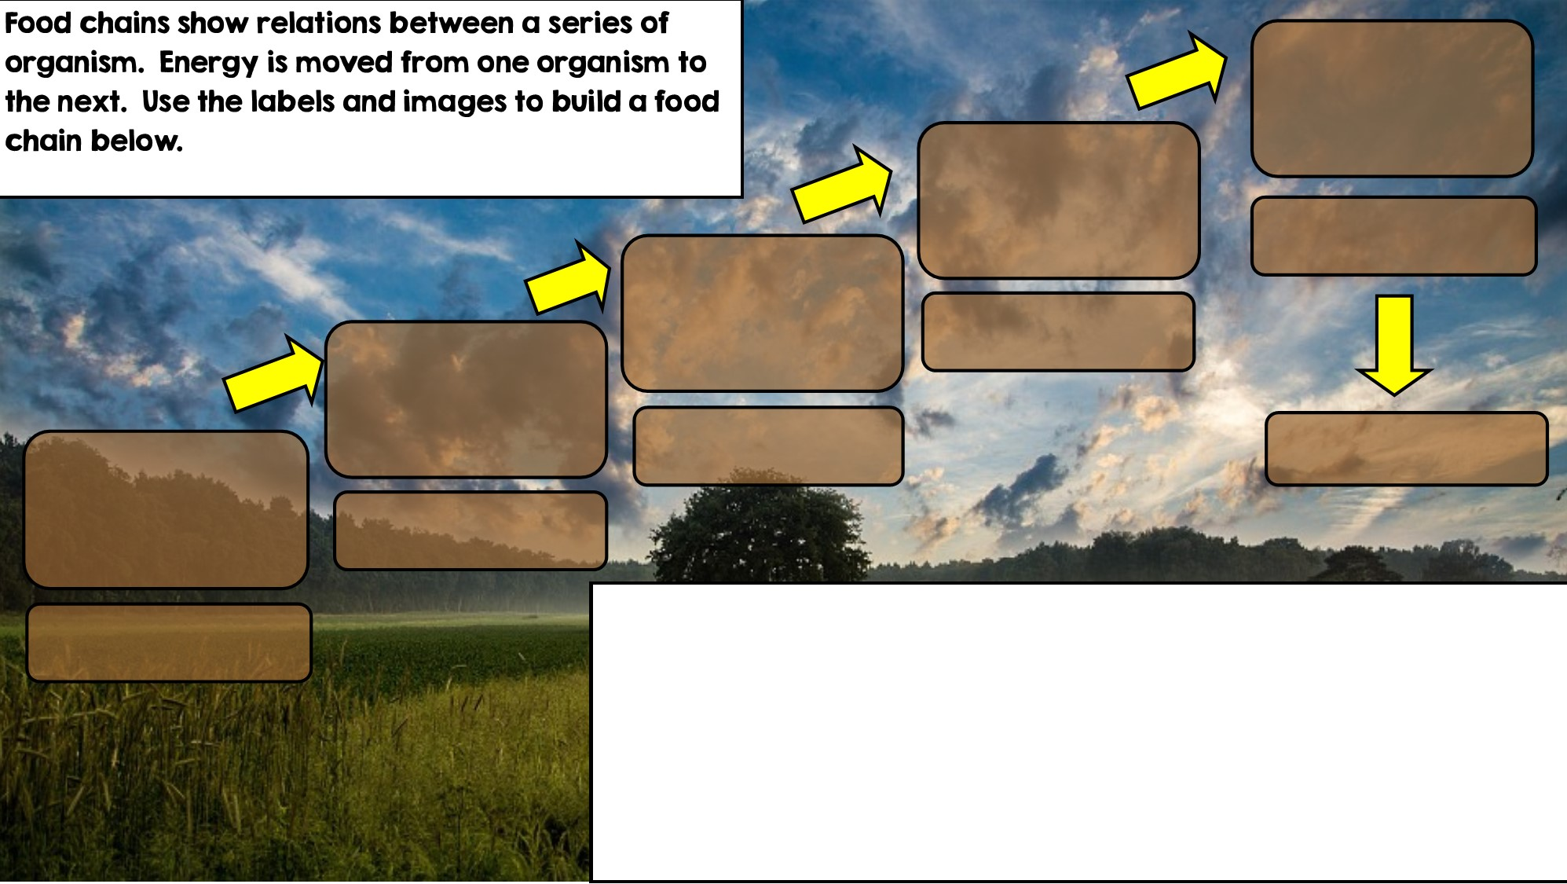

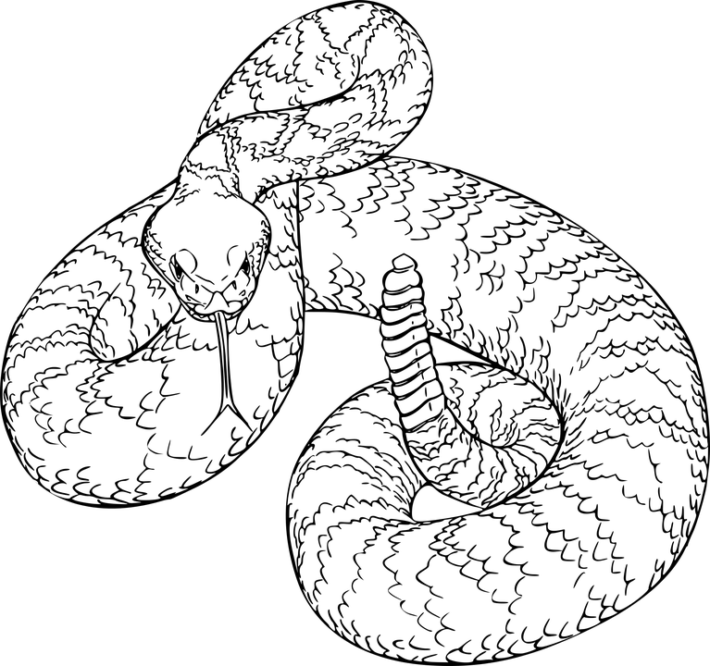
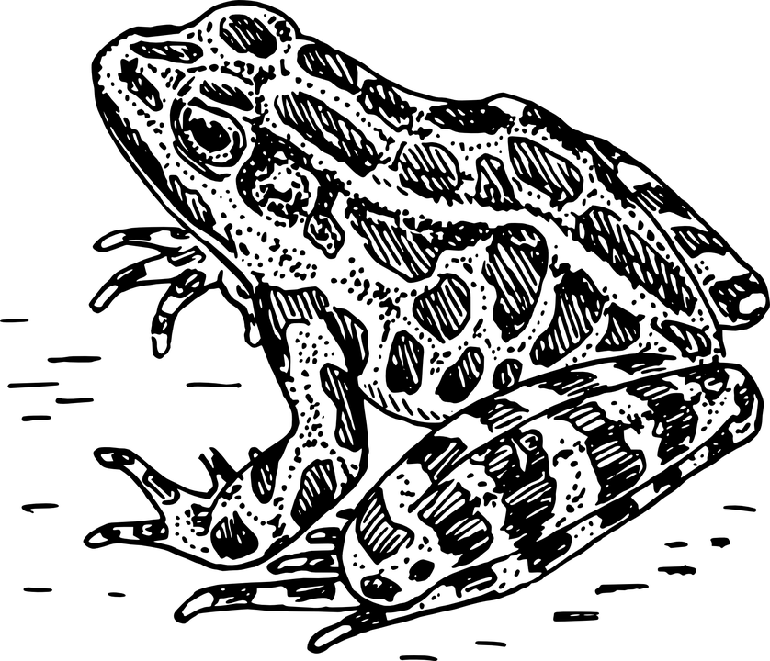
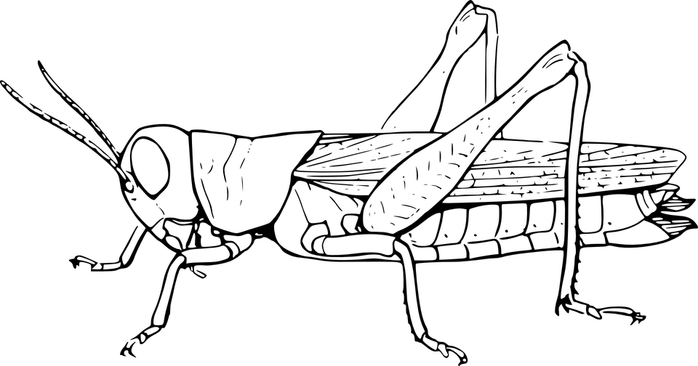

Producer: Autotroph
Secondary Consumer
Primary Consumer: Heterotroph
Decomposer
Tertiary Consumer
Apex Predator

Slide 4
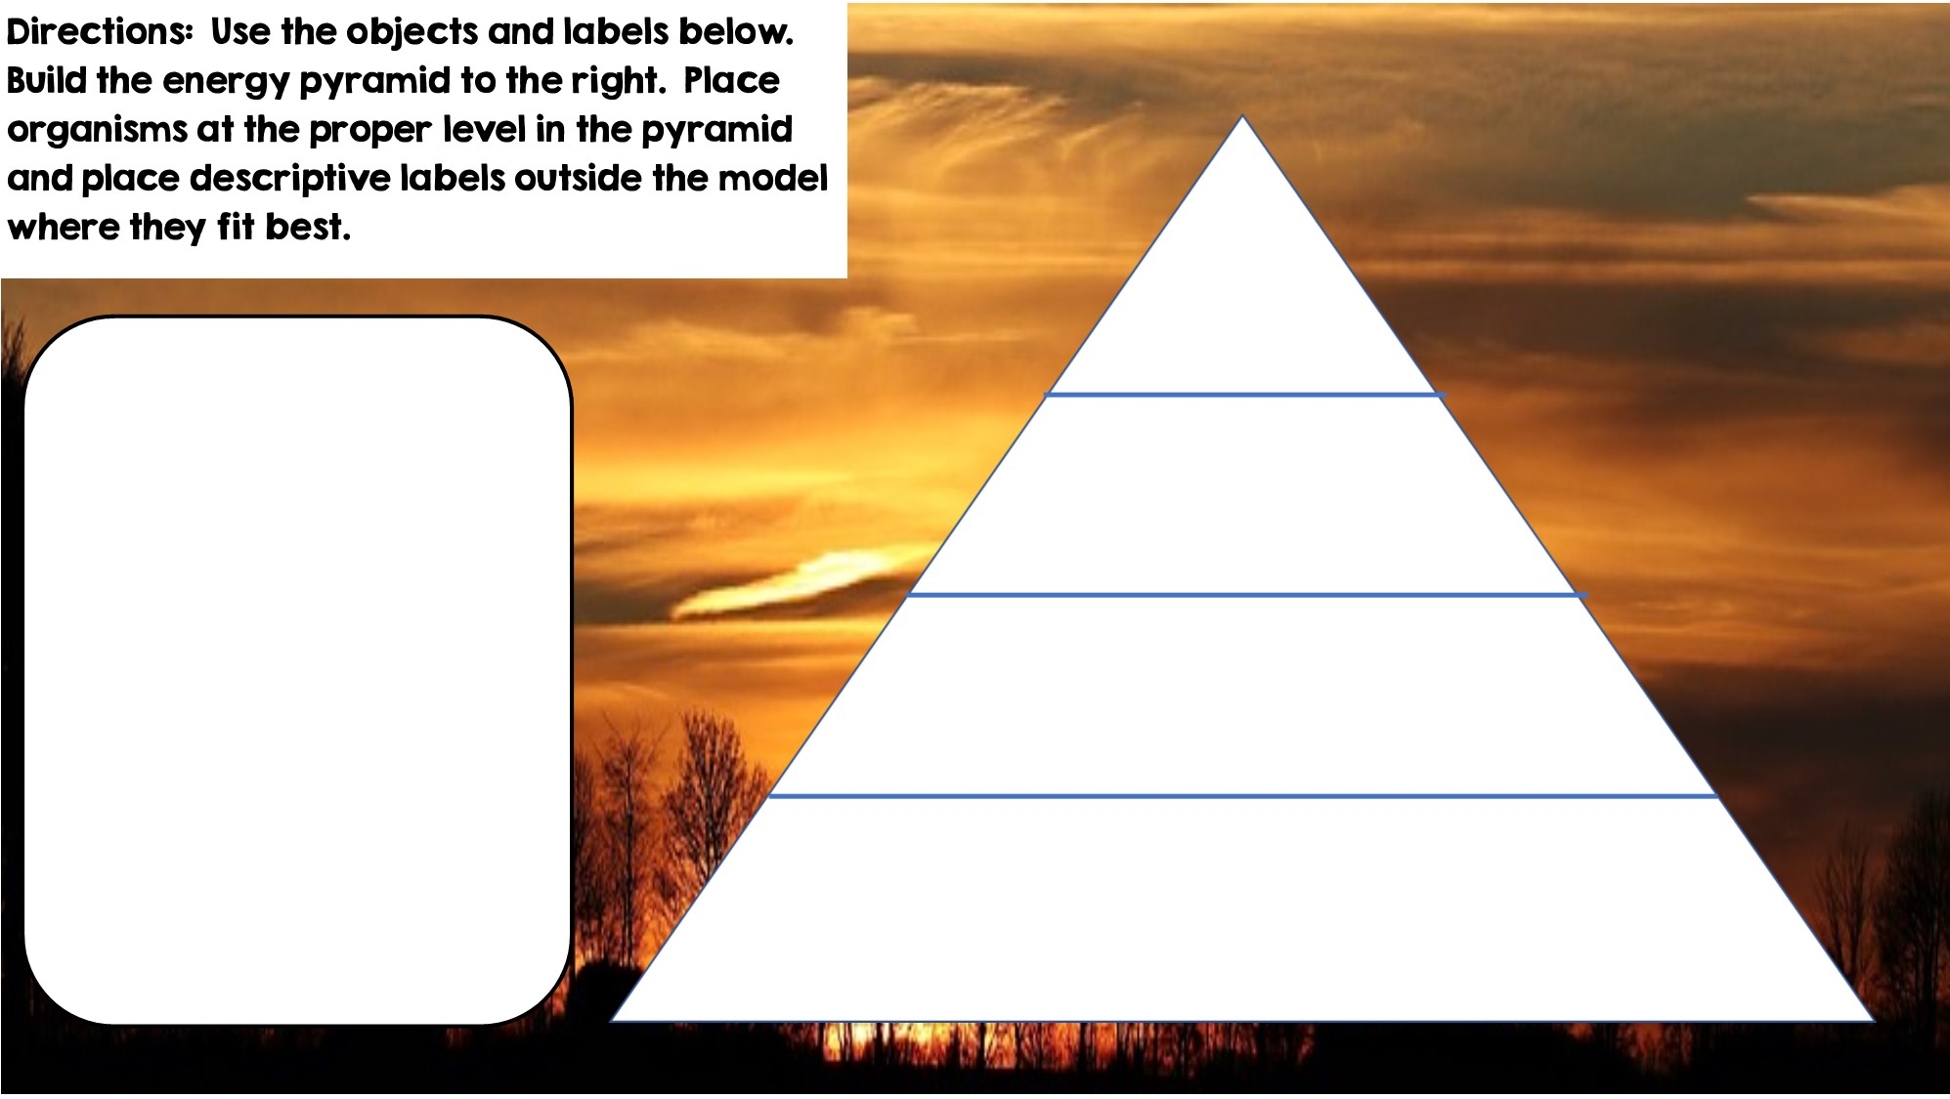



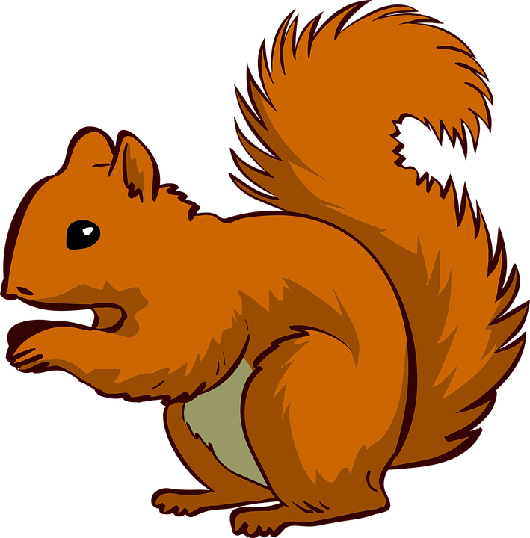


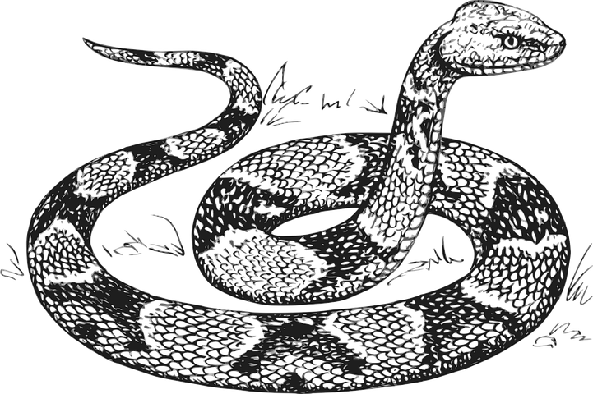


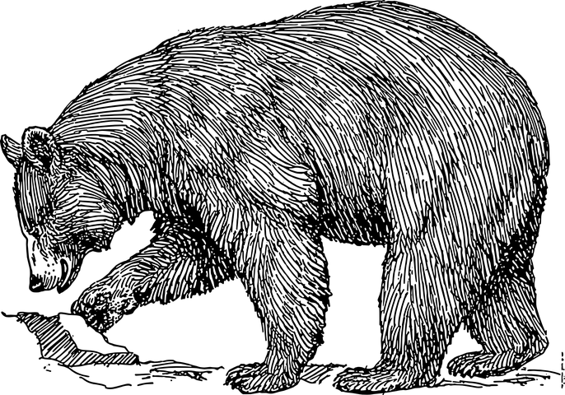

Only 10% of the energy from each tropic level is transferred
Tertiary Consumers
Producers
Secondary Consumers
Primary Consumers
Heterotrophs
Heterotrophs
Autotrophs
Heterotrophs

Slide 5
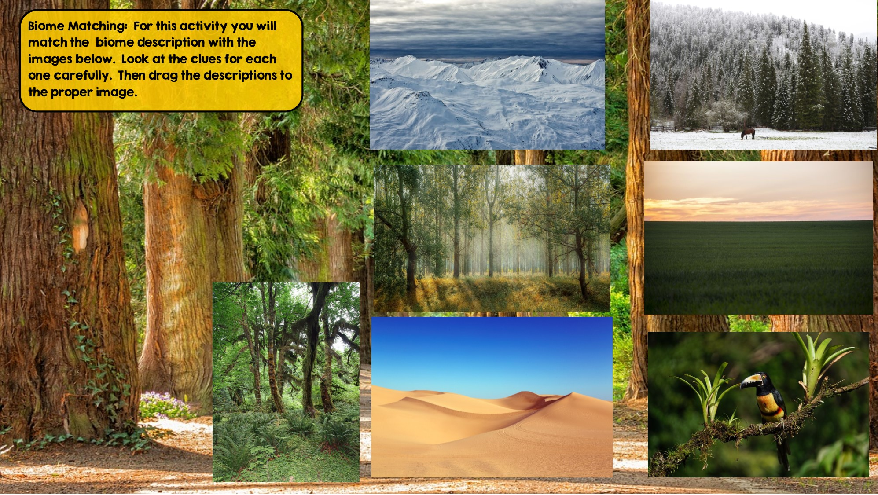
Taiga
Hint: Snowy Forest
Grassland
Hint: Very few trees grow
Tundra
Hint: Cold Desert
Tropical Rainforest:
Hint: Found near equator
Temperate Deciduous Forest Hint: Four distinct seasons
Desert
Hint: little to no water
Temperate Rainforest
Hint: Cool rainforest

Slide 6
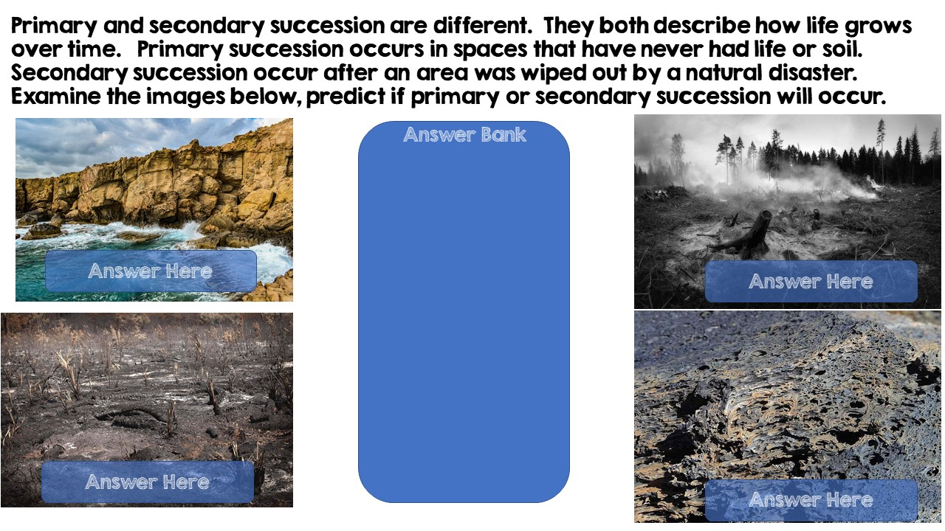
Primary Succession
Primary Succession
Secondary Succession
Secondary Succession

Slide 7
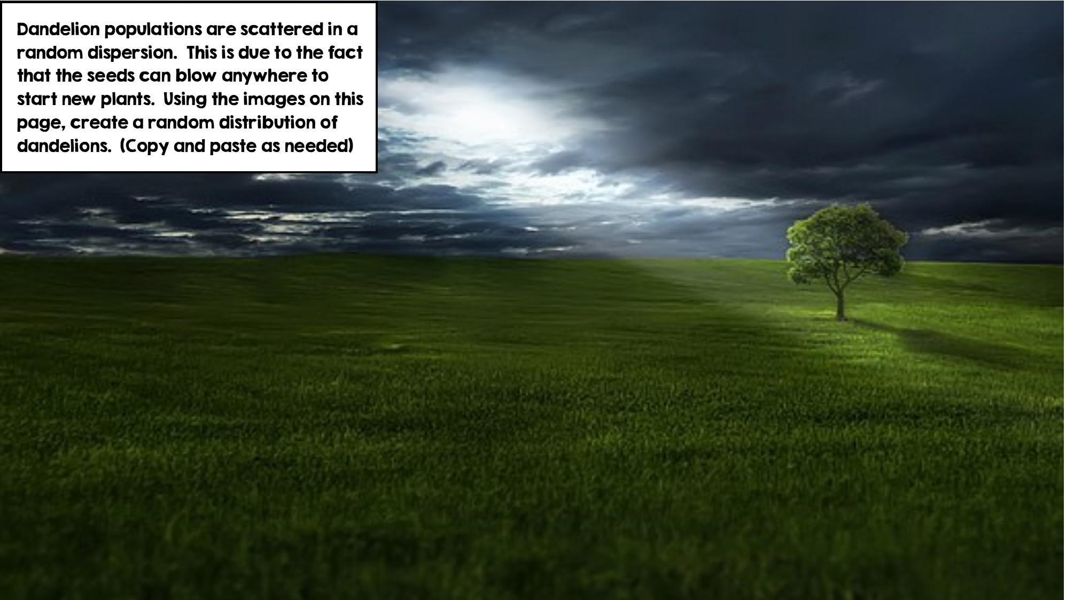
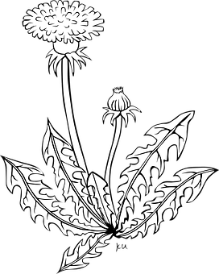

Slide 8
