Slide 1
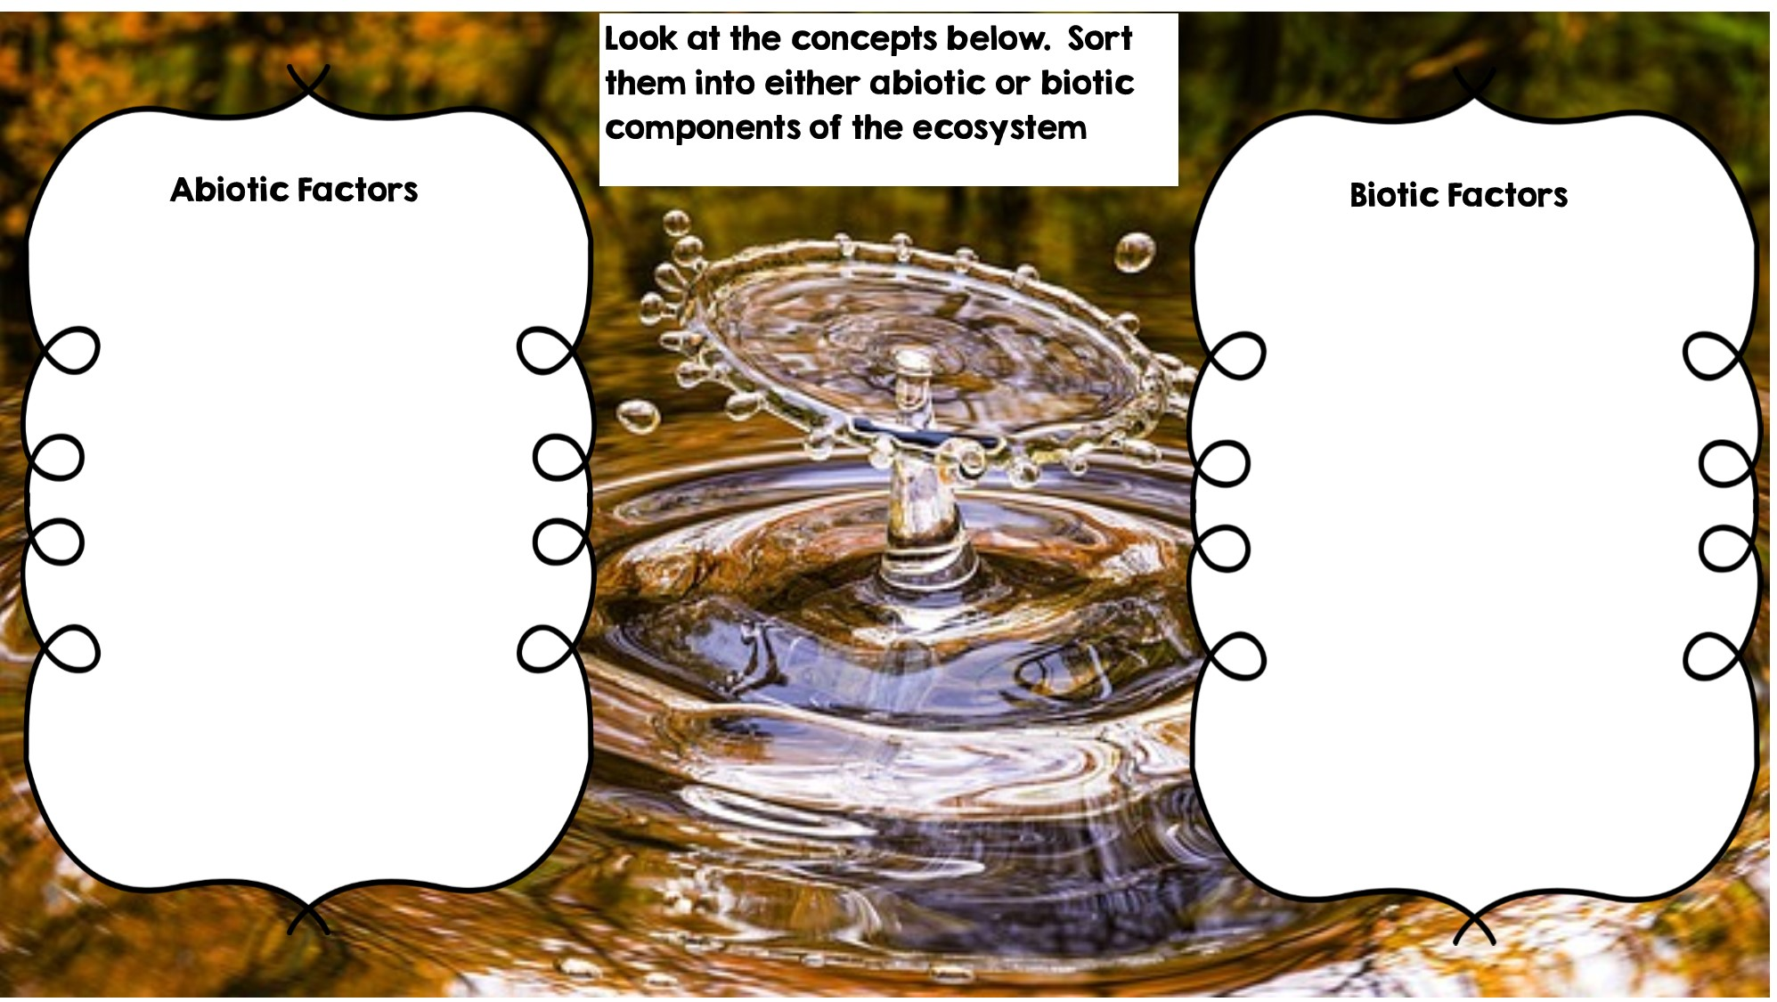
Rocks
Flowers
Temperature
Frog
Water
Fox
Dead Animal
Sunlight
Grass
Deer
Rotting Log

Slide 2
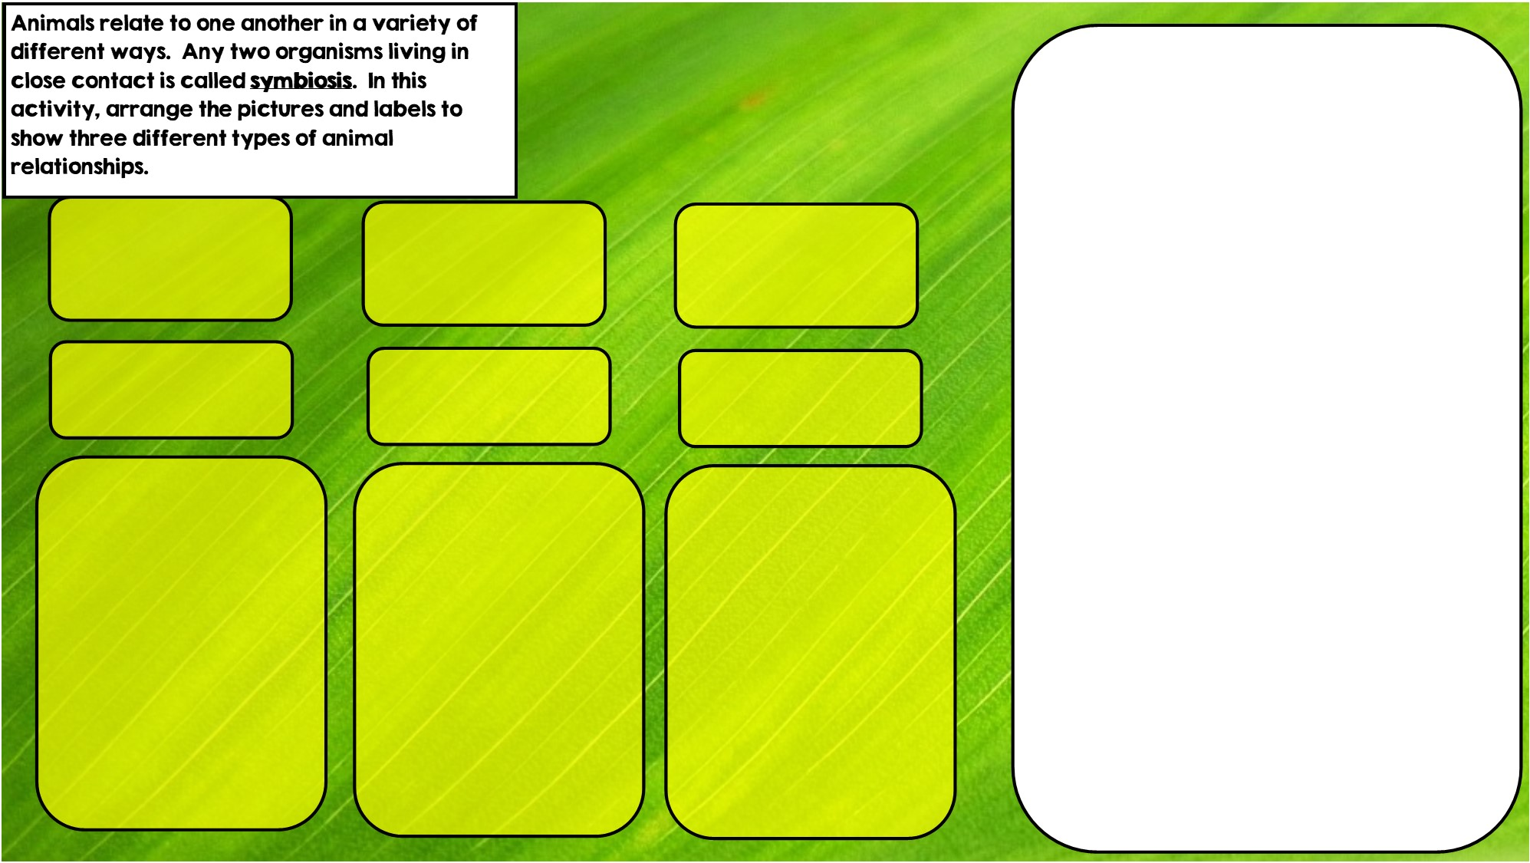

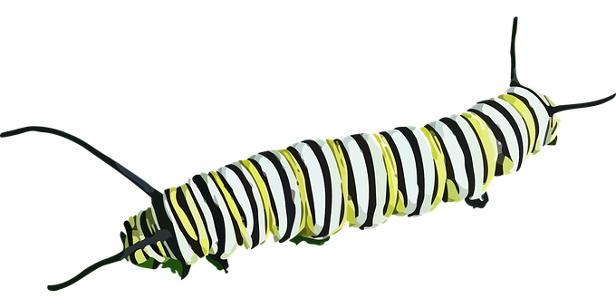


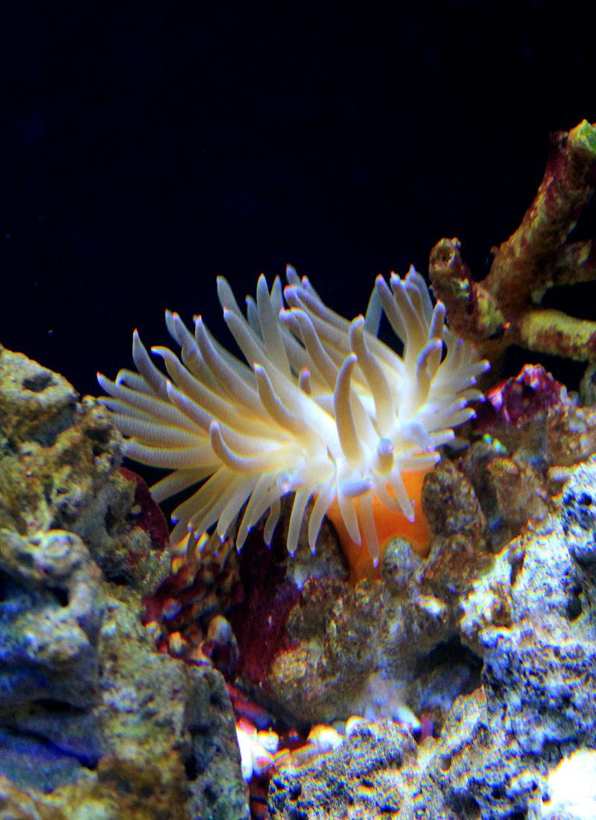
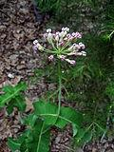
Hint: I eat toxic leaves
Hint: I live in stingers
Hint: I live in intestines
Commensalism is where one organism benefits and doesn’t hurt the other.
Parasitism is where one organisms benefits and the other is hurt
Mutualism is where both organisms benefit

Slide 3
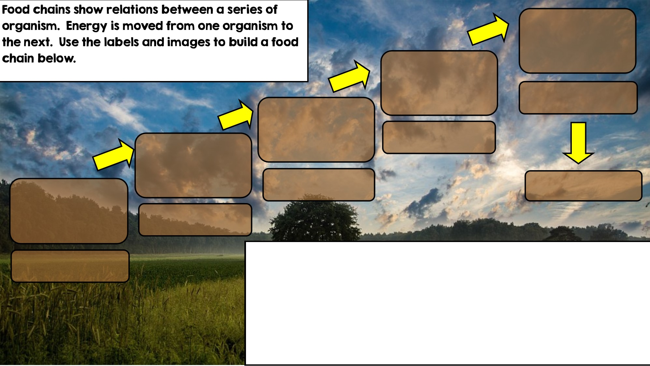

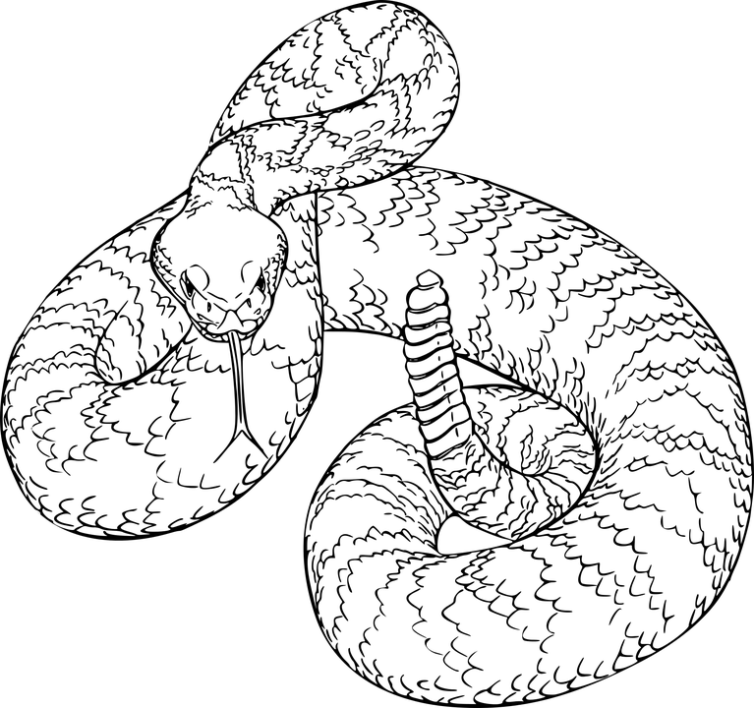
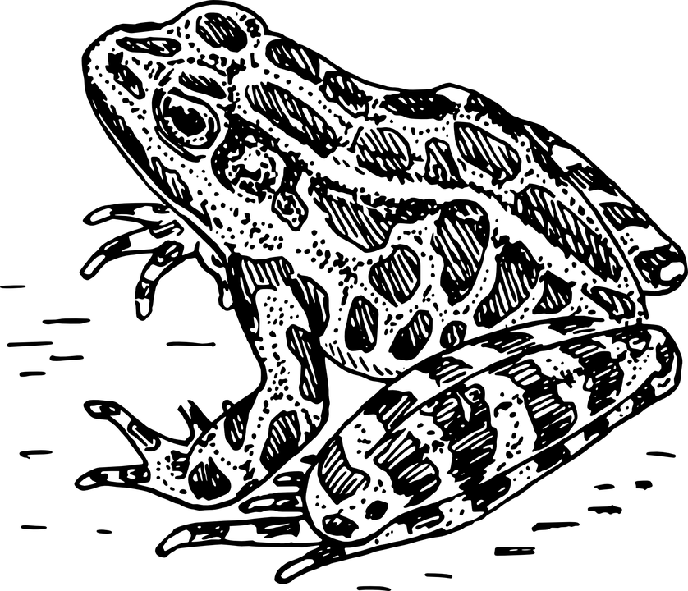
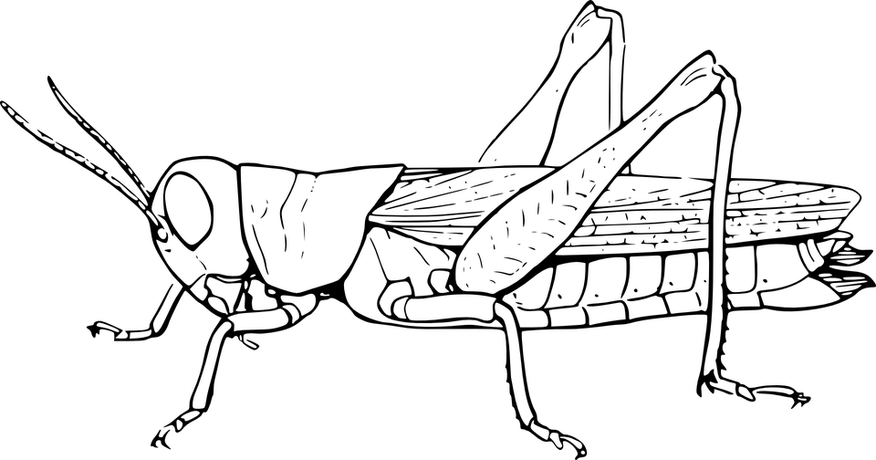

Apex Predator
Tertiary Consumer
Secondary Consumer
Decomposer
Primary Consumer: Heterotroph
Producer: Autotroph

Slide 4
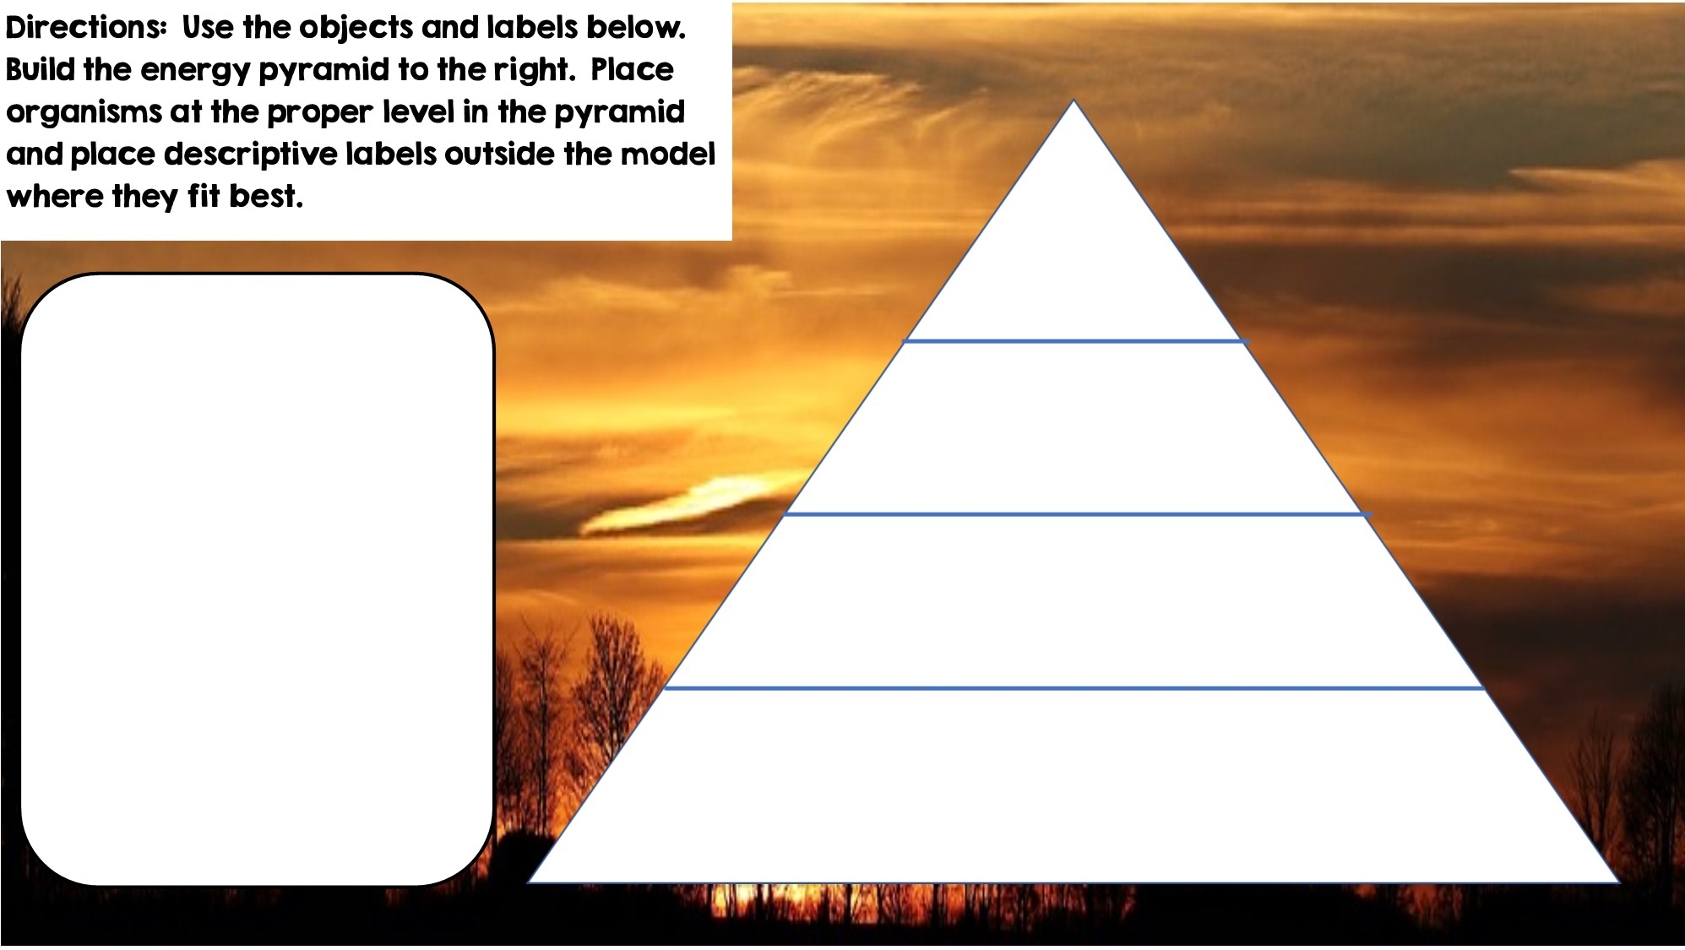
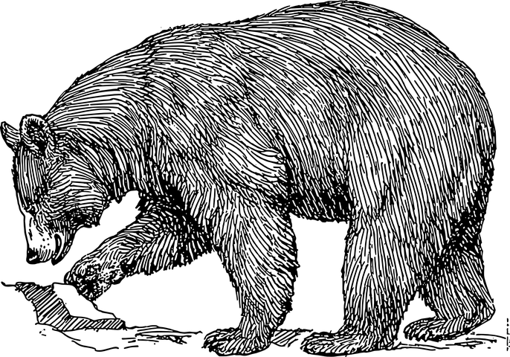
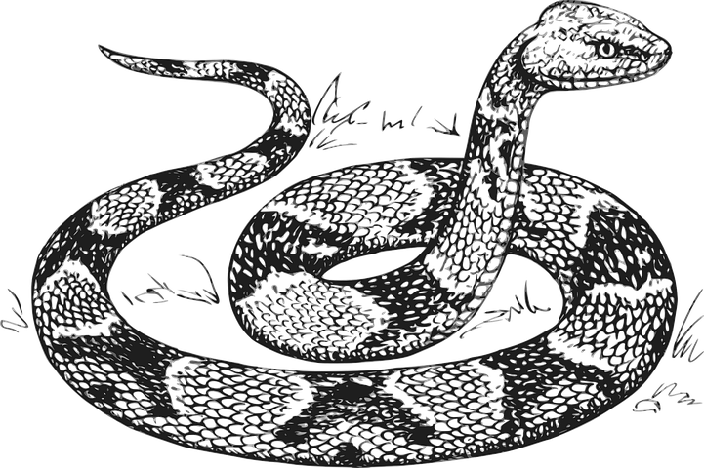

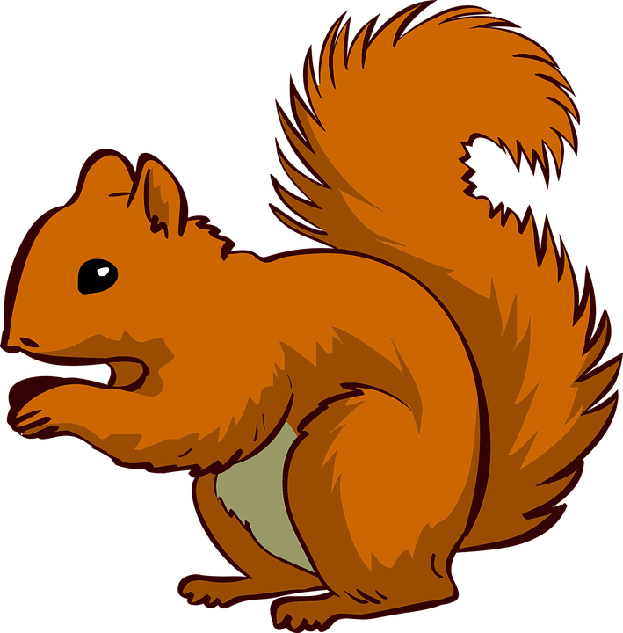







Only 10% of the energy from each tropic level is transferred
Heterotrophs
Tertiary Consumers
Heterotrophs
Secondary Consumers
Heterotrophs
Primary Consumers
Producers
Autotrophs

Slide 5
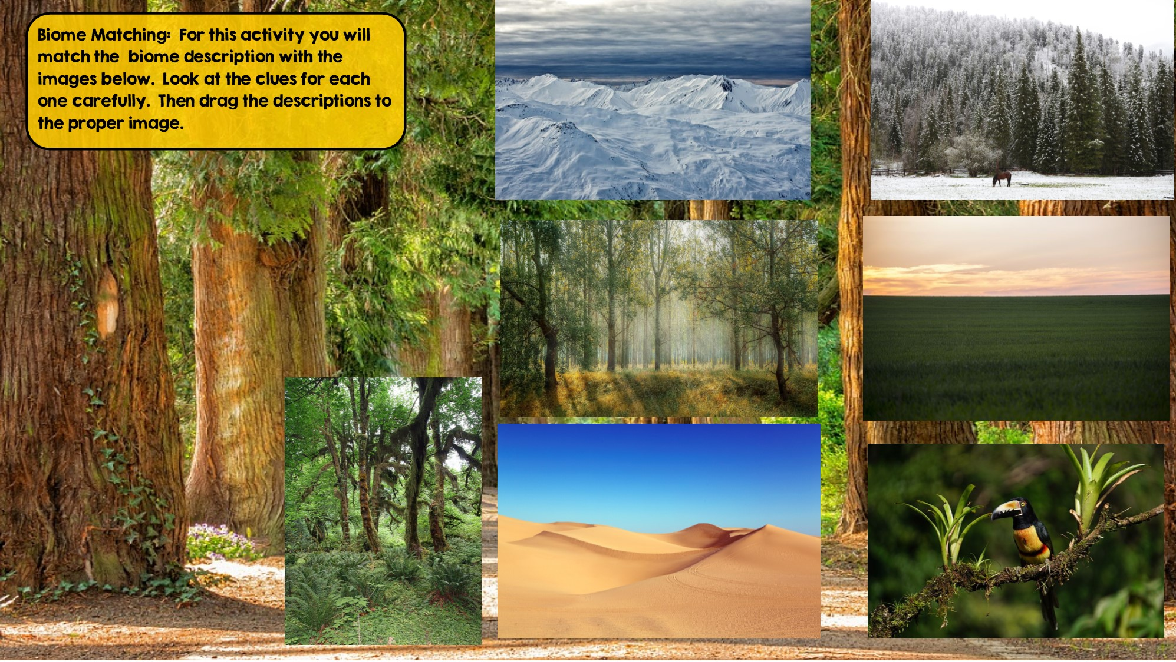
Taiga
Hint: Snowy Forest
Tundra
Hint: Cold Desert
Grassland
Hint: Very few trees grow
Temperate Deciduous Forest Hint: Four distinct seasons
Temperate Rainforest
Hint: Cool rainforest
Tropical Rainforest:
Hint: Found near equator
Desert
Hint: little to no water

Slide 6
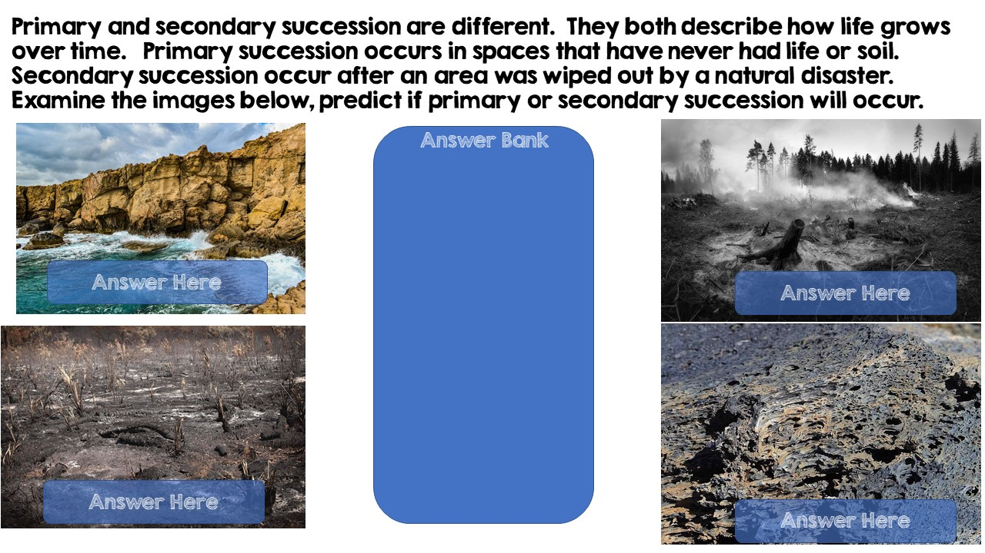
Primary Succession
Secondary Succession
Secondary Succession
Primary Succession

Slide 7
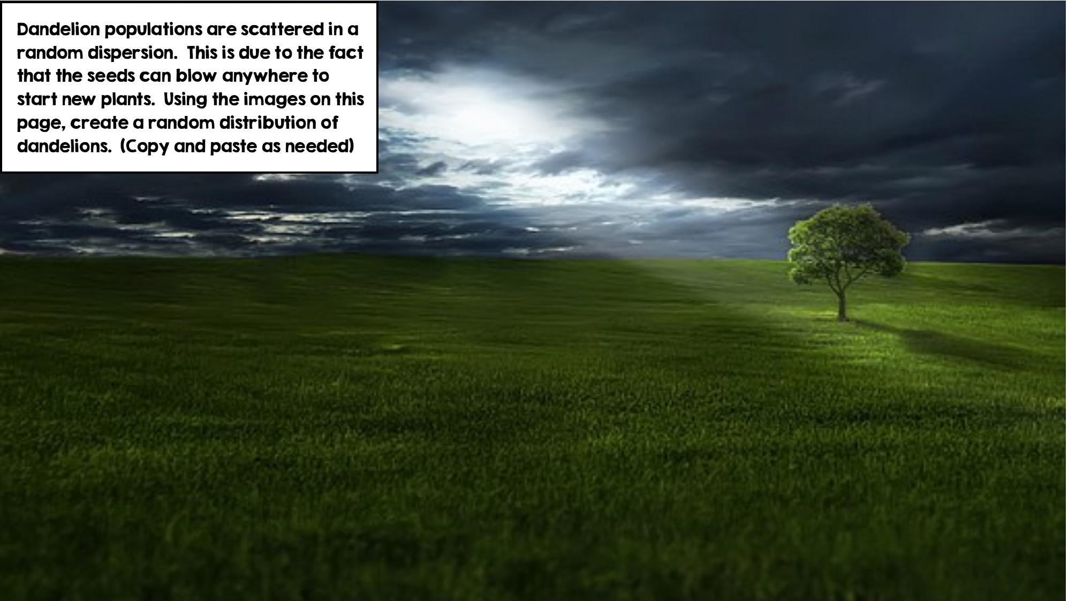
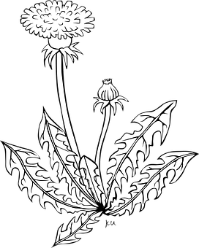

Slide 8
