Slide 1
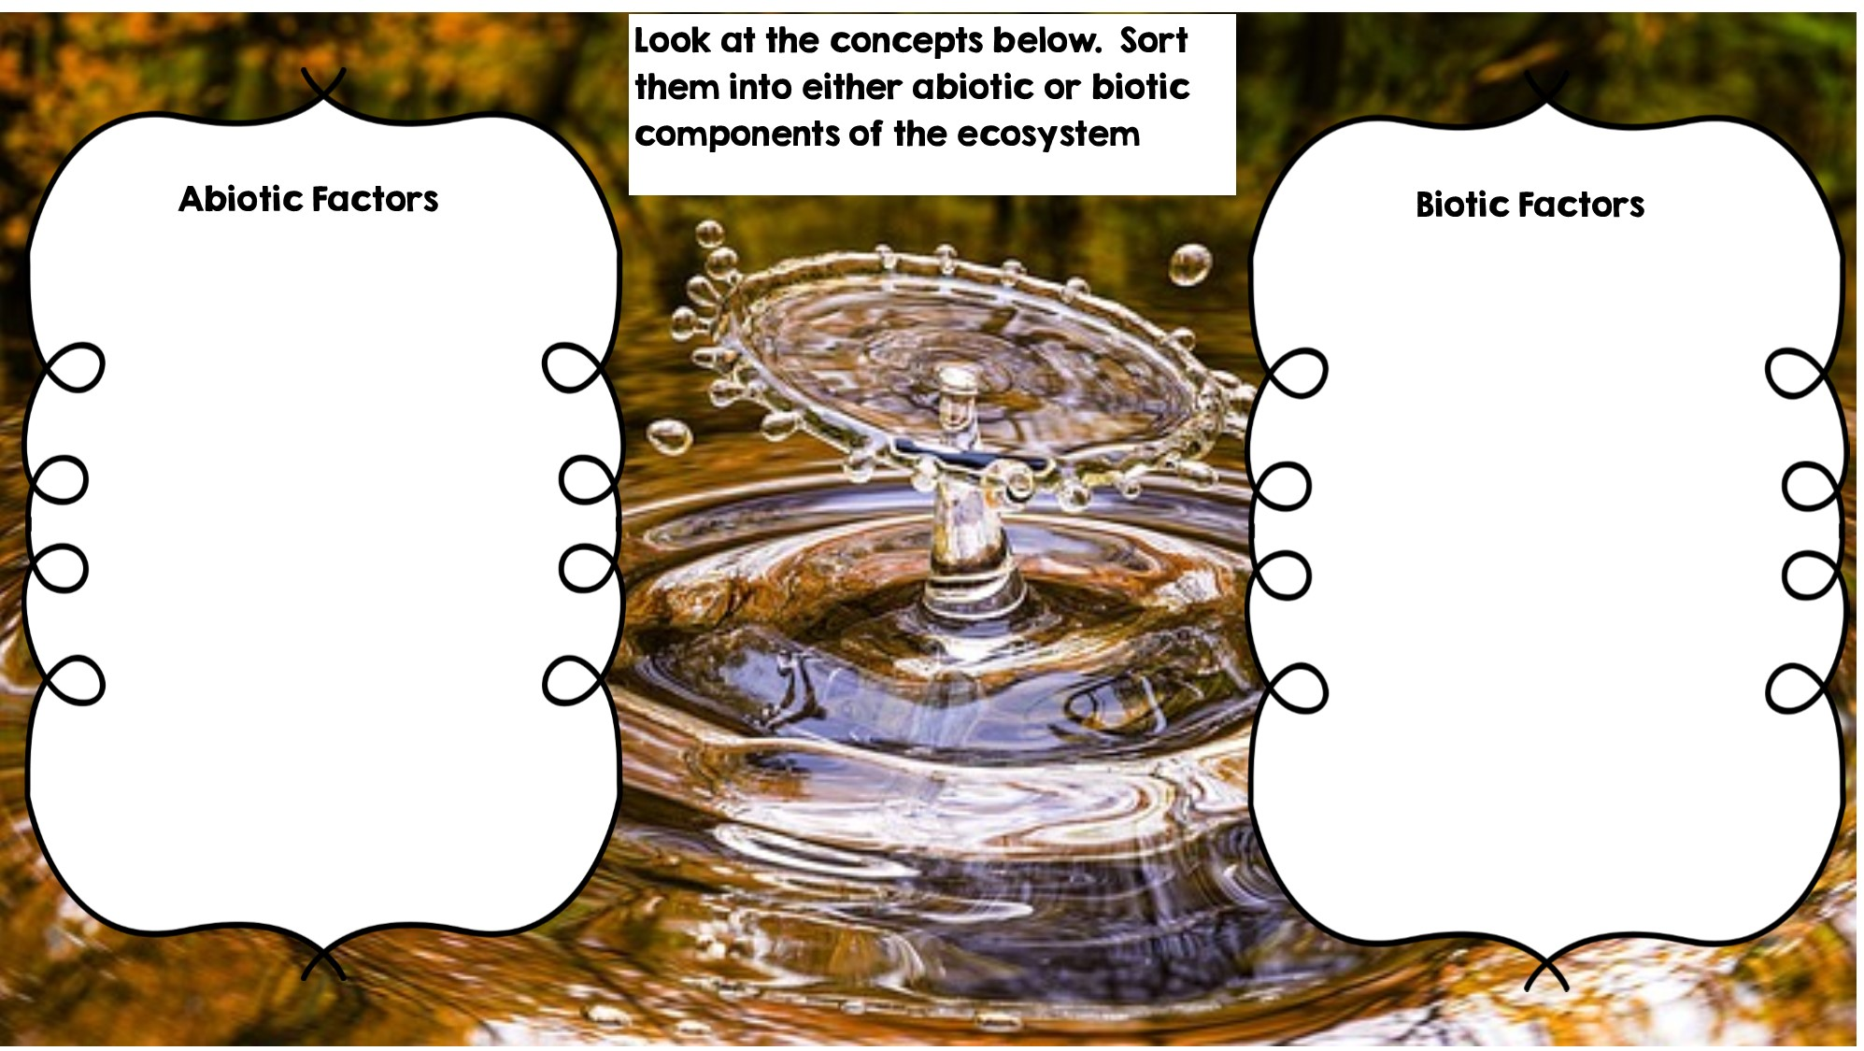
Fox
Rocks
Frog
Temperature
Flowers
Water
Rotting Log
Sunlight
Dead Animal
Grass
Deer

Slide 2
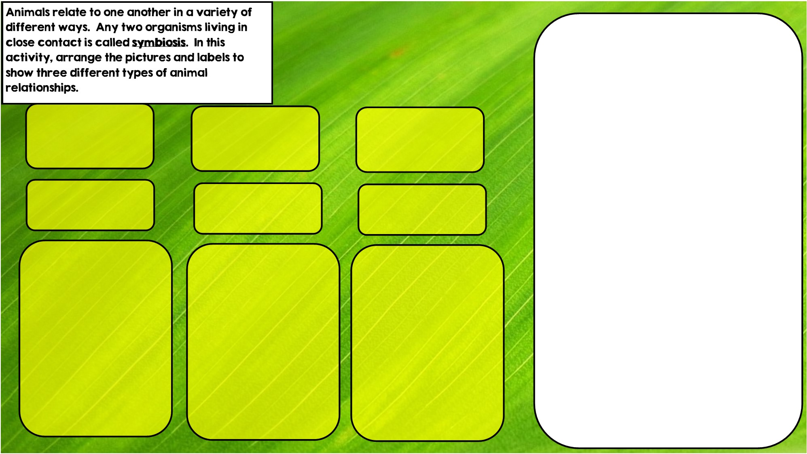
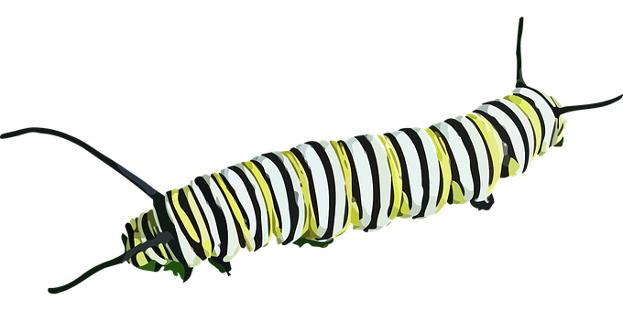
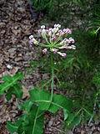


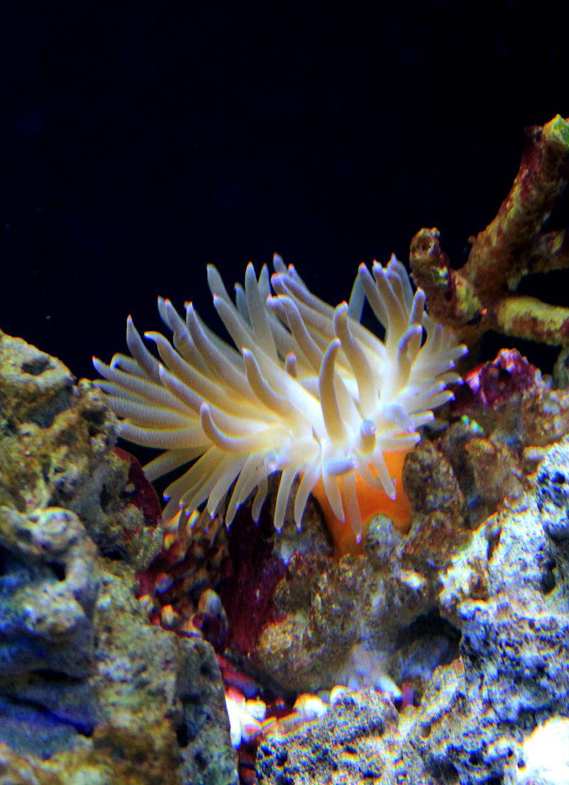

Hint: I eat toxic leaves
Hint: I live in intestines
Hint: I live in stingers
Mutualism is where both organisms benefit
Parasitism is where one organisms benefits and the other is hurt
Commensalism is where one organism benefits and doesn’t hurt the other.

Slide 3
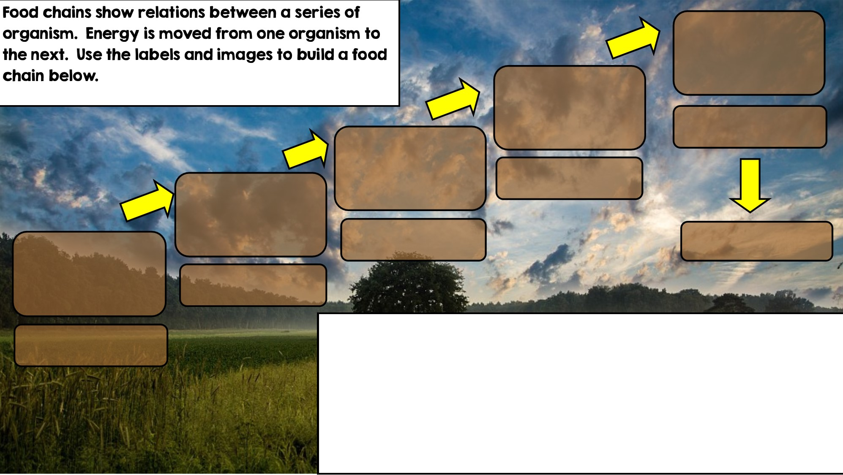

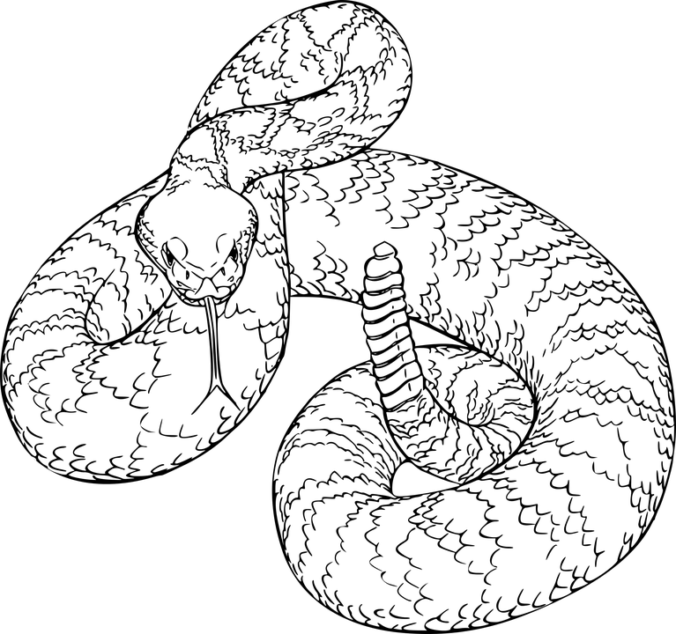
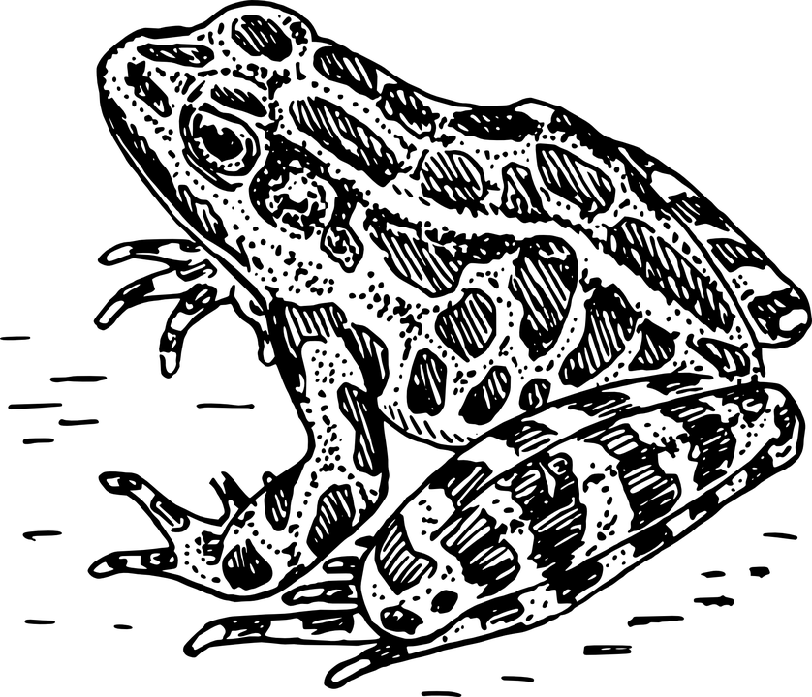
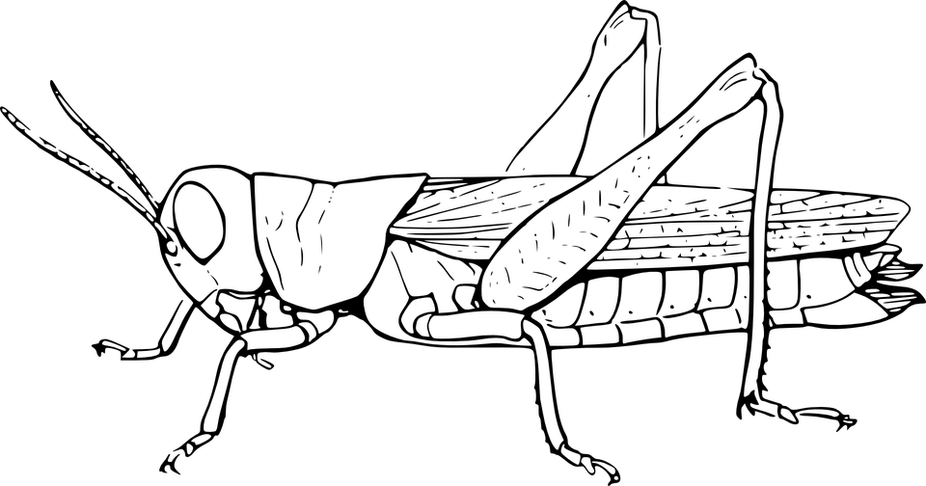

Tertiary Consumer
Third Consumer
Producer: Autotroph
Secondary Consumer
Apex Predator
Primary Consumer: Heterotroph
Decomposer

Slide 4
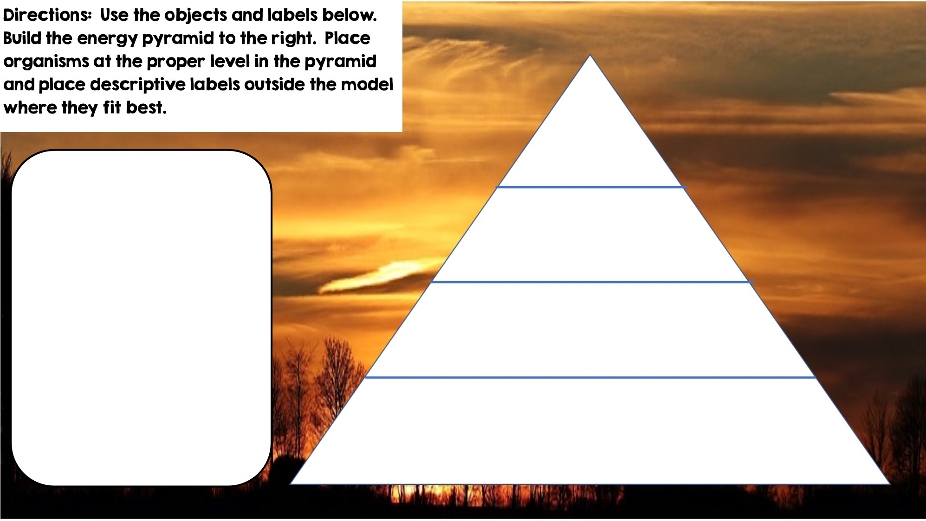
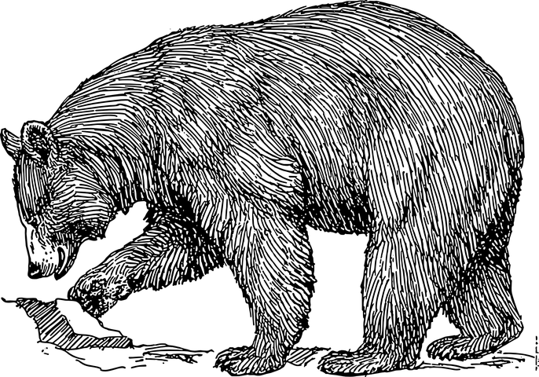







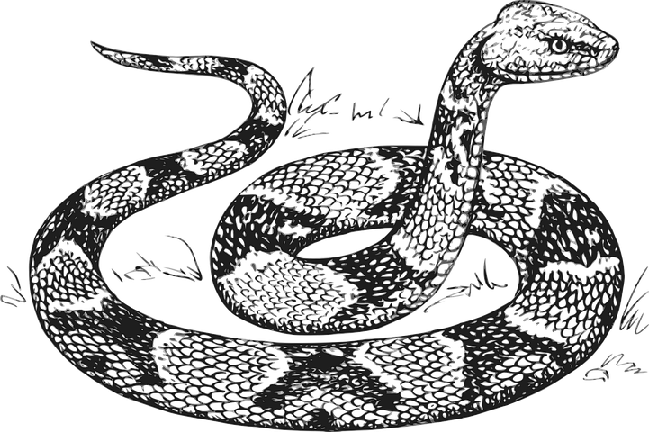


Only 10% of the energy from each tropic level is transferred
Heterotrophs
Tertiary Consumers
Heterotrophs
Secondary Consumers
Heterotrophs
Primary Consumers
Autotrophs
Producers

Slide 5
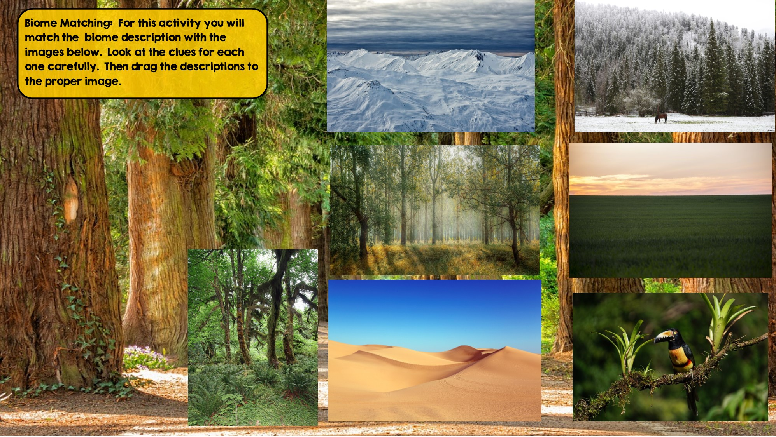
Tundra
Hint: Cold Desert
Taiga
Hint: Snowy Forest
Temperate Deciduous Forest Hint: Four distinct seasons
Grassland
Hint: Very few trees grow
Temperate Rainforest
Hint: Cool rainforest
Tropical Rainforest:
Hint: Found near equator
Desert
Hint: little to no water

Slide 6
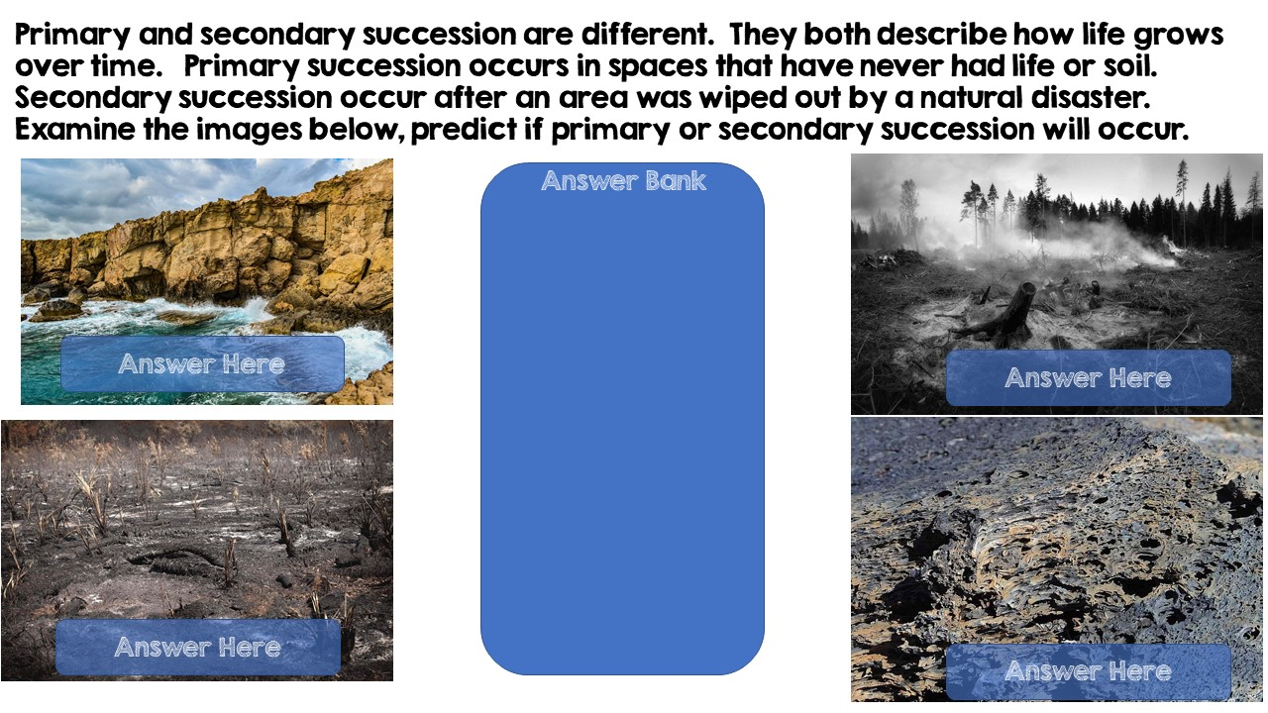
Primary Succession
Secondary Succession
Secondary Succession
Primary Succession

Slide 7
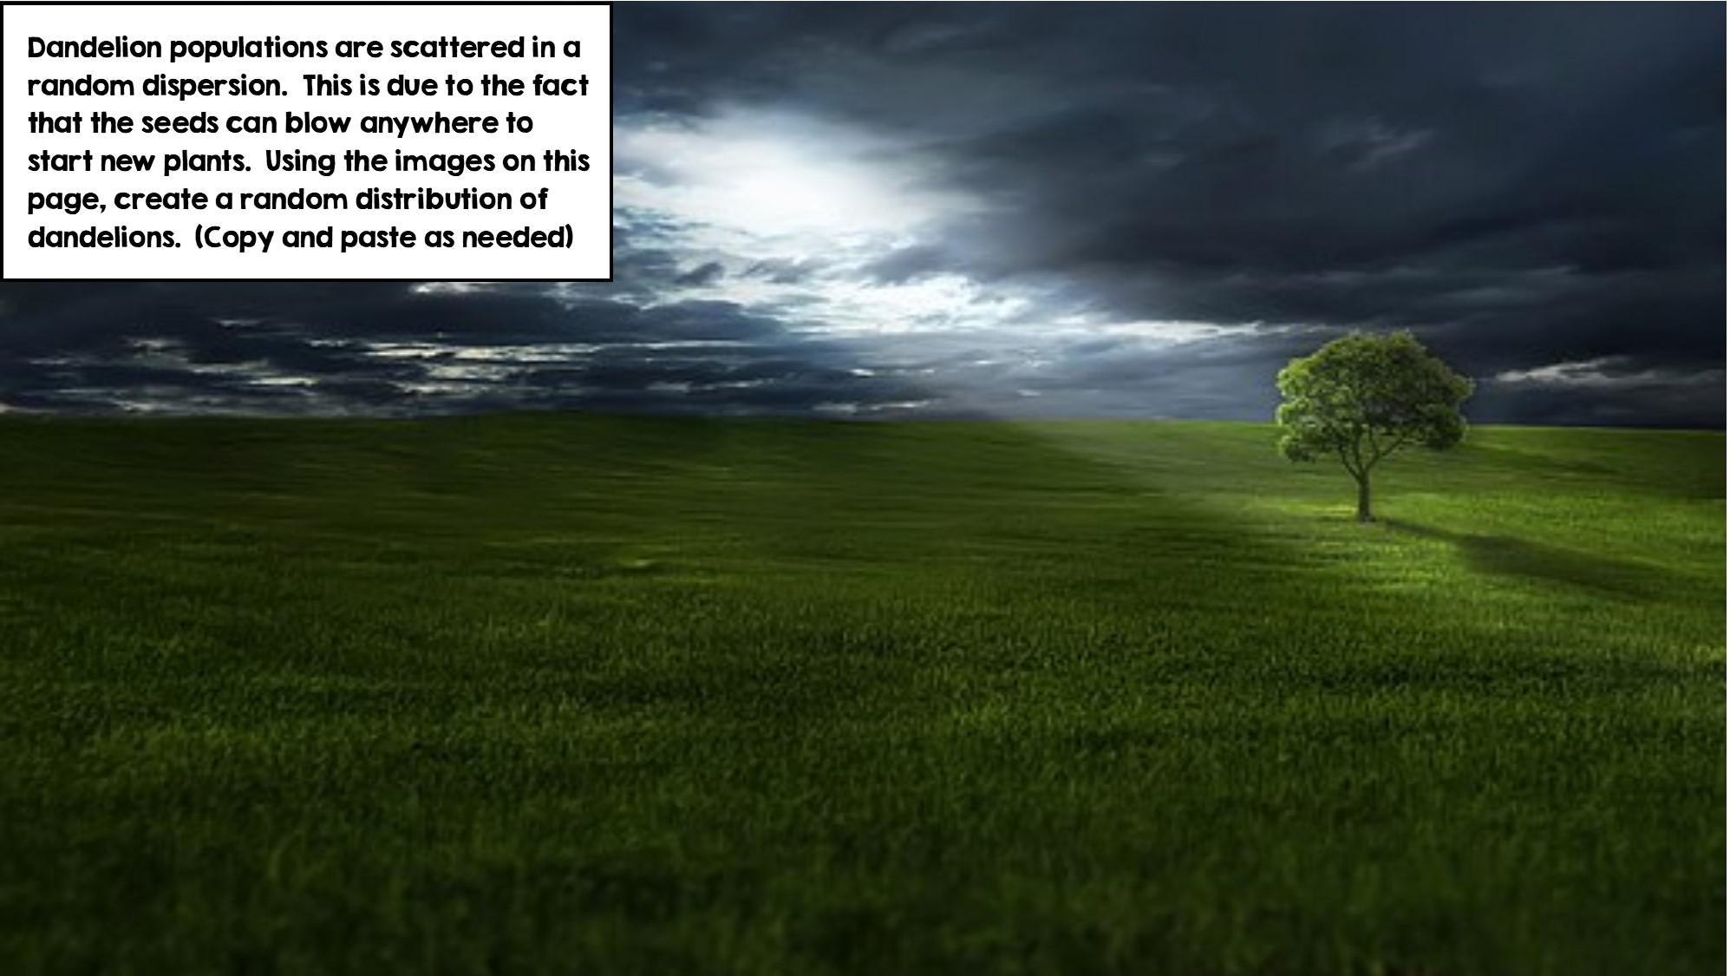


Slide 8
