Slide 1
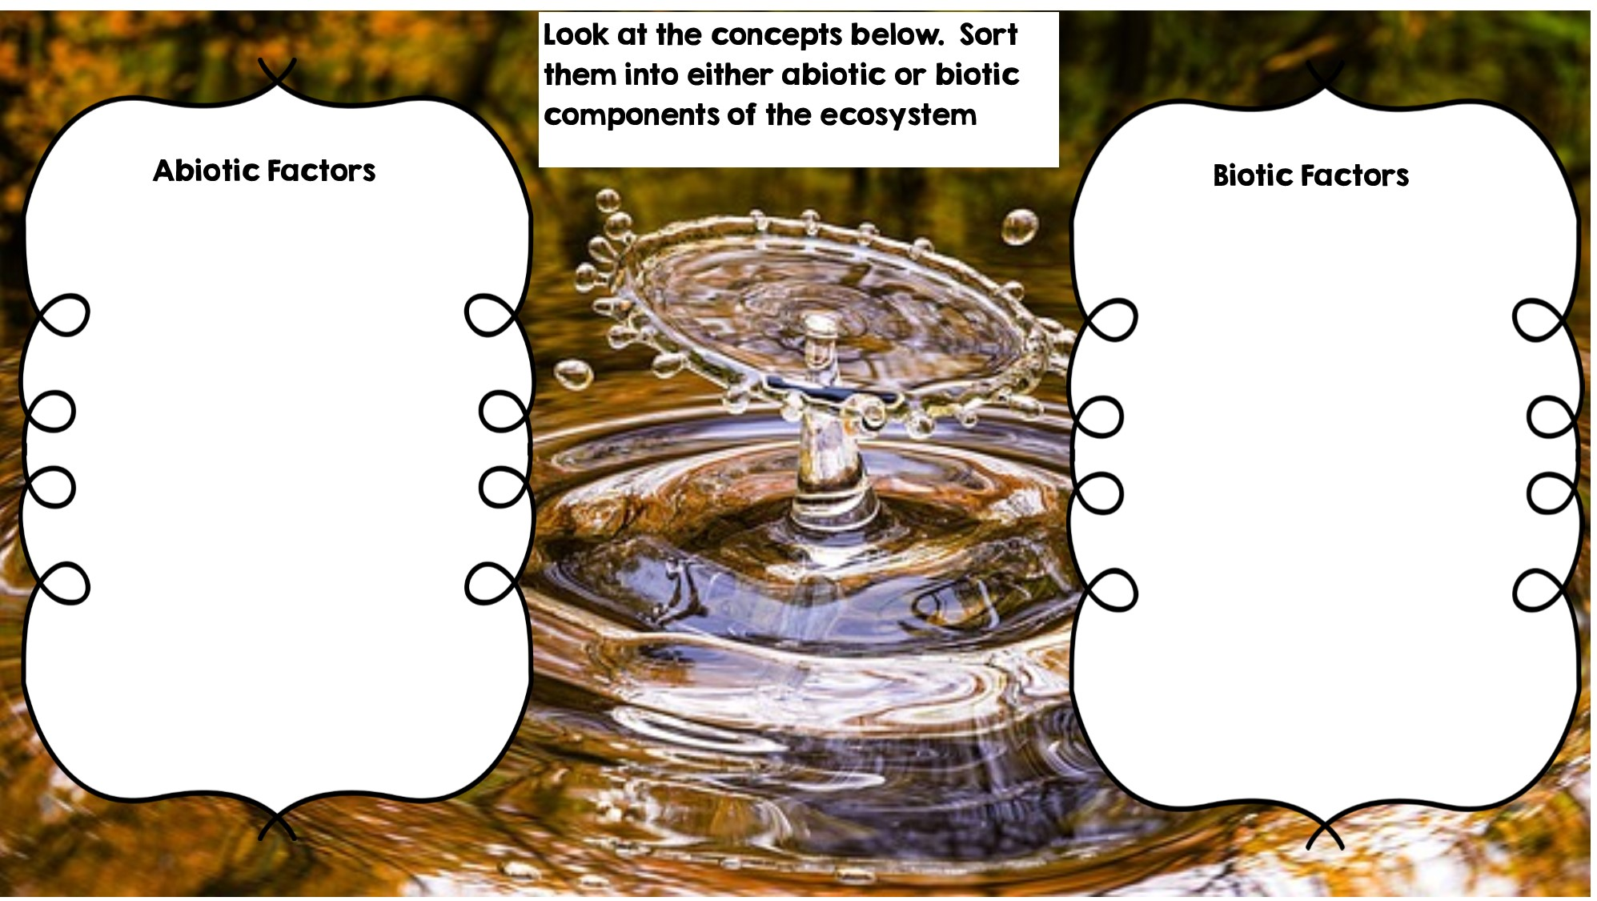
Rocks
Fox
Frog
Temperature
Flowers
Dead Animal
Sunlight
Grass
Water
Deer
Rotting Log

Slide 2
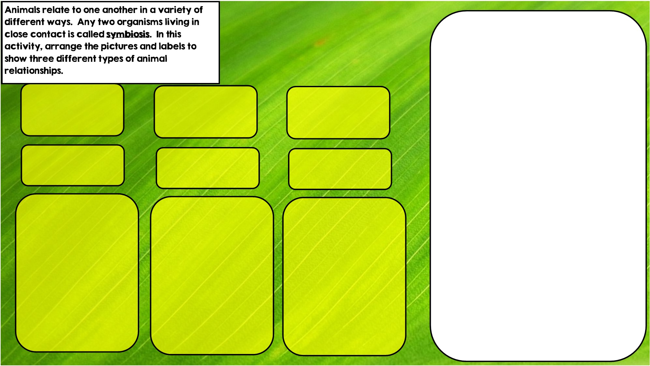

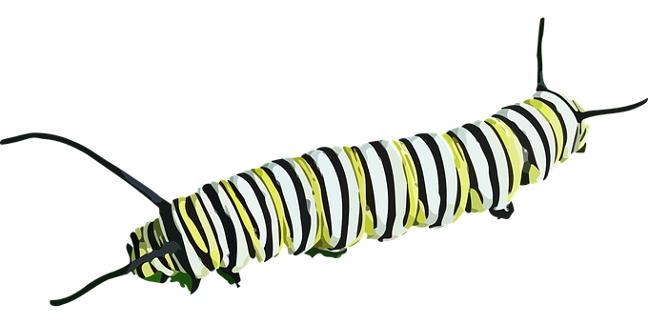

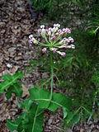

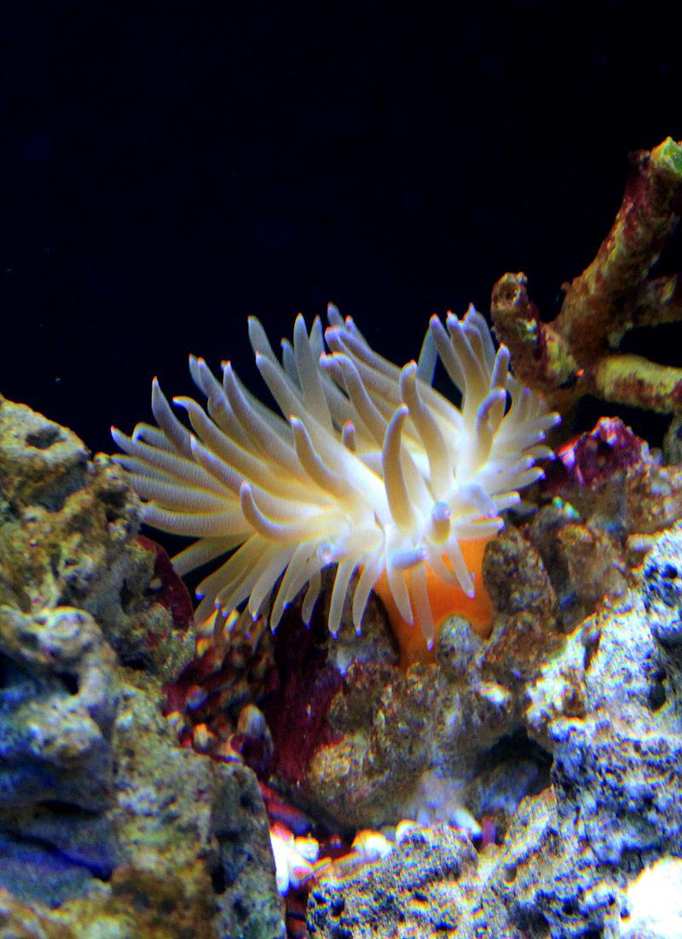
Hint: I live in stingers
Hint: I live in intestines
Hint: I eat toxic leaves
Parasitism is where one organisms benefits and the other is hurt
Commensalism is where one organism benefits and doesn’t hurt the other.
Mutualism is where both organisms benefit

Slide 3
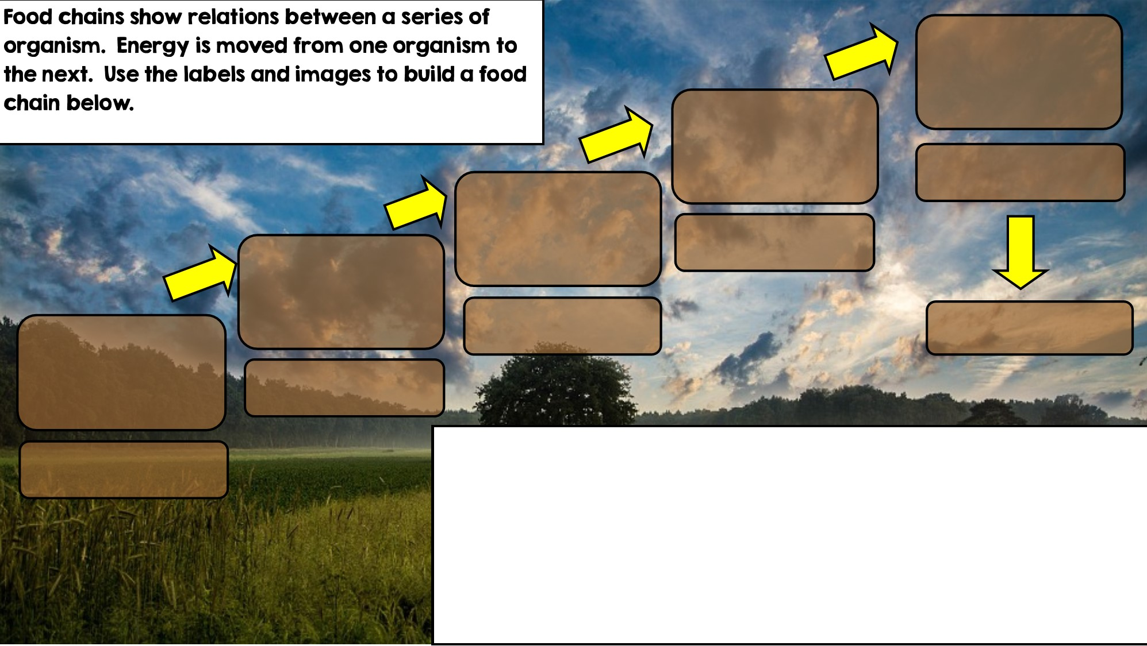

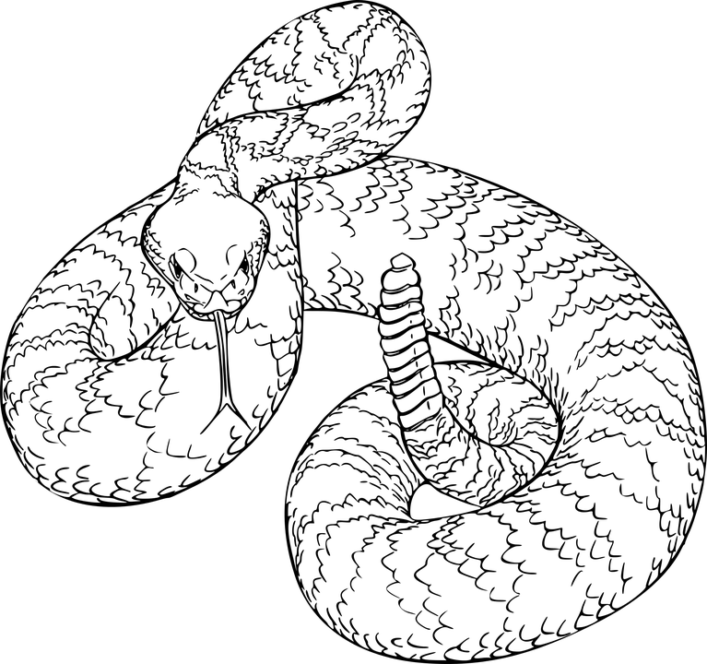
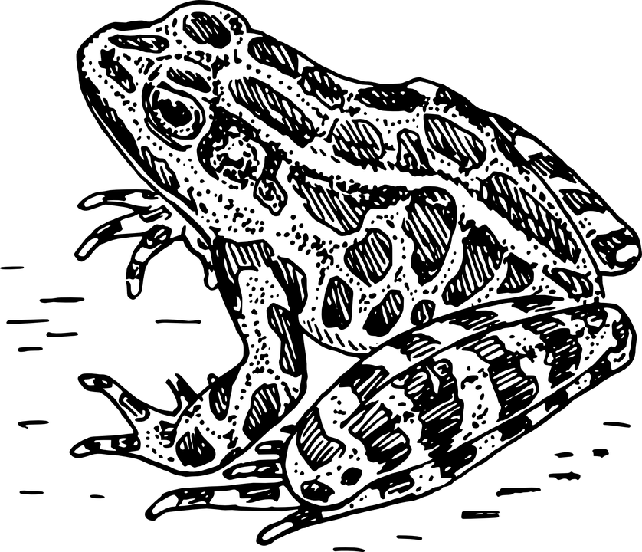
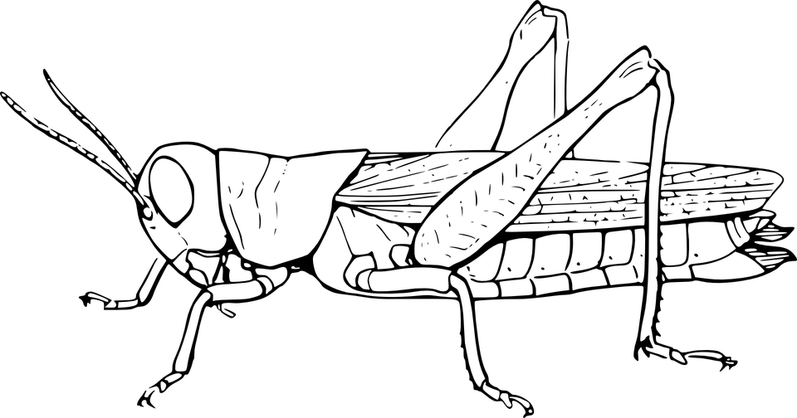

Apex Predator
Tertiary Consumer
Secondary Consumer
Decomposer
Primary Consumer: Heterotroph
Producer: Autotroph

Slide 4
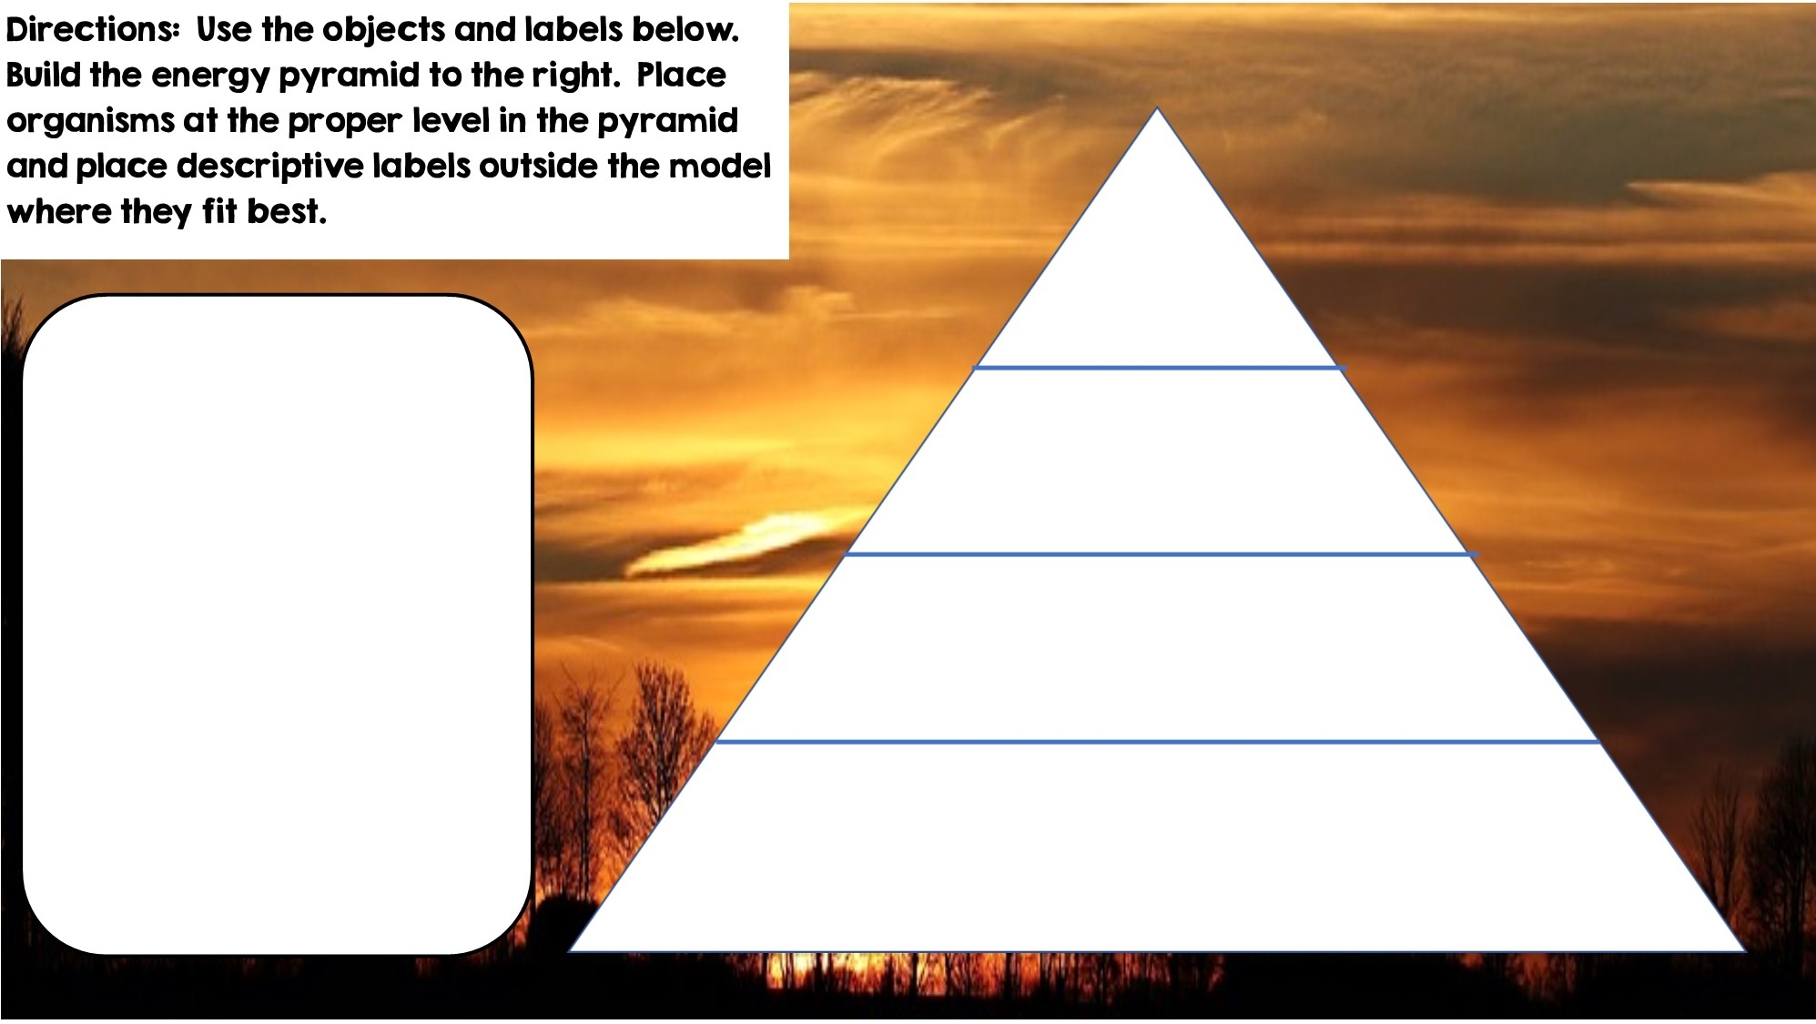

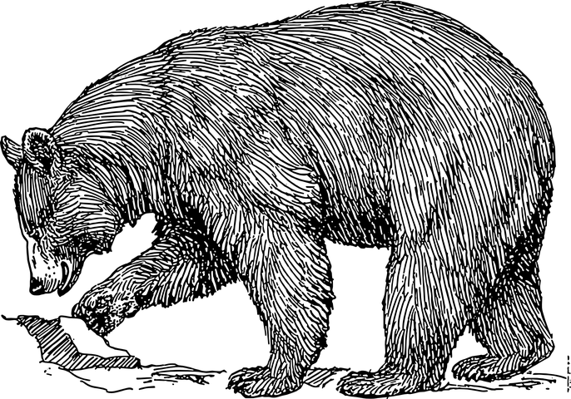

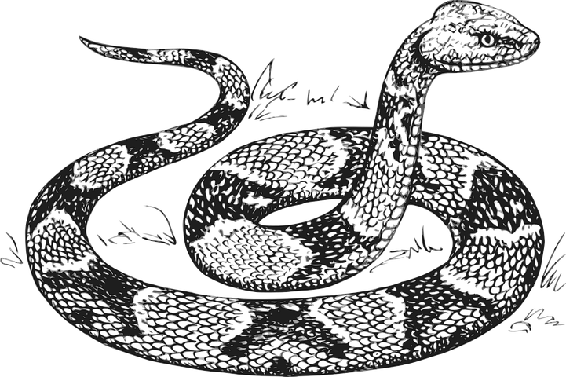



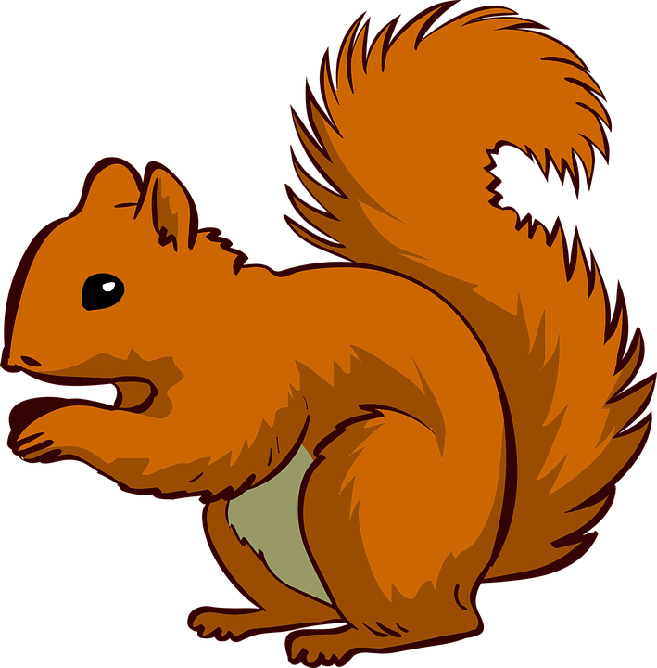



Only 10% of the energy from each tropic level is transferred
Tertiary Consumers
Heterotrophs
Secondary Consumers
Heterotrophs
Heterotrophs
Primary Consumers
Autotrophs
Producers

Slide 5
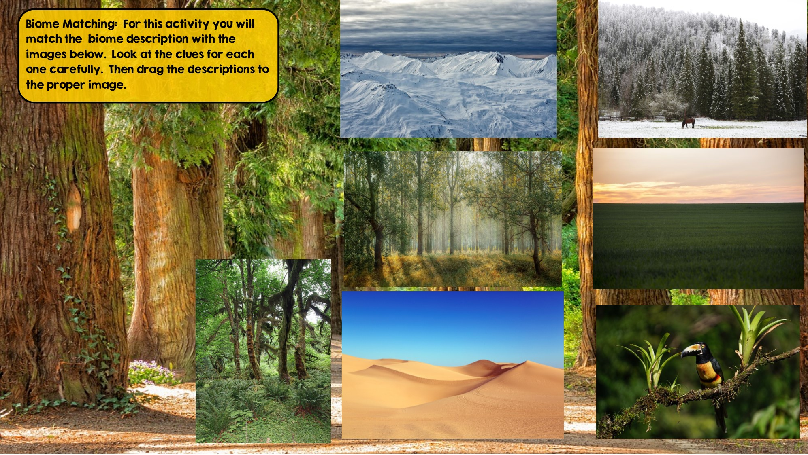
Tundra
Hint: Cold Desert
Taiga
Hint: Snowy Forest
Temperate Deciduous Forest Hint: Four distinct seasons
Grassland
Hint: Very few trees grow
Temperate Rainforest
Hint: Cool rainforest
Tropical Rainforest:
Hint: Found near equator
Desert
Hint: little to no water

Slide 6
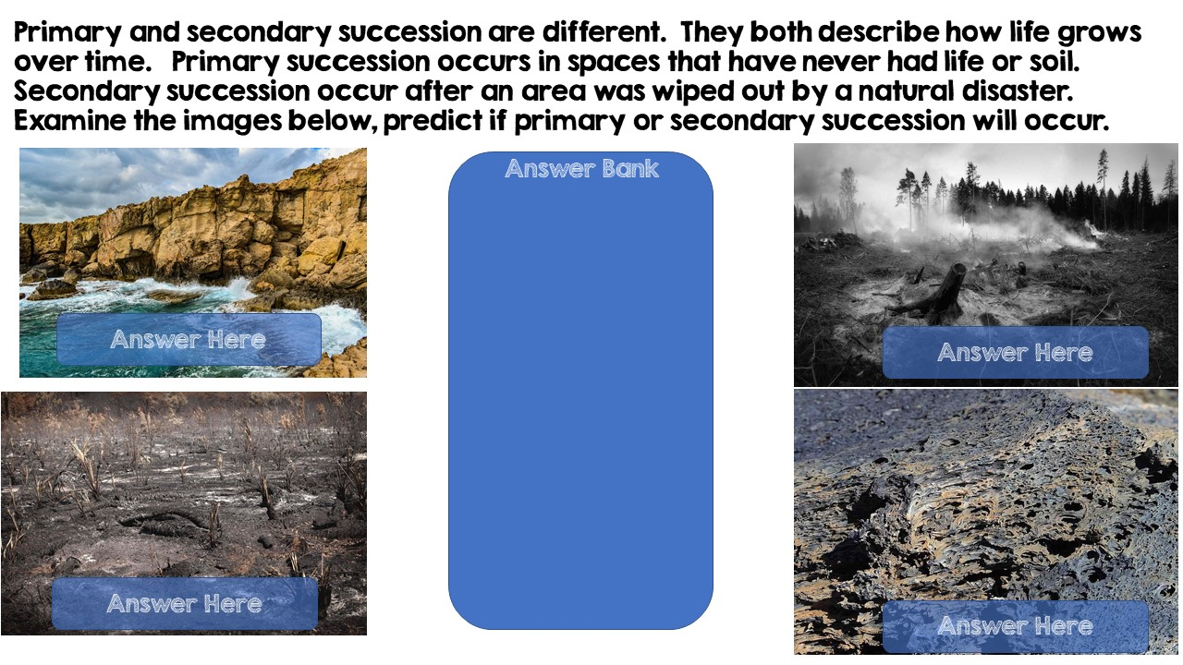
Secondary Succession
Primary Succession
Primary Succession
Secondary Succession

Slide 7
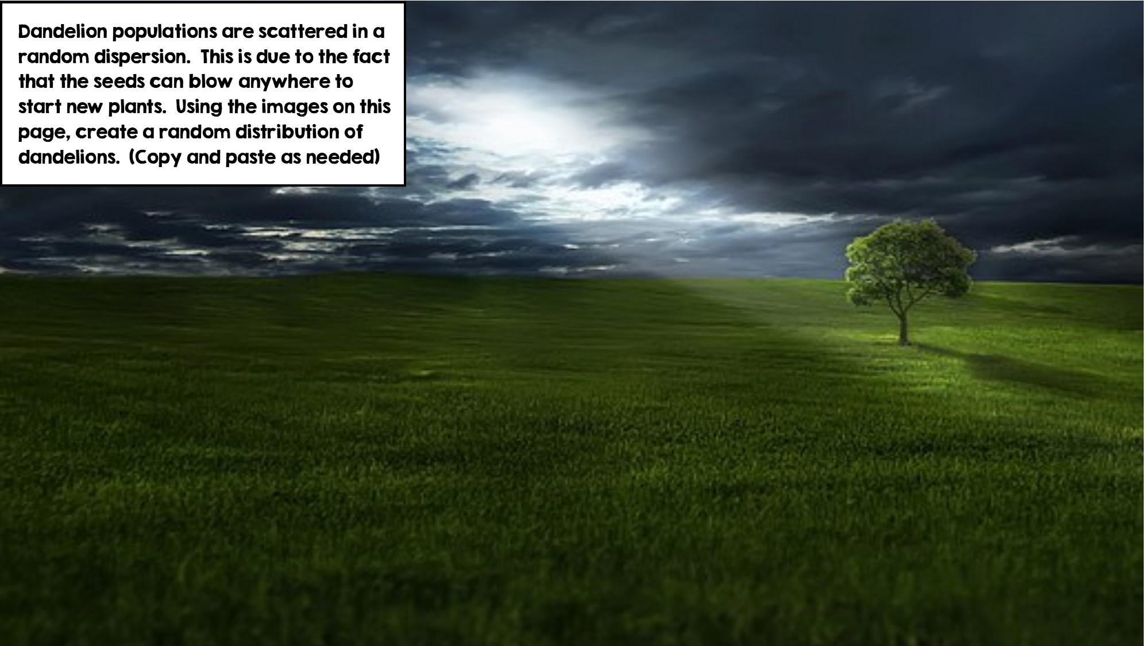
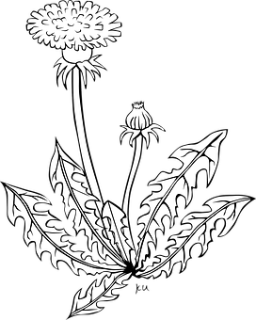

Slide 8
