Slide 1
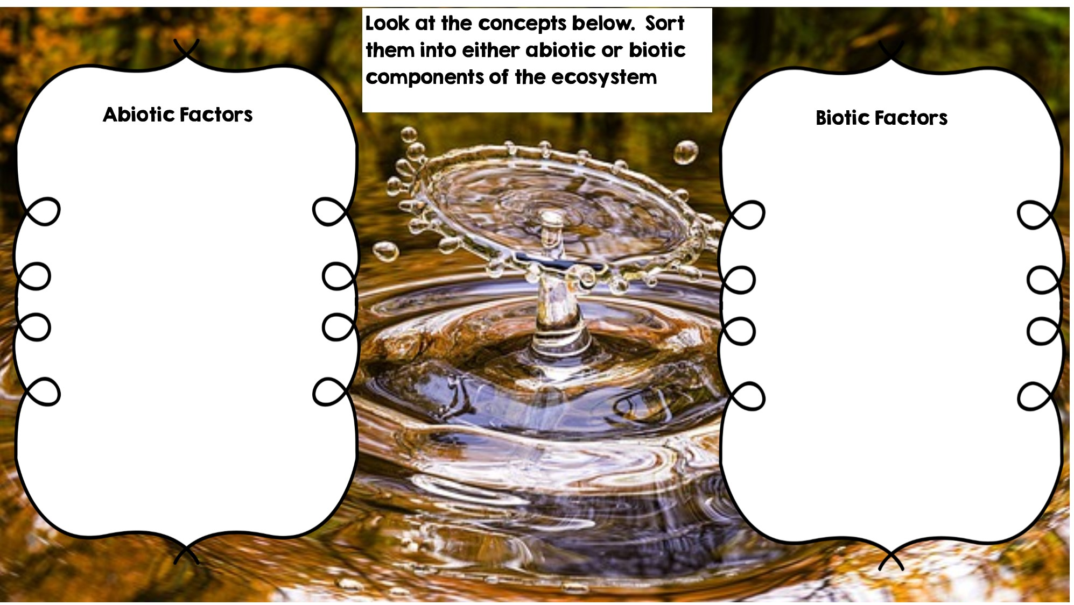
Water
Deer
Dead Animal
Temperature
Fox
Flowers
Frog
Grass
Rotting Log
Rocks
Sunlight

Slide 2
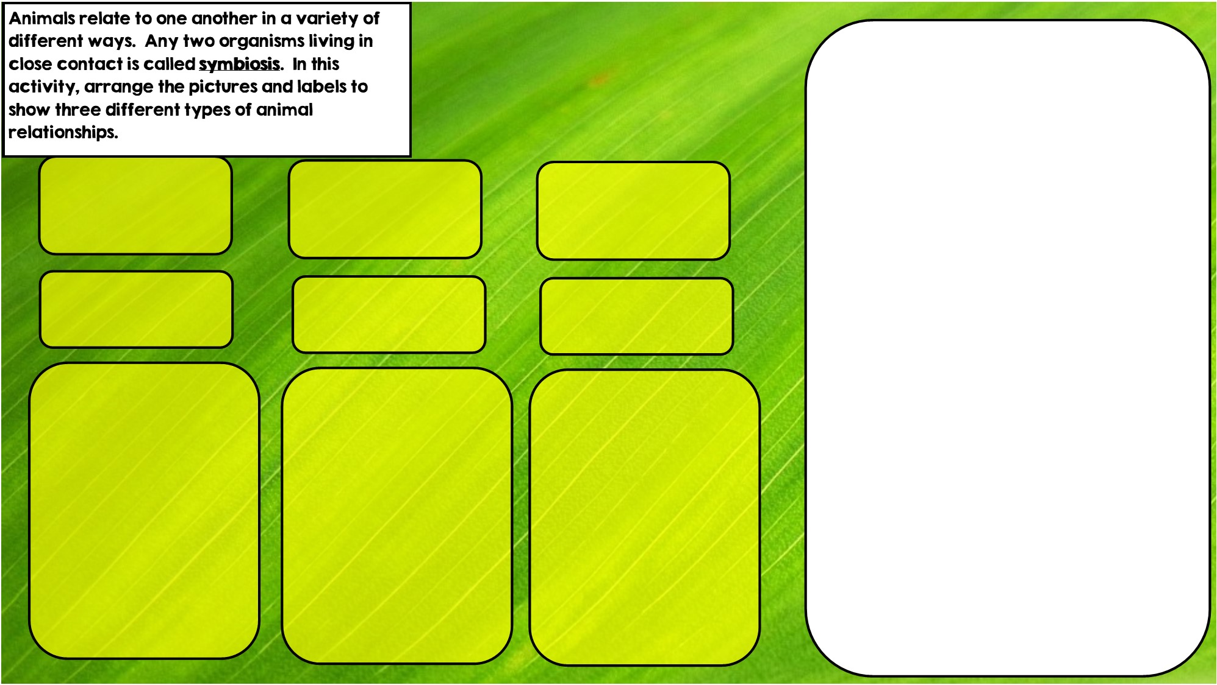

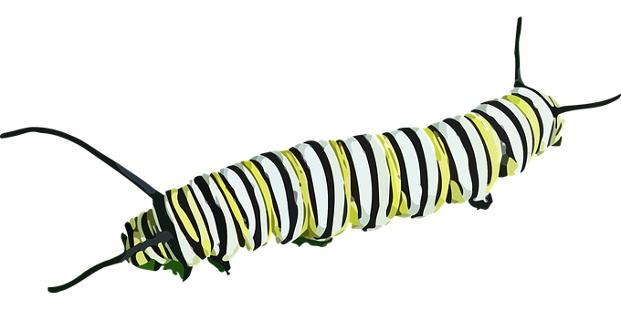

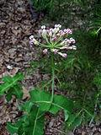
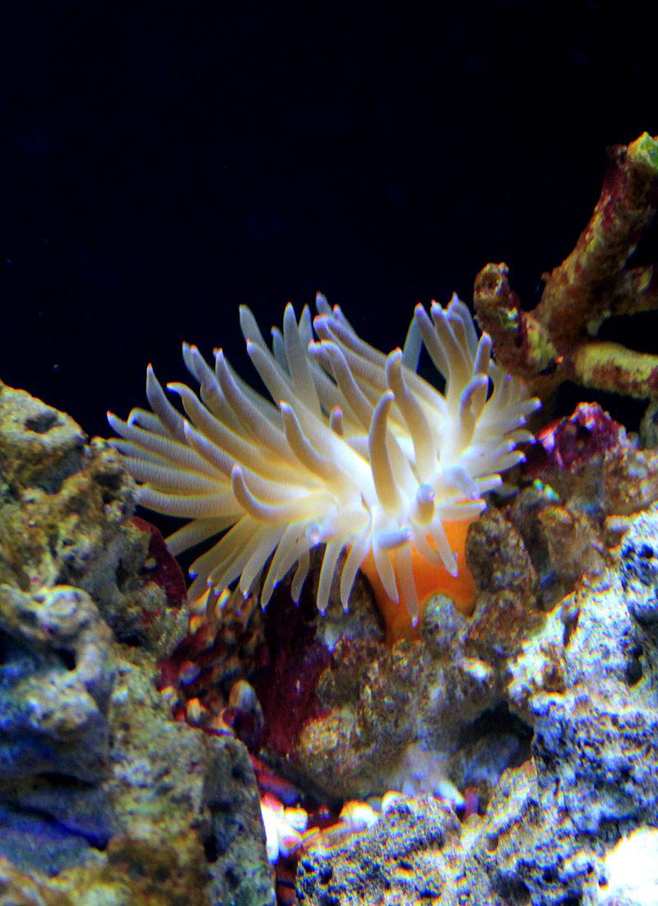

Commensalism is where one organism benefits and doesn’t hurt the other.
Parasitism is where one organisms benefits and the other is hurt
Mutualism is where both organisms benefit
Hint: I live in intestines
Hint: I eat toxic leaves
Hint: I live in stingers

Slide 3
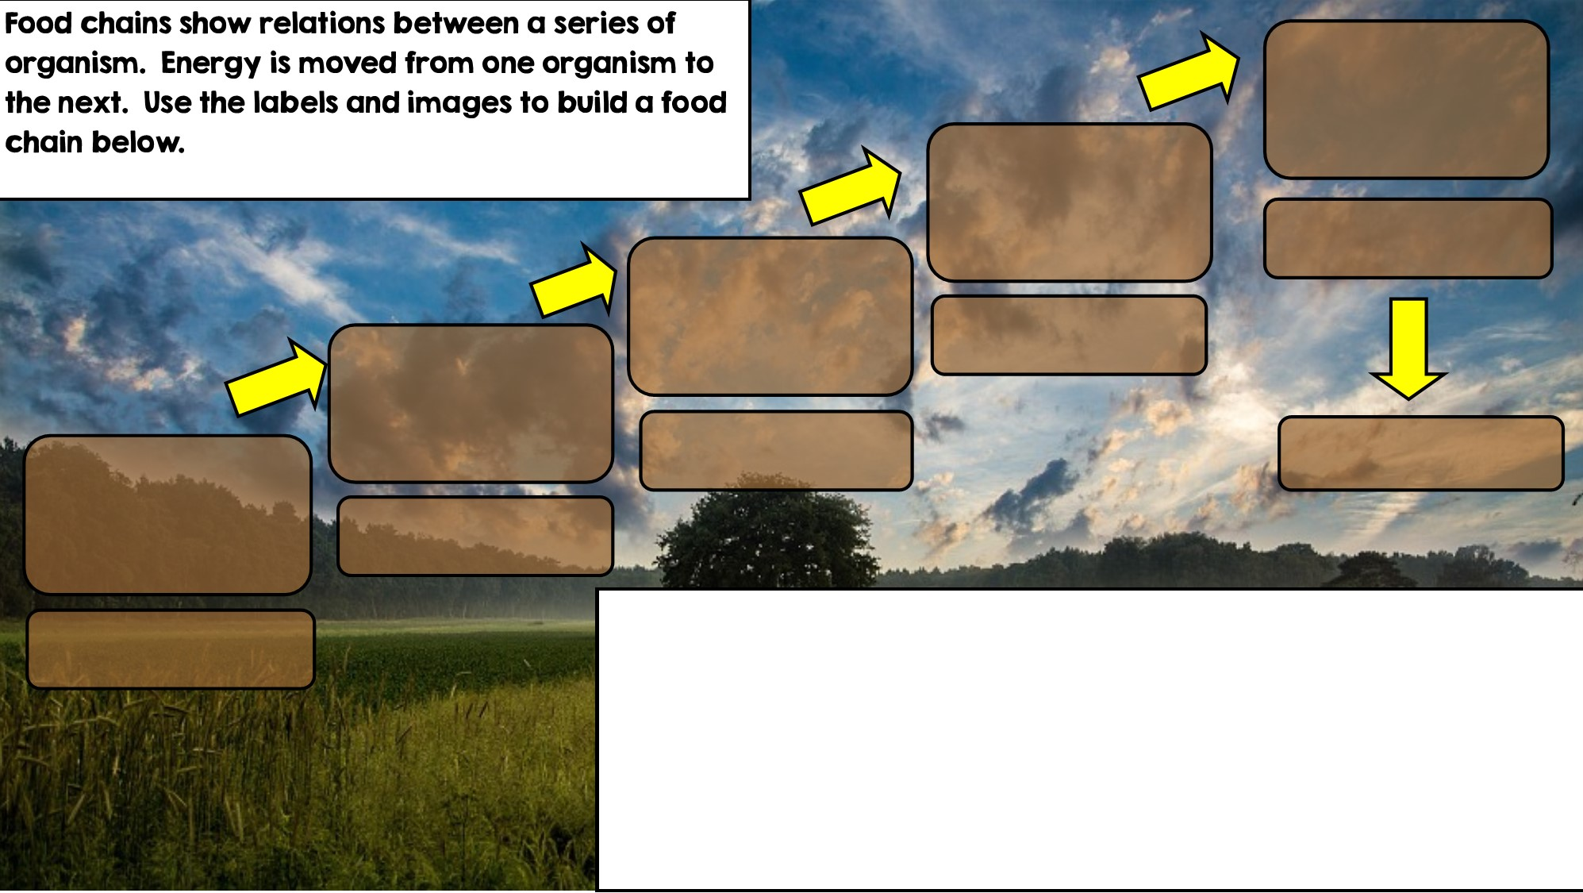
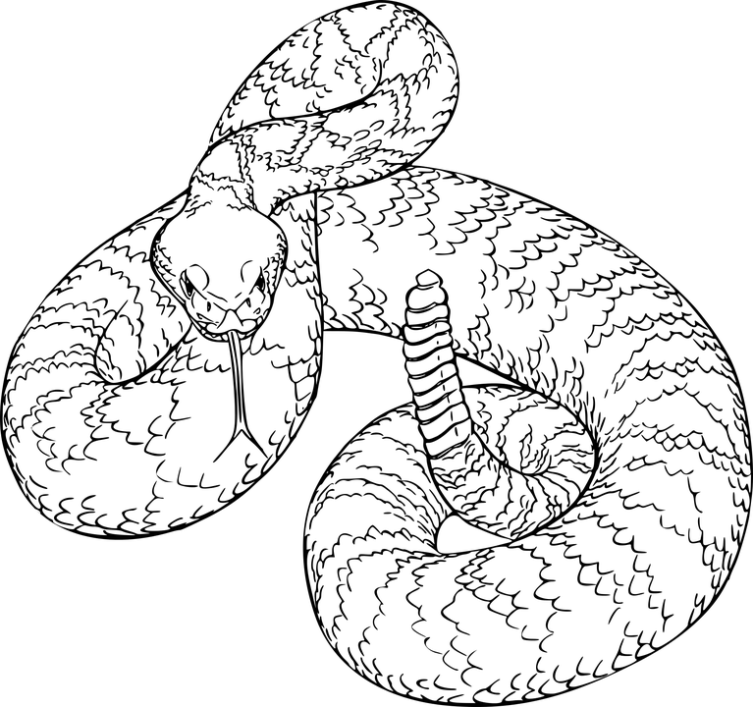
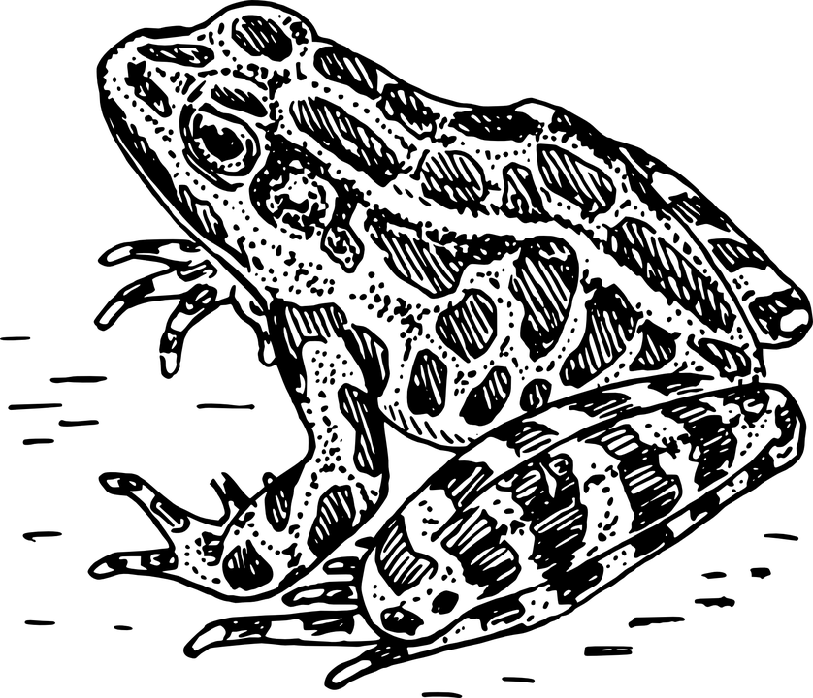

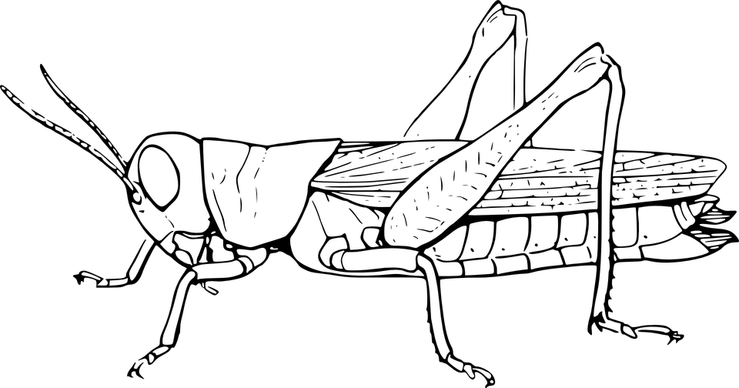

Primary Consumer: Heterotroph
Apex Predator
Secondary Consumer
Decomposer
Tertiary Consumer
Producer: Autotroph

Slide 4
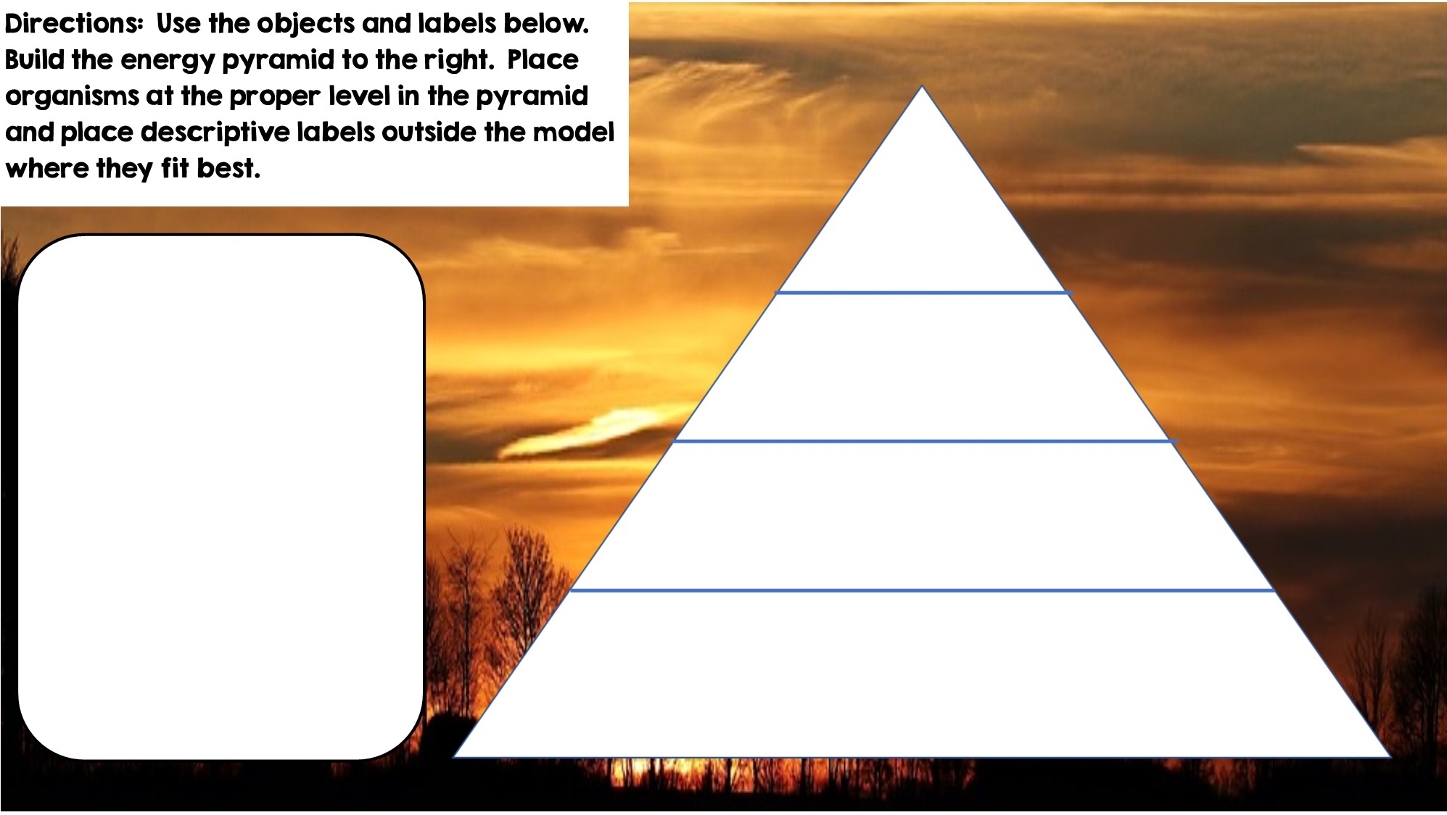
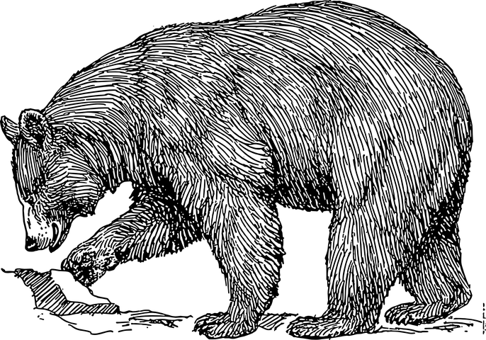
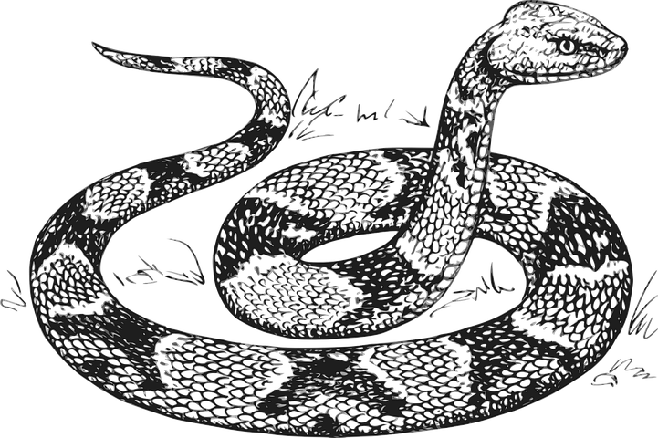



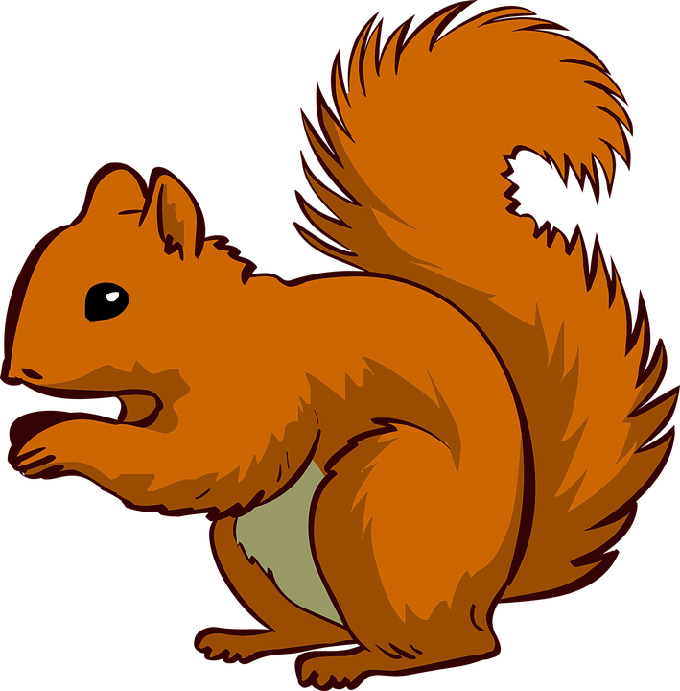





Only 10% of the energy from each tropic level is transferred
Primary Consumers
Secondary Consumers
Tertiary Consumers
Heterotrophs
Heterotrophs
Heterotrophs
Producers
Autotrophs

Slide 5
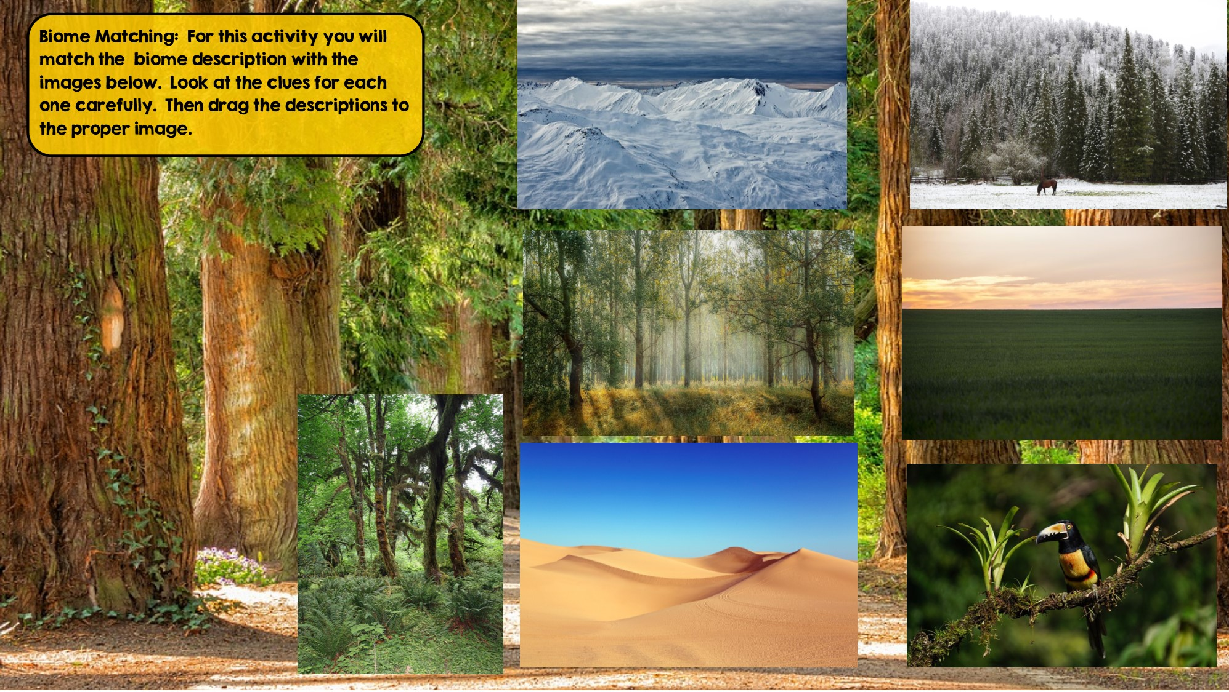
Tundra
Hint: Cold Desert
Taiga
Hint: Snowy Forest
Temperate Rainforest
Hint: Cool rainforest
Grassland
Hint: Very few trees grow
Tropical Rainforest:
Hint: Found near equator
Temperate Deciduous Forest Hint: Four distinct seasons
Desert
Hint: little to no water

Slide 6
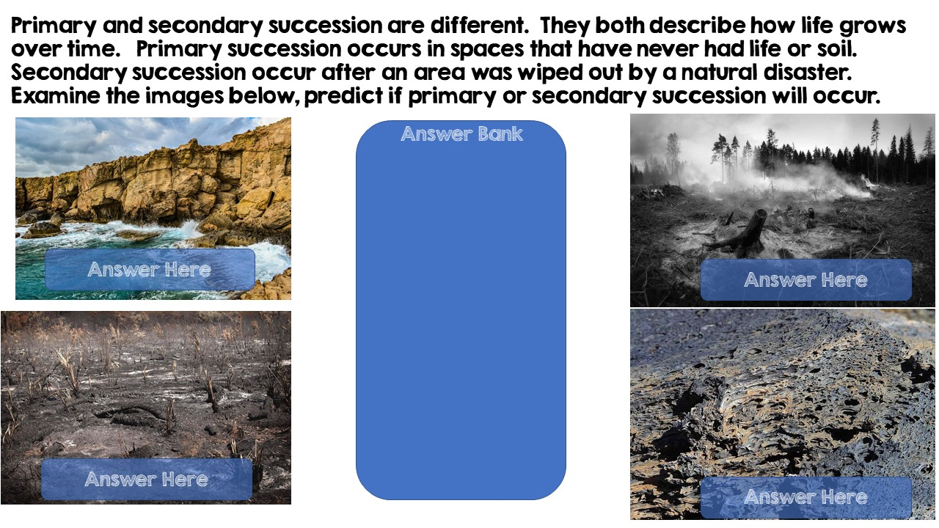
Primary Succession
Secondary Succession
Primary Succession
Secondary Succession

Slide 7
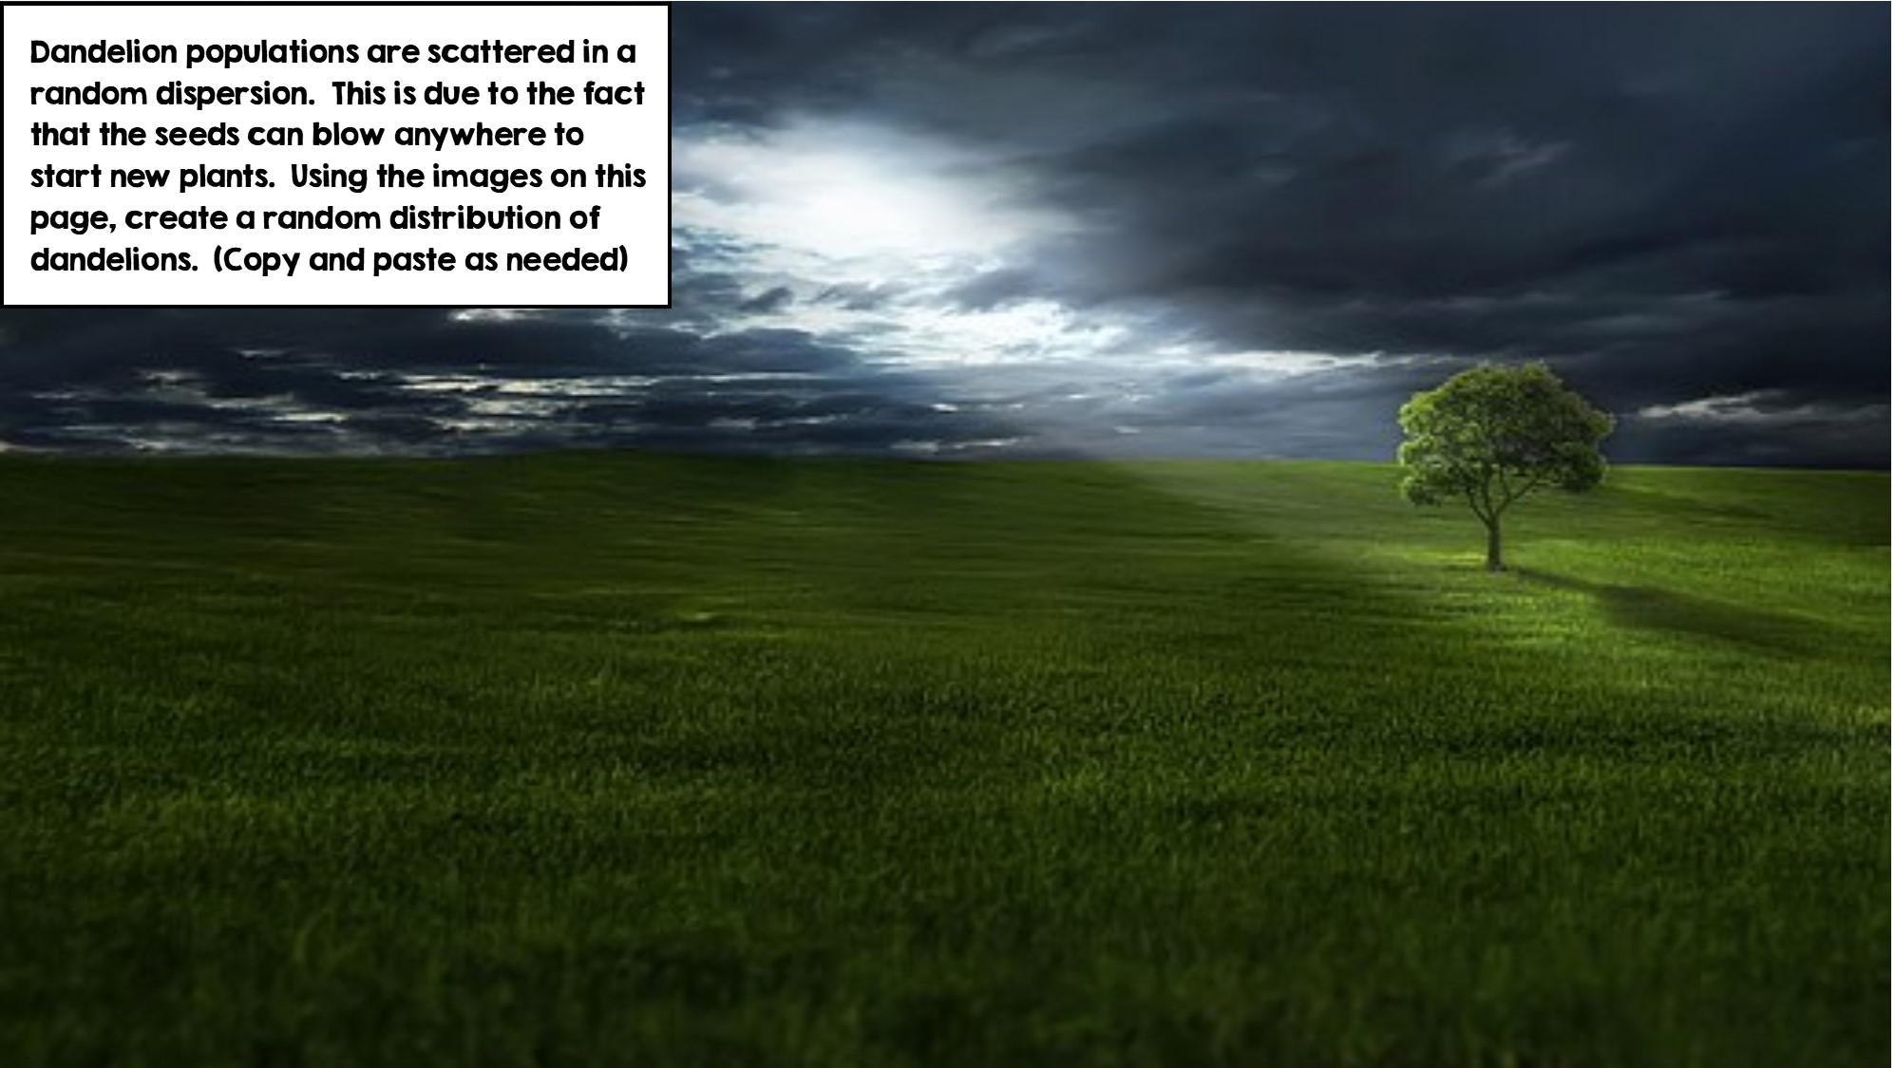
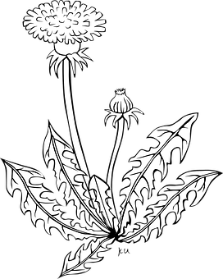

Slide 8
