Slide 1
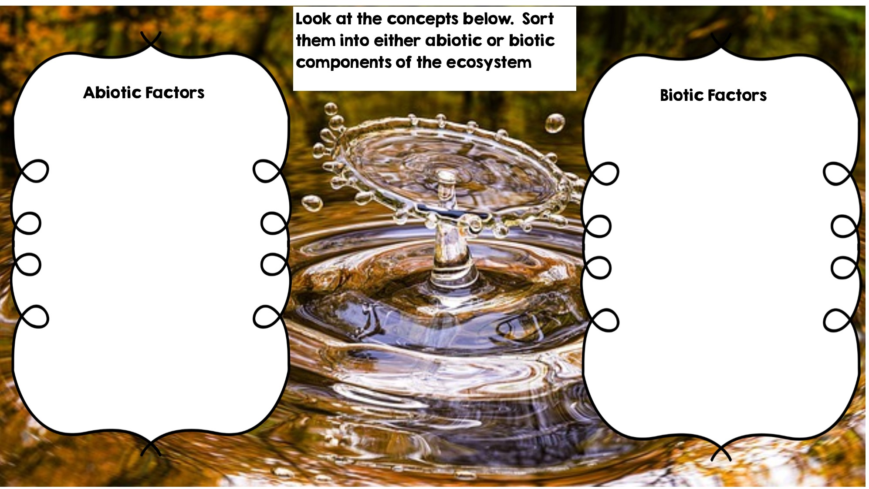
Rocks
Fox
Rotting Log
Frog
Sunlight
Water
Grass
Dead Animal
Flowers
Deer
Temperature

Slide 2
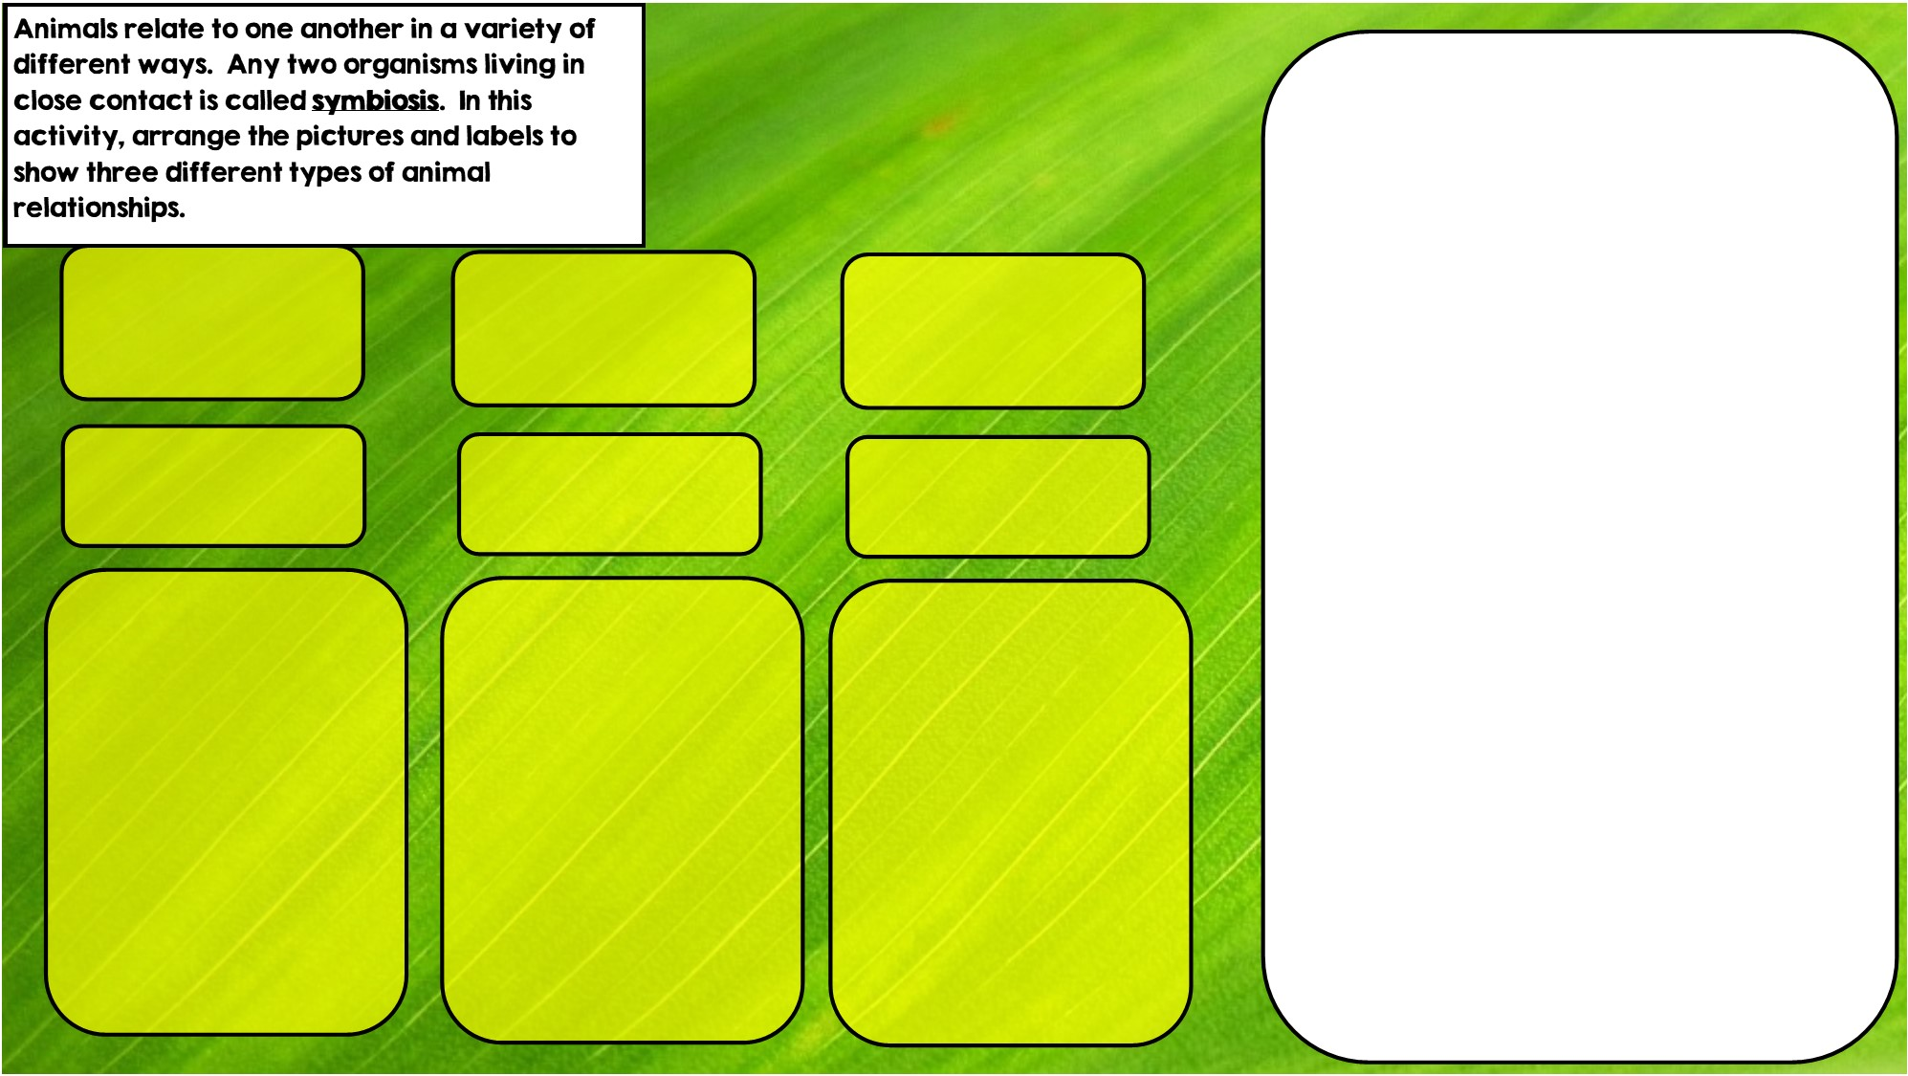

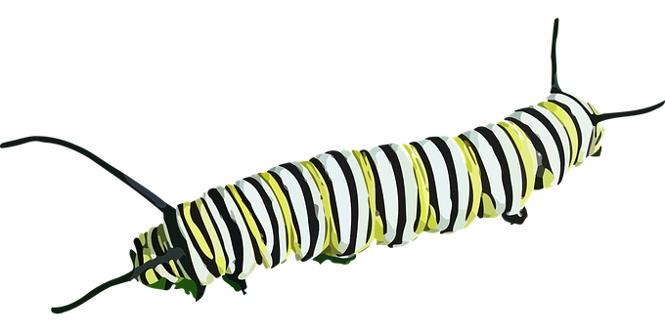

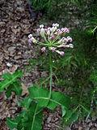
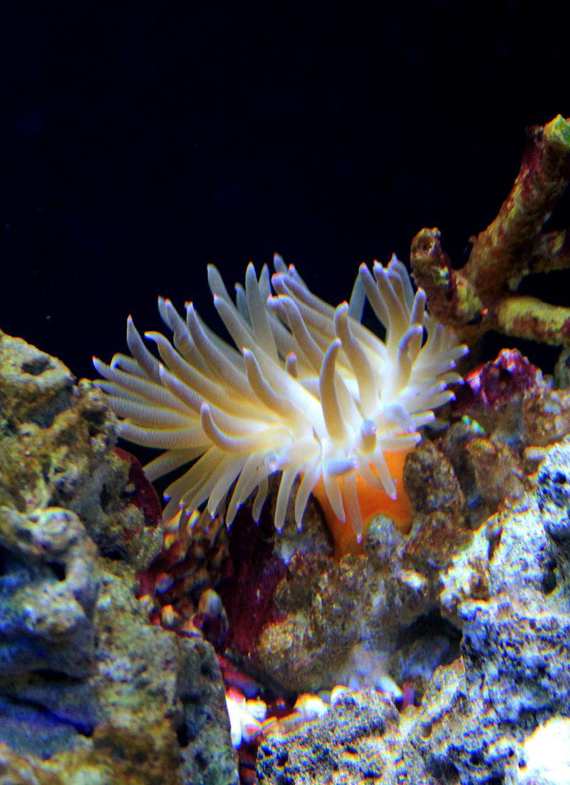

Hint: I live in stingers
Hint: I live in intestines
Hint: I eat toxic leaves
Commensalism is where one organism benefits and doesn’t hurt the other.
Mutualism is where both organisms benefit
Parasitism is where one organisms benefits and the other is hurt

Slide 3
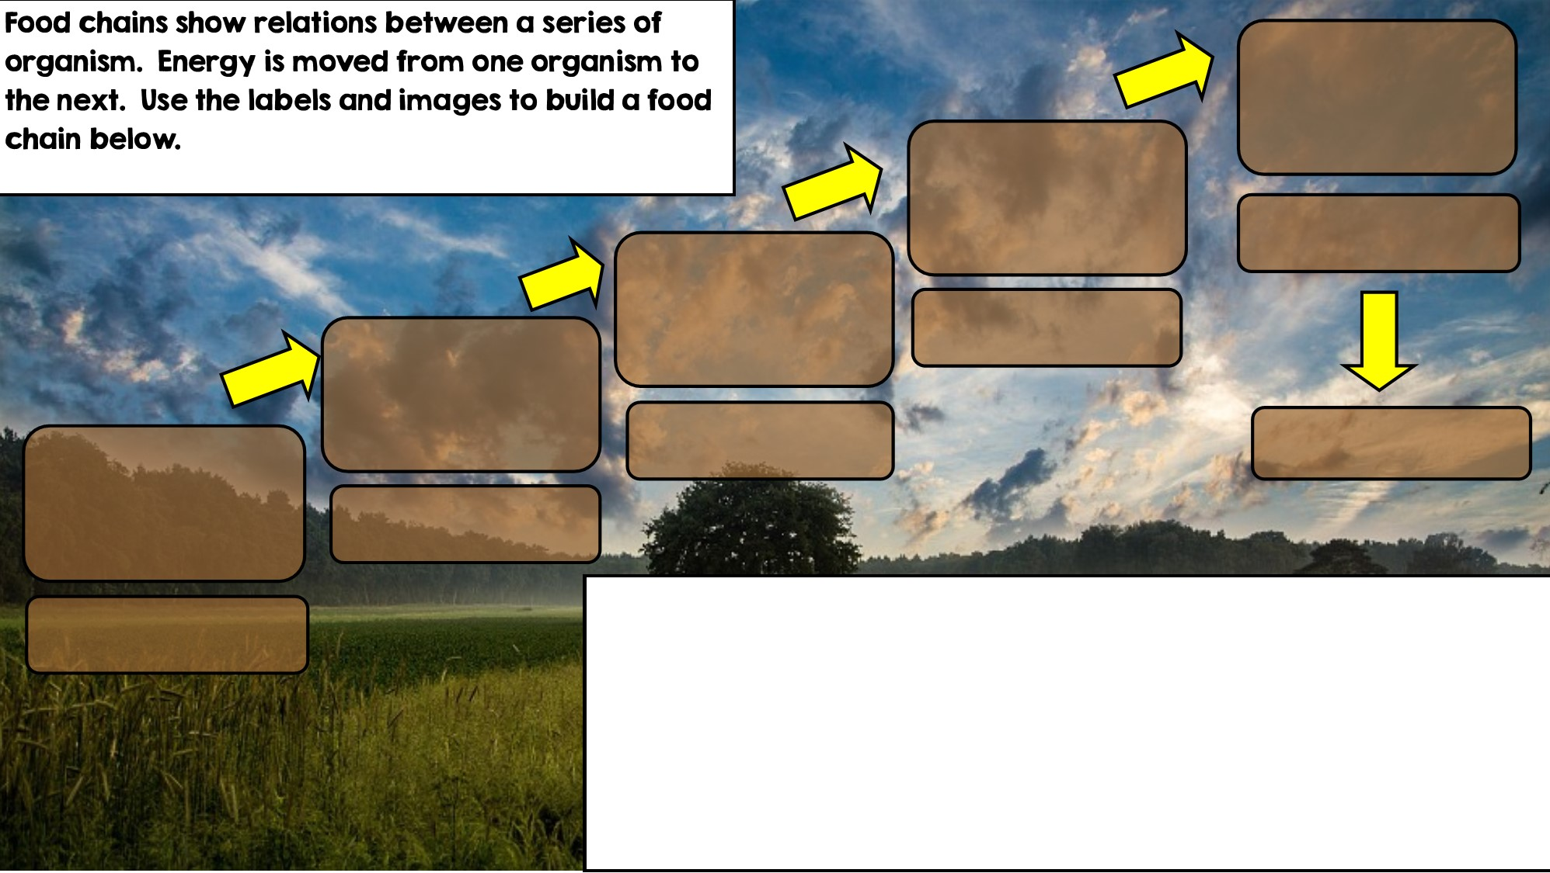

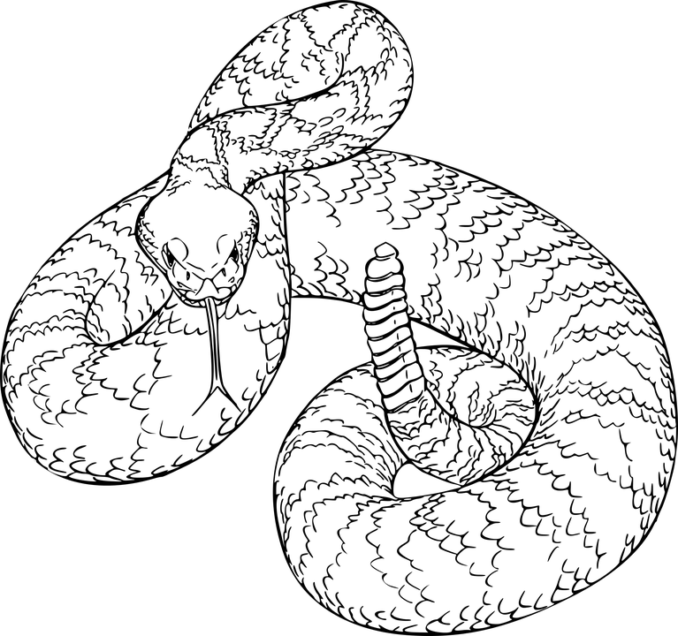
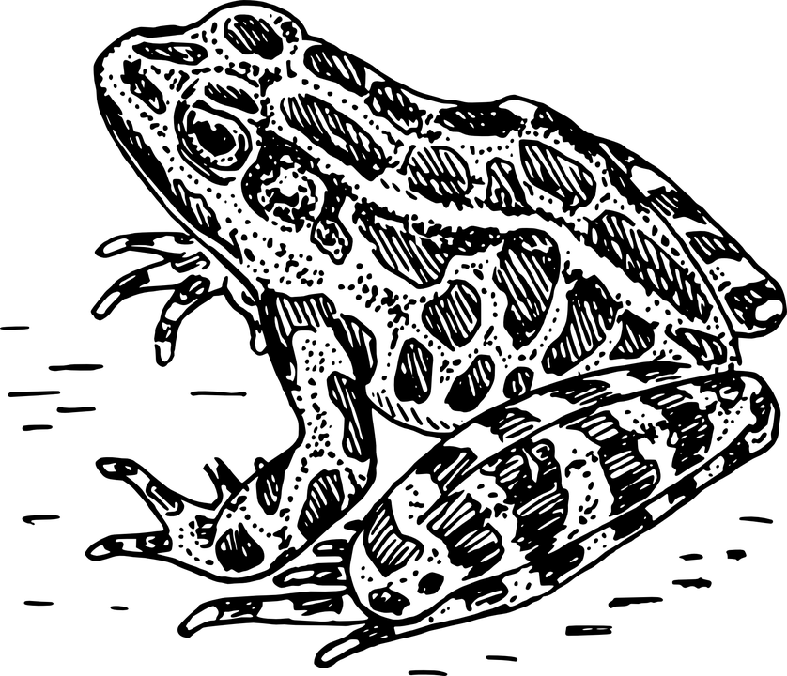
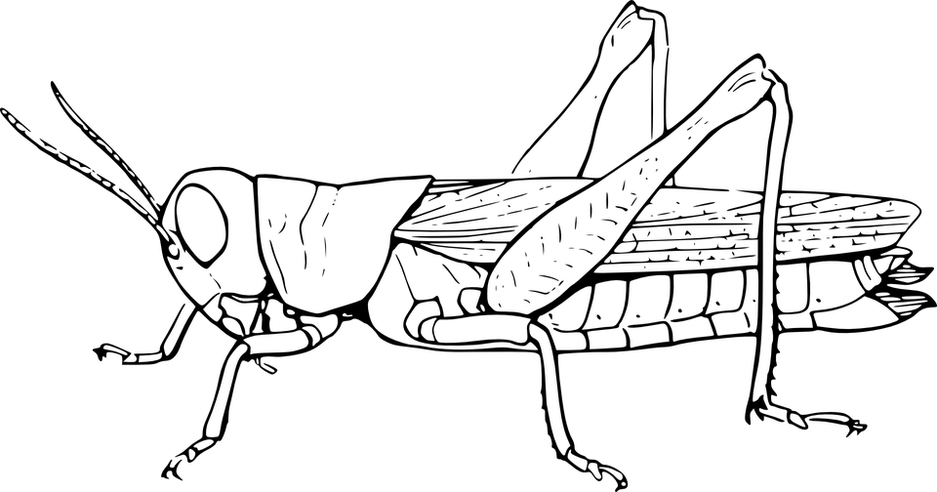

Apex Predator
Tertiary Consumer
Secondary Consumer
Decomposer
Primary Consumer: Heterotroph
Producer: Autotroph

Slide 4
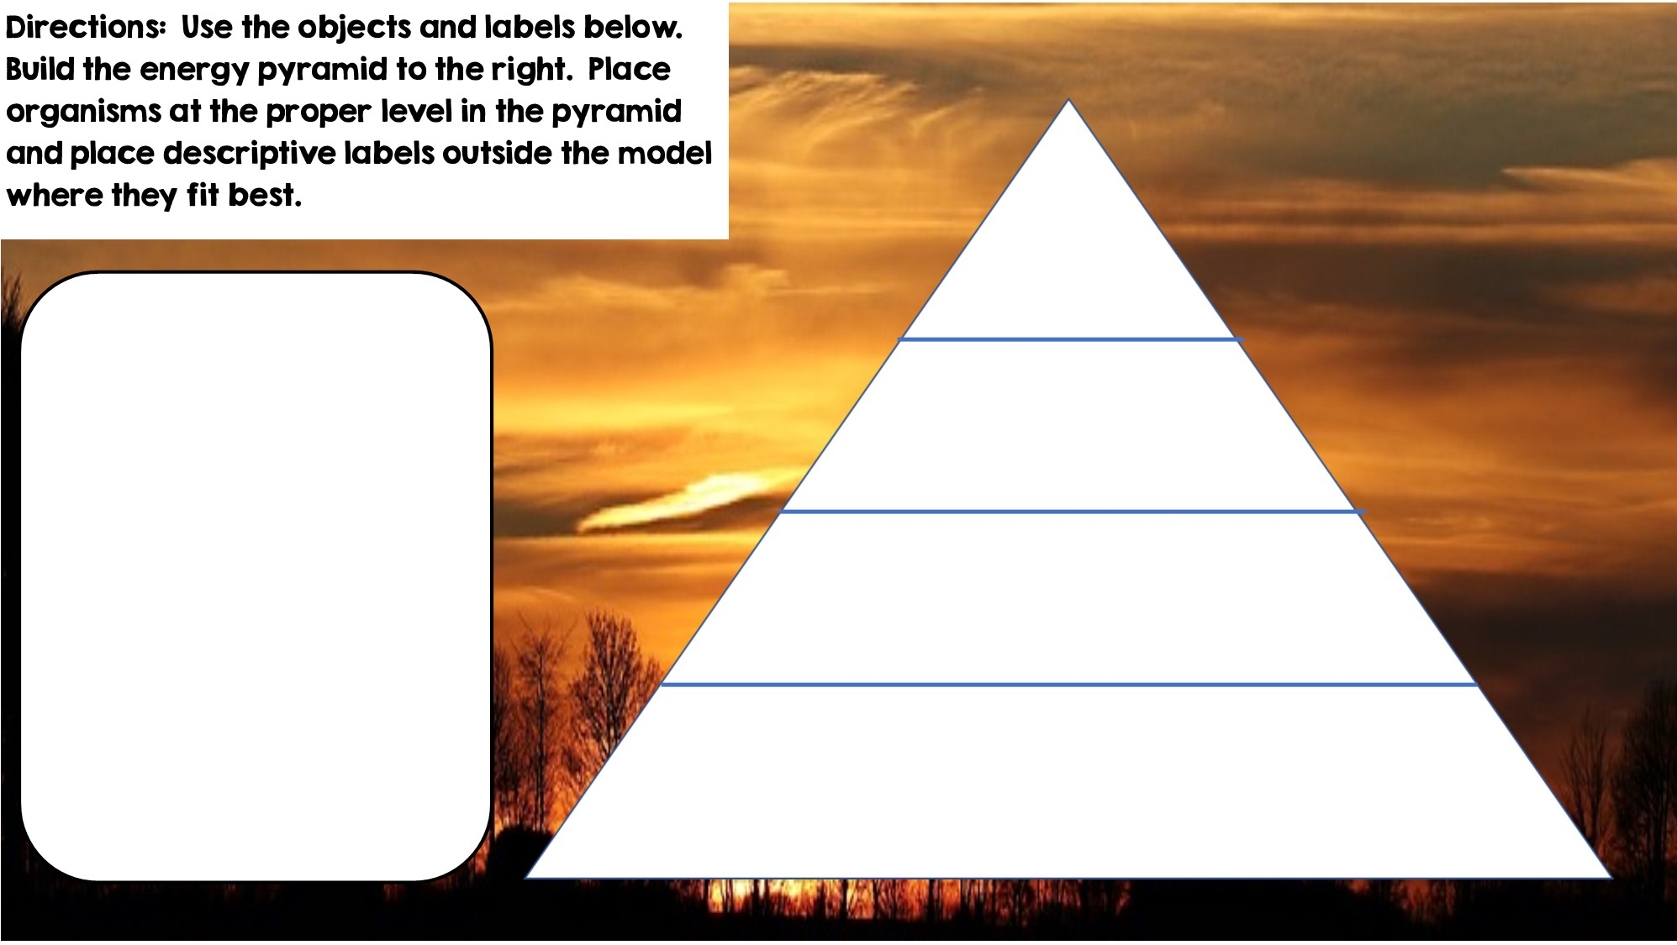
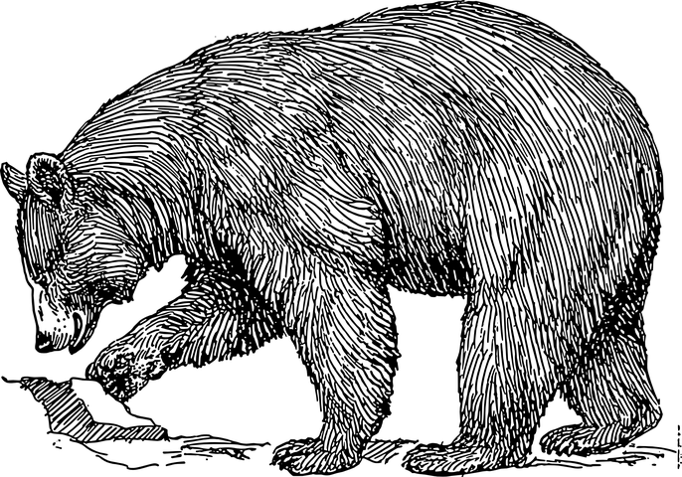
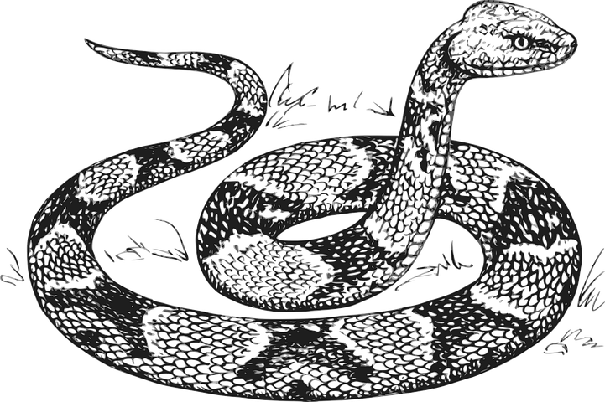







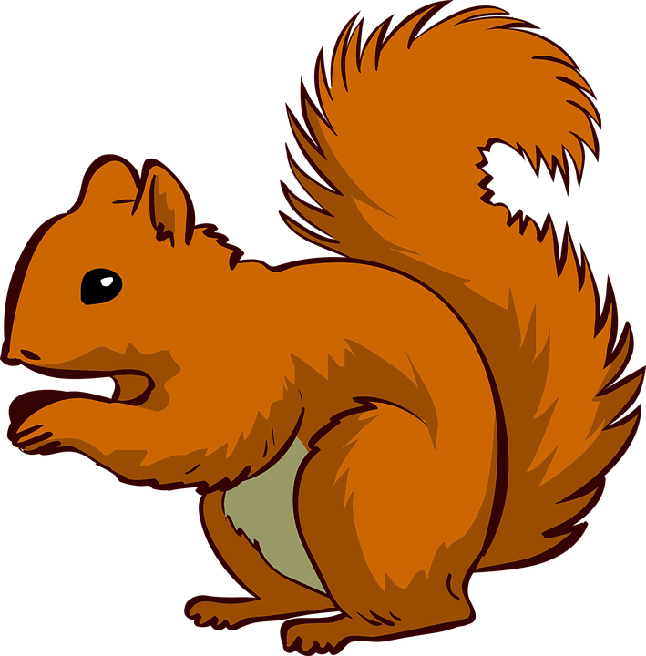

Only 10% of the energy from each tropic level is transferred
Tertiary Consumers
Heterotrophs
Heterotrophs
Secondary Consumers
Autotrophs
Heterotrophs
Primary Consumers
Producers

Slide 5
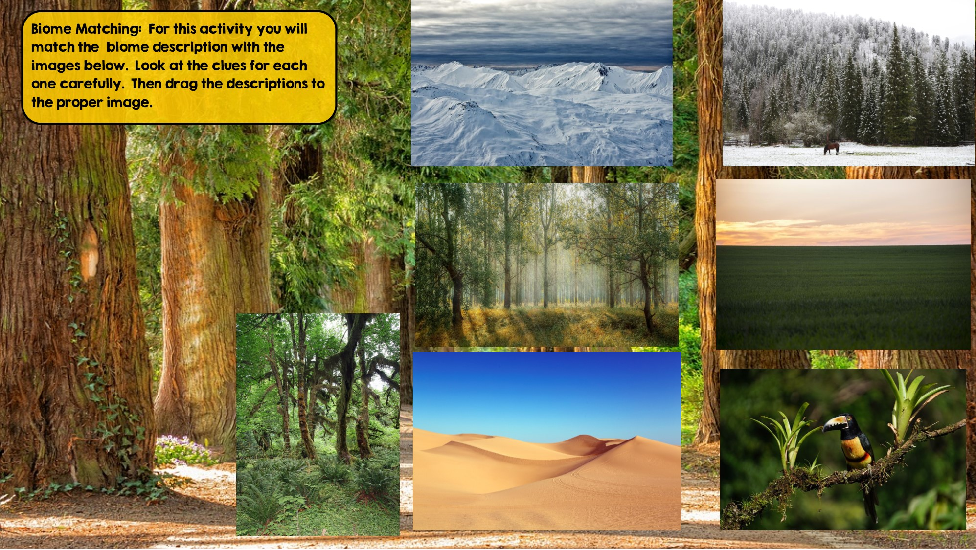
Tundra
Hint: Cold Desert
Taiga
Hint: Snowy Forest
Temperate Rainforest
Hint: Cool rainforest
Grassland
Hint: Very few trees grow
Temperate Deciduous Forest Hint: Four distinct seasons
Tropical Rainforest:
Hint: Found near equator
Desert
Hint: little to no water

Slide 6
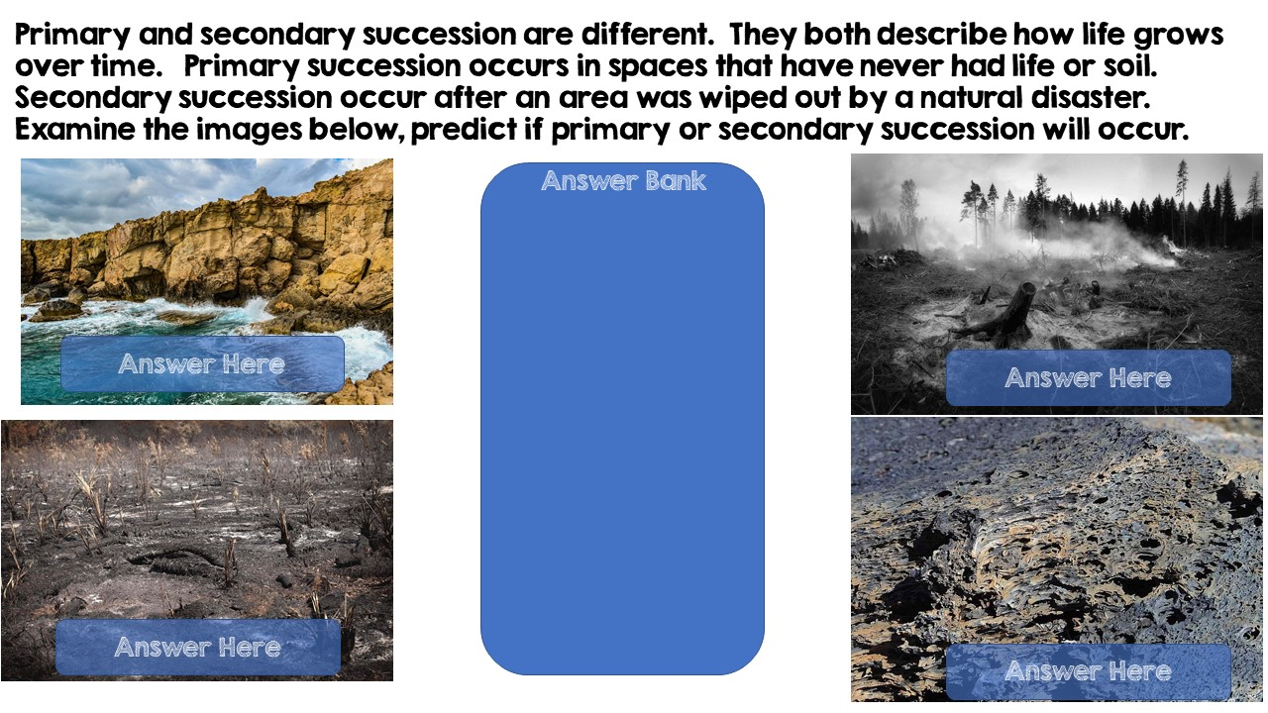
Primary Succession
Secondary Succession
Secondary Succession
Primary Succession

Slide 7
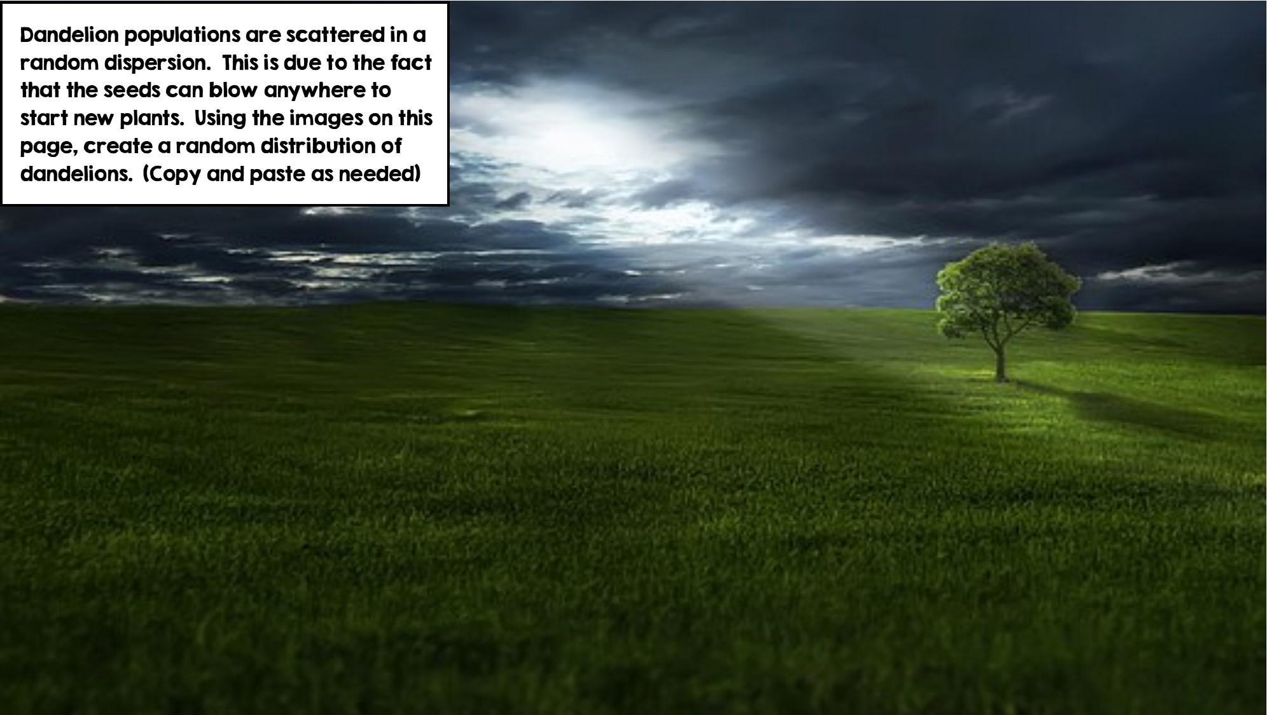
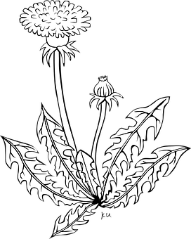

Slide 8
