Slide 1
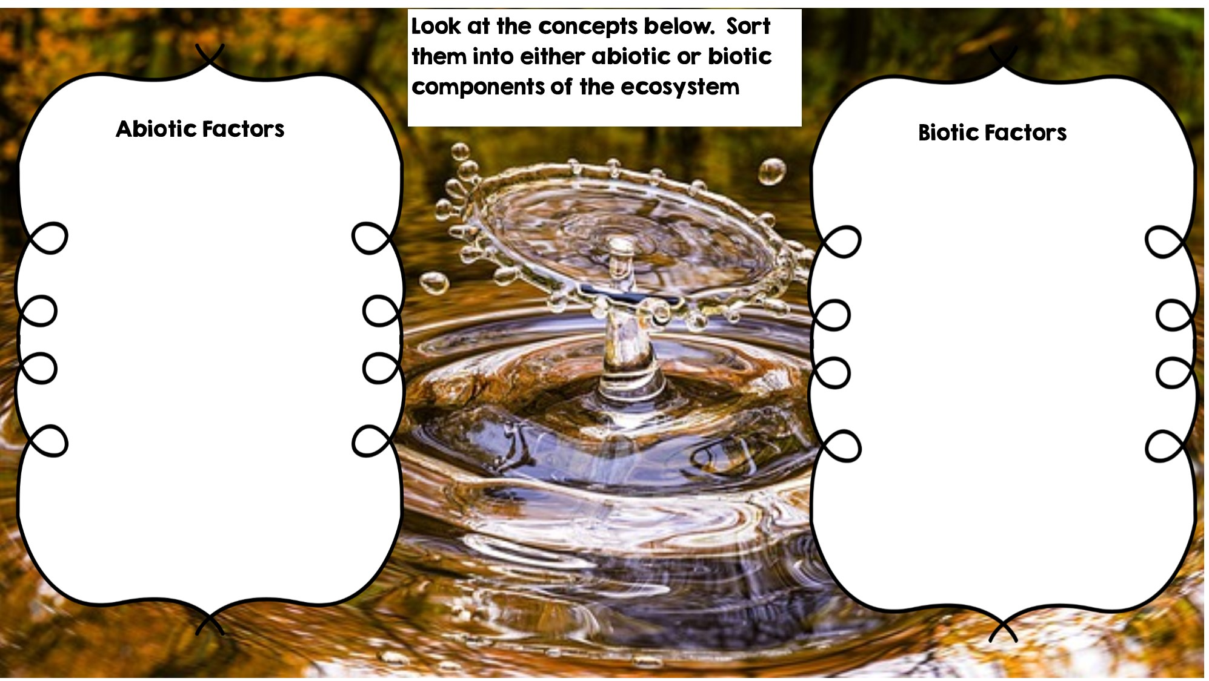
Rocks
Fox
Frog
Water
Flowers
Temperature
Dead Animal
Sunlight
Grass
Rotting Log
Deer

Slide 2
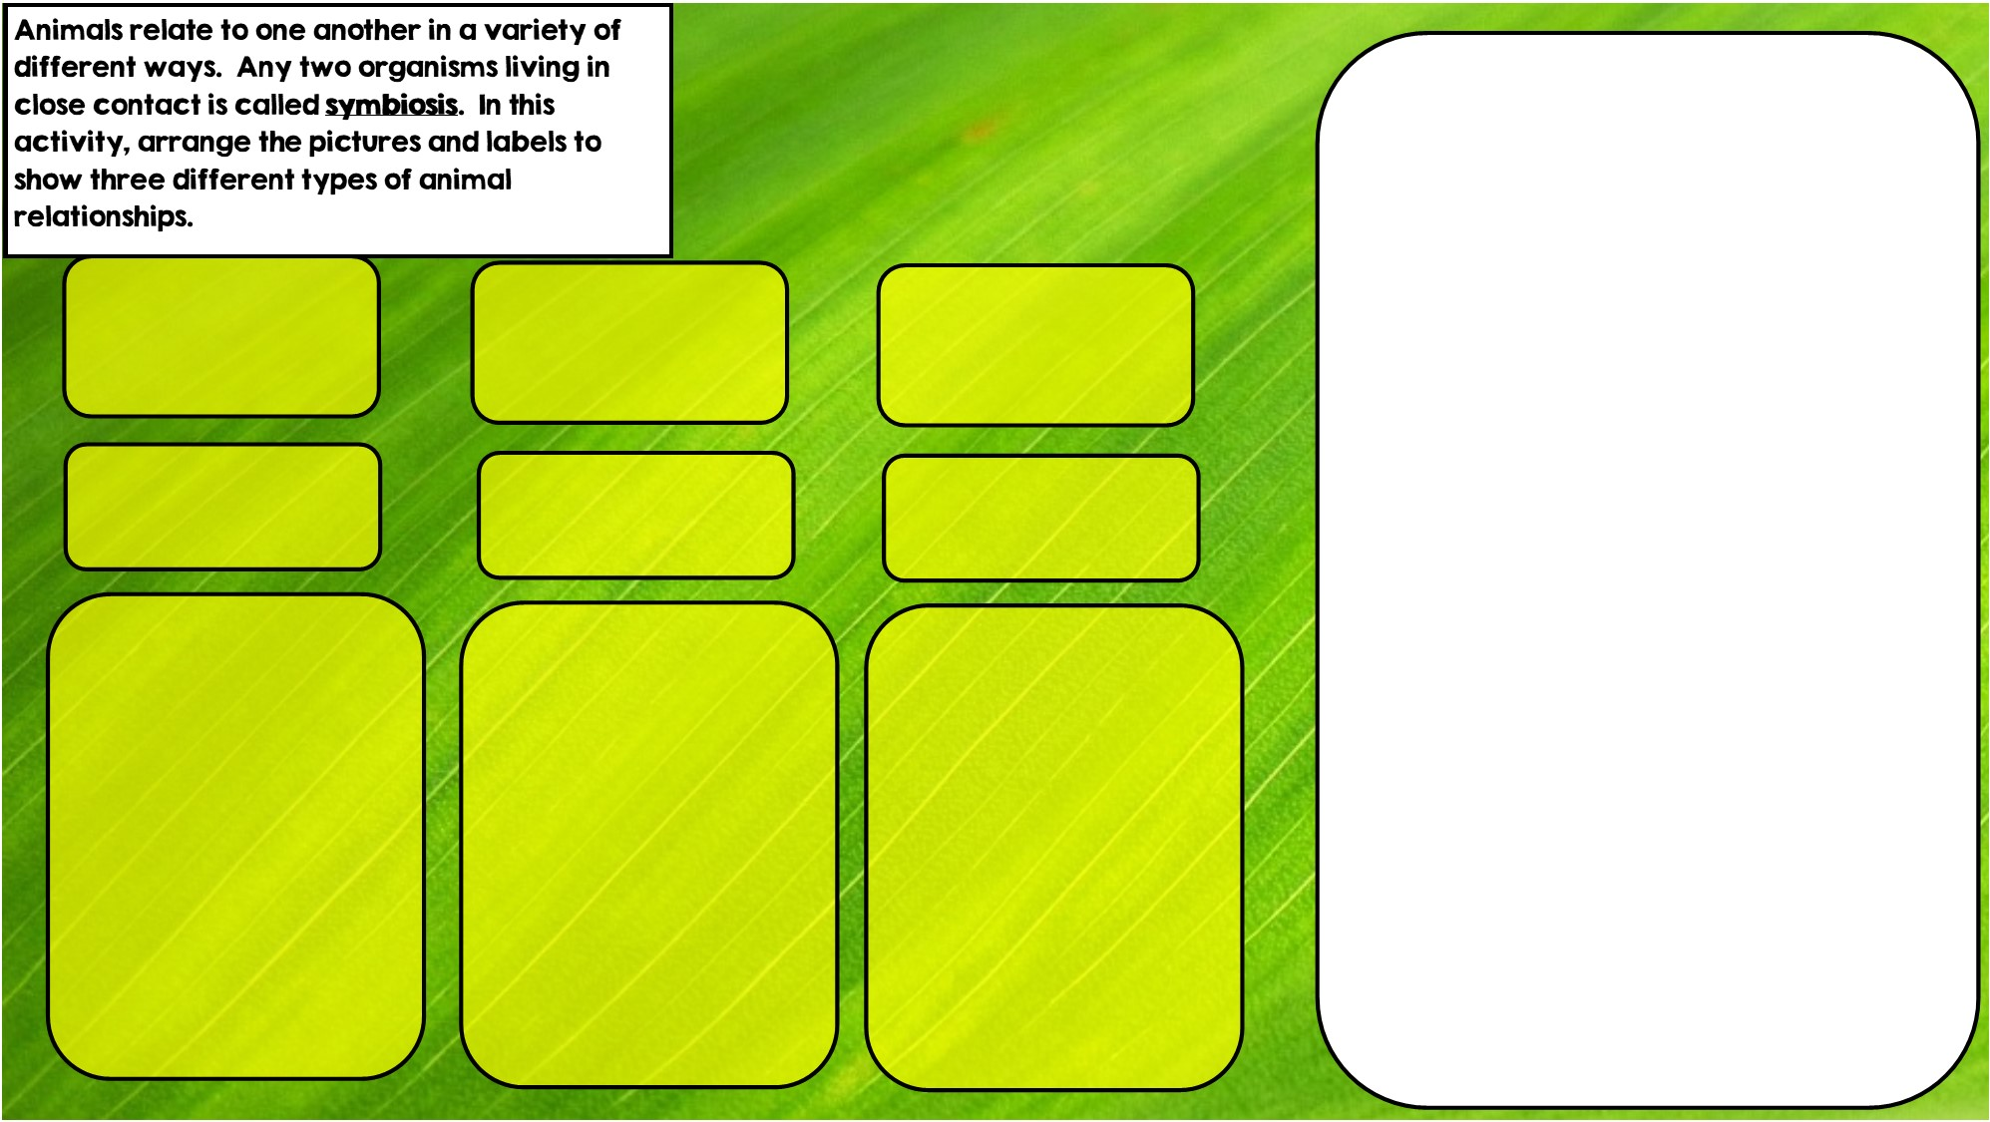

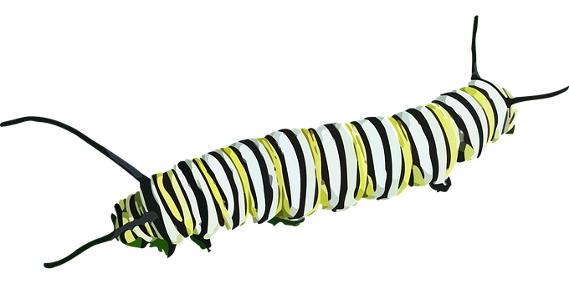

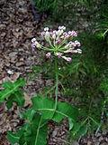
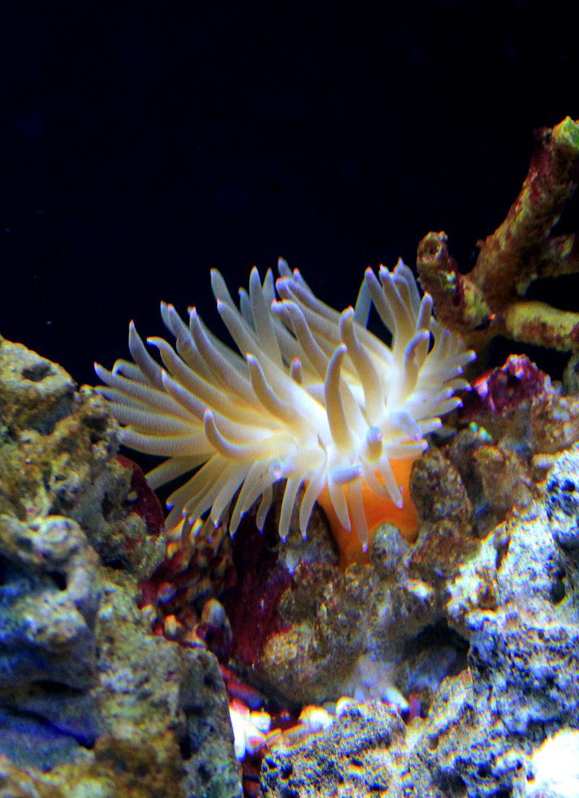

Hint: I eat toxic leaves
Hint: I live in stingers
Hint: I live in intestines
Commensalism is where one organism benefits and doesn’t hurt the other.
Mutualism is where both organisms benefit
Parasitism is where one organisms benefits and the other is hurt

Slide 3
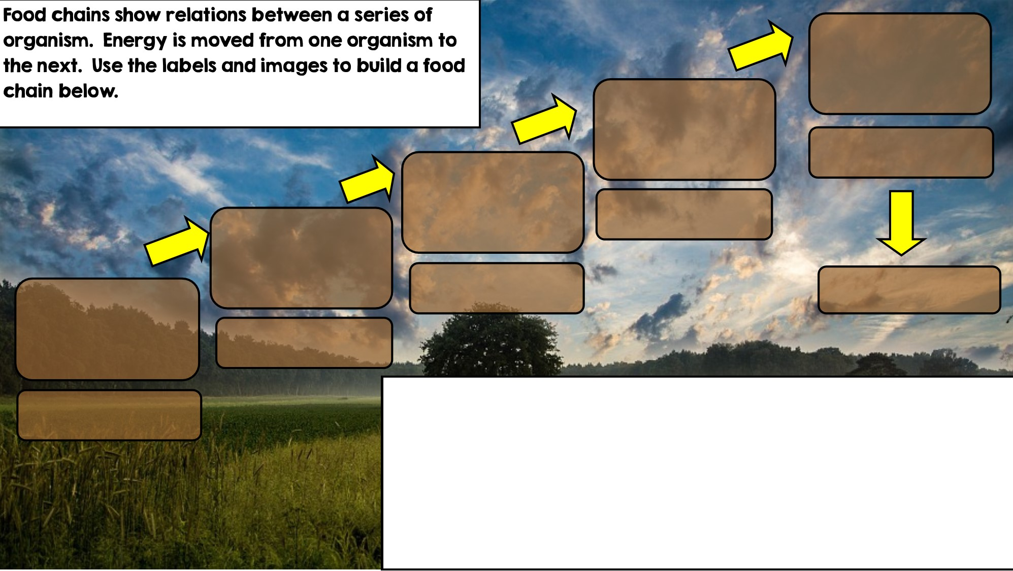

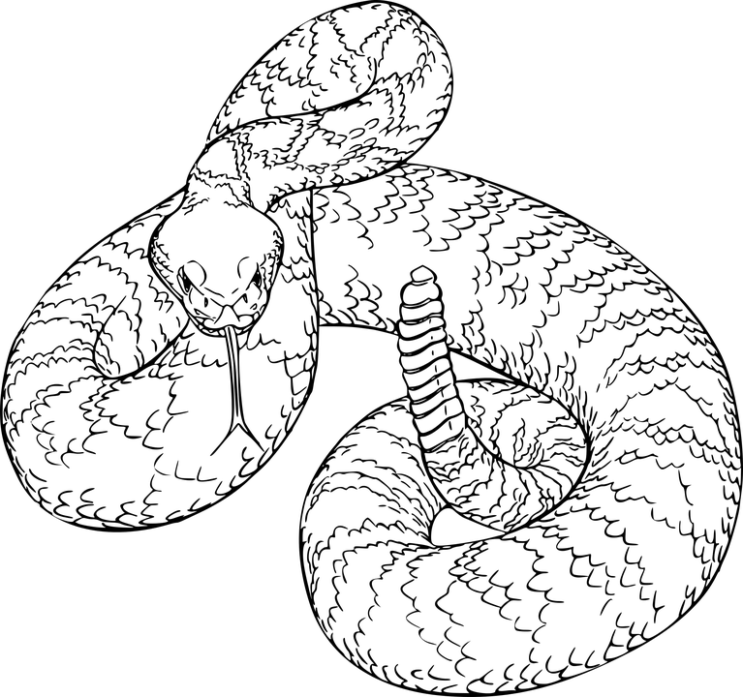
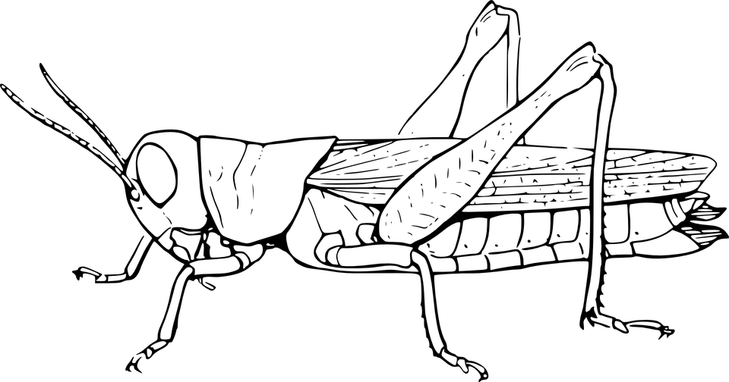

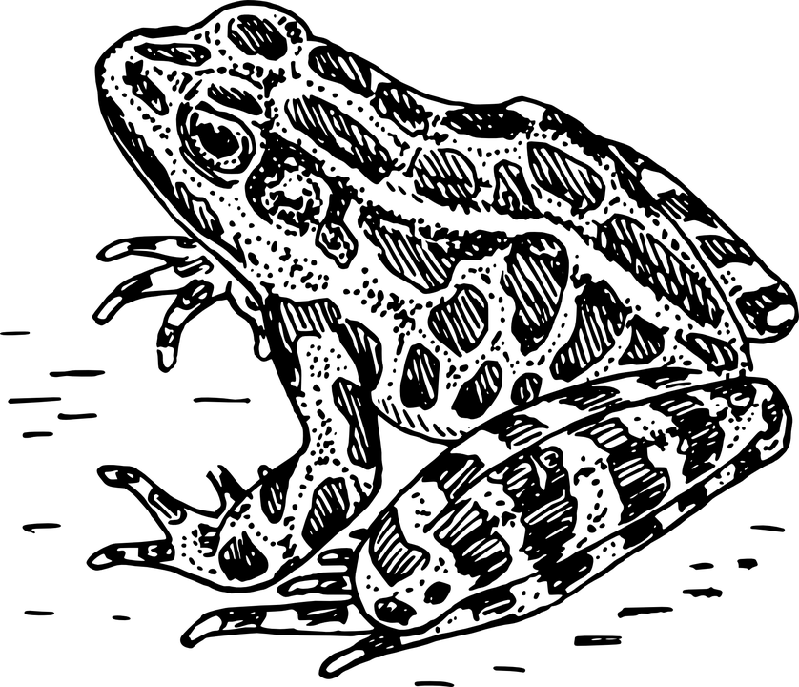
Producer: Autotroph
Secondary Consumer
Primary Consumer: Heterotroph
Decomposer
Tertiary Consumer
Apex Predator

Slide 4
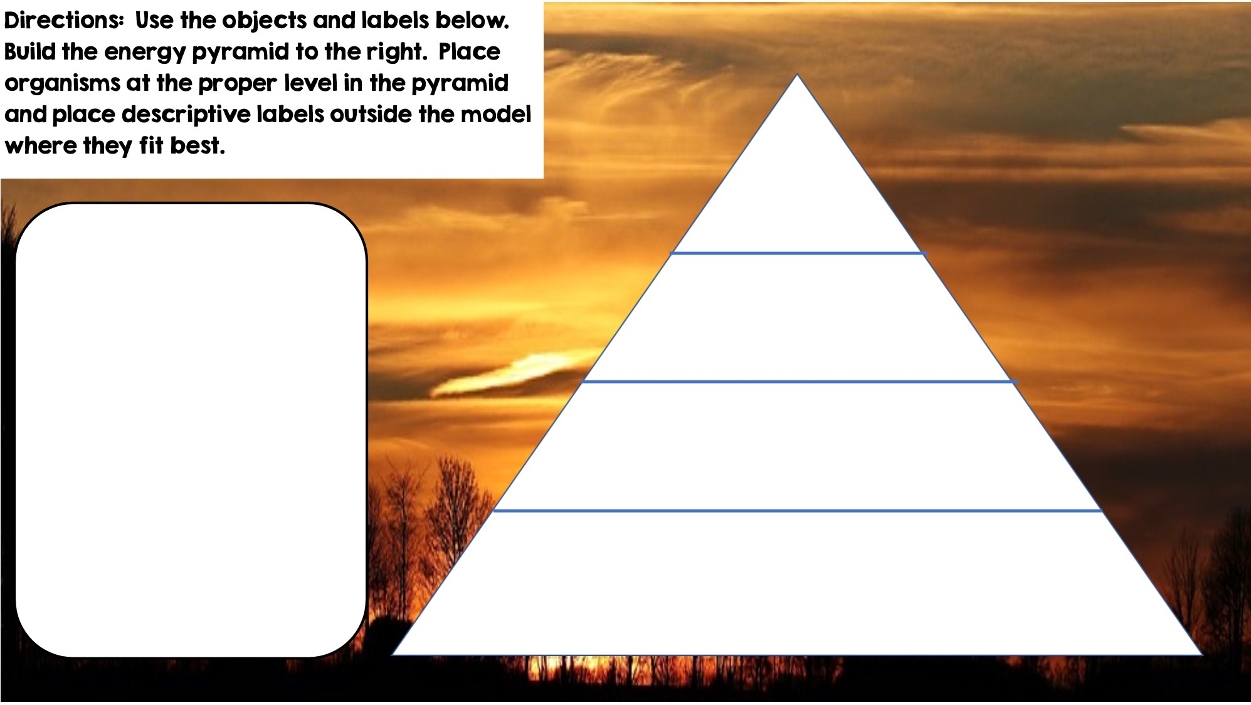
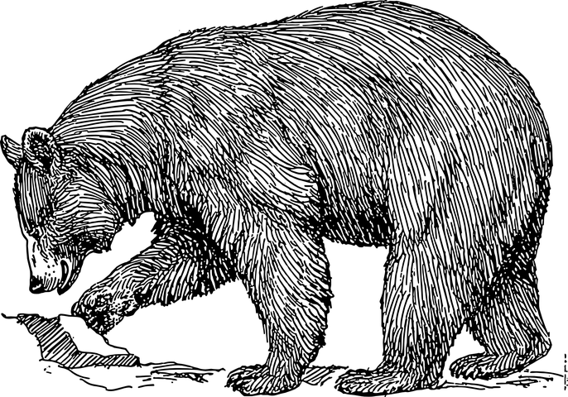


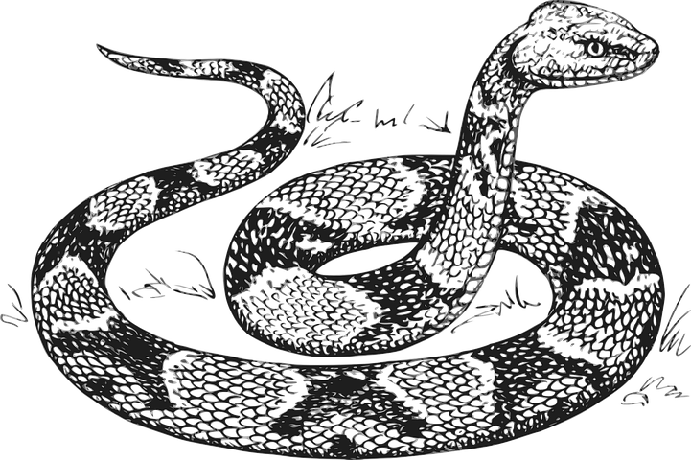
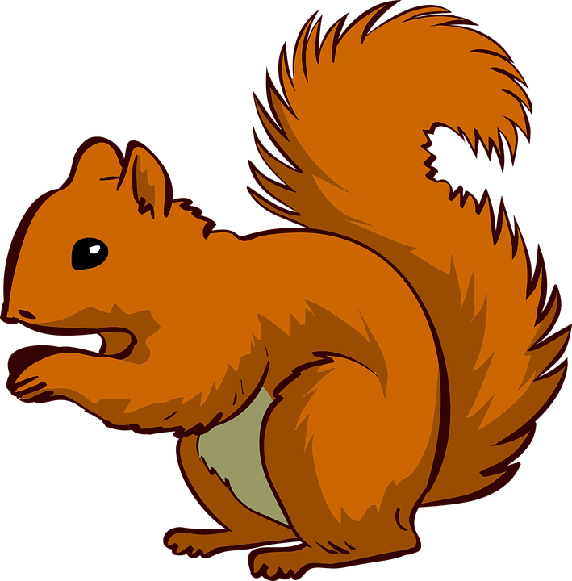






Only 10% of the energy from each tropic level is transferred
Tertiary Consumers
Producers
Secondary Consumers
Primary Consumers
Heterotrophs
Heterotrophs
Autotrophs
Heterotrophs

Slide 5
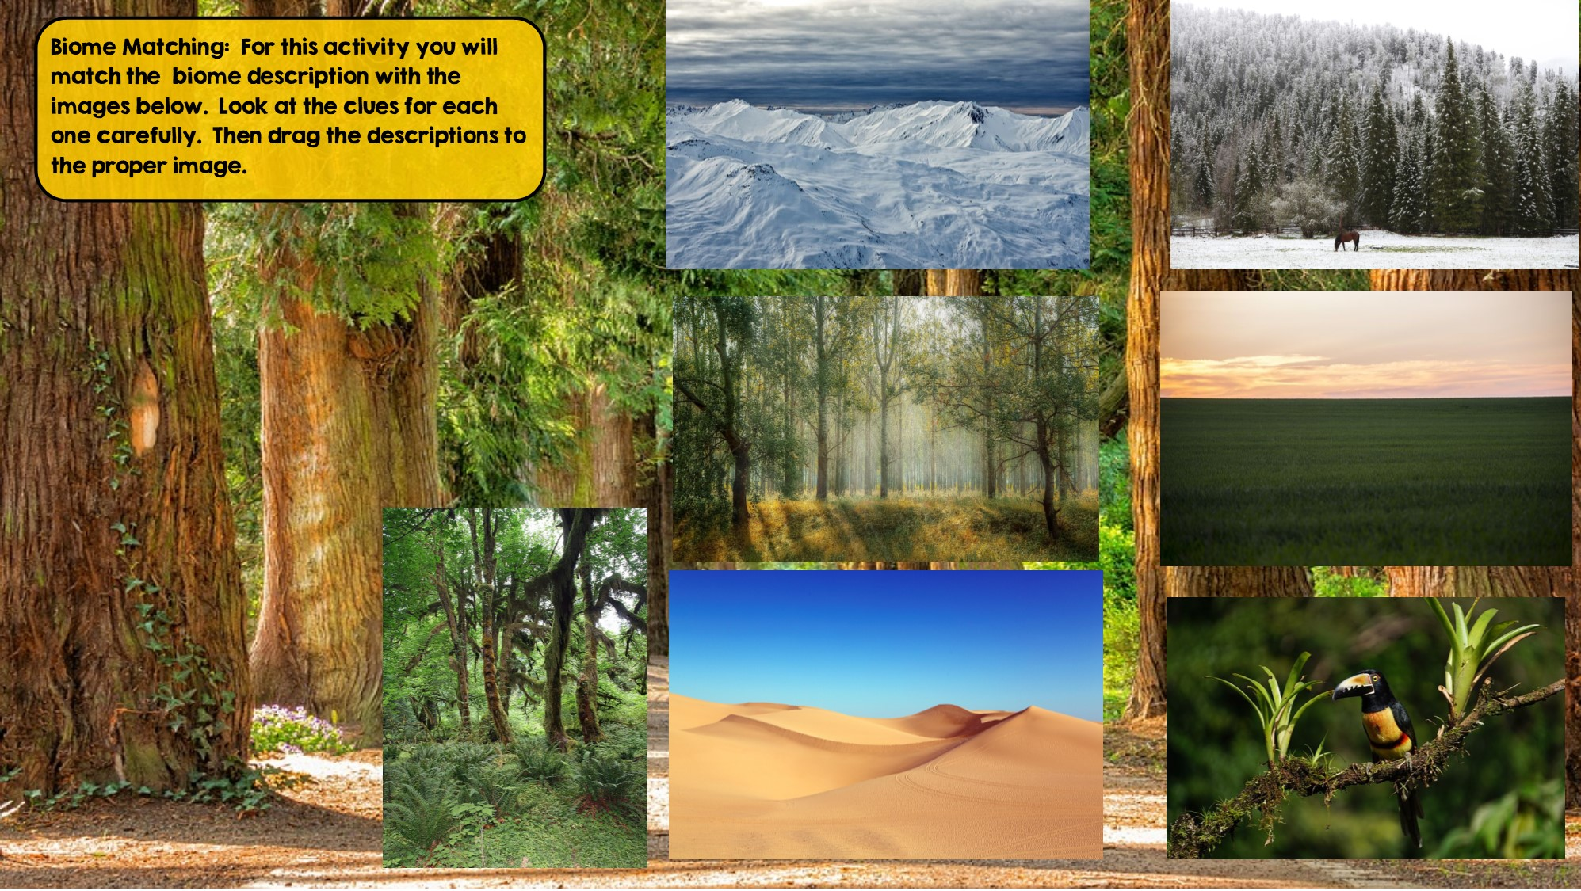
Tundra
Hint: Cold Desert
Taiga
Hint: Snowy Forest
Tropical Rainforest:
Hint: Found near equator
Grassland
Hint: Very few trees grow
Temperate Rainforest
Hint: Cool rainforest
Desert
Hint: little to no water
Temperate Deciduous Forest Hint: Four distinct seasons

Slide 6
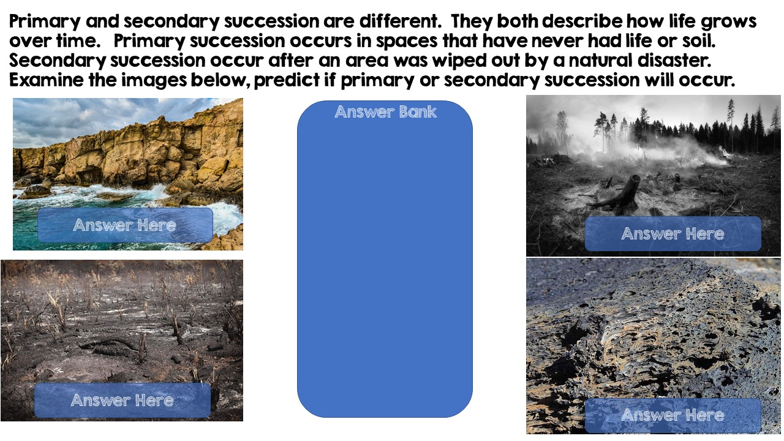
Primary Succession
Secondary Succession
Secondary Succession
Primary Succession

Slide 7
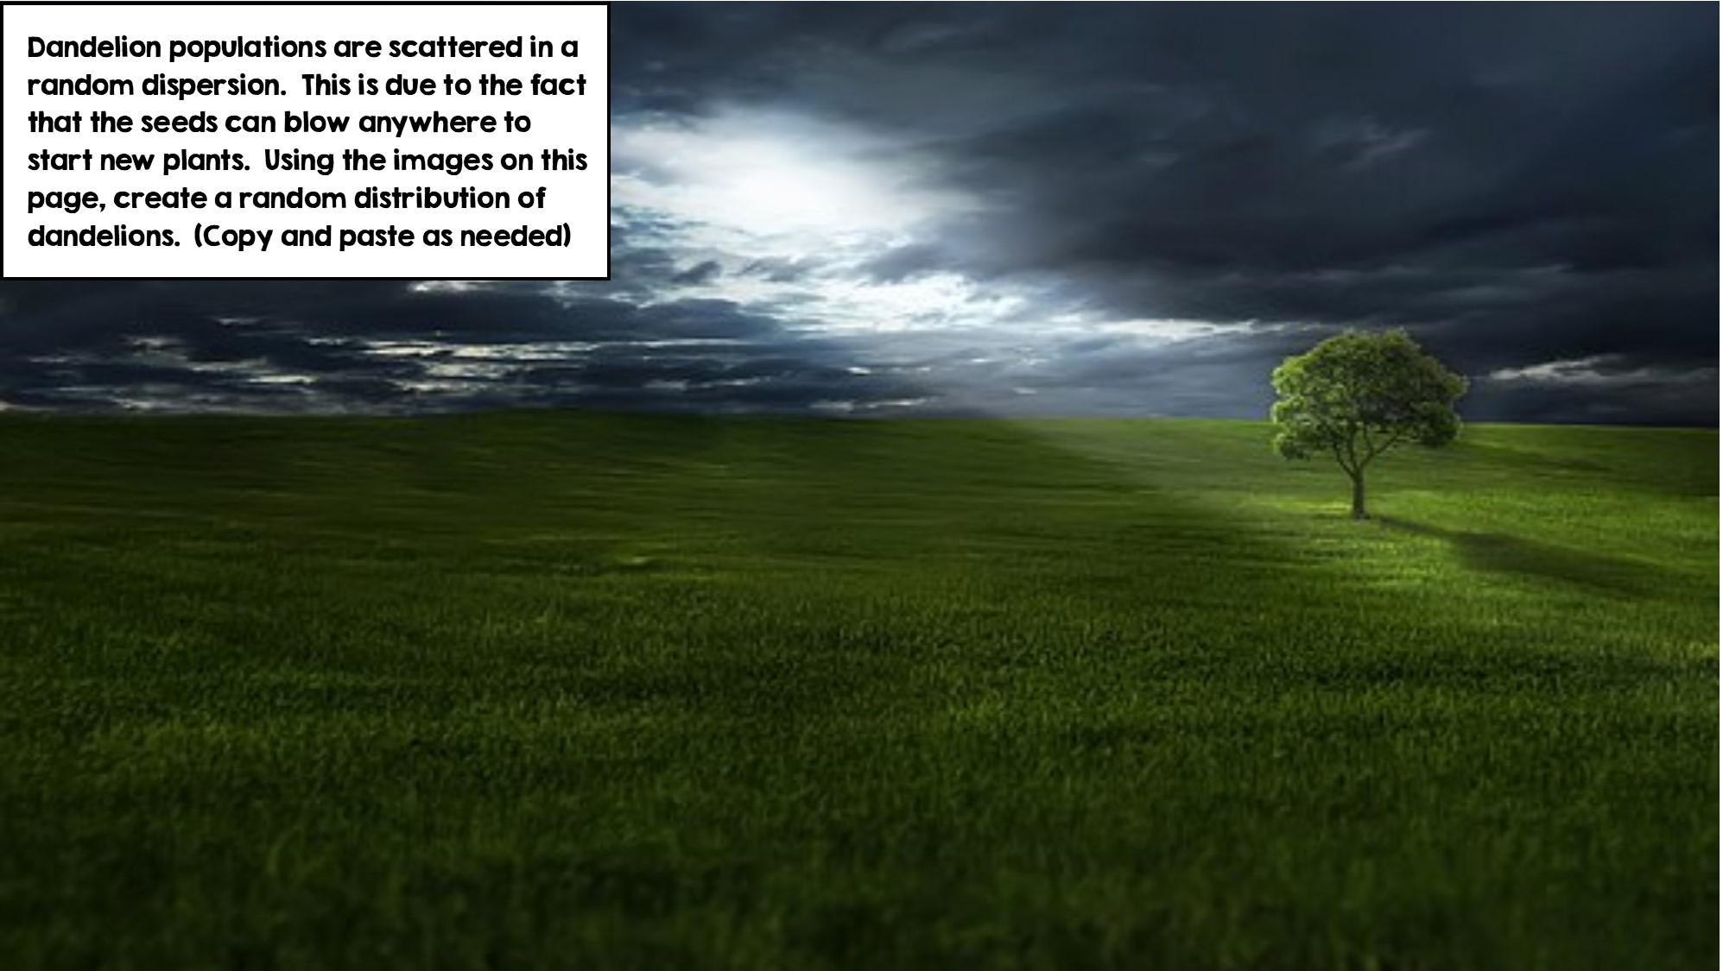
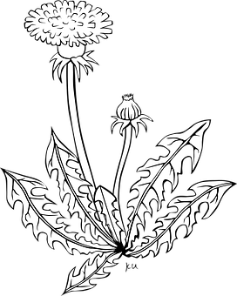

Slide 8
