Slide 1
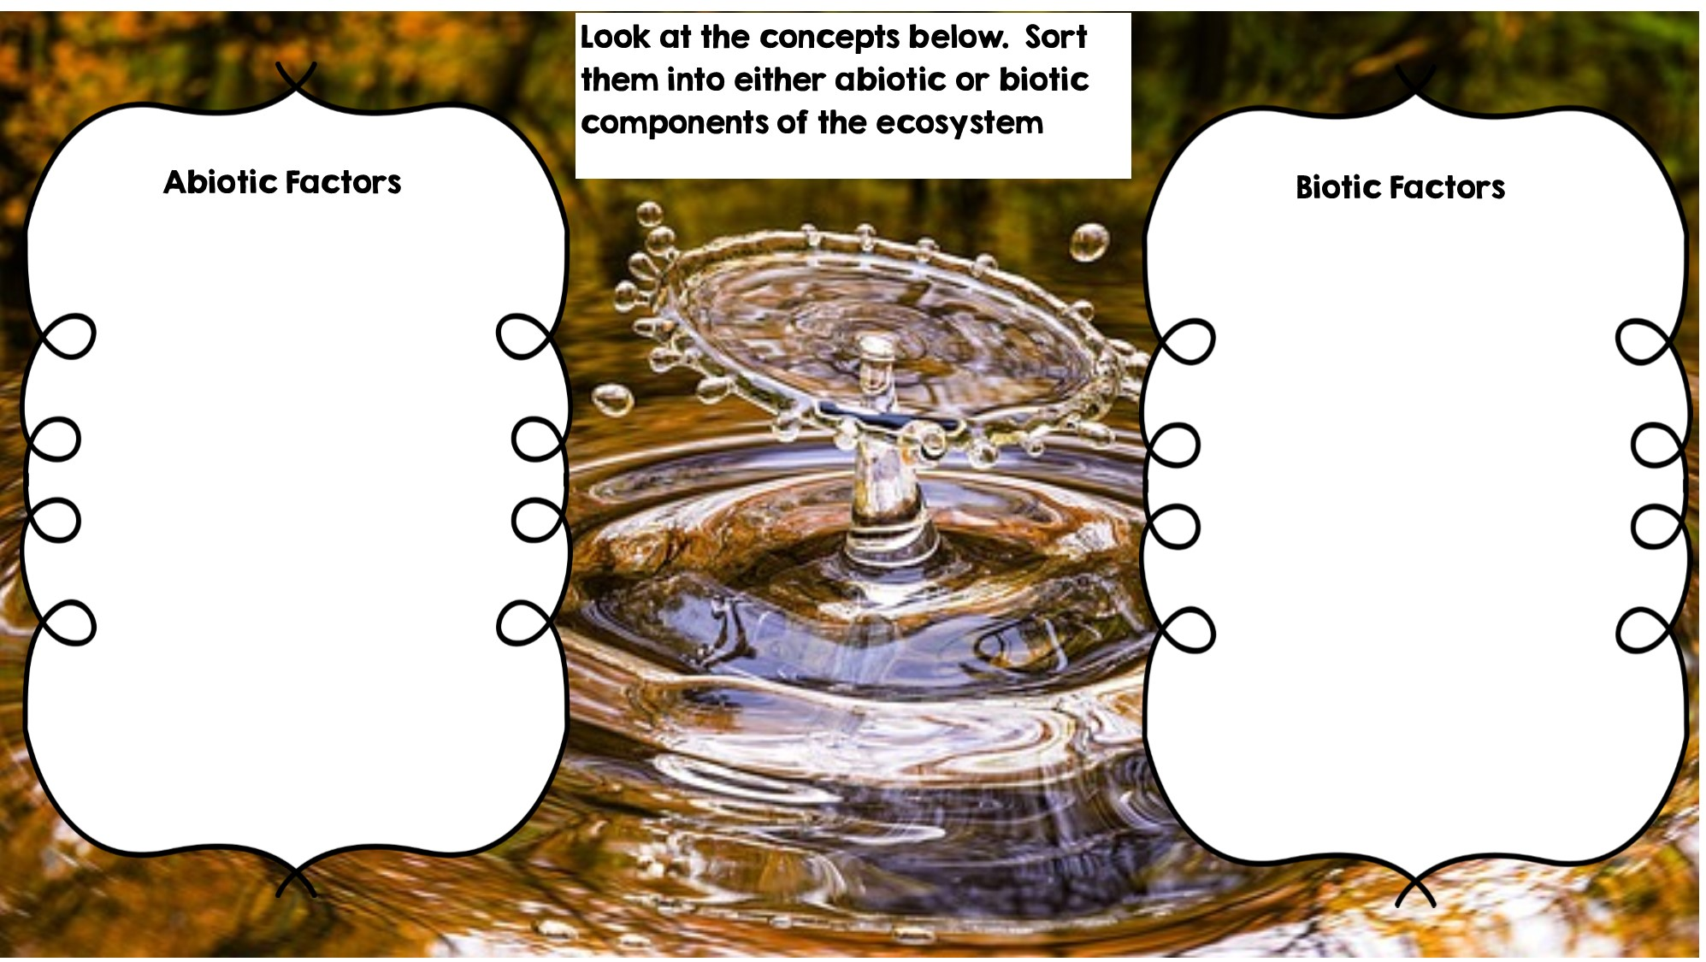
Rocks
Frog
Fox
Temperature
Water
Flowers
Rotting Log
Dead Animal
Grass
Sunlight
Deer

Slide 2
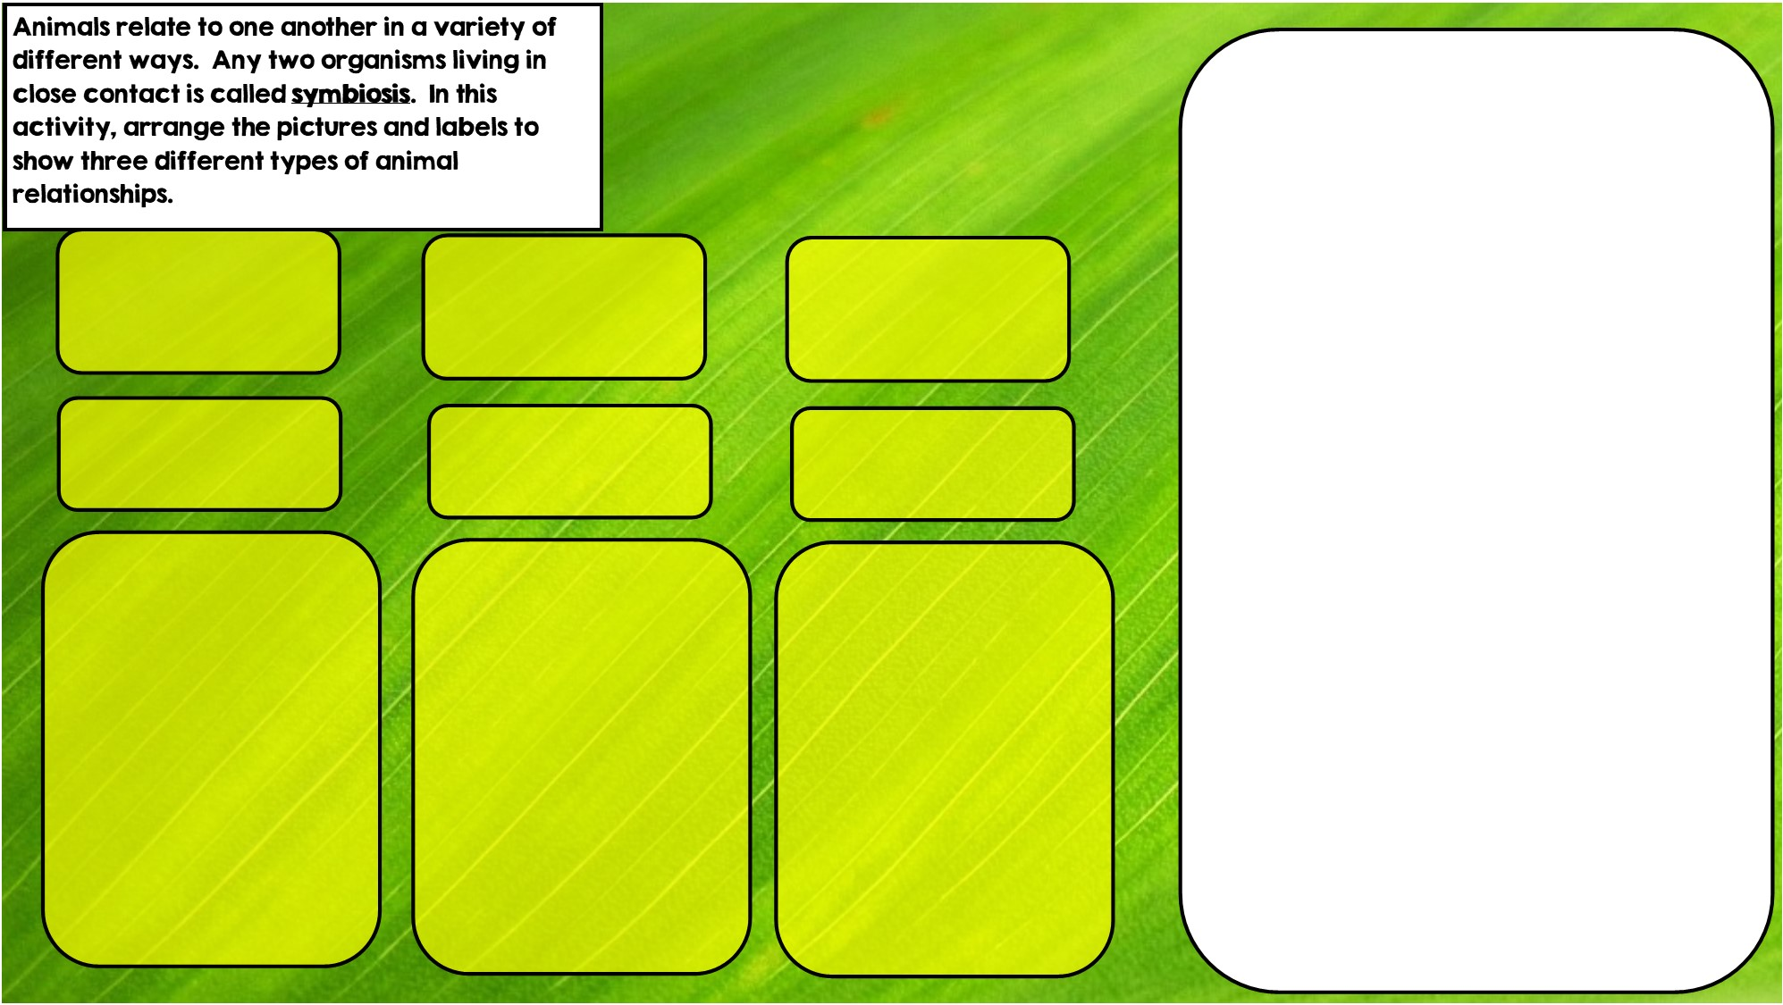
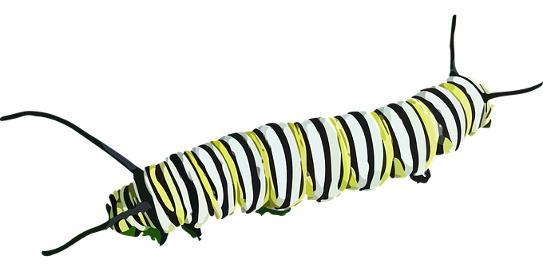


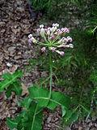
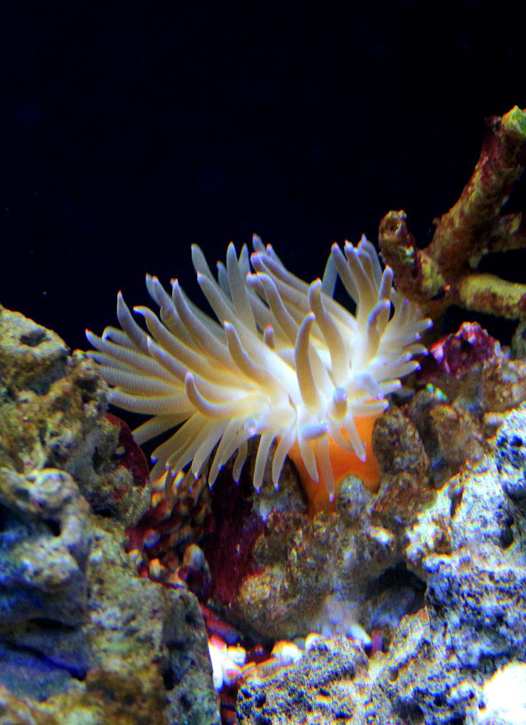

Hint: I live in stingers
Hint: I live in intestines
Hint: I eat toxic leaves
Commensalism is where one organism benefits and doesn’t hurt the other.
Mutualism is where both organisms benefit
Parasitism is where one organisms benefits and the other is hurt

Slide 3
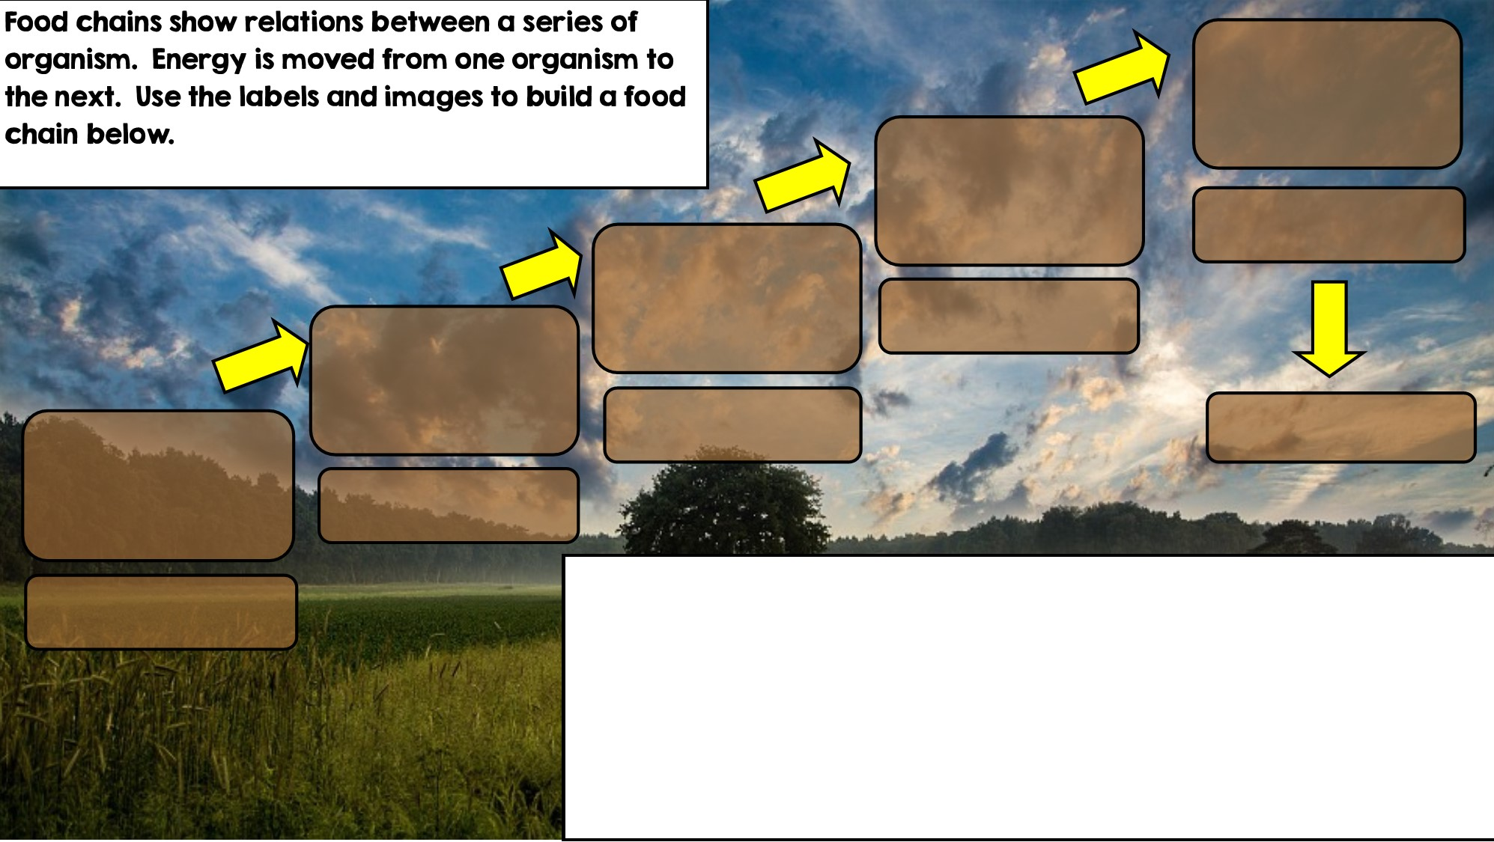

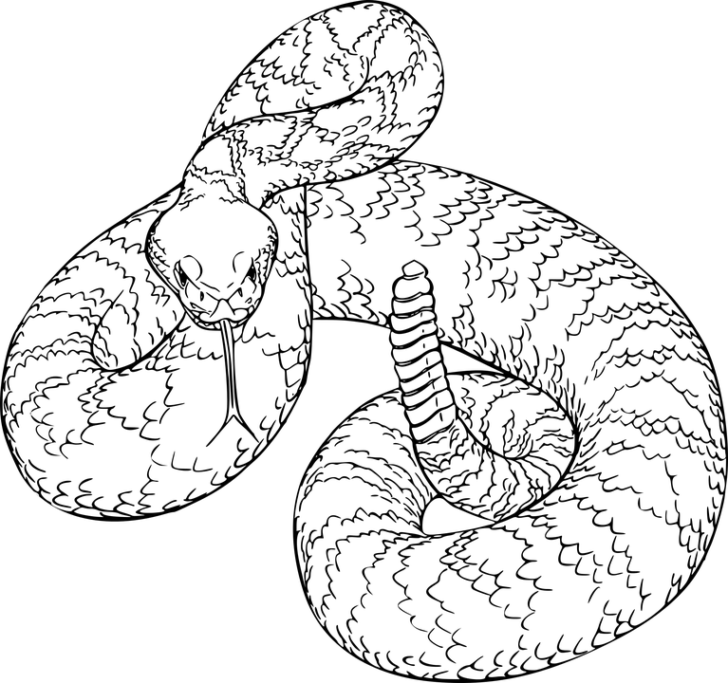
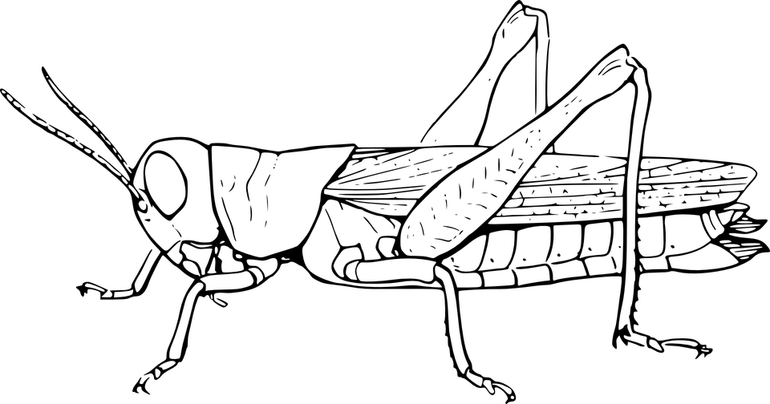

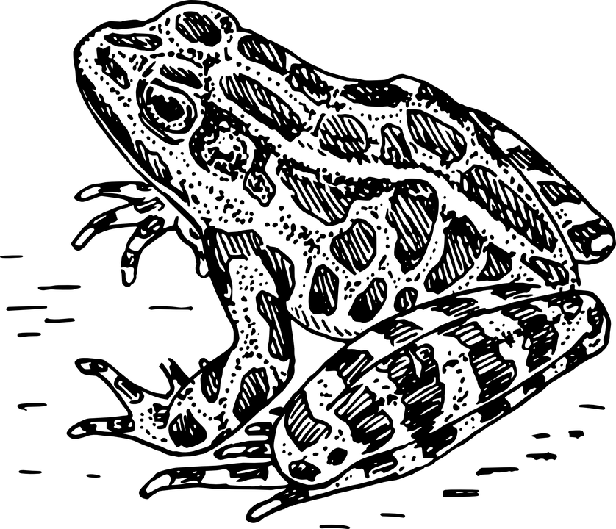
Producer: Autotroph
Secondary Consumer
Primary Consumer: Heterotroph
Decomposer
Tertiary Consumer
Apex Predator

Slide 4
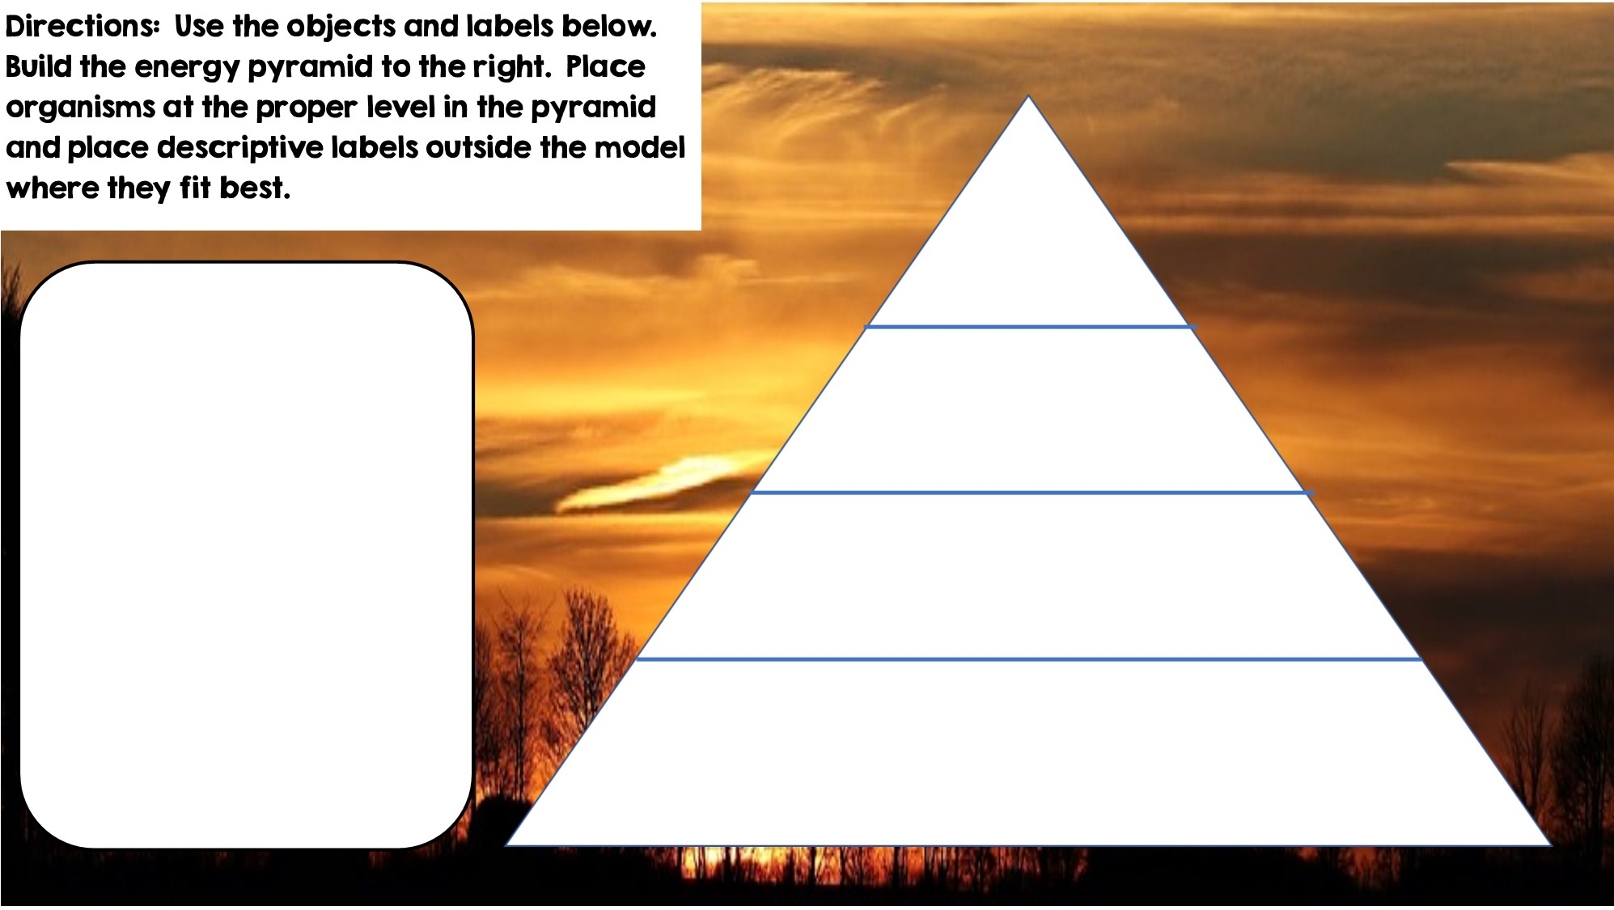



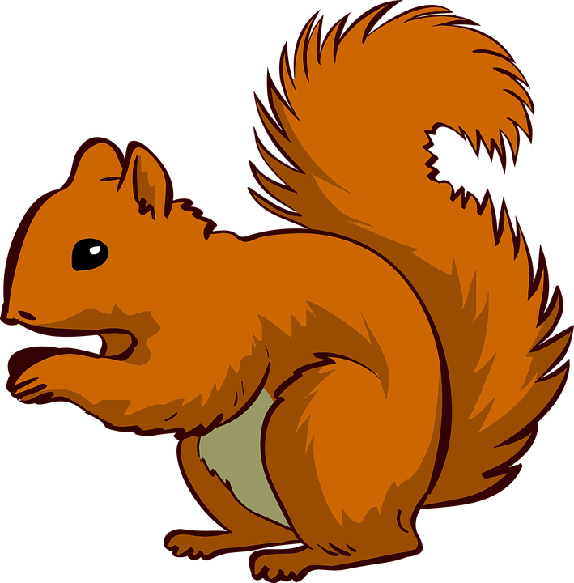


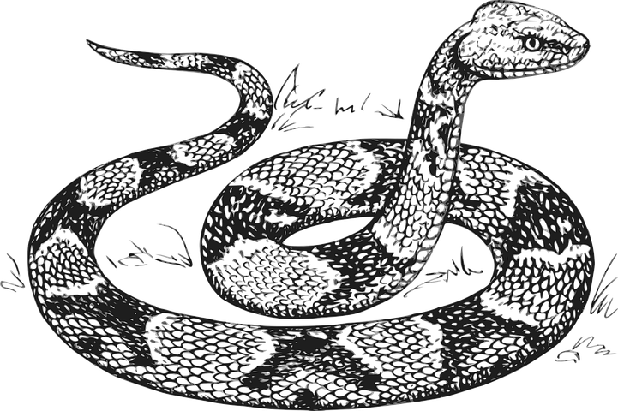


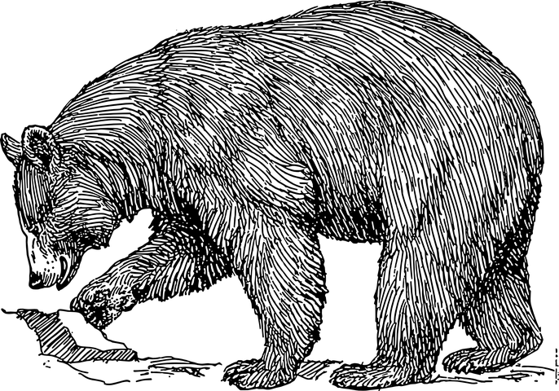

Only 10% of the energy from each tropic level is transferred
Tertiary Consumers
Producers
Secondary Consumers
Primary Consumers
Heterotrophs
Heterotrophs
Autotrophs
Heterotrophs

Slide 5
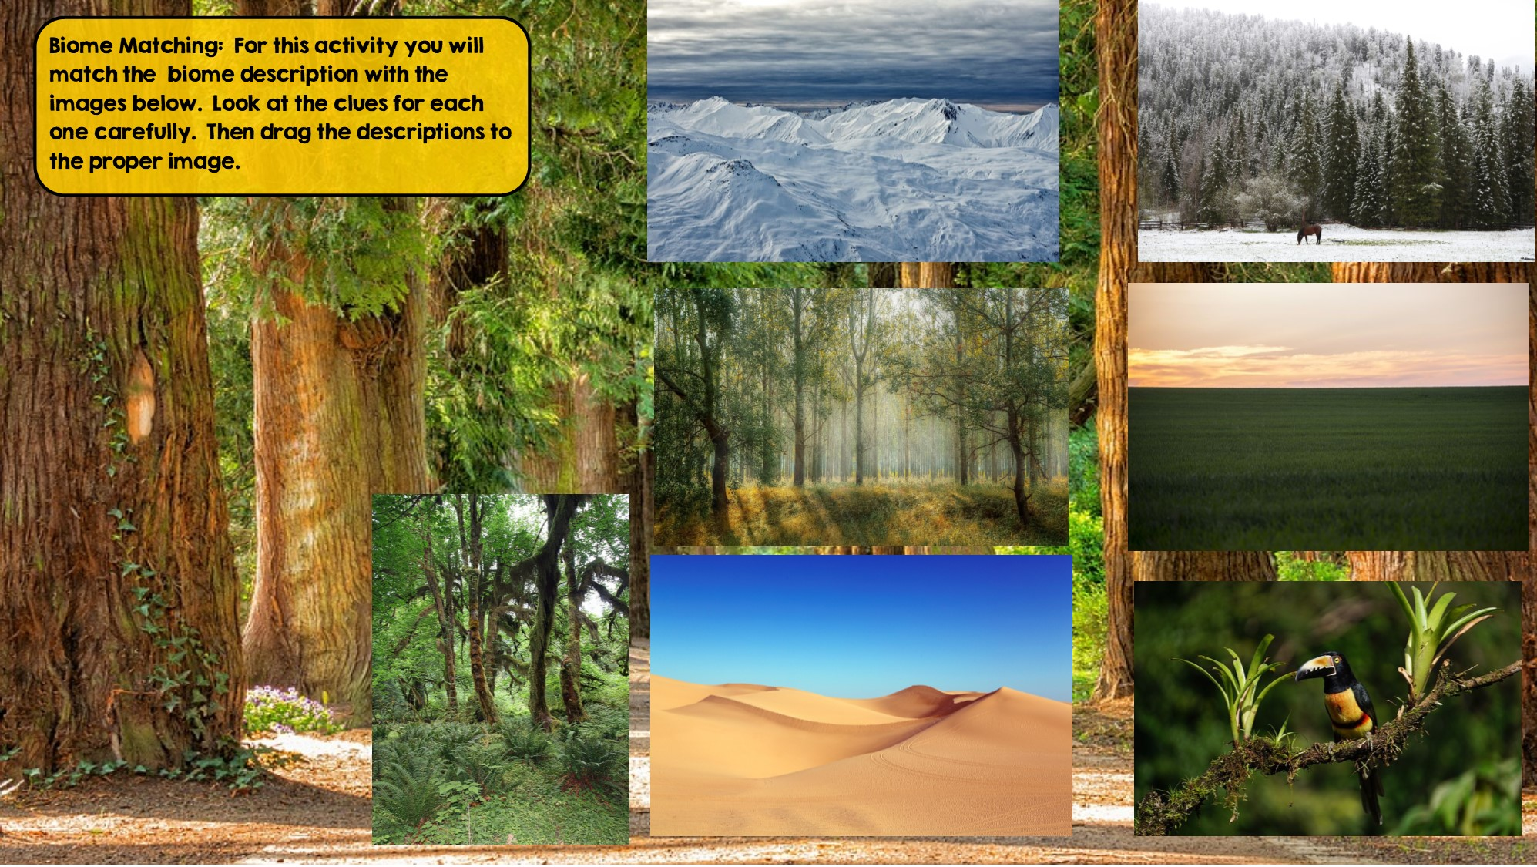
Taiga
Hint: Snowy Forest
Grassland
Hint: Very few trees grow
Tundra
Hint: Cold Desert
Tropical Rainforest:
Hint: Found near equator
Temperate Deciduous Forest Hint: Four distinct seasons
Desert
Hint: little to no water
Temperate Rainforest
Hint: Cool rainforest

Slide 6
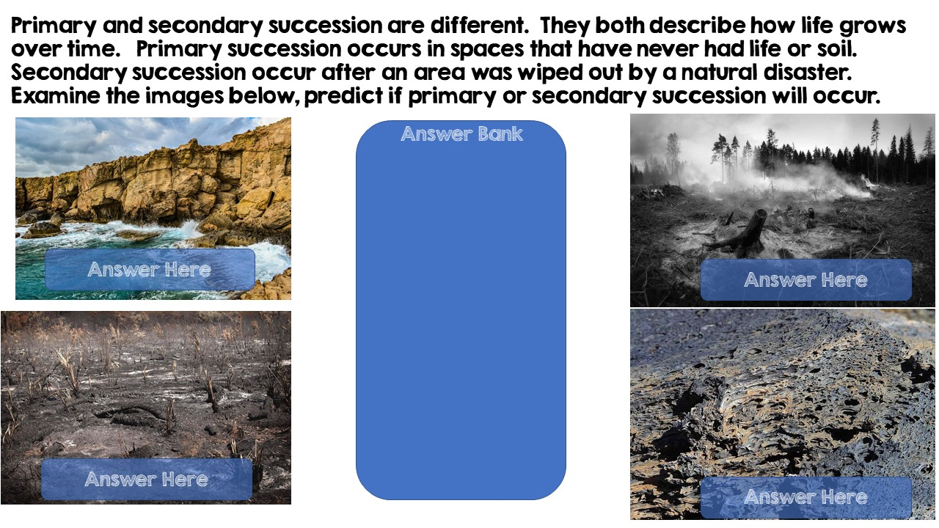
Primary Succession
Primary Succession
Secondary Succession
Secondary Succession

Slide 7
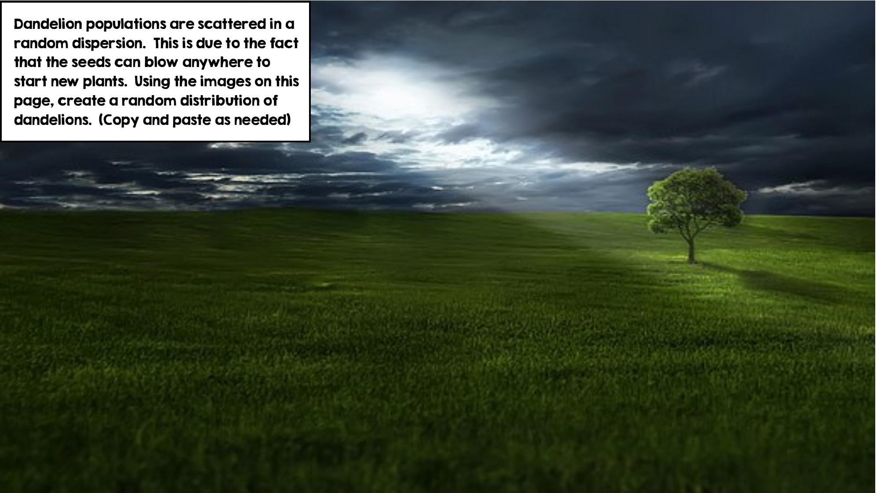
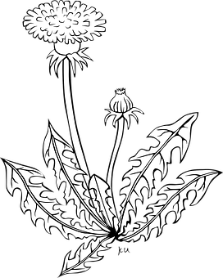

Slide 8
