Slide 1
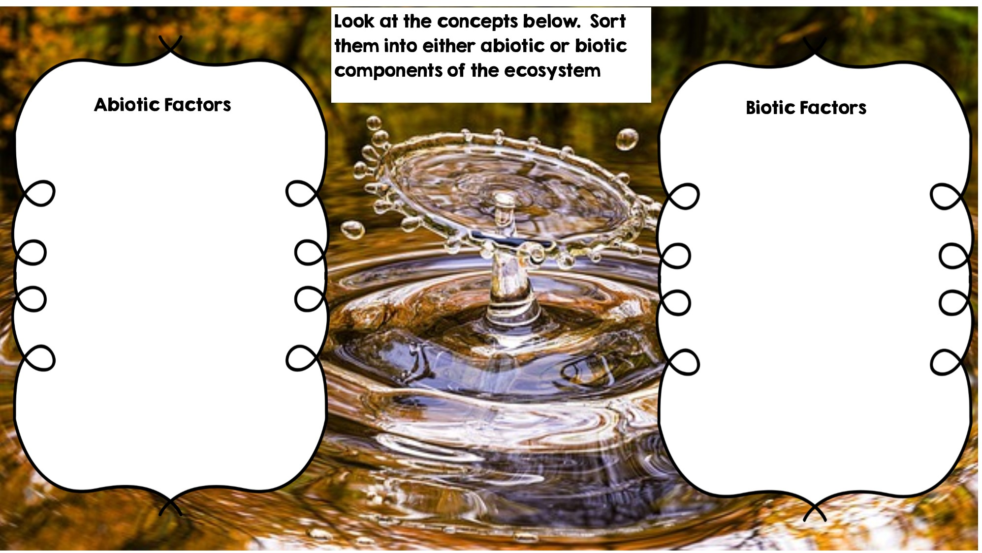
Rocks
Frog
Fox
Temperature
Water
Flowers
Rotting Log
Dead Animal
Grass
Sunlight
Deer

Slide 2
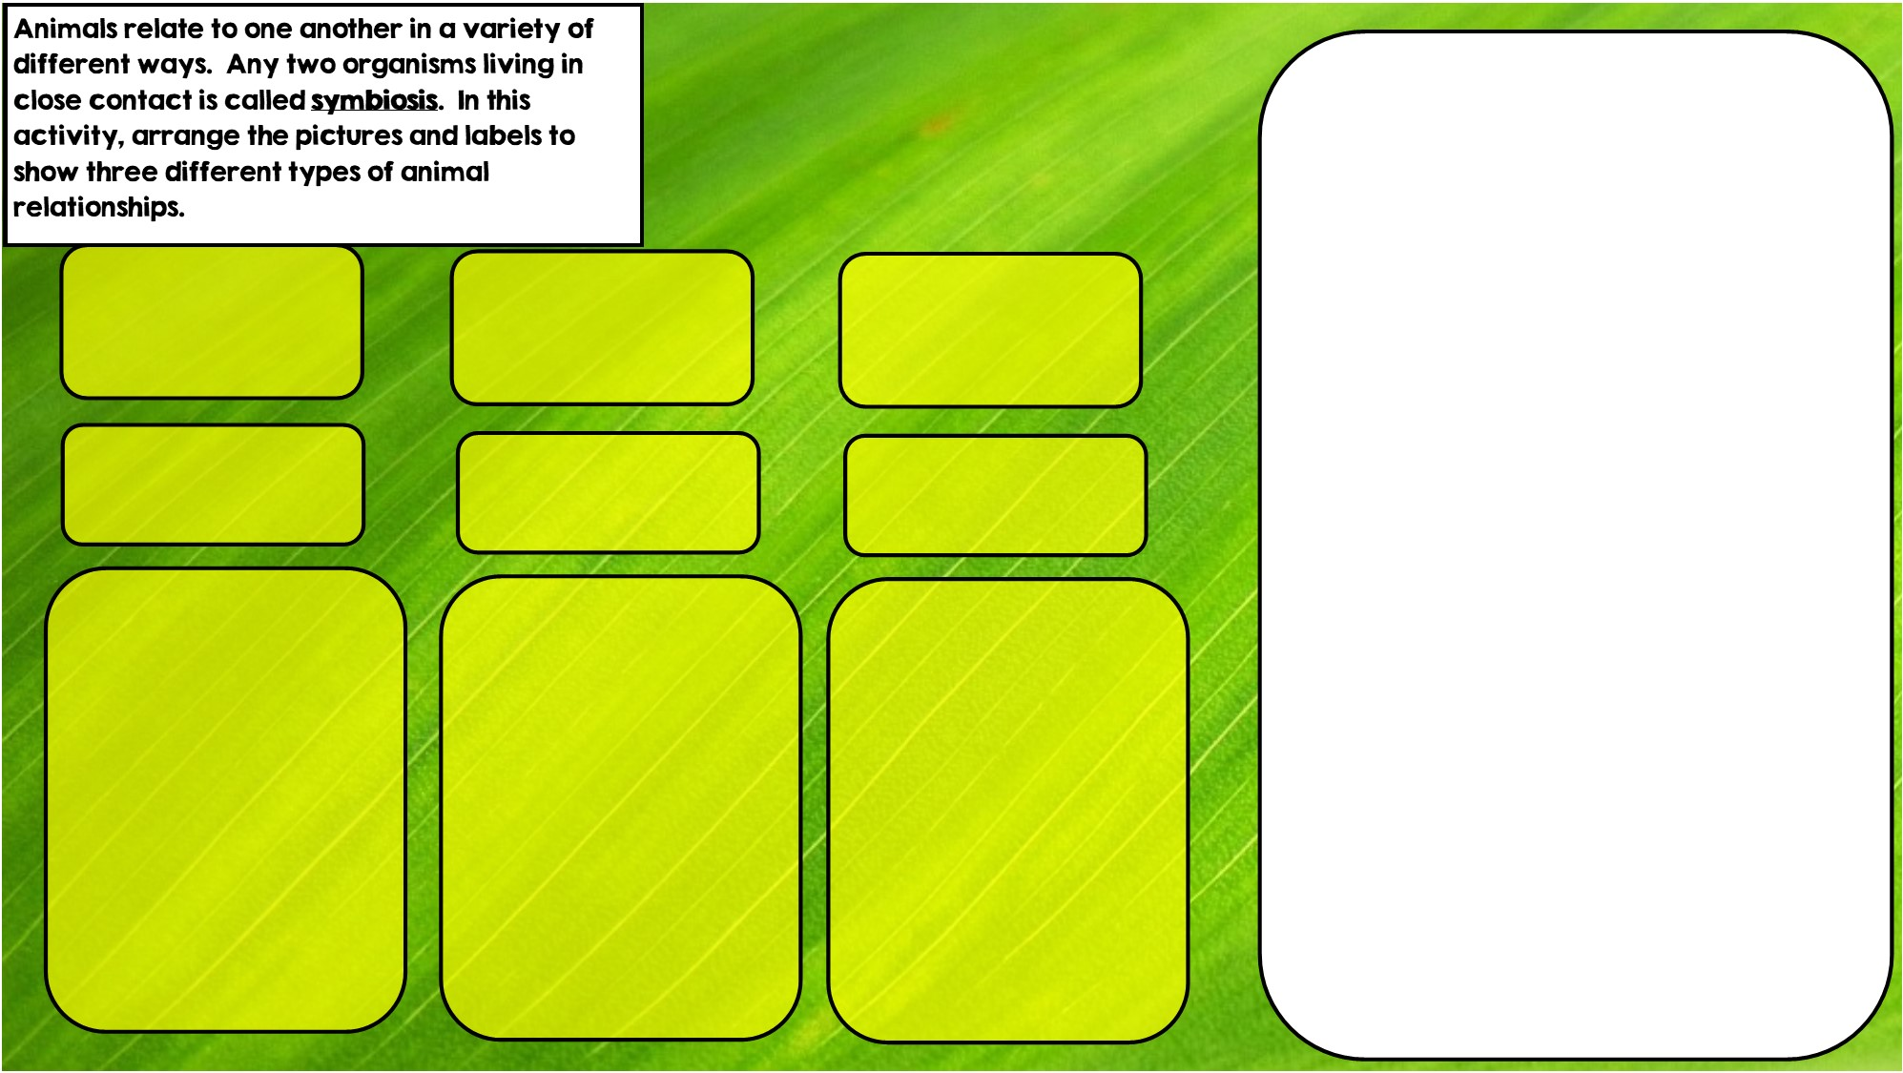

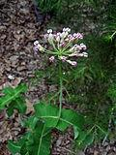
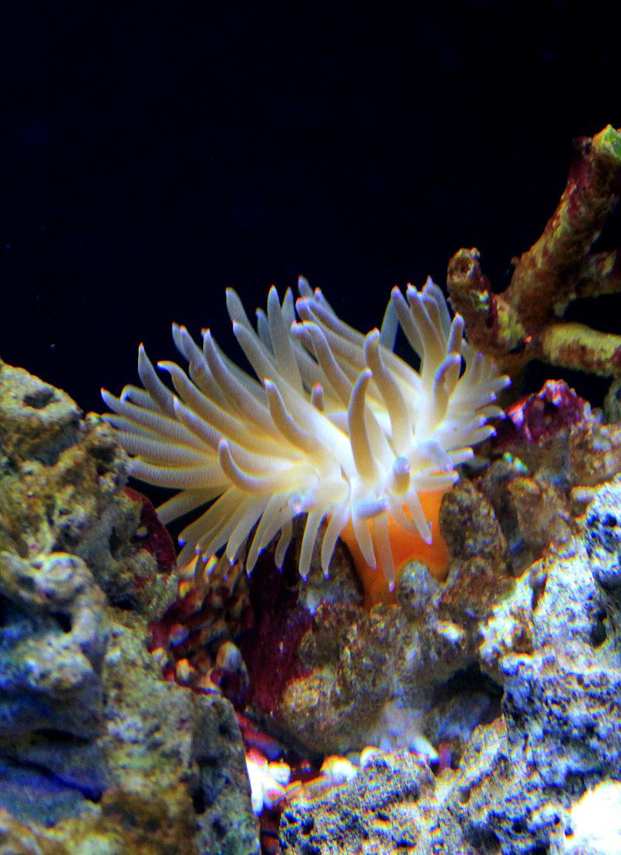


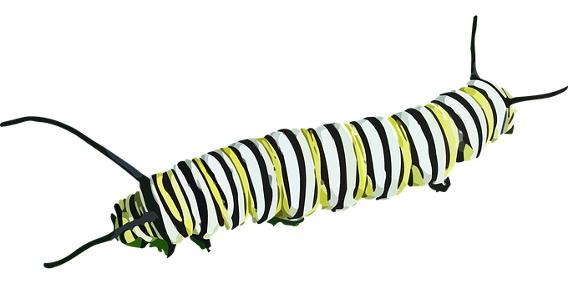
Commensalism is where one organism benefits and doesn’t hurt the other.
Parasitism is where one organisms benefits and the other is hurt
Hint: I live in intestines
Hint: I live in stingers
Hint: I eat toxic leaves
Mutualism is where both organisms benefit

Slide 3
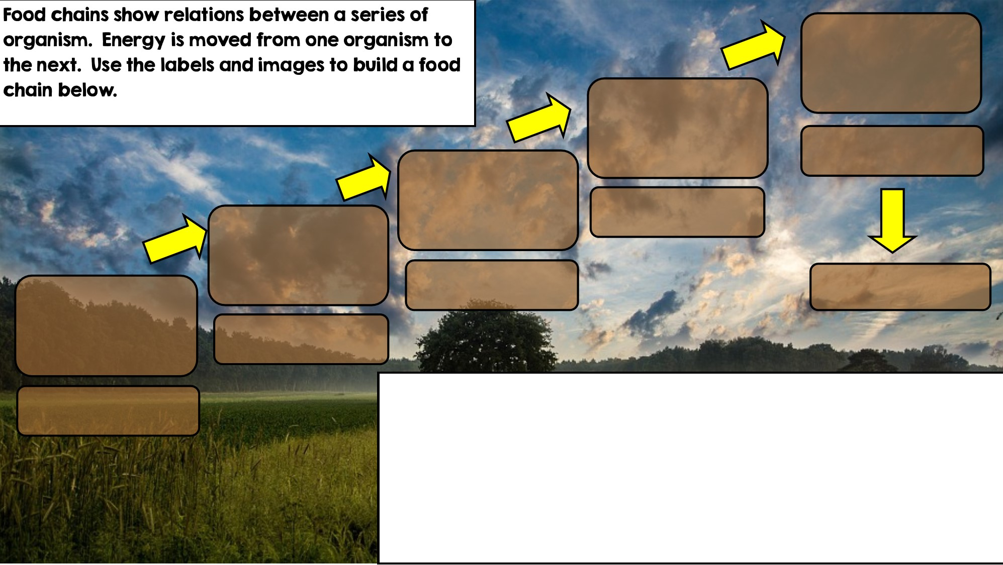
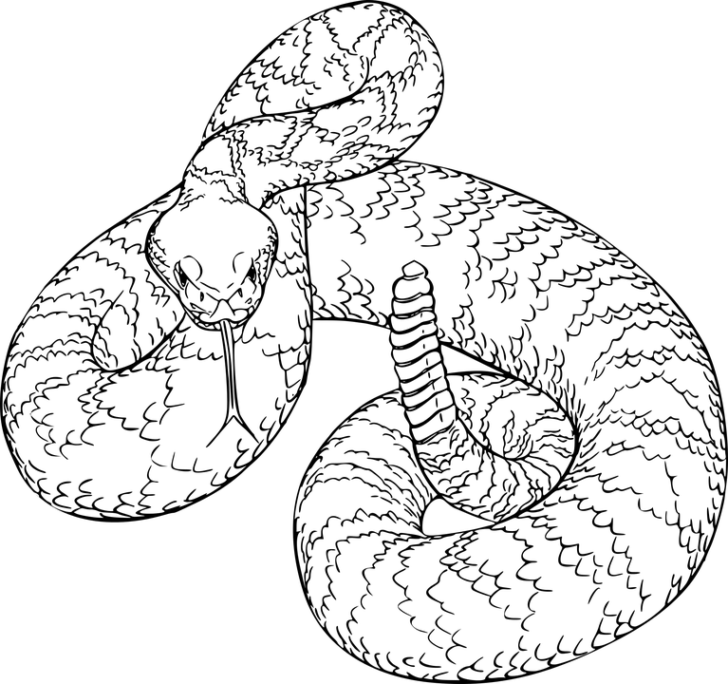
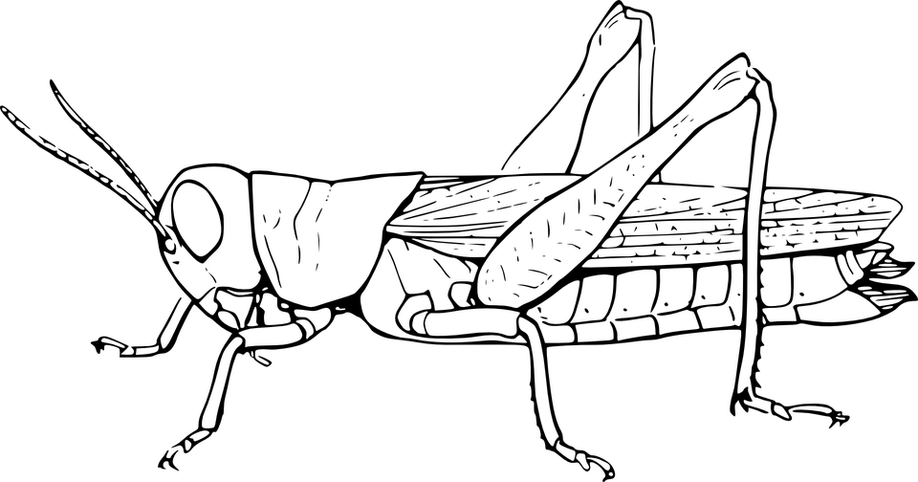

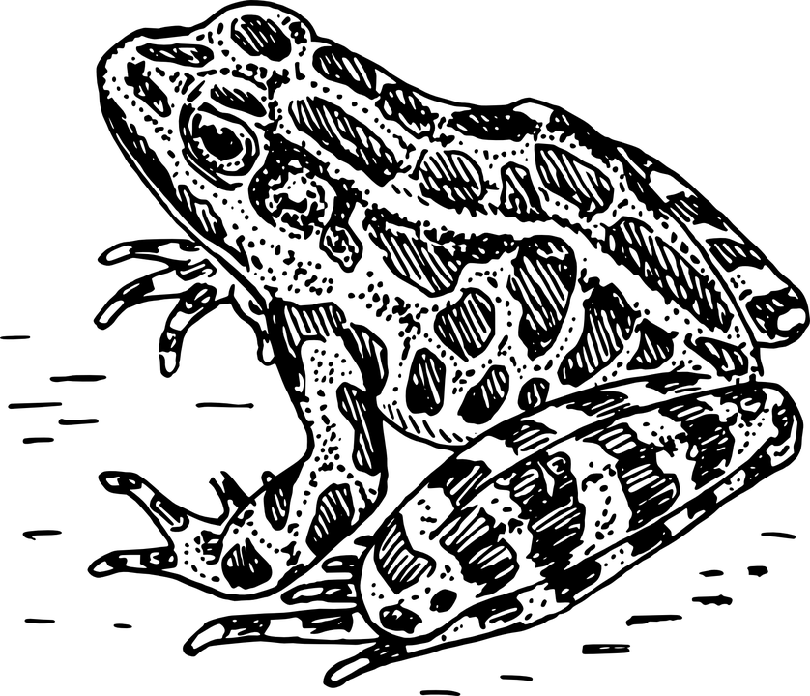

Apex Predator
Decomposer
Tertiary Consumer
Primary Consumer: Heterotroph
Secondary Consumer
Producer: Autotroph

Slide 4
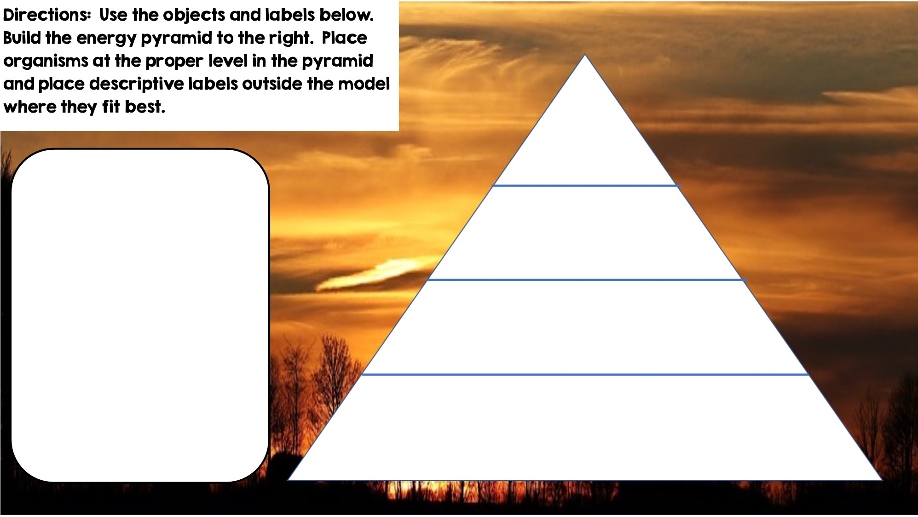
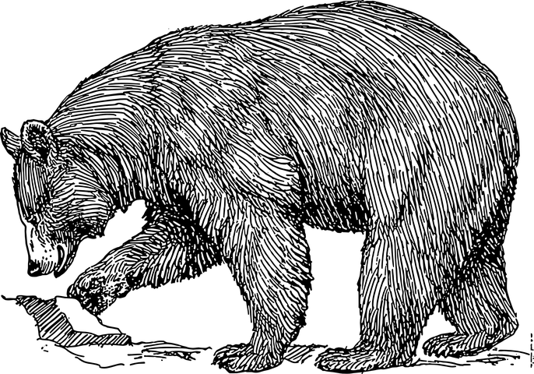
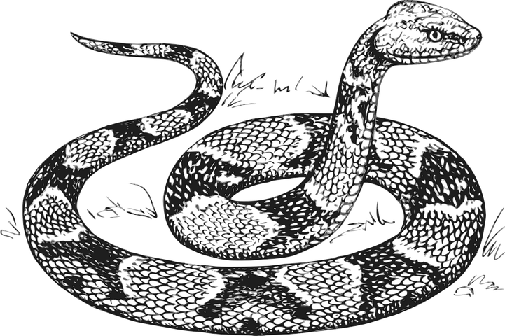


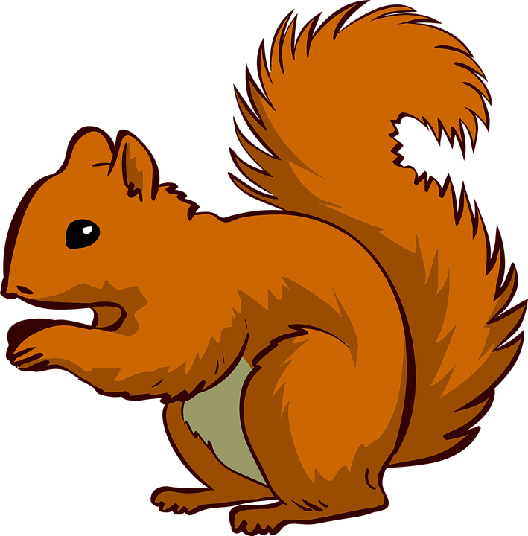






Only 10% of the energy from each tropic level is transferred
Tertiary Consumers
Secondary Consumers
Primary Consumers
Heterotrophs
Heterotrophs
Autotrophs
Heterotrophs
Producers

Slide 5
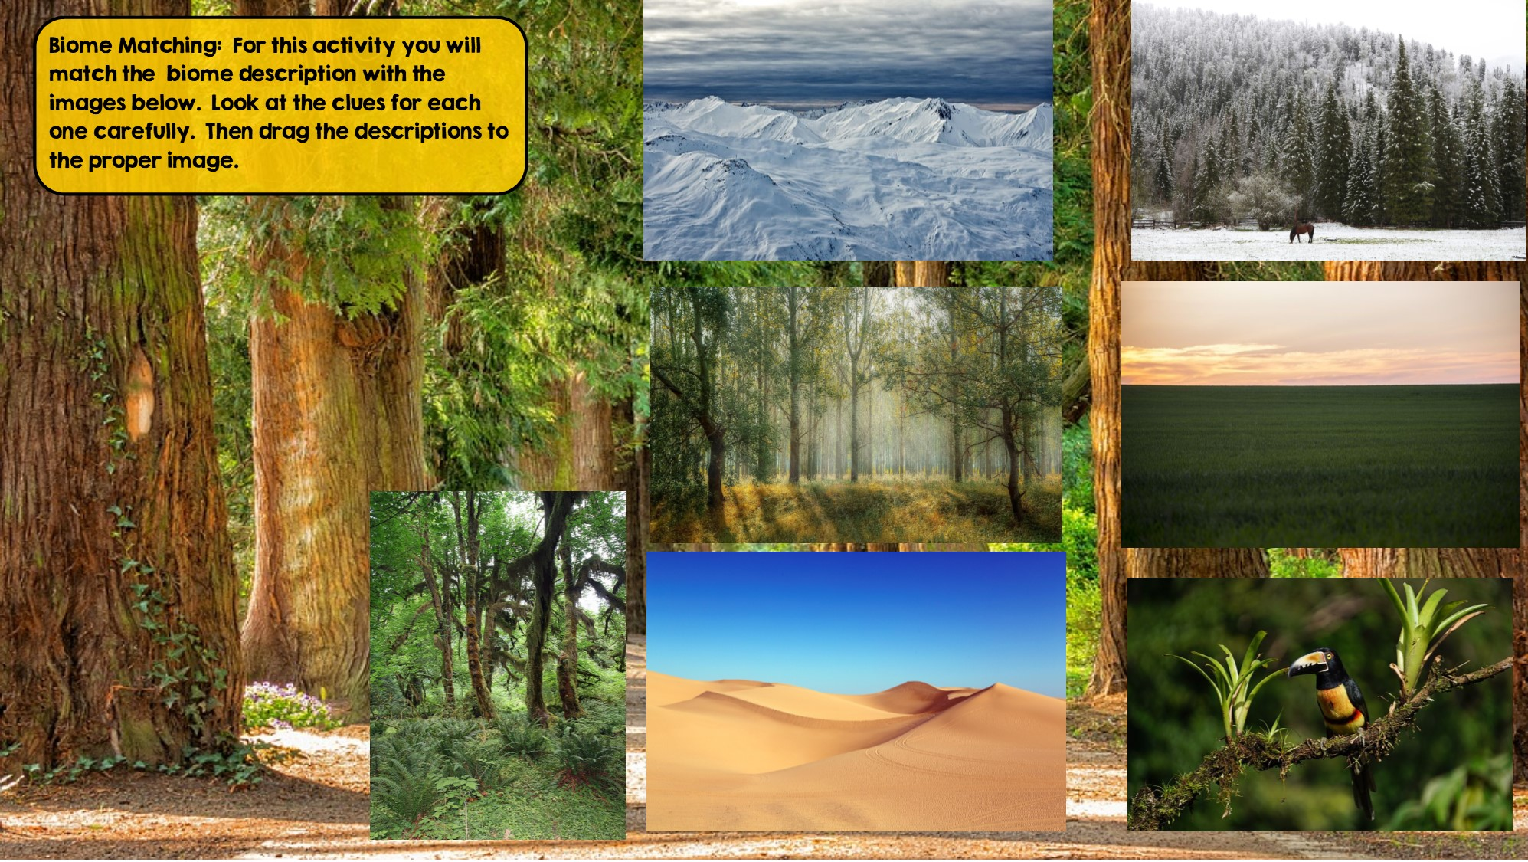
Taiga
Hint: Snowy Forest
Tundra
Hint: Cold Desert
Temperate Deciduous Forest Hint: Four distinct seasons
Temperate Rainforest
Hint: Cool rainforest
Grassland
Hint: Very few trees grow
Desert
Hint: little to no water
Tropical Rainforest:
Hint: Found near equator

Slide 6
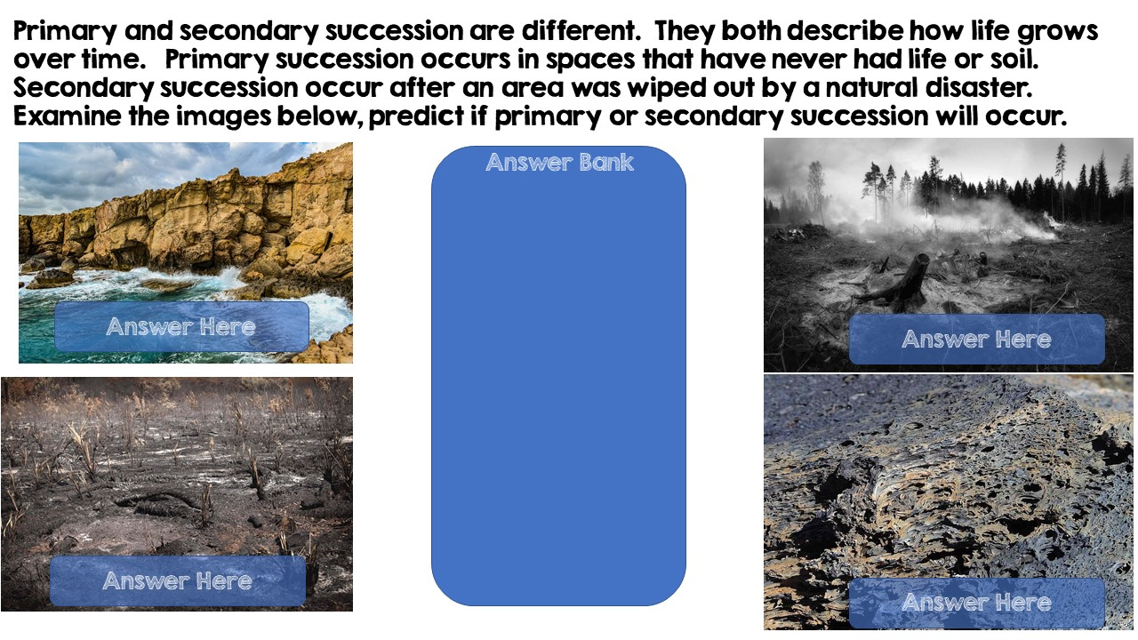
Primary Succession
Secondary Succession
Primary Succession
Secondary Succession

Slide 7
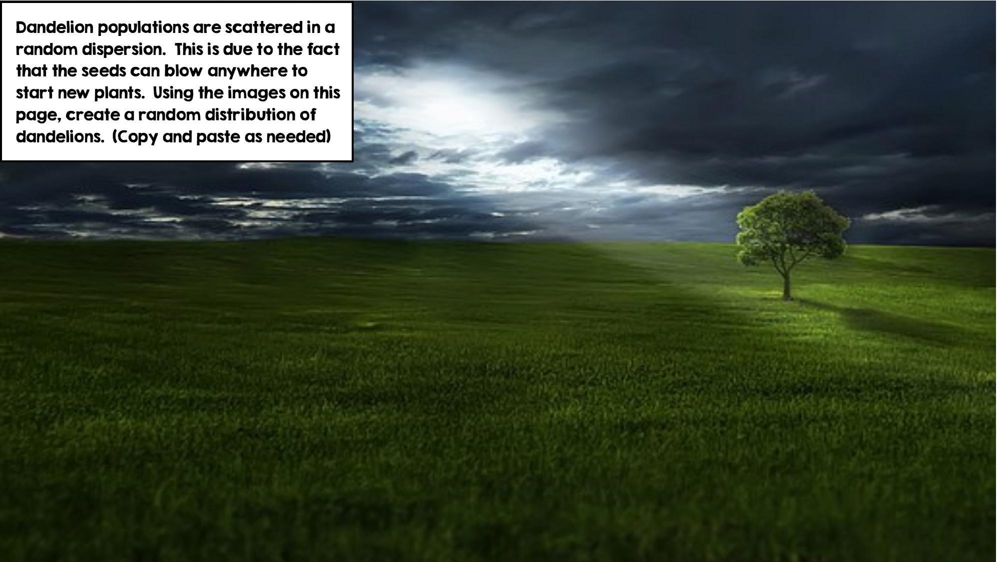
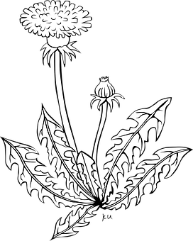

Slide 8
