Slide 1
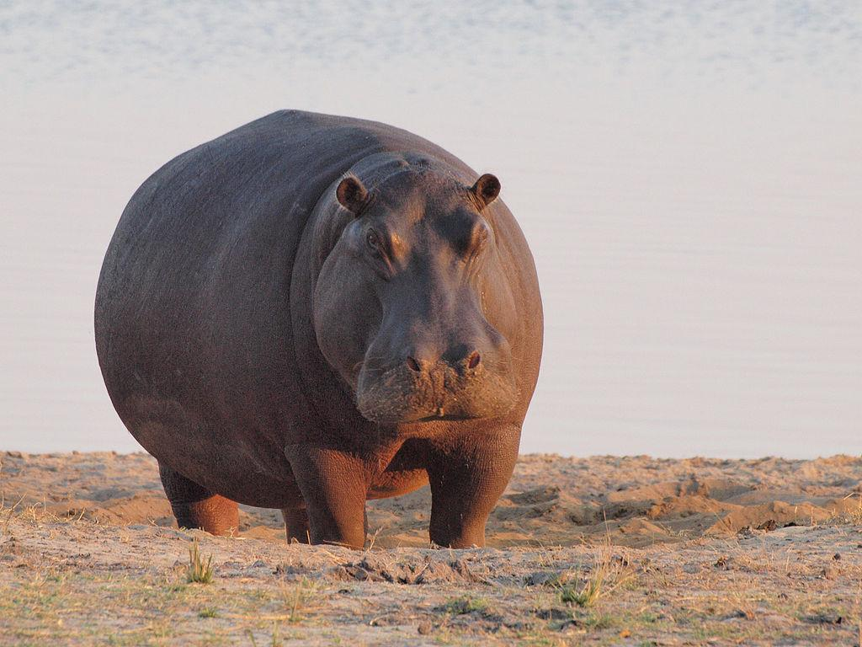
The Large Hippopotamus
By Abdul Khan
Notes:
1 Background Color
1 Title (or write the question)
1 Pictures
1 Include Transitions
1 Answering question using complete sentences (multiple sentences if needed to fully explain your answer)
1 Accuracy of information
6

Slide 2
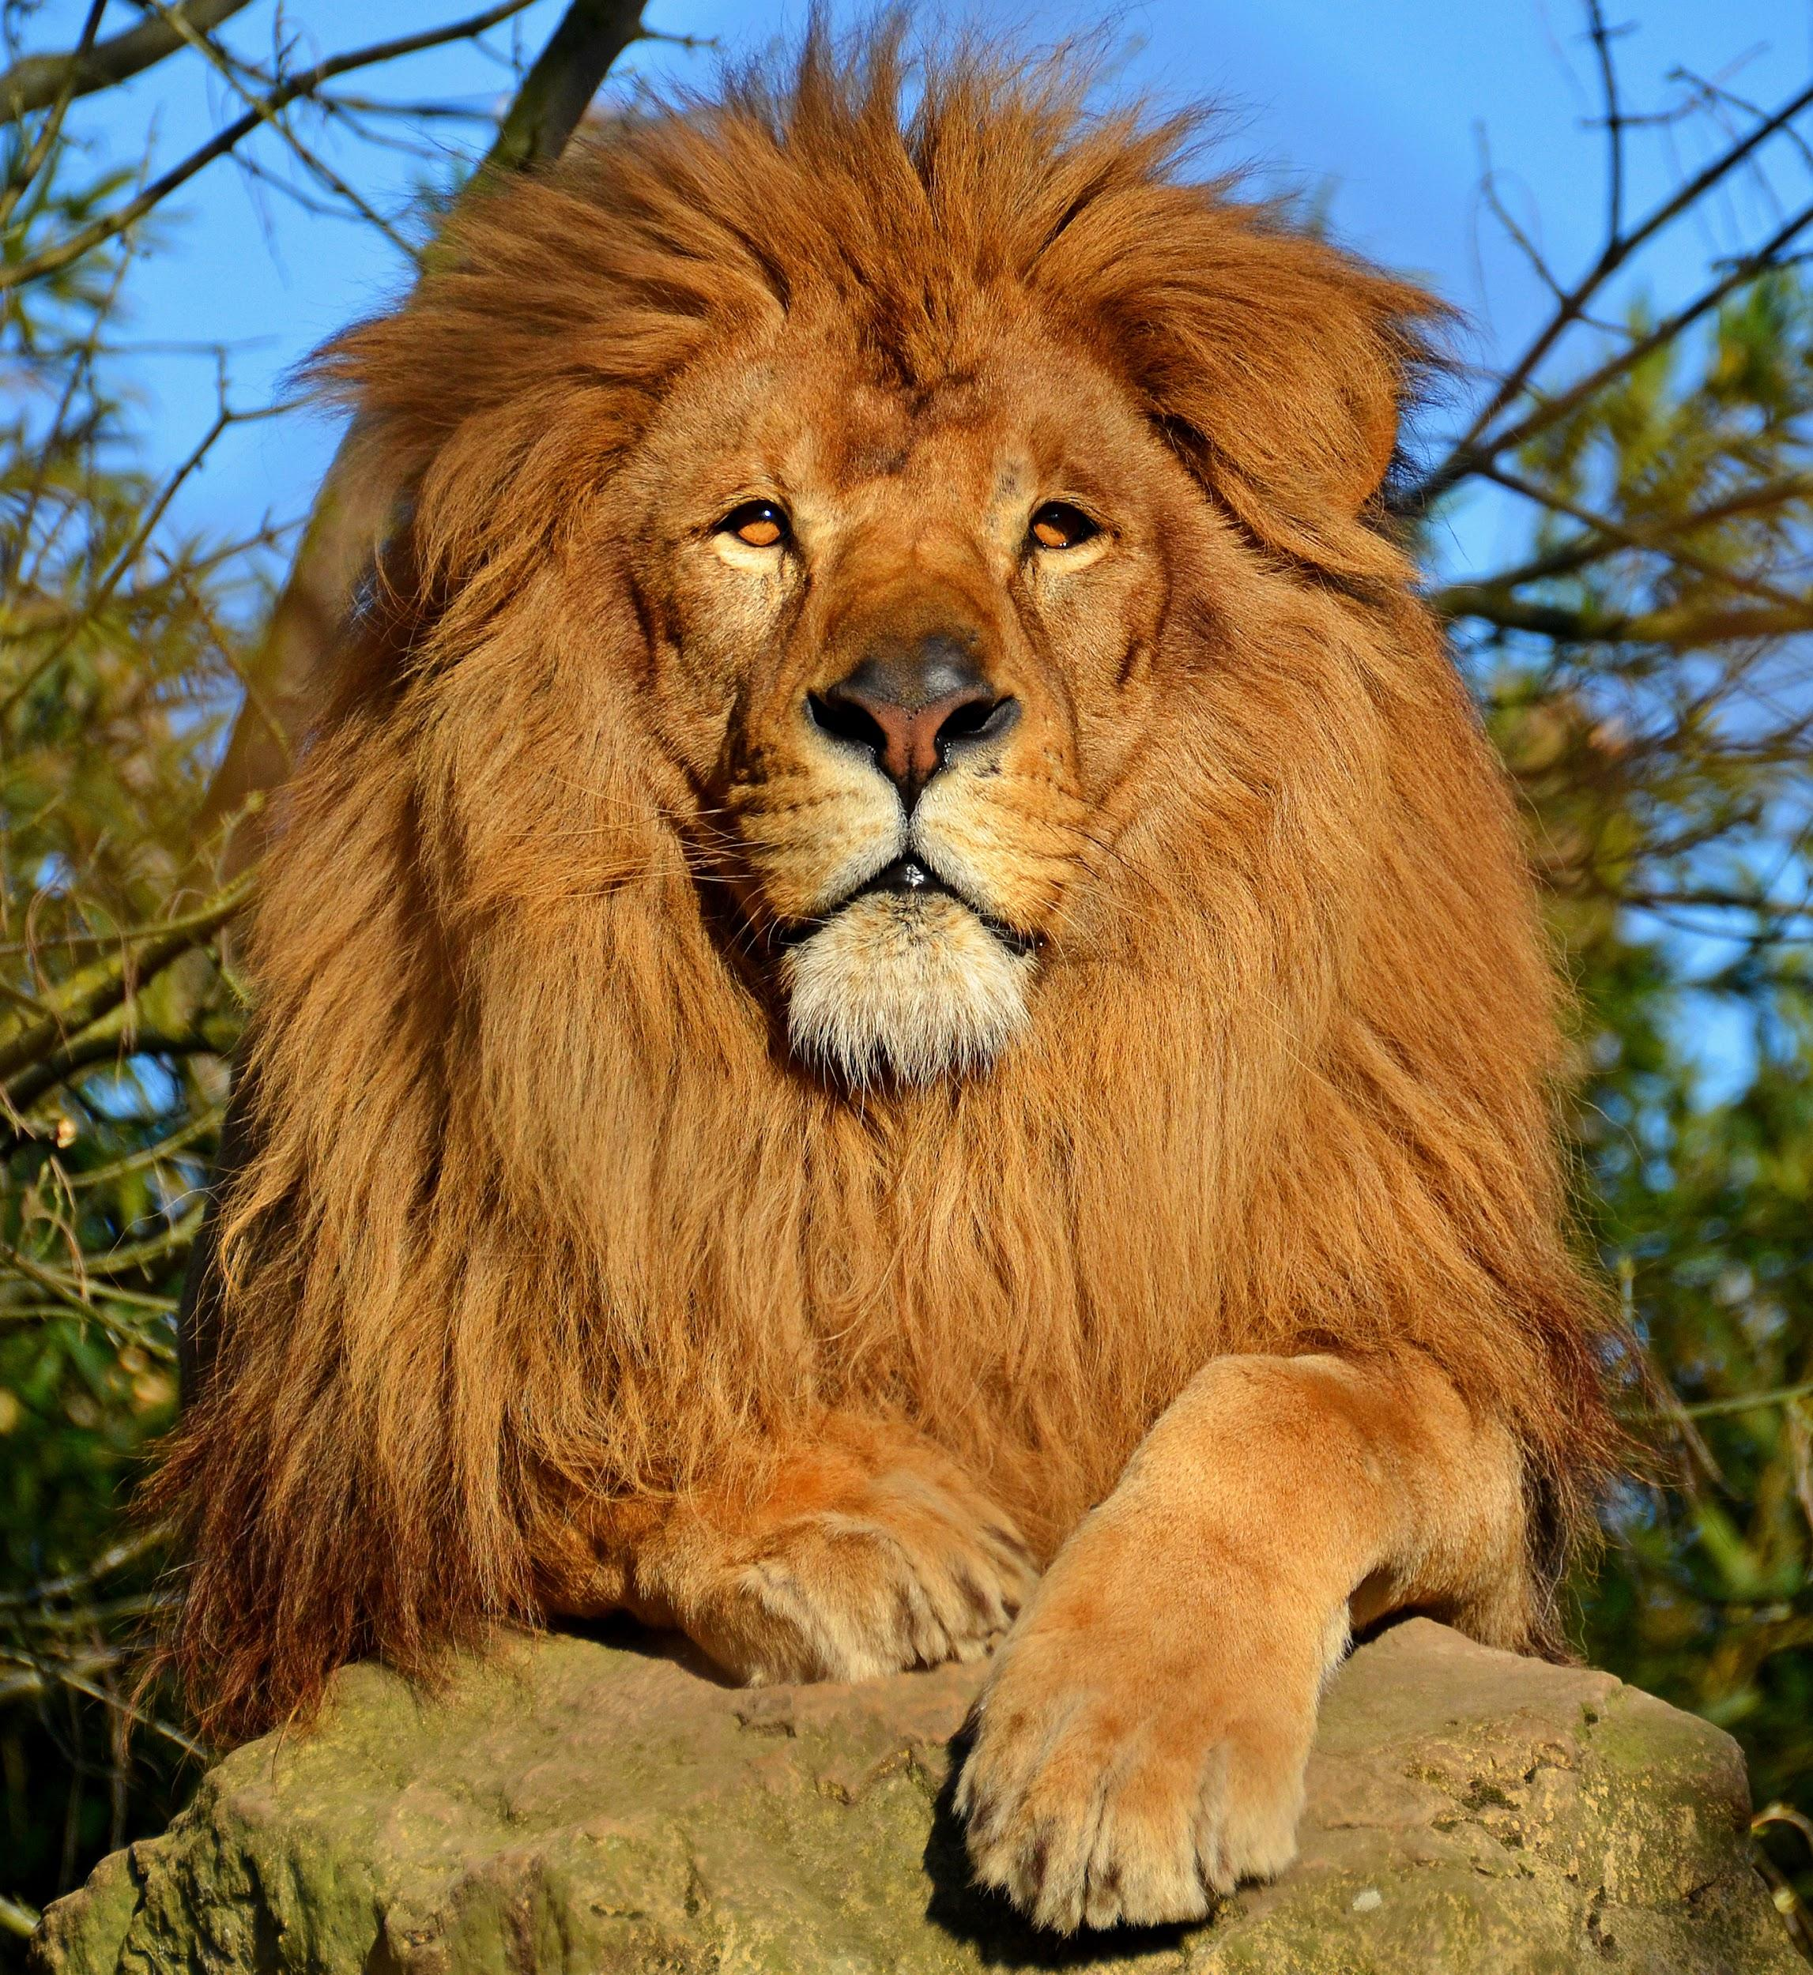
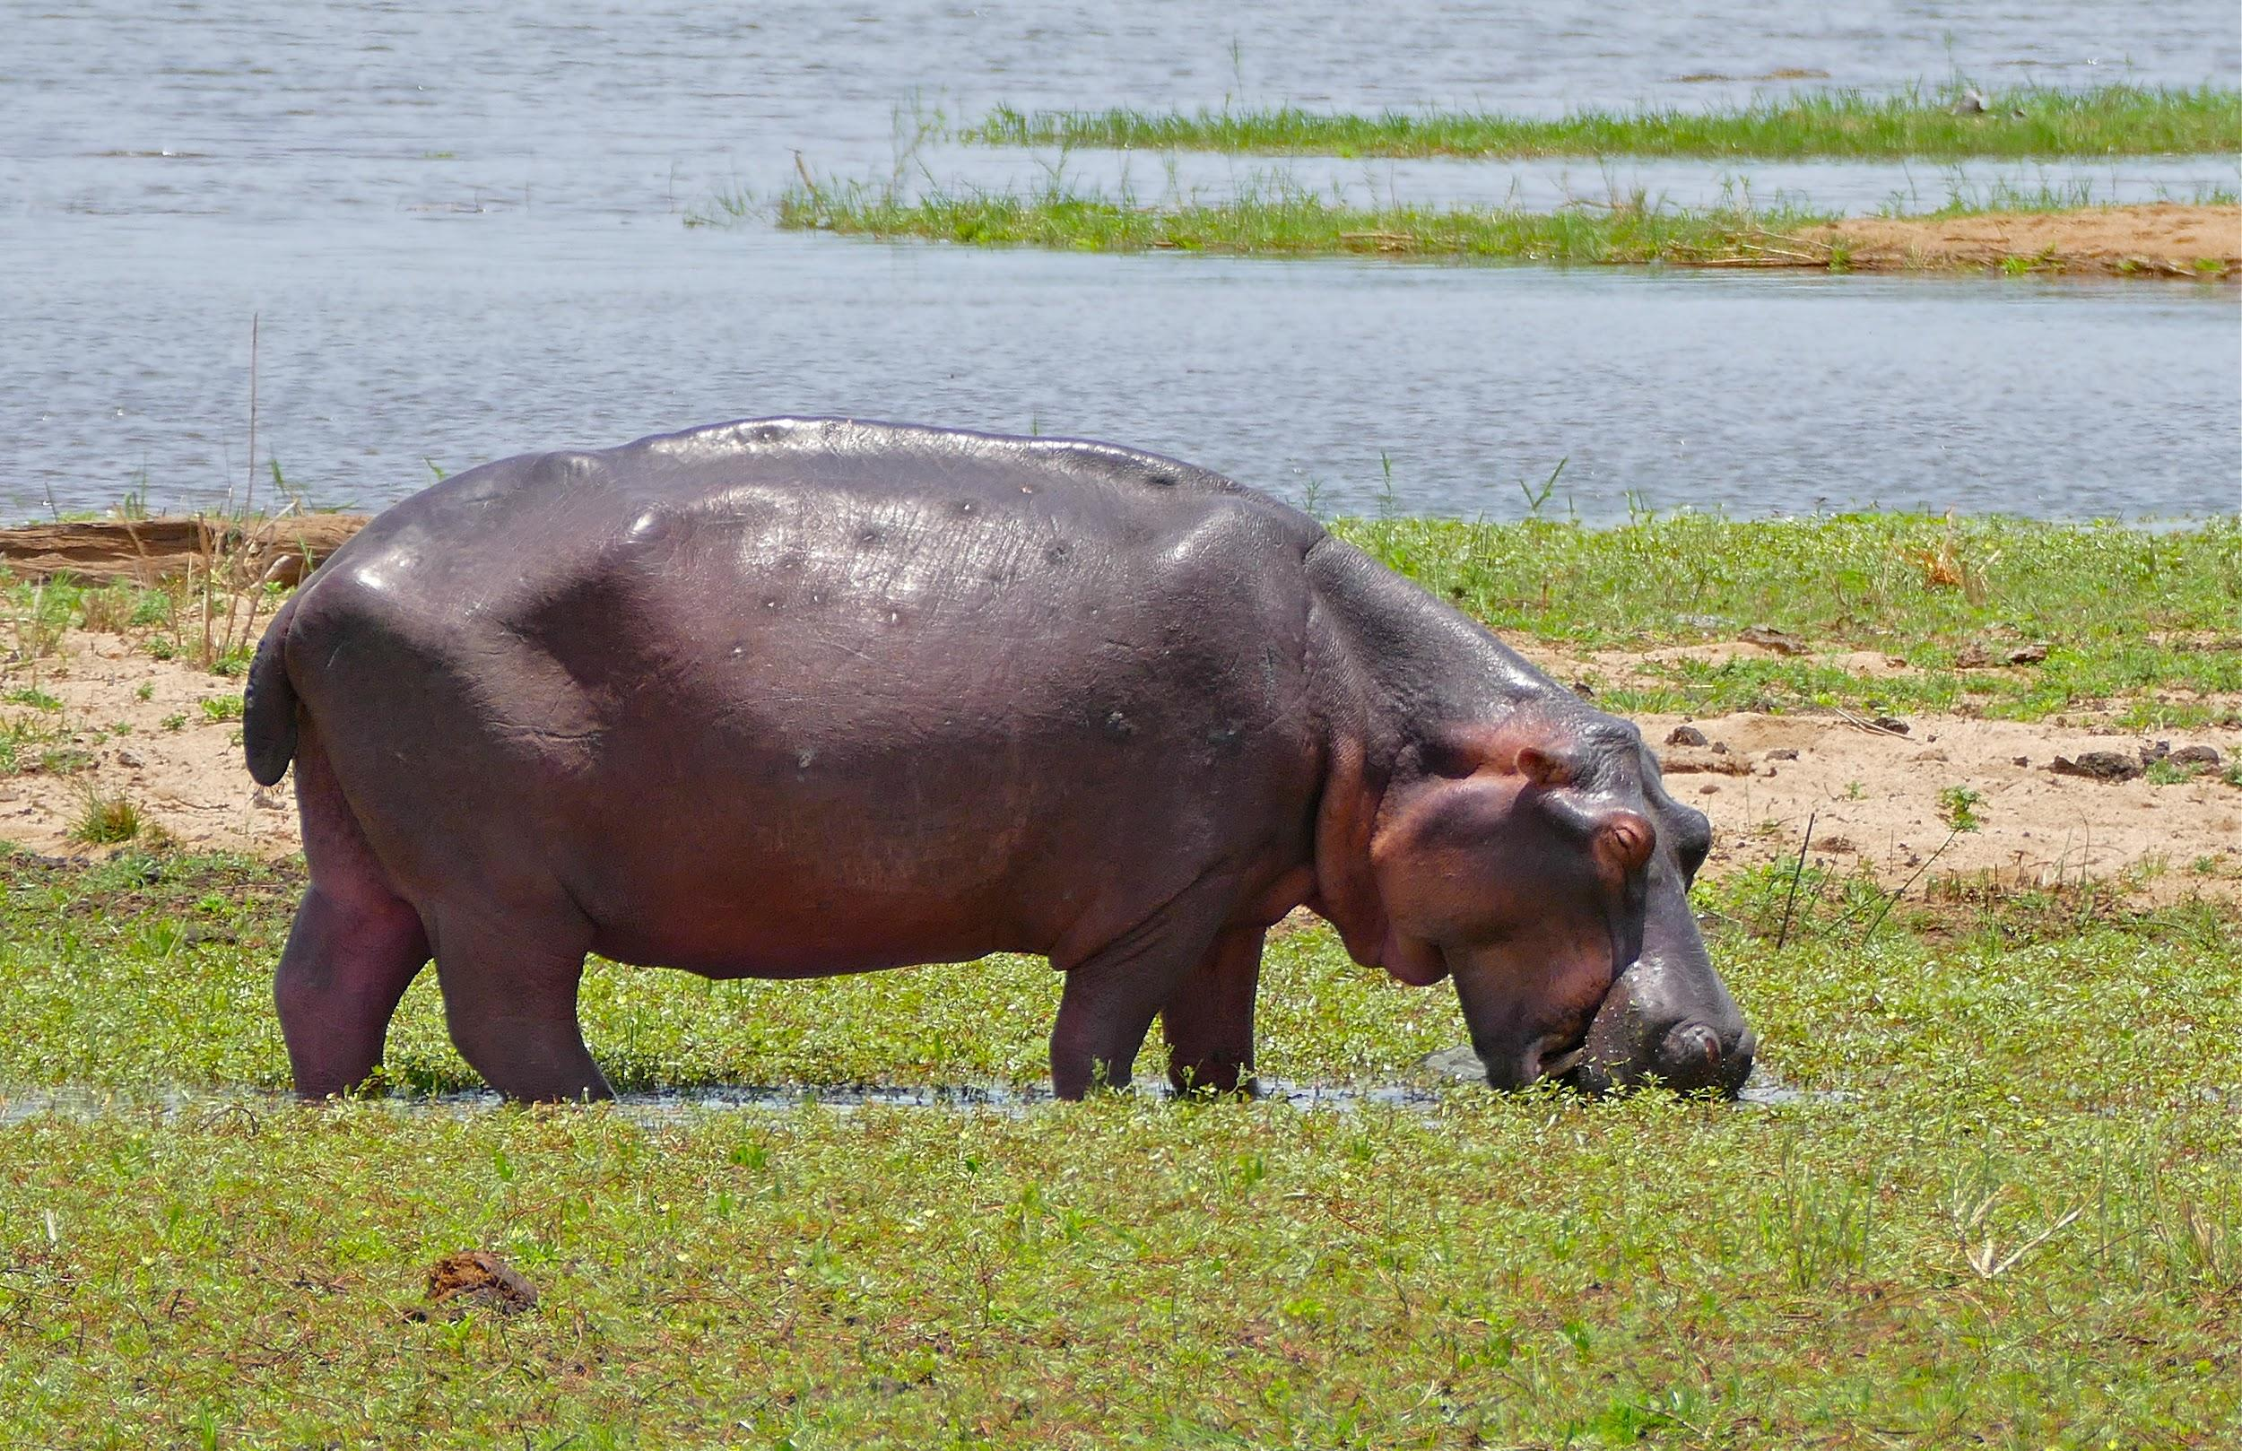
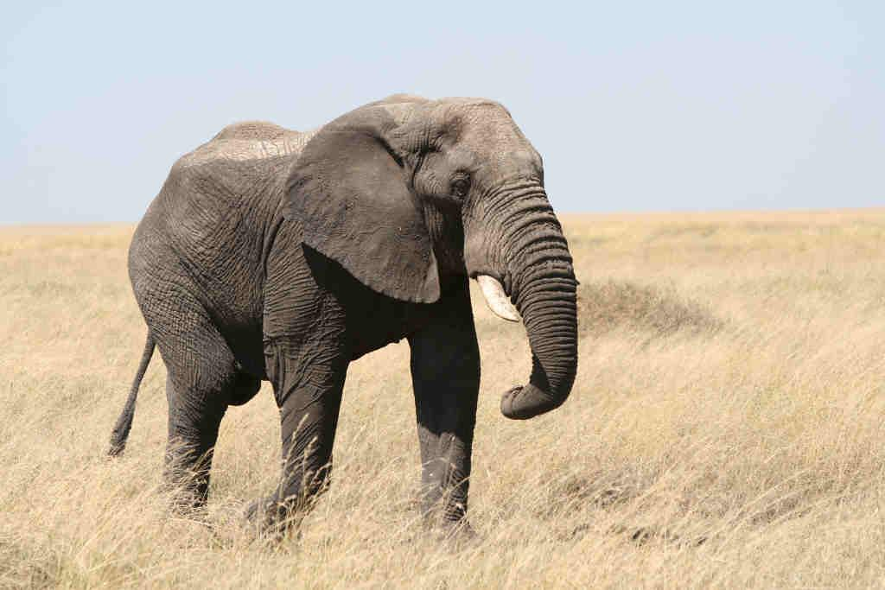
Where did the large Hippo come from?
The Large Hippo came from Africa. Africa is home to many of the world's most famous fauna in human culture such as lions‚ rhinos‚ cheetahs‚ giraffes‚ antelope, hippos, leopards, zebras‚ and African elephants among many others.
Notes:
1 Background Color
1 Title (or write the question)
1 Pictures
1 Include Transitions
0Answering question using complete sentences (multiple sentences if needed to fully explain your answer)
1 Accuracy of information
5
Delete the duplicate “come from” in the title.

Slide 3
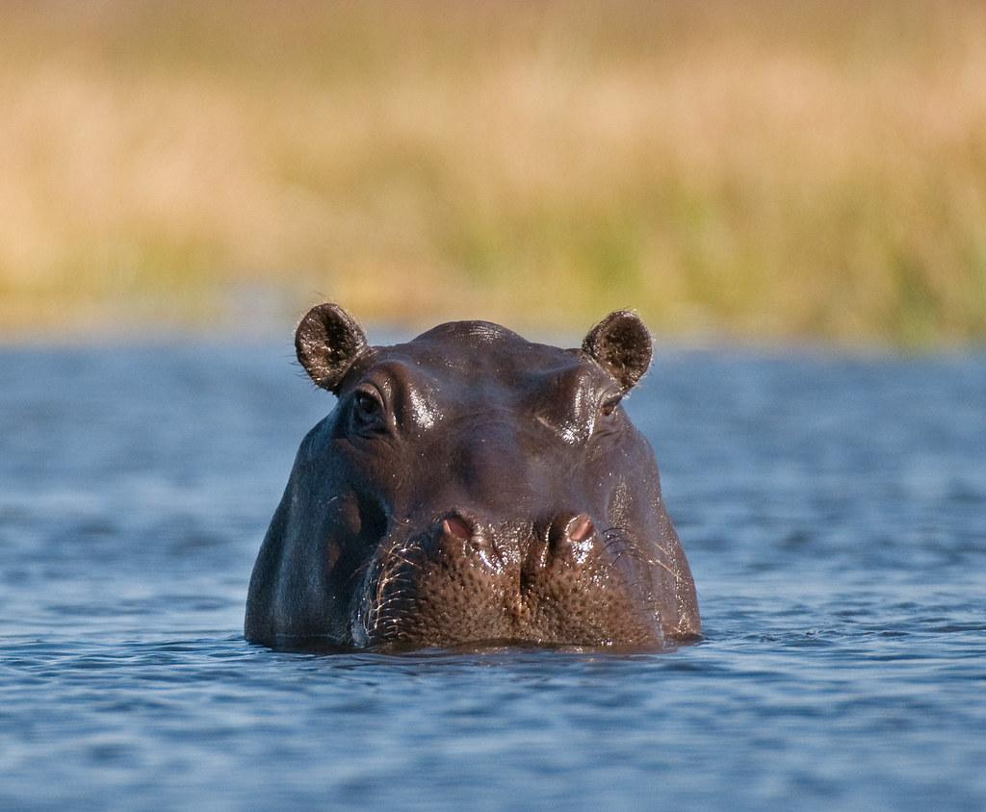
What ecosystem does the Large Hippo live in?
The large hippo lives near bodies of water such as lakes and rivers. They also live in hot climates like Africa.
Notes:
1 Background Color
1 Title (or write the question)
1 Pictures
1 Include Transitions
5 Answering question using complete sentences (multiple sentences if needed to fully explain your answer)
1 Accuracy of information
5
…hot climates like Africa.. You used “such as” in the last sentence.

Slide 4
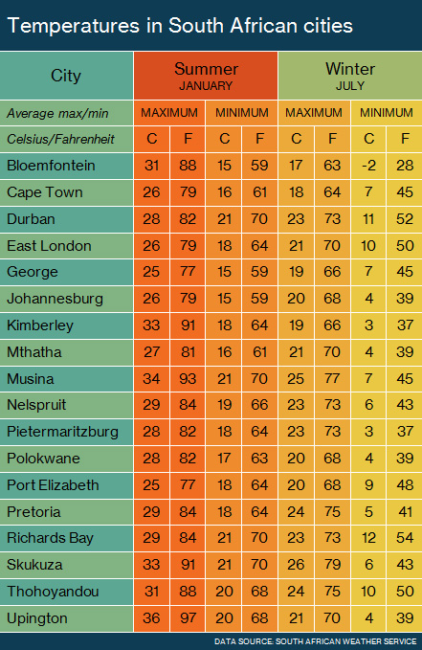
What is it like in the ecosystem?
The average temperature in east Africa ranges from 65 degrees Fahrenheit to 100 degrees farenheit in the summer. In the winter it is a low of 55 degrees Fahrenheit and a high of 88 degrees Fahrenheit. Africa has soaring humidity and northern africa is very dry and home to the Sahara desert.
Notes:
1 Background Color
1 Title (or write the question)
1 Pictures
1 Include Transitions
0 Answering question using complete sentences (multiple sentences if needed to fully explain your answer)
1 Accuracy of information
5
Fahrenheit should always be capitalized. You can also use F. instead of the word. 100 deg F.

Slide 5
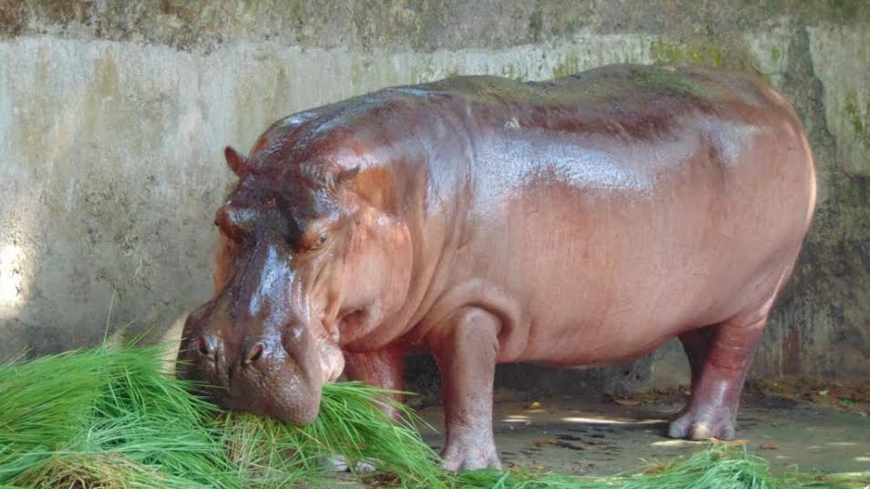
What type of consumer is the Large Hippo?
The Large Hippo is a Herbivore, and mostly eat plants.
Notes:
1 Background Color
1 Title (or write the question)
1 Pictures
1 Include Transitions
1 Answering question using complete sentences (multiple sentences if needed to fully explain your answer)
1 Accuracy of information
6

Slide 6
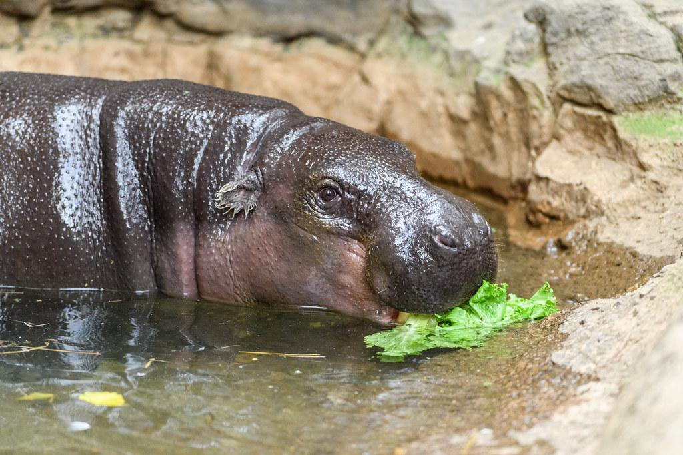
What food does the Hippo eat?
The Large hippo eats grass, leaves, fruit and aquatic plants.
Notes:
0 Background Color
1 Title (or write the question)
1 Pictures
1 Include Transitions
1 Answering question using complete sentences (multiple sentences if needed to fully explain your answer)
1 Accuracy of information
5
This is hard to read against this background. Capitalize Hippo when in the title.

Slide 7
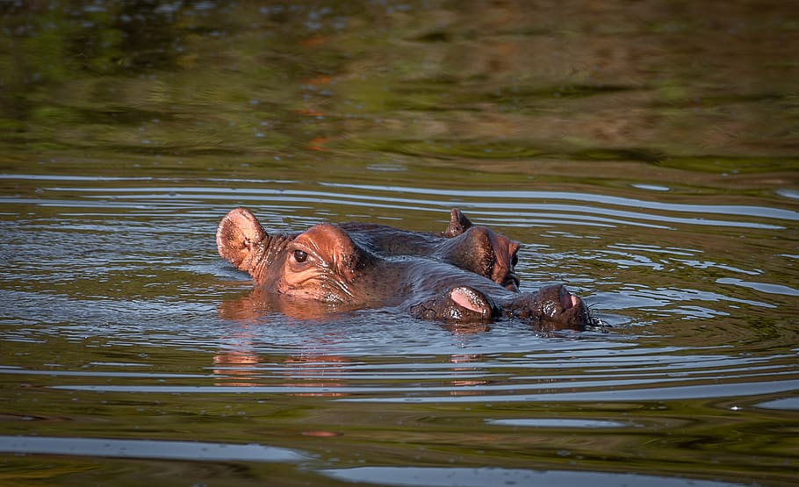
Does the Hippo have predators?
A full-grown adult hippo doesn't have much in the way of natural predators. ... Crocodiles, lions, hyenas, and leopards are all potential threats while growing up—but the most dangerous thing to a young hippo is another hippo.
Notes:
1 Background Color
1 Title (or write the question)
1 Pictures
1 Include Transitions
1 Answering question using complete sentences (multiple sentences if needed to fully explain your answer)
1 Accuracy of information
6

Slide 8
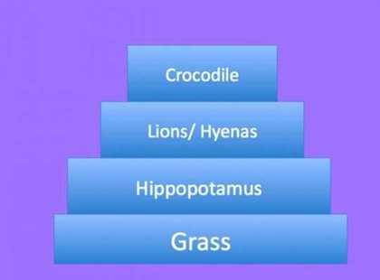
What is a typical food chain for the Large Hippo?
The Large Hippo is a plant eater and eats grass and other plants. Large cats such as lions hyenas or sometimes crocodiles eat hippos.
Notes:
0 Background Color
1 Title (or write the question)
1 Pictures
1 Include Transitions
1 Answering question using complete sentences (multiple sentences if needed to fully explain your answer)
1 Accuracy of information
5
This text is hard to read against this background.

Slide 9
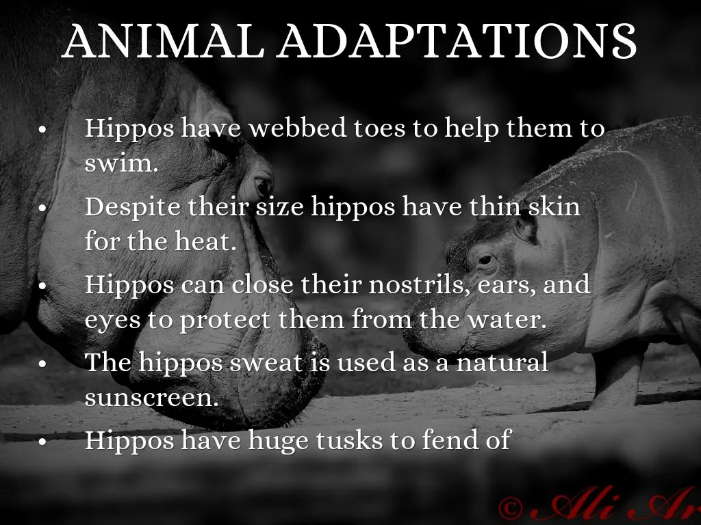
Does the Large Hippo have any adaptations to help it survive?
Yes the Large Hippo has many adaptations to help it survive such as having webbed toes to help them swim, thin skin for the heat and much more.
Notes:
1 Background Color
1 Title (or write the question)
1 Pictures
1 Include Transitions
0 Answering question using complete sentences (multiple sentences if needed to fully explain your answer)
1 Accuracy of information
5
Since the title is a sentence Large hippo in the paragraph also.

Slide 10
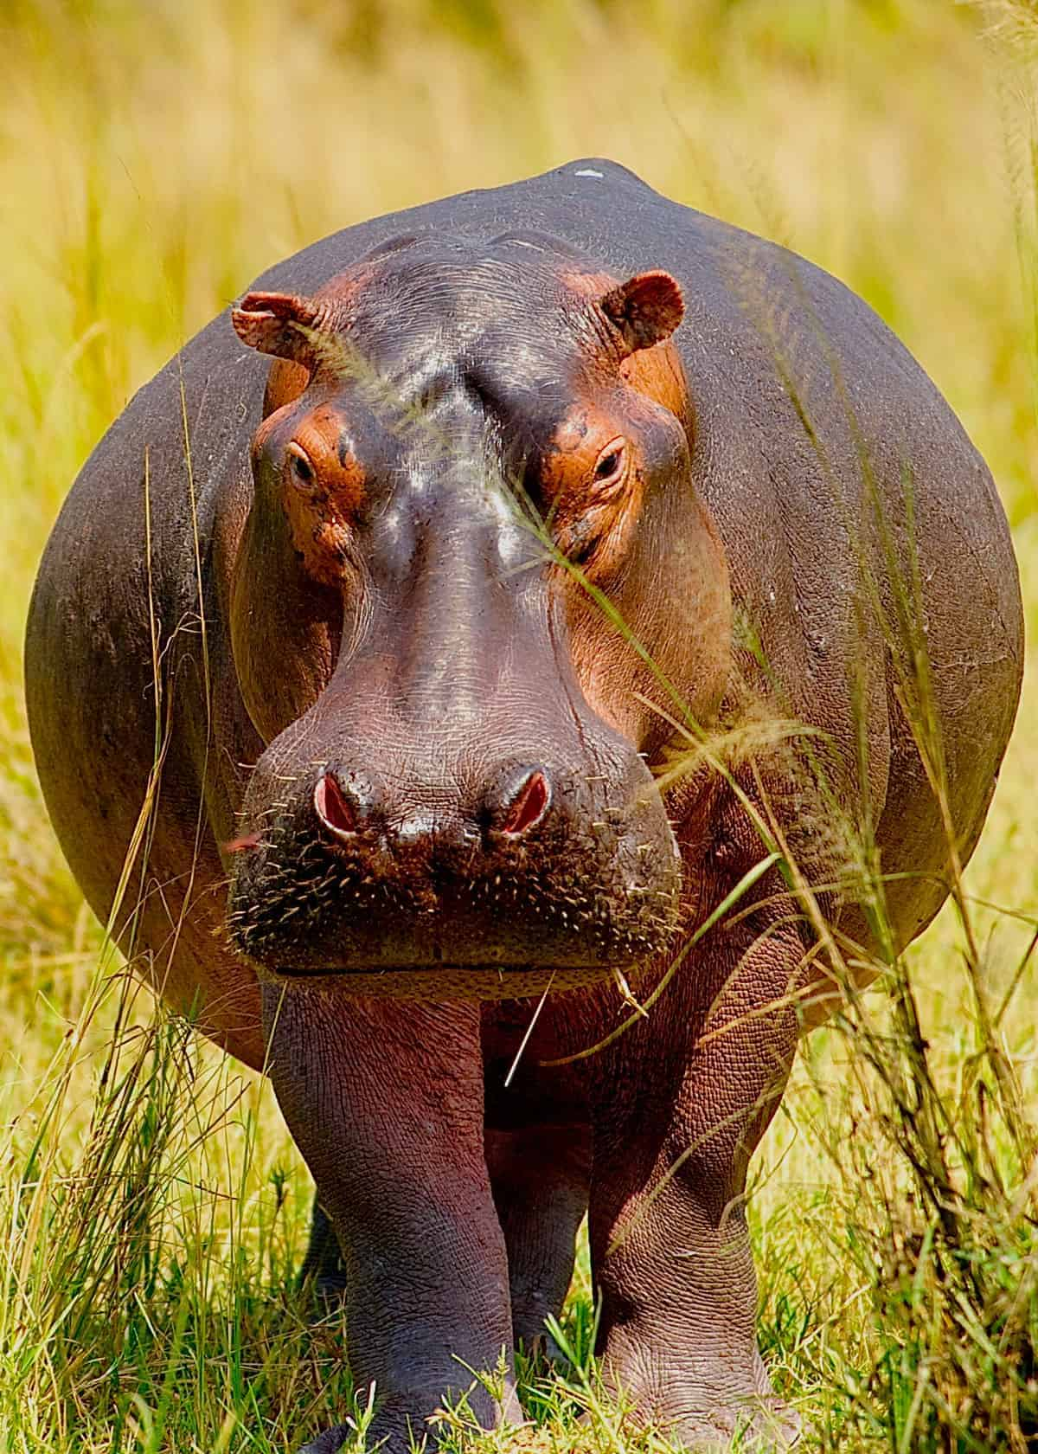
Basic info about the Large hippo.
It weighs between 3,000 lbs to 9,920 lbs. It has a length if 10.8 ft to 16.5 ft. Hippos are large semi-aquatic mammals, with a large barrel-shaped body, short legs, a short tail and an enormous head! They have greyish to muddy-brown skin, which fades to a pale pink colour underneath. These magnificent mammals were once found throughout all sub-saharan Africa.
Notes:
1 Background Color
1 Title (or write the question)
1 Pictures
1 Include Transitions
0 Answering question using complete sentences (multiple sentences if needed to fully explain your answer)
1 Accuracy of information
5
Since the title is not a sentence… Basic Info About The Large Hippo

Slide 11
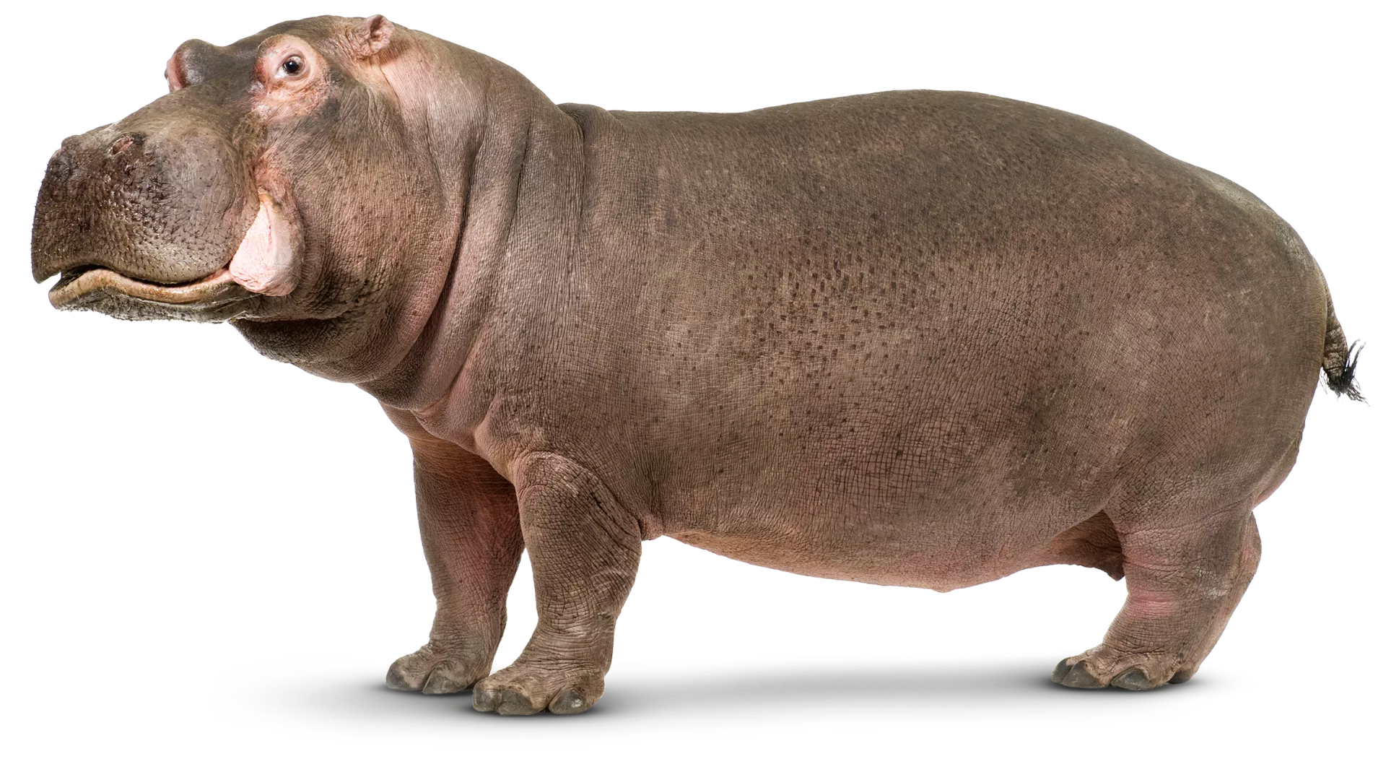
More basic information about the Large Hippo.
The male hippo weighs from 3,500 pounds to 9,920 pounds.The female hippo weighs 3,000 pounds. Also the male and female hippo has a length of 10.8 to 16.5 feet with a shoulder height of 5.2 feet.
Notes:
1 Background Color
1 Title (or write the question)
1 Pictures
1 Include Transitions
1 Answering question using complete sentences (multiple sentences if needed to fully explain your answer)
1 Accuracy of information
6

Slide 12
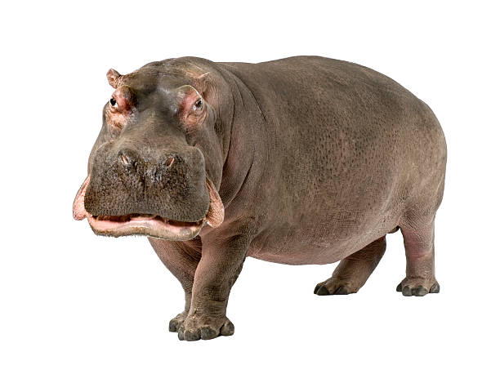
What is the lifespan of the Large Hippo?
The lifespan of the Large Hippo is 40 to 50 years.
Notes:
1 Background Color
1 Title (or write the question)
1 Pictures
1 Include Transitions
1 Answering question using complete sentences (multiple sentences if needed to fully explain your answer)
1 Accuracy of information
6

Slide 13
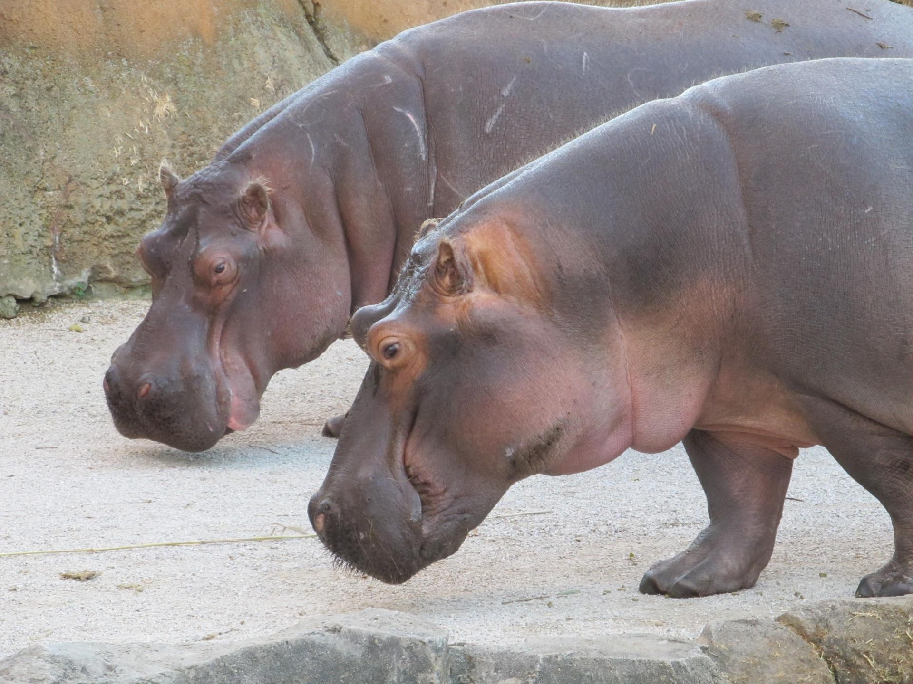
Facts about the Large Hippo.
Hippos can’t sink or swim.
They have very sensitive skin.
They cannot breath underwater.
Hippos are territorial in the water.
They are not big eaters.
Hippos have a british connection.
Hippos are almost bullet proof.
It is one of the most dangerous animals.
Notes:
1 Background Color
1 Title (or write the question)
1 Pictures
1 Include Transitions
0 Answering question using complete sentences (multiple sentences if needed to fully explain your answer)
1 Accuracy of information
5
#7 is missing the period.

Slide 14
Sources
https://www.awf.org/wildlife-conservation/hippopotamus
https://en.wikipedia.org/wiki/Fauna_of_Africa#:~:text=Africa%20is%20home%20to%20many,African%20elephants%20among%20many%20others.
Notes:
6

