Slide 1
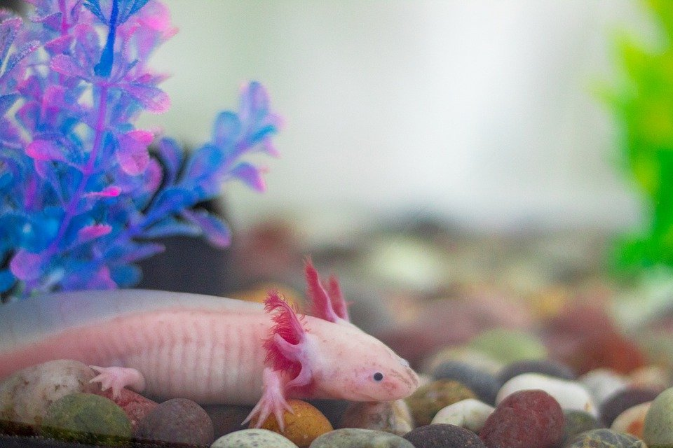
Creature Project
By Aidan Berg
My creature is an Axolotl

Slide 2
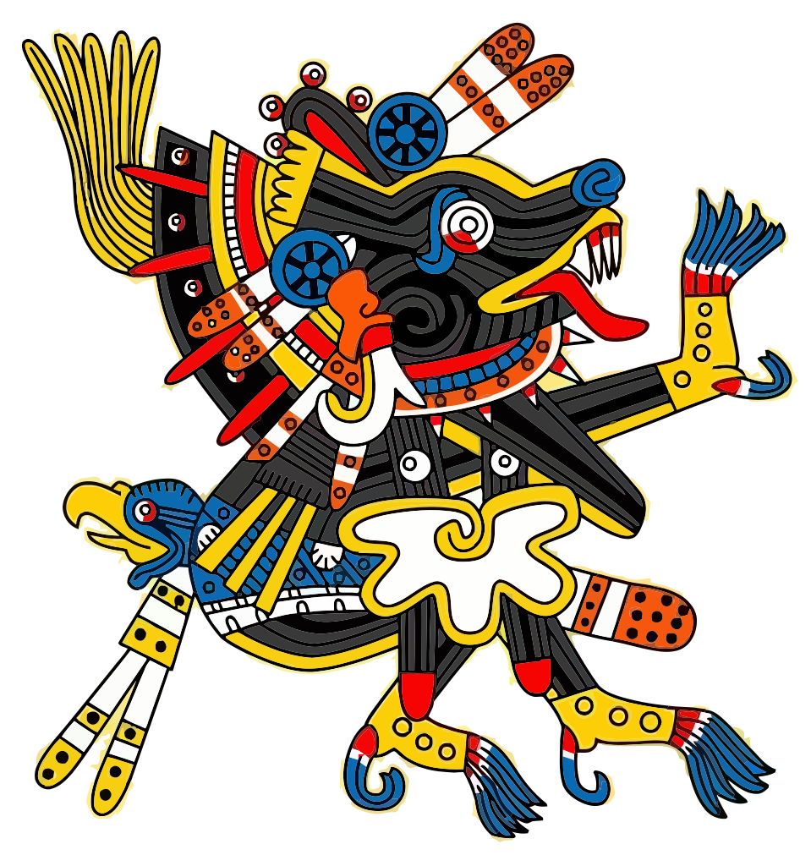
History of the Axolotl
When the aztecs settled in mexico the found the axolotl.
They named it Axolotl after Xolotl, their god of fire and lightning.
It was found in the 13th century.

Slide 3
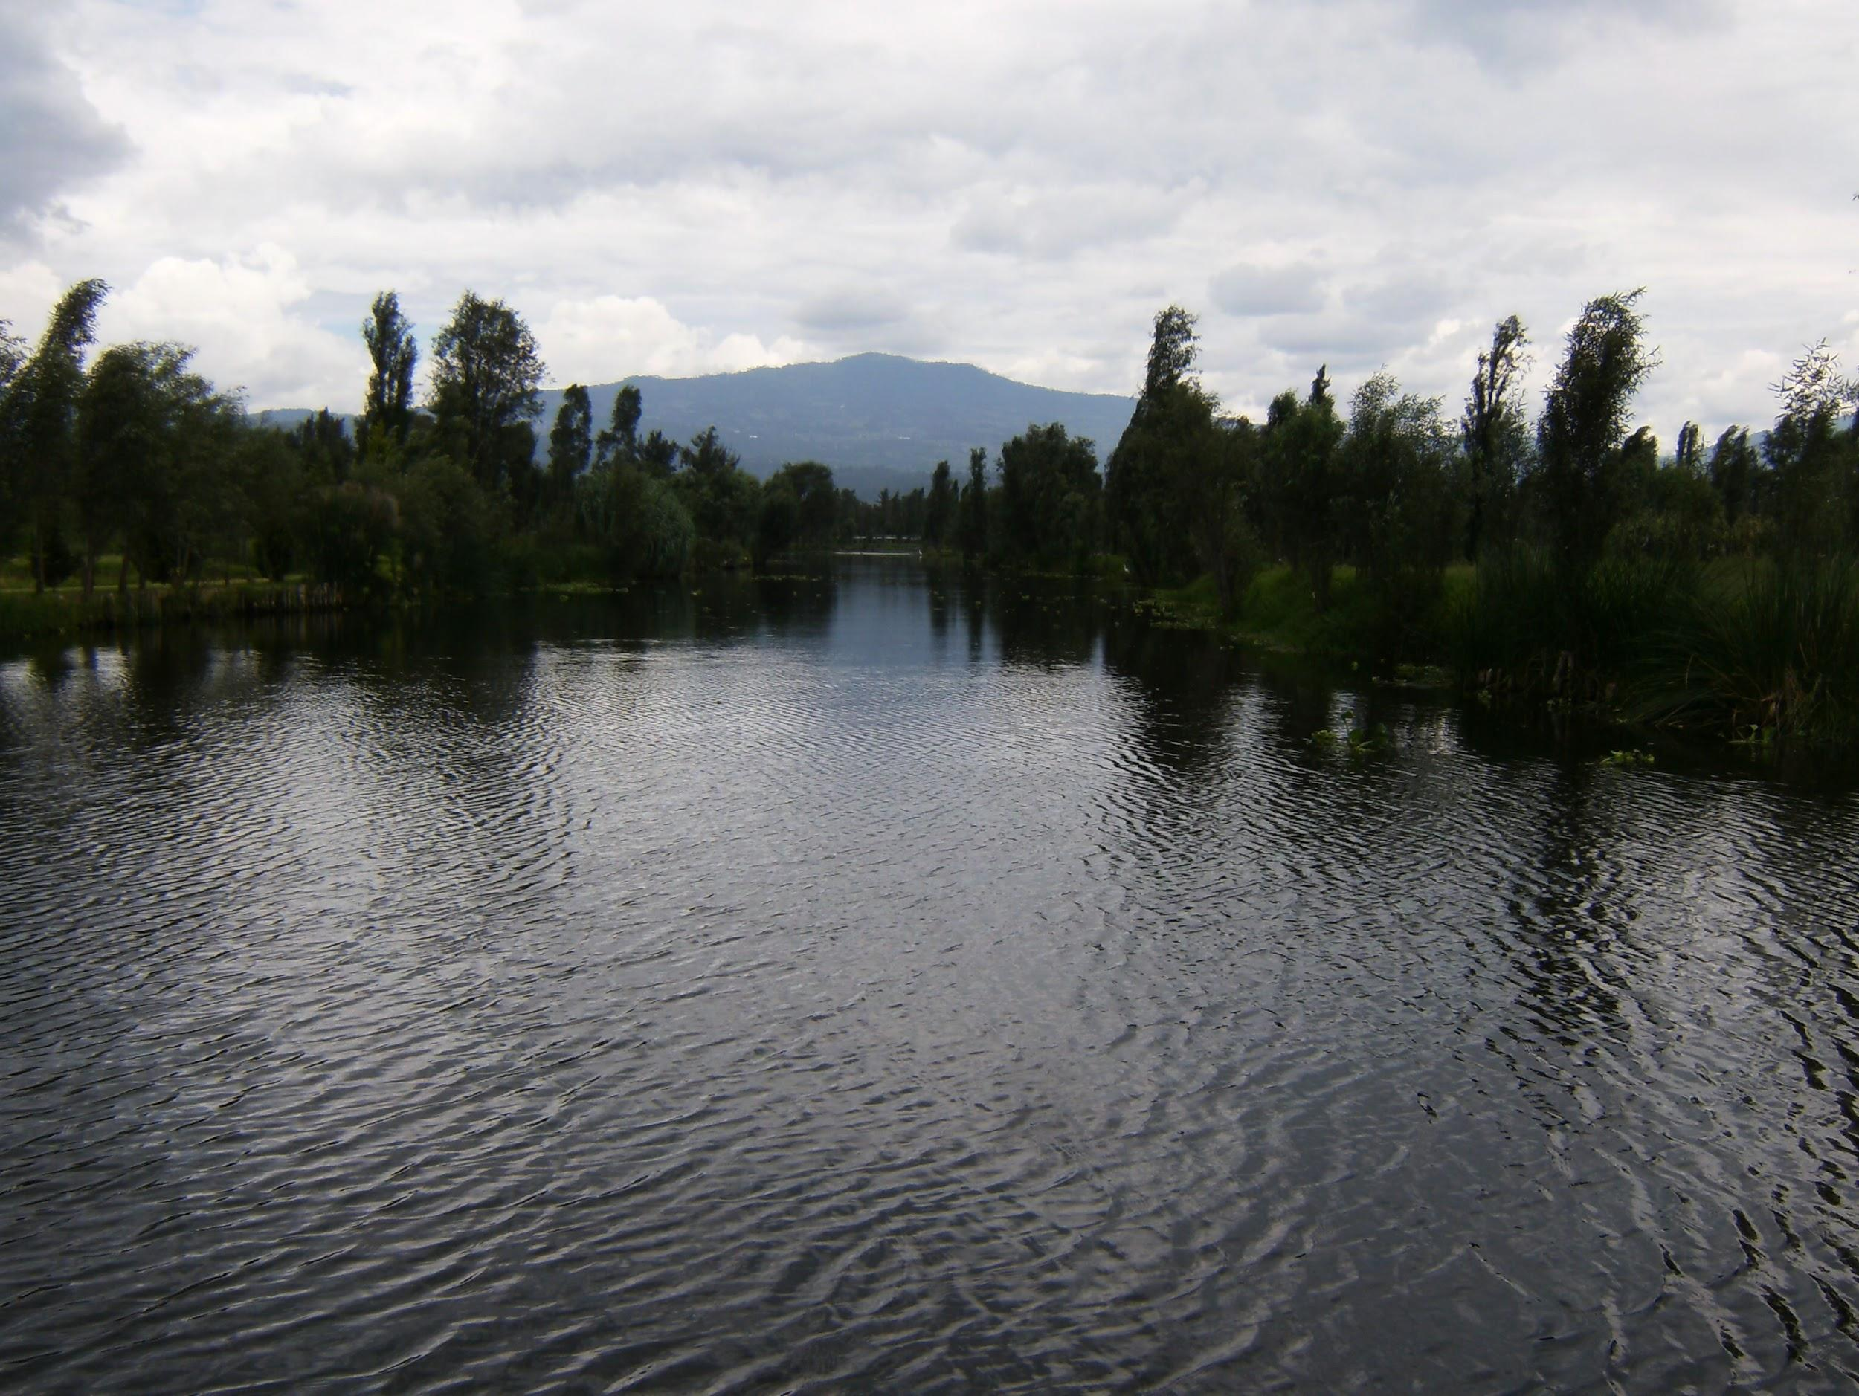
The ecosystem that an Axolotl comes from.
The Axolotl lives in the swampy remnants of Lake Xochimilco.
The Axolotl also lives in canals leading to the southern edge of Mexico City.

Slide 4
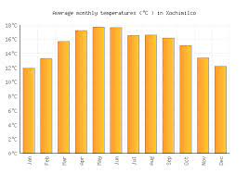
What is the Axolotls ecosystem like?
There ecosystem is in still water lakes.
The temperature of the water that the axolotl lives in usually stays between 74-84 degrees Fahrenheit and it rains between may- September and is usually sunny.

Slide 5
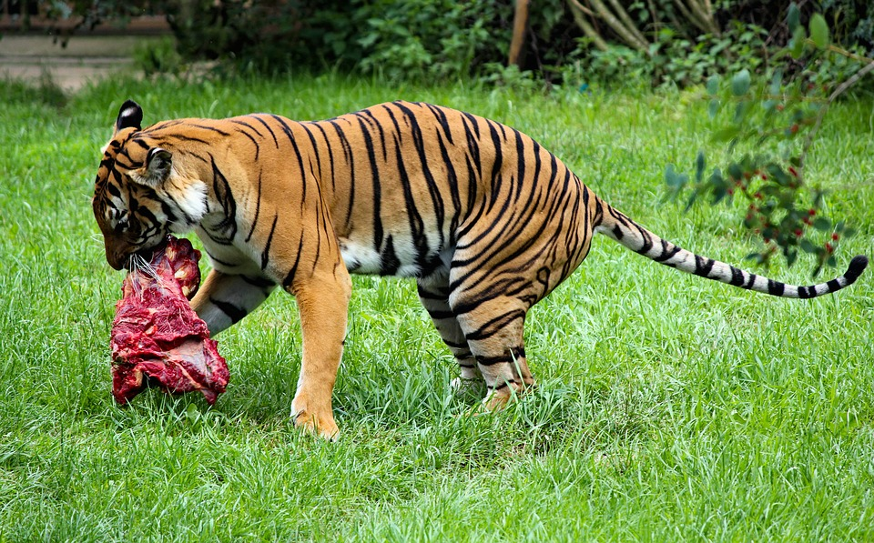
What type of consumer is the Axolotl?
The Axolotl is a carnivore and feeds on purely meat.

Slide 6
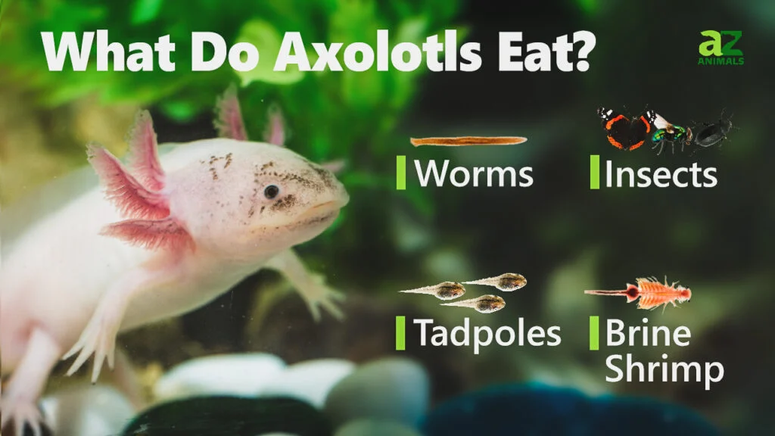
What do Axolotls eat?
The Axolotl eats worms, larvae, insects, tadpoles, and brine shrimp.

Slide 7
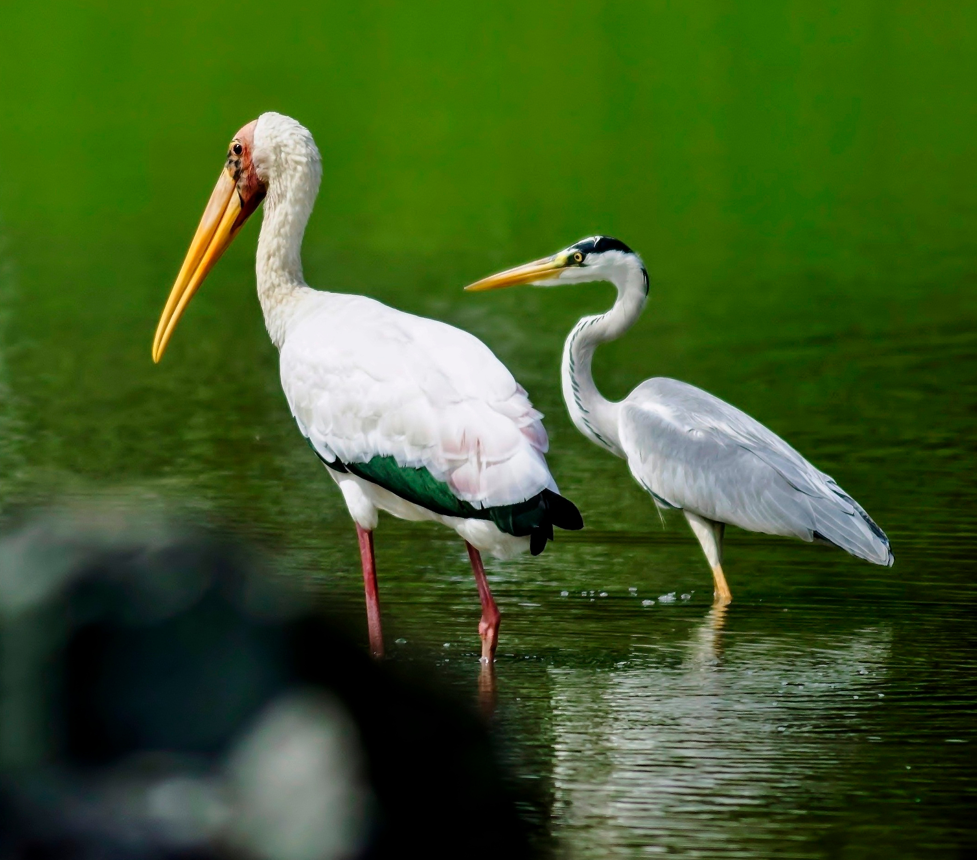
What predators does an Axolotl have?
The Axolotl used to have many predators but now that the new species of fish called the Asian Carp and the African Tilapia.
Also, Storks, Herons, and other large fish tend to pray on the Axolotl.

Slide 8
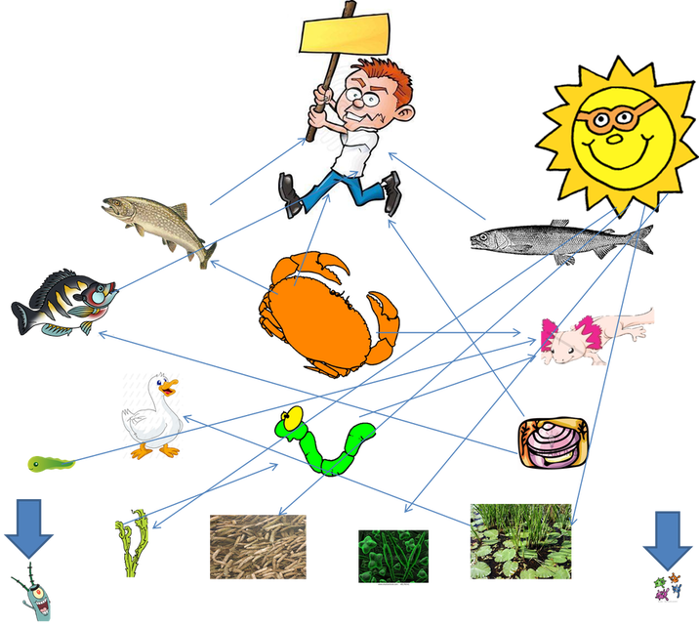
What is the typical food chain of an Axolotl
Usually the plants grow in the lake then the worms and bugs eat them and then usually larger fish eat the Axolotl and then the stork or heron comes and eats the large fish.
Notes:
Hard to read -1

Slide 9
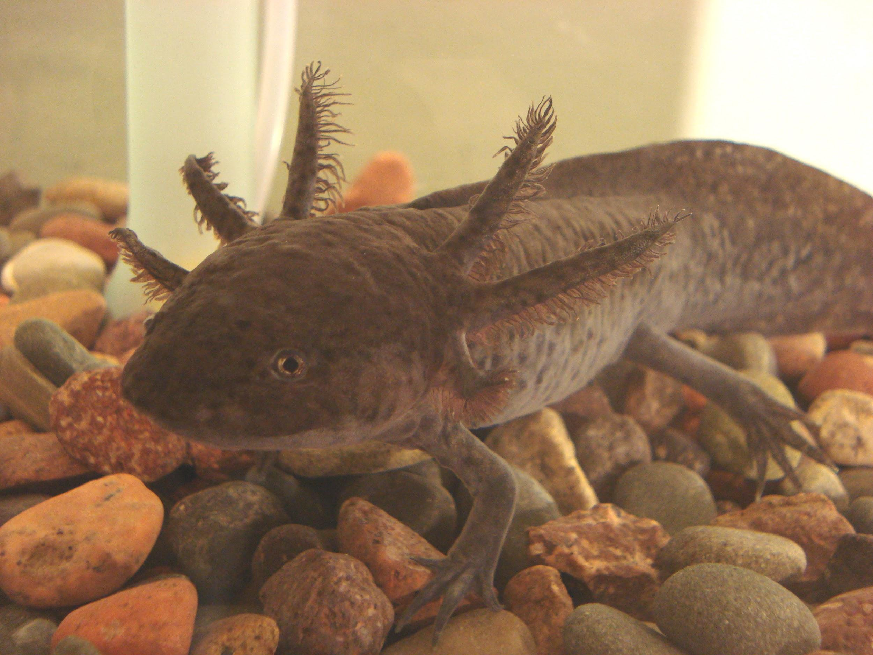
Does the Axolotl have any specific adaptations to survive?
One of the Axolotls most notable adaptations is there ability to blend in with their environment due to some axolotls with the muddy brown color they are able to camouflage in the mud.The Axolotl can also regenerate limbs if they do get chopped off.

Slide 10
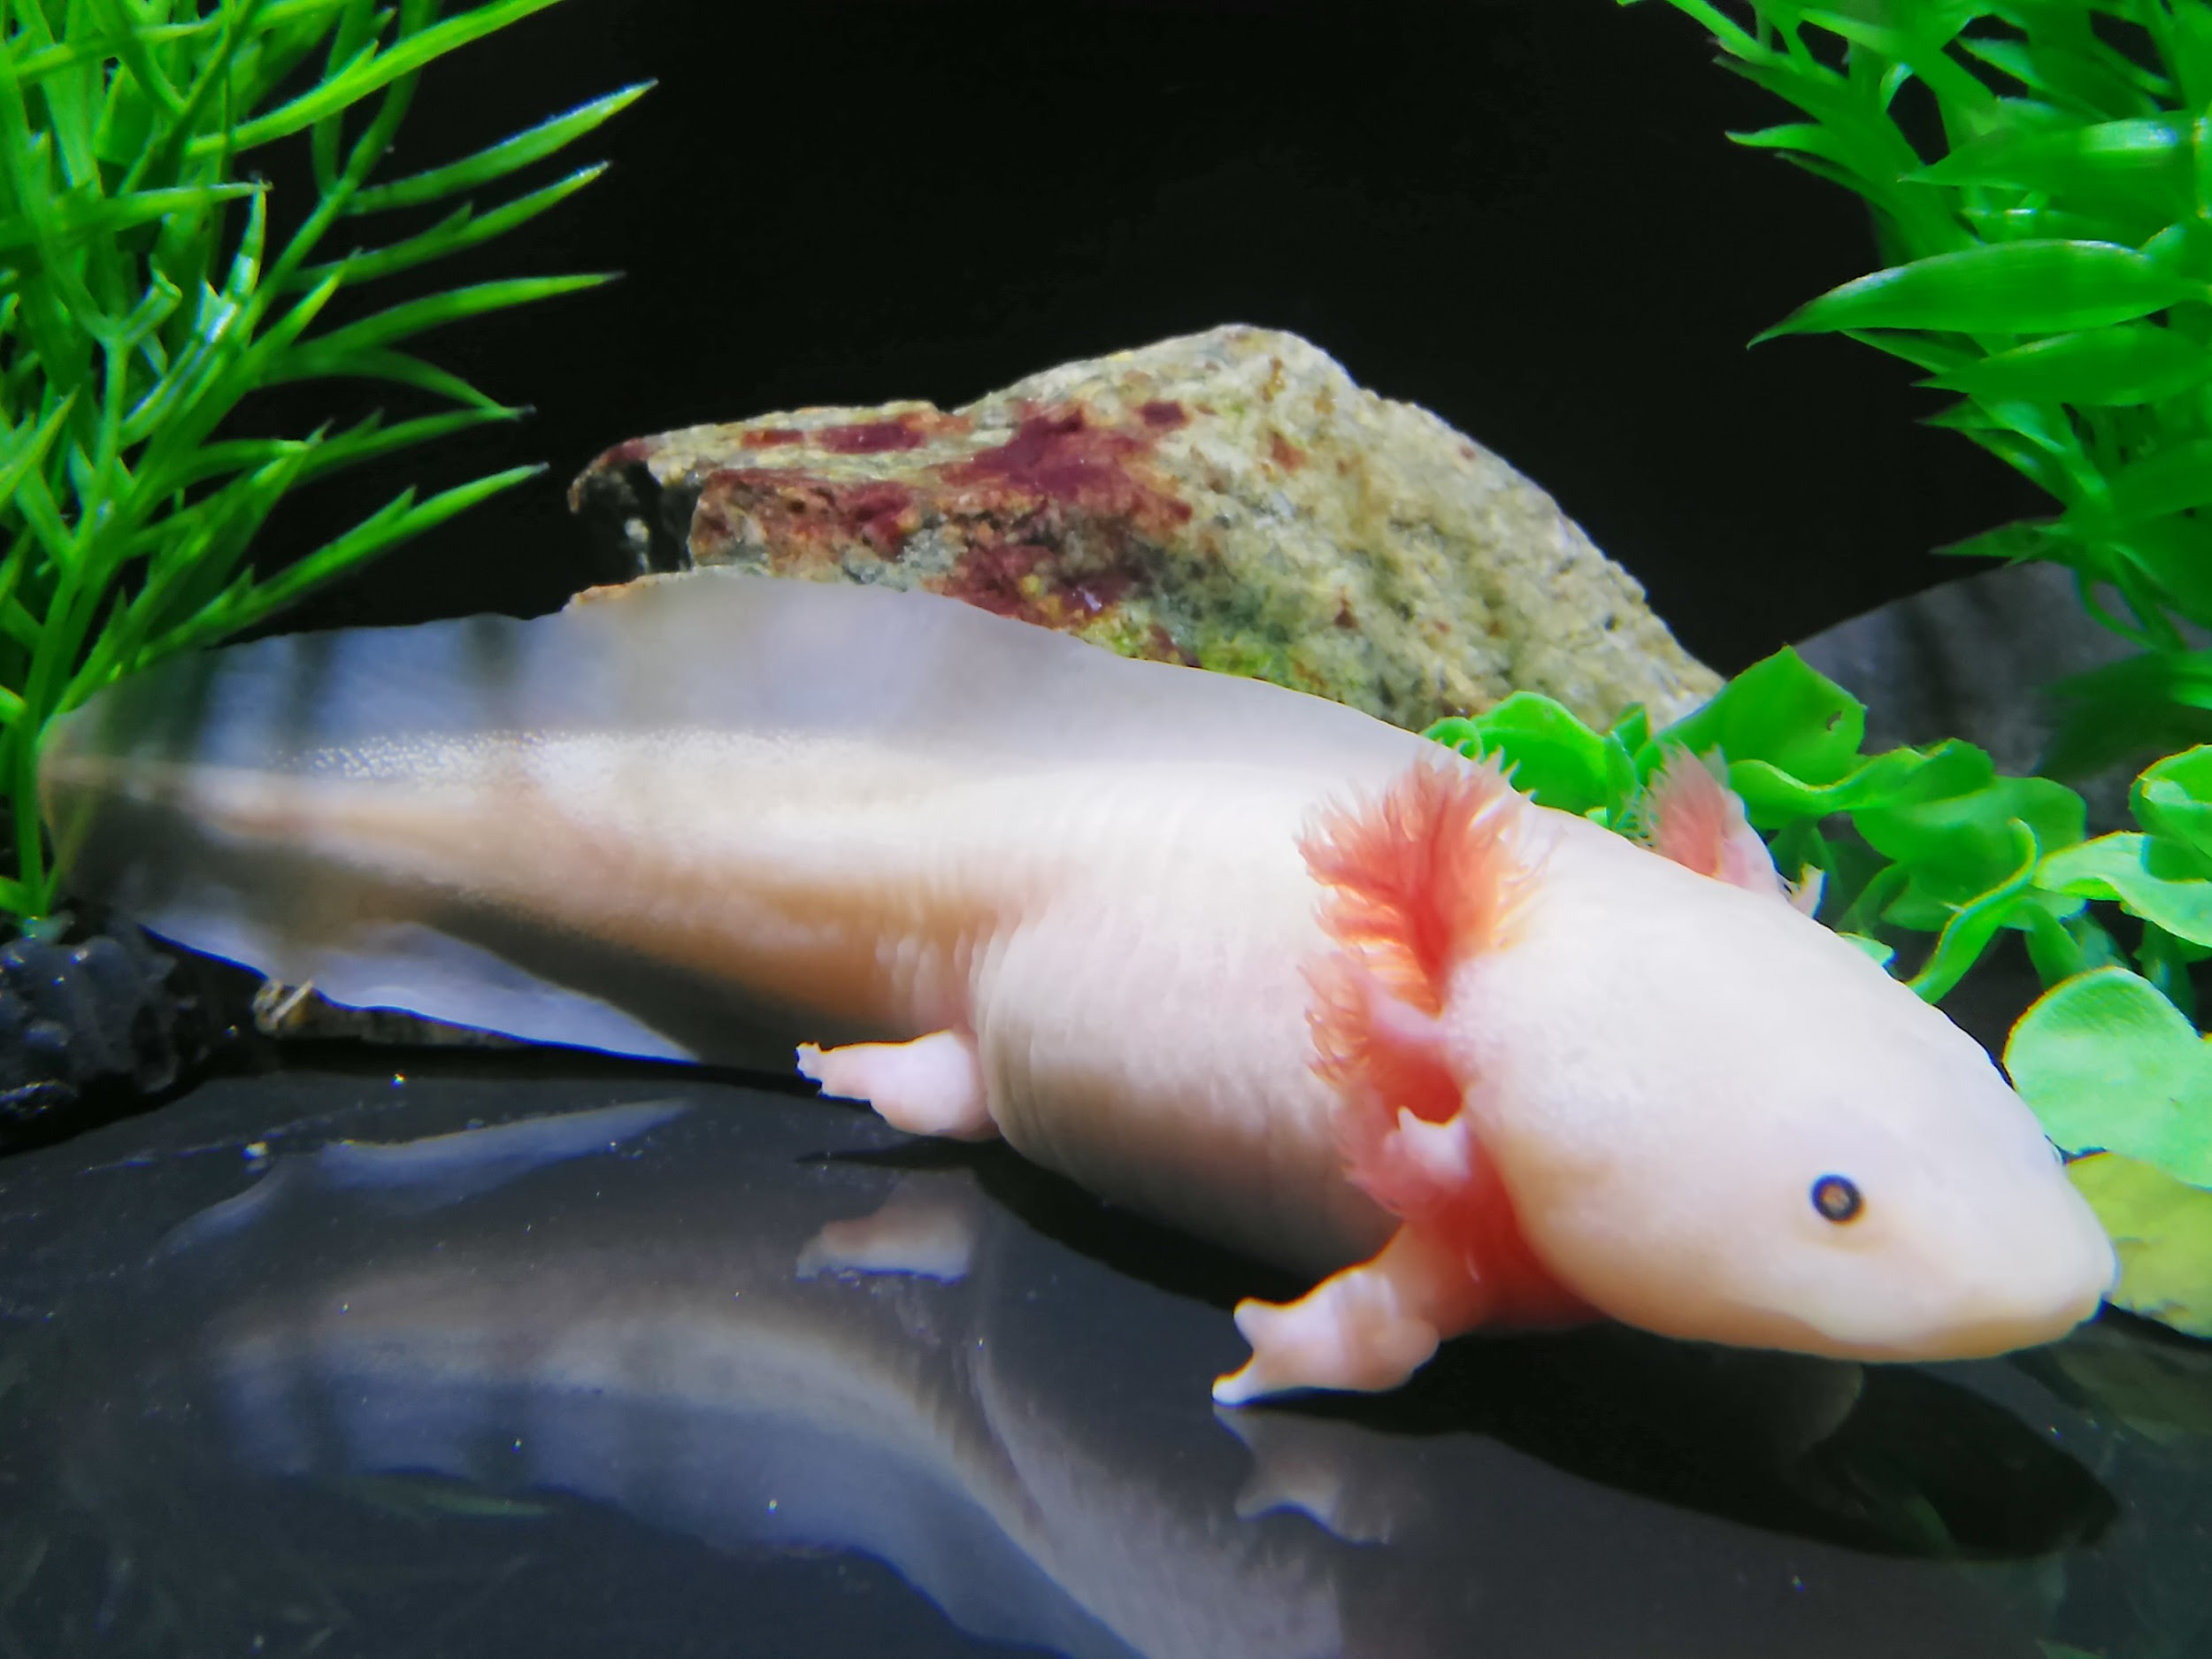
What does the Axolotl look like and how big is it?
The Axolotl looks like a small reptilian fish with legs and a long tail and little frilly gills on its head.The Adult Axolotl can reach of too 12 inches tall and 10.5 ounces in size.

Slide 11
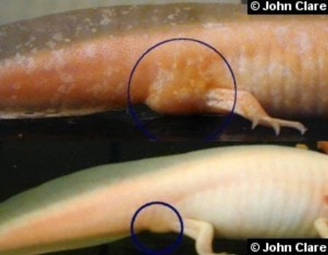
Are the male and female Axolotl the same in size and weight?
The male Axolotl is the smaller gender coming in at 12 inches and 10.5 ounces. The female Axolotl is the bigger gender and comes in at about 18 inches and 14 ounces.

Slide 12
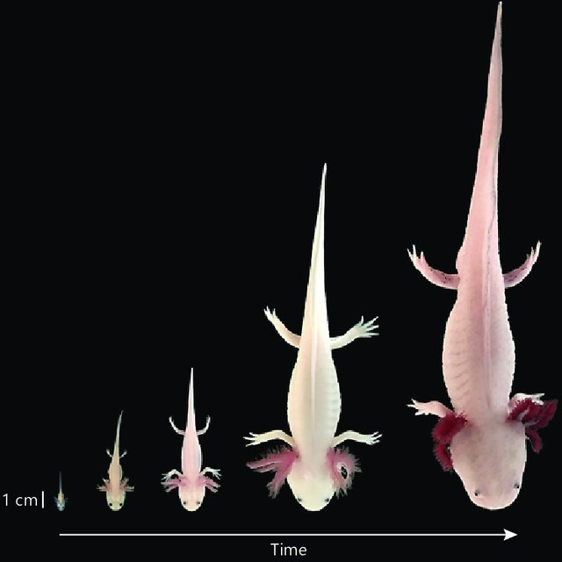
What is the lifespan of the Axolotl?
The lifespan of the axolotl can very from 5-6 years in the wild if well fed. Whereas, in a home they can live up to 7 years.

Slide 13
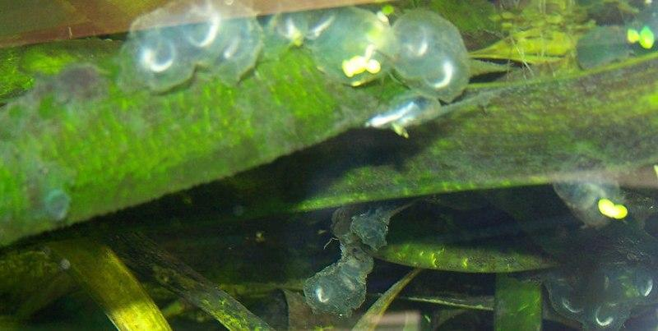
8 Fun Facts About The Axolotl
It has the name “Mexican Walking Fish” because of it similarity to a fish and it has legs.
Axolotls grow lungs and occasionally breath from the surface.
Axolotls look like their always smiling because of there mouth formation.
The Axolotl creature is almost extinct.
The Axolotl can lay from 300 to 1000 eggs!
Axolotl Eggs hatch within 2 weeks from being laid.
The axolotl can be found in only that place in the wild and it's called Lake Xochimilco.
The Axolotl can regrow its organs if necessary.

Slide 14
Sources
https://animalfactguide.com/animal-facts/axolotl/
axolotl | Description, Diet, Habitat, & Lifespan | Britanni
https://axolotlnerd.com

