Slide 1
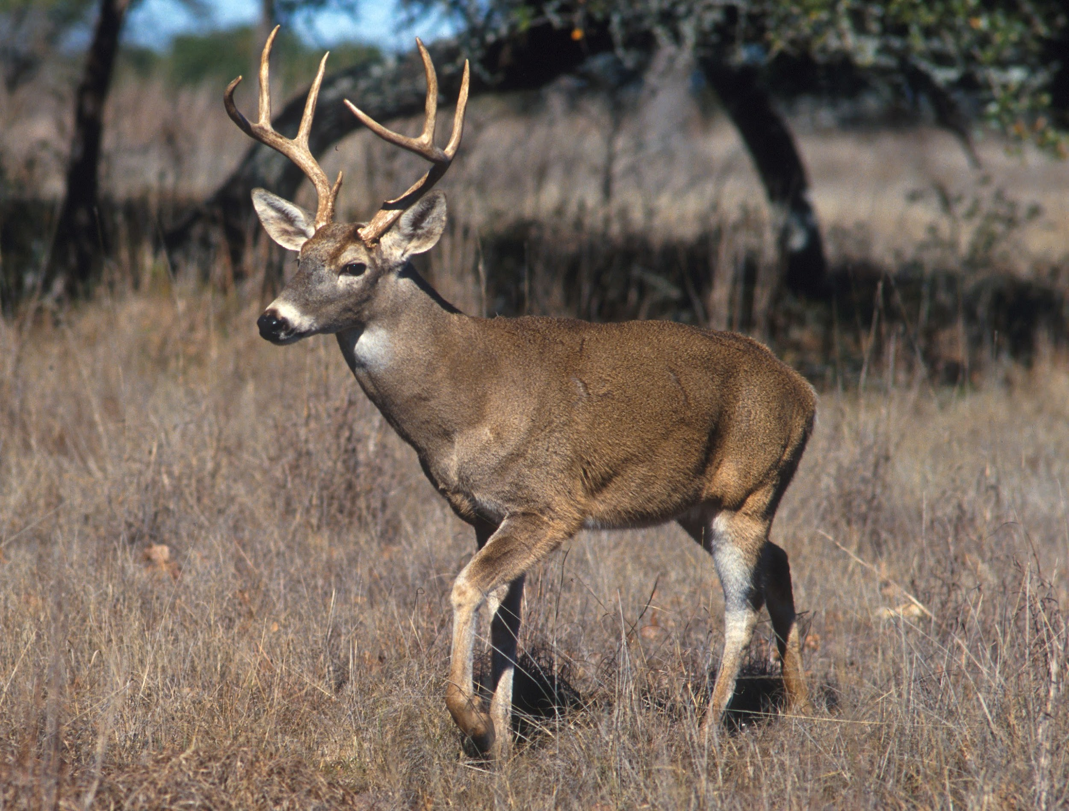
Creature Project
By Allax Howarth
Notes:
1 Background Color
1 Title (or write the question)
1 Pictures
0 Include Transitions
1 Answering question using complete sentences (multiple sentences if needed to fully explain your answer)
1 Accuracy of information
5

Slide 2
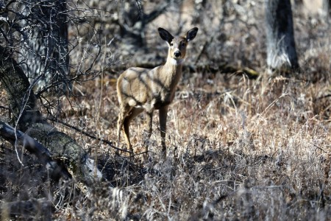
What Is My Creature?
My creature is the Whitetail Deer.
Notes:
1 Background Color
0 Title (or write the question)
0 Pictures
0 Include Transitions
1 Answering question using complete sentences (multiple sentences if needed to fully explain your answer)
1 Accuracy of information
3

Slide 3
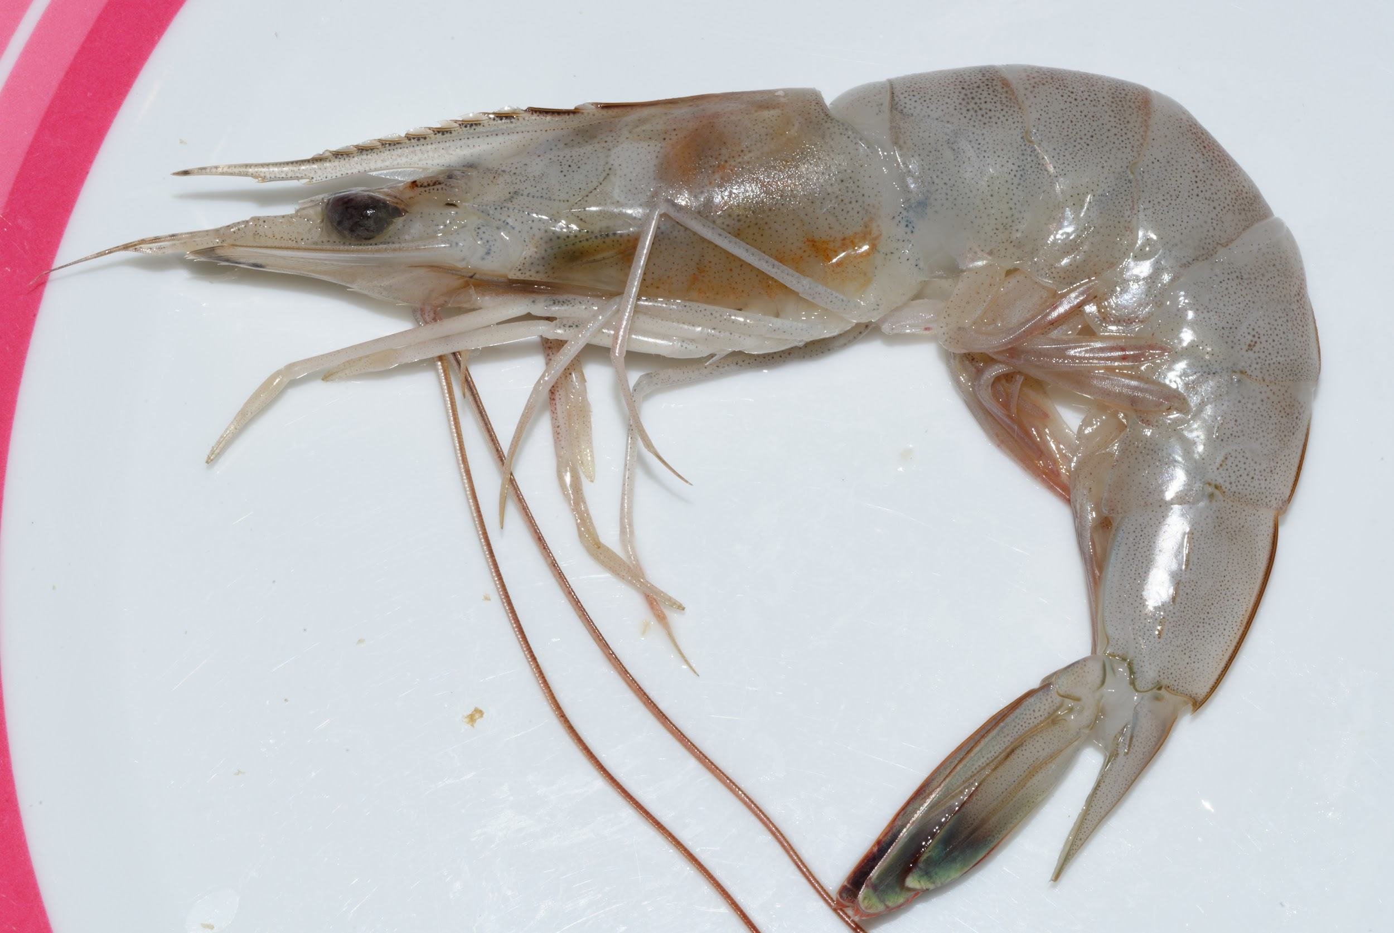
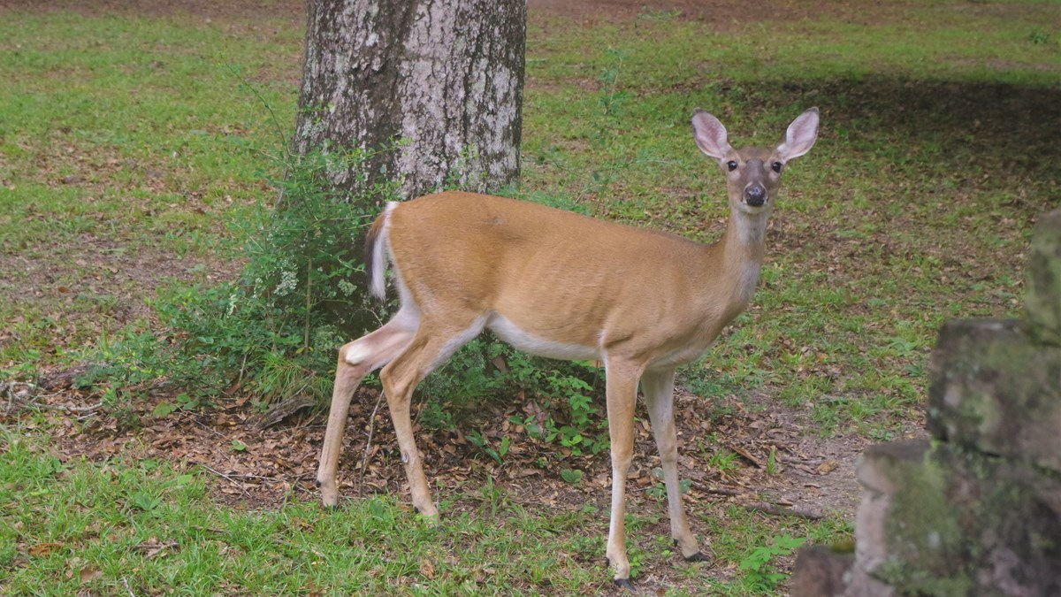
History of the Whitetail Deer And Where They Came From
The Whitetail Deer is native from the southernmost regions of Canada to the Northernmost regions of South America. Whitetail Deer typically inhabit fields and meadows. Whitetail Deer are in the Cervidae family of mammals.
Notes:
0 Background Color
1 Title (or write the question)
1 Pictures
1 Include Transitions
0 Answering question using complete sentences (multiple sentences if needed to fully explain your answer)
1 Accuracy of information
Text is hard to read
4

Slide 4

This is an extreme example of the Whitetail deer’s climate. Montana is one of the northernmost states of the United states being on the border with Canada.
Notes:
0 Background Color
0 Title (or write the question)
1 Pictures
0 Include Transitions
1 Answering question using complete sentences (multiple sentences if needed to fully explain your answer)
0 Accuracy of information
Vague
2

Slide 5

What Does the Whitetail Deer Consume?
The Whitetail Deer is a Herbivore, meaning it does not eat meat. A Whitetail Deer’s Diet may consist of grass, mushrooms, leaves and seeds.
Notes:
1 Background Color
1 Title (or write the question)
0 Pictures
0 Include Transitions
0 Answering question using complete sentences (multiple sentences if needed to fully explain your answer)
1 Accuracy of information
Text is hard to read against background
3

Slide 6
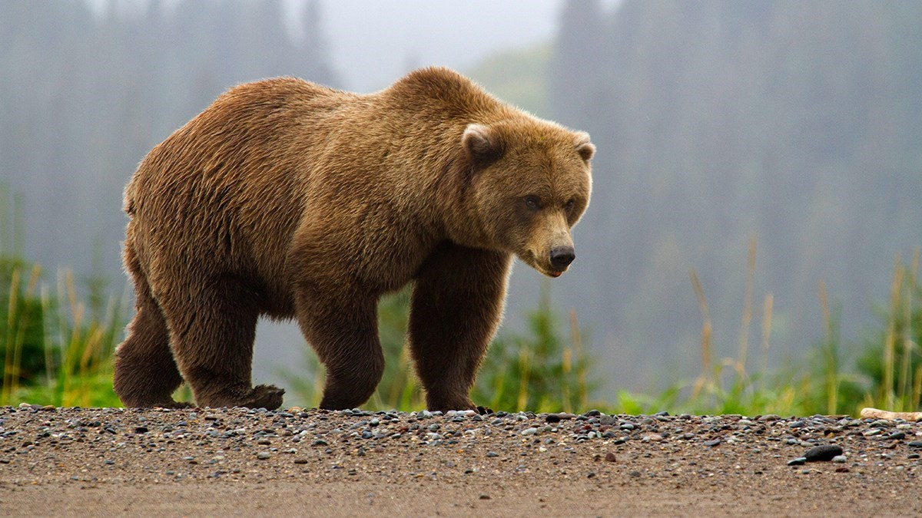
What Hunts the Whitetail Deer?
The Whitetail Deer may be hunted by Bears, jaguars, coyotes, wolves, mountain lions and us humans. The Whitetail deer’s most prominent predator is human because populations of most other predators have dwindled.
Notes:
1 Background Color
1 Title (or write the question)
0 Pictures
0 Include Transitions
0 Answering question using complete sentences (multiple sentences if needed to fully explain your answer)
1 Accuracy of information
Hard to read this is true for all slides…
3

Slide 7
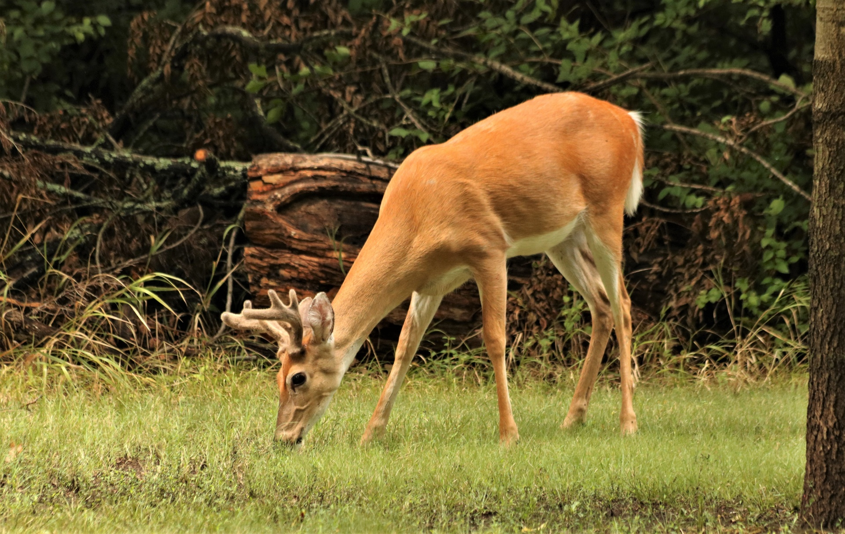
Where Is the Whitetail Deer On the Food Chain?
The Whitetail Deer eats primary producers and get eaten by omnivores and carnivores.
Notes:
1 Background Color
1 Title (or write the question)
0 Pictures
0 Include Transitions
0 Answering question using complete sentences (multiple sentences if needed to fully explain your answer)
1 Accuracy of information
3

Slide 8
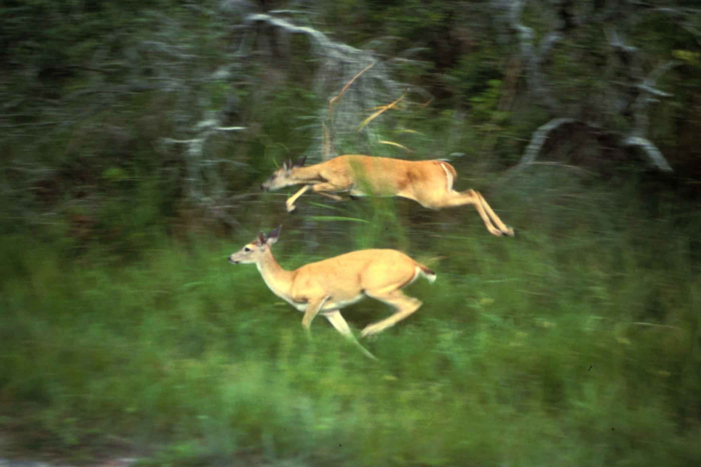
The Whitetail Deer’s Survival Tactics
Whitetail Deer have coats with hollow hairs that insulate it in the cold. The Whitetail Deer also have long legs that allow it to travel at speeds up to 30mph. lastly ,it has color changing coat that helps it blend in during different seasons.
Notes:
1 Background Color
1 Title (or write the question)
0 Pictures
0 Include Transitions
0 Answering question using complete sentences (multiple sentences if needed to fully explain your answer)
1 Accuracy of information
3

Slide 9
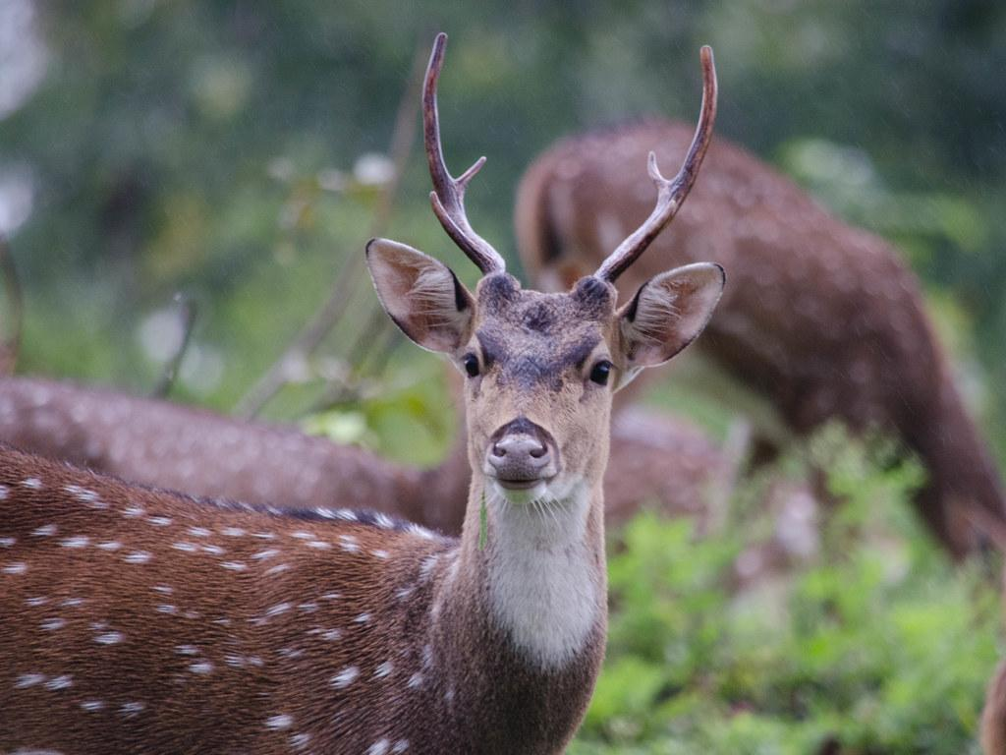
What Does the Whitetail Deer look like?
The whitetail deer has long legs, a white tail, white around its eyes, nose and stomach. Males have antlers. Males can weigh between 150 to 300 lbs and females can weigh 90 to 200 lbs. Adult Whitetail Deer can be as tall as 1.7 to 3.9 feet tall at the shoulder.
Notes:
1 Background Color
1 Title (or write the question)
0 Pictures
0 Include Transitions
0 Answering question using complete sentences (multiple sentences if needed to fully explain your answer)
1 Accuracy of information
3

Slide 10
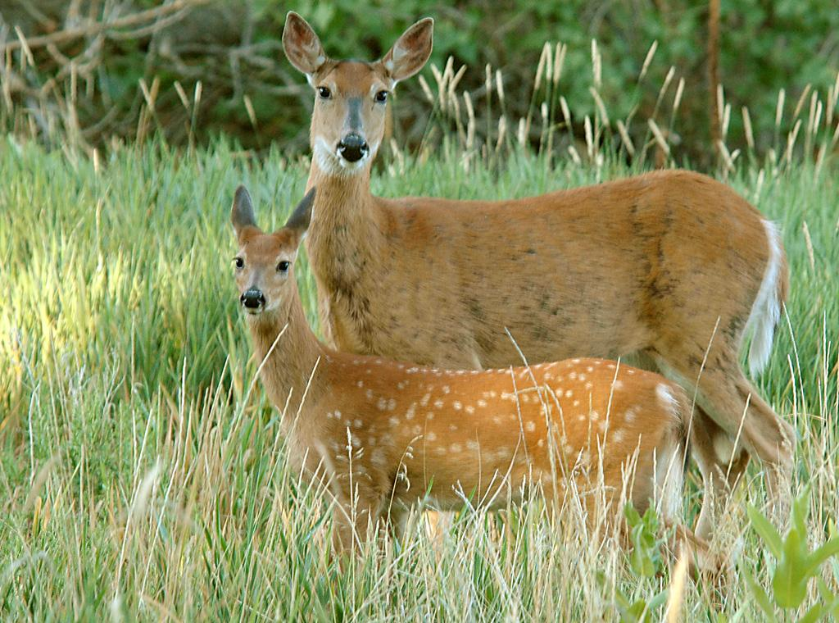
Do Male And Female Whitetail Deer Look and Weigh the same?
No, Whitetail Deer don’t Weigh or look the same, although they are similar.
Notes:
1 Background Color
1 Title (or write the question)
0 Pictures
0 Include Transitions
0 Answering question using complete sentences (multiple sentences if needed to fully explain your answer)
1 Accuracy of information
3

Slide 11
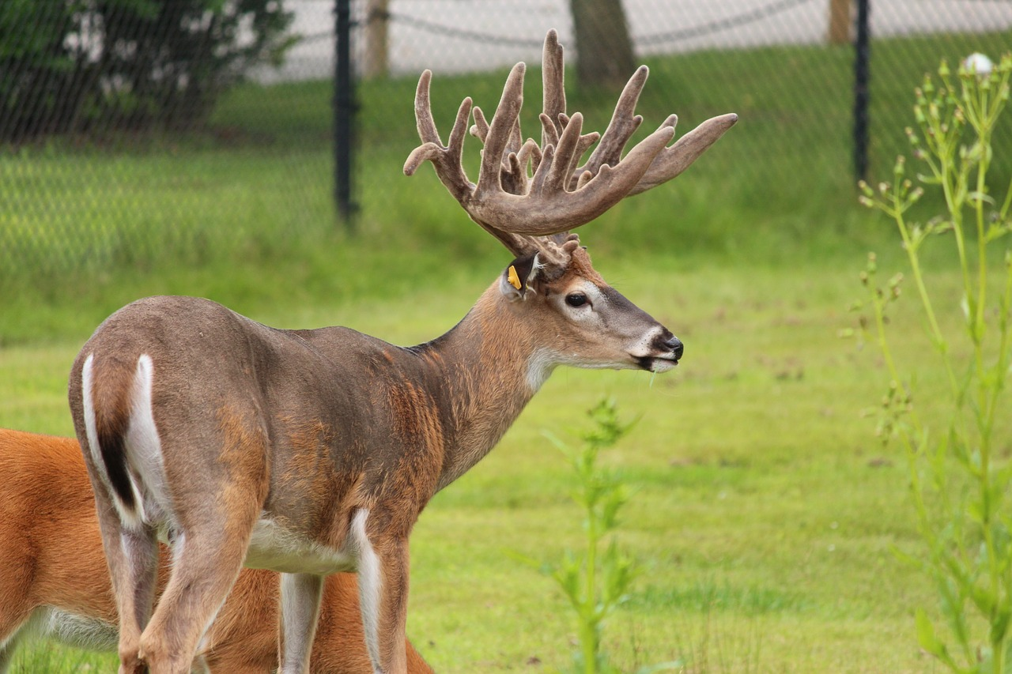
What Is the Whitetail Deer’s average lifespan?
The average Whitetail Deer’s lifespan is 2 to 3 years old although they can get as old as 20.
Notes:
1 Background Color
1 Title (or write the question)
0 Pictures
0 Include Transitions
0 Answering question using complete sentences (multiple sentences if needed to fully explain your answer)
1 Accuracy of information
3

Slide 12
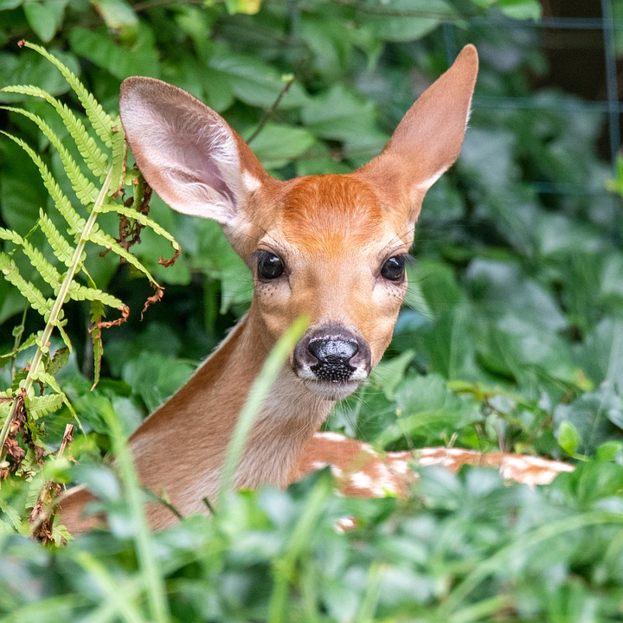
8 Facts About the Whitetail Deer - Part 1 of 2
1- Whitetail Deer are found in North America ,Central America, and South America
2- Whitetail Deer are the most common deer species in North America
3- Only some Individuals migrate
4-Whitetail Deer grazing can influence the Ecosystem.
Notes:
1 Background Color
1 Title (or write the question)
0 Pictures
0 Include Transitions
0 Answering question using complete sentences (multiple sentences if needed to fully explain your answer)
1 Accuracy of information
3

Slide 13
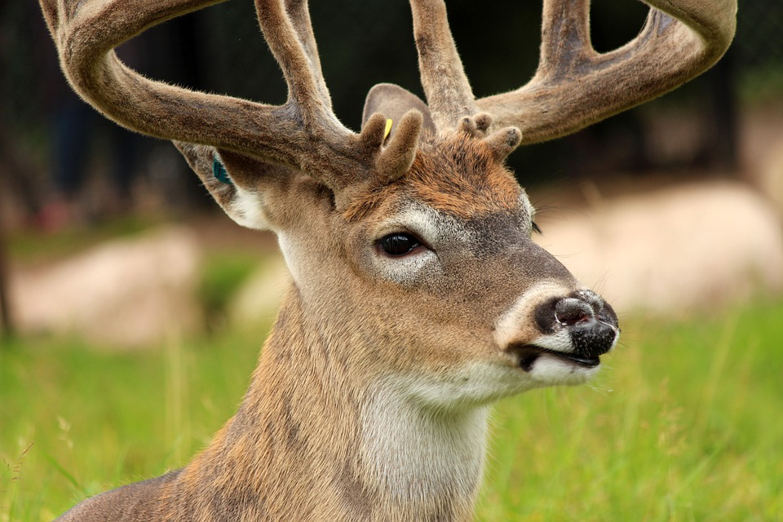
8 Facts About the Whitetail Deer - Part 2 of 2
5- They often live alone
6- Disney’s Bambi was modeled after a Whitetail Deer
7- They live 3 times longer in captivity then the wild
8- Only bucks grow antlers
Notes:
1 Background Color
1 Title (or write the question)
0 Pictures
0 Include Transitions
0 Answering question using complete sentences (multiple sentences if needed to fully explain your answer)
1 Accuracy of information
2

Slide 14
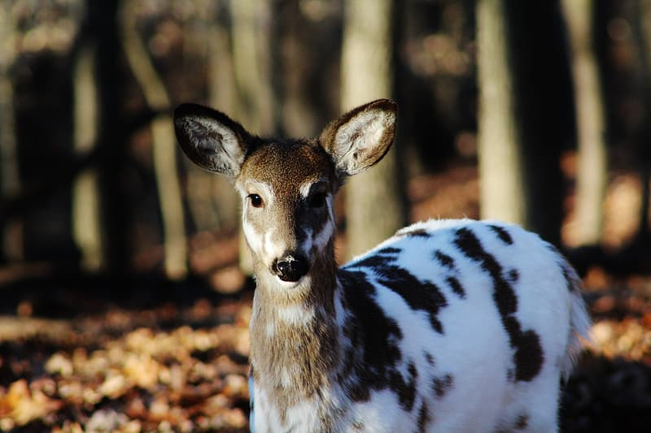
Credit To My Sources
Credit to: nationalgeographic.com, weather.com, msudeer.msstate.edu, biokids.umich.edu, cosleyzoo.org, animals.com, nhpbs.org and treehugger.com
Notes:
1 Background Color
0 Title (or write the question)
0 Pictures
0 Include Transitions
0 Answering question using complete sentences (multiple sentences if needed to fully explain your answer)
1 Accuracy of information
Did you miss a slide, you made two from the 8 things but still have only 14

