Slide 1
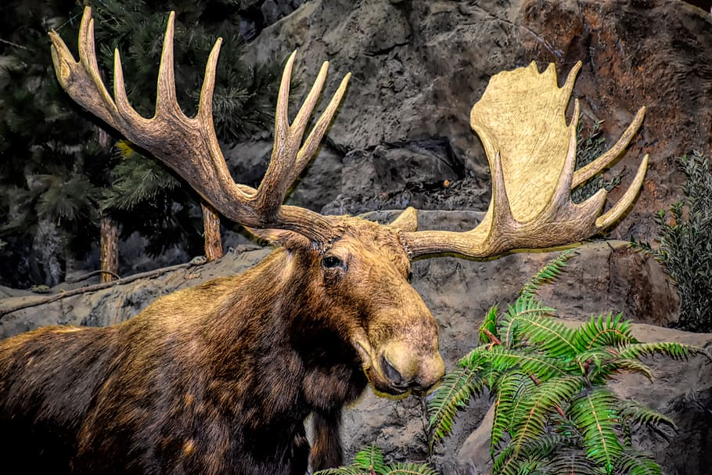
Shiras moose
Notes:
1 Background Color
1 Title (or write the question)
1 Pictures
1 Include Transitions
0 Answering question using complete sentences (multiple sentences if needed to fully explain your answer)
1 Accuracy of information
5
When the title is like this Moose would be capitalized as well. Your name is not present here..

Slide 2

Where Does Shiras Moose Come From
Shiras moose is found throughout southwest Canada and the States, it is the smallest out of 3 mooas found in North America
Notes:
1 Background Color
1 Title (or write the question)
1 Pictures
1 Include Transitions
0 Answering question using complete sentences (multiple sentences if needed to fully explain your answer)
1 Accuracy of information
5
Please put a question mark on the title. There is an extra space between moose and is. ….States, and is the smallest out of the three types of moose found……

Slide 3
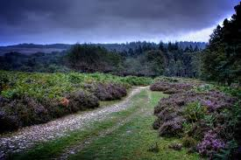
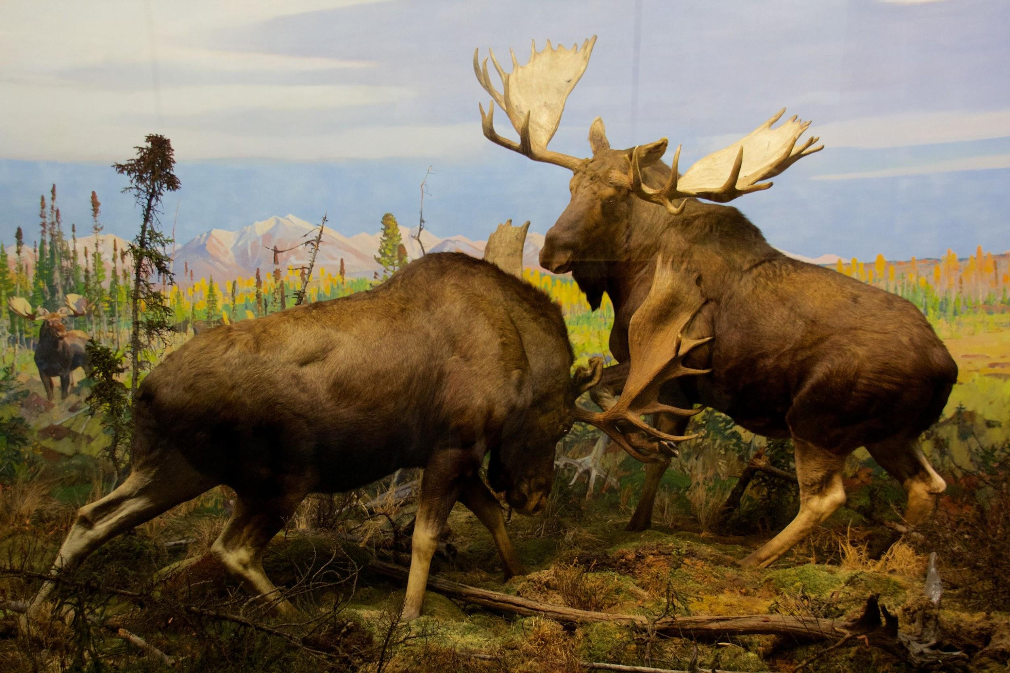
Ecosystem
Shiras moose ecosystem live in forested areas and willow flats from southeastern
Notes:
1 Background Color
1 Title (or write the question)
1 Pictures
1 Include Transitions
0 Answering question using complete sentences (multiple sentences if needed to fully explain your answer)
1 Accuracy of information
5
Please remove the word ecosystem in the sentence. Also, it seems the sentence is incomplete. Southeastern Canada?

Slide 4
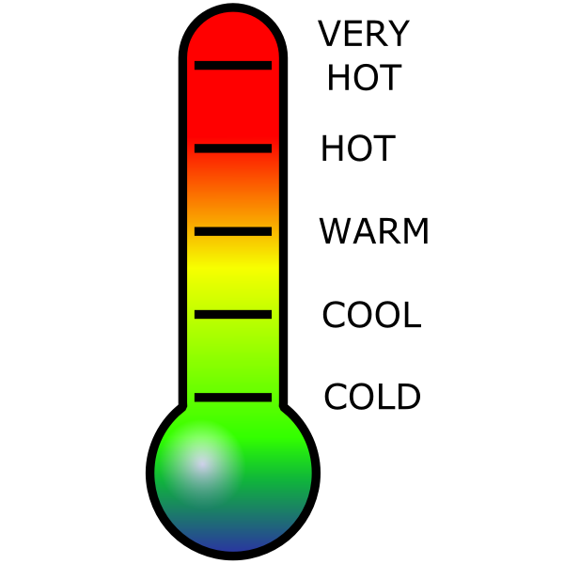
weather
The weather for shiras moose is at summer temperatures above 57oF and winter temperatures above 23oF moose start to heat stress
Notes:
1 Background Color
1 Title (or write the question)
1 Pictures
1 Include Transitions
0 Answering question using complete sentences (multiple sentences if needed to fully explain your answer)
1 Accuracy of information
5
Weather should be capitalized in the title. Spell out deg. This sentence is awkward and makes little sense. Please reword it to make it clearer.

Slide 5
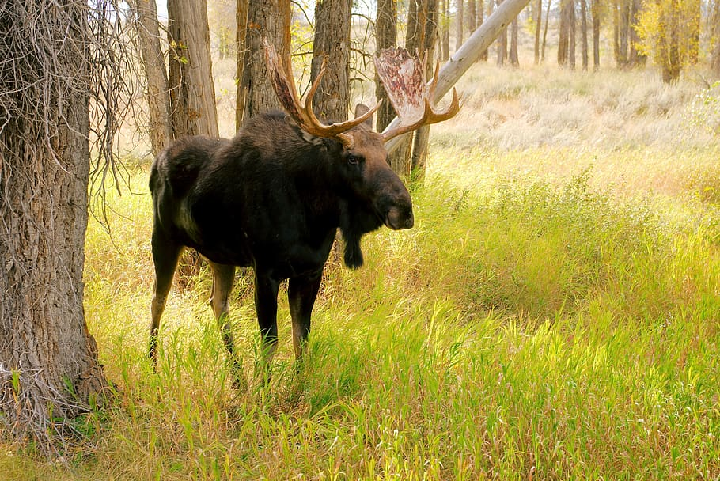
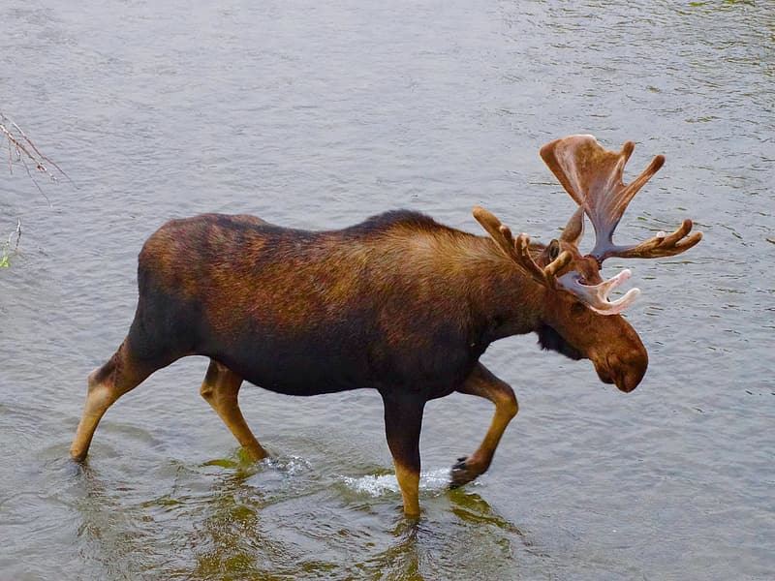
Consumer
The shiras moose is a herbivores.
Notes:
1 Background Color
1 Title (or write the question)
1 Pictures
1 Include Transitions
0 Answering question using complete sentences (multiple sentences if needed to fully explain your answer)
1 Accuracy of information
5
Herbivore should be singler.

Slide 6
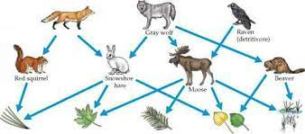
Food chain
Moose eats plants because it is good for then
Notes:
1 Background Color
1 Title (or write the question)
1 Pictures
1 Include Transitions
0 Answering question using complete sentences (multiple sentences if needed to fully explain your answer)
1 Accuracy of information
5
When the title is not a sentence Capitalize all words… Food Chain. …eat should be singular. Them, not then..

Slide 7
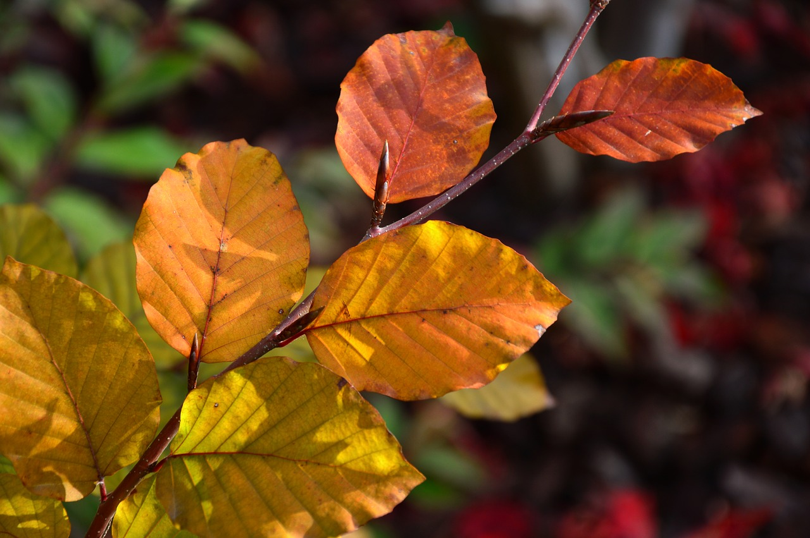
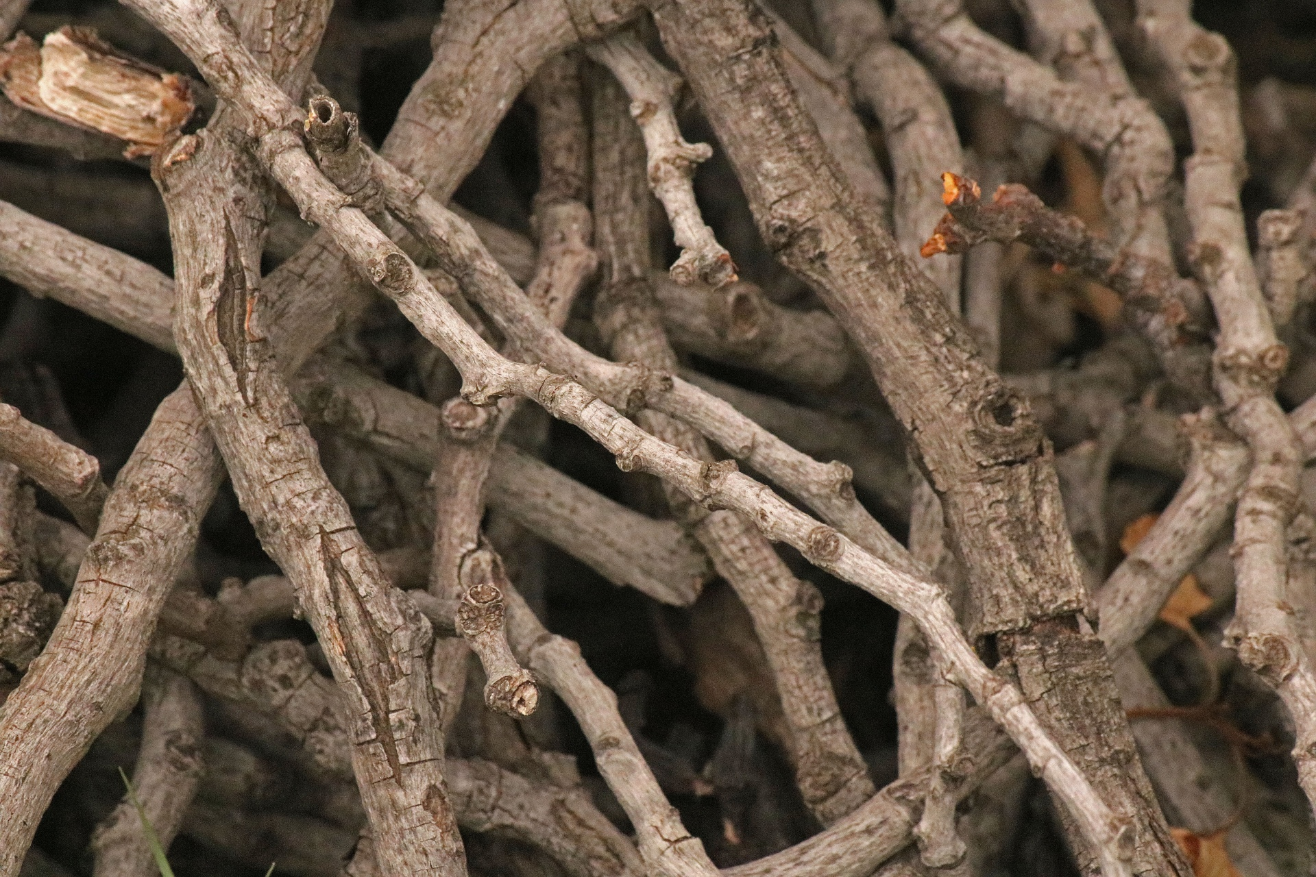
What Food Dose It Eat
The shiras moose eats leaves, twigs, buds and aquatic vegetation
Notes:
1 Background Color
1 Title (or write the question)
1 Pictures
1 Include Transitions
0 Answering question using complete sentences (multiple sentences if needed to fully explain your answer)
1 Accuracy of information
5
….Does It Eat… Here this is actually a sentence so it would be What food does it eat? Please place a period after vegetation.

Slide 8
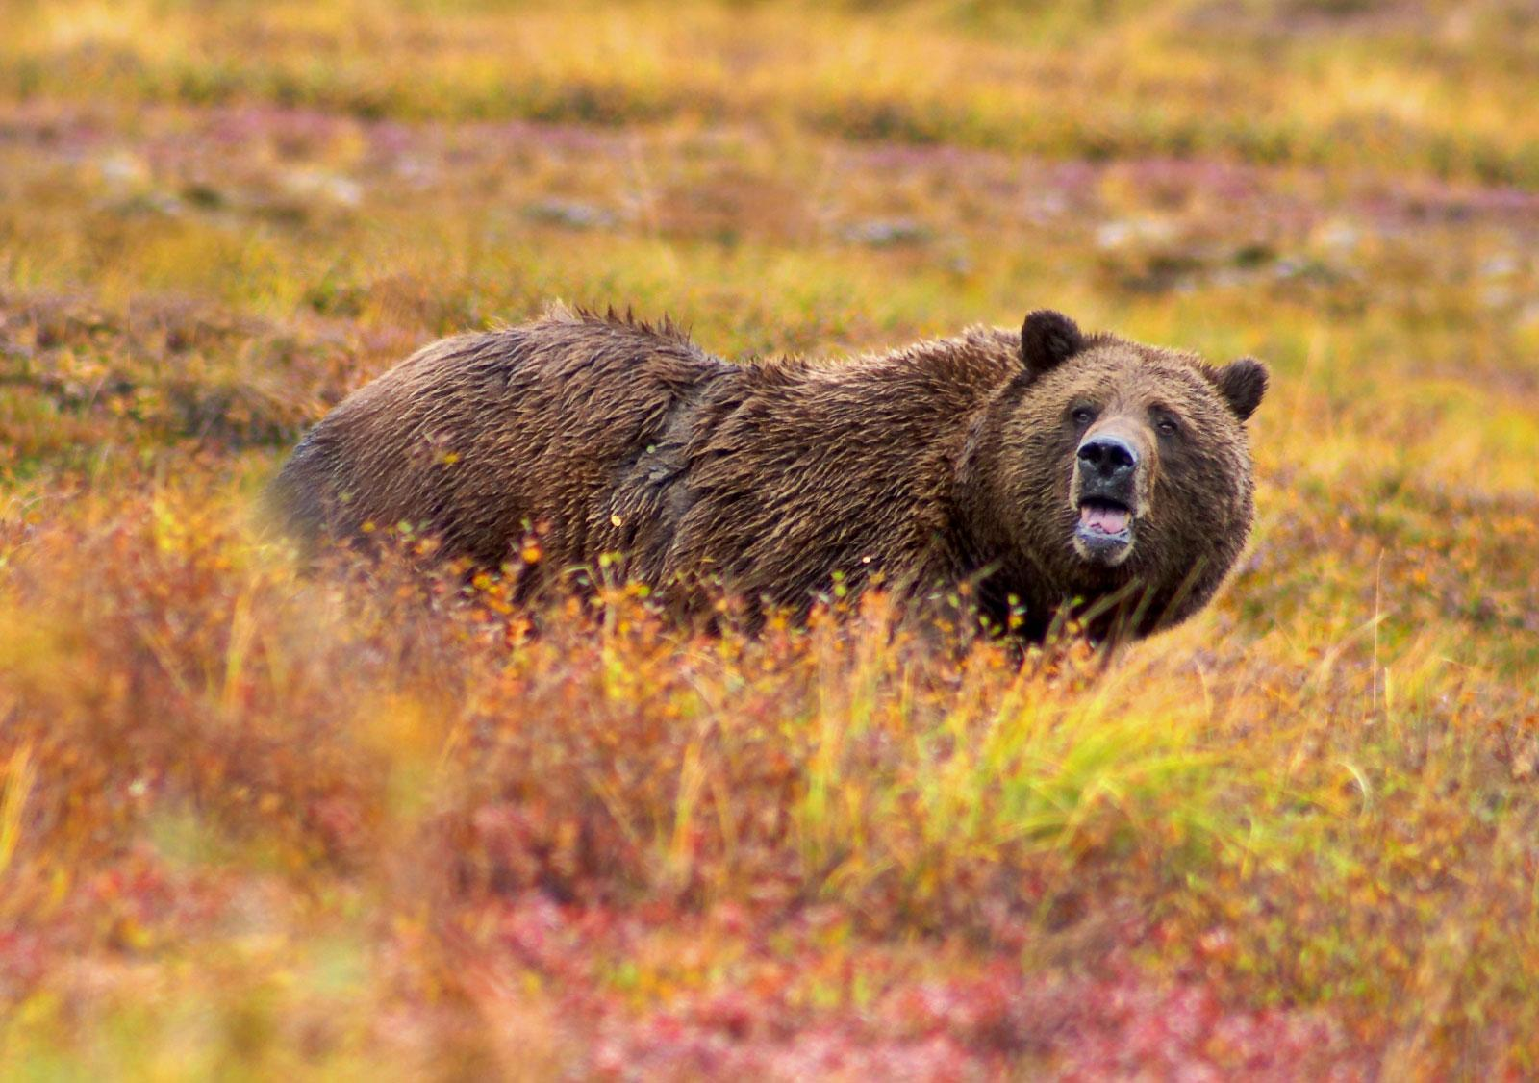
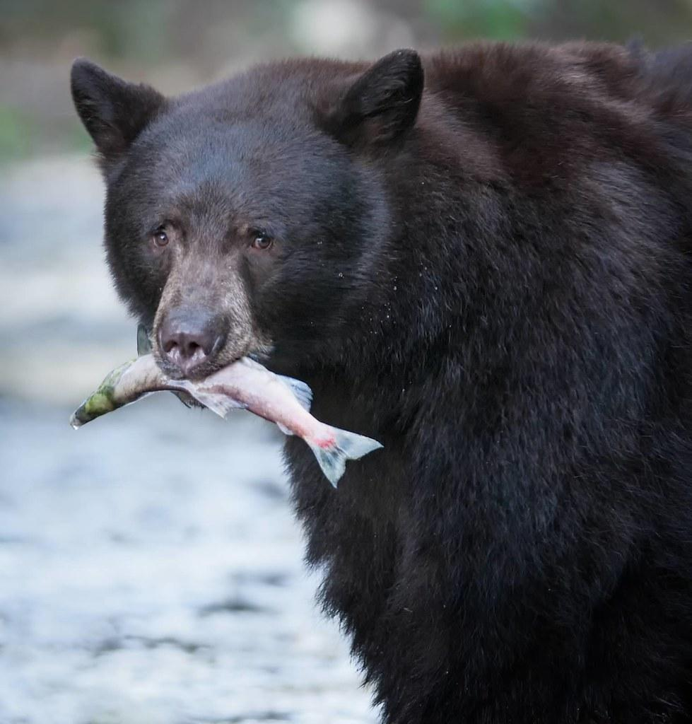
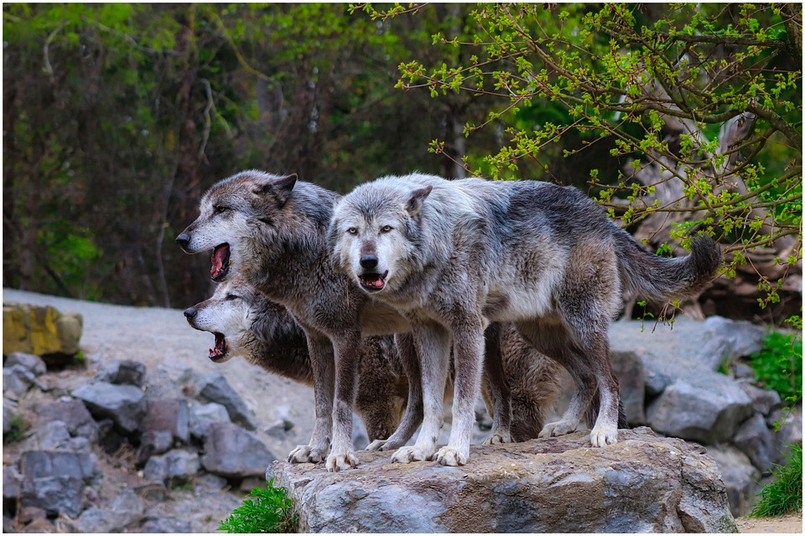
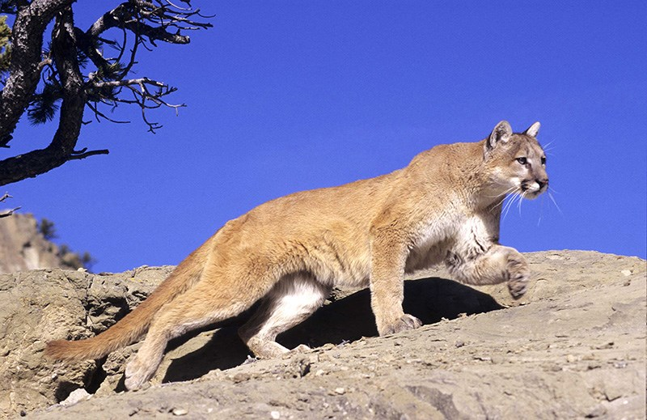
Predators
Shiras moose predators are black bears, grizzly bears, wolves and mountain lions.
Notes:
1 Background Color
1 Title (or write the question)
1 Pictures
1 Include Transitions
0 Answering question using complete sentences (multiple sentences if needed to fully explain your answer)
1 Accuracy of information
5
The way this is worded you need to put “The” in the front of the sentence. ….wolves, and lions.

Slide 9
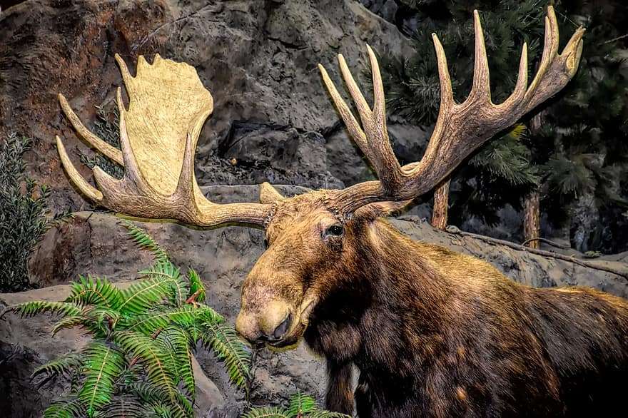
Help It Survive
The shiras moose will shed its large, heavy antlers as winter begins, which helps it to conserve energy
Notes:
1 Background Color
1 Title (or write the question)
1 Pictures
1 Include Transitions
0 Answering question using complete sentences (multiple sentences if needed to fully explain your answer)
1 Accuracy of information
5
Place a period after energy.

Slide 10
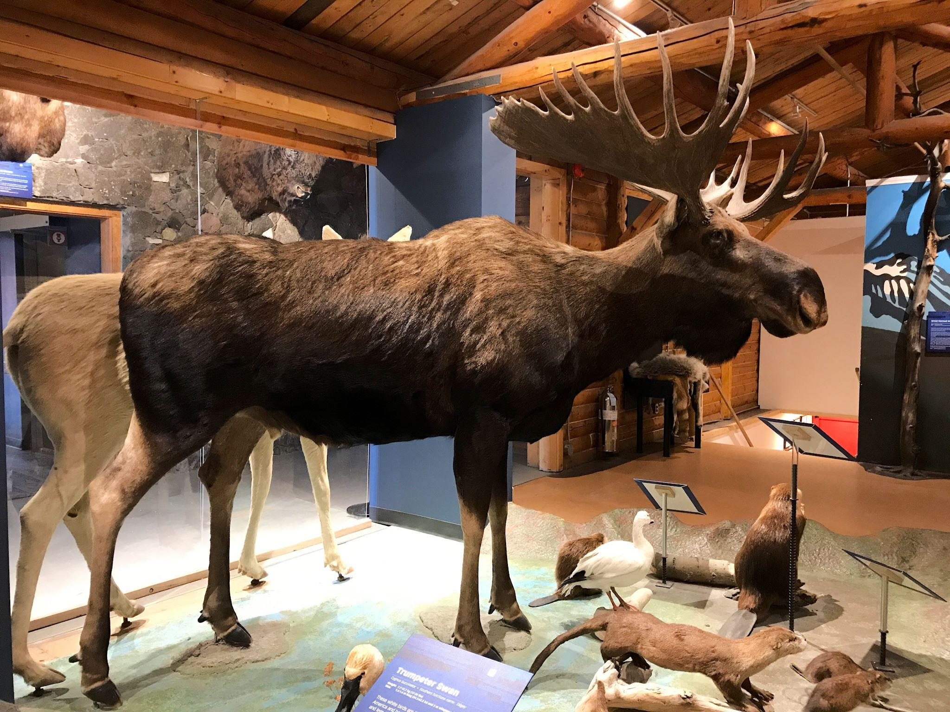
Shiras moose can weight up to 600 to 1,400 pounds
Shiras moose can de 10 feet tall
Notes:
1 Background Color
0 Title (or write the question)
1 Pictures
1 Include Transitions
0 Answering question using complete sentences (multiple sentences if needed to fully explain your answer)
1 Accuracy of information
4
This slide has no title. ….can weigh from 600 pounds to 1400 pounds. Shiras moose can be 10 feet tall.

Slide 11
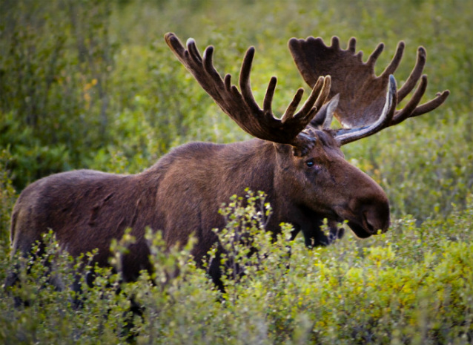
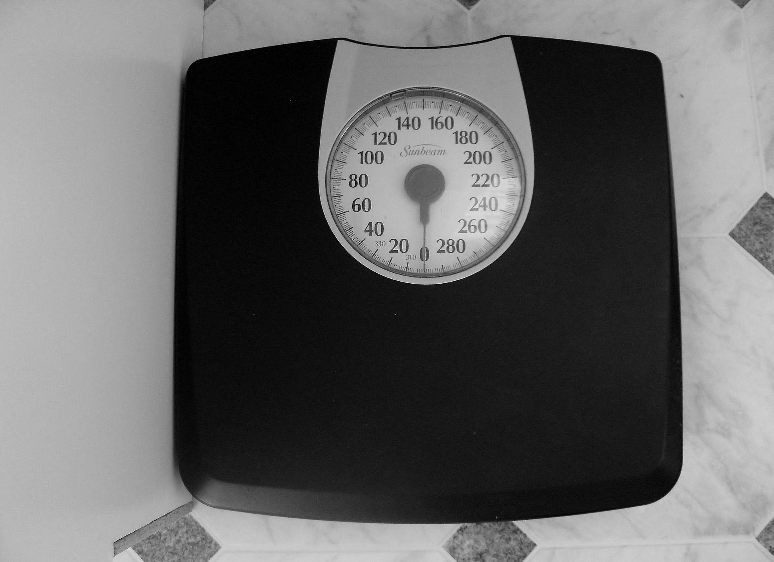
Weigh
A males shiras moose can weigh can be 794 to 1,323 pounds
A female shiras moose can weigh can be 595 to 882 pounds
Notes:
1 Background Color
0 Title (or write the question)
1 Pictures
1 Include Transitions
0 Answering question using complete sentences (multiple sentences if needed to fully explain your answer)
1 Accuracy of information
4
The title is misleading as this is the difference between male and female moose. Male should be singular, ….can weigh from 794 lbs to 1323 lbs. On the other hand, female…..from 594 lbs up to 882 lbs…

Slide 12
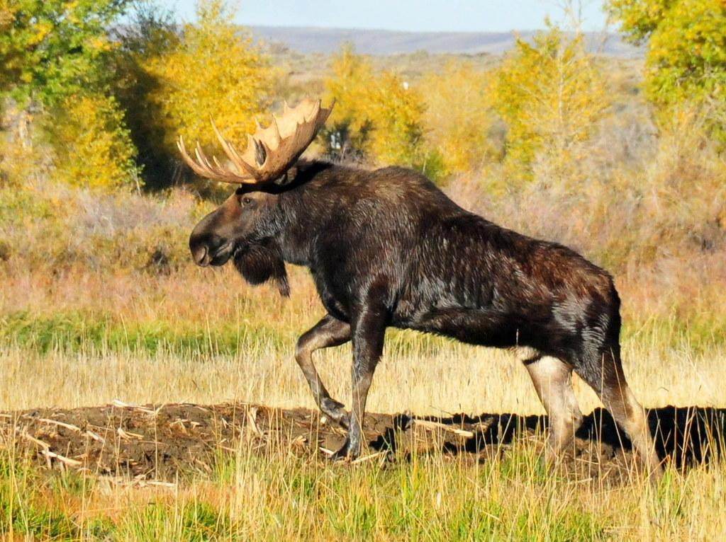

Life Span
The shiras moose can live more than 20 years in the wild, but many bein to suffer the symptoms of old age before then
Notes:
1 Background Color
1 Title (or write the question)
1 Pictures
1 Include Transitions
0 Answering question using complete sentences (multiple sentences if needed to fully explain your answer)
1 Accuracy of information
5
Lifespan is one word.
…many begin to suffer…….before then.

Slide 13
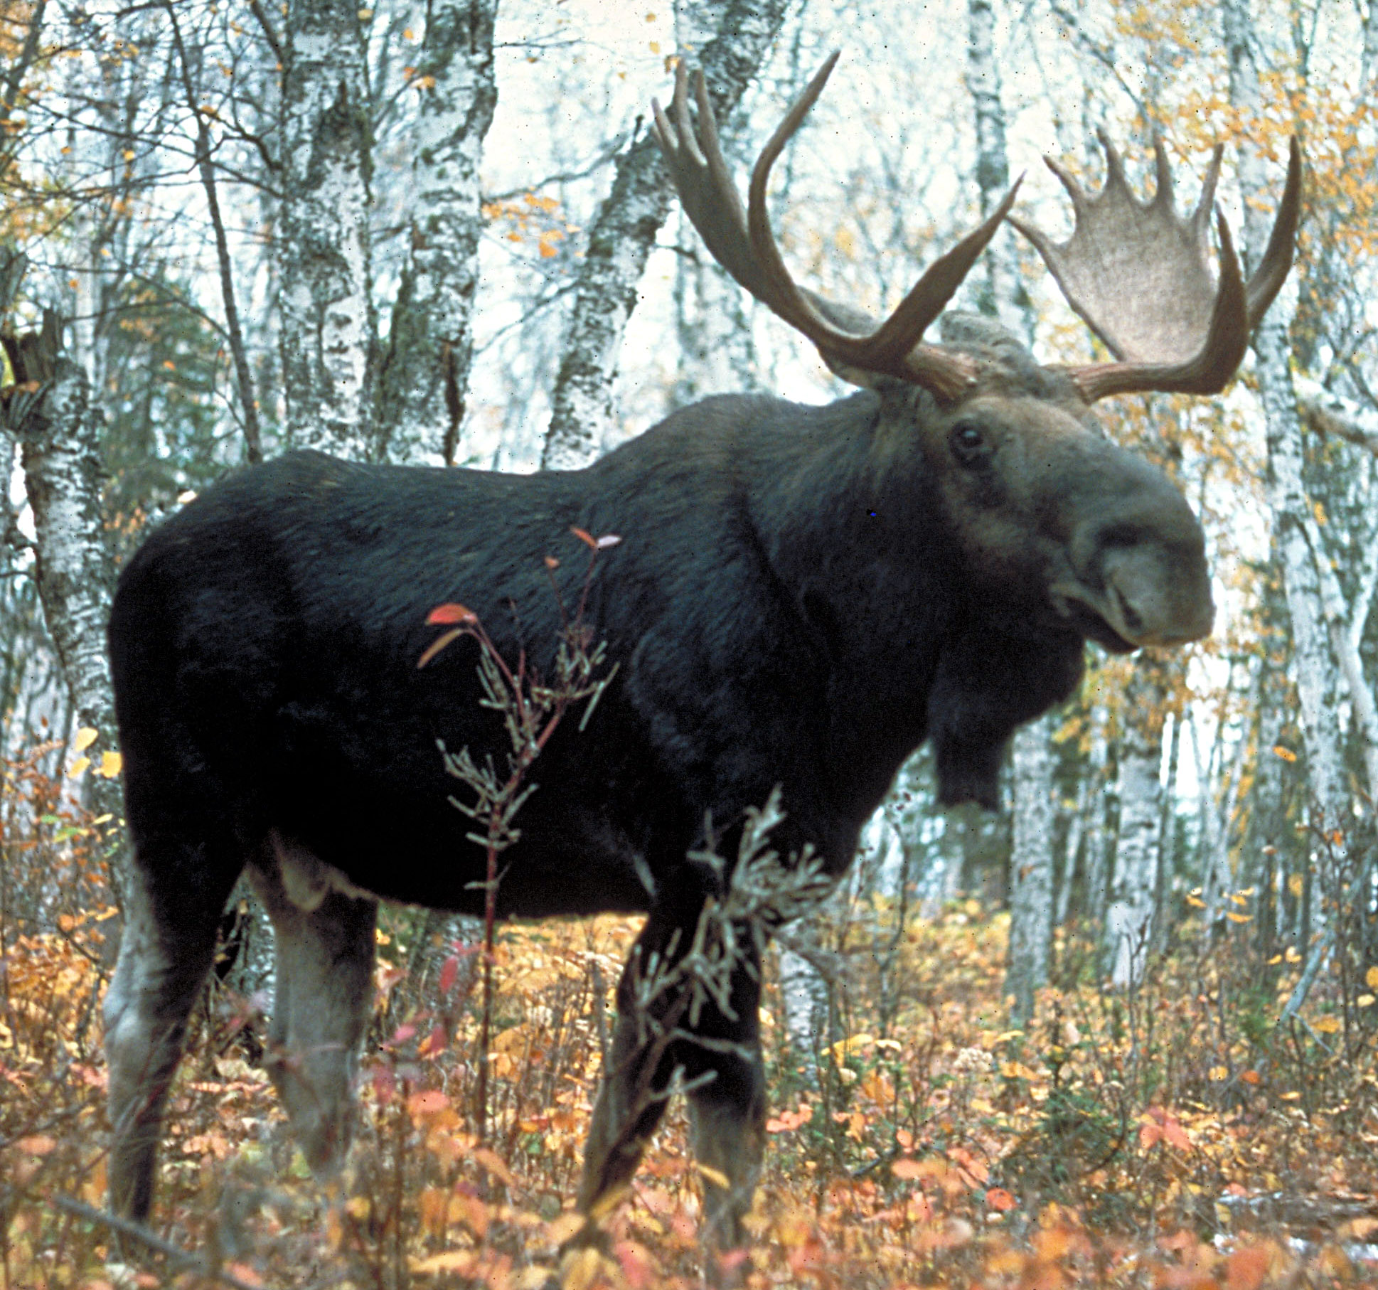
Facts
-Mooses can run up to 35mph -Moose are strong swimmers and can swim up to 6mph -Moose can stand up after laying down, they first their haunches that is followed by the front portion of their body. -they can swim many moles without stopping and can stay underwater for up to 30 seconds -they nibble on the plants growing in the water -it is never a good idea to approach a moose -moose are faster than humans so you can’t outrun one -moose are smart animals
Notes:
1 Background Color
1 Title (or write the question)
1 Pictures
1 Include Transitions
0 Answering question using complete sentences (multiple sentences if needed to fully explain your answer)
1 Accuracy of information
5
Please place in a list using bullet or number.. If you run out of room you can make the page two columns or use another slide.

Slide 14
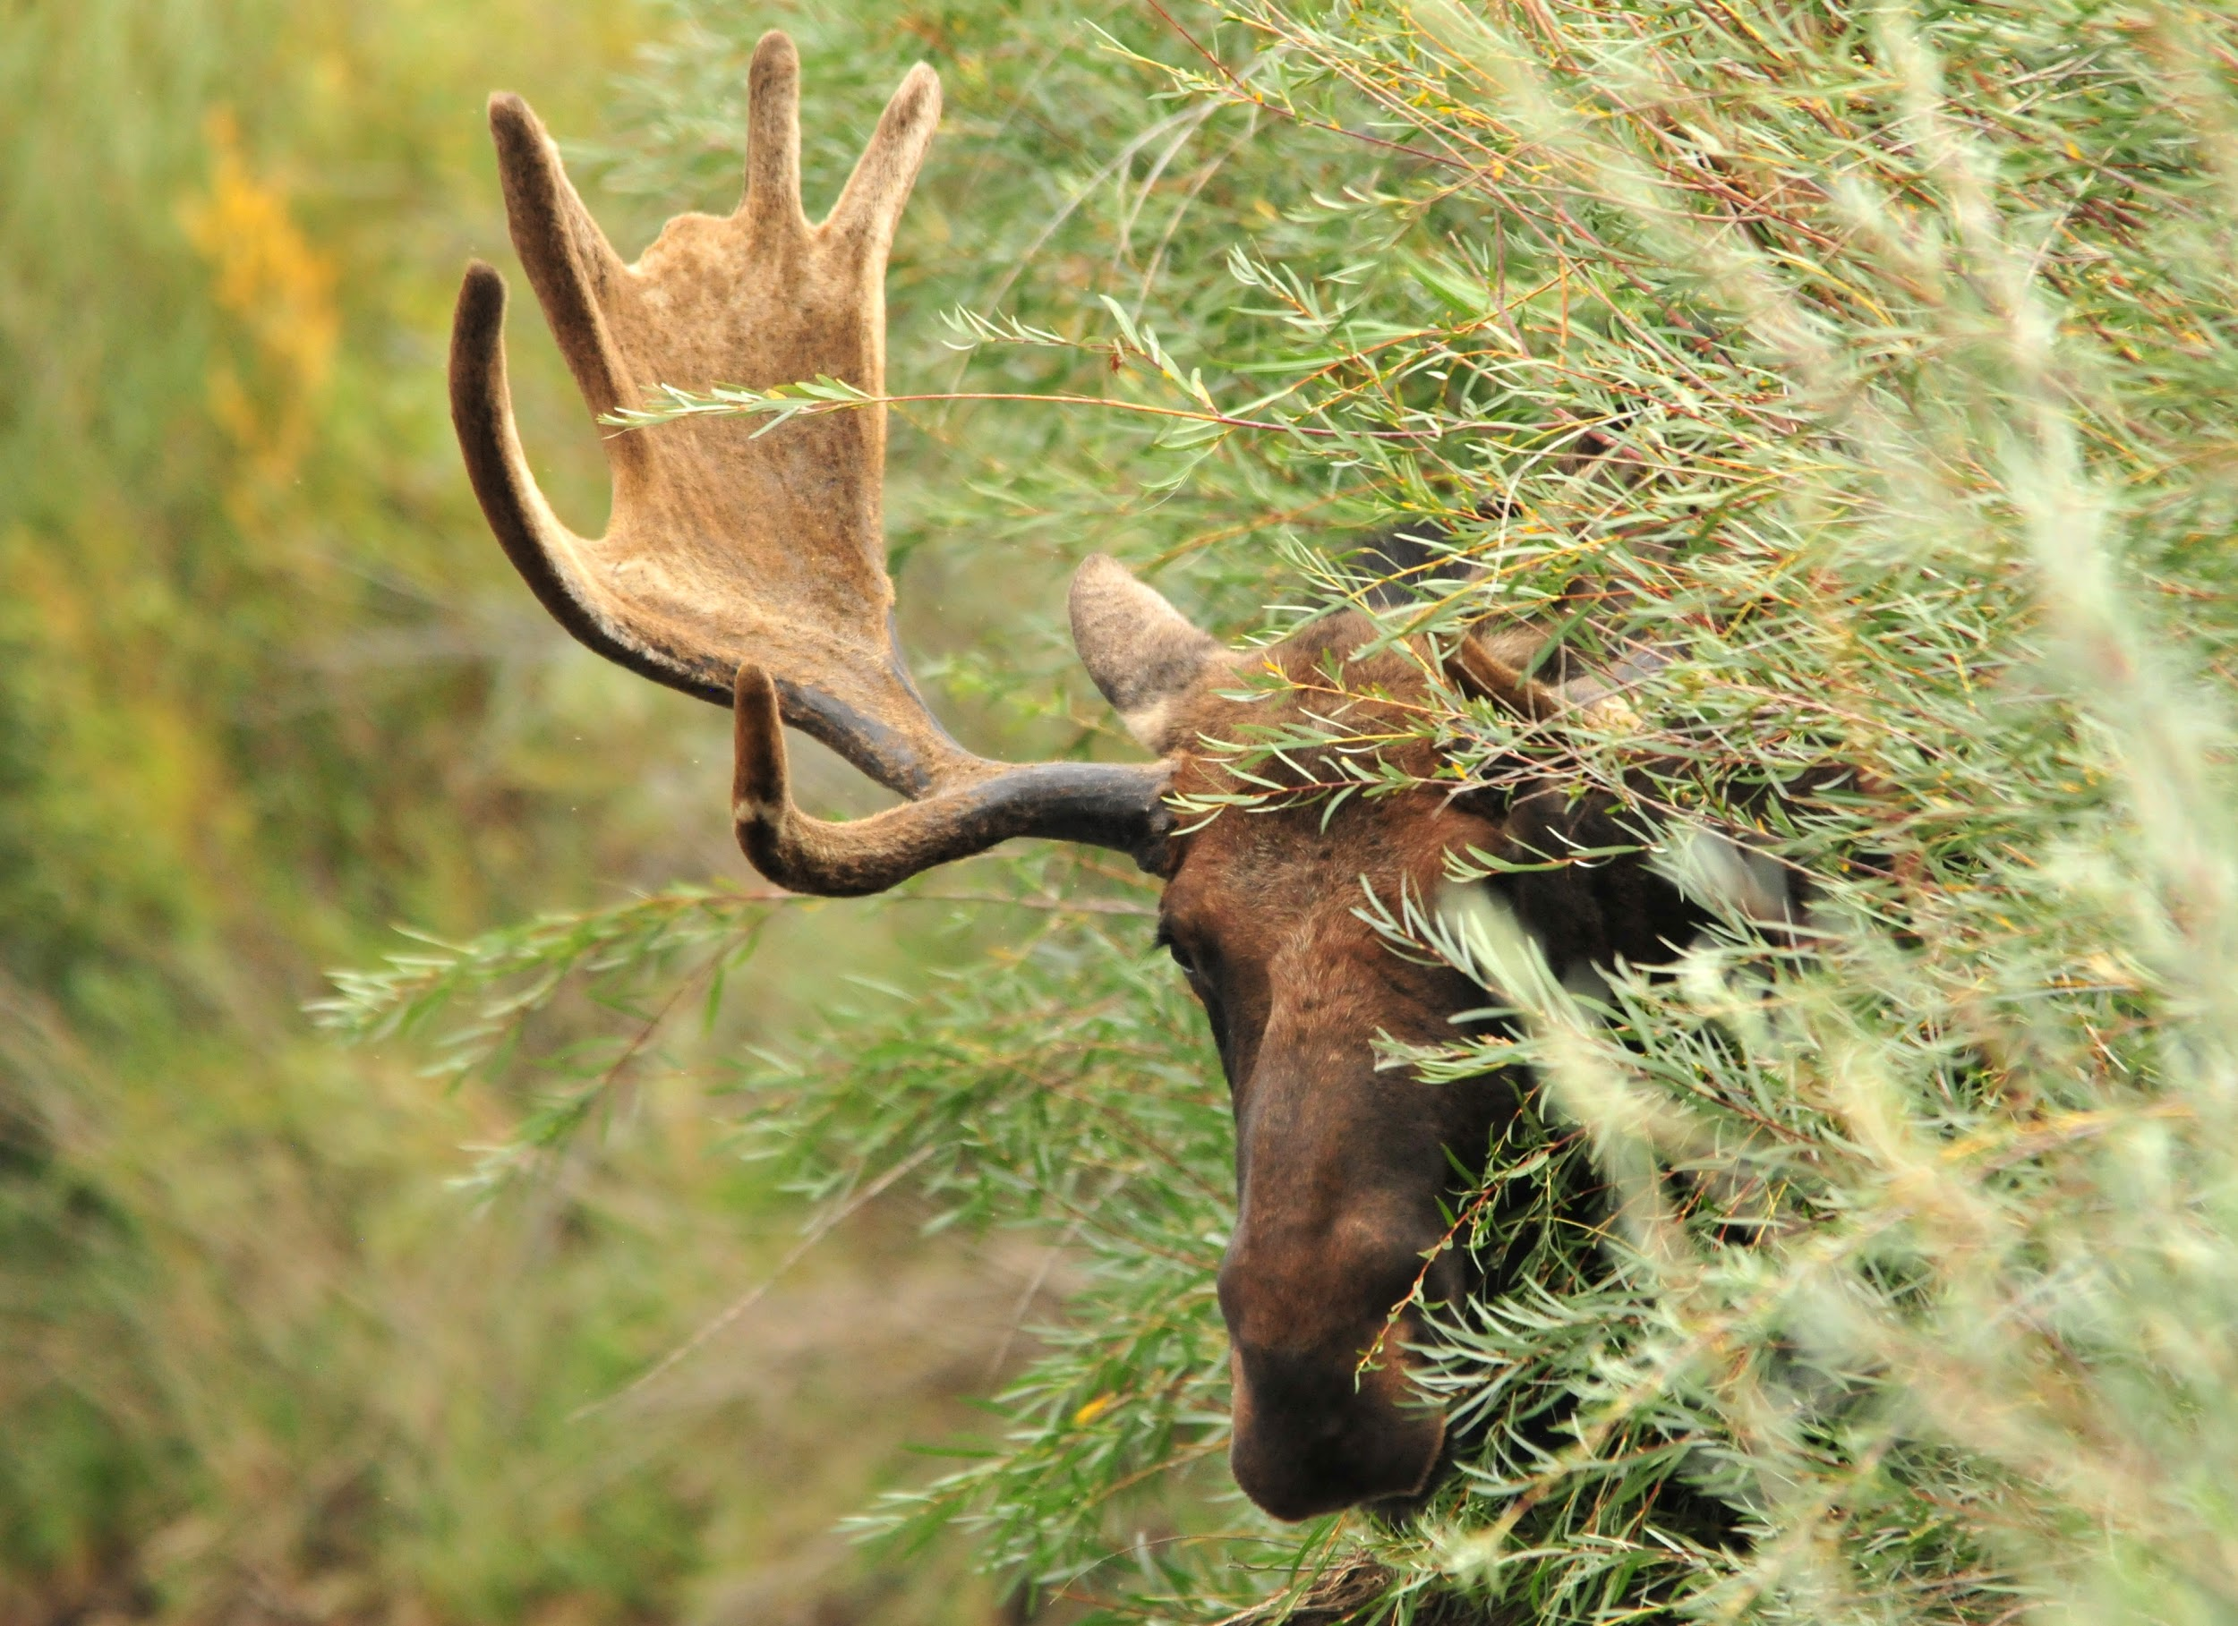
Moose Facts
https://www.dec.ny.gov › wildlife_pdf › moose1
Moose | National Wildlife Federation
Notes:
1 Background Color
0 Title (or write the question)
1 Pictures
1 Include Transitions
0 Answering question using complete sentences (multiple sentences if needed to fully explain your answer)
1 Accuracy of information
5
This slide needs a title. Make all text the same size.

