Slide 1
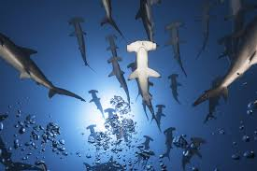
The Great Hammerhead Shark
by : Anna Martinez
Notes:
1 Background Color
1 Title (or write the question)
1 Pictures
1 Include Transitions
1 Answering question using complete sentences (multiple sentences if needed to fully explain your answer)
1 Accuracy of information
6

Slide 2
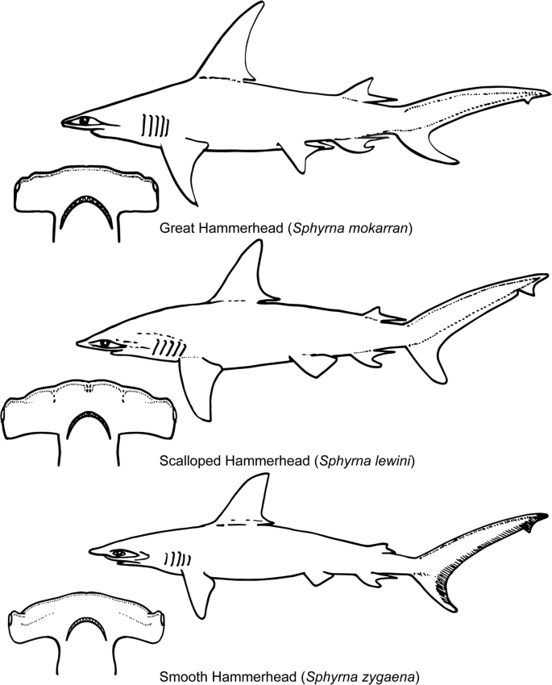
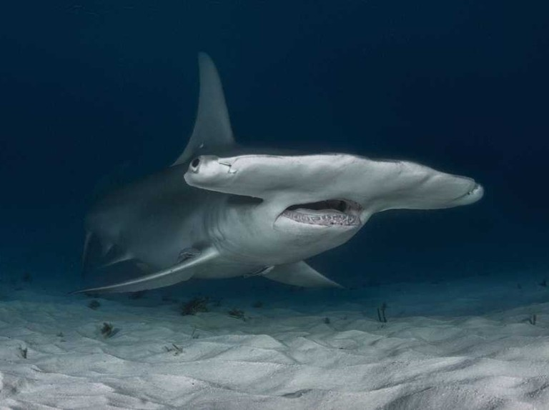
Where does the Great Hammerhead Shark come from?
There is no recorded evidence of where the Hammerhead Shark came from but scientists state it most likely first appeared in the ocean over 20 million years ago.
Notes:
1 Background Color
1 Title (or write the question)
1 Pictures
1 Include Transitions
0 Answering question using complete sentences (multiple sentences if needed to fully explain your answer)
1 Accuracy of information
5
….came from, but we do……

Slide 3
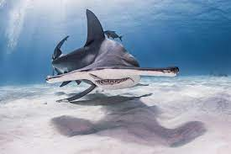
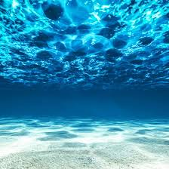
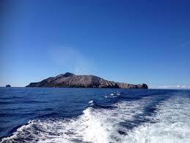
What ecosystem does the Great Hammerhead Shark live in?
The Great Hammerhead lives in tropical and temperate waters worldwide. They either live off-shore or near shorelines. The Great Hammerhead Shark is usually spotted in the summer seeking more cooler and fresher water.
Notes:
1 Background Color
1 Title (or write the question)
1 Pictures
1 Include Transitions
0 Answering question using complete sentences (multiple sentences if needed to fully explain your answer)
1 Accuracy of information
5
Hammerheads are usually spotted in ……

Slide 4
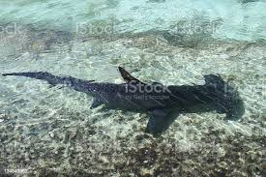
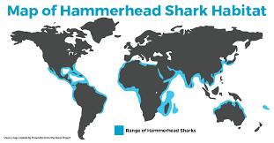
What is it like in the ecosystem?
Hammerhead Sharks live in Marine ecosystems and tropical waters. They live in any ocean habitat, the deep ocean, open ocean, coral reefs and unde the Arctic ice. The breed lives in environments with high salt levels. The ecosystem has movement of water, water pressure, amount of light and saltiness of water.
Notes:
1 Background Color
1 Title (or write the question)
1 Pictures
1 Include Transitions
0 Answering question using complete sentences (multiple sentences if needed to fully explain your answer)
1 Accuracy of information
5
The text is slightly hard to read with its font color. ….coral reefs, and under the Arctic ice. This breed of shark prefers oceans with high salt levels. The variable which create its perfect ecosystem include water movement, water pressure, the amount of light, and the saltiness of water.

Slide 5
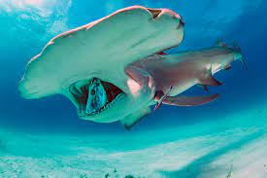
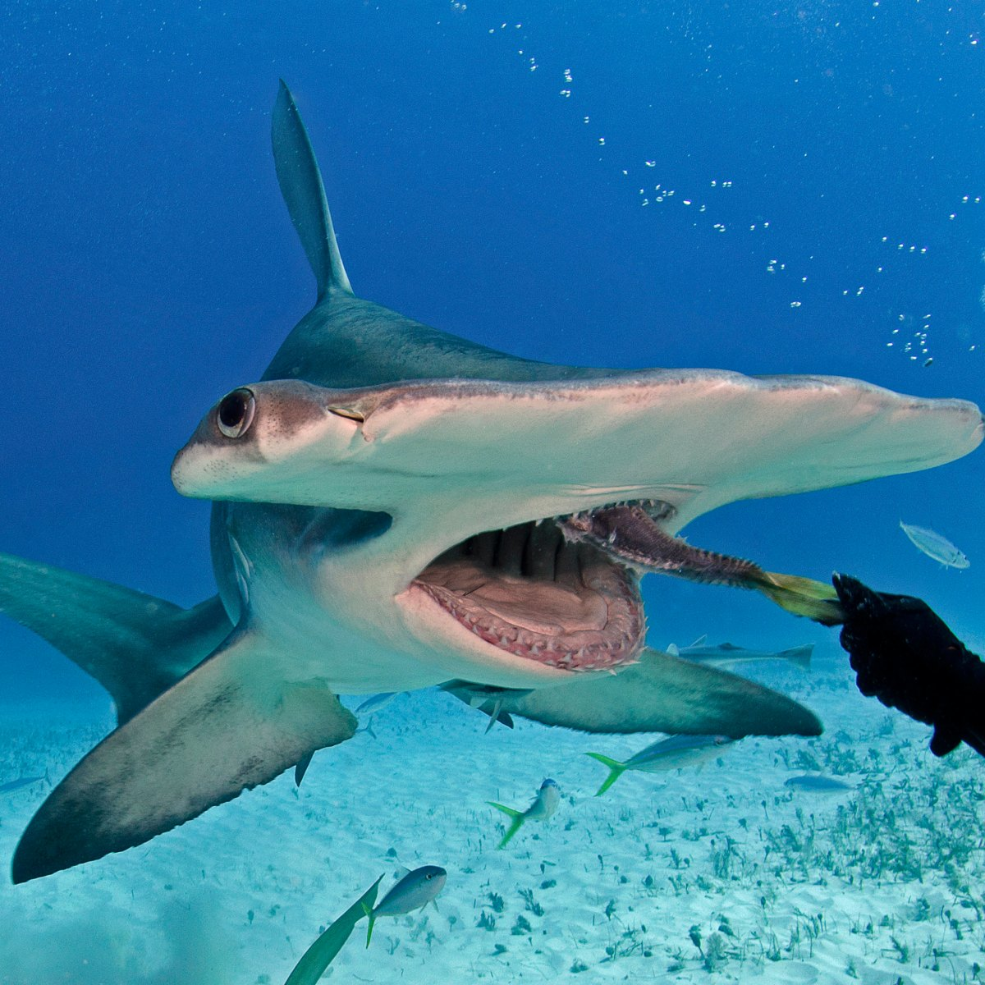
What type of consumer is the Great Hammerhead Shark?
The Great Hammerhead Shark is a carnivore. The Great Hammerhead only eats meat and protein.
Notes:
1 Background Color
1 Title (or write the question)
1 Pictures
1 Include Transitions
0 Answering question using complete sentences (multiple sentences if needed to fully explain your answer)
1 Accuracy of information
5
Great hammerhead sharks have a consistent diet of meat.

Slide 6
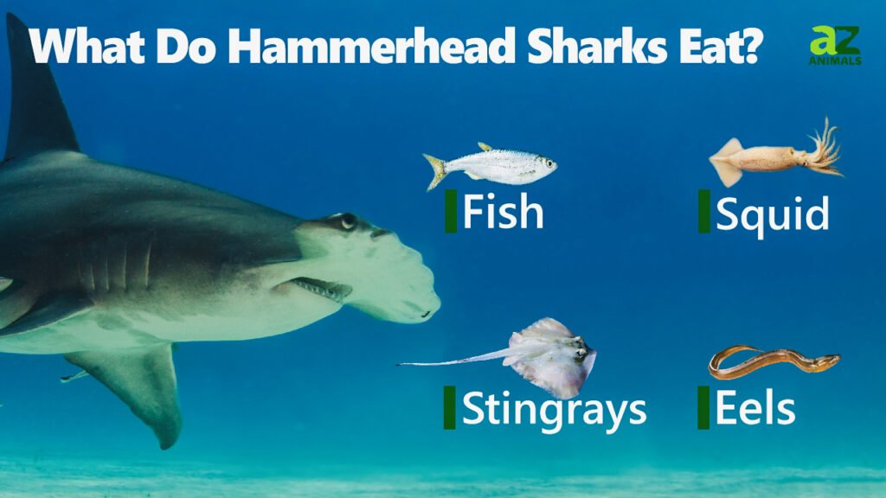
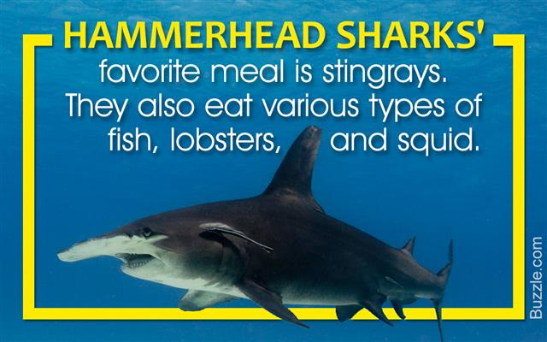
What specific foods does the Great Hammerhead shark eat?
A list a couple of the the types of food the Hammerhead Shark eats is, stingrays, cephalopods and other small sharks. The Hammerhead Shark usually hunts on the seafloor. The Hammerhead particularly uses their heads to pin down stingrays to feast on their wings.
Notes:
1 Background Color
1 Title (or write the question)
1 Pictures
1 Include Transitions
0 Answering question using complete sentences (multiple sentences if needed to fully explain your answer)
1 Accuracy of information
5
There is an extra space in the title between shark and eat. A list of a couple of the types of food hammerhead sharks eat are; stingrays, cephalopods, and other small sharks.

Slide 7
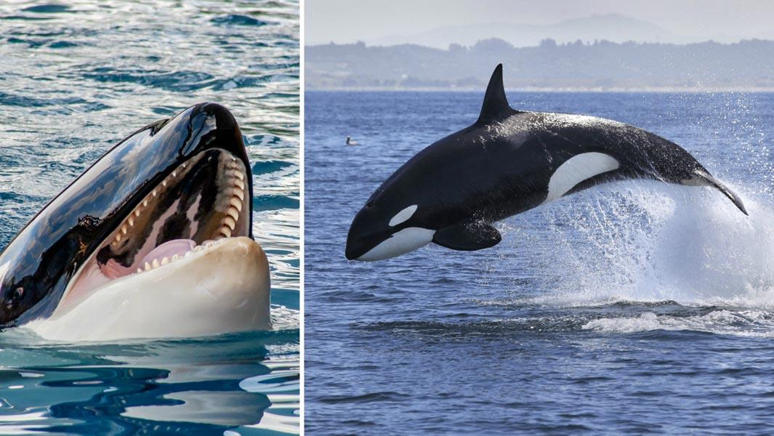
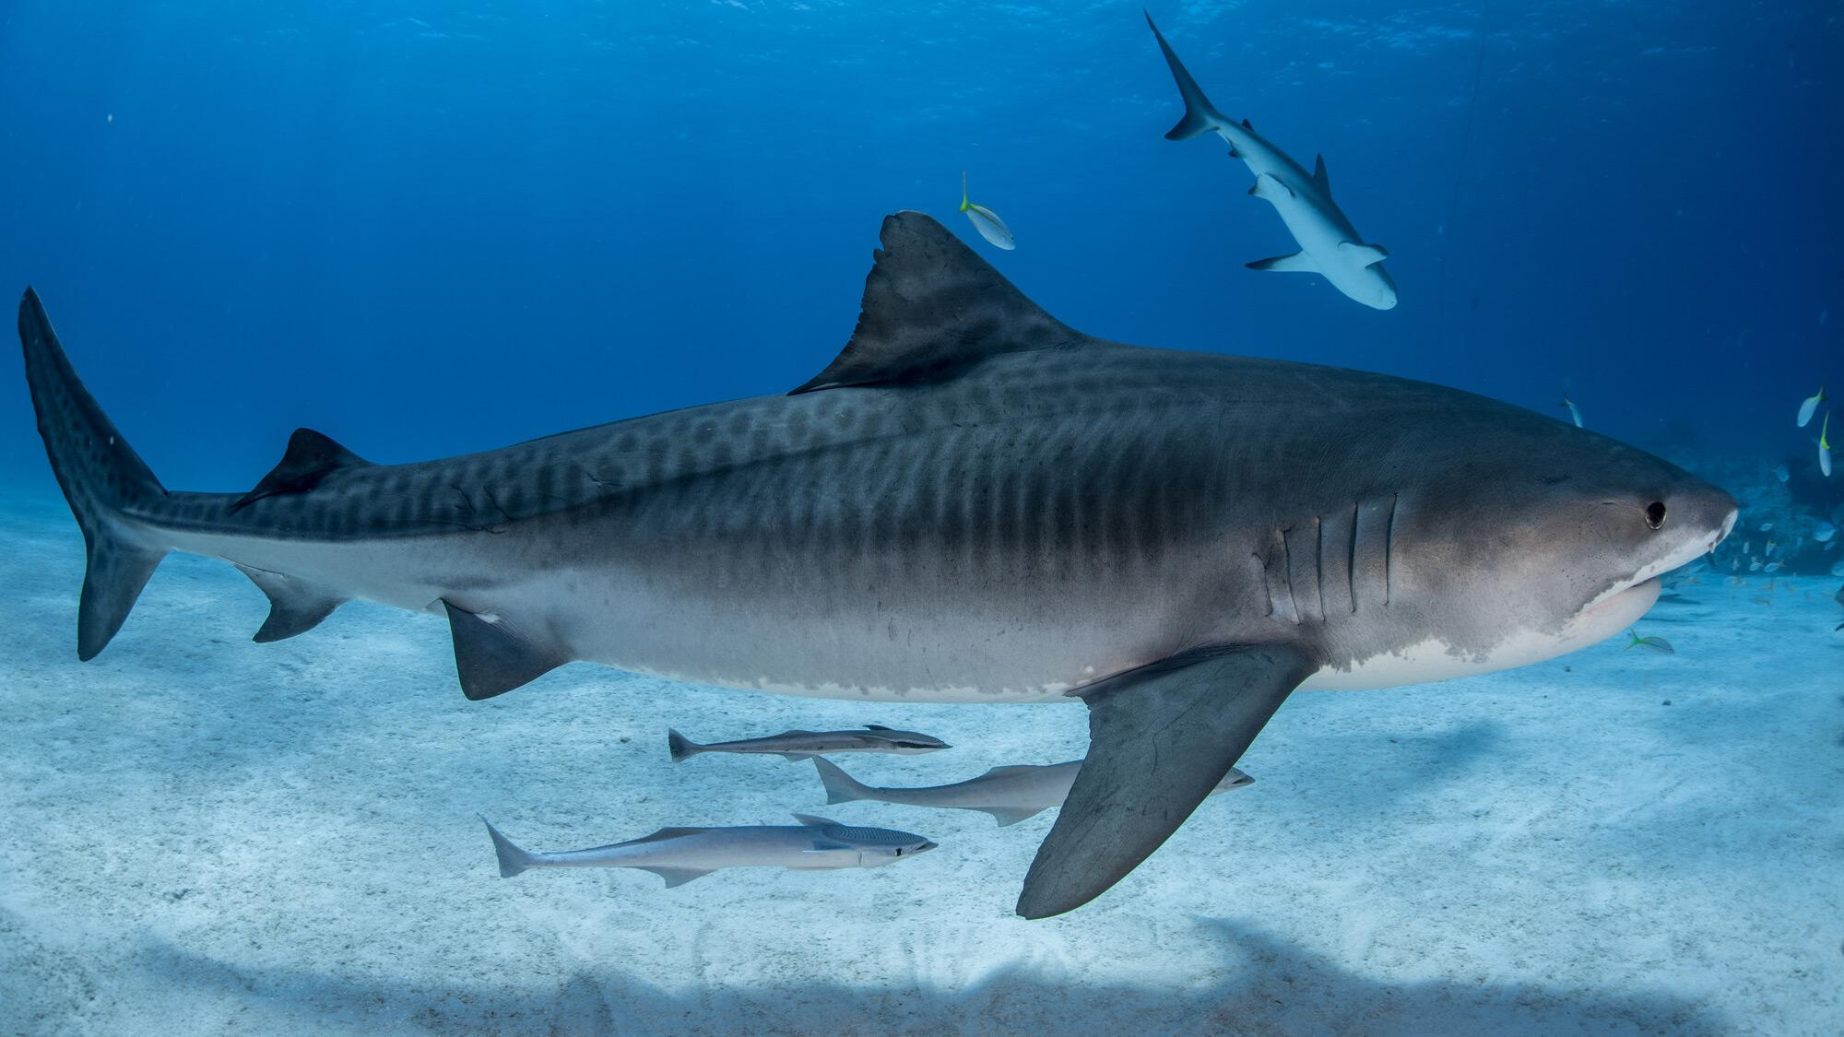
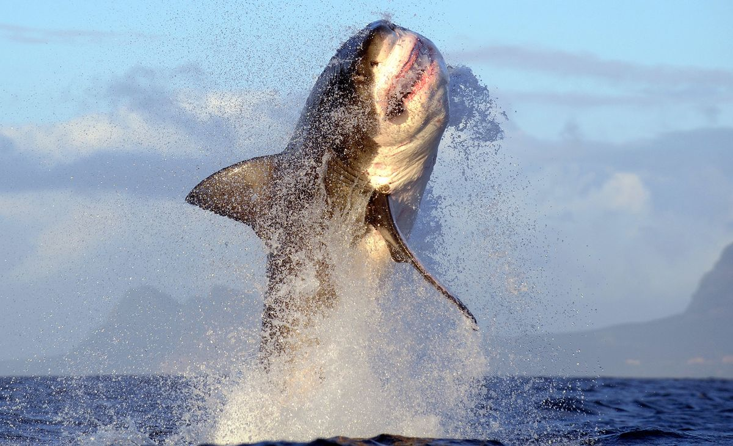
Does the Hammerhead Shark have any predators?
Yes, the Hammerhead Shark does have predators. Their predators are The Tiger Shark, The Great White Shark and The Killer Whale. Some Hammerhead Sharks are their own predators, sometimes eating the smaller versions of their species.
Notes:
1 Background Color
1 Title (or write the question)
1 Pictures
1 Include Transitions
0 Answering question using complete sentences (multiple sentences if needed to fully explain your answer)
1 Accuracy of information
5
…are Tiger sharks, Great white sharks, and Killer whales.

Slide 8
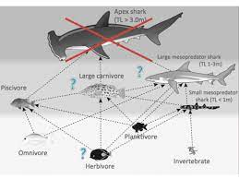
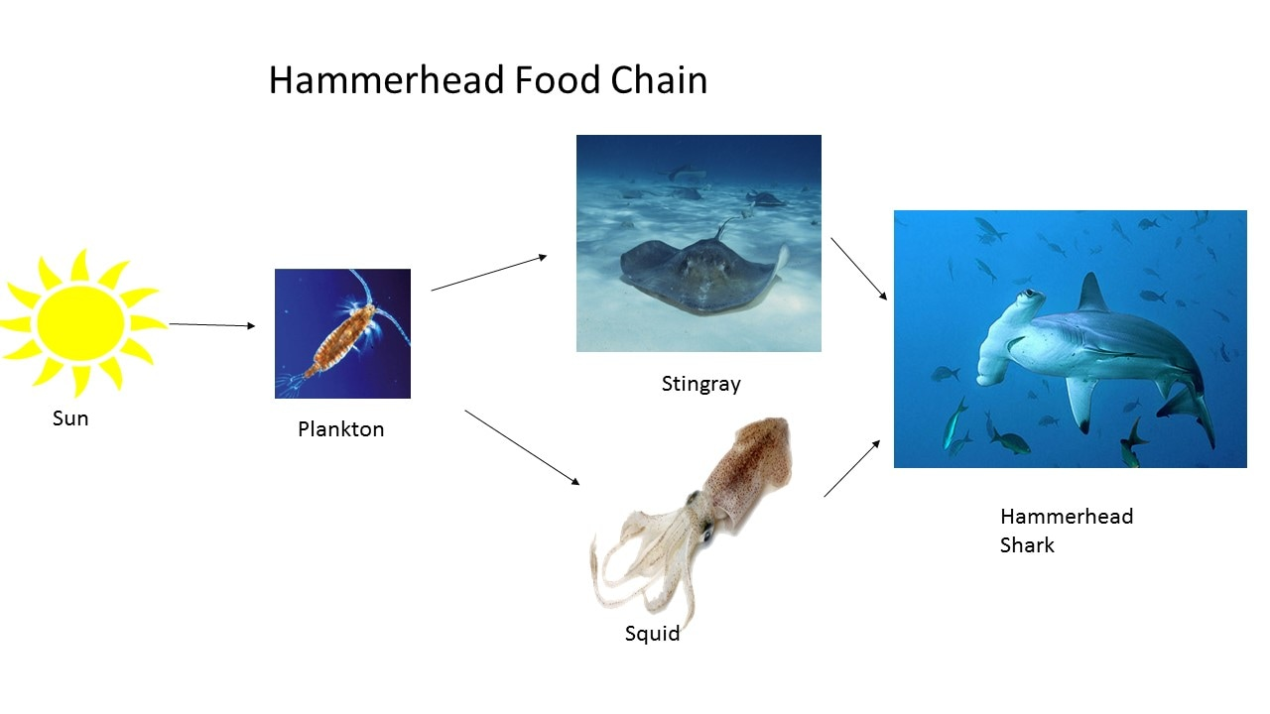
What is the typical food chain for the Great Hammerhead Shark?
The Hammerhead Shark is the apex predator of their food chain. The Hammerhead sharks eats the stingray. The stingray eats invertebrates and crustaceans. The Crustaceans, like shrimp, eat algae. Algae is a producer so it gets its food from the sun.
Notes:
1 Background Color
1 Title (or write the question)
1 Pictures
1 Include Transitions
0 Answering question using complete sentences (multiple sentences if needed to fully explain your answer)
1 Accuracy of information
5
Crustaceans, like shrimp, eat algae.

Slide 9
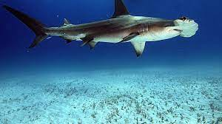
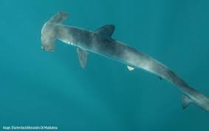
The Great Hammerhead Sharks adaptations.
The Great Hammerhead Shark has many useful adaptations. One of the many is its sleek and aerodynamic bodies. Their body help them not only move faster but it also helps them make quick and sharp turns in fast occurrences in order to catch prey and escape from predators.
Notes:
1 Background Color
1 Title (or write the question)
1 Pictures
1 Include Transitions
0 Answering question using complete sentences (multiple sentences if needed to fully explain your answer)
1 Accuracy of information
5
Since the tile is not a sentence…. The Great Hammerhead Shark Adaptations
“Its” is the possessive form of it. …not only move faster….

Slide 10
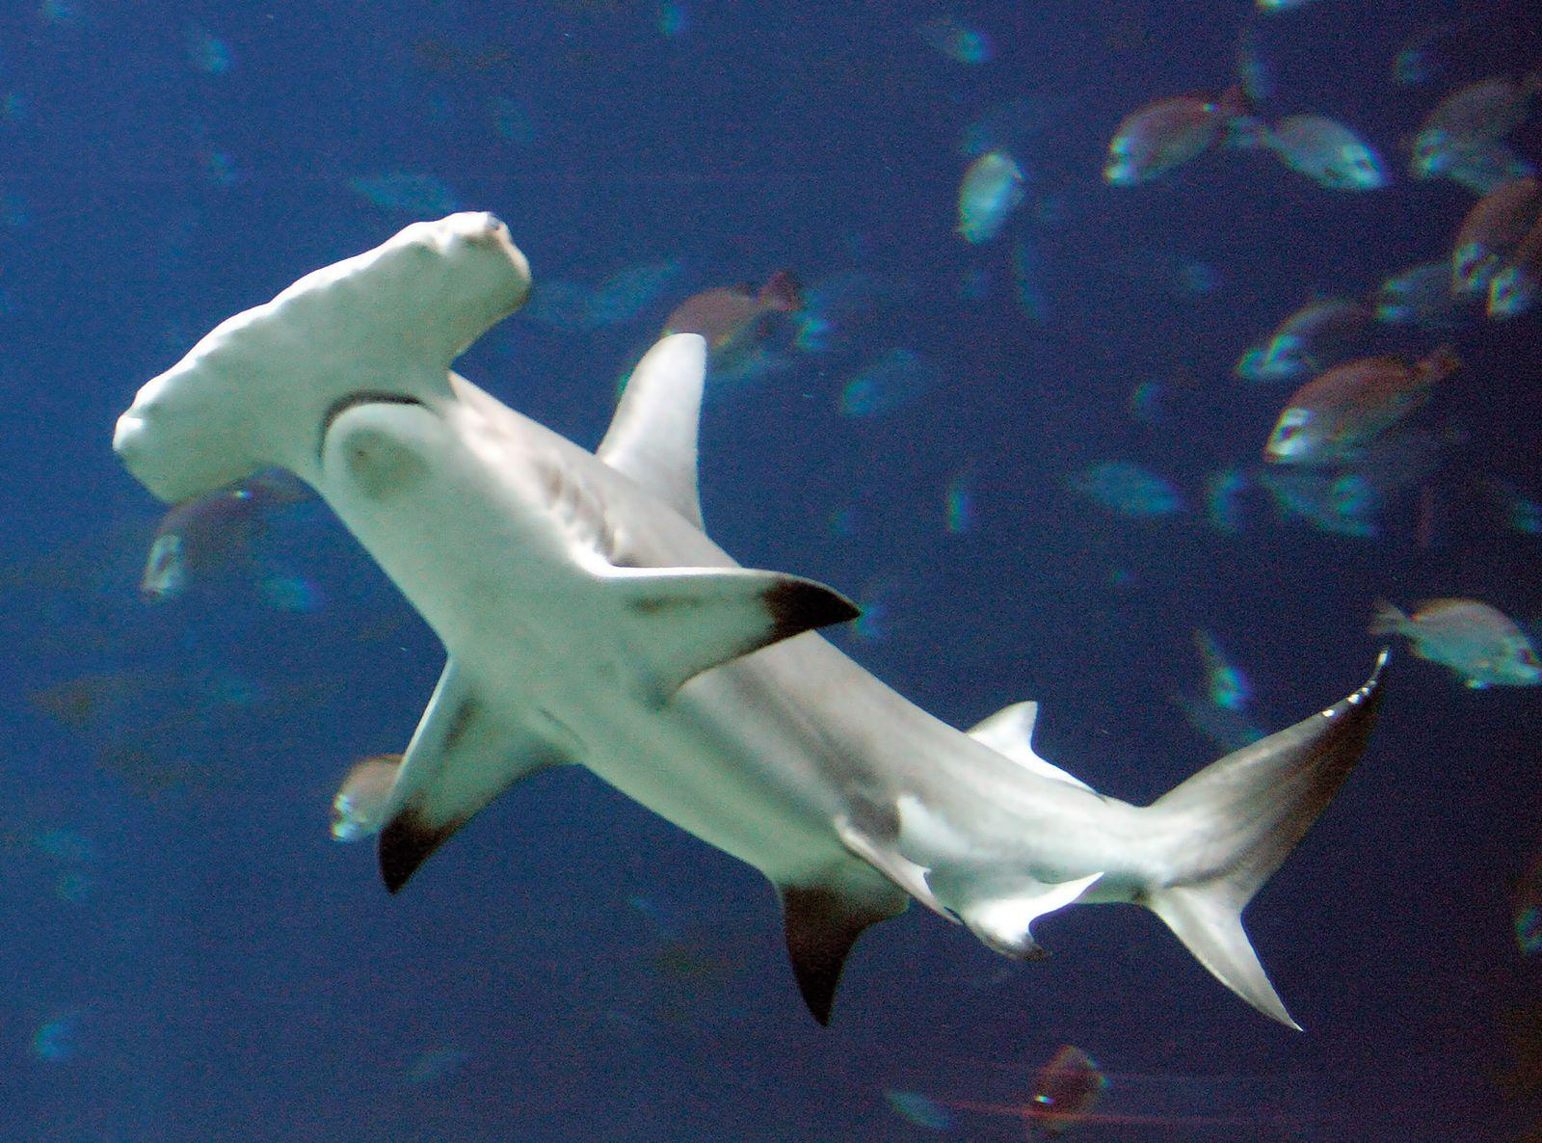
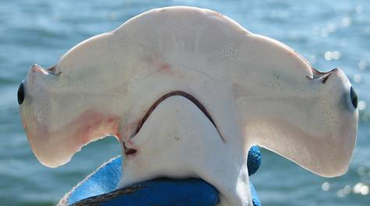
The Great Hammerhead Shark Characteristics.
The Great Hammerhead shark is usually a dusky brown to a light gray on the dorsal surface. They have a stout body and a classic shark body shape with a curved first dorsal fin. Great Hammerhead’s head are flattened and extended that forms a hammer shape. The Great Hammerhead has serrated triangular teeth. Great Hammerheads can reach up to the maximum length of 18-20 feets. The average weight for this shark is 500 pounds, but some can reach up to 1,000 pounds.
Notes:
1 Background Color
1 Title (or write the question)
1 Pictures
1 Include Transitions
0 Answering question using complete sentences (multiple sentences if needed to fully explain your answer)
1 Accuracy of information
5
Since the title is not a sentence… The Great Hammerhead Shark Characteristics
…extended which forms a hammer shape. Hammerheads have serrated triangular teeth. Feet is the plural, feets is not a word.

Slide 11
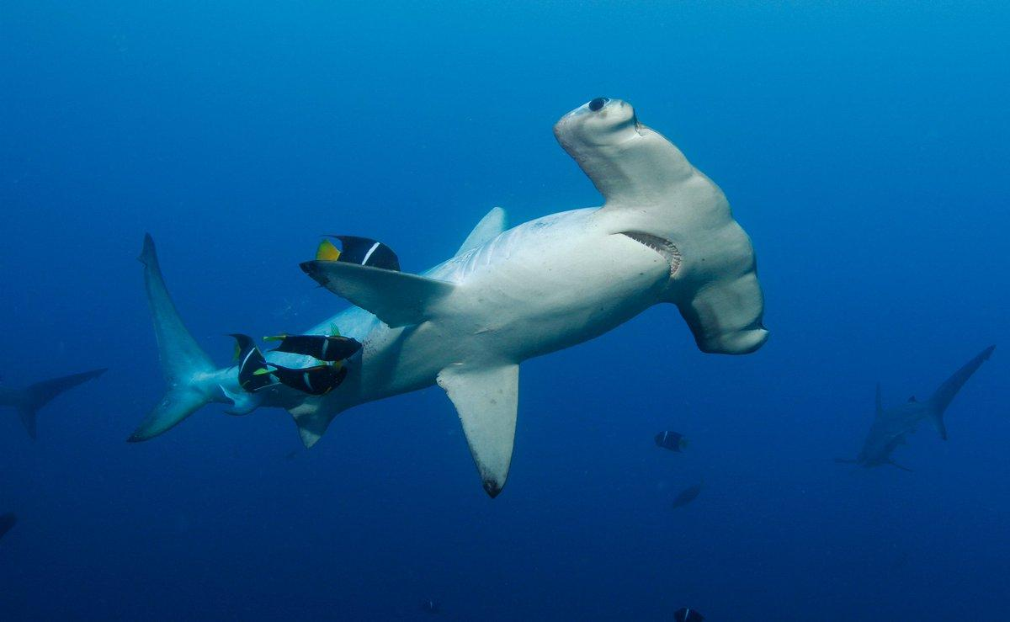
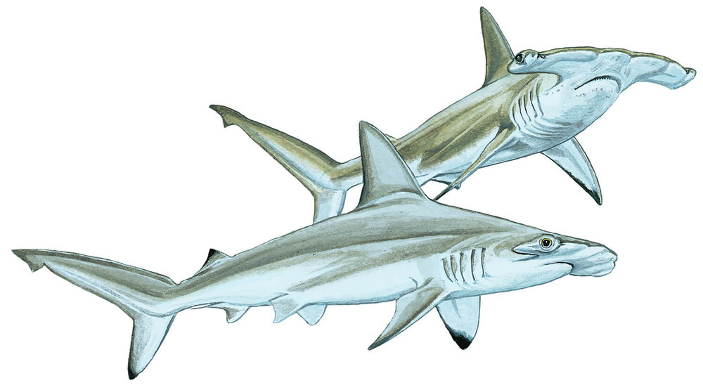
Male Great White Hammerhead vs Female Great White Hammerhead.
The male Great White Hammerhead can weigh up to 900 pounds and up to 20 feet meanwhile the female Great Hammerhead can usually go up to 880 pounds and around only 8 to 11 feet.
Notes:
1 Background Color
1 Title (or write the question)
1 Pictures
1 Include Transitions
0 Answering question using complete sentences (multiple sentences if needed to fully explain your answer)
1 Accuracy of information
5
…900 lbs and can be up to 20 ft long. Meanwhile, the female can usually grow up to 880 lbs and to a length of only 8 to 11 ft. delete the rest as it takes from the clearity. …

Slide 12
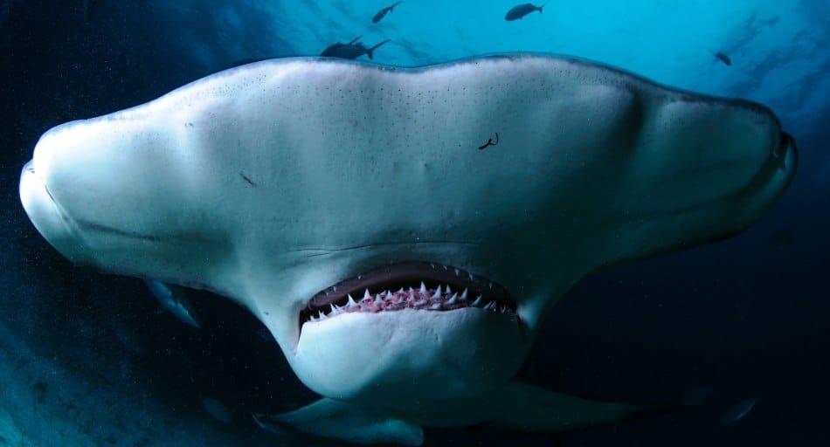
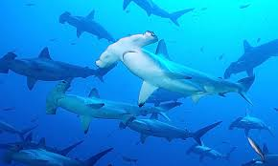
Great Hammerhead Shark lifespan
Great Hammerhead Sharks lifespan can be 20-30 years. The oldest Great Hammerhead Shark ever recorded was 40 years old.
Notes:
1 Background Color
1 Title (or write the question)
1 Pictures
1 Include Transitions
0 Answering question using complete sentences (multiple sentences if needed to fully explain your answer)
1 Accuracy of information
5
Lifespan is one word. ..can be 20-30 years.

Slide 13
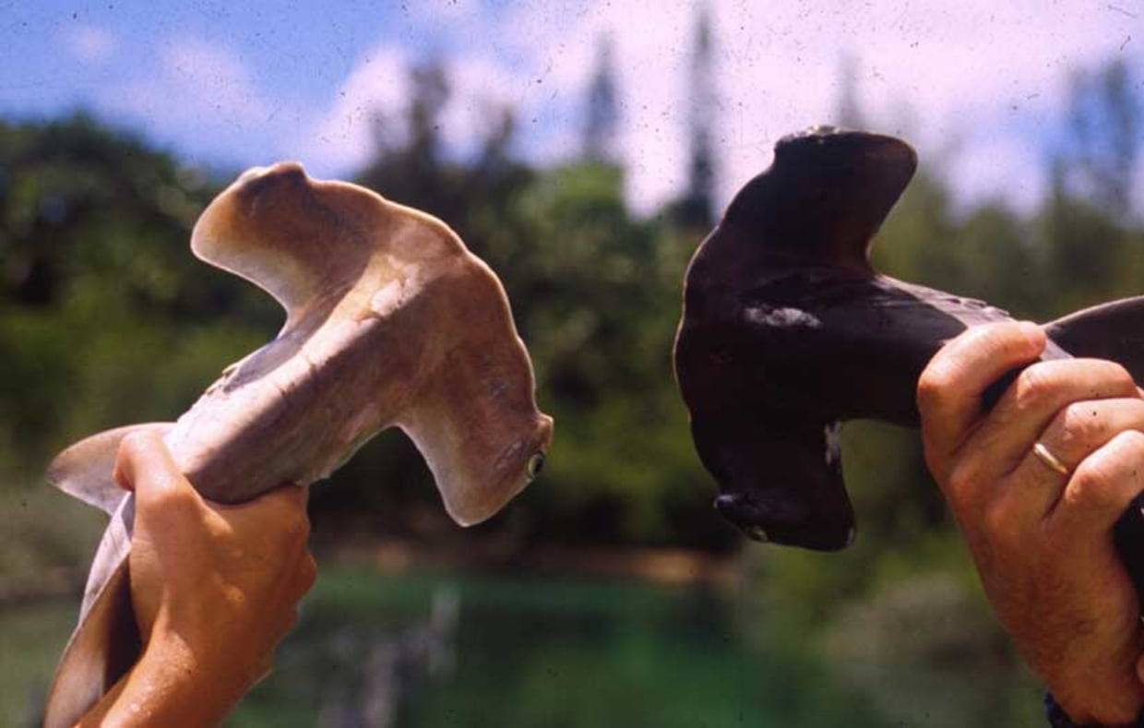
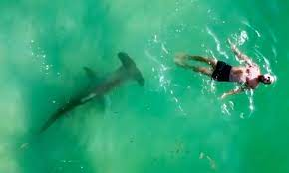
Great Hammerhead Shark Facts
The position of the Great Hammerhead’s eyes give them a perfect 360° vision.
Regardless of the Great Hammerhead Shark’s alarming appearance, their attacks are very rare.
Great Hammerhead Sharks can get tans! Due to hanging usually in shallow water they can get tan. They can get to light brown to nearly all black.
Notes:
1 Background Color
1 Title (or write the question)
1 Pictures
1 Include Transitions
1 Answering question using complete sentences (multiple sentences if needed to fully explain your answer)
1 Accuracy of information
6

Slide 14
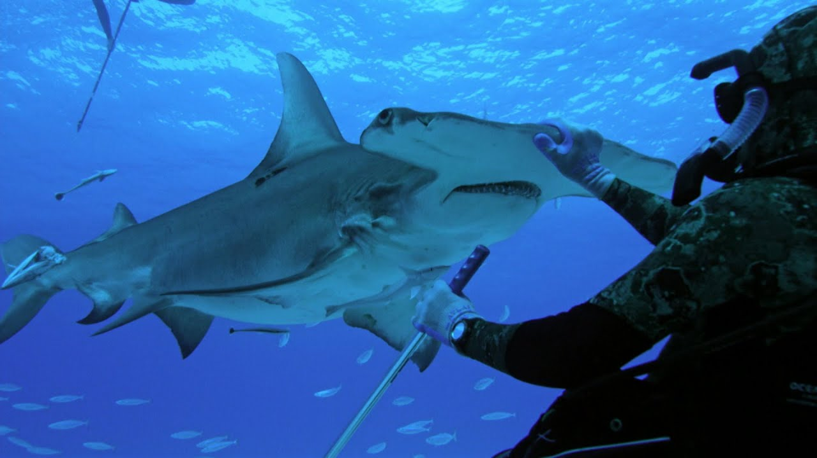
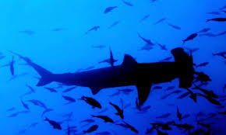
Great Hammerhead Shark facts PT.2
-Great Hammerhead Sharks like to swim sideways!
-Great Hammerheads have a deeper perception that other sharks!
- The longest Great Hammerhead ever recorded was 20 feet long and weighed 991 pounds!
- Great Hammerheads Sharks scientific name is Syphrna mokarran.
Notes:
1 Background Color
1 Title (or write the question)
1 Pictures
1 Include Transitions
1 Answering question using complete sentences (multiple sentences if needed to fully explain your answer)
1 Accuracy of information
6

Slide 15
Information Resources
https://livescience.com https://ocean.si.edu https://www.mysticaquarium.org
https://www.nationalgeographic.org https://oceana.org https://sciencing.com
https://www.floridamuseum.ufl.edu https://sharksider.com https://www.sharktrust.org
Notes:
1 Background Color
1 Title (or write the question)
1 Pictures
1 Include Transitions
1 Answering question using complete sentences (multiple sentences if needed to fully explain your answer)
1 Accuracy of information
6

Slide 16
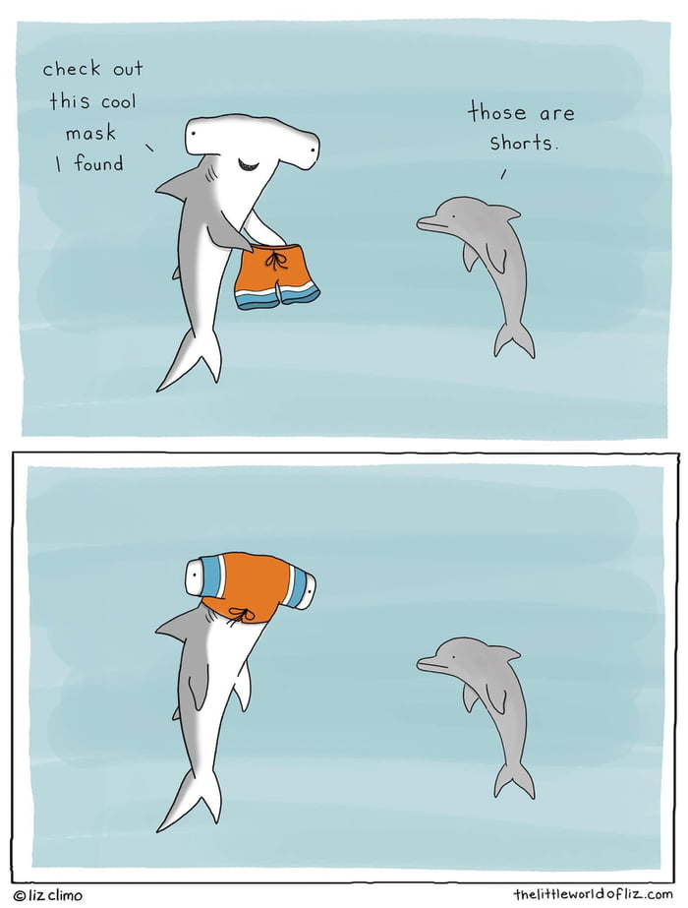
:)
Notes:
Extra slide not scored

