Slide 1
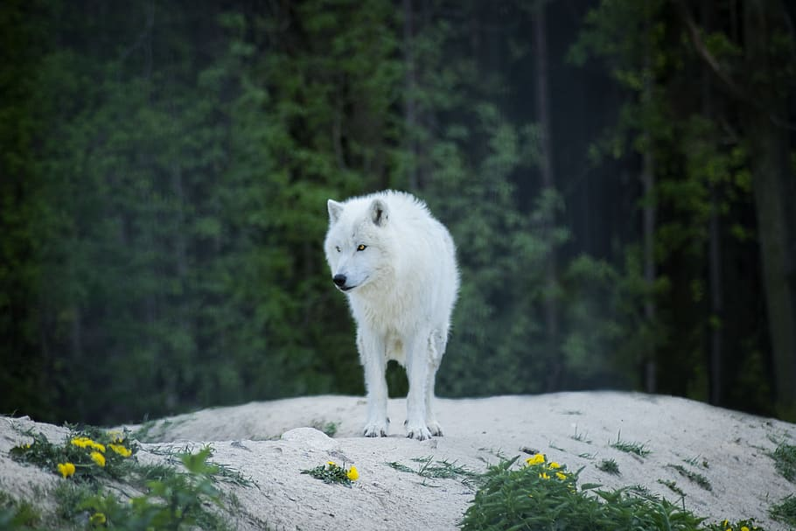
The Alexander Archipelago wolf.
By Athziry Castro.

Slide 2
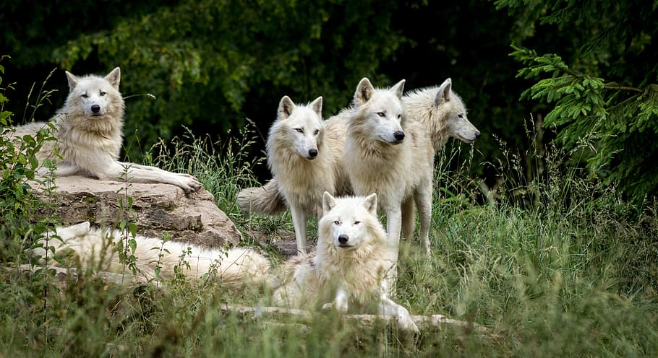
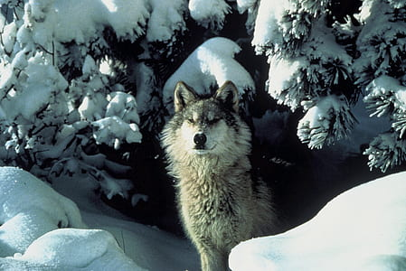
The Alexander Archipelago wolf originates from,
Alaska, it first arrived sometime between 7,000 and 8,000 years ago. After the end of the Wisconsin glaciation period.

Slide 3
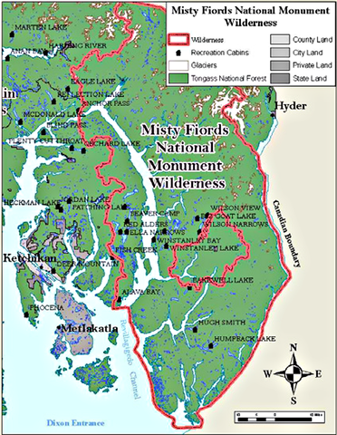
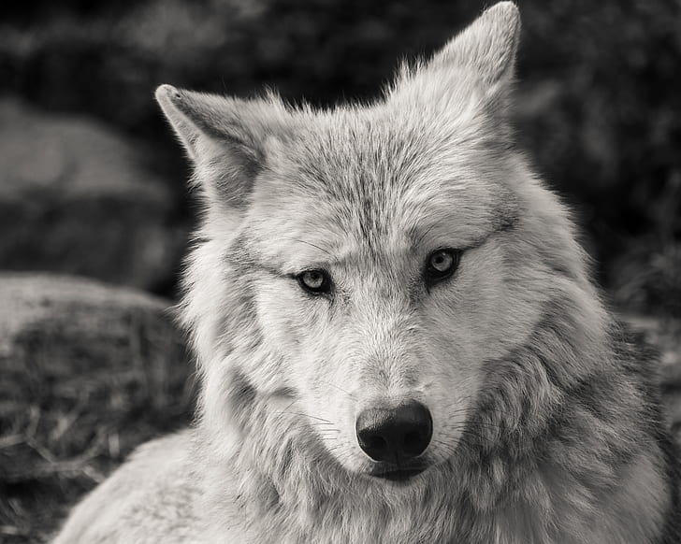
The Archipelago wolf’s ecosystem.
The Alexander archipelago wolf can be found on the southeastern Alaskan mainland from Dixon Entrance to Yakutat Bay, as well as some islands.

Slide 4
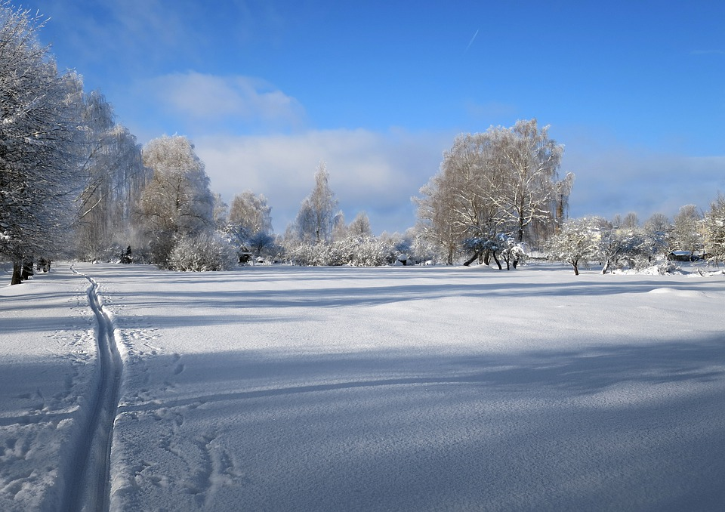

In the Alexander archipelago ecosystem temperature .
In the Southeastern part of Alaska it is comfortable, the climate is maritime, that means that in Alaska it is cool and has mild winters, the normal temperature in July is about 65 degrees, and on sunny days it can be around the 70’s and 80’s. Now in january the temperature can be at 24 degrees.
< - >

Slide 5
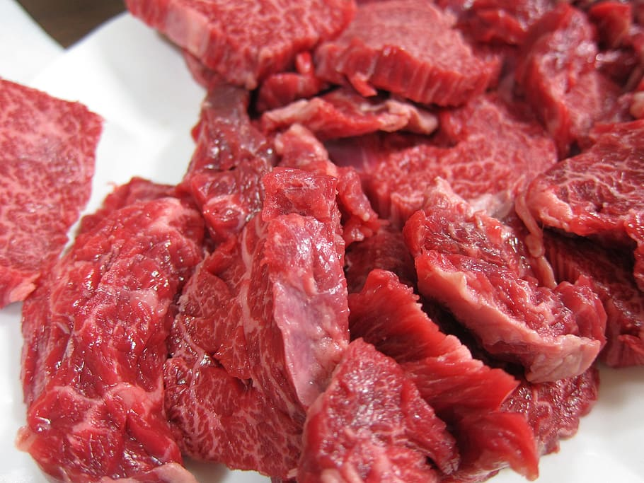
Carnivorous.
The Alexander Archipelago wolf is a secondary or tertiary, however many wolves are apex predators, so wolves are carnivorous which means they eat meat.

Slide 6
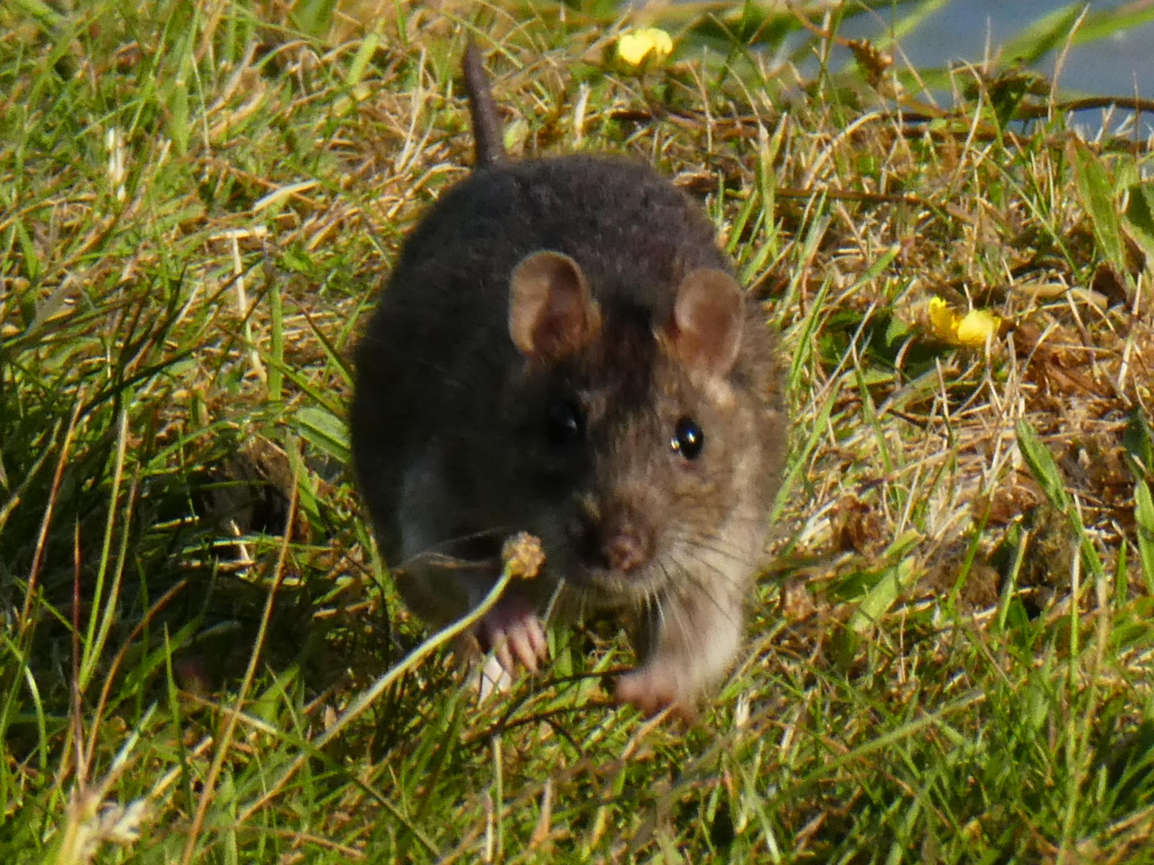
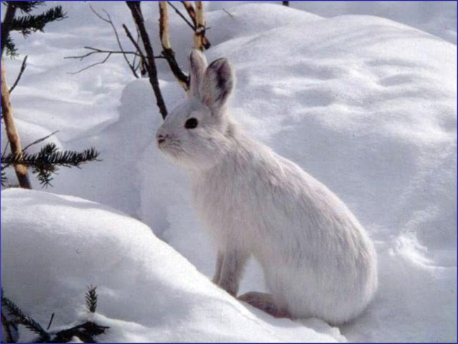
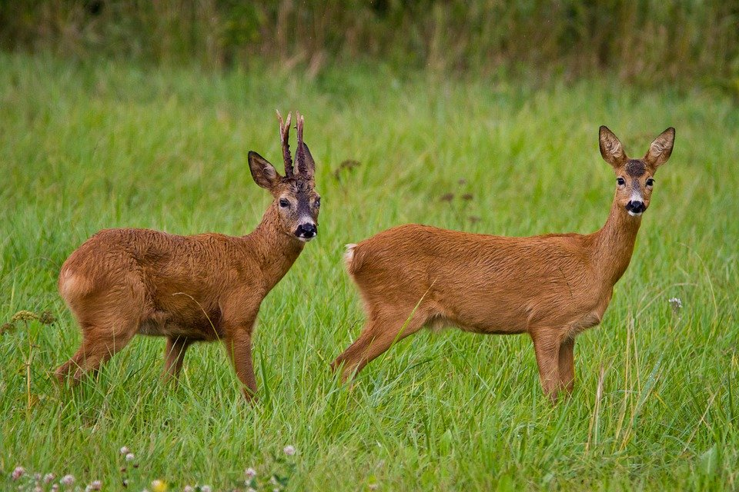
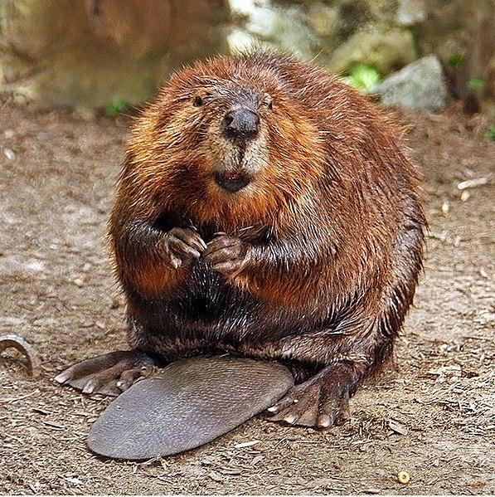
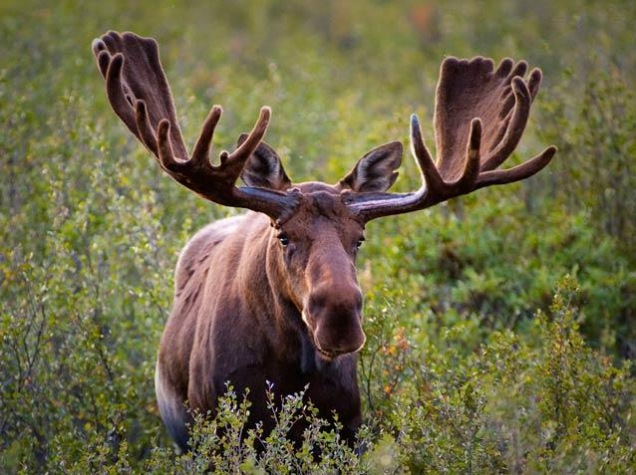
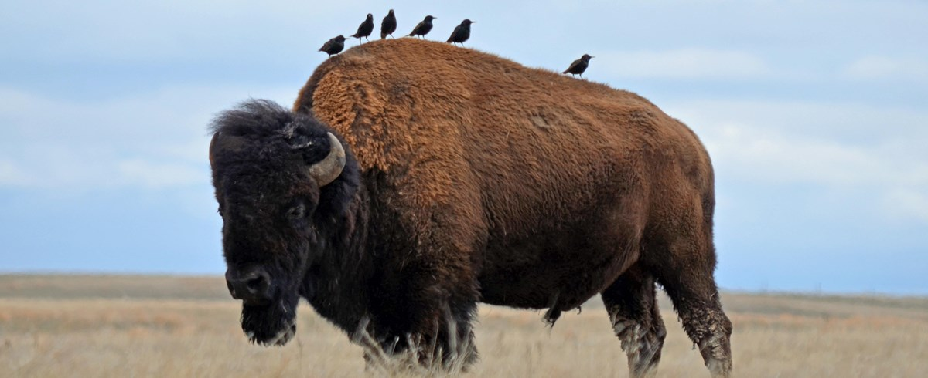
The type of food that wolves eat are,
Deers, elk, bison, and moose, wolves prefer to eat large hoofed animals, they also like to eat smaller animals as well like beavers, rodents, and hares.

Slide 7
A wolves predator…
A wolves predator is, grizzly bears, polar bears, and siberian tigers.

