Slide 1
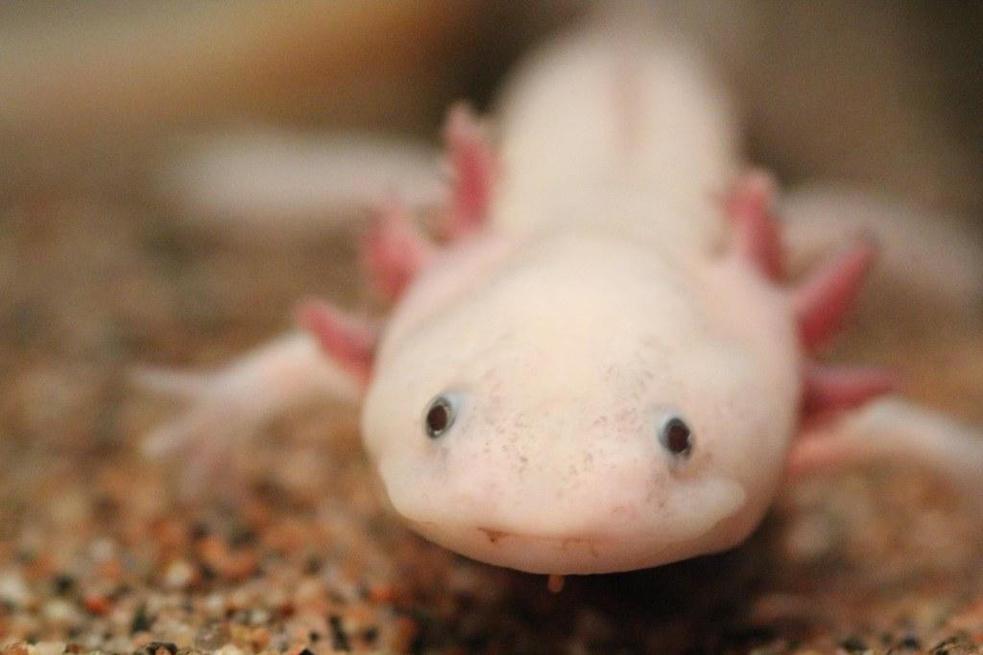
Axolotl’s
By Ayden Mckinnon
Notes:
1 Background Color
1 Title (or write the question)
1 Pictures
1 Include Transitions
1 Answering question using complete sentences (multiple sentences if needed to fully explain your answer)
1 Accuracy of information
6

Slide 2

What are Axolotls?
Axolotls are a type of Mexican Salamander!
Notes:
1 Background Color
1 Title (or write the question)
1 Pictures
1 Include Transitions
1 Answering question using complete sentences (multiple sentences if needed to fully explain your answer)
1 Accuracy of information
6

Slide 3
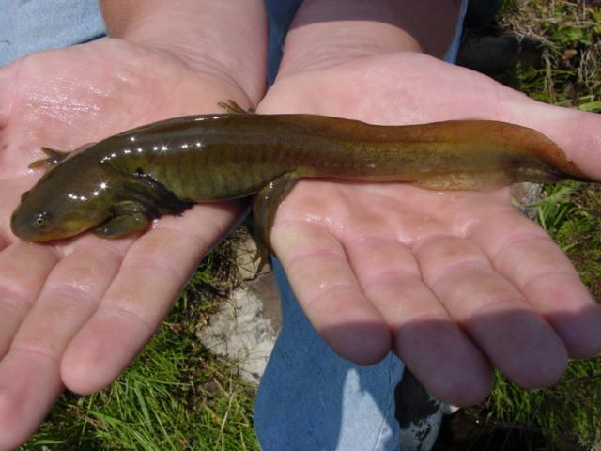
What do axolotls look like
They have a dark colored with greenish mottling and some have a silverish highlights with a flat body with a big head and adorable face!
Notes:
1 Background Color
1 Title (or write the question)
1 Pictures
1 Include Transitions
0 Answering question using complete sentences (multiple sentences if needed to fully explain your answer)
1 Accuracy of information
5
Please place a question mark after the title.
They are dark collared with….. Have silverish highlights….with a flat body, big head, and adorable face.

Slide 4
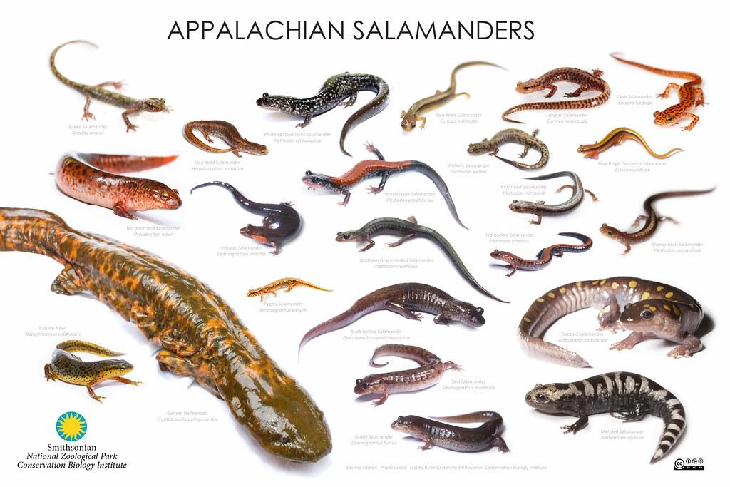
Are axolotlss a fish or lizard?
They are neither! They are a type of mexican salamander that originated in lakes Xochimilco and Challco.
Notes:
1 Background Color
1 Title (or write the question)
1 Pictures
1 Include Transitions
0 Answering question using complete sentences (multiple sentences if needed to fully explain your answer)
1 Accuracy of information
5
Are axolotls a fish or a lizard?

Slide 5
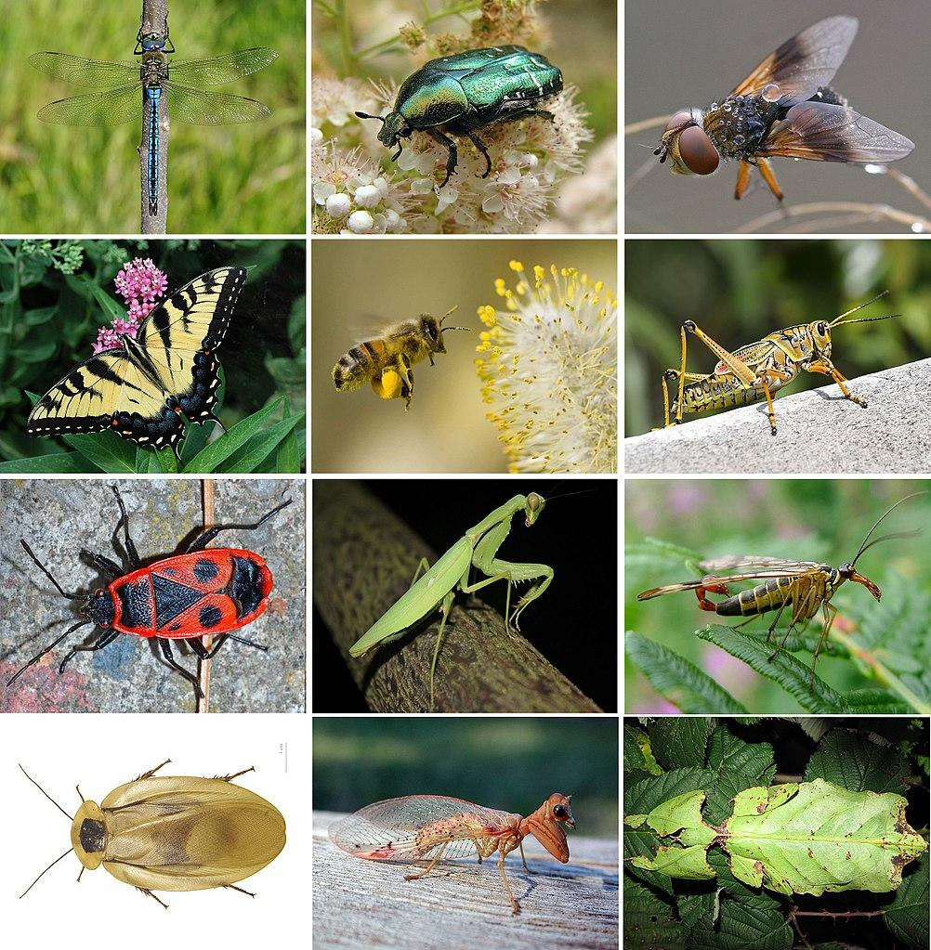
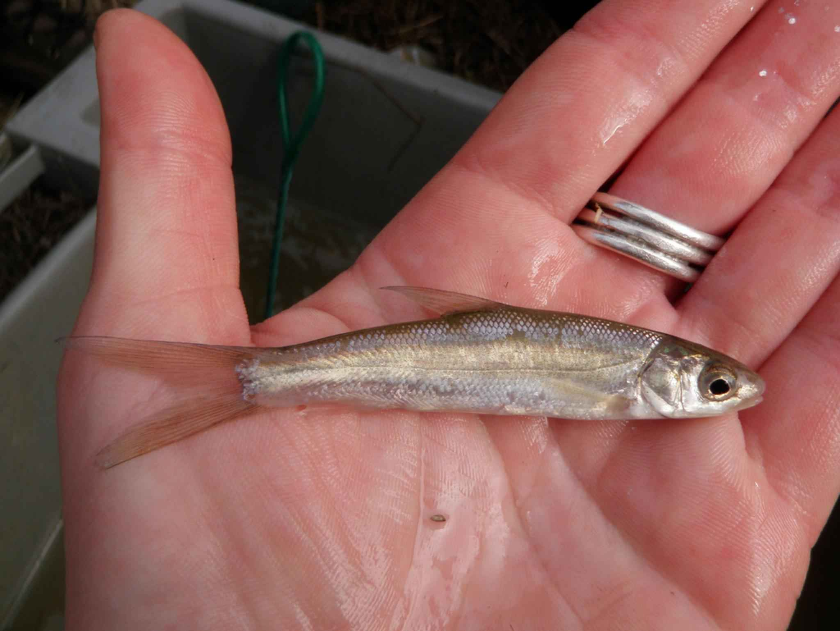
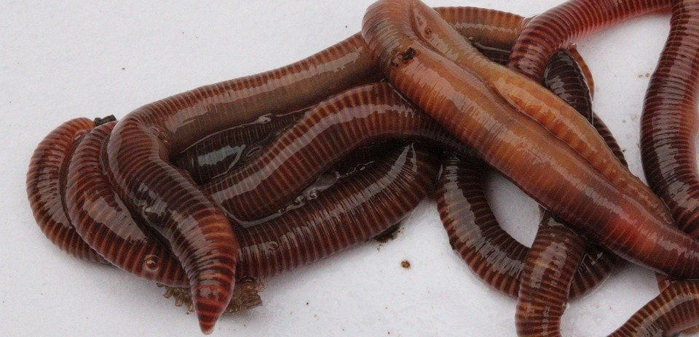
What type of food do axolotls eat?
They eat most food that fit in there mouth such as smaller fish, worms, insects, and even smaller salamanders.
Notes:
1 Background Color
1 Title (or write the question)
1 Pictures
1 Include Transitions
0 Answering question using complete sentences (multiple sentences if needed to fully explain your answer)
1 Accuracy of information
5
…eat most any food that will fit in their mouth…..

Slide 6
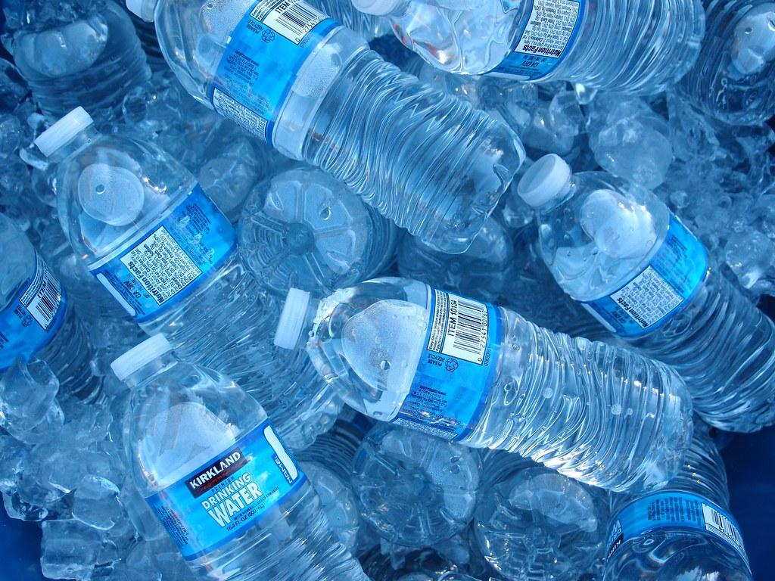
Do axolotls need drink’s?
Yes! They need bottled water Because of the minerals, sodium chloride, potassium chloride, and other things!
Notes:
1 Background Color
1 Title (or write the question)
1 Pictures
1 Include Transitions
0 Answering question using complete sentences (multiple sentences if needed to fully explain your answer)
0 Accuracy of information
4
Do axolotls need to drink?
In the wild they cannot buy bottled water.

Slide 7

How long do axolotls live?
They live an average for 5-6 years but some live up to 17 years !
Notes:
1 Background Color
1 Title (or write the question)
1 Pictures
1 Include Transitions
1 Answering question using complete sentences (multiple sentences if needed to fully explain your answer)
1 Accuracy of information
6

Slide 8

Can axolotls get illnesses?
Yes they can get stressed and then succumb to a disease mainly because of the owner not knowing its needs.
Notes:
Extra slide no scored.
…can become stressed….succumb to disease. This happens mainly because an owner…… what about in the wild?

Slide 9
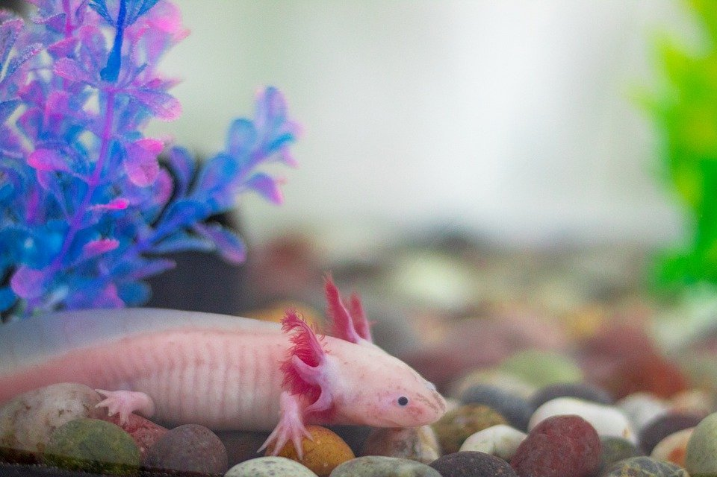
Are all axolotl’s a transparent pink color?
No! Those are albino axolotls, they are quite rare to find but the most common to see in pictures if you look up Axolotl’s.
Notes:
1 Background Color
1 Title (or write the question)
1 Pictures
1 Include Transitions
0 Answering question using complete sentences (multiple sentences if needed to fully explain your answer)
1 Accuracy of information
5
…find, but are the most common seen in pictures.

Slide 10

How many types of axolotls are there?
There is over 20 types of Axolotls!
Notes:
1 Background Color
1 Title (or write the question)
1 Pictures
1 Include Transitions
1 Answering question using complete sentences (multiple sentences if needed to fully explain your answer)
1 Accuracy of information
6

Slide 11
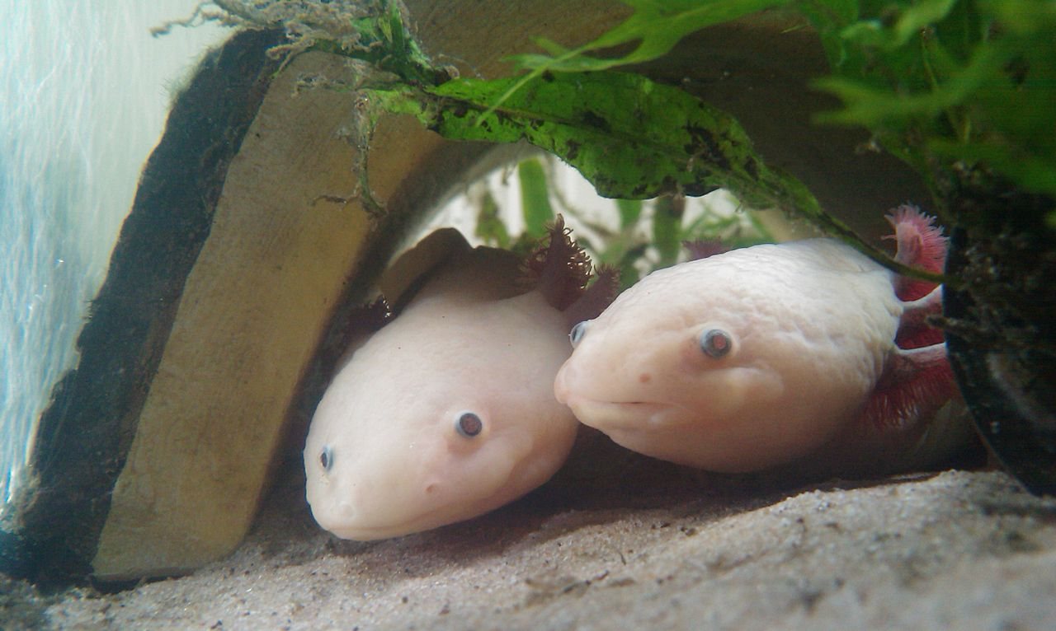
What type of consumer are they?
Axolotl’s are a type of consumer!
Notes:
1 Background Color
1 Title (or write the question)
1 Pictures
1 Include Transitions
1 Answering question using complete sentences (multiple sentences if needed to fully explain your answer)
0 Accuracy of information
5
What Kind of Consumer are they??

Slide 12
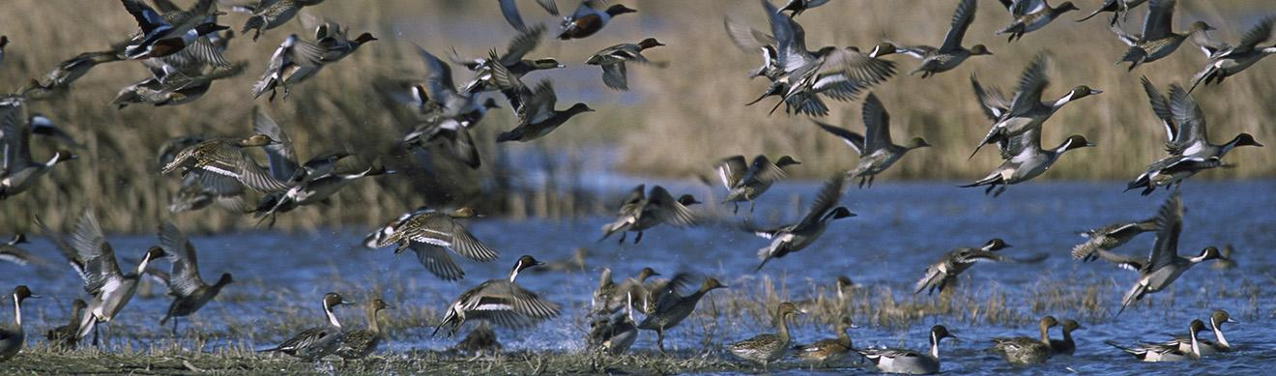
Do they have any predators?
Yes they do! The most common of which are many types of birds some of these birds insist of storks and herons.
Notes:
1 Background Color
1 Title (or write the question)
1 Pictures
1 Include Transitions
0 Answering question using complete sentences (multiple sentences if needed to fully explain your answer)
1 Accuracy of information
5
…types of birds. A couple of the birds that eat them are storks and herons.

Slide 13
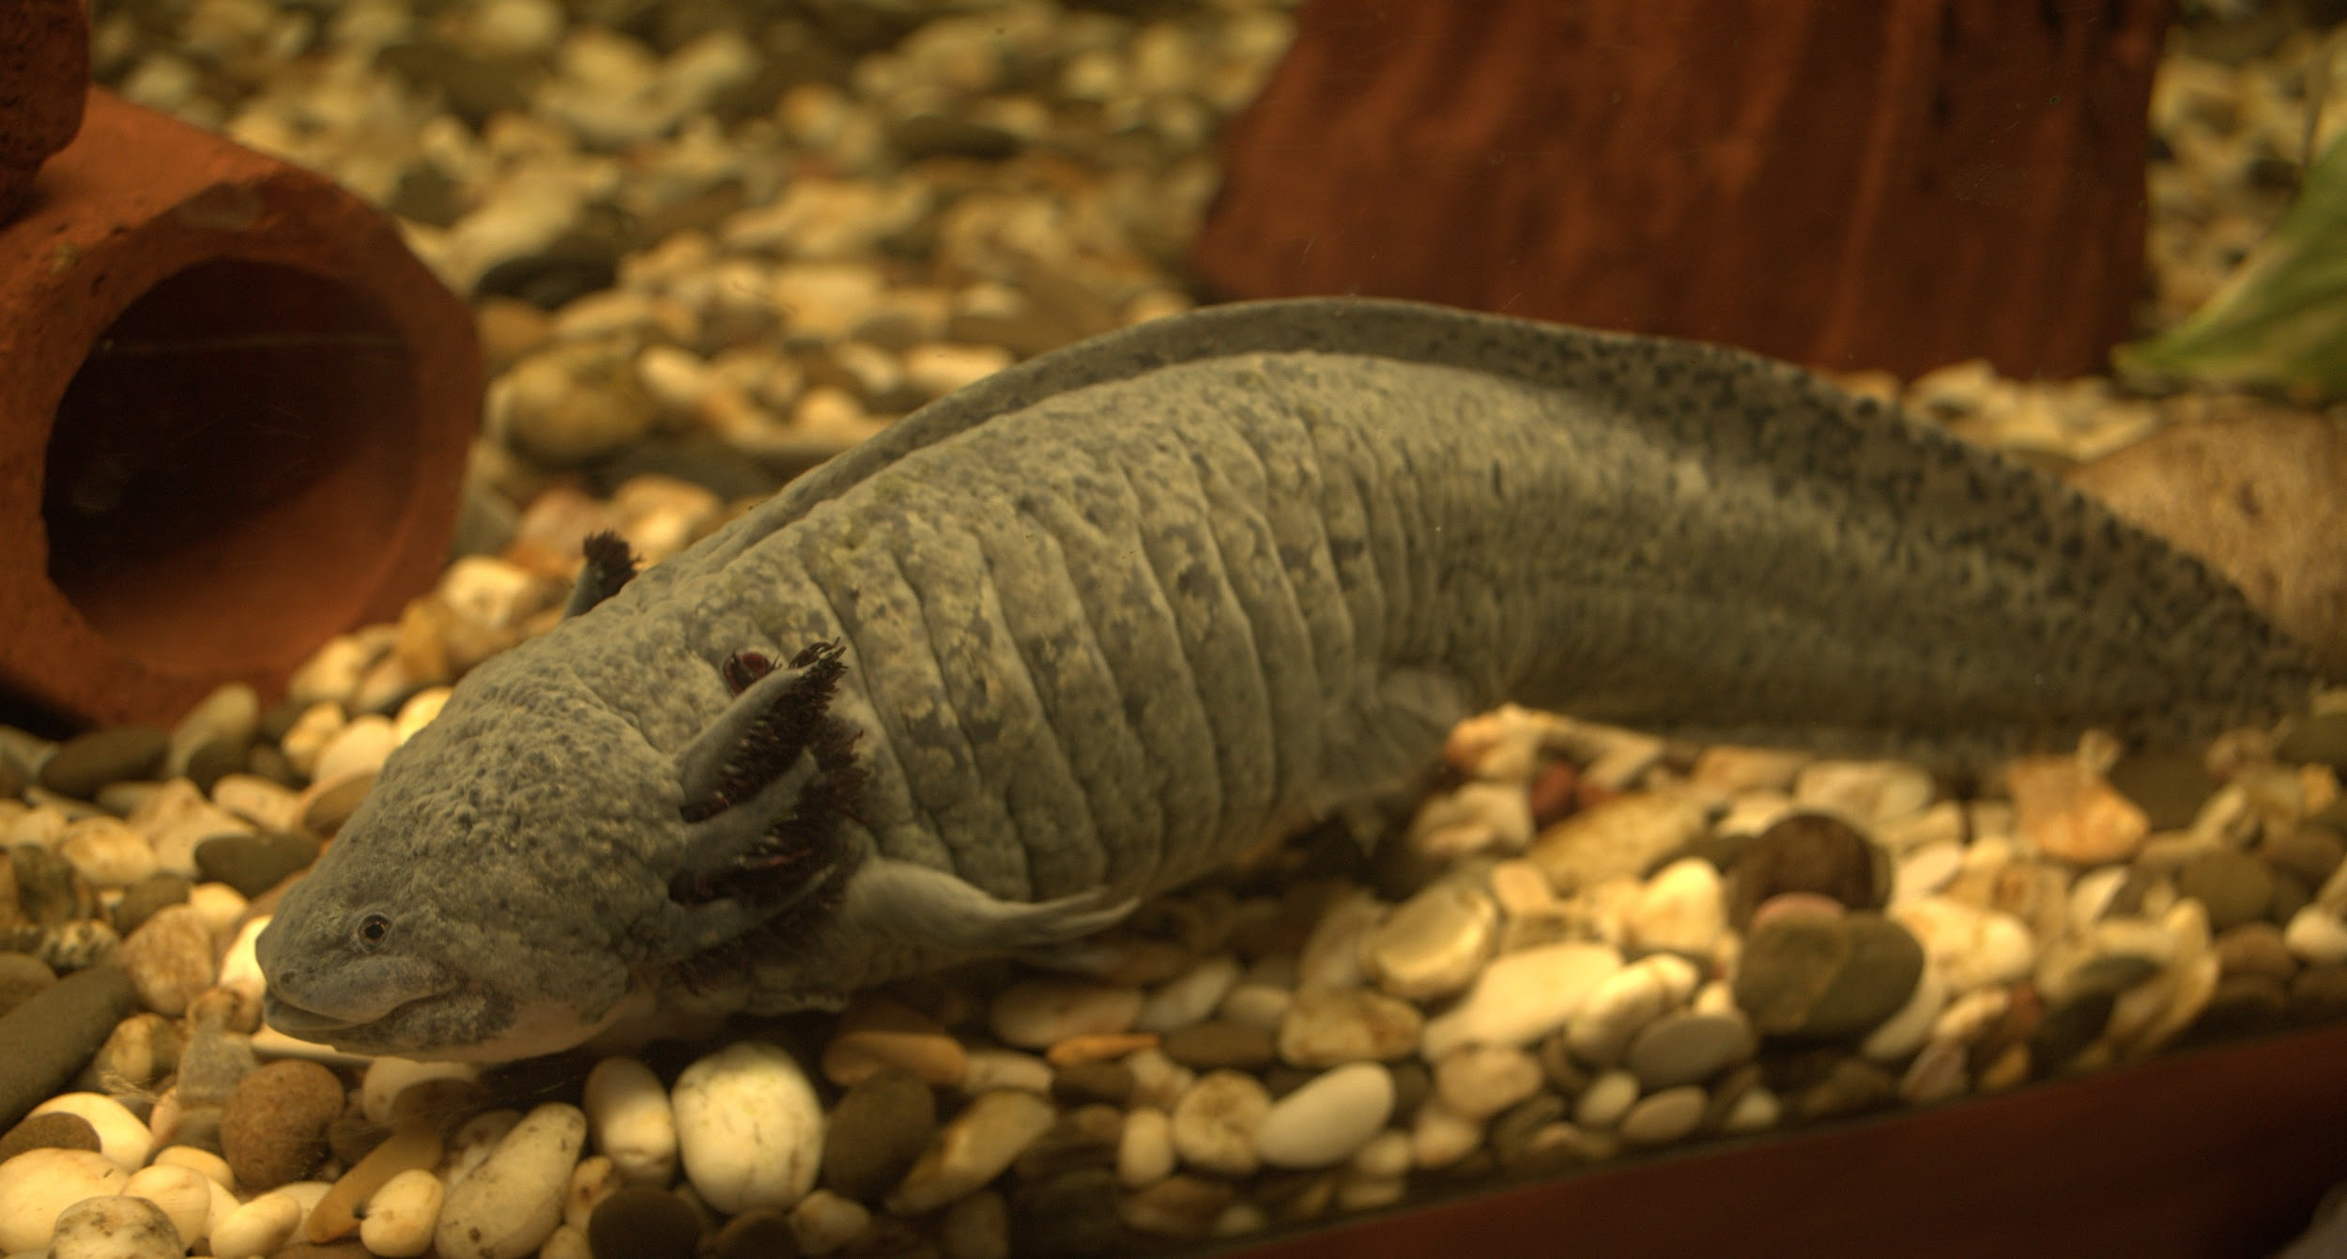
Do the males and females weigh the same
Females can way up to 10.5 ounces and males can way up to 10.5 so yes they way the same!
Notes:
1 Background Color
1 Title (or write the question)
1 Pictures
1 Include Transitions
0 Answering question using complete sentences (multiple sentences if needed to fully explain your answer)
1 Accuracy of information
5
Please put a question mark behind the title. …… up to 10.5 ounces–so yes they weigh the same.

Slide 14

8 facts on Axolotls
Axolotls can have many different colors on there body while some are noticeable others aren't.
They are native to 1 place in the world.
They are carnivorous
They are highly endangered and there is roughly 700-1200 left :(
If they lose a limb it can grow back
Axolotl’s look like babies their whole lives!
White albino’s are the rarest to find in the wild
You can eat them! :)
Notes:
1 Background Color
1 Title (or write the question)
1 Pictures
1 Include Transitions
0 Answering question using complete sentences (multiple sentences if needed to fully explain your answer)
1 Accuracy of information
5
Keep the same type of font throughout the paragraph. Please use either bullets or numbers. Make sure each sentence is punctuated..
You are missing the sources page please add it… -6 off the top.

Slide 15

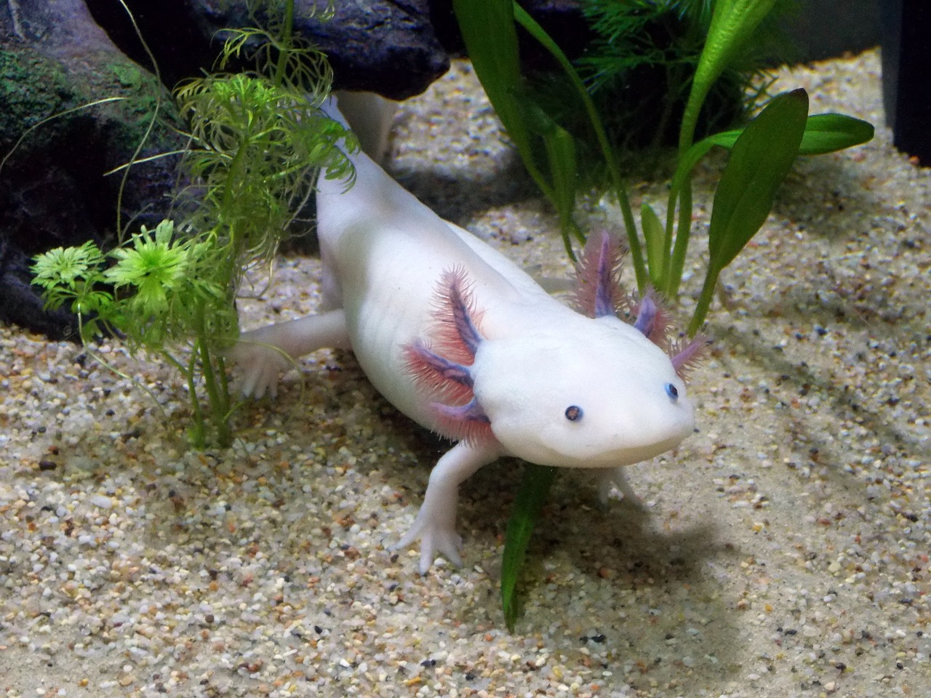
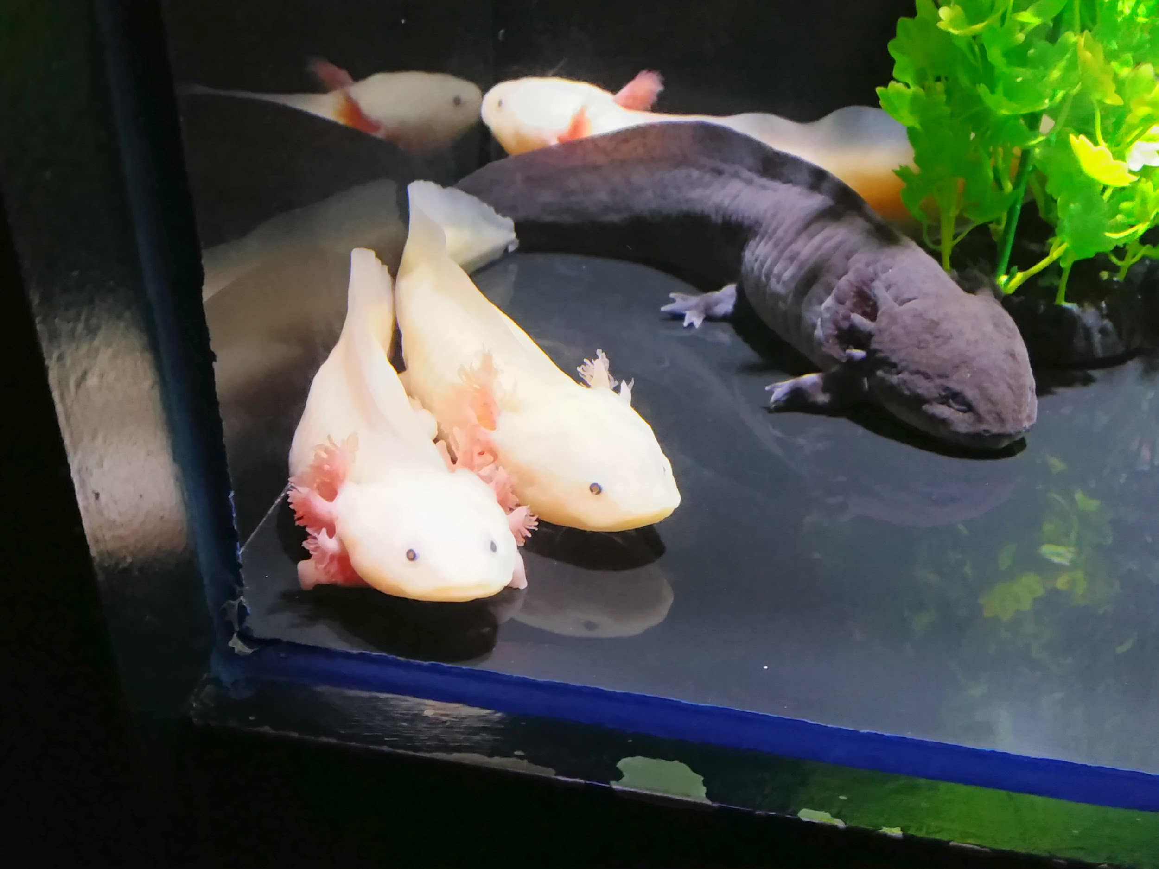
Where did I find this information?
I found my information from articles on google or from books made about axolotl’s

