Slide 1
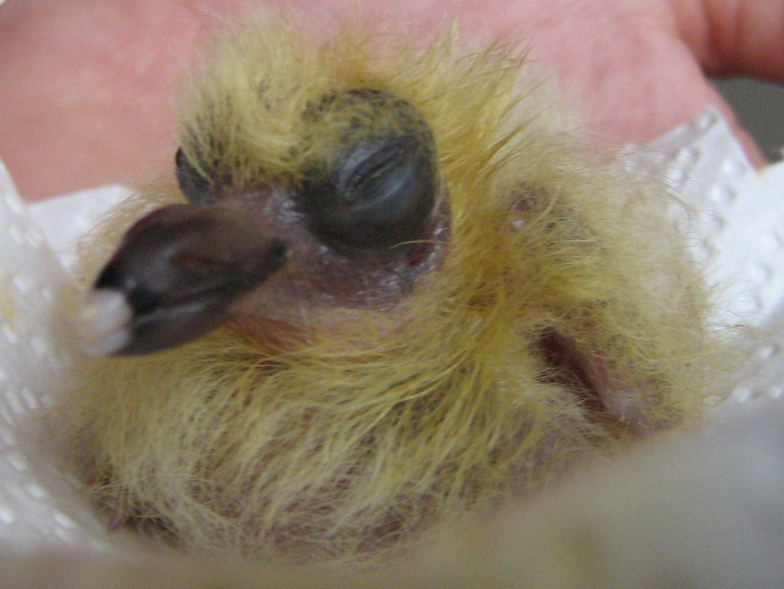
Rock Dove
By Delilah.A.Osorio
Notes:
1 Background Color
1 Title (or write the question)
1 Pictures
1 Include Transitions
1 Answering question using complete sentences (multiple sentences if needed to fully explain your answer)
1 Accuracy of information
6

Slide 2
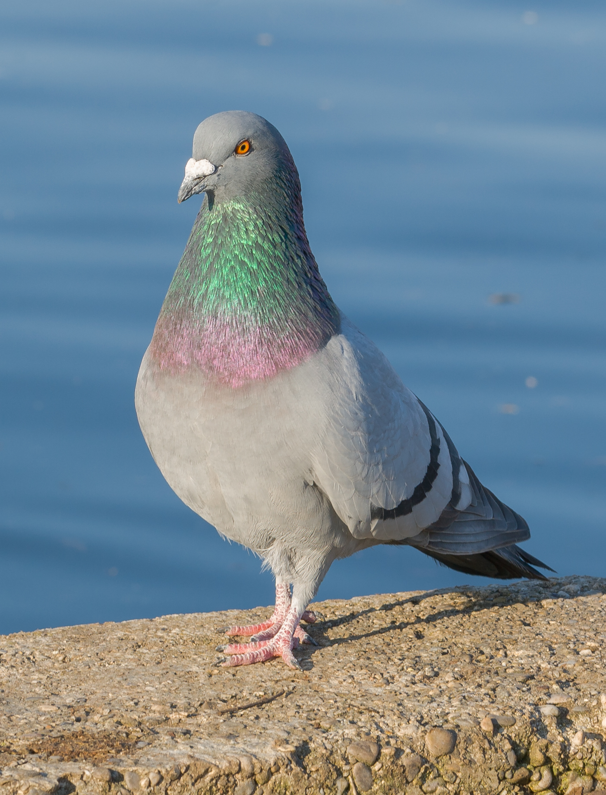
Where This Fantastic Bird Comes From
Pigeons are originally from Europe to North Africa but the rock pigeon is commonly found in big citys such as NYC(New York City).
Notes:
1 Background Color
1 Title (or write the question)
1 Pictures
1 Include Transitions
0 Answering question using complete sentences (multiple sentences if needed to fully explain your answer)
1 Accuracy of information
5.
Title either Where did this fantastic bird come from? Or Where This Fantastic Bird Comes From
There is an extra space between originally and from. Please write out New York City.

Slide 3
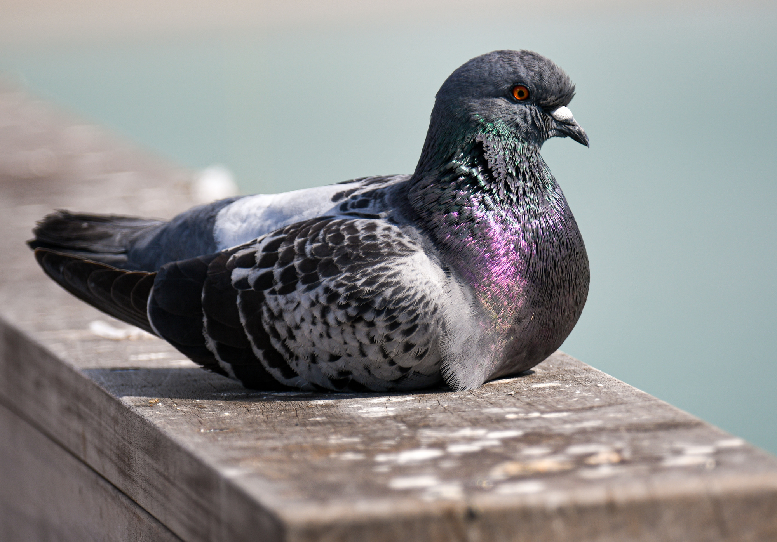
Their Ecosystem
Ahh the Rock Pigeon, found often in the concrete jungle that is NYC. They live in trees in and parks, but also perch on buildings. They share this location with many a creature including (but not limited to) rats, humans, and other birds.
Notes:
1 Background Color
1 Title (or write the question)
1 Pictures
1 Include Transitions
5 Answering question using complete sentences (multiple sentences if needed to fully explain your answer)
1 Accuracy of information
5
NYC. They live in… ..parks, but also…. Including () rats, humans, and other birds.

Slide 4
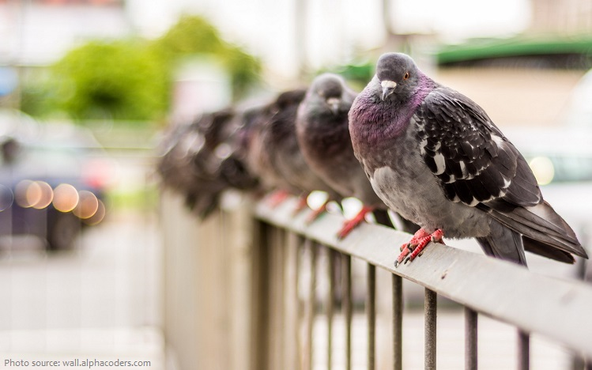
The Ecosystem but more in depth
The common temperature in NYC were the Rock Dove is found is between 28, 85 degrees normally. It rarely goes any higher or lower than that.
They do be chillin though!
<---------------
Notes:
1 Background Color
1 Title (or write the question)
1 Pictures
1 Include Transitions
0 Answering question using complete sentences (multiple sentences if needed to fully explain your answer)
1 Accuracy of information
5
There should always be a space after a comma. Goes.. not gose. exclamation point after though.

Slide 5
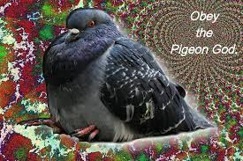
Pigeon Food
The Rock Pigeon has a somewhat omnivorous diet, so if you ever wanted to eat like a pigeon now you can so listen up. In the wild they eat seeds, berries, acorns some grasses, and earthworms, however, in the city these birds are FAT, they get fed bread crumbs, popcorn, and other things birds should probably not eat.
Notes:
1 Background Color
1 Title (or write the question)
1 Pictures
1 Include Transitions
0 Answering question using complete sentences (multiple sentences if needed to fully explain your answer)
1 Accuracy of information
5
If the title is not a sentence the use capital letters.. Pigeon Food
….eat seeds, berries, acorns, grasses, and earthworms. However, in the city…..get fed bread crumbs, popcorn, and other….

Slide 6
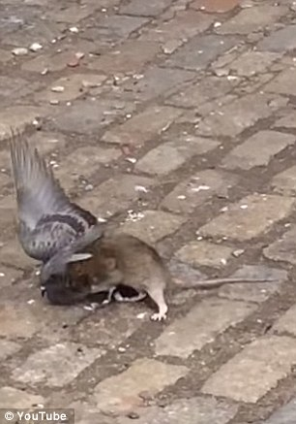
Pigeon Murders
Sadly, the world is not perfect, and whether it be for food or debt many a pigeons are taken off the planet. The pigeon killers are commonly racoons, opossums, and red tailed hawks.( idk man im just saying that if you make a pigeon real fat by feeding it junk food it may die from obesity).
Epic fight of the century---->
Notes:
1 Background Color
1 Title (or write the question)
1 Pictures
1 Include Transitions
0 Answering question using complete sentences (multiple sentences if needed to fully explain your answer)
1 Accuracy of information
5
Sadly, the world… Pigeon killers are commonly racoons, opossums, and red tailed…
Delete the space after the (... put a period after ). The epic fight of the century! —>

Slide 7
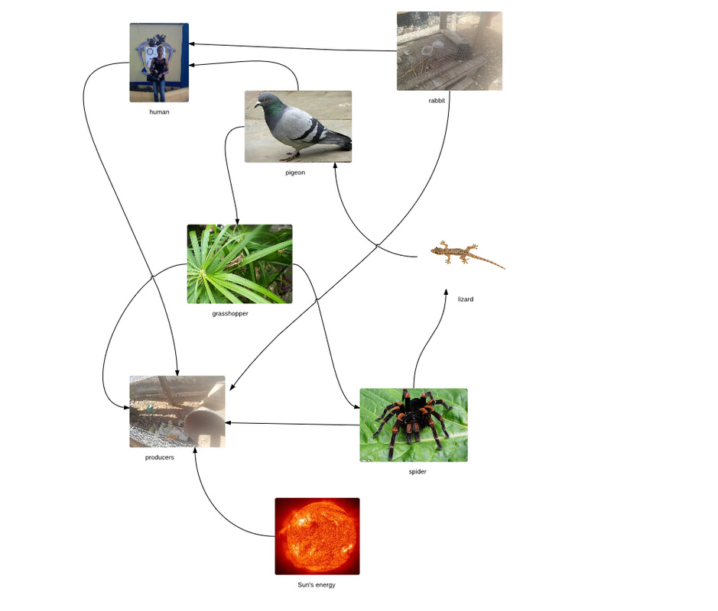
The Food Chain
So the food chain of the pigeon is simple first it eats seeds then it gets eaten by an opossum then the opossum get eaten by a hawk.
Notes:
1 Background Color
1 Title (or write the question)
1 Pictures
1 Include Transitions
0 Answering question using complete sentences (multiple sentences if needed to fully explain your answer)
1 Accuracy of information
5
When the title is not a sentence use caps. The Food Chain
…simple. First, it eats…..gets eaten by an opossum… gets eaten by a hawk.

Slide 8
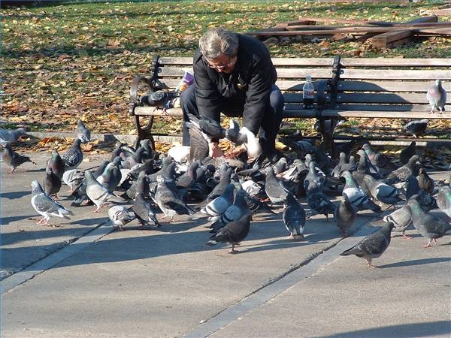
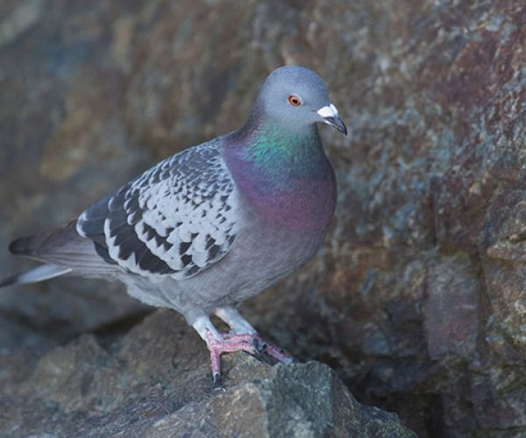
Adaptations?
As far as I can tell there only adaptation was to start bothering humans for food so they can be fed and get fat.
Notes:
1 Background Color
1 Title (or write the question)
1 Pictures
1 Include Transitions
0 Answering question using complete sentences (multiple sentences if needed to fully explain your answer)
1 Accuracy of information
5
…can tell their only…is to start bothering…so they can be…fat.

Slide 9
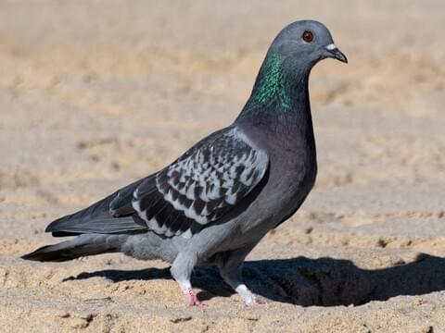
What Does The Rock Pigeon Look Like?
Adult males weigh 8.4 – 13 ounces. Typically the females weight is around the same but they are slightly smaller. As for looks this bird is grey with some more colorful feathers circulating around its neck.
Notes:
1 Background Color
1 Title (or write the question)
1 Pictures
1 Include Transitions
0 Answering question using complete sentences (multiple sentences if needed to fully explain your answer)
1 Accuracy of information
5
What does the Rock pigeon look like?
…..oz. Typically, the females…but they are slightly. As for looks, this …feathers circulating..

Slide 10
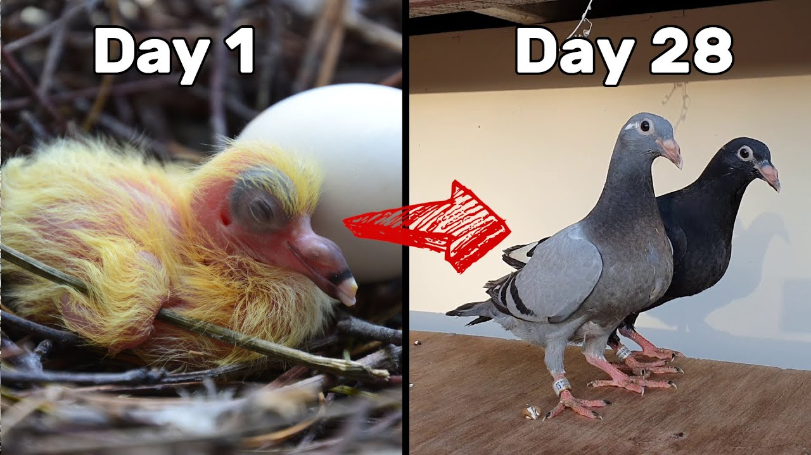
How long can the rock pigeon live?
On the average Pigeons live for 6 years which is not bad for a bird–thats like what the age of a first grader.
Notes:
1 Background Color
1 Title (or write the question)
1 Pictures
1 Include Transitions
0 Answering question using complete sentences (multiple sentences if needed to fully explain your answer)
1 Accuracy of information
5
Please put a question mark at the end of the title.
On the average pigeons live for 6 years–which is not bad for a bird. That is about the age of a first grader. Don’t use colloquial words and slang.

Slide 11
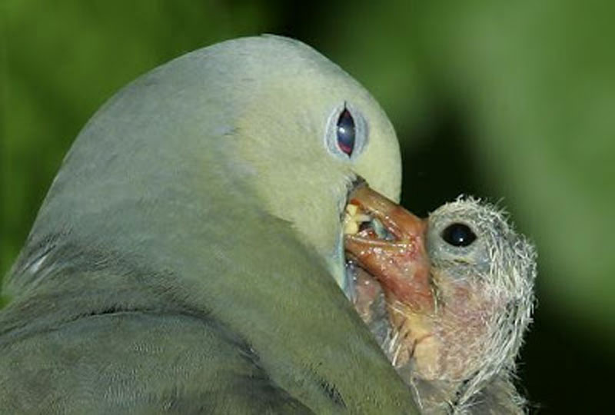
Fun Facts
1: The birds scientific name is the “Columba livia”.
2: It takes 6 months for them to become adults.
3: There speed can reach up to (93 mph).
4: They feed their babies “Pigeon milk”.
Notes:
1 Background Color
1 Title (or write the question)
1 Pictures
1 Include Transitions
0 Answering question using complete sentences (multiple sentences if needed to fully explain your answer)
1 Accuracy of information
5
Possibly Fun Facts.
Every sentence needs the first word capitalized, and punctuation on the end.

Slide 12
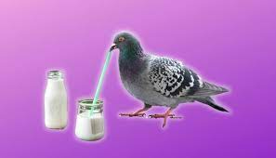
More Fun-ish Facts
1: They incubate their eggs for usually 16-19 days.
2: Most ( not all) pigeons are family men by that I mean they mate for life.
3: They may raise up to 5 children per brood.
4: They are known as the common pigeon due to the fact that there are domesticated faster than other Pigeons.
Notes:
Not scored extra slide.
Moe Fun-ish Facts.
Every sentence needs the first word capitalized, and punctuation on the end.

Slide 13
Sites
https://www.audubon.org/field-guide/bird/rock-pigeon
https://www.allaboutbirds.org/guide/Rock_Pigeon/overview
https://ebird.org/species/rocpig
.0.
Notes:
6

Slide 14

Brewster
Now that you have read all the science stuff it's time for you to know the real reason why I picked the Rock Pigeon or just Pigeon in general
It's because of him; yes this fine specimen of a man
His name is Brewster and he's the best he sells you
Coffee for 200 bell ( dollars)
Notes:
Not scored extra slide.

Slide 15

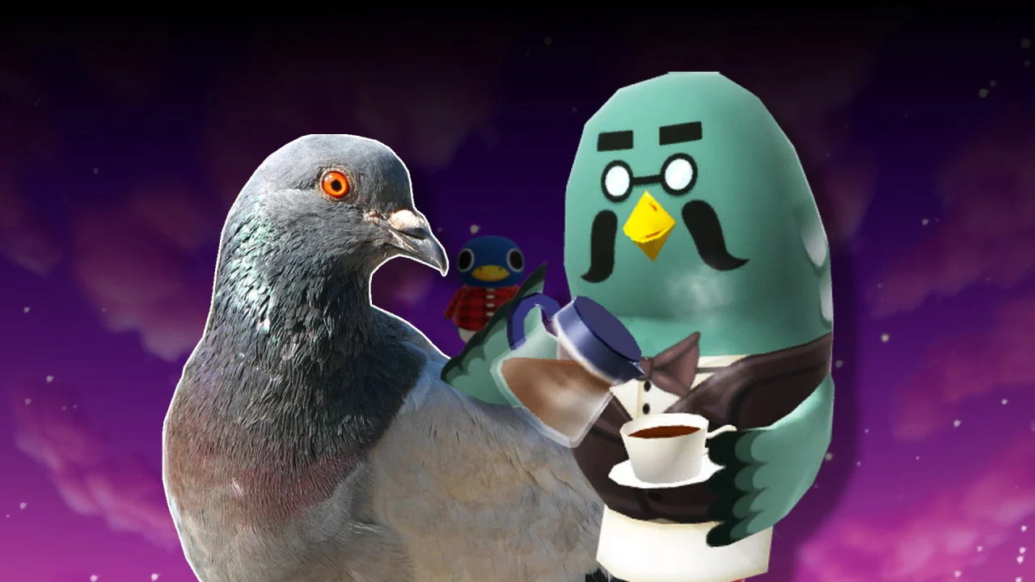
So Snazy
Look at him he's just the best, a true pigeon
He even has a scandal
“The dark secret of Brewster Pigeon milk?!?!”
Notes:
Not scored extra slide.

