Slide 1
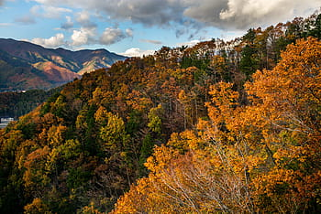
Creature Project
By Elijah Ramos

Slide 2
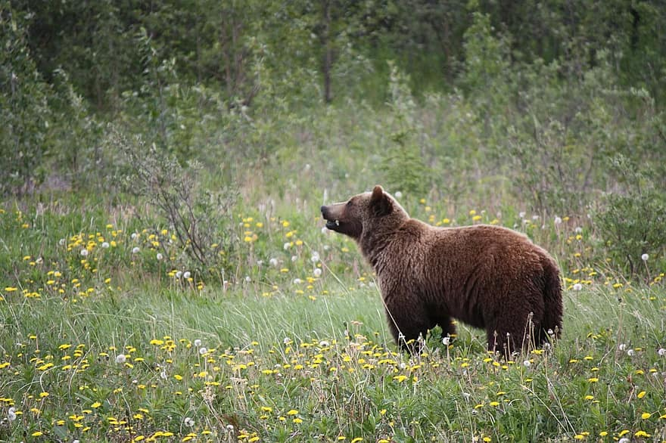
What is your creature!
I chose the Grizzly bear because their like big teddy bears.

Slide 3
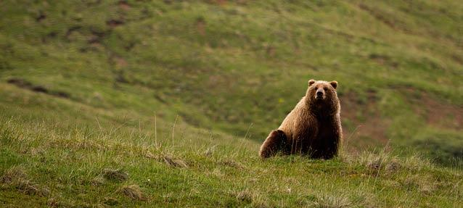
What is the lifespan for your creature
A grizzly bear lifespan is between 20-25 years

Slide 4
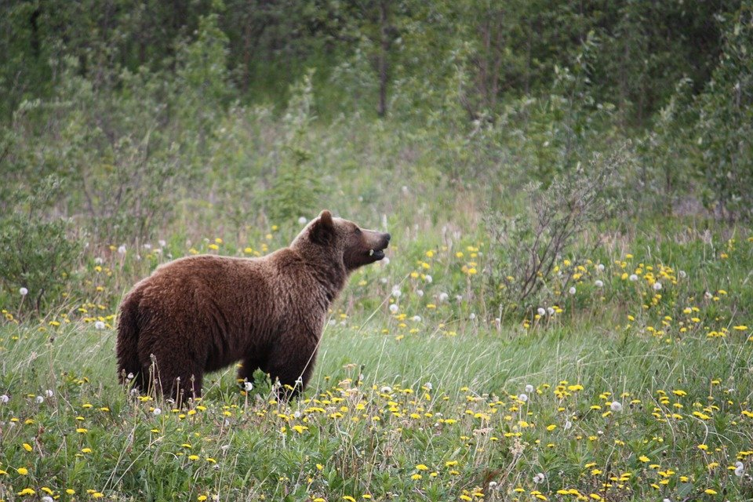
Interesting facts about the Grizzly bear!
1. Climate changes can lead to grizzly bears to change their diets. 2. Grizzly bears love to eat moths and more insects. 3. The hump on a grizzly bears back is a huge muscle. 4. They'll eat other bears. 5. Grizzly bears front claws can be longer than a human's finger. 6. Grizzly bears are actually really scared of humans.
7.
8.

Slide 5
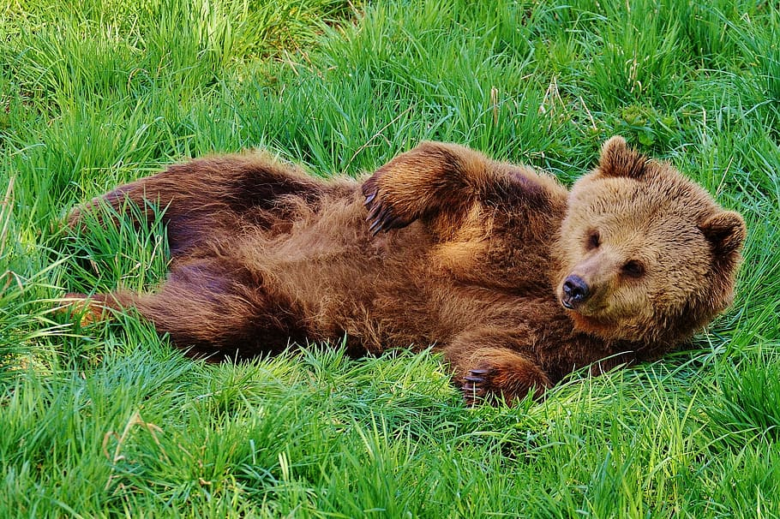
Where grizzly bears come from!
Today grizzly bears are found in many places such as Alaska, Washington and possibly South colorado. They range from alaska to mexico and mississippi river system.

Slide 6
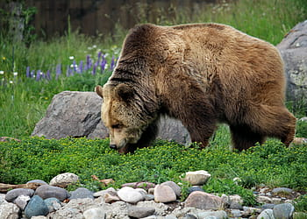
What ecosystem do they live in?
Grizzly bears have many ecosystems such as WoodLands, Forests, Meadows and more. Grizzly bears like the forests to have lower populations (Moose,Deers).

Slide 7
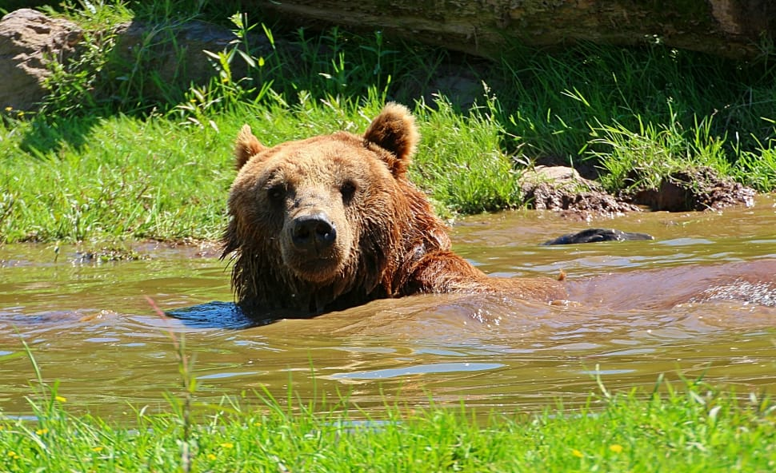
Do Grizzly bears have predators?
Well Grizzly bears do have predators. Humans are one of them for hunting and skinning the bears for their amazing fluffy hair, Cougars is another predator also a very fearless animal.

Slide 8
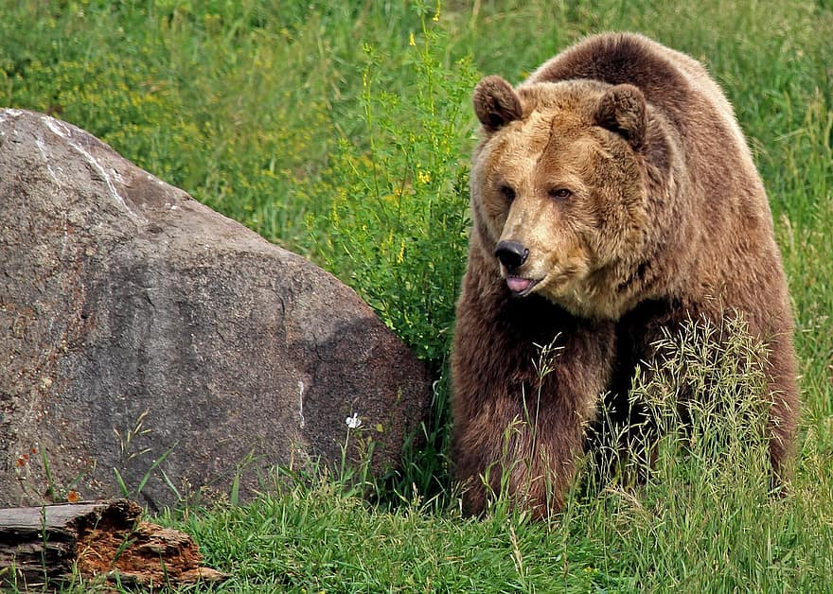
How much does a grizzly bear weight and h0w tall?
Grizzly bears weighing up to 800 lbs (363 kilograms) and the average size of a grizzly bear is 3.3 ft

Slide 9
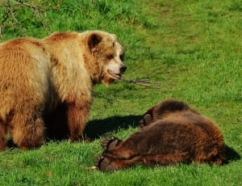
Are Males and Female grizzly bears the same?
The male grizzly bear is much bigger than a female, The average male grizzly bear can grow up to 3.6-4.6 ft on the other side of the grizzly family is females growing up to be 3-3.8 ft.

Slide 10
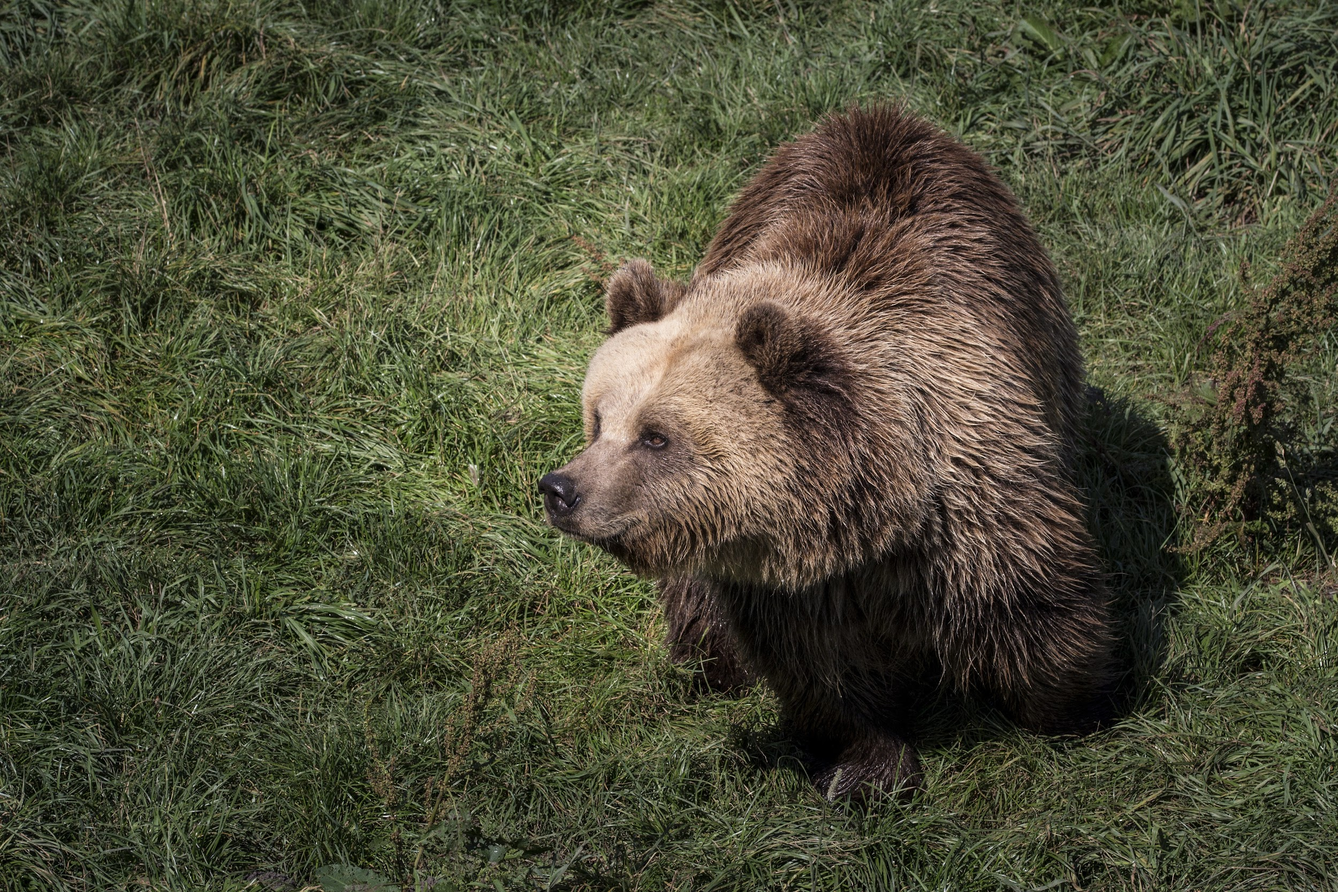
Grizzly bears food chain
Grizzly bears eat anything they can find such as In

