Slide 1
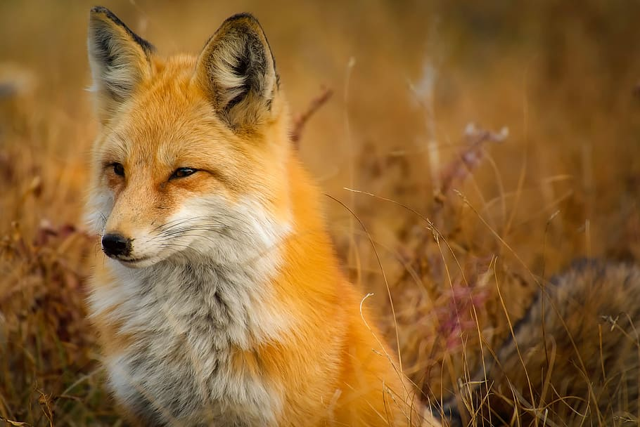
Creature Project
The Sierra Nevada red fox
Frank

Slide 2
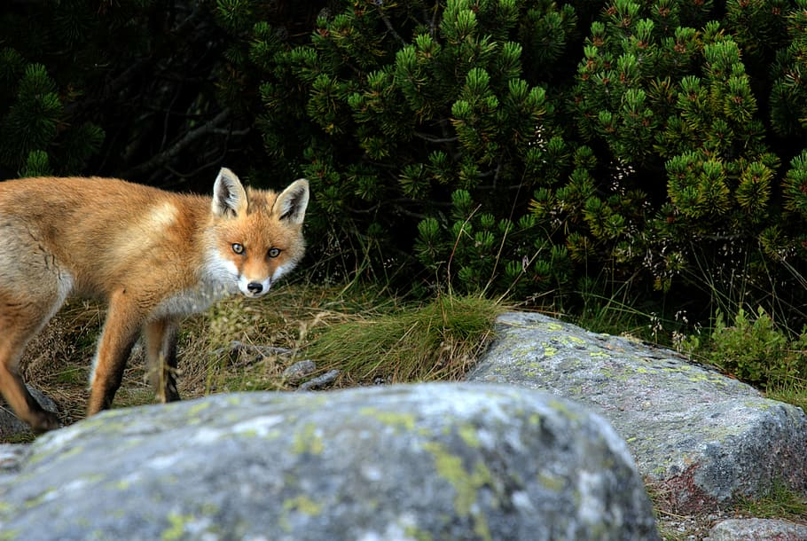
The history of where my creature is from
RANGE: The Sierra Nevada red fox historically ranged from Tulare Country northward through California's Sierra Nevada Mountains and the Cascade Mountains of Northern California and Oregon. ... Mating and den construction occur in January and February; the fox is believed to be monogamous.

Slide 3
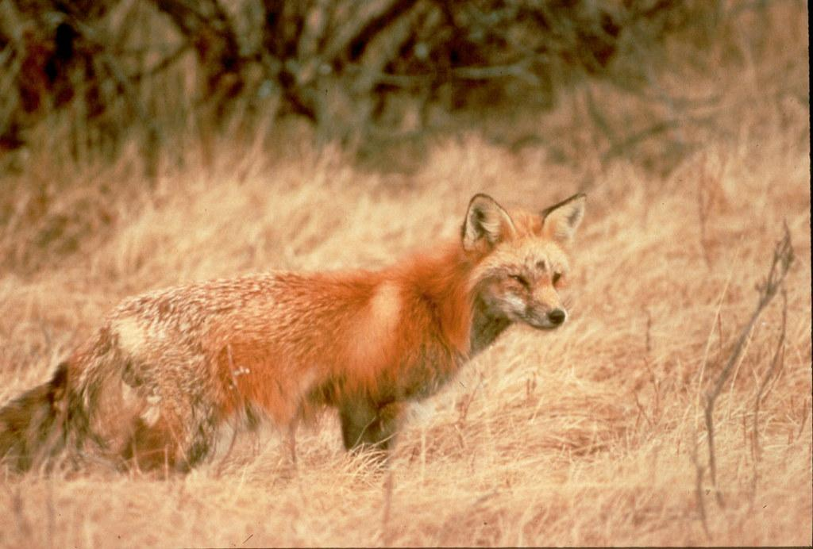
What ecosystem do they live in
HABITAT: The Sierra Nevada red fox lives in a wide range of remote, high-elevation alpine and subalpine habitats, including meadows; dense, mature forest; talus; and fell fields.

Slide 4
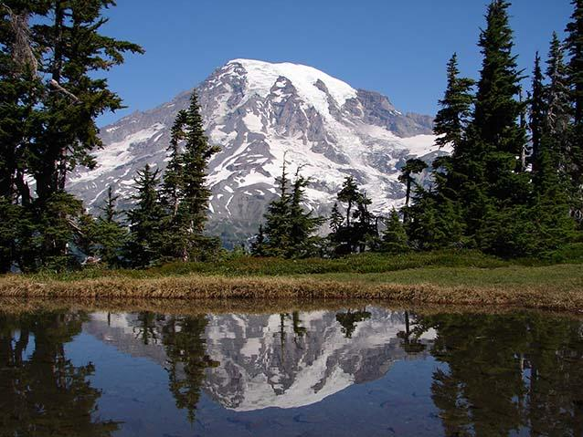
What is it like in their ecosystem?
The Sierra Nevada mountains are within the temperate coniferous forest biome. The Sierra Nevada also includes different vegetation zones, from montane forests to subalpine and alpine zones all determined by elevation. Ecosystems are dynamic and continually changing through time.

Slide 5
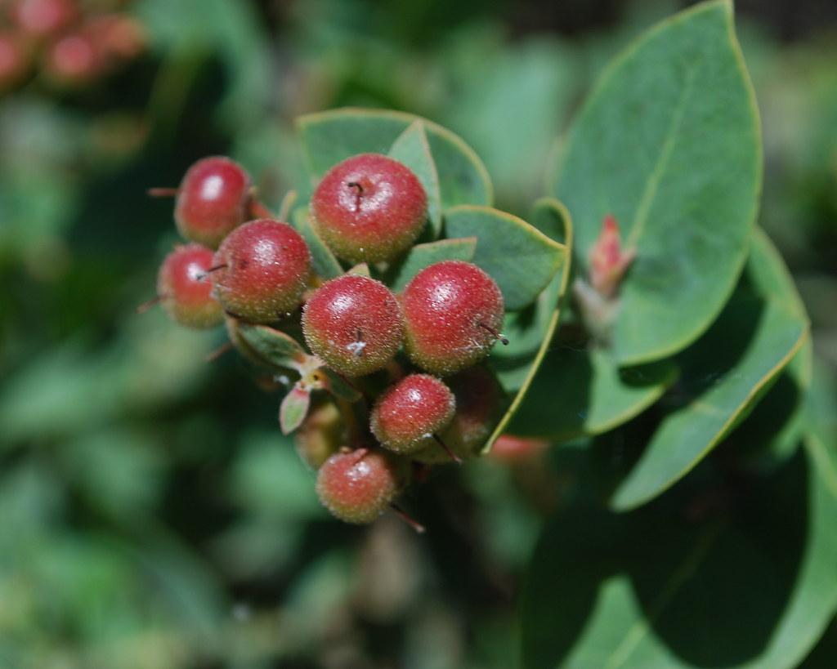
What type of consumer is your creature?
At home in elevations above 6,000 feet, Sierra Nevada red foxes live amongst red fir, lodgepole pines, and alpine fell-fields. As members of the dog family, they are carnivores and prey upon mice, squirrels, hares, and gophers, but also eat manzanita berries.

Slide 6
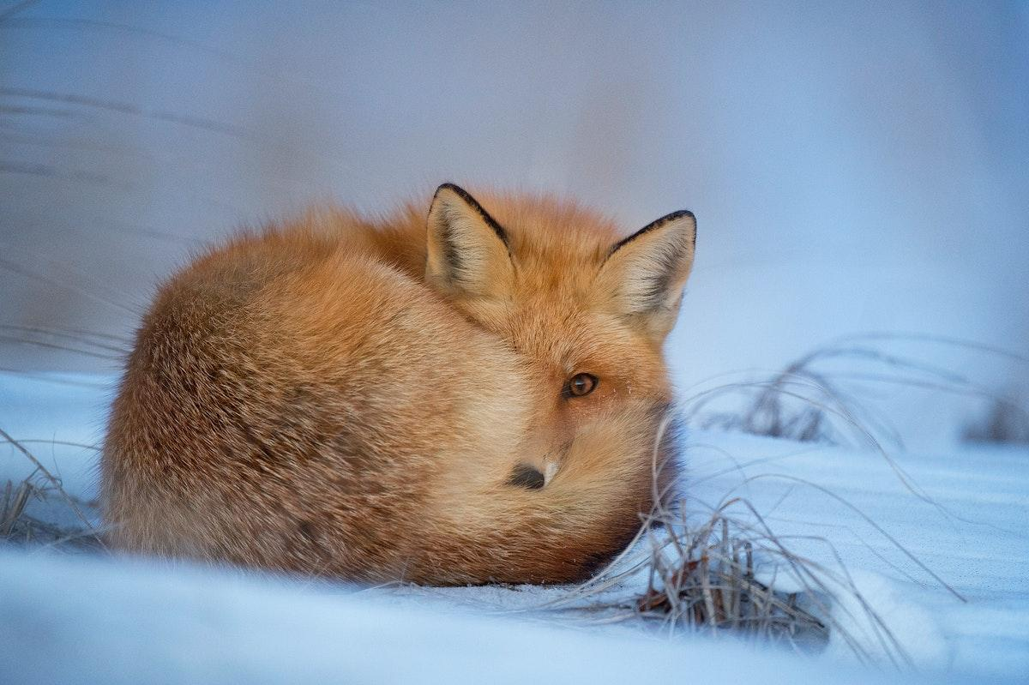
Based on question 5, what specific foods does your creature typically eat?
As members of the dog family, they are carnivores and prey upon mice, squirrels, hares, and gophers, but also eat manzanita berries

Slide 7
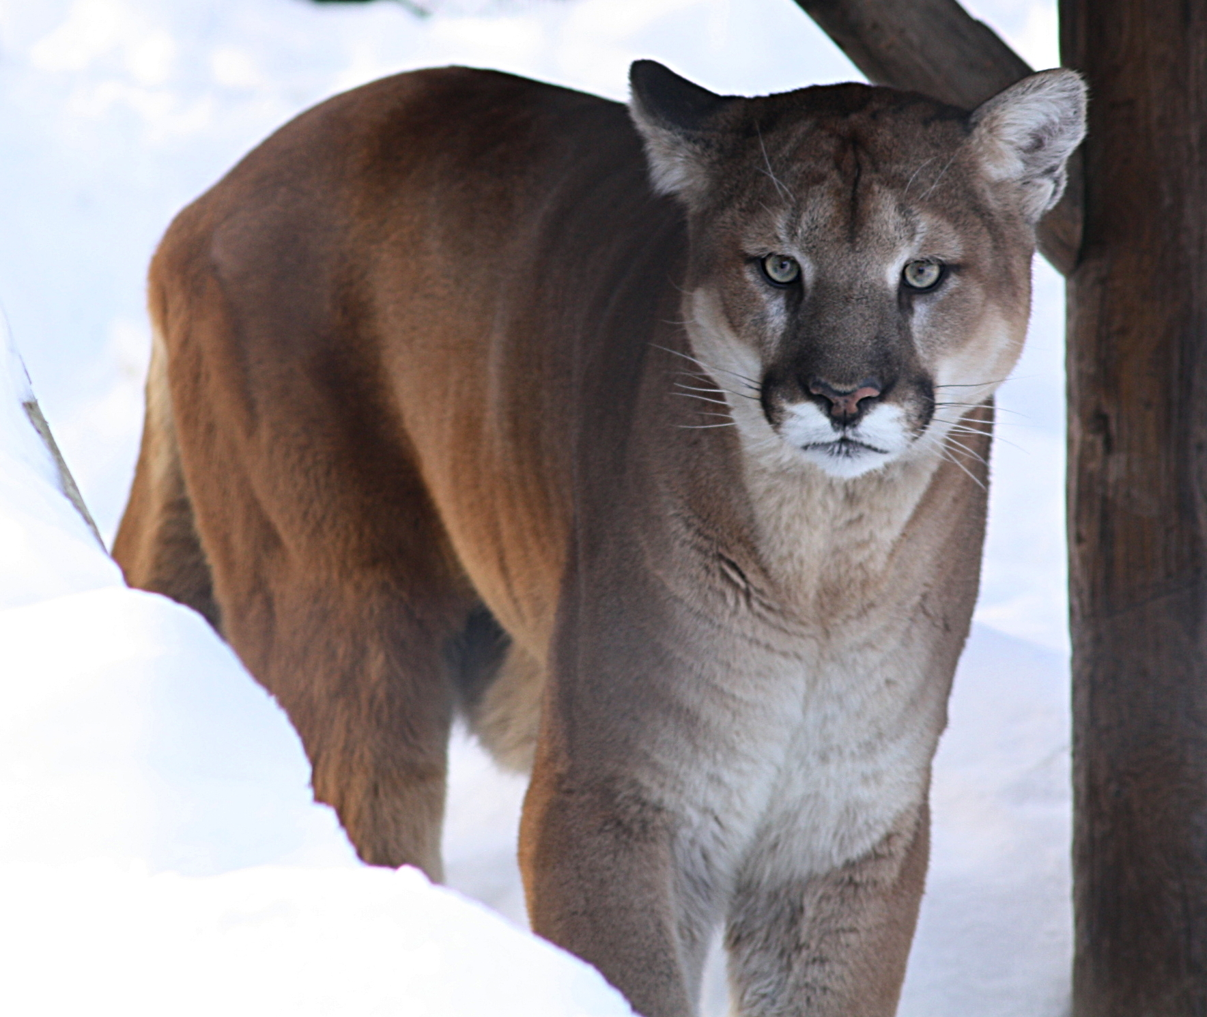
Does your creature have any predators?
Predators such as coyotes and mountain lions compete with the fox for prey. Snowshoe hares and Douglas squirrels are important food sources. Non-native red foxes pose a potential threat: Interbreeding could reduce the Sierra Nevada red fox subspecies' genetic diversity and ability to reproduce

Slide 9
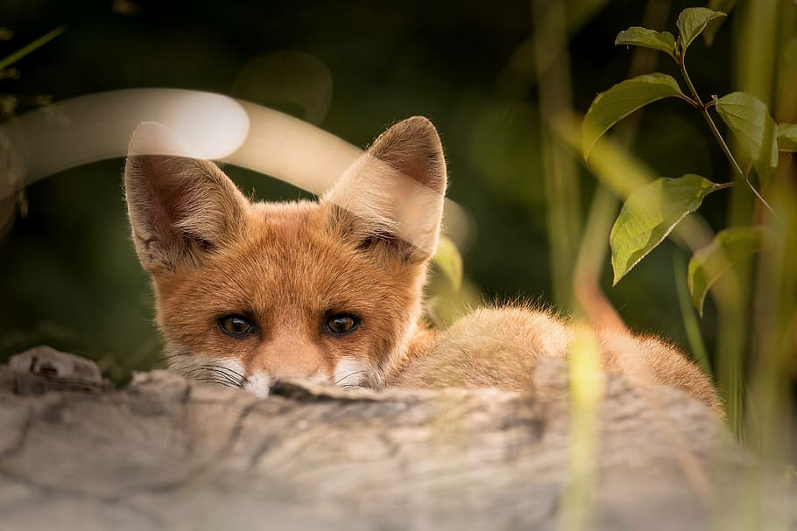
Does your creature have any specific adaptions to help it survive?
Foxes have excellent senses of eyesight, hearing, and smell.
Their sharp, pointed teeth are typical to carnivores and help them to tear through meat.
The colors of the fox's fur blend in with its surroundings and allow it to camouflage well.

Slide 10
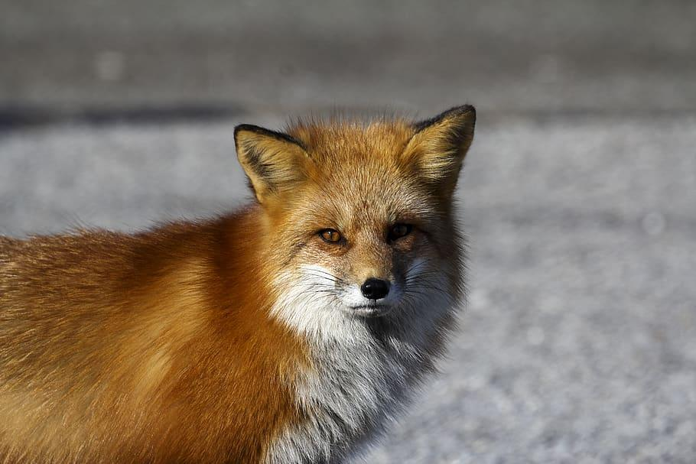
What does your creature look like, how much does it weigh, and how tall is it?
The Sierra Nevada red fox has a small, slender body and legs; long, pointed ears; an elongated snout; and a long, white-tipped tail. It is typically smaller than lowland red fox subspecies, with males weighing up to 9.2 pounds and measuring up to 3.4 feet long and females up to 7.7 pounds and 3.2 feet.

Slide 11
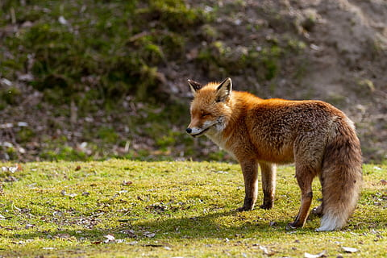
Do males and females of your creature weigh the same and are the same size?
The Sierra Nevada red fox has a small, slender body and legs; long, pointed ears; an elongated snout; and a long, white-tipped tail. It is typically smaller than lowland red fox subspecies, with males weighing up to 9.2 pounds and measuring up to 3.4 feet long and females up to 7.7 pounds and 3.2 feet.

