Slide 1
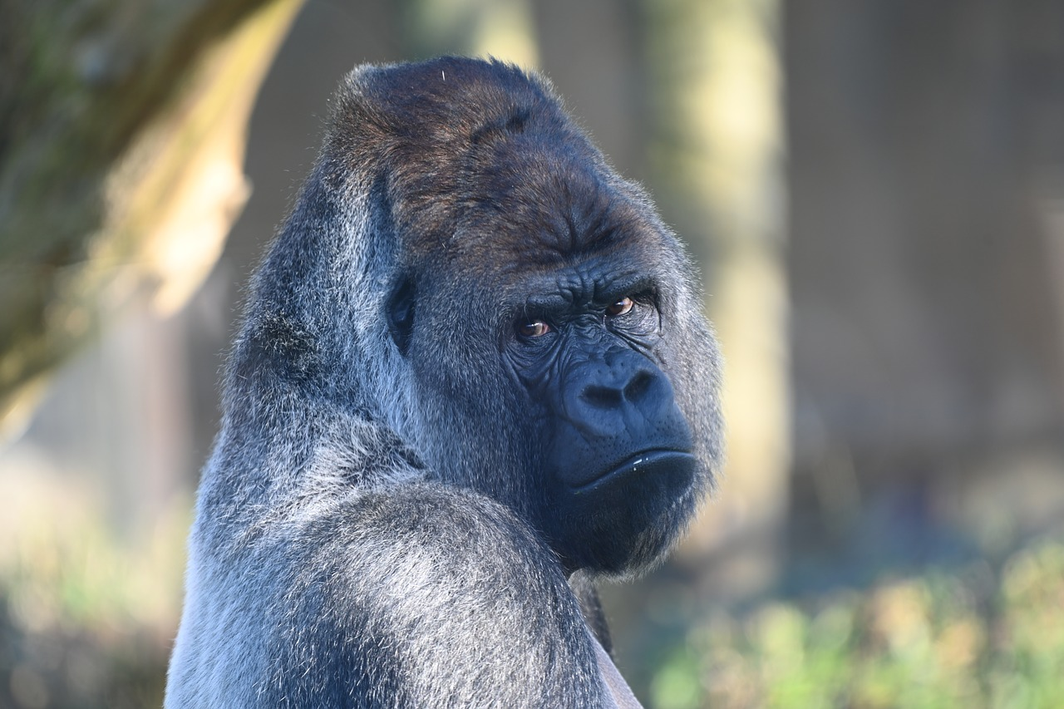
Mountain Gorilla
By Ian Moreno
Notes:
1 Background Color
1 Title (or write the question)
1 Pictures
1 Include Transitions
1 Answering question using complete sentences (multiple sentences if needed to fully explain your answer)
1 Accuracy of information
6

Slide 2
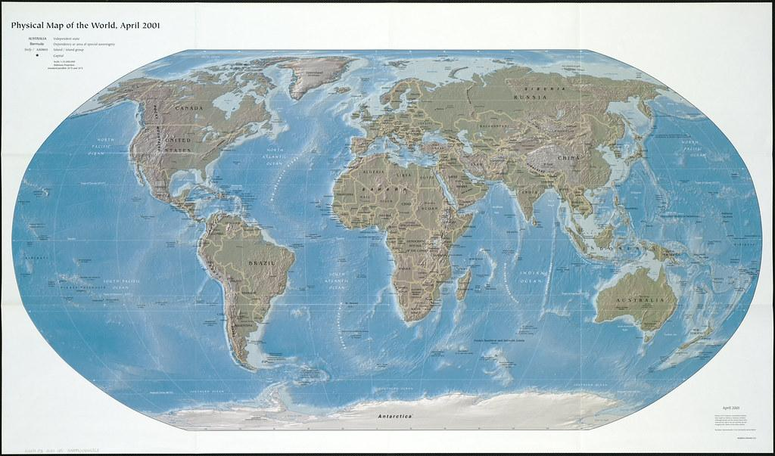
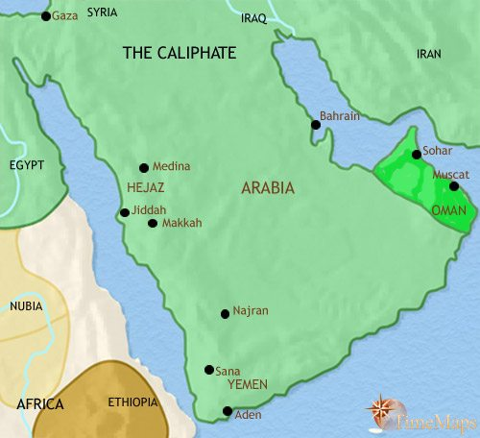
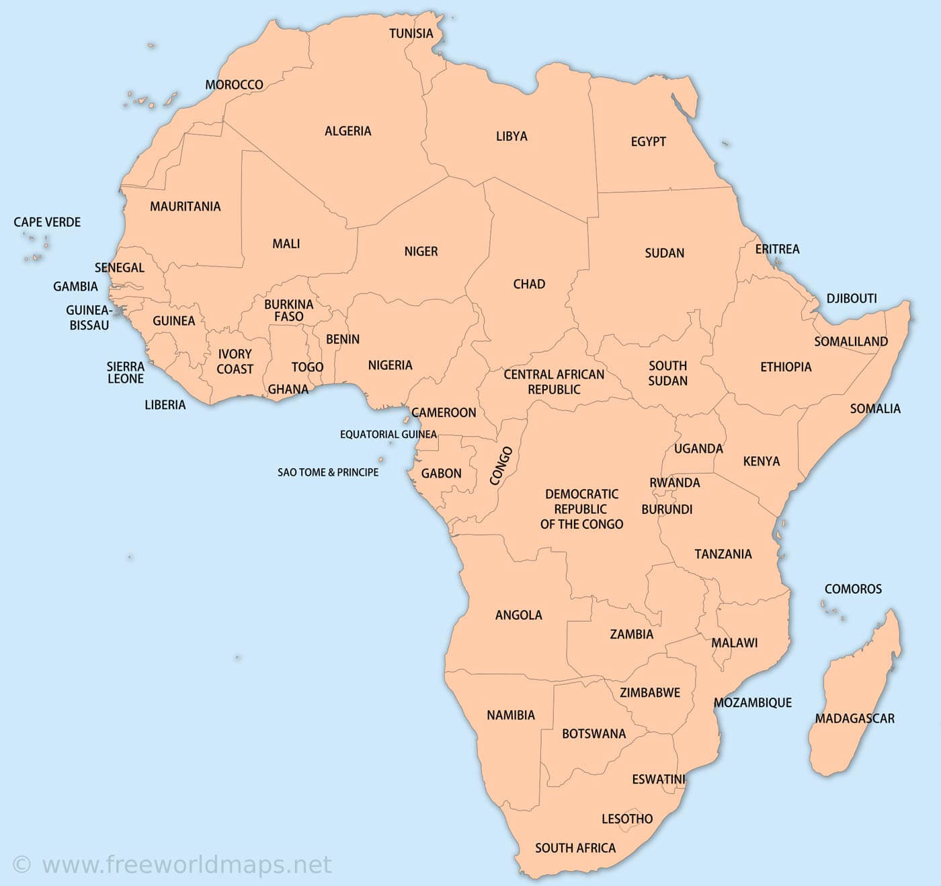
History of where your creature came from.
Mountains Gorillas started to come from Africa and Arabia.
Notes:
1 Background Color
1 Title (or write the question)
1 Pictures
1 Include Transitions
1 Answering question using complete sentences (multiple sentences if needed to fully explain your answer)
1 Accuracy of information
6

Slide 3
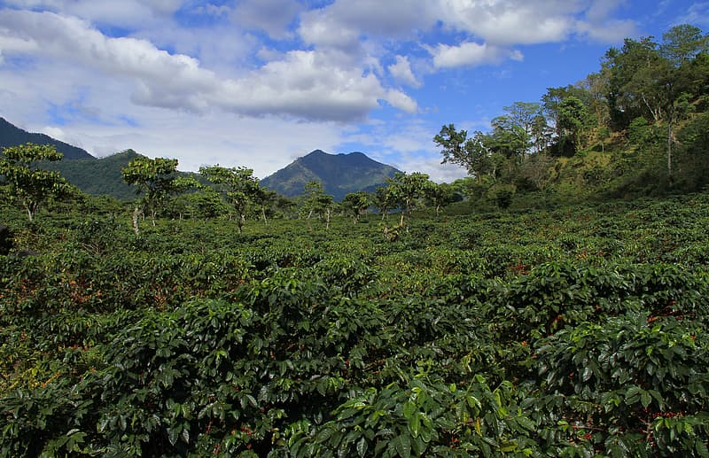
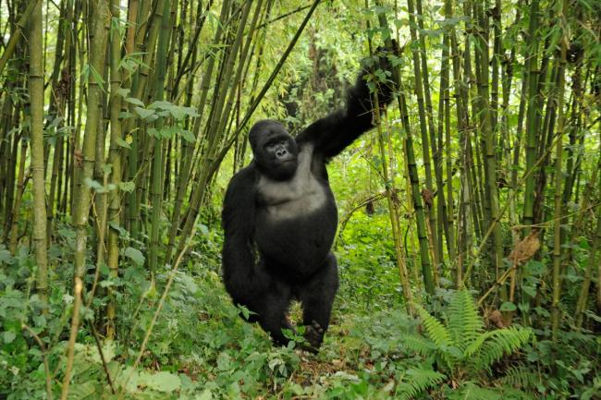
What ecosystem do they live in?
Mountain gorillas normally live in forest up in the mountains.
Notes:
0 Background Color
1 Title (or write the question)
1 Pictures
1 Include Transitions
1 Answering question using complete sentences (multiple sentences if needed to fully explain your answer)
1 Accuracy of information
5
The text is a little hard to read against this background.

Slide 4
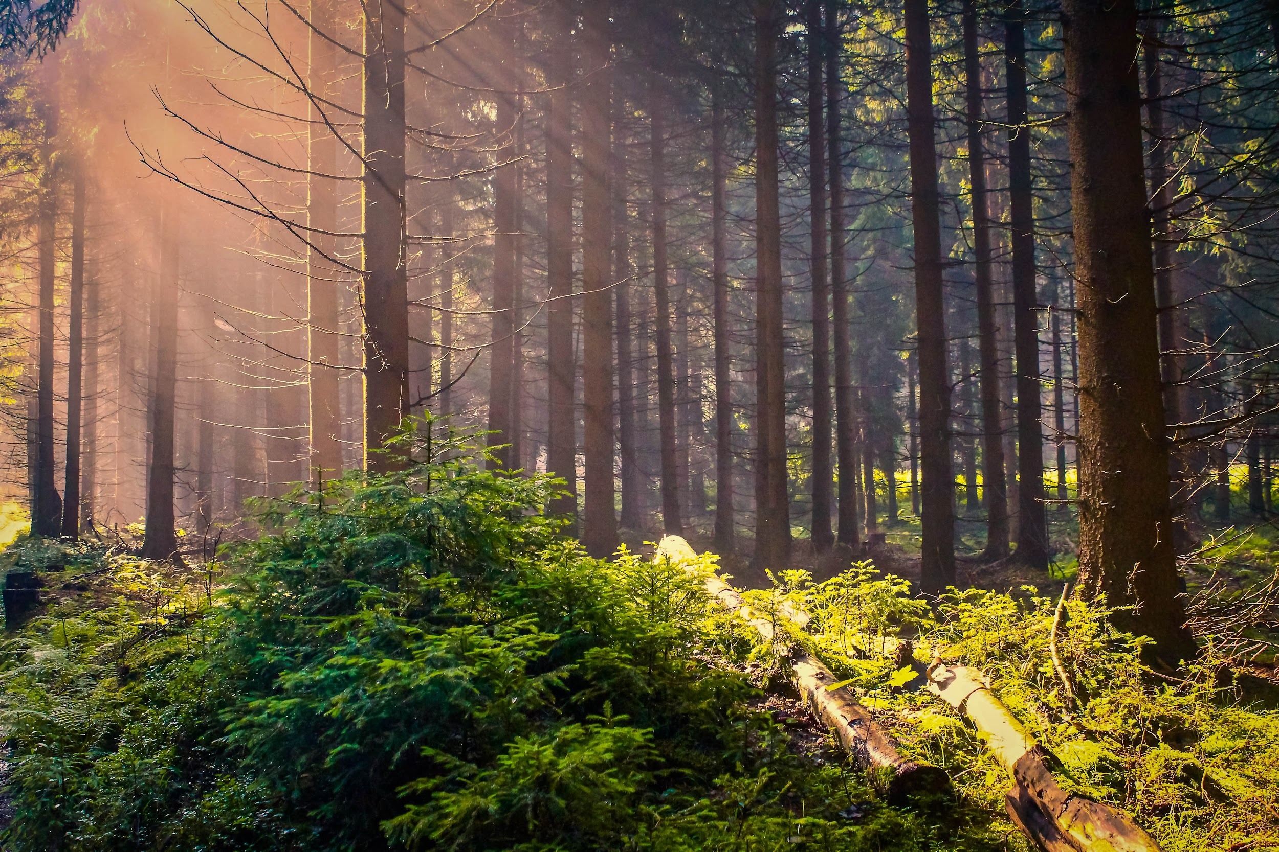
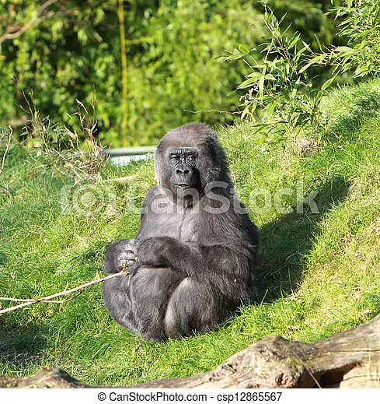
What is it like in the ecosystem?
The average temperature of the ecosystem of a mountain gorilla is normally 73 fahrenheit.
Notes:
1 Background Color
1 Title (or write the question)
1 Pictures
1 Include Transitions
0 Answering question using complete sentences (multiple sentences if needed to fully explain your answer)
1 Accuracy of information
5
Text is hard to read against the background. ..73 deg Fahrenheit.

Slide 5
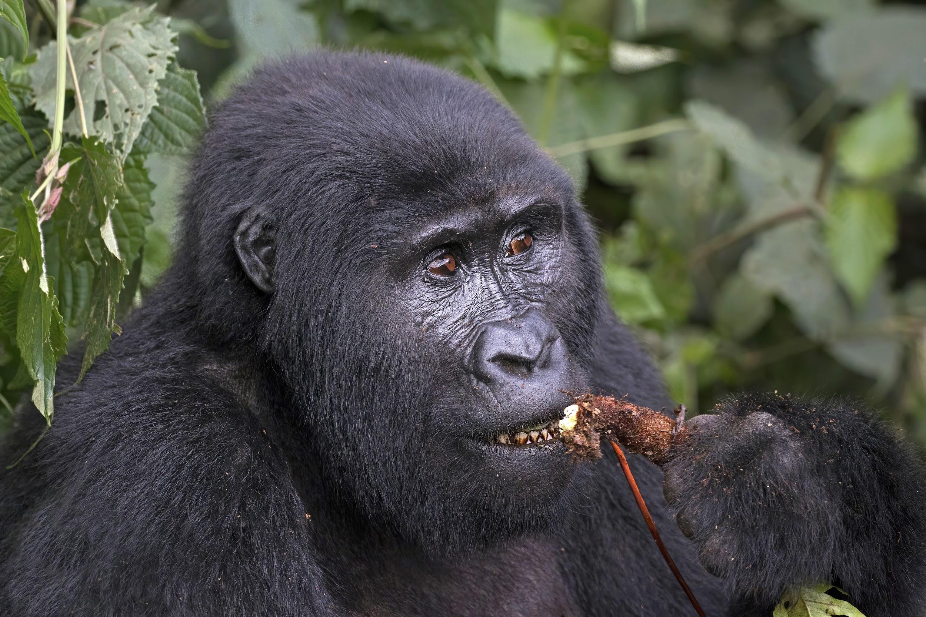
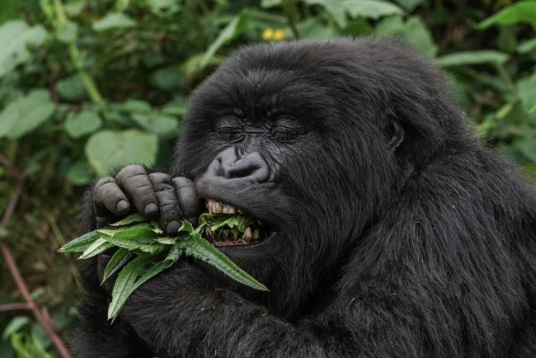
What type of consumer is your creature?
Mountains gorillas are omnivores which means they eat meat and vegetables.
Notes:
1 Background Color
1 Title (or write the question)
1 Pictures
1 Include Transitions
0 Answering question using complete sentences (multiple sentences if needed to fully explain your answer)
1 Accuracy of information
5
The text is hard to read against the background.

Slide 6
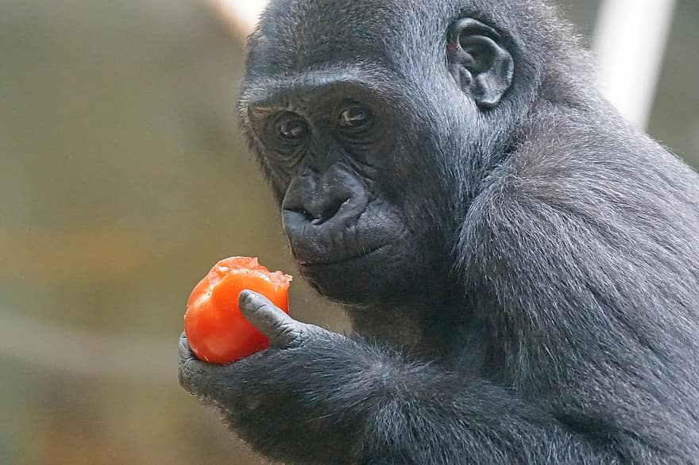
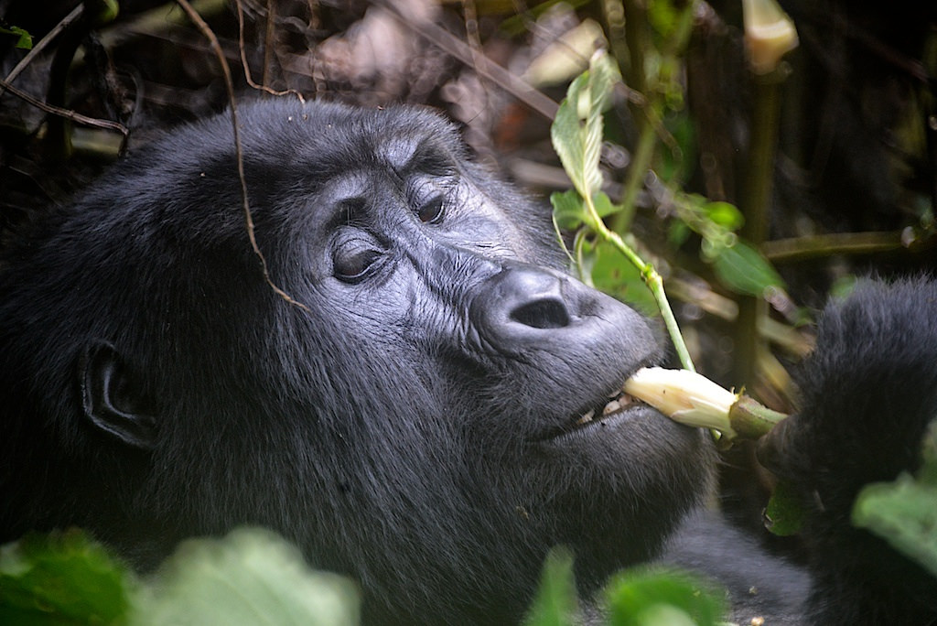
what specific foods does your creature typically eat?
Mountains gorillas normally eat fleshy leaves,shoot, vines, grass and stems of plants and for meat they rarely eat ants or termites.
Notes:
1 Background Color
1 Title (or write the question)
1 Pictures
1 Include Transitions
0 Answering question using complete sentences (multiple sentences if needed to fully explain your answer)
1 Accuracy of information
5
What specific….fleshy leave shoots, vines, grass, stems of plants, ants, and termites.

Slide 7
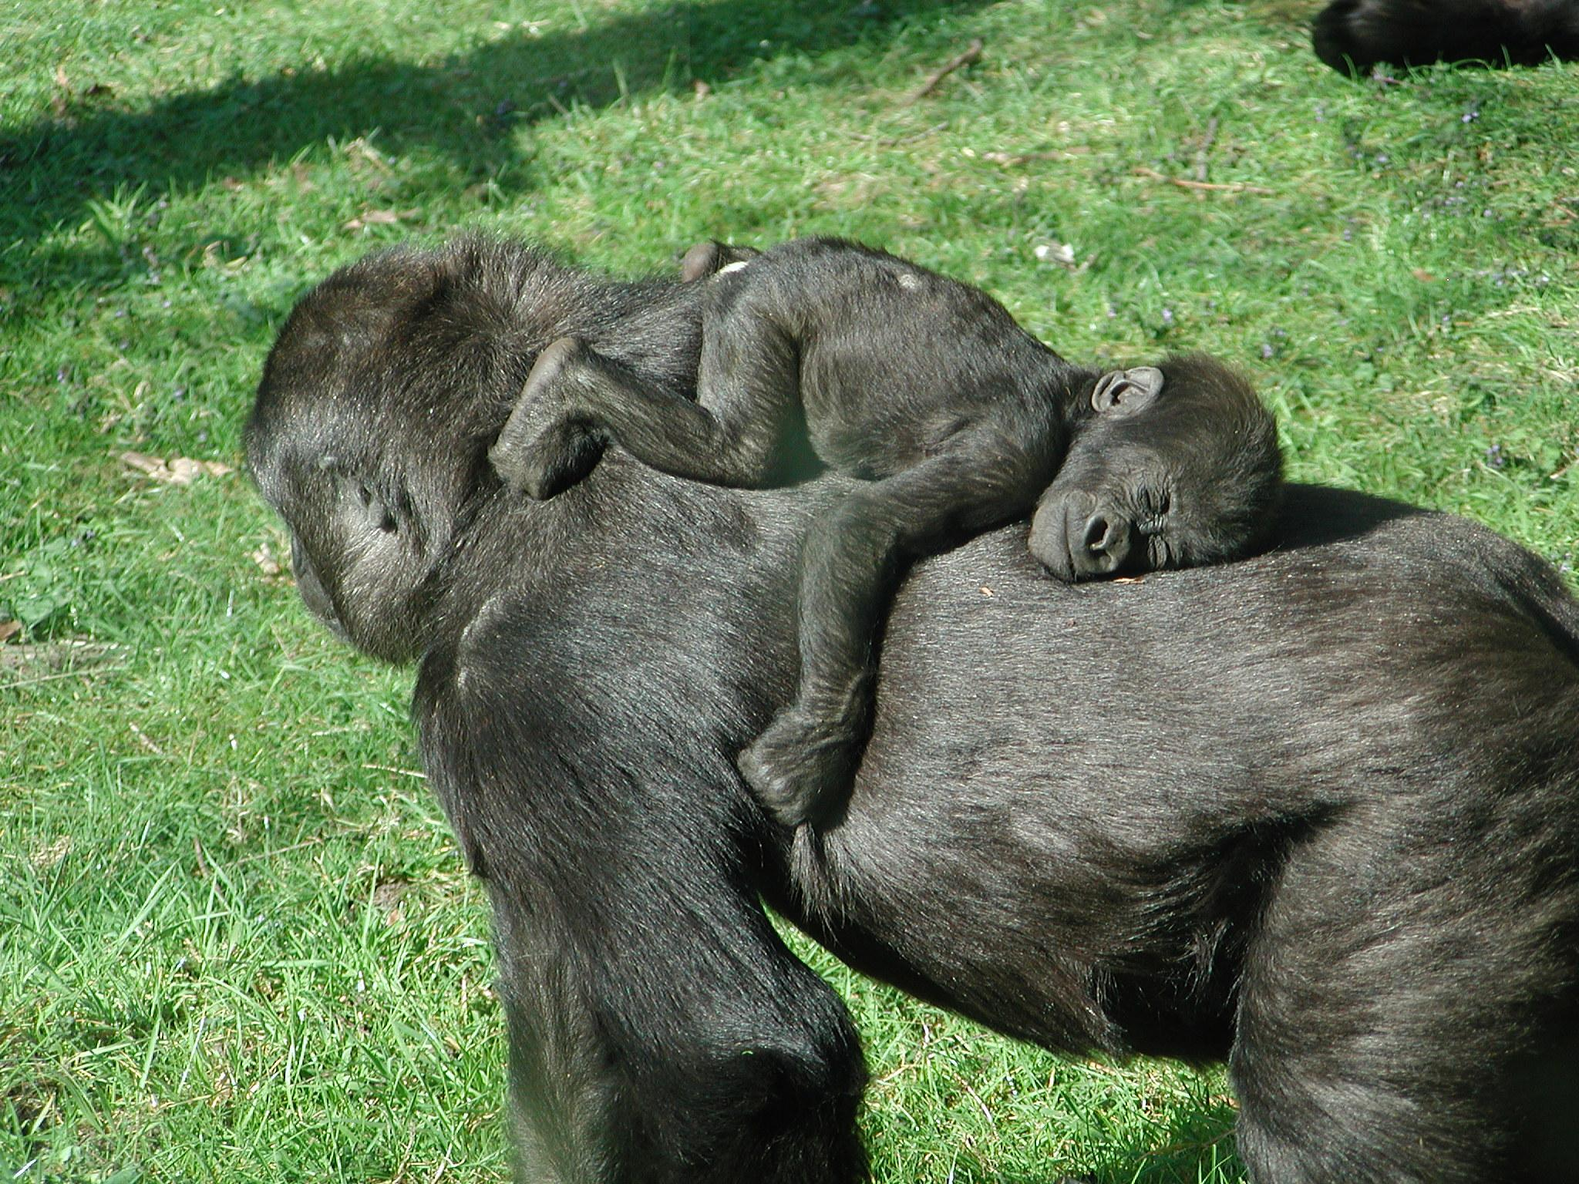
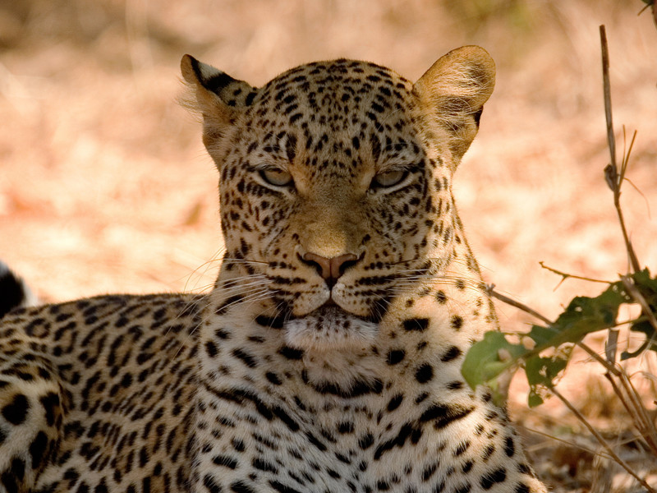
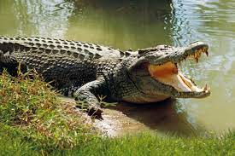
Does your creature have any predators?
Mountains gorillas don’t usually have preadorter but crocodiles and leopard normally attack baby gorillas.
Notes:
1 Background Color
1 Title (or write the question)
1 Pictures
1 Include Transitions
0 Answering question using complete sentences (multiple sentences if needed to fully explain your answer)
1 Accuracy of information
5
The text is hard to read against the background. …and leopards normally attack baby…..

Slide 8
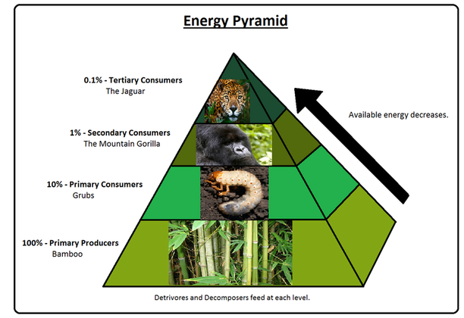
What is a typical food chain for your creature?
Notes:
1 Background Color
1 Title (or write the question)
1 Pictures
1 Include Transitions
1 Answering question using complete sentences (multiple sentences if needed to fully explain your answer)
1 Accuracy of information
6

Slide 9
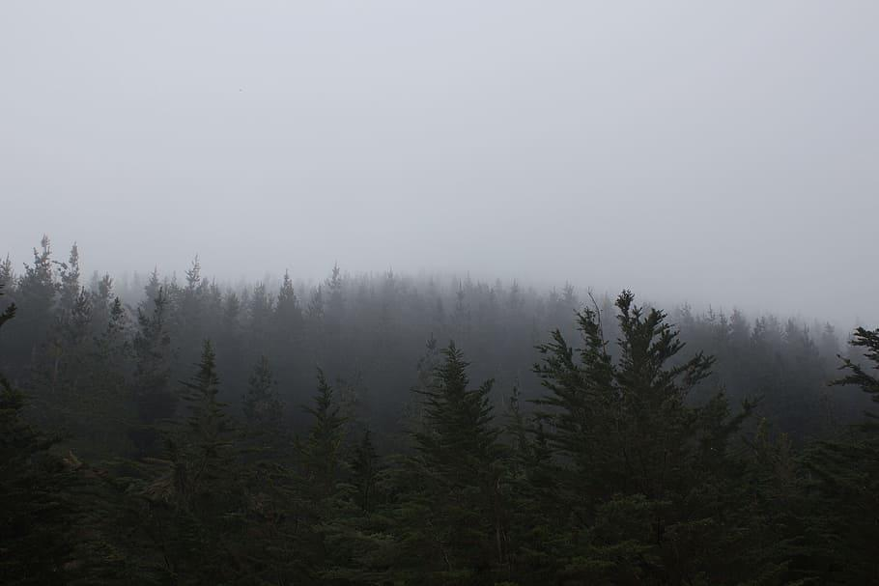
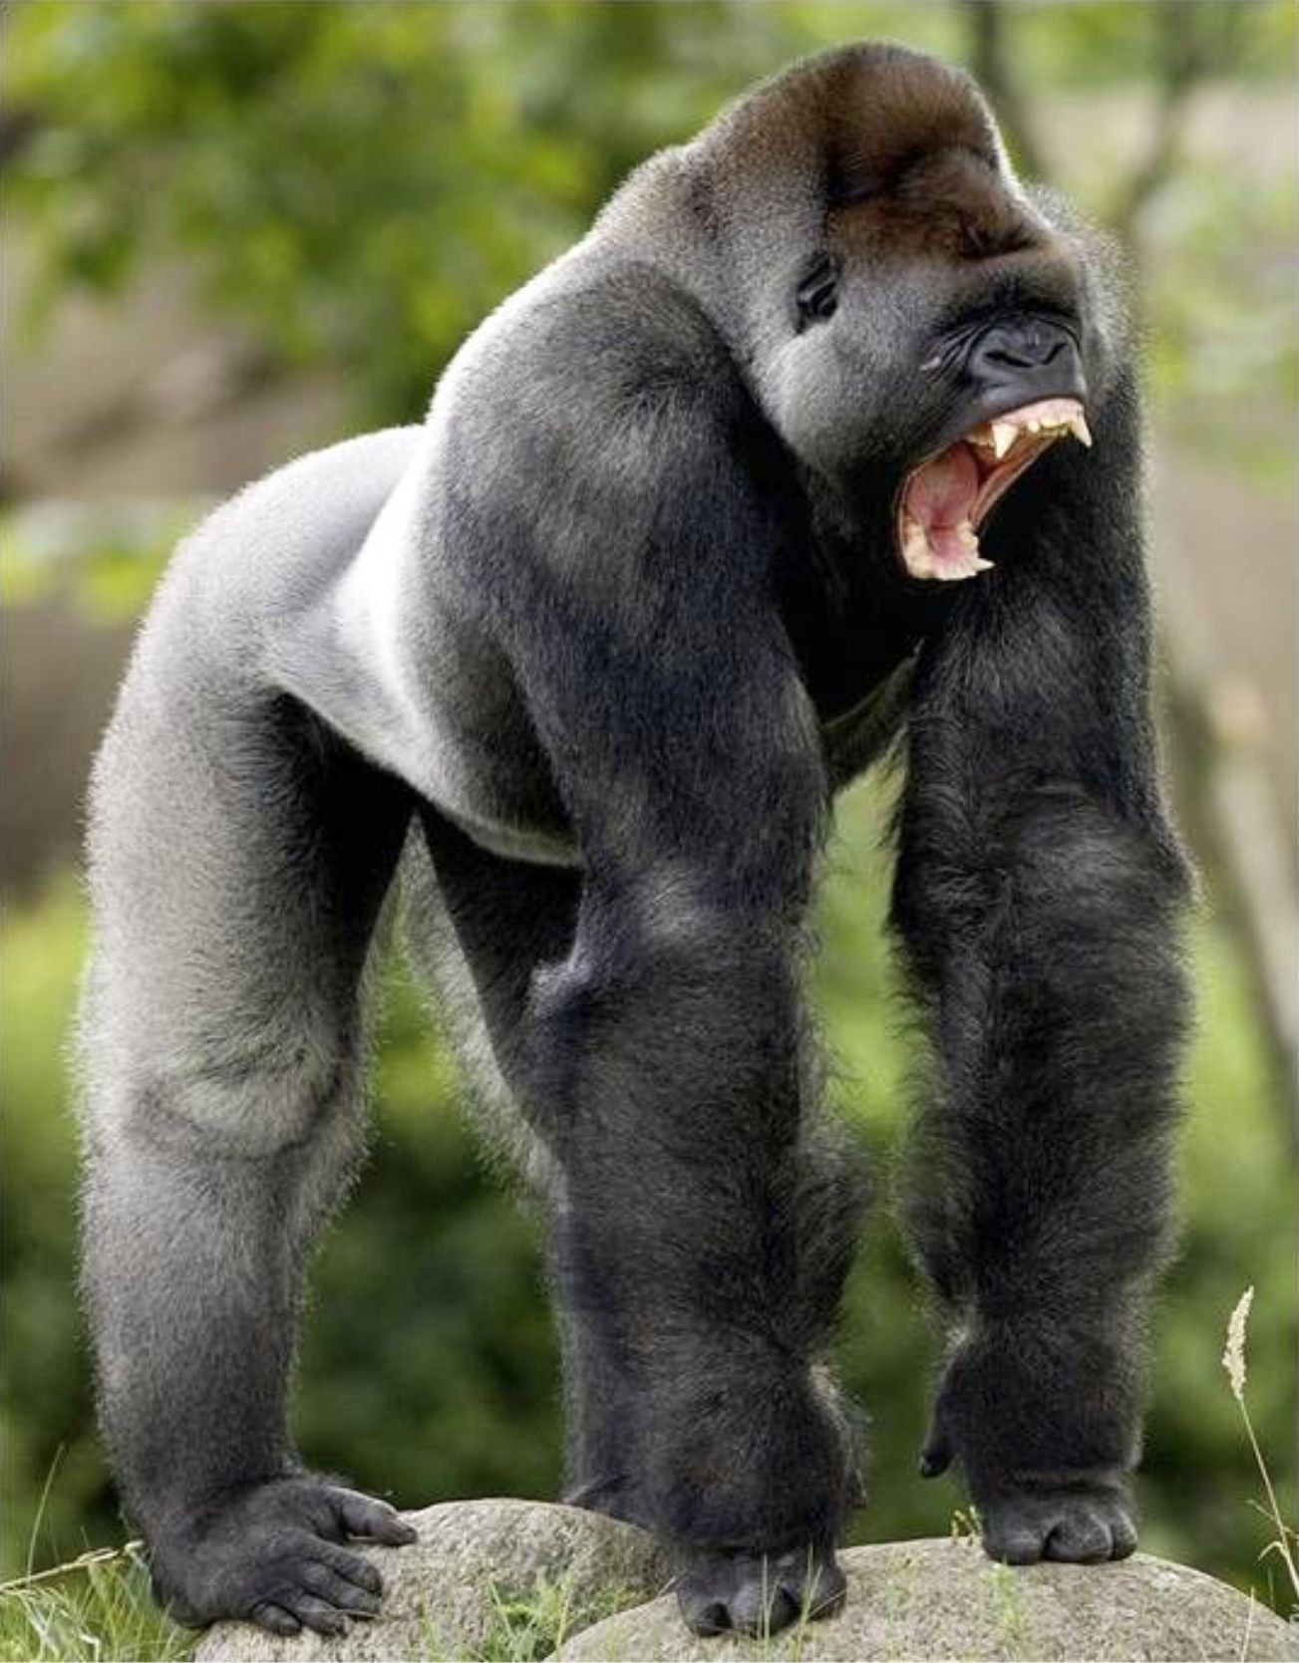
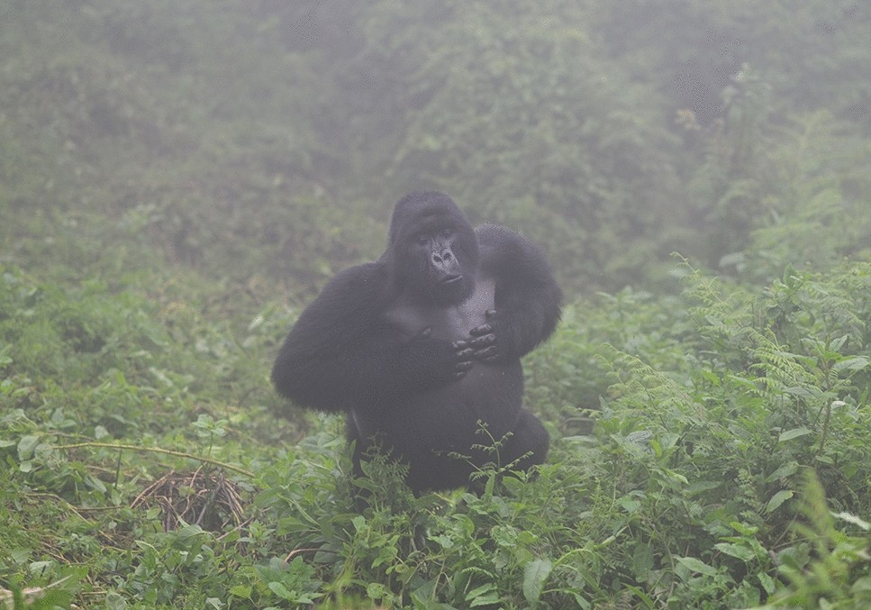
Does your creature have any specific adaptations to help it survive
Mountains gorillas have very thick fur to cover them up from the cold weather or in winter time. They also are very strong and have sharp teeth to defend their self.
Notes:
1 Background Color
1 Title (or write the question)
1 Pictures
1 Include Transitions
0 Answering question using complete sentences (multiple sentences if needed to fully explain your answer)
1 Accuracy of information
5
Put a question mark at the end of the title. ….defend themselves.

Slide 10
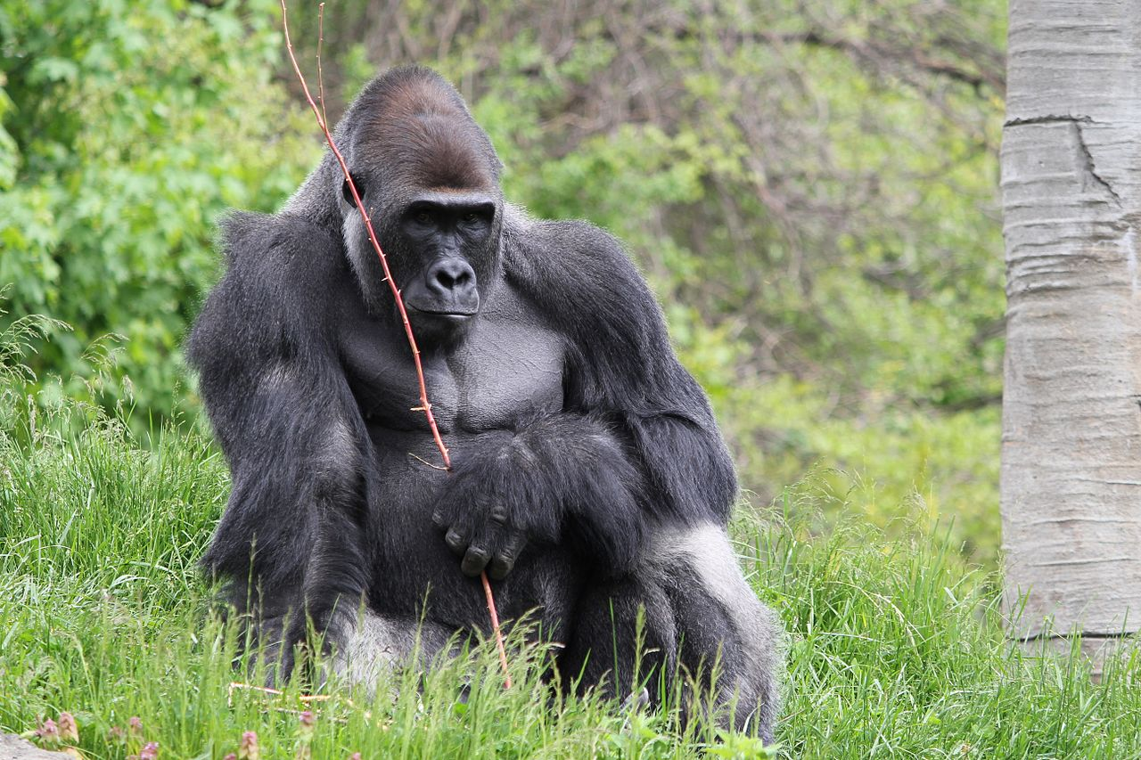
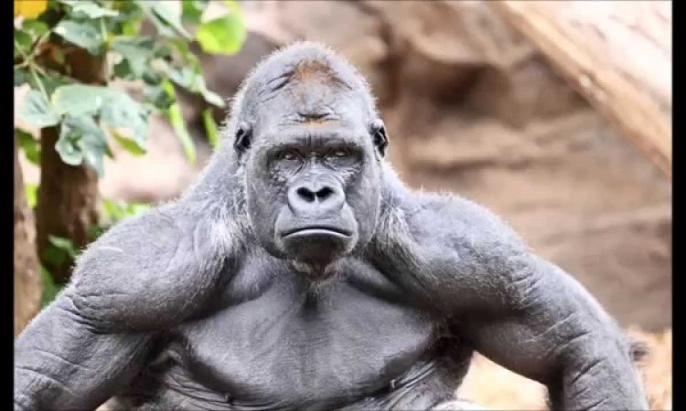
What does your creature look like, how much does it weigh, and how tall is it?
A mountain gorilla average high is from 4 to 6 feet and normally weight from 310 to 450 pounds
Notes:
1 Background Color
1 Title (or write the question)
1 Pictures
1 Include Transitions
0 Answering question using complete sentences (multiple sentences if needed to fully explain your answer)
1 Accuracy of information
5
The text is hard to read against the background.

Slide 11
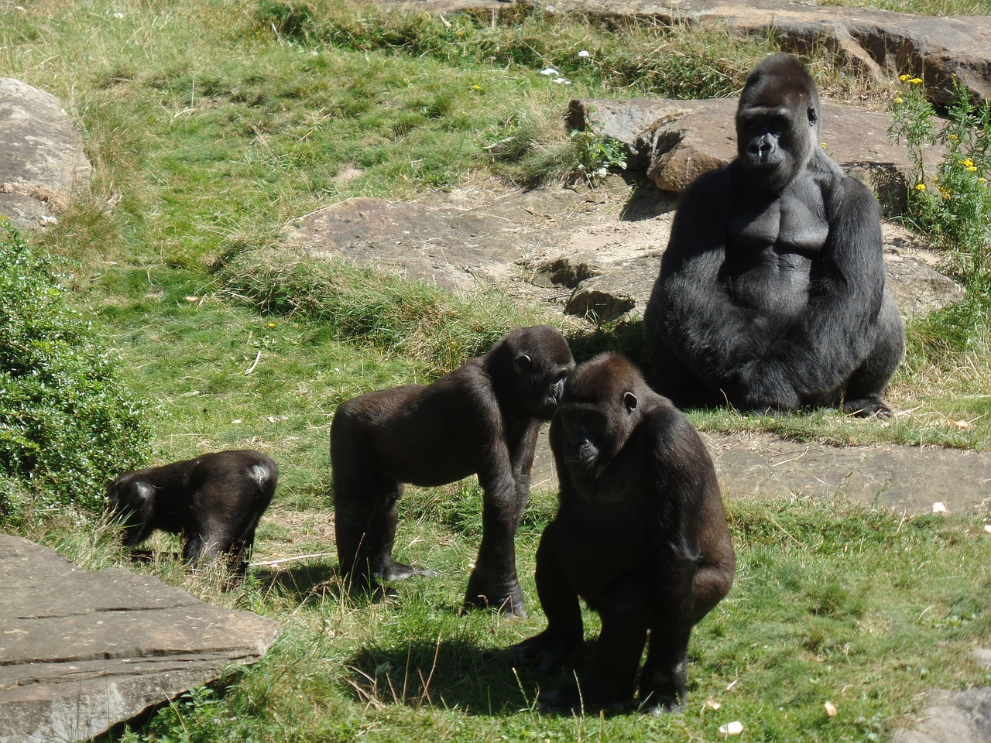
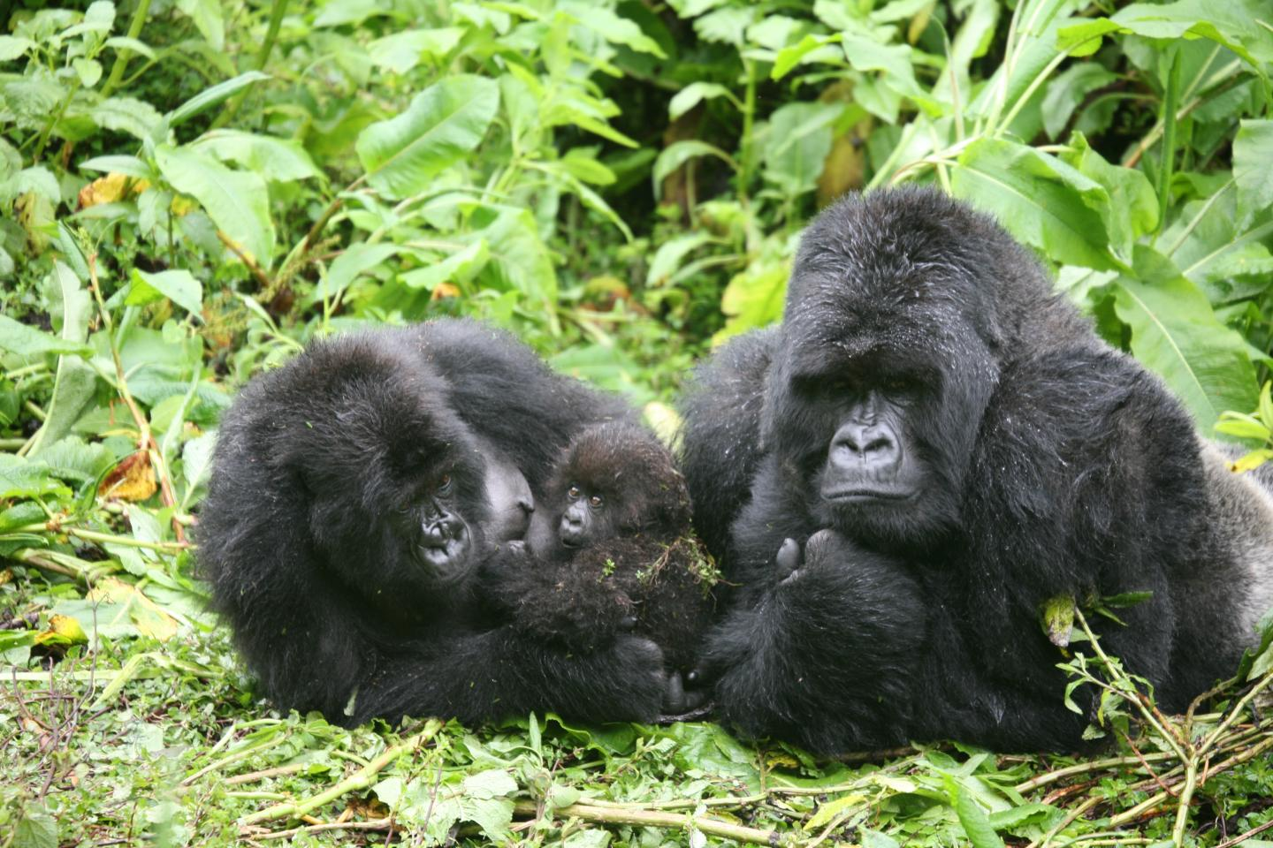
Do males and females of your creature weigh the same and are the same size?
No, indeed their not a female averagely weight about 158 pound and are about 5 feet tall.
Notes:
1 Background Color
1 Title (or write the question)
1 Pictures
1 Include Transitions
0 Answering question using complete sentences (multiple sentences if needed to fully explain your answer)
1 Accuracy of information
5
The text is hard to read against the background.
Title. .the same , and are they the same size?
Indeed they’re not. The females average weight is about…
Is this smaller or larger than the males?

Slide 12
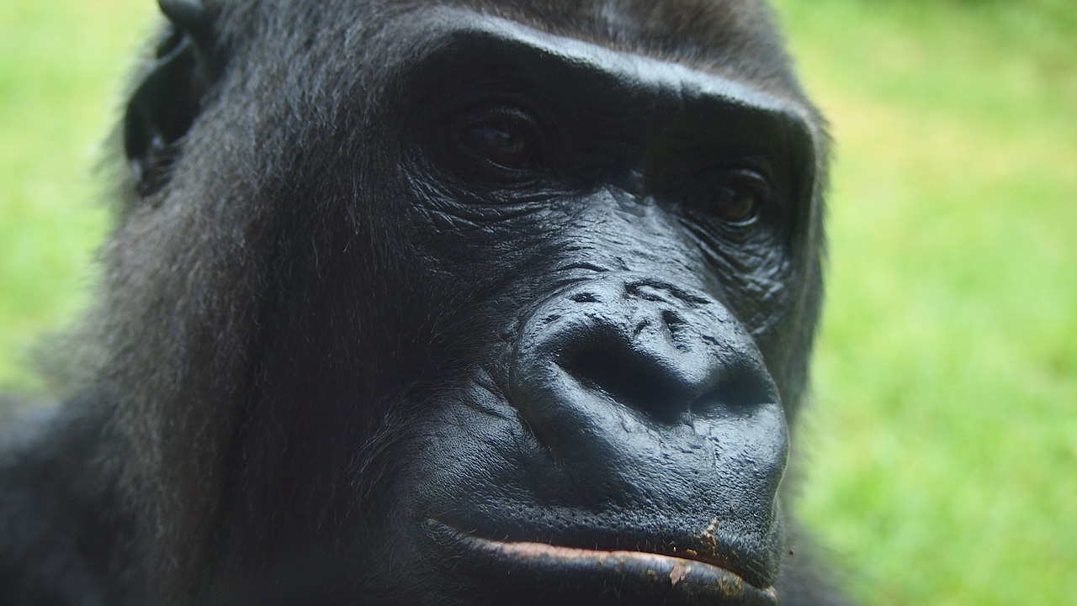
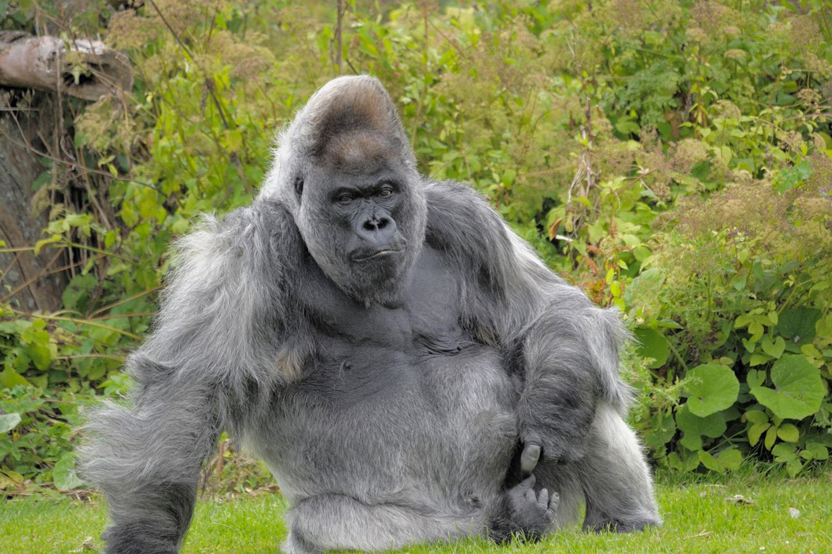
What is the lifespan of your creature?
Mountains gorilla normally live over 40 years.
Notes:
1 Background Color
1 Title (or write the question)
1 Pictures
1 Include Transitions
1 Answering question using complete sentences (multiple sentences if needed to fully explain your answer)
1 Accuracy of information
6

Slide 13
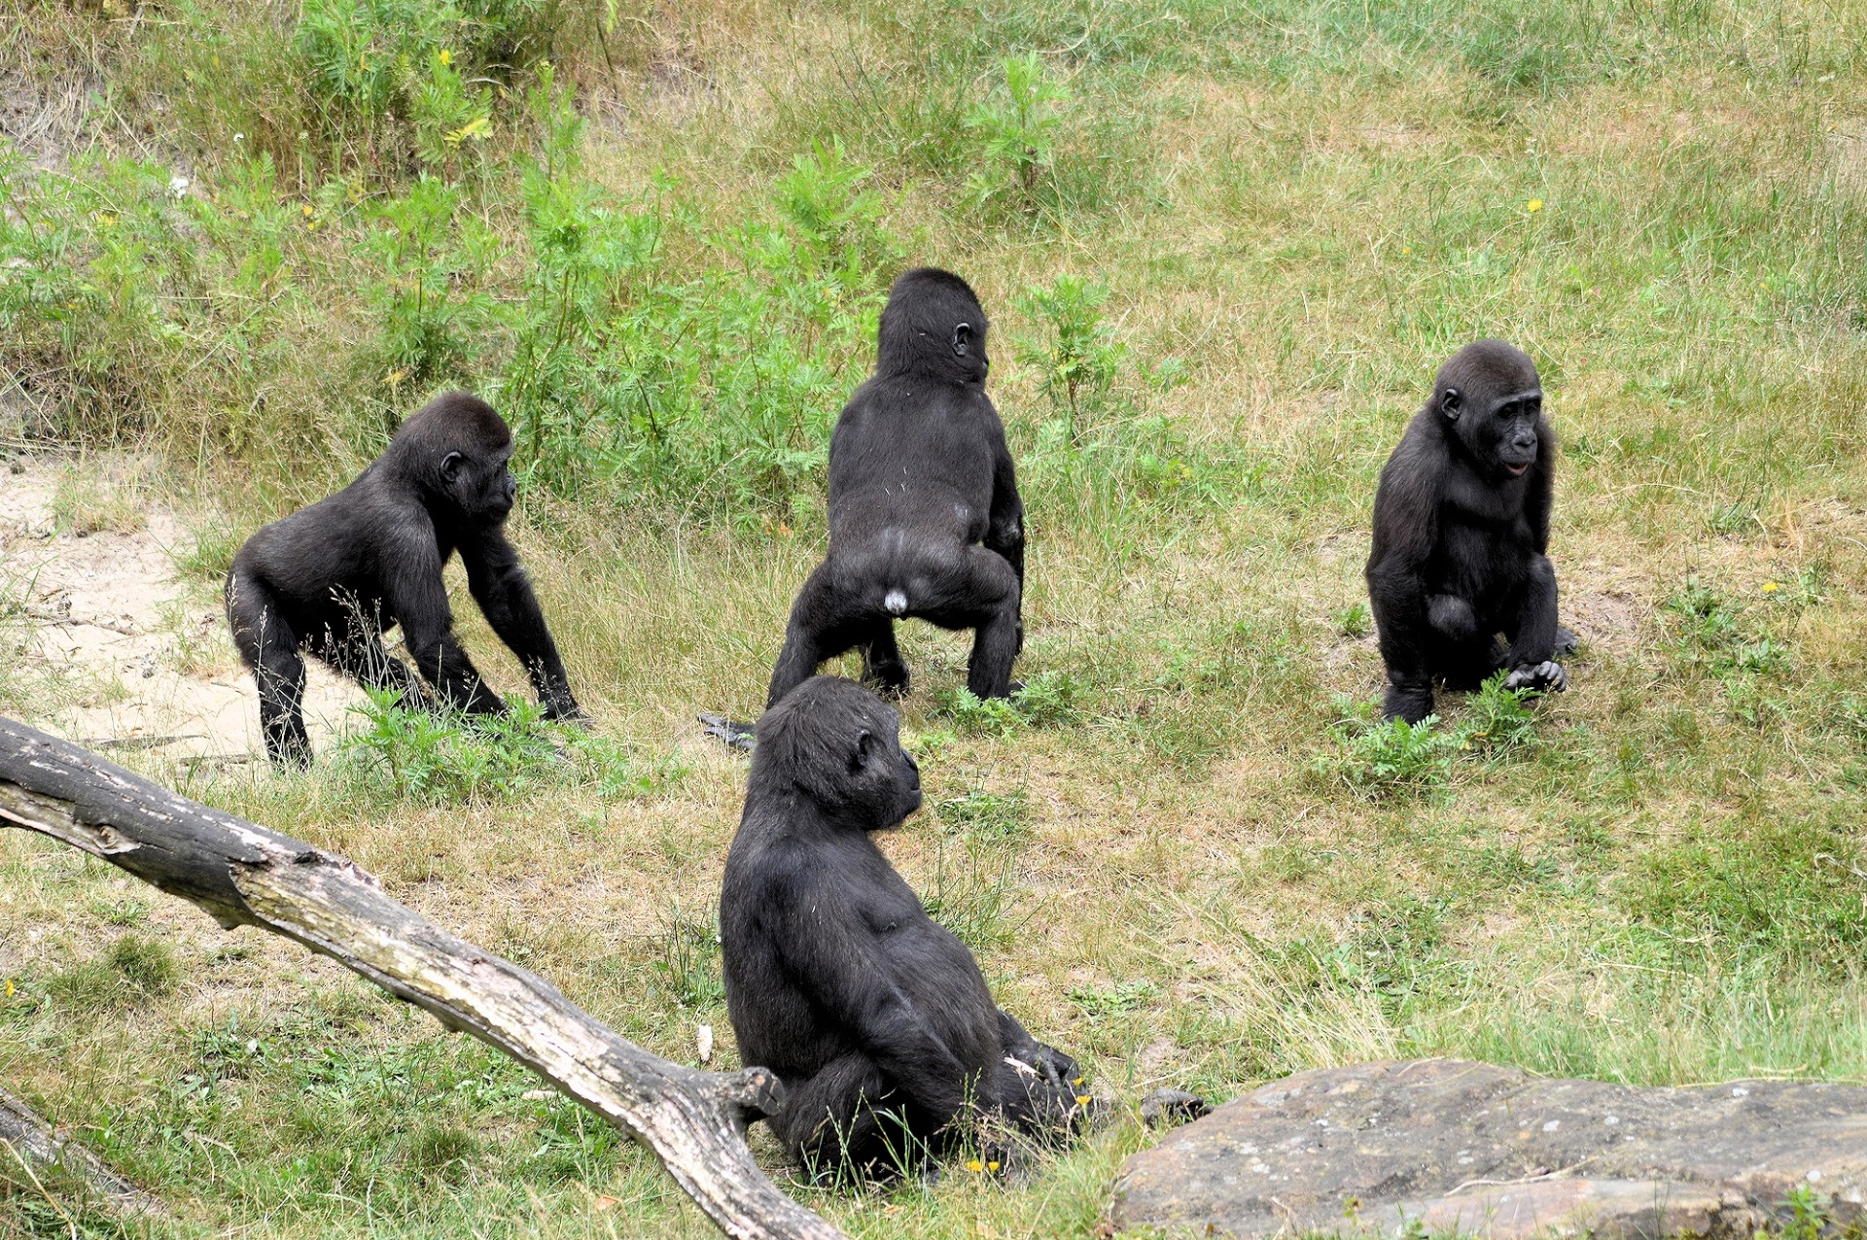
8 interesting facts about mountains gorillas
1 there is around 1,063 mountains gorillas still in the wild
2 they have 16 different types of calls
3 they are able to eat all day
4 they are very playful and very tuff.
5 mountains are start to talk human langue
6 a gorillas net worth is 1 billion dollars
7 they are scared of caterpillars
8 after the male gorilla of the family dies the female take over.
Notes:
1 Background Color
1 Title (or write the question)
1 Pictures
1 Include Transitions
0 Answering question using complete sentences (multiple sentences if needed to fully explain your answer)
1 Accuracy of information
5
The text is hard to read against the background.
The title needs to be larger font than the paragraph.
Every sentence starts with a capital letter, and ends with punctuation.

Slide 14
https://www.wwf.org.uk/learn/fascinating-facts/gorillas#:~:text=In%20the%20wild%2C%20gorillas%20can%20live%20to%20over%2040%20years%20old&text=Males%20between%208%2D12%20years,them%20the%20name%20'silverback'.
https://www.africangorilla.com/information/mountain-gorilla-size-height-weight/
https://study.com/academy/lesson/mountain-gorillas-life-cycle-mating-lifespan.html
Website I used
Notes:
1 Background Color
1 Title (or write the question)
1 Pictures
1 Include Transitions
0 Answering question using complete sentences (multiple sentences if needed to fully explain your answer)
1 Accuracy of information
5
Please plase the title on the top.

