Slide 1
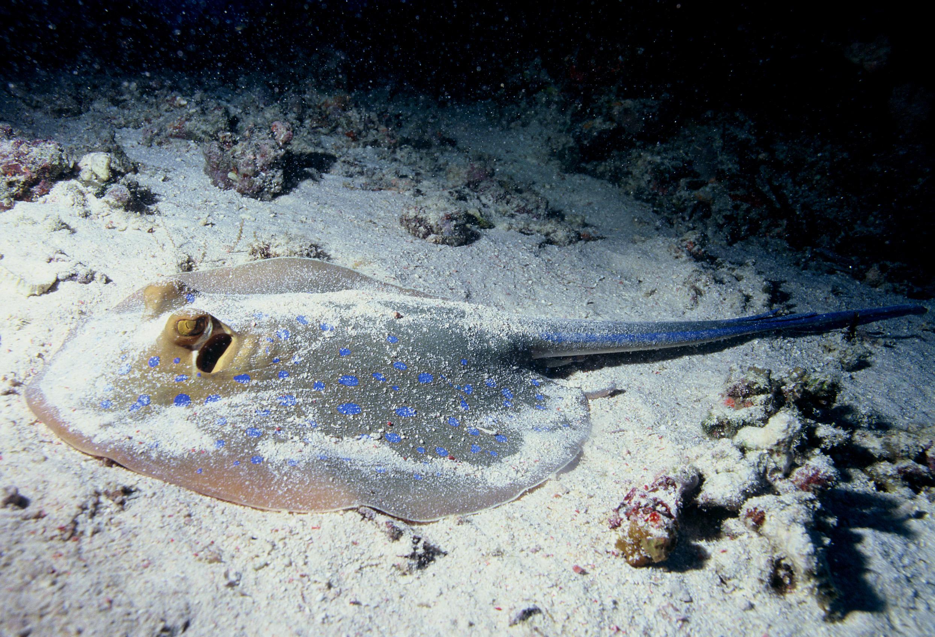
Short-tailed Stingray.
Jace Robinson

Slide 2

Where are Stingrays from?
Short-tailed Stingrays are found in seas almost everywhere.Commonly found in Austrailia, Stingrays are also presumed to be harmless or are they.

Slide 3
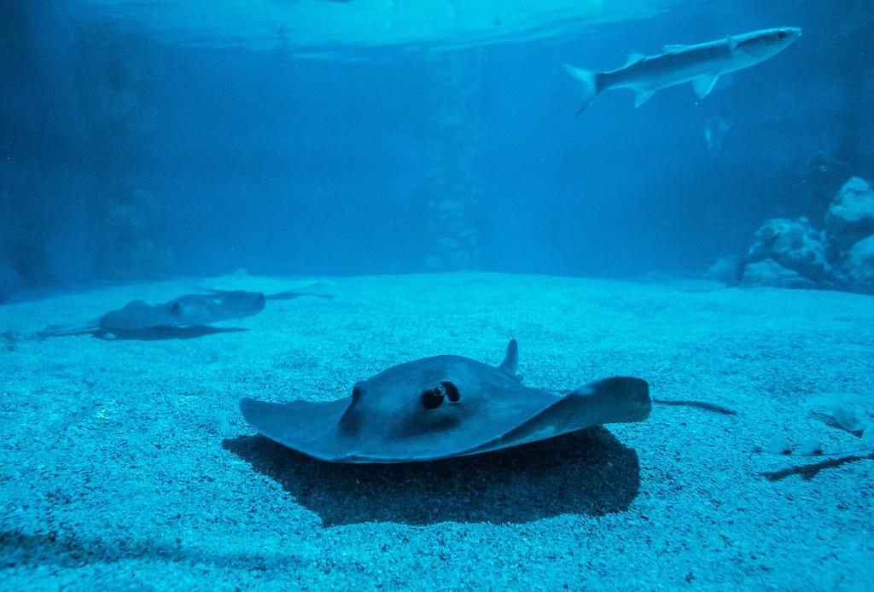
Habitats.
Short-tailed Stingrays are commonly found everywhere, Around the world in the seas in Salt water rivers, everywhere.

Slide 4
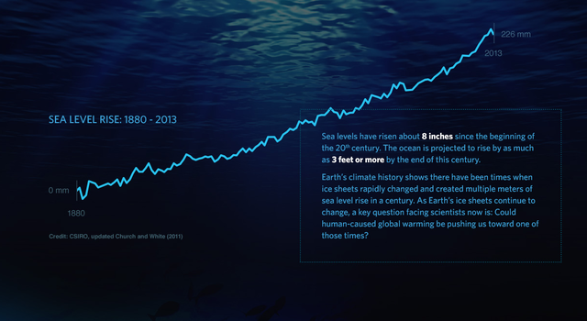
The Ecosystem.
In a Stingrays ecosystem it is usually cold. The ocean is typically cold unless it’s the summer and you’re in mexico.
The average temperature of the
Ocean is around 60 degrees
fahrenheit.Depending on the time
Of day it is Raining,Sunny,Cloudy
And Stormy.

Slide 5
Types of cunsumers

