Slide 1
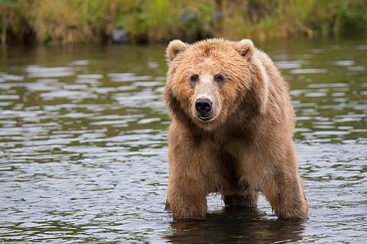

Brown Bear
By: Julissa Fregoso H.
Notes:
1 Background Color
1 Title (or write the question)
1 Pictures
1 Include Transitions
1 Answering question using complete sentences (multiple sentences if needed to fully explain your answer)
1 Accuracy of information
6

Slide 2

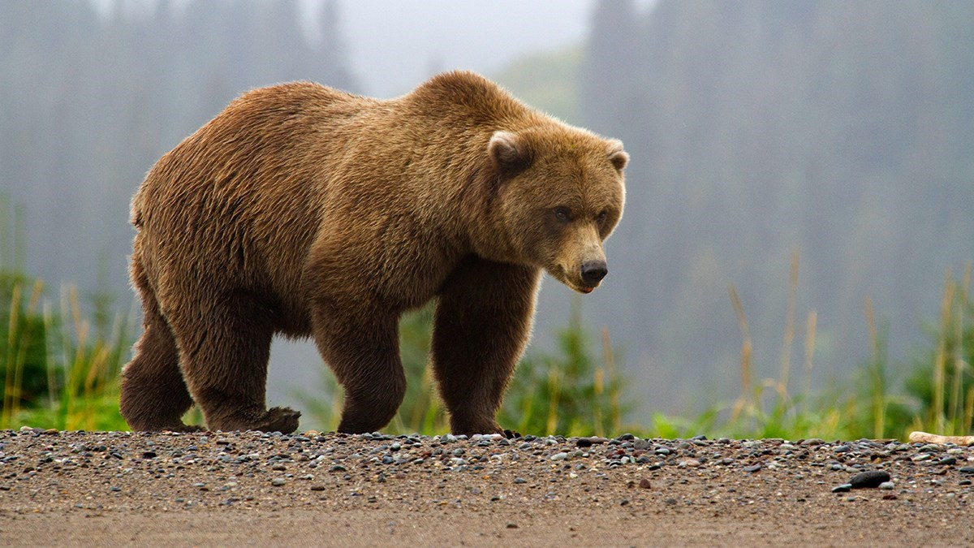
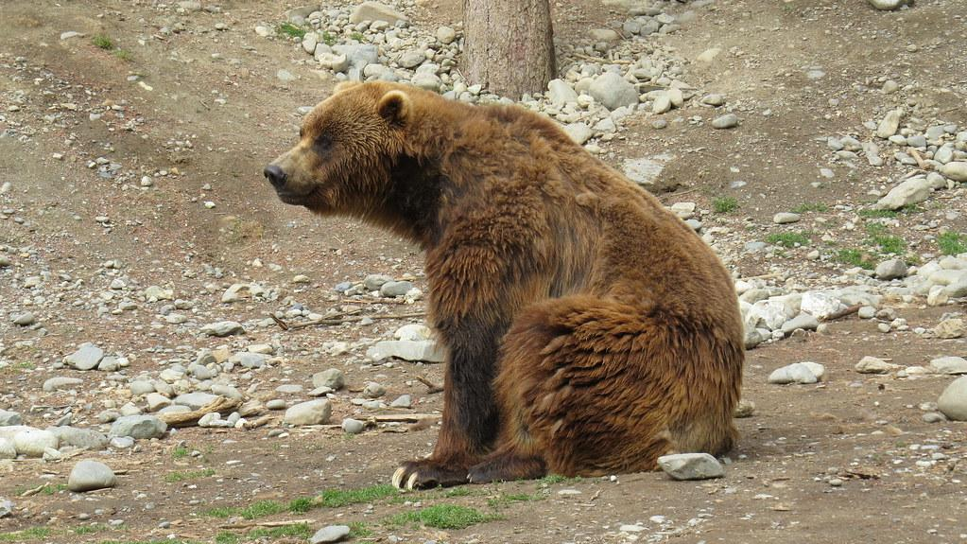

Where do Brown Bears Come from?
Did you know brown bears are brown?
(a joke)
Brown Bears can actually be found in many habitats, but they can live in Europe, North America and Asia.
What’s the Brown Bears ecosystem?
A Brown Bear’s ecosystem in Europe is in ‘deserts, to high mountains, forests and ice fields.
Notes:
1 Background Color
1 Title (or write the question)
1 Pictures
1 Include Transitions
0 Answering question using complete sentences (multiple sentences if needed to fully explain your answer)
1 Accuracy of information
5
What about in the Americas? Also split this into two slides.

Slide 3
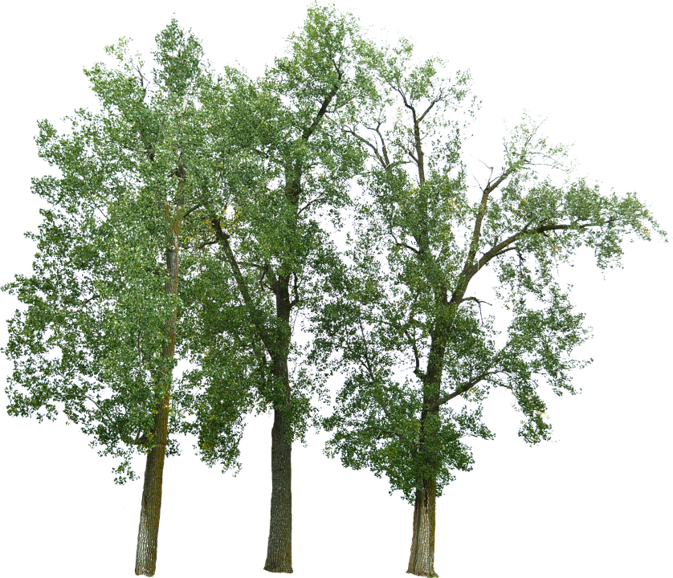
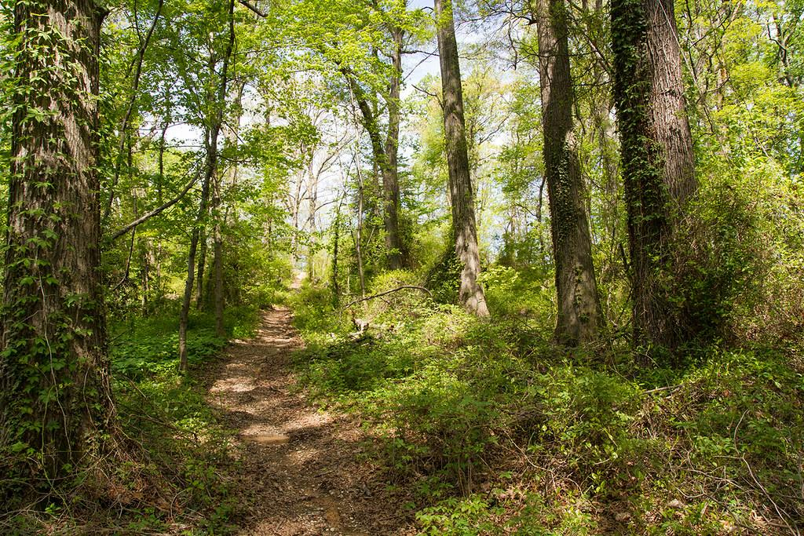
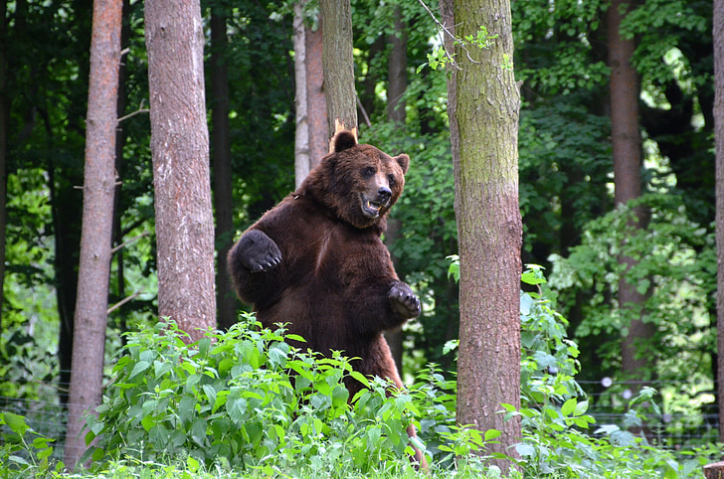
How’s it like in a Bears ecosystem?(In details)
The average temperature in forests is 35°F to 87°F. Forests. It’s usually sunny in forests but every once in a while it could rain.
Brown bears also live in mountains.
Notes:
1 Background Color
1 Title (or write the question)
1 Pictures
1 Include Transitions
0 Answering question using complete sentences (multiple sentences if needed to fully explain your answer)
1 Accuracy of information
5
Delete the word Forests after 87.. It could snow as well…..

Slide 4
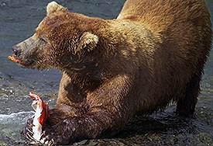
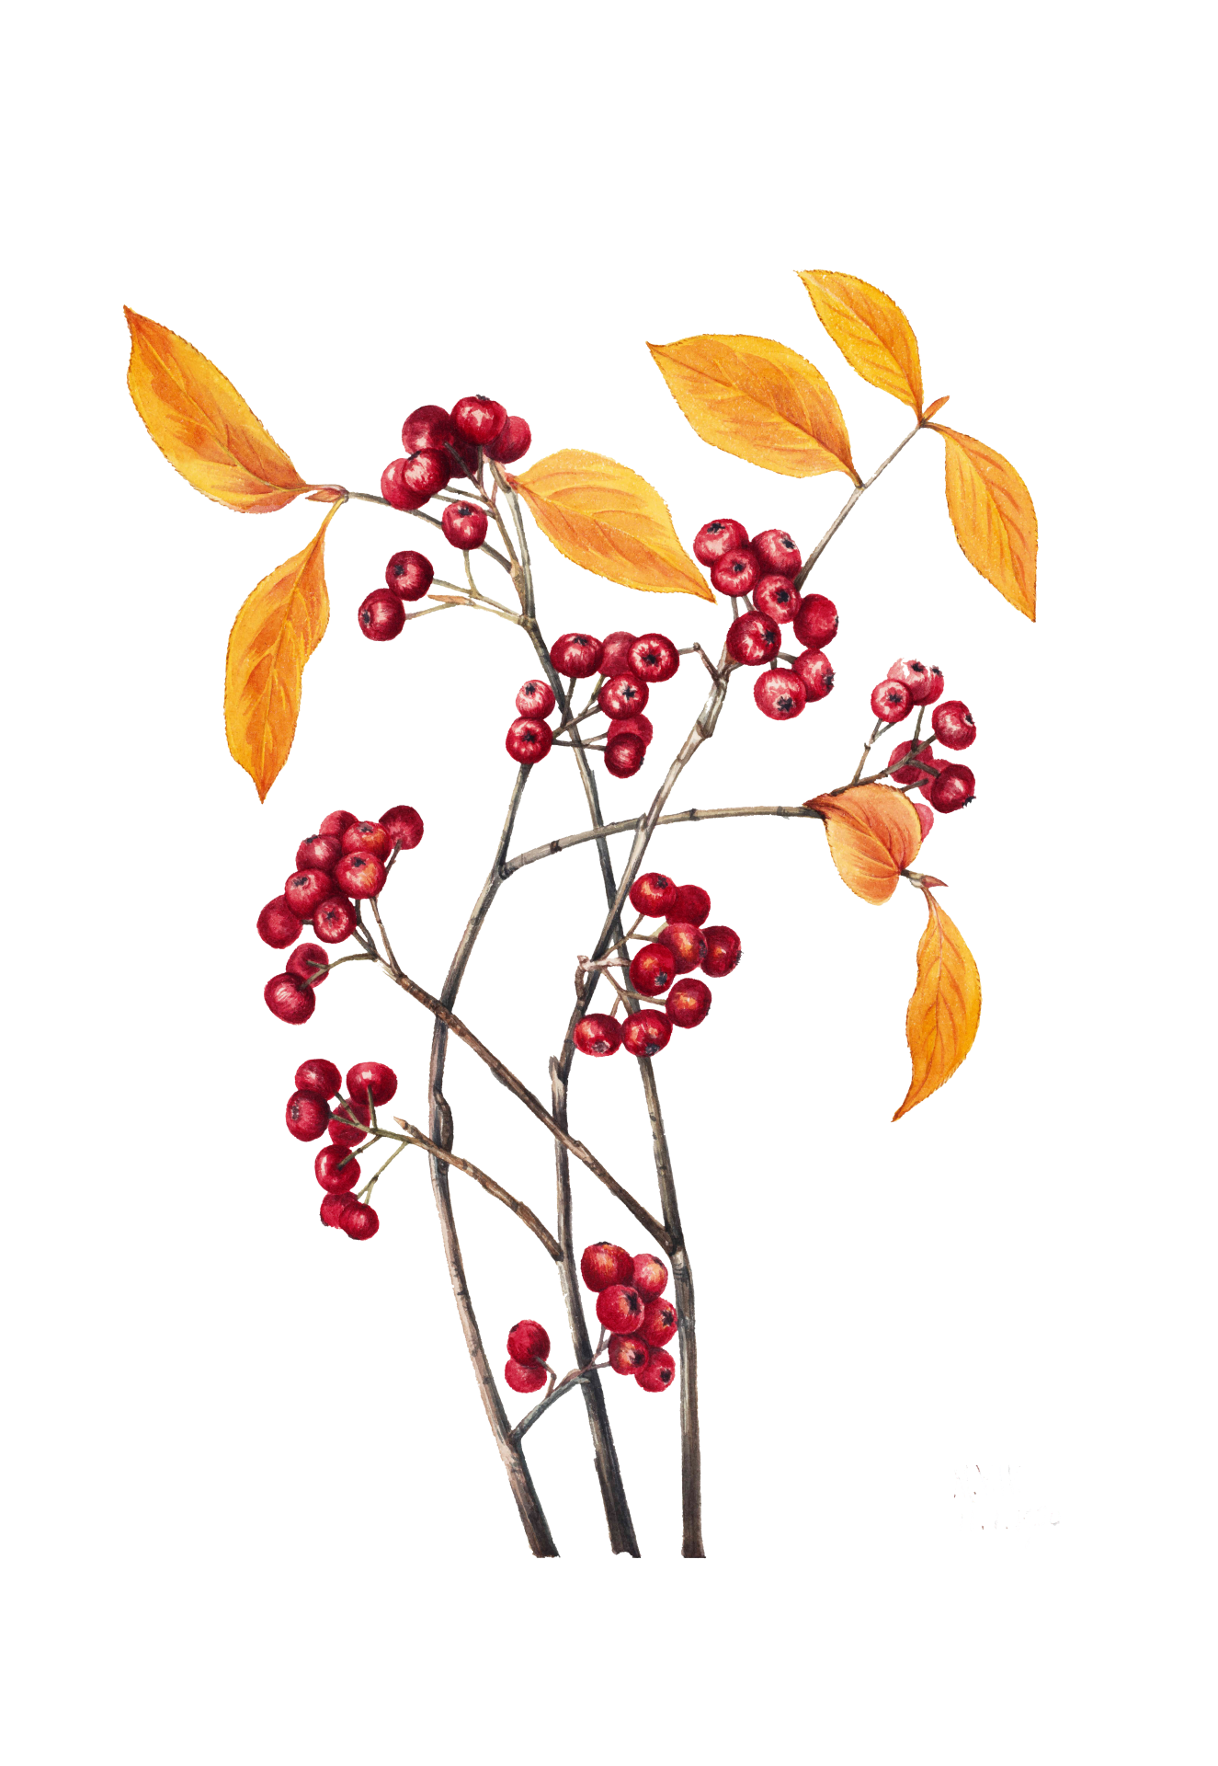
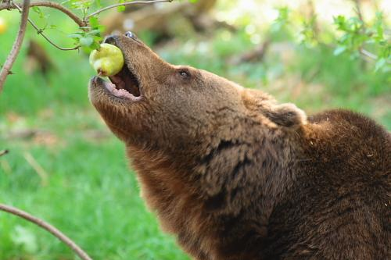
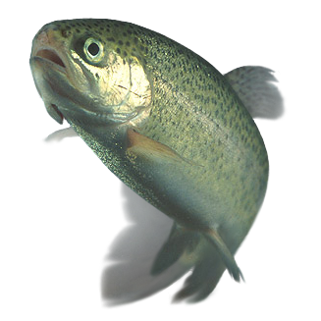
What type of consumer is a Brown Bear?
A Brown Bear is a consumer. Brown bears only eat and don't produce anything.
What specific foods does a Brown Bear eat?
Brown bears are omnivores, so they eat plants, berries, fish, and small mammals.
Notes:
1 Background Color
1 Title (or write the question)
1 Pictures
1 Include Transitions
0 Answering question using complete sentences (multiple sentences if needed to fully explain your answer)
1 Accuracy of information
5
The word omnivores should be in the first section.. That is a consumer classification. Again split this into two slides…

Slide 5
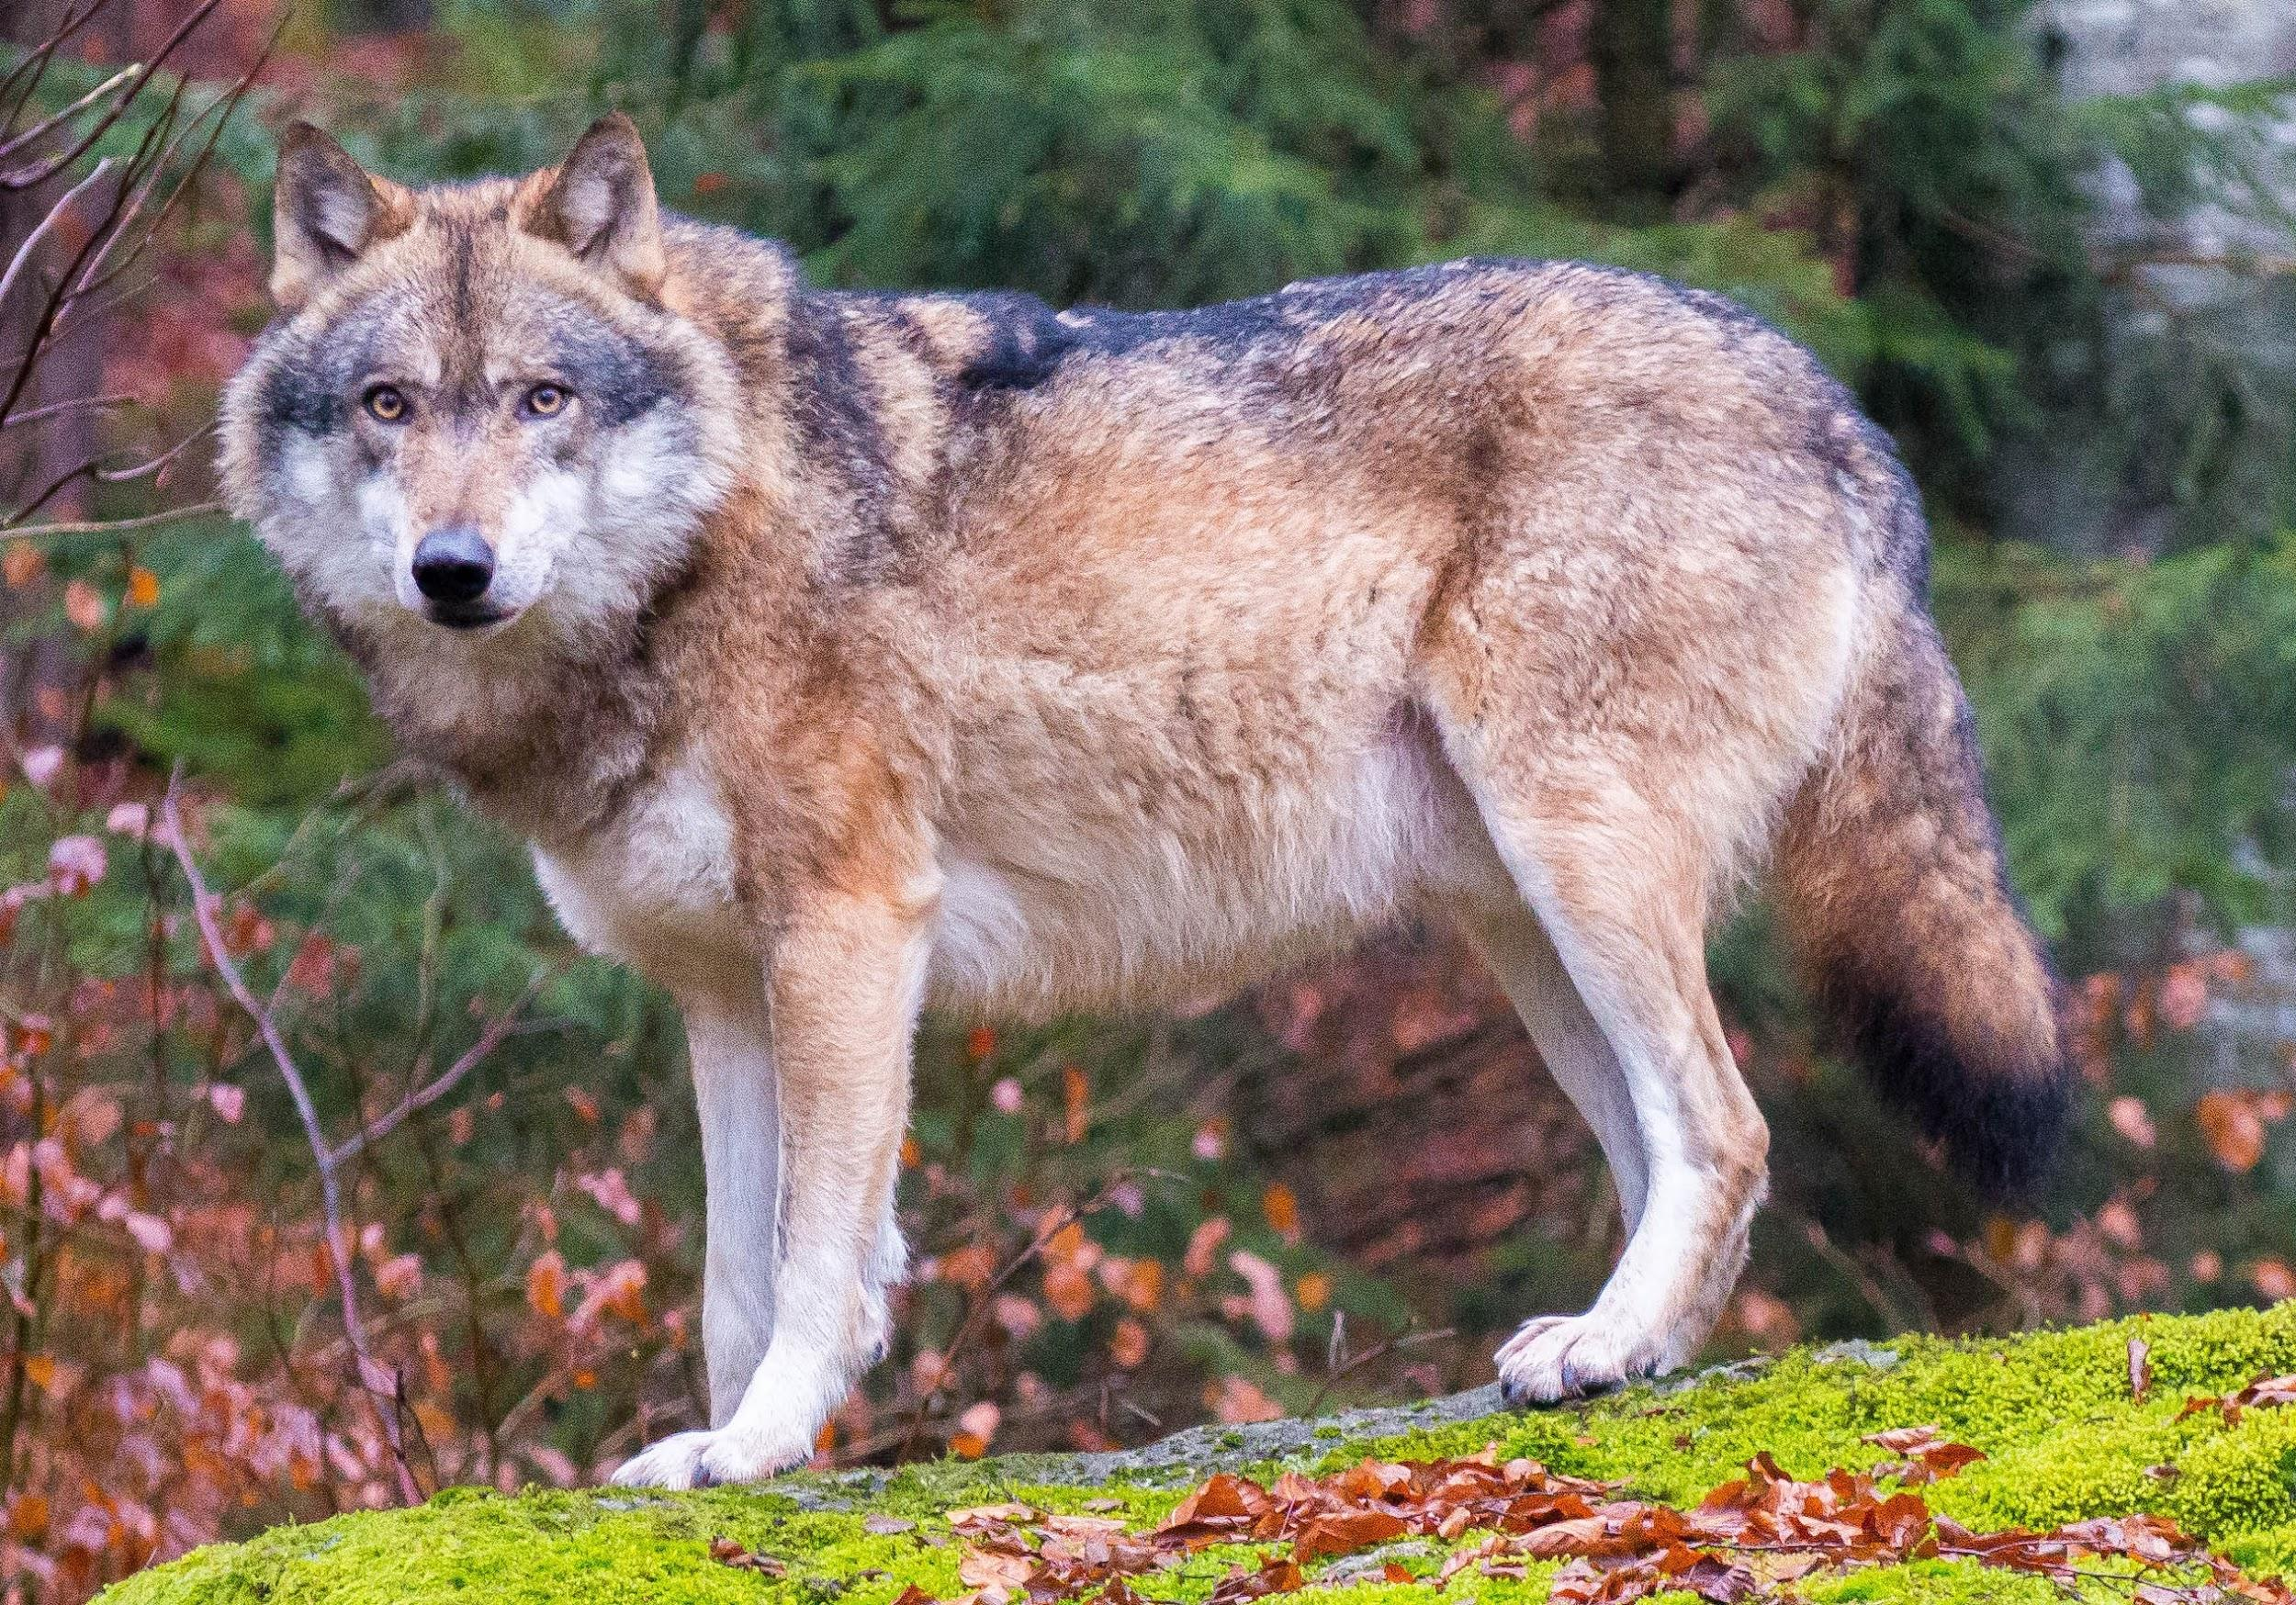
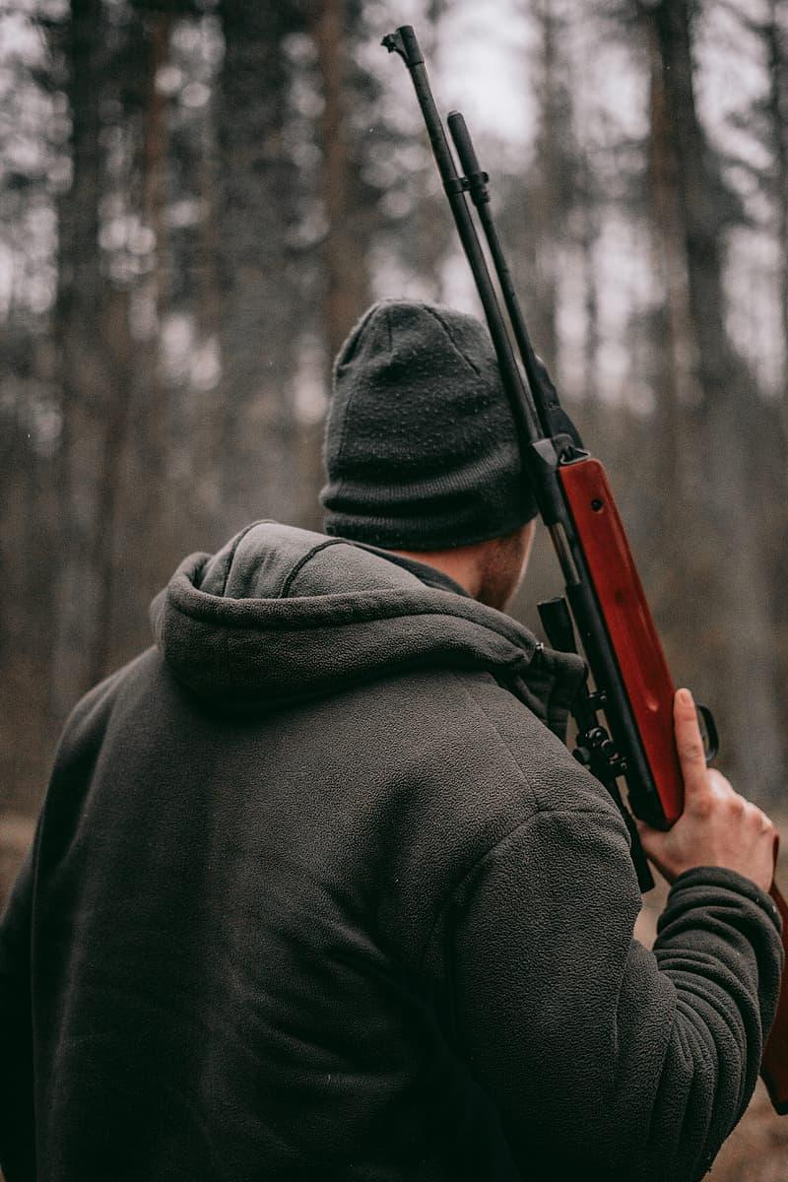
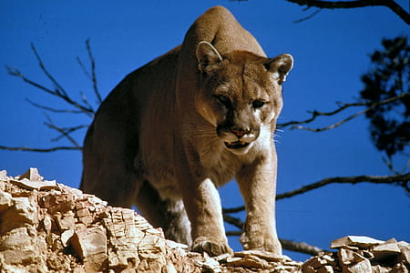
Does a Brown Bear have any predators?
A brown bears predators are wolves, cougars, and sadly humans. (humans are ever creatures predators)
Other types of bears have different types of predators
Notes:
1 Background Color
1 Title (or write the question)
1 Pictures
1 Include Transitions
0 Answering question using complete sentences (multiple sentences if needed to fully explain your answer)
1 Accuracy of information
5
The brown bears predators are… …are every creatures….

Slide 6

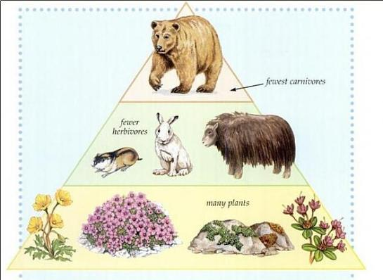

What's the food chain of a Brown Bear?
It all starts with…
1st. Plants
2nd. Bunnies (or any tiny mammal that eats plants)
3rd (last). Brown Bears
Notes:
1 Background Color
1 Title (or write the question)
1 Pictures
1 Include Transitions
0 Answering question using complete sentences (multiple sentences if needed to fully explain your answer)
1 Accuracy of information
5
Better to delete the text and let the picture explain it.

Slide 7
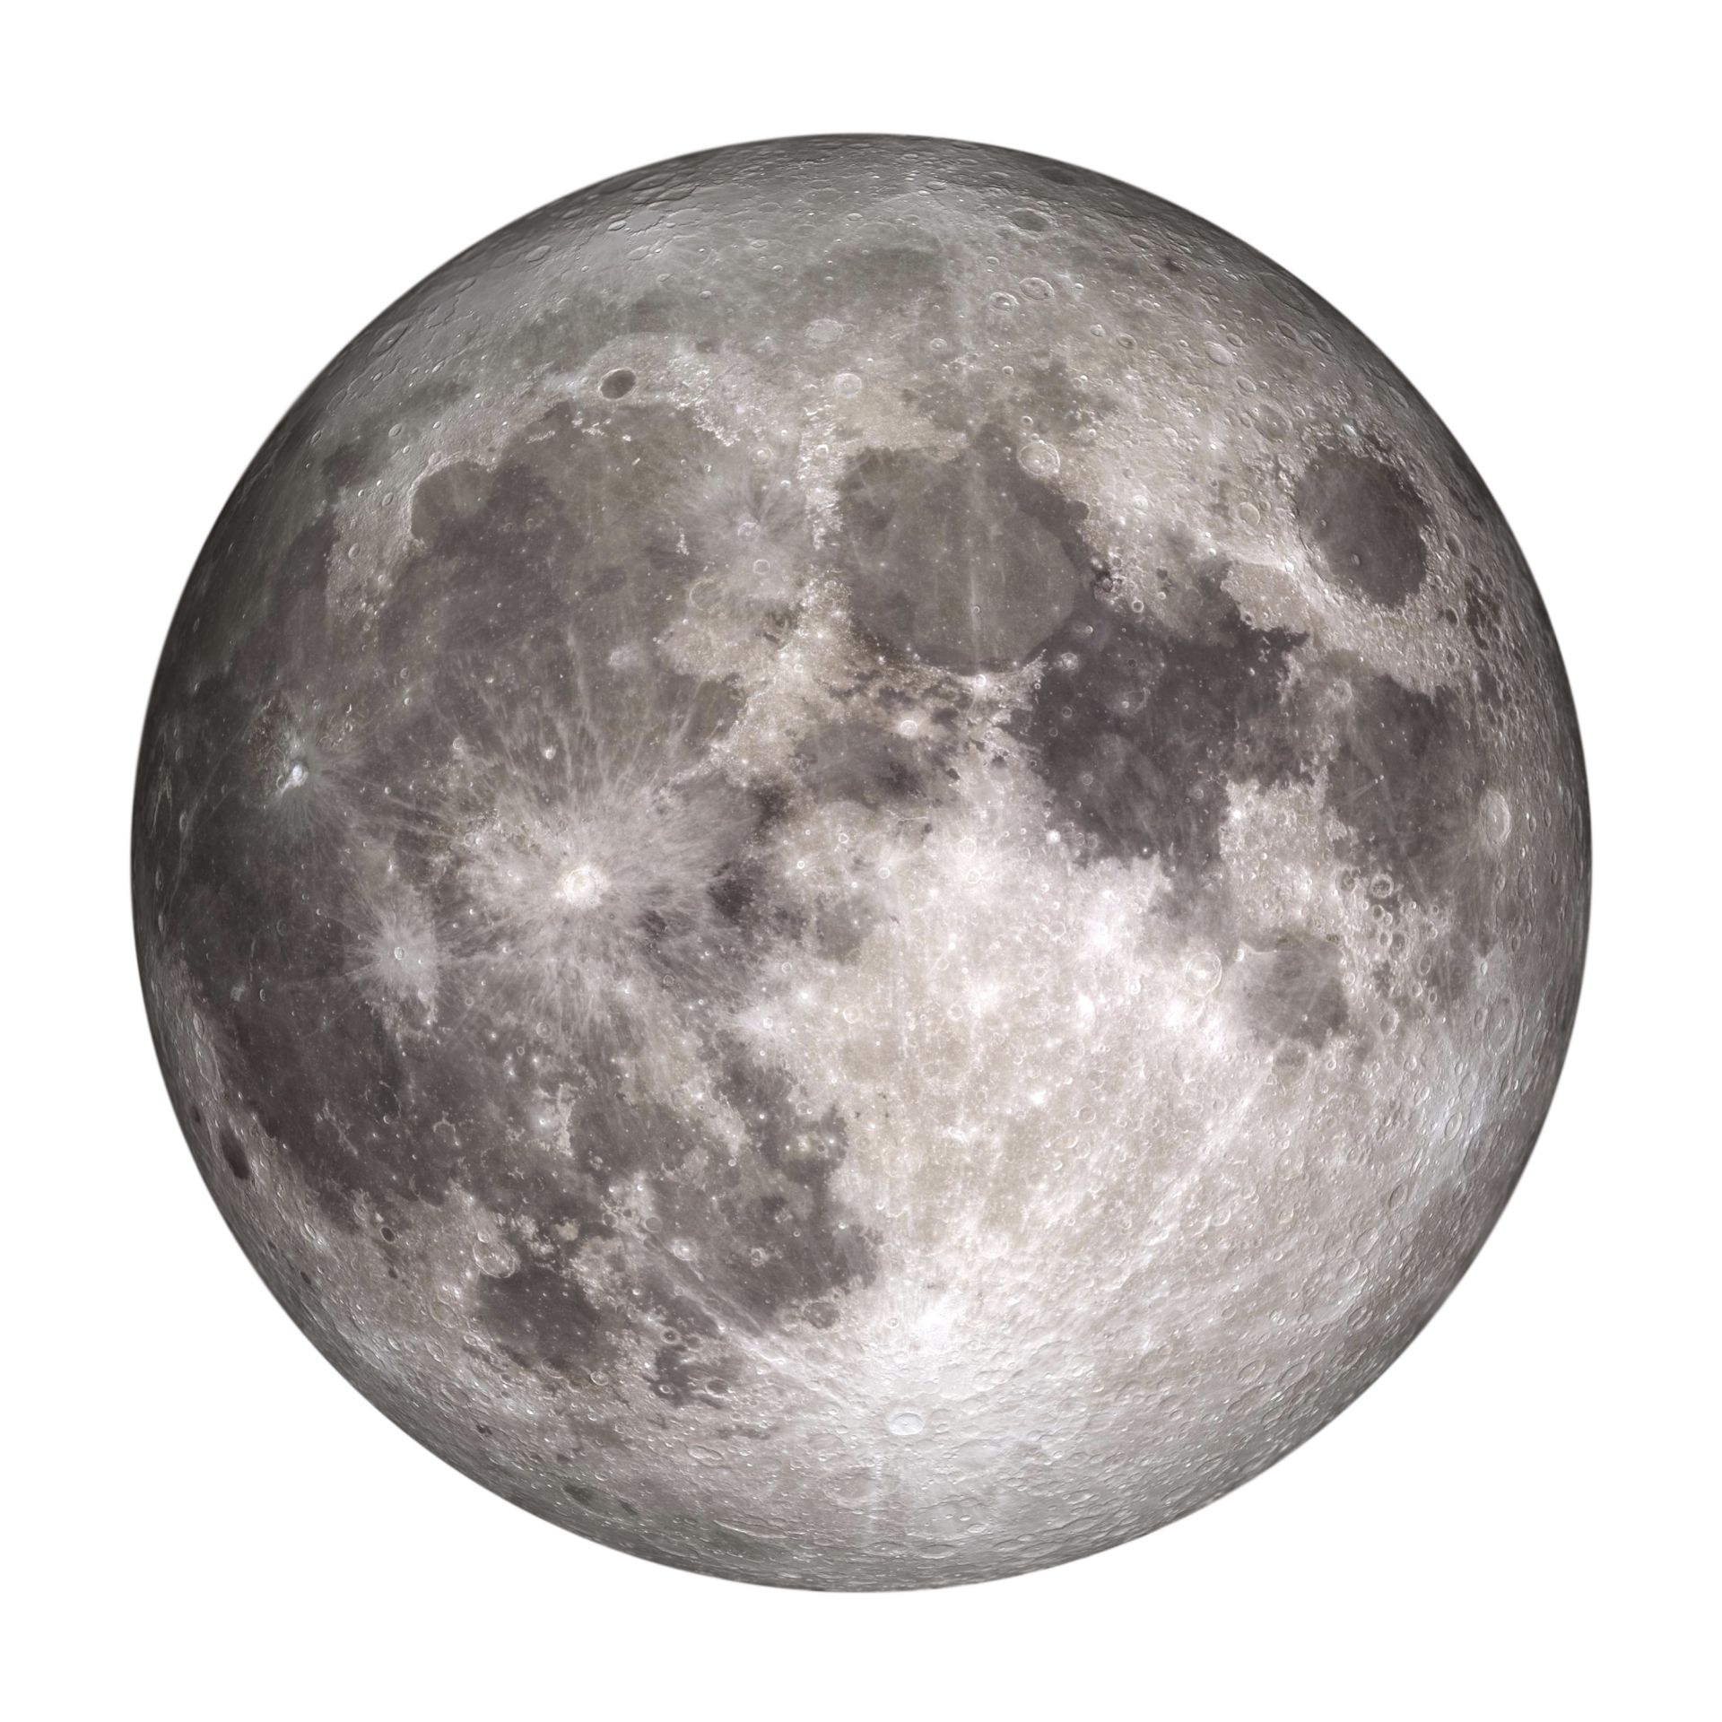
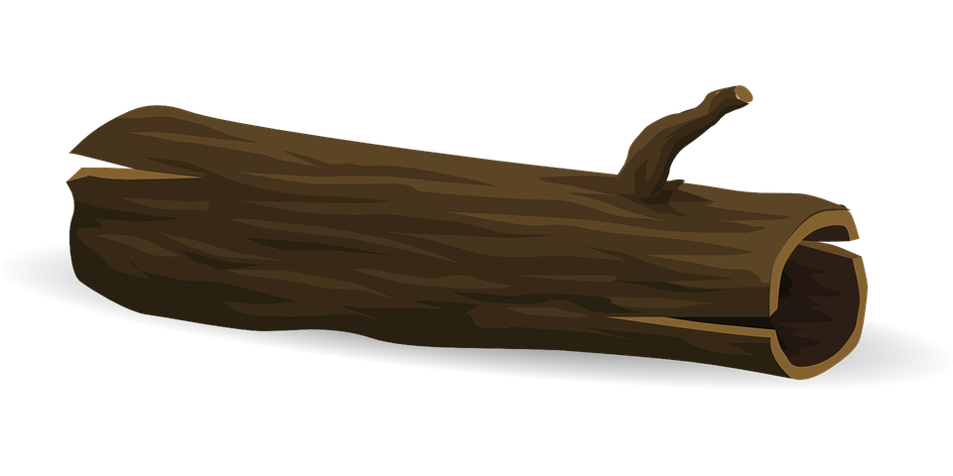
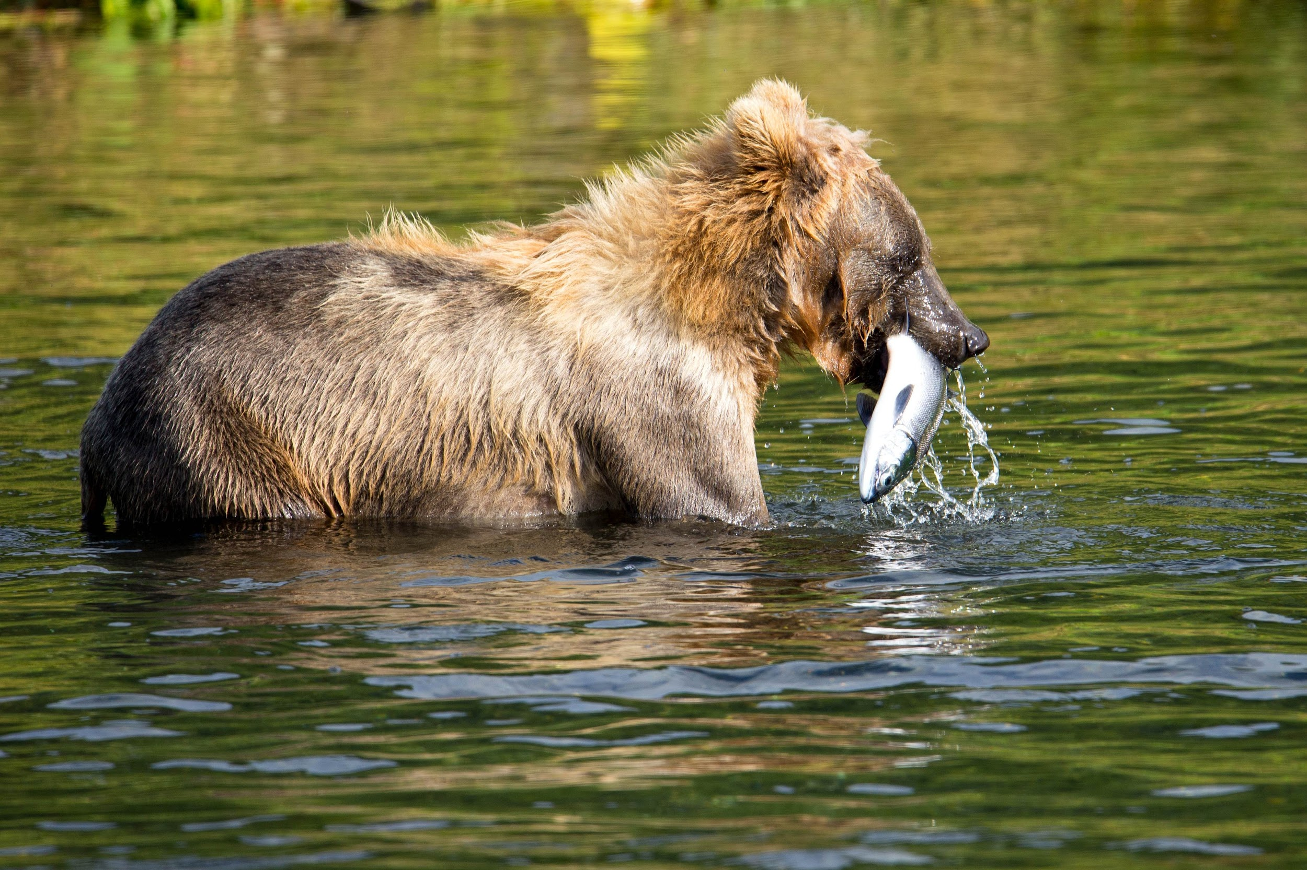
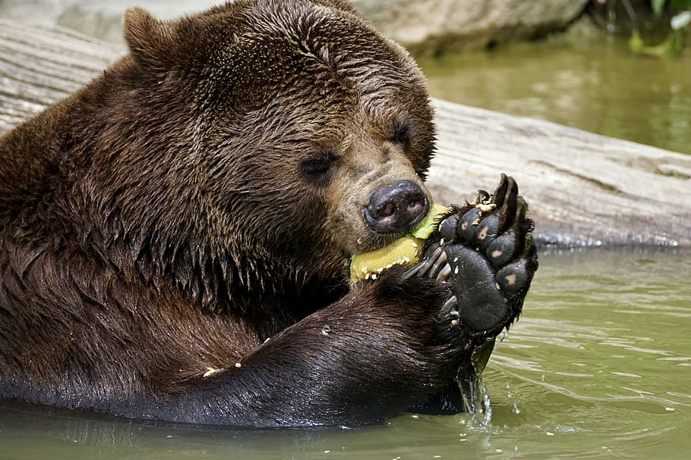
What are a Brown Bears specific adaptations to help it survive?
A keen sense of smell
Strong curved claws for climbing trees and ripping logs
A tapetum lucidum to aid night vision.
Canine teeth for ripping open logs
Notes:
1 Background Color
1 Title (or write the question)
1 Pictures
1 Include Transitions
0 Answering question using complete sentences (multiple sentences if needed to fully explain your answer)
1 Accuracy of information
5
Title.. What are the Brown Bears specific adaptations that hot it to survive?
Please put a period at the end of each sentence.

Slide 8
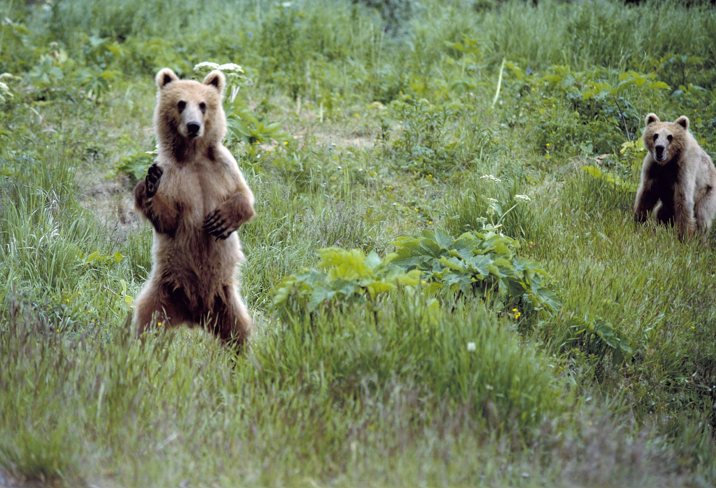
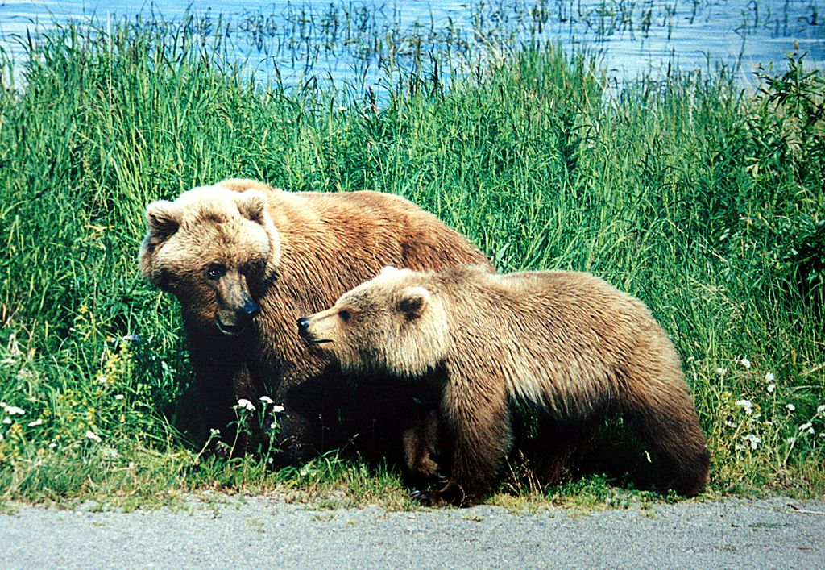

What do Brown bears look like, how much do they weigh, how tall are they?
Brown bears look exactly how their name is but, they are brown and big with lots of fur. Brown Bears weigh about 180 – 1,300 lbs. A Brown Bears height walking on its 4 legs is 2.3 – 5 ft, And Brown Bears height standing on 2 feet is 5–7 feet.
Are female bears and male bears weigh or are the same size?
According to google, male and female bears have a height difference saying female bears are smaller than male bears. Male brown bears weigh 400 - 1,200 pounds and female bears weigh 300 - 800.
Notes:
1 Background Color
1 Title (or write the question)
1 Pictures
1 Include Transitions
0 Answering question using complete sentences (multiple sentences if needed to fully explain your answer)
1 Accuracy of information
5
…..The Brown Bears height walking on its 4… Standing the Brown Bear can be anywhere from 5 to 7ft tall.
Title.. Are female Brown bears and male Brown bears the same weight, and are they the same size? …..difference. Female bears are smaller than..
Please separate these into two slides.

Slide 9
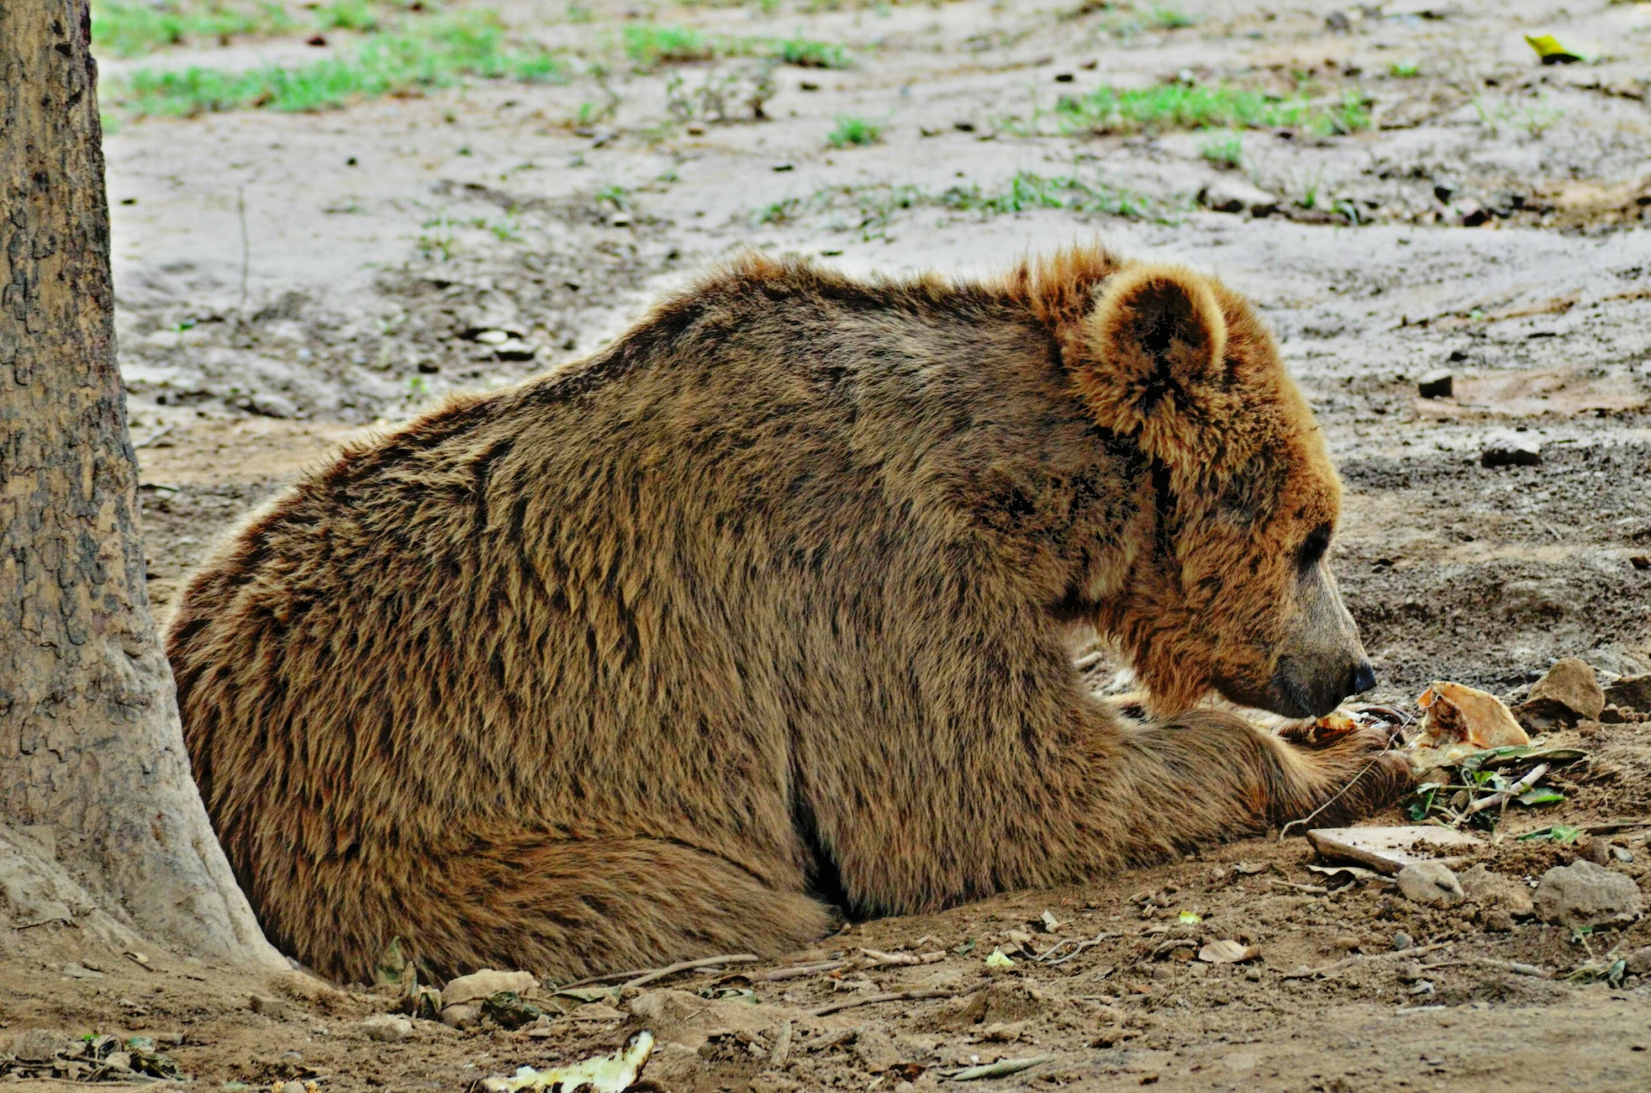

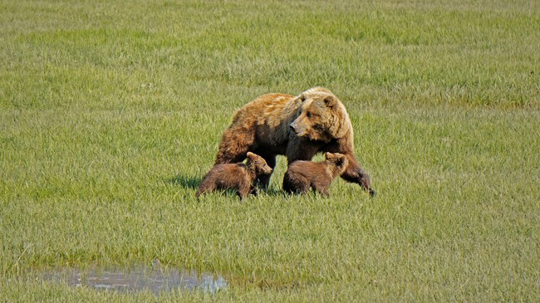

How long do Brown Bears live?
Brown bears don't live as long as an average human does but they usually live for 20 – 30 years.
Fun fact there has been a bear that’s lives longer than 30 years, a female polar bear that’s lived until the age of 41-42 and died in 2008.
Notes:
1 Background Color
1 Title (or write the question)
1 Pictures
1 Include Transitions
1 Answering question using complete sentences (multiple sentences if needed to fully explain your answer)
1 Accuracy of information
6

Slide 10
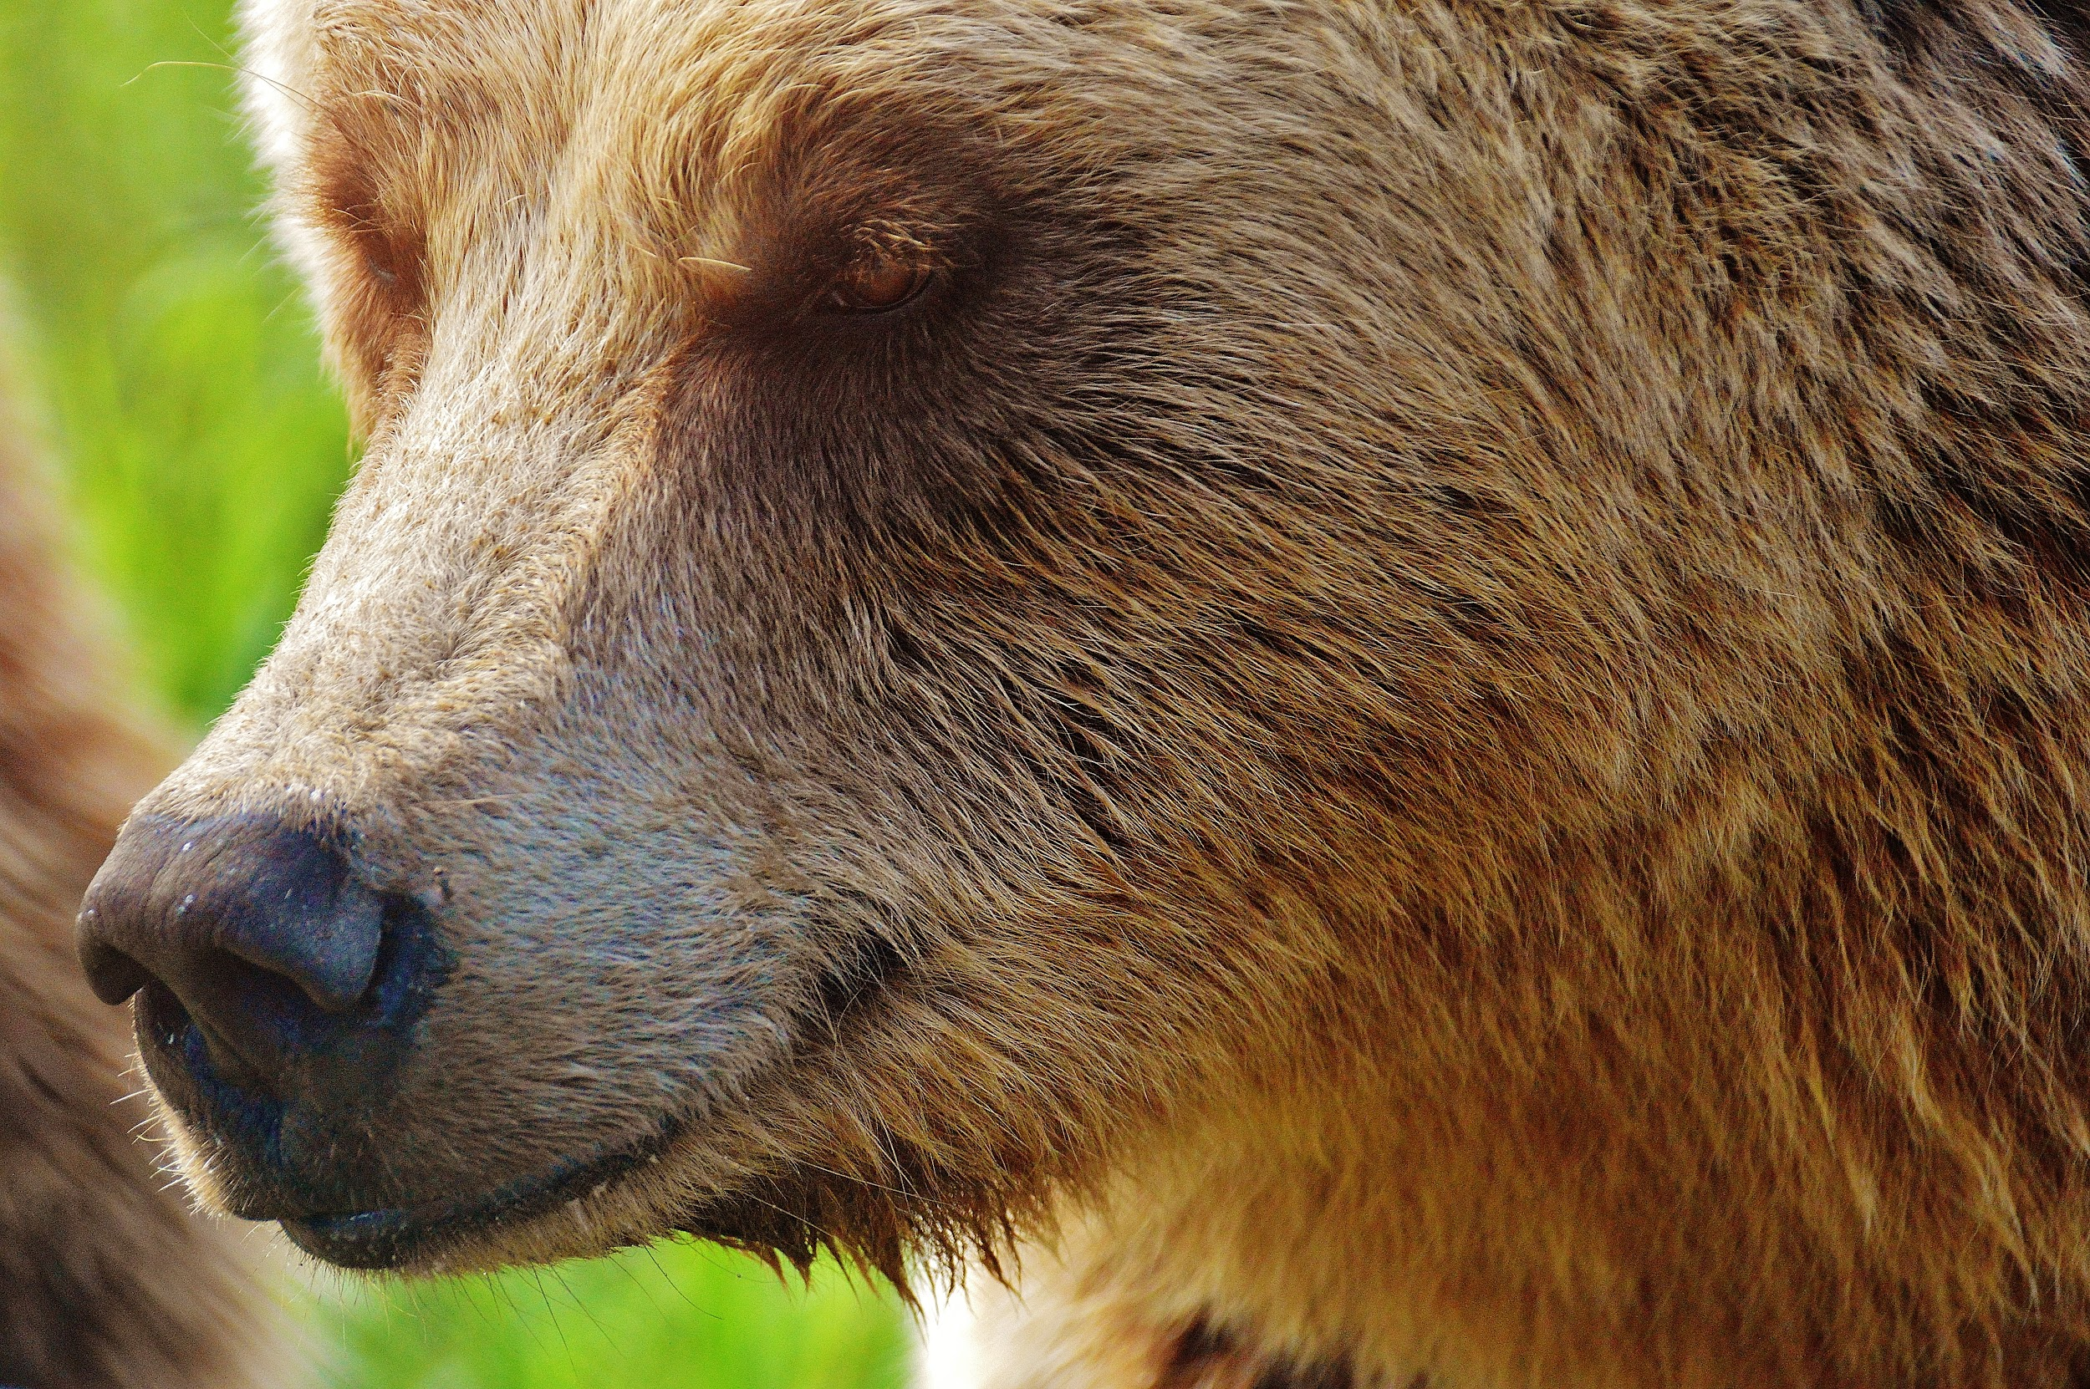
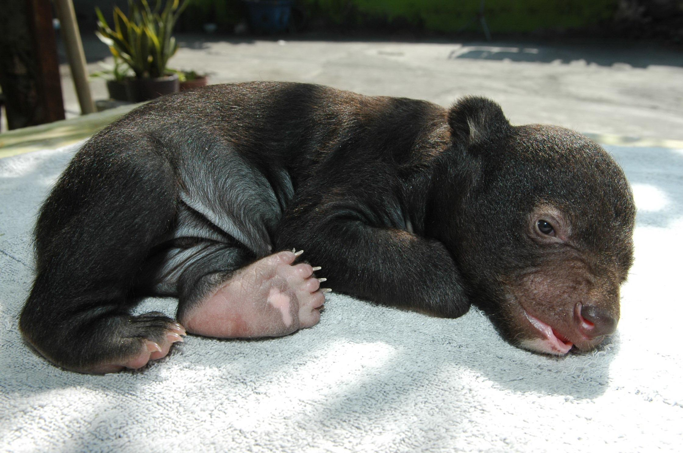
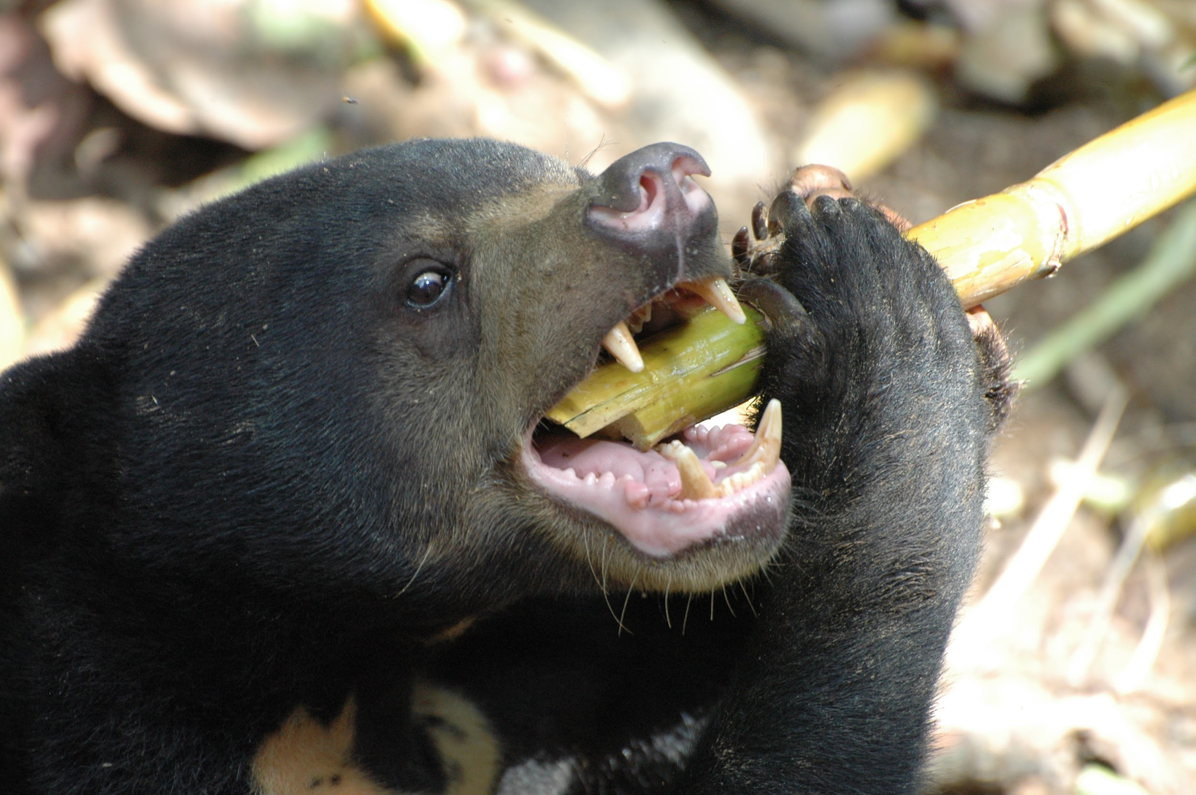
8 facts about Brown Bears (p. 1)
A bear's sense of smell is 2,100 times better than people’s
A brown bear can smell scents up to 2 miles away
Bear cubs are typically born the size of a small chipmunk
Brown Bears have a large head that holds an average of 42 teeth
Notes:
1 Background Color
1 Title (or write the question)
1 Pictures
1 Include Transitions
0 Answering question using complete sentences (multiple sentences if needed to fully explain your answer)
1 Accuracy of information
5
Please put a period behind every sentence.

Slide 11
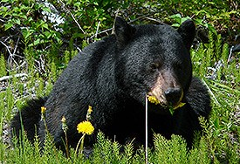

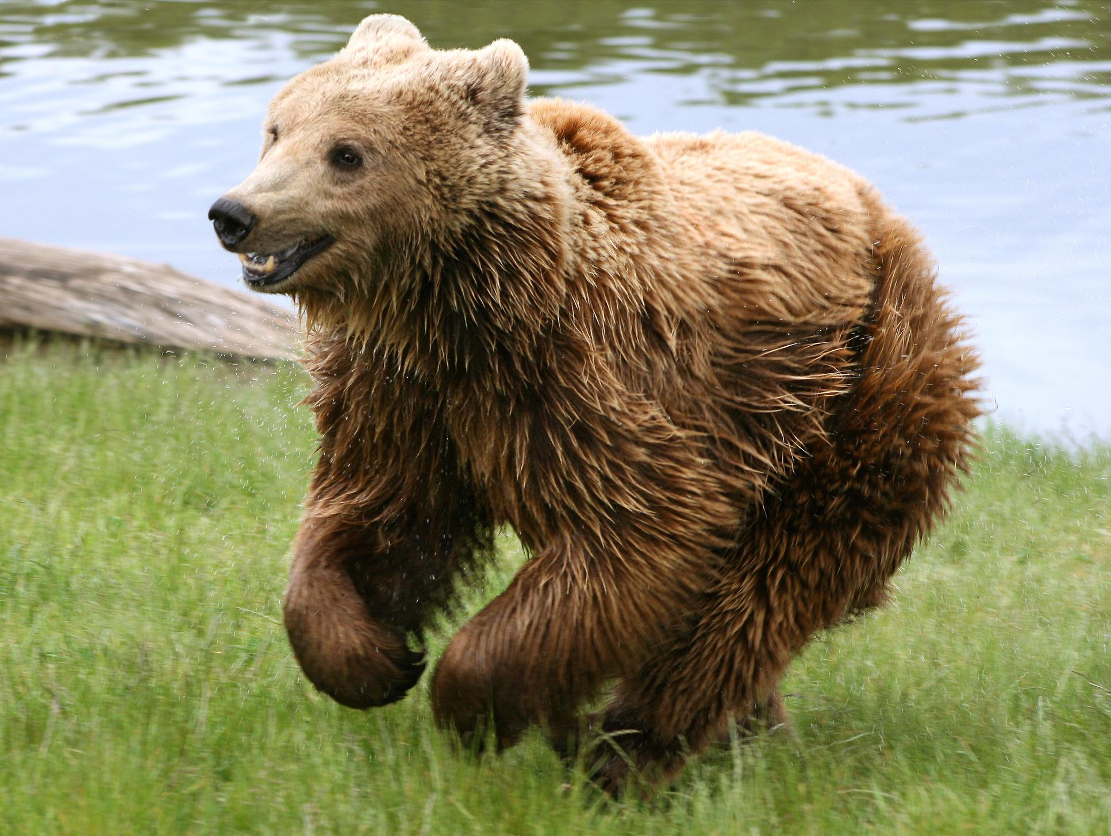
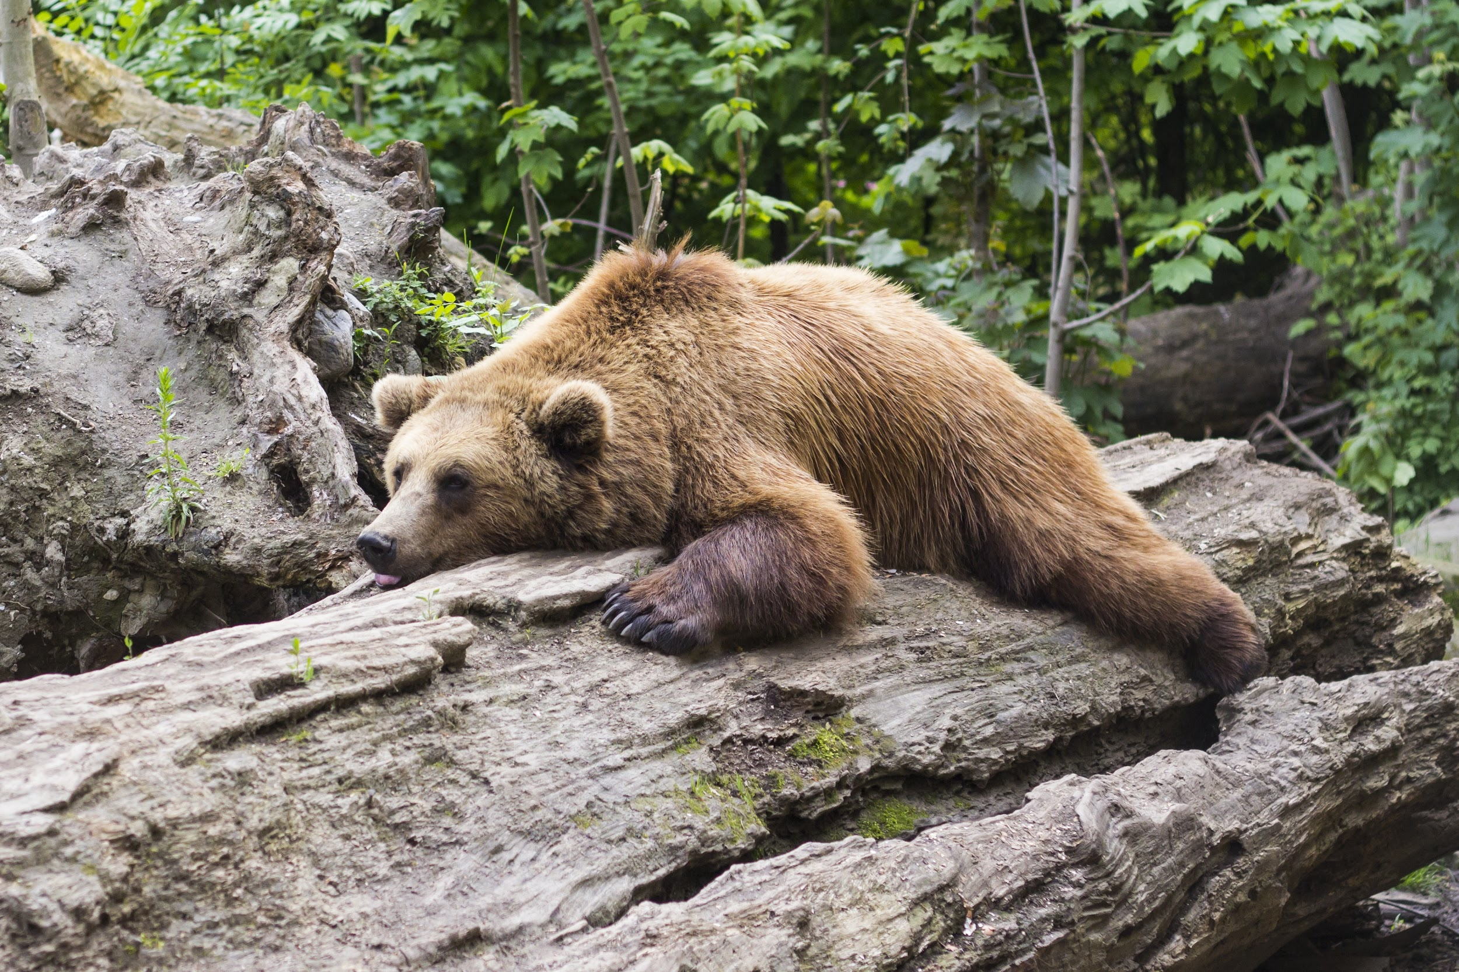
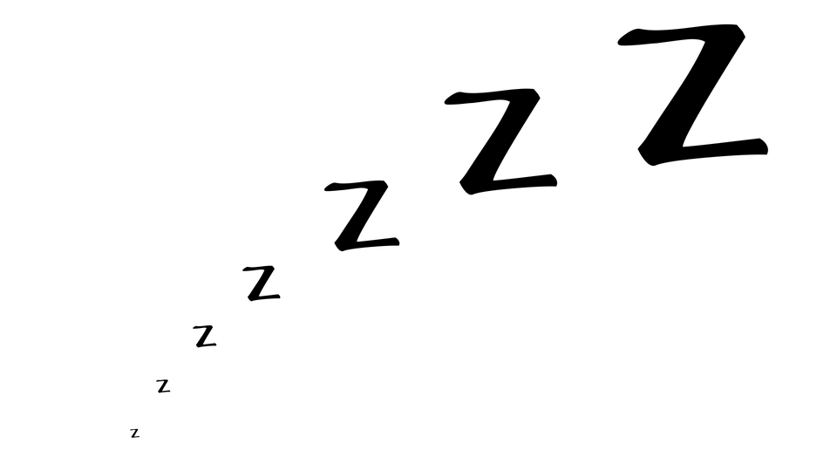
8 facts about Brown Bears (p. 2)
Brown bears aren’t just brown. Some are cream or black
They can run fast, up to 30 miles per hour
They hibernate in spring
can run fast, up to 30 miles per hour
Notes:
Not score. Last slide continued.
…aren’t just brown some are ….. The last one is a duplicate…. Please put a period at the end of every sentence.

Slide 12
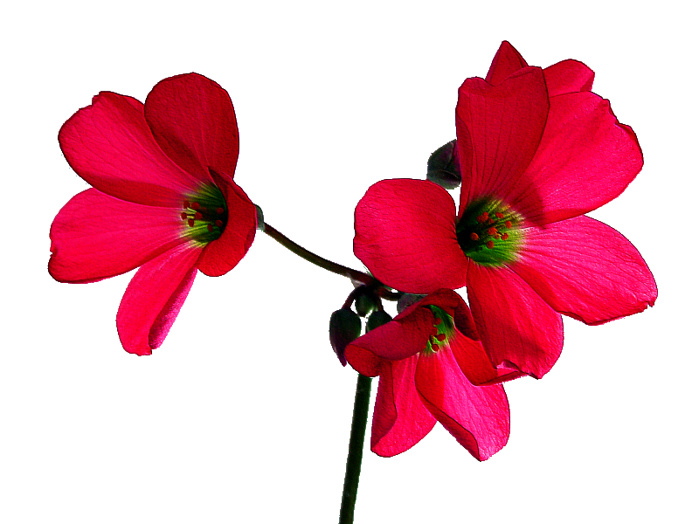

Websites I used:
https://bear.org/adaptations-for-obtaining-food/
https://patch.com/washington/woodinville/10-things-you-might-not-know-about-brown-bears-woodinville
Notes:
6

Slide 13
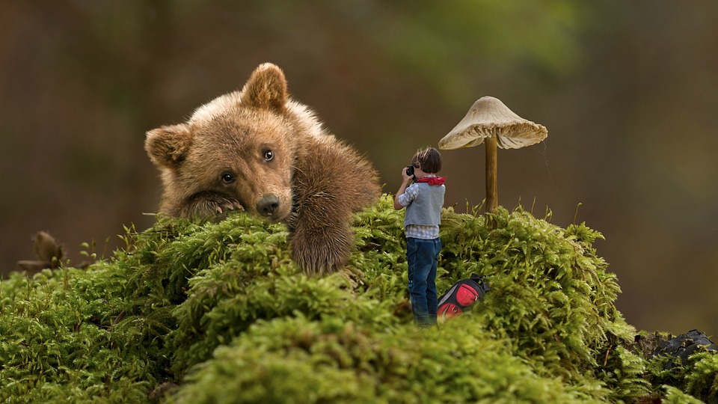
THE END
Notes:
Not scored extra slide.

