Slide 1
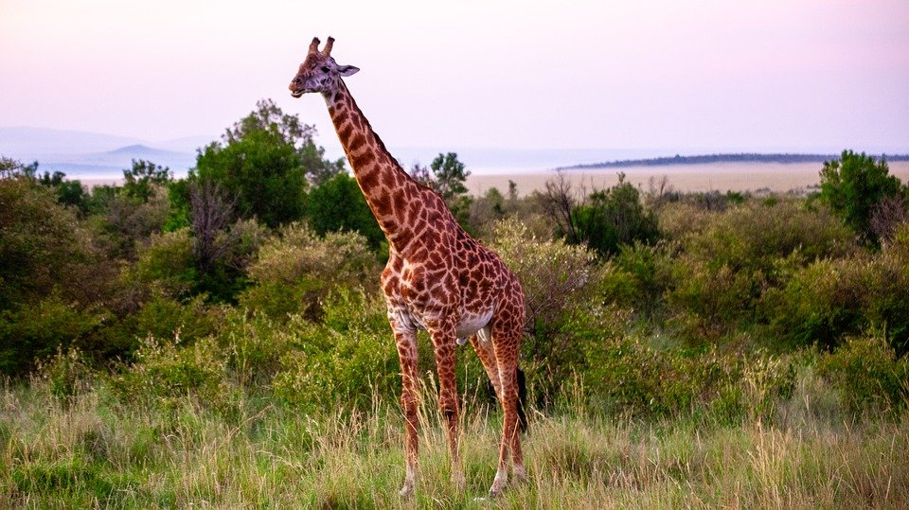
The Giraffe
Keithen McConnell
Notes:
1 Background Color
1 Title (or write the question)
1 Pictures
1 Include Transitions
1 Answering question using complete sentences (multiple sentences if needed to fully explain your answer)
1 Accuracy of information
6

Slide 2
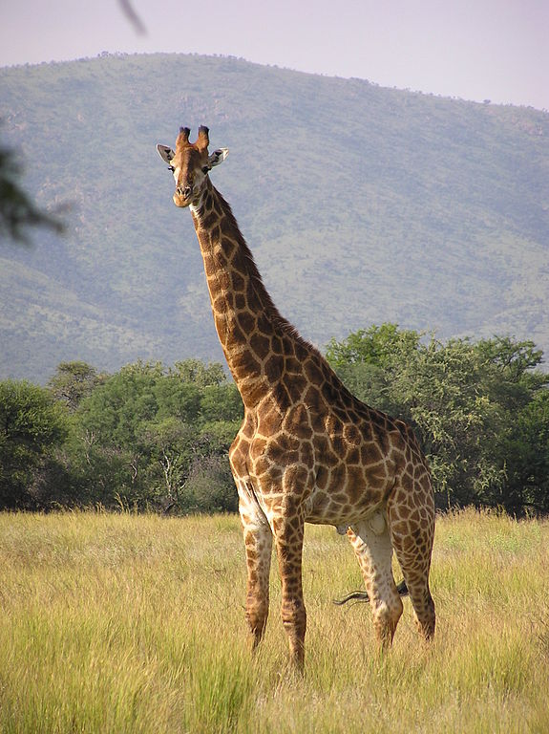
Where did the giraffe originate from?
The giraffe surprisingly originated from Eurasia. They say
The giraffe probably came from temperate Eurasia.
Notes:
1 Background Color
1 Title (or write the question)
1 Pictures
1 Include Transitions
0 Answering question using complete sentences (multiple sentences if needed to fully explain your answer)
1 Accuracy of information
4
The text is hard to read change the font color. Delete everything after Eurasia, duplicate into.

Slide 3
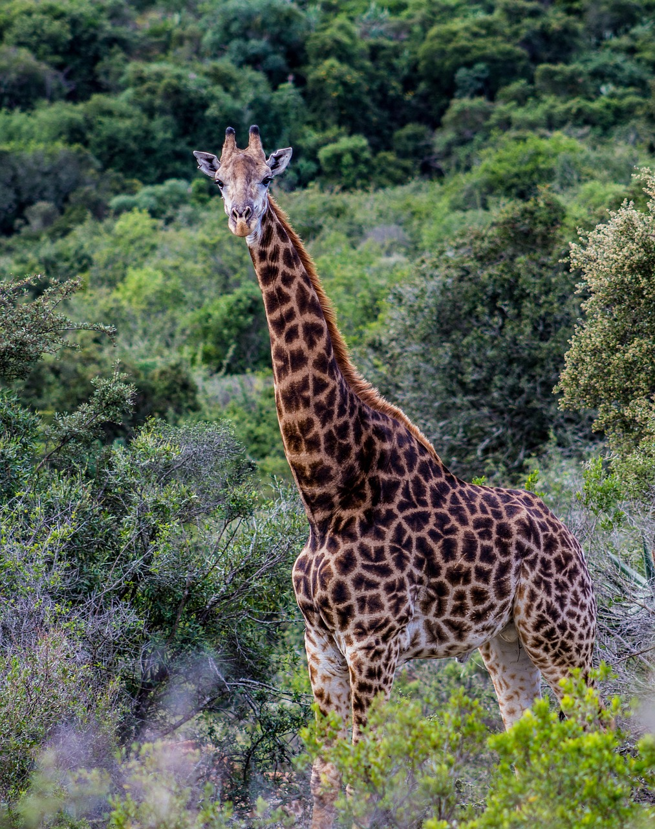
What ecosystems do they live in?
Giraffes live in the semi arid savannah and savannah woodlands in Africa.
Notes:
1 Background Color
1 Title (or write the question)
1 Pictures
1 Include Transitions
1 Answering question using complete sentences (multiple sentences if needed to fully explain your answer)
1 Accuracy of information
6

Slide 4
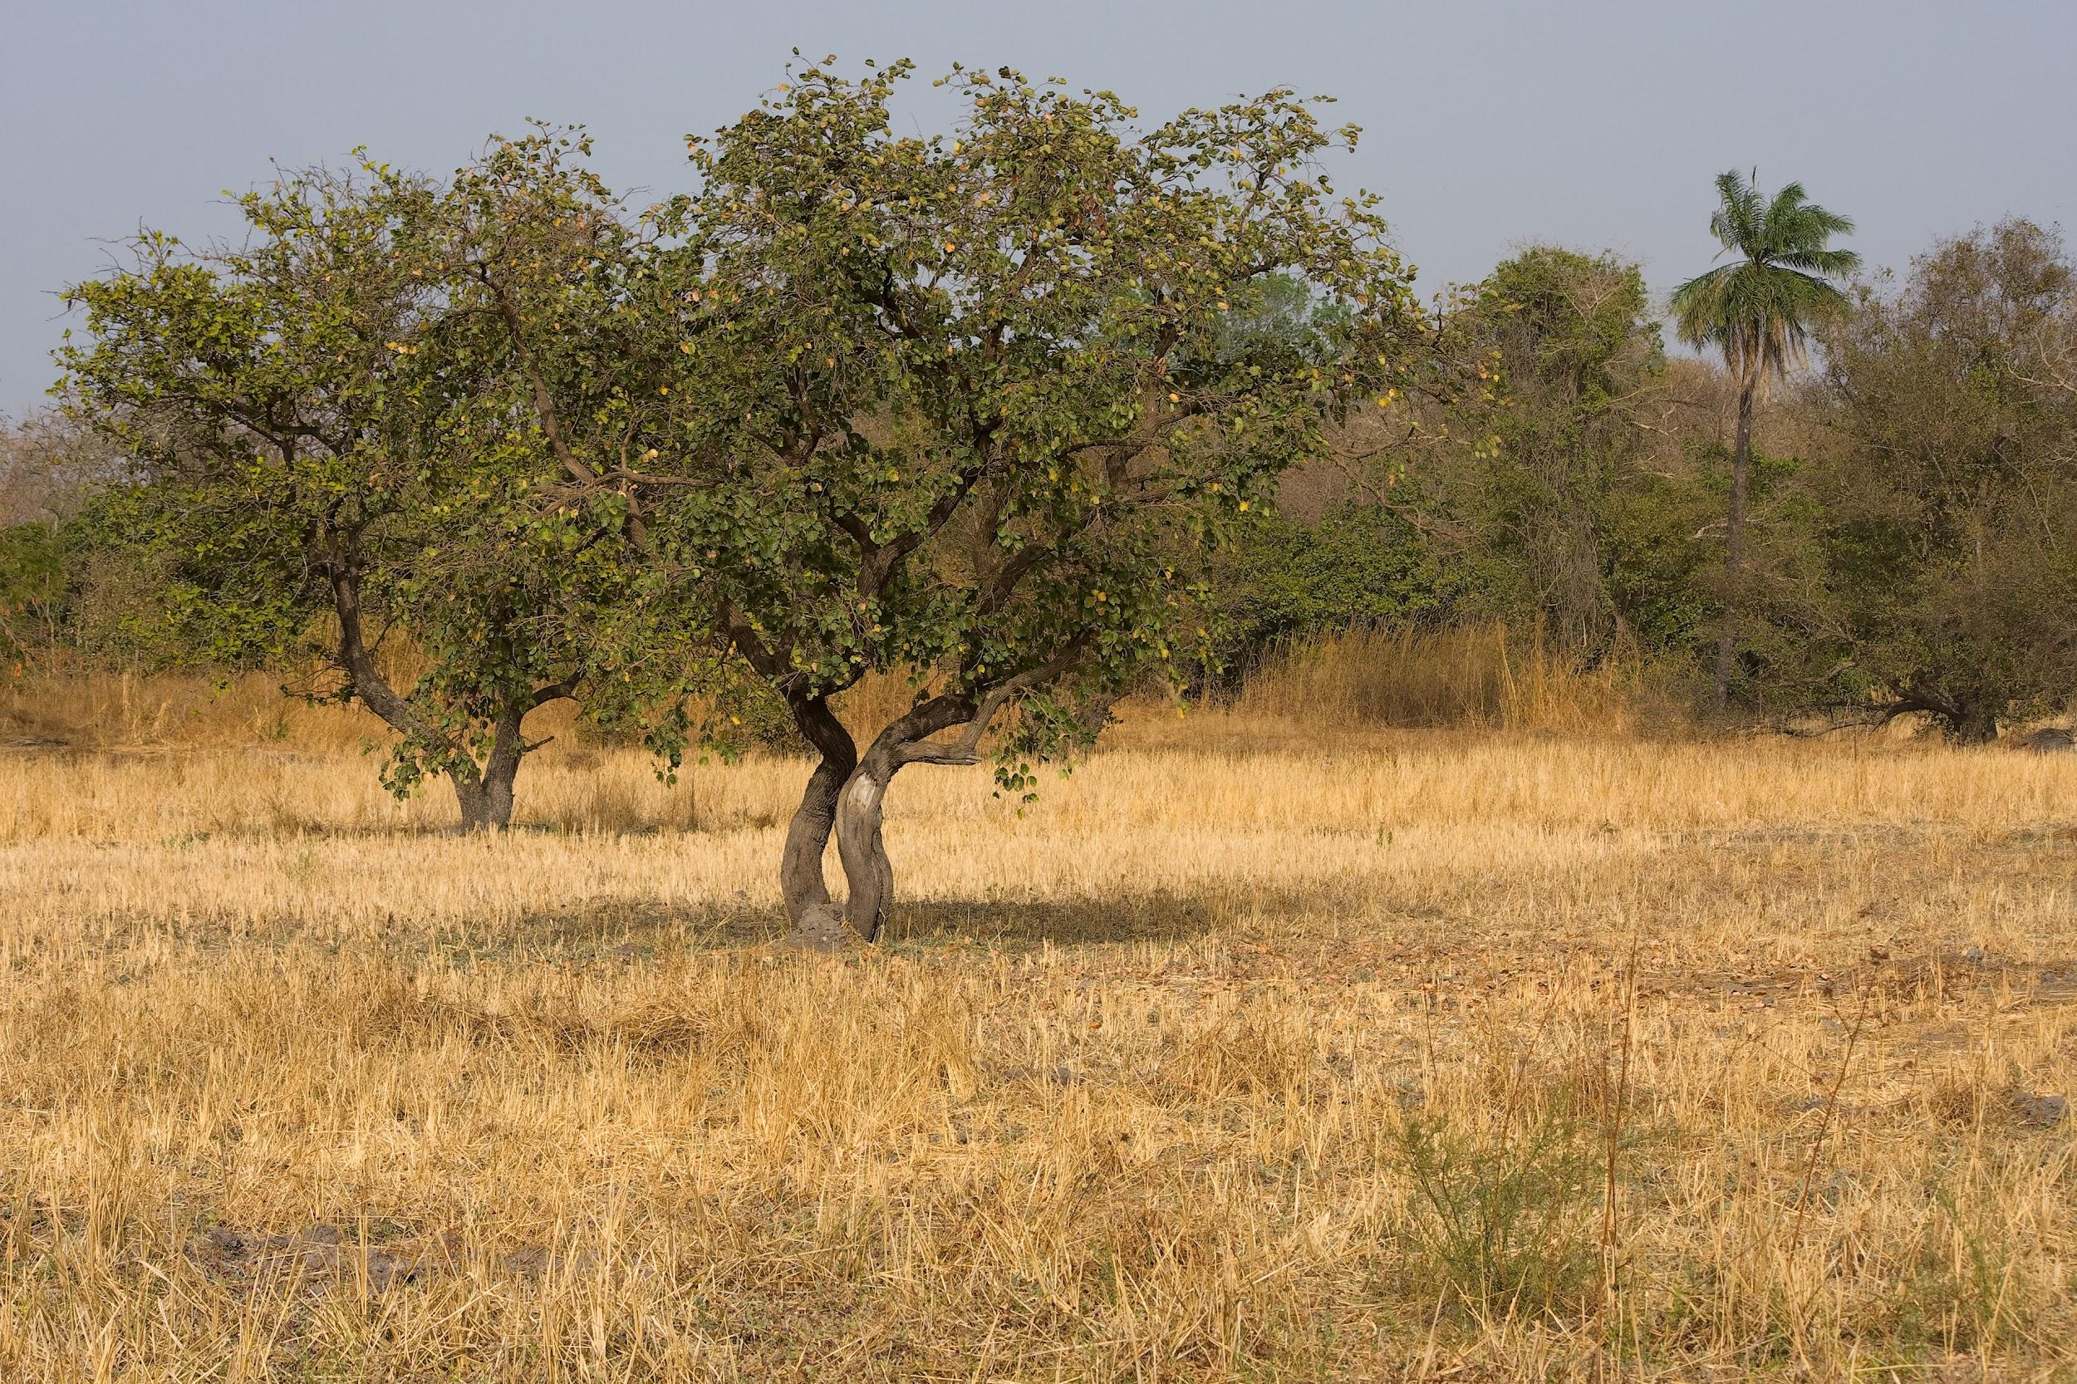
What is it like in the ecosystem?
The climate is a bit of both.
It’s wet enough for a couple of
trees and shrubs but to dry for
woodlands. In the dry season, it's about
70 degrees, and the rainy season
is about 80 degrees.
Notes:
1 Background Color
1 Title (or write the question)
1 Pictures
1 Include Transitions
0 Answering question using complete sentences (multiple sentences if needed to fully explain your answer)
1 Accuracy of information
5
…shrubs but also to dry to be called woodlands.

Slide 5
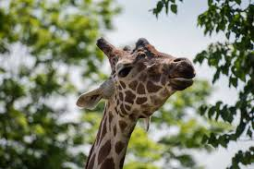
What type of consumer is a Giraffe?
Giraffes are herbivores, so they like to only eat plants.
Notes:
1 Background Color
1 Title (or write the question)
1 Pictures
1 Include Transitions
1 Answering question using complete sentences (multiple sentences if needed to fully explain your answer)
1 Accuracy of information
6

Slide 6
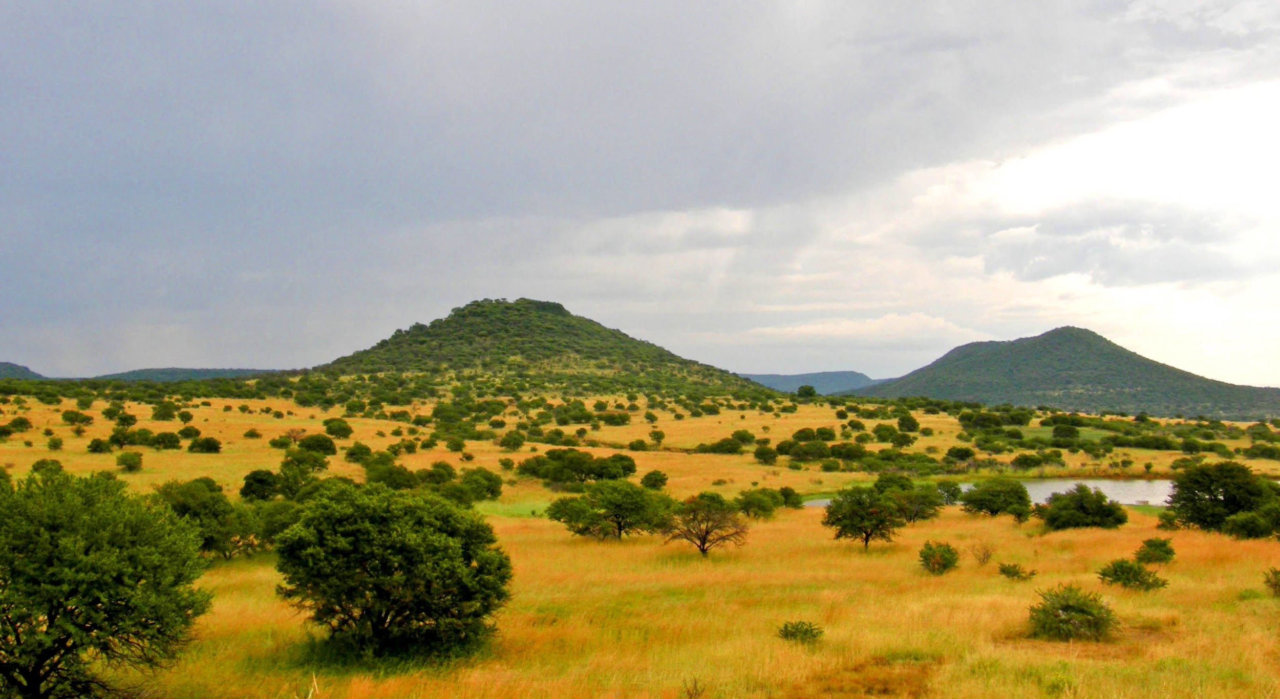
What specific type of plants do giraffes eat?
They typically eat leaves and buds on trees and shrubs.
Notes:
1 Background Color
1 Title (or write the question)
1 Pictures
1 Include Transitions
0 Answering question using complete sentences (multiple sentences if needed to fully explain your answer)
1 Accuracy of information
5
Duplicate information…. State that giraffes really love Acacia leaves.

Slide 7
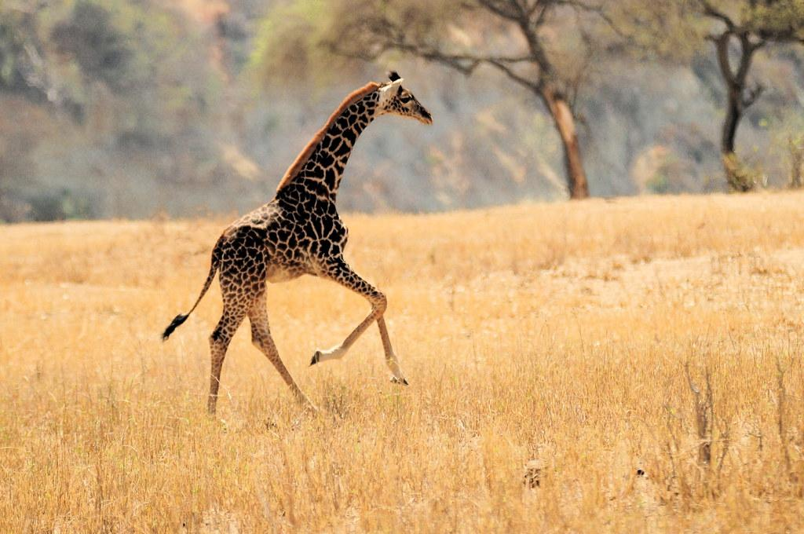
Does the giraffe have any predators?
Yes, the giraffe does have predators, and those are lions, leopards, and hyenas.
Notes:
1 Background Color
1 Title (or write the question)
1 Pictures
1 Include Transitions
0 Answering question using complete sentences (multiple sentences if needed to fully explain your answer)
1 Accuracy of information
5
The text of the title is hard to read against the background. …Yes, giraffes do have predators they are lions, …….

Slide 8
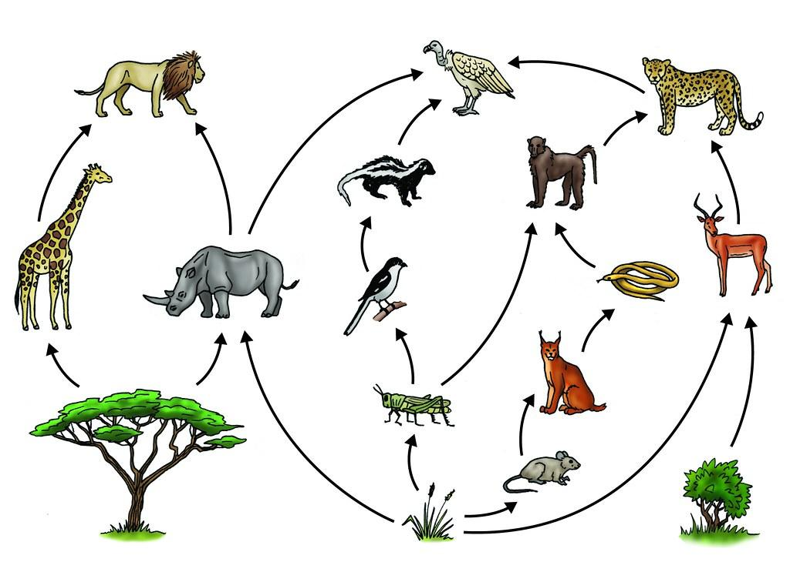
The Food Chain
Notes:
1 Background Color
1 Title (or write the question)
1 Pictures
1 Include Transitions
1 Answering question using complete sentences (multiple sentences if needed to fully explain your answer)
1 Accuracy of information
6

Slide 9
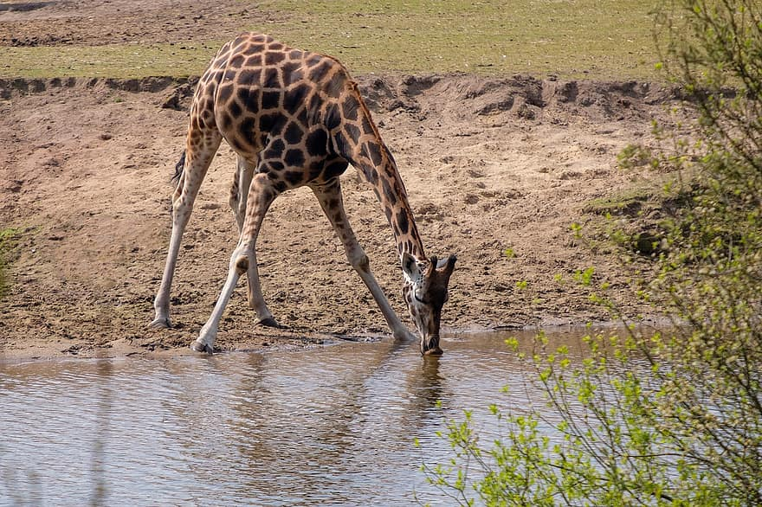
Did the giraffe develop any specific adaptations to help it survive?
Yes, they did! There very long necks help them feed at very high levels in the treetops. It also helps them to spot predators. They also can go weeks without water.
Notes:
1 Background Color
1 Title (or write the question)
1 Pictures
1 Include Transitions
0 Answering question using complete sentences (multiple sentences if needed to fully explain your answer)
1 Accuracy of information
5
Their very long…

Slide 10
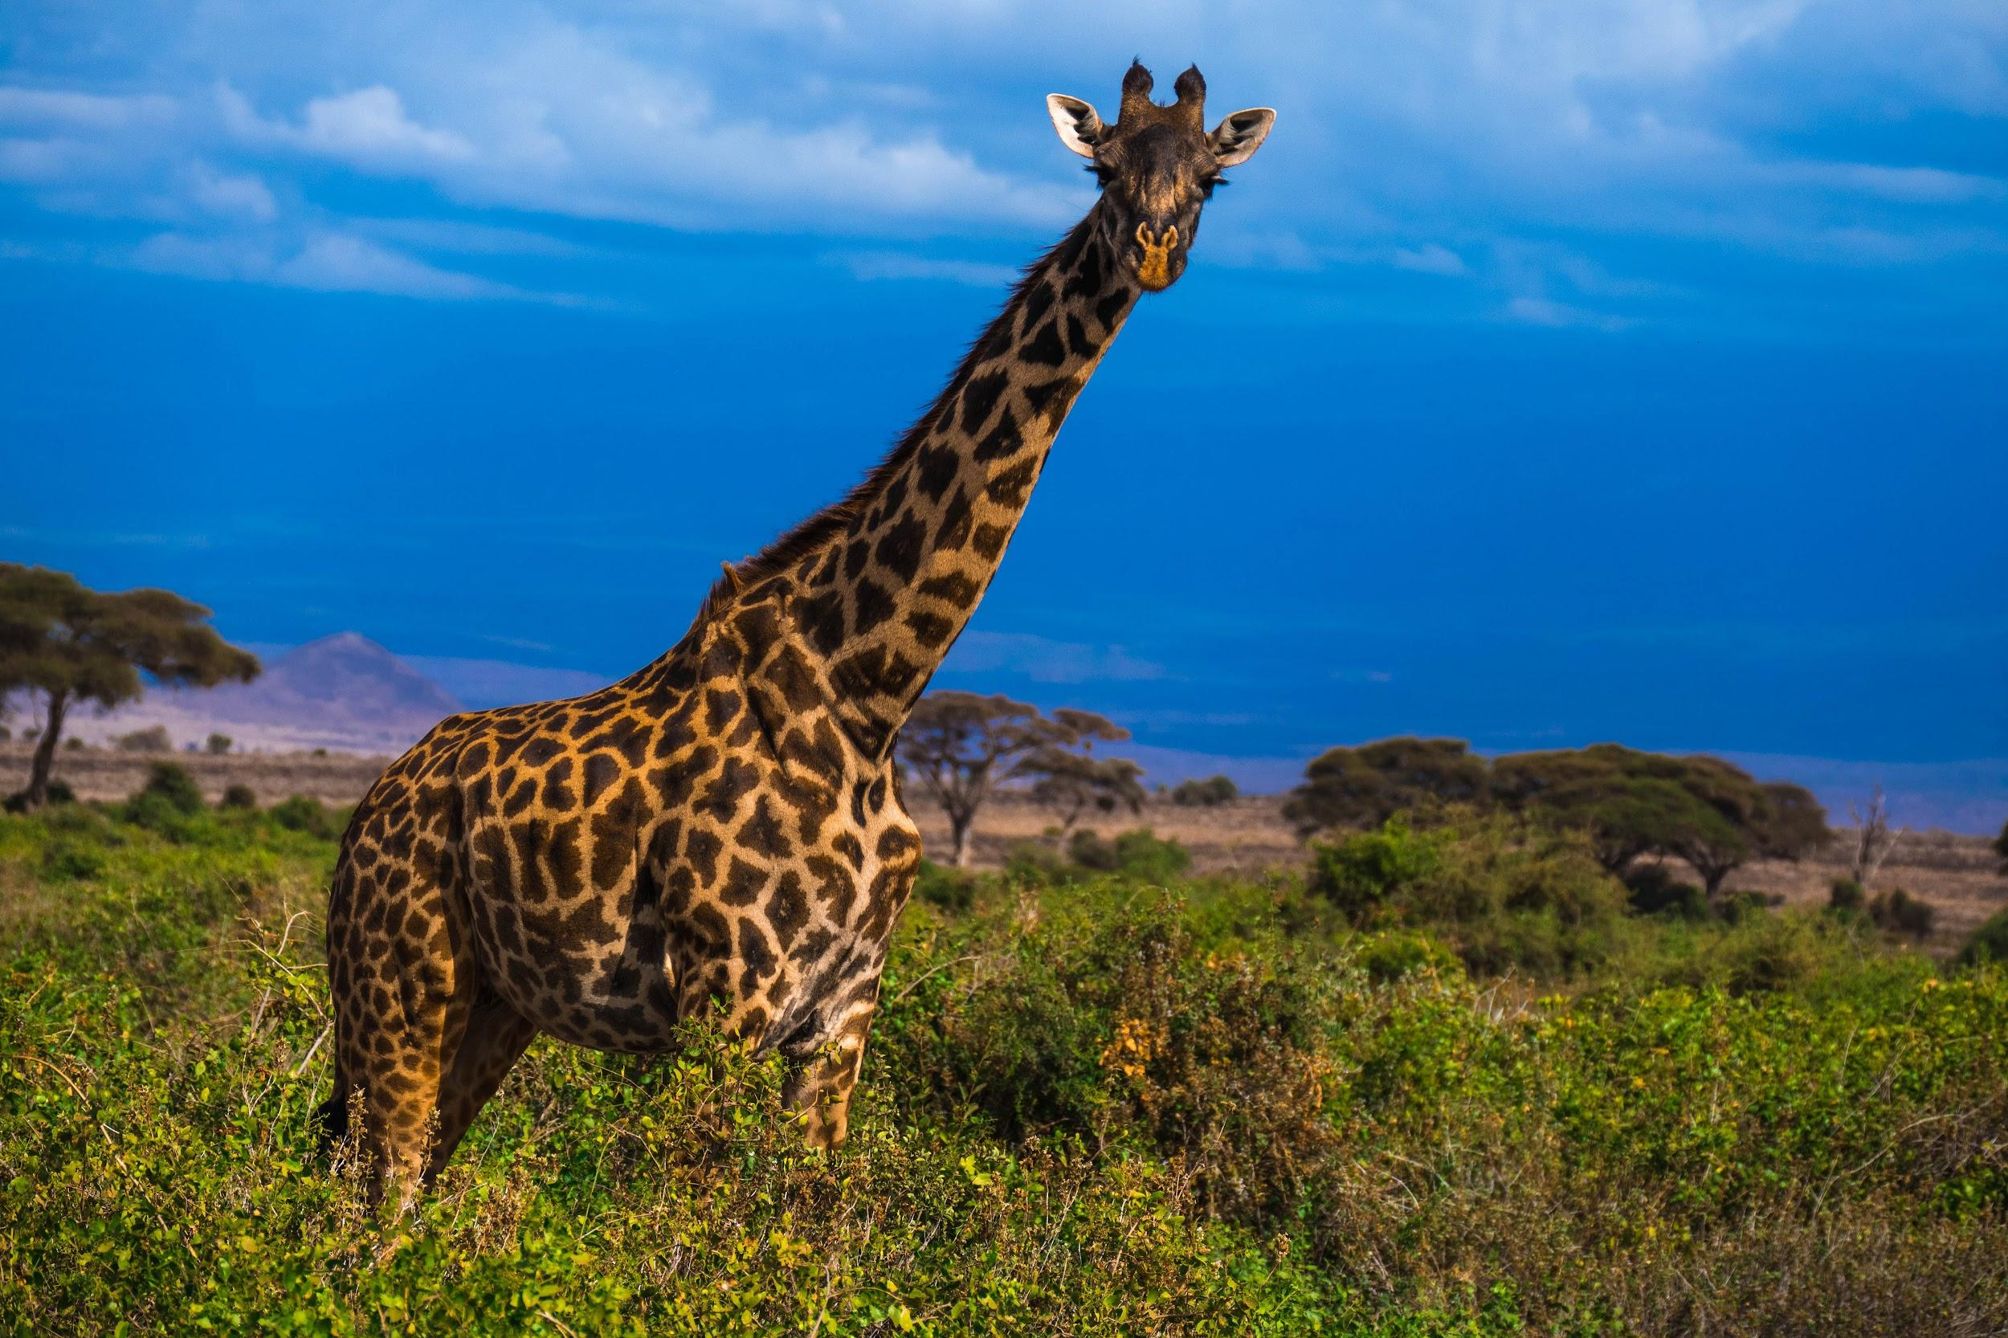
How much does a giraffe weigh? How tall is the giraffe? What does the giraffe even look like?
Giraffes typically weigh 4,200 pounds. They usually grow up to 16 - 18 feet tall. Giraffes have very long necks, four very skinny legs, and have a spotted coat.
Notes:
1 Background Color
1 Title (or write the question)
1 Pictures
1 Include Transitions
1 Answering question using complete sentences (multiple sentences if needed to fully explain your answer)
1 Accuracy of information
6

Slide 11
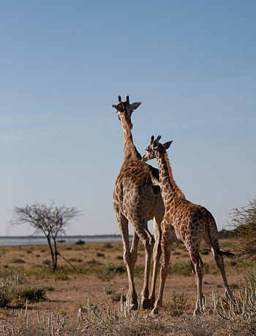
Do male and female giraffes weigh the same? And, are they the same size?
No, male giraffes tend to weigh more and are taller than the female.
Notes:
1 Background Color
1 Title (or write the question)
1 Pictures
1 Include Transitions
0 Answering question using complete sentences (multiple sentences if needed to fully explain your answer)
1 Accuracy of information
5
Title… Do male and female giraffes weigh the same, and are they the same size?

Slide 12
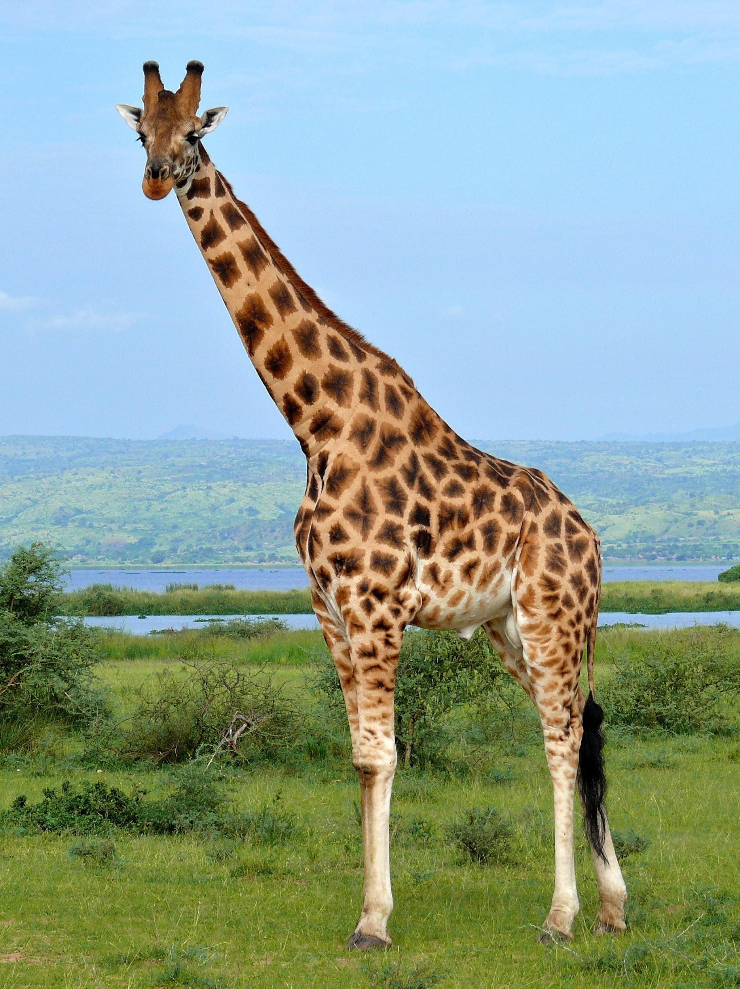
What is the lifespan of a giraffe?
Giraffes tend to live up to 26 years in the wild.
Notes:
1 Background Color
1 Title (or write the question)
1 Pictures
1 Include Transitions
1 Answering question using complete sentences (multiple sentences if needed to fully explain your answer)
1 Accuracy of information
6

Slide 13
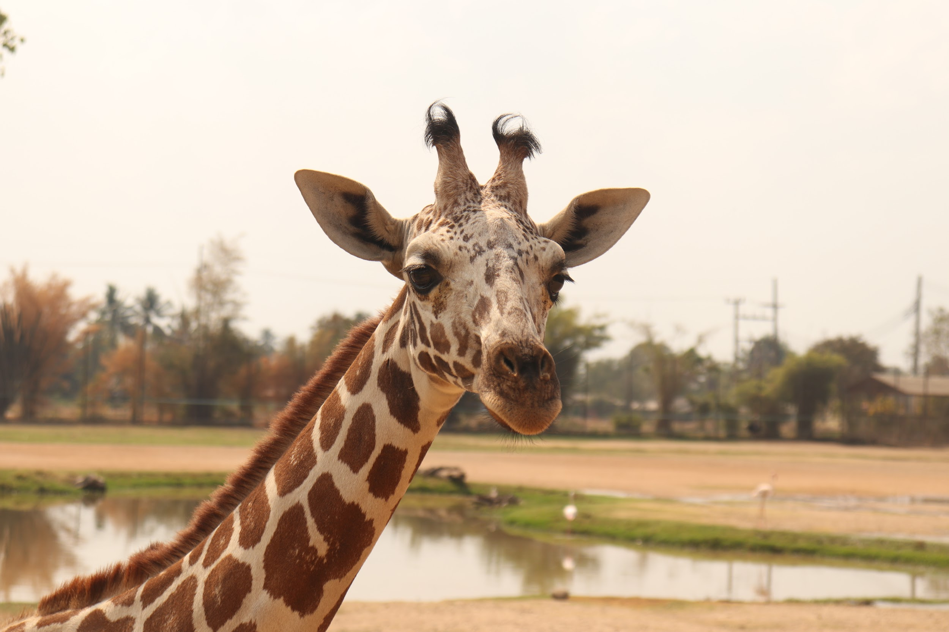
Fun Facts About the Giraffe
Did you know that a giraffe's heart is 2 feet long and weighs 25 pounds?
Giraffes are the tallest mammals on earth.
Giraffes sleep and give birth all while standing up.
A newborn giraffe can start walking after about an hour.
No two individual giraffes have the exact same spots.
The average length of a giraffes tongue is about 20 inches.
Giraffes have the same number of bones in their necks as humans.
Giraffes only need about 4 hours of sleep.
Notes:
1 Background Color
1 Title (or write the question)
1 Pictures
1 Include Transitions
1 Answering question using complete sentences (multiple sentences if needed to fully explain your answer)
1 Accuracy of information
6
Please use bullet points or numbers.

Slide 14
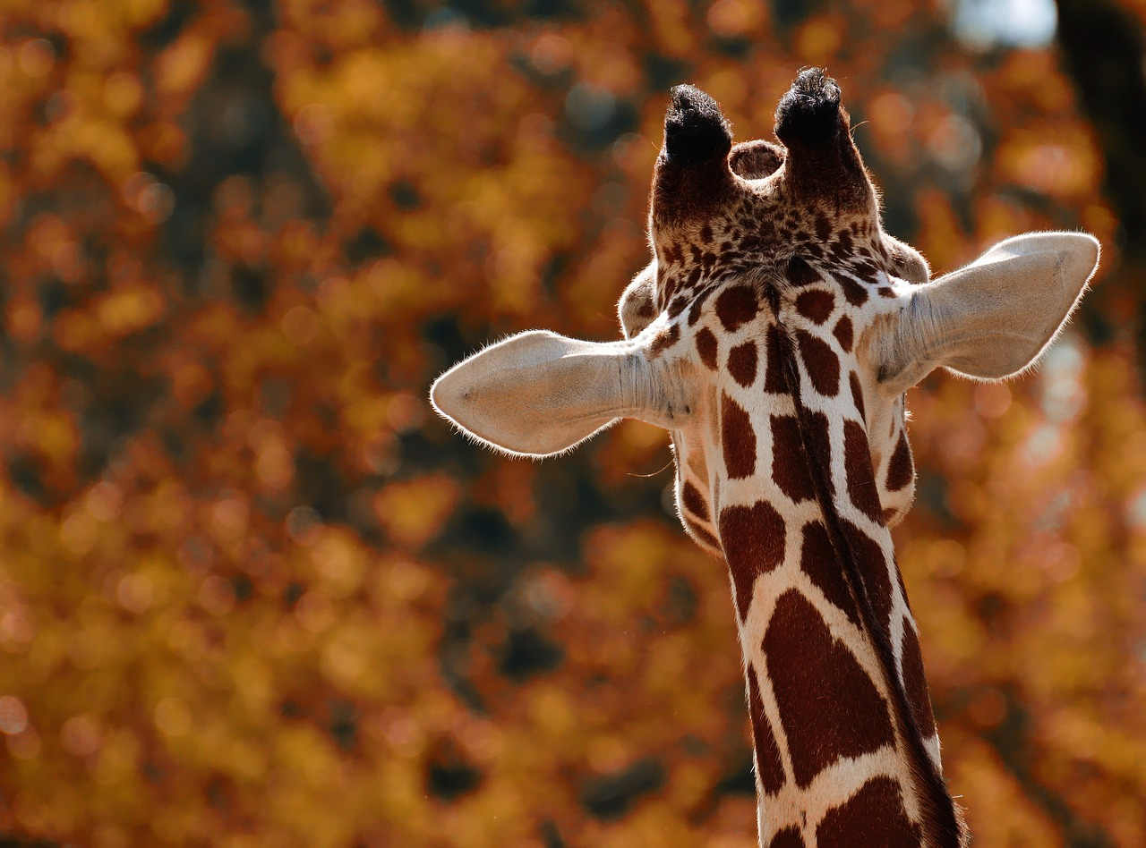
Sources
discoverwildlife.com
biologicaldiversity.org
animalcorner.org
lisbdnet.com
giraffeconservation.org
awf.org
veeriku.tartu.ee
dosomething.orh
pbs.org
britannica.com
funkidslive.com
Notes:
6

