Slide 1
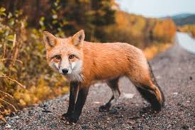
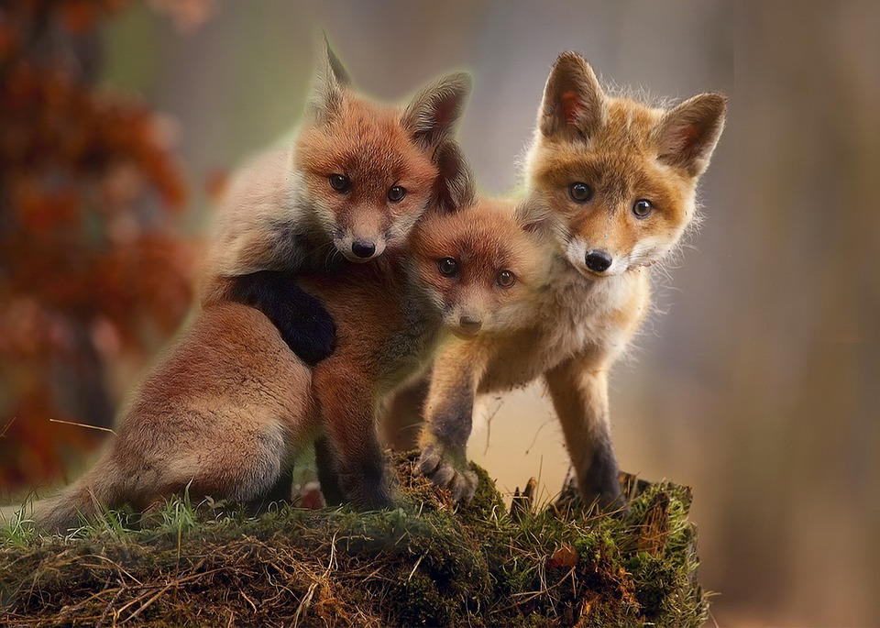
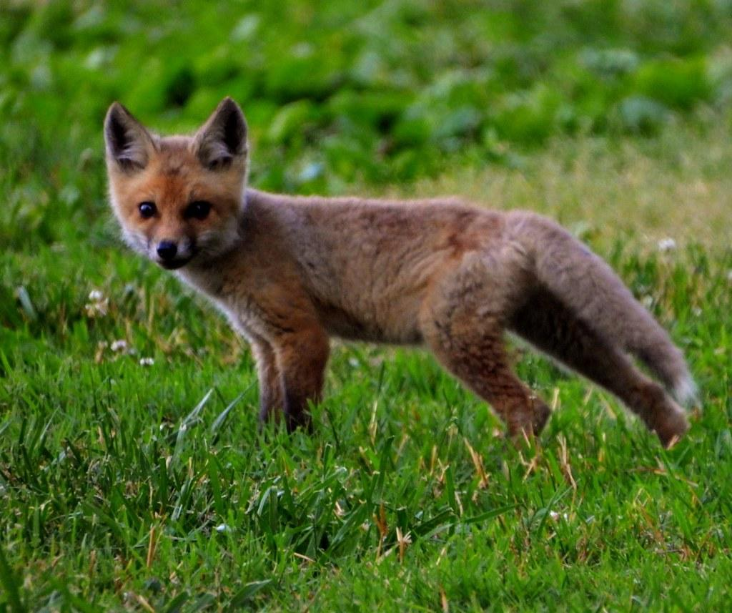
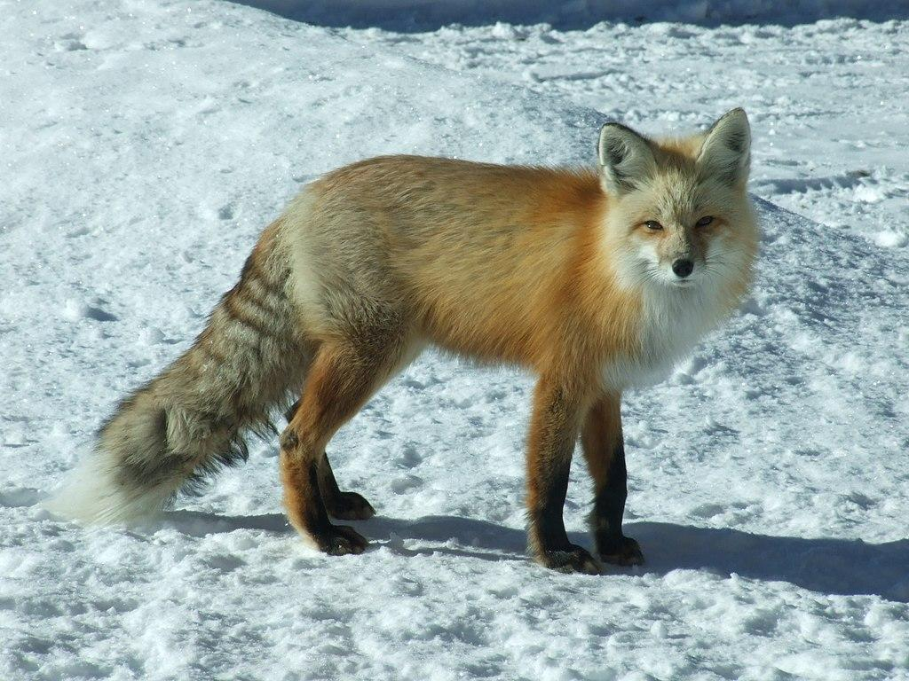
Red Fox
By Kenzie Harrison
Notes:
1 Background Color
1 Title (or write the question)
1 Pictures
0 Include Transitions
1 Answering question using complete sentences (multiple sentences if needed to fully explain your answer)
1 Accuracy of information
5
This slide has no transition.

Slide 2
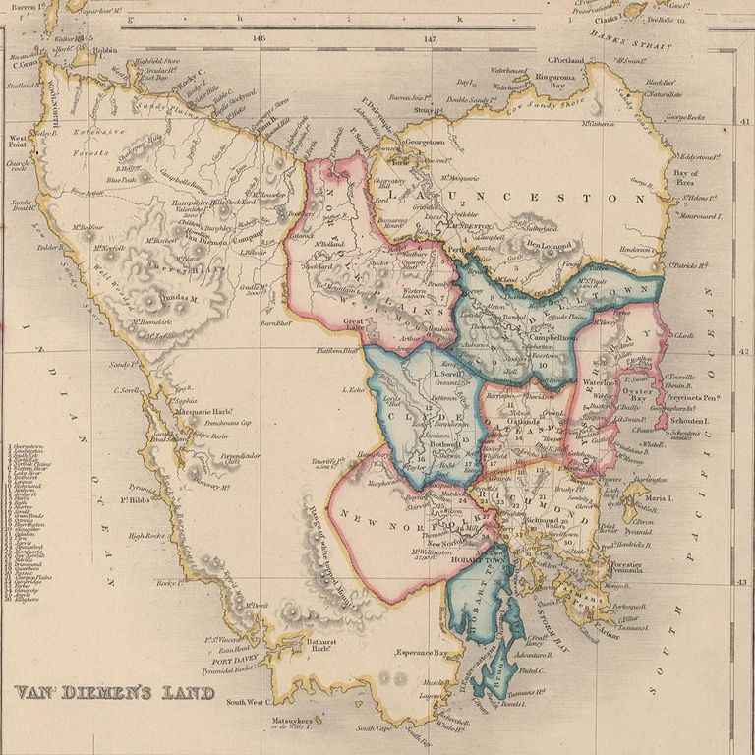
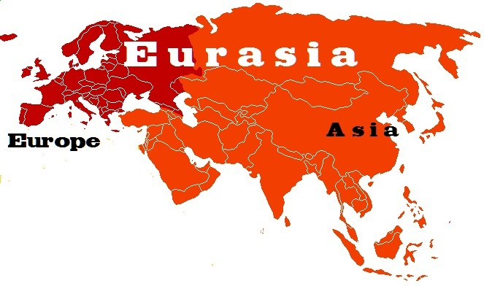
History of where the Red Fox came from
The Red fox originated from smaller sized ancestors from Eurasia. But they were introduced to the British colonies of Van Diemen’s land.
Notes:
1 Background Color
1 Title (or write the question)
1 Pictures
1 Include Transitions
0 Answering question using complete sentences (multiple sentences if needed to fully explain your answer)
1 Accuracy of information
5
Either use a sentence for the title or a label. So … History of the Red Fox… Or What is the history of where the Red fox came from?
…ancestors in Eurasia. Don’t start a sentence with”but”. There were introduced…..

Slide 3
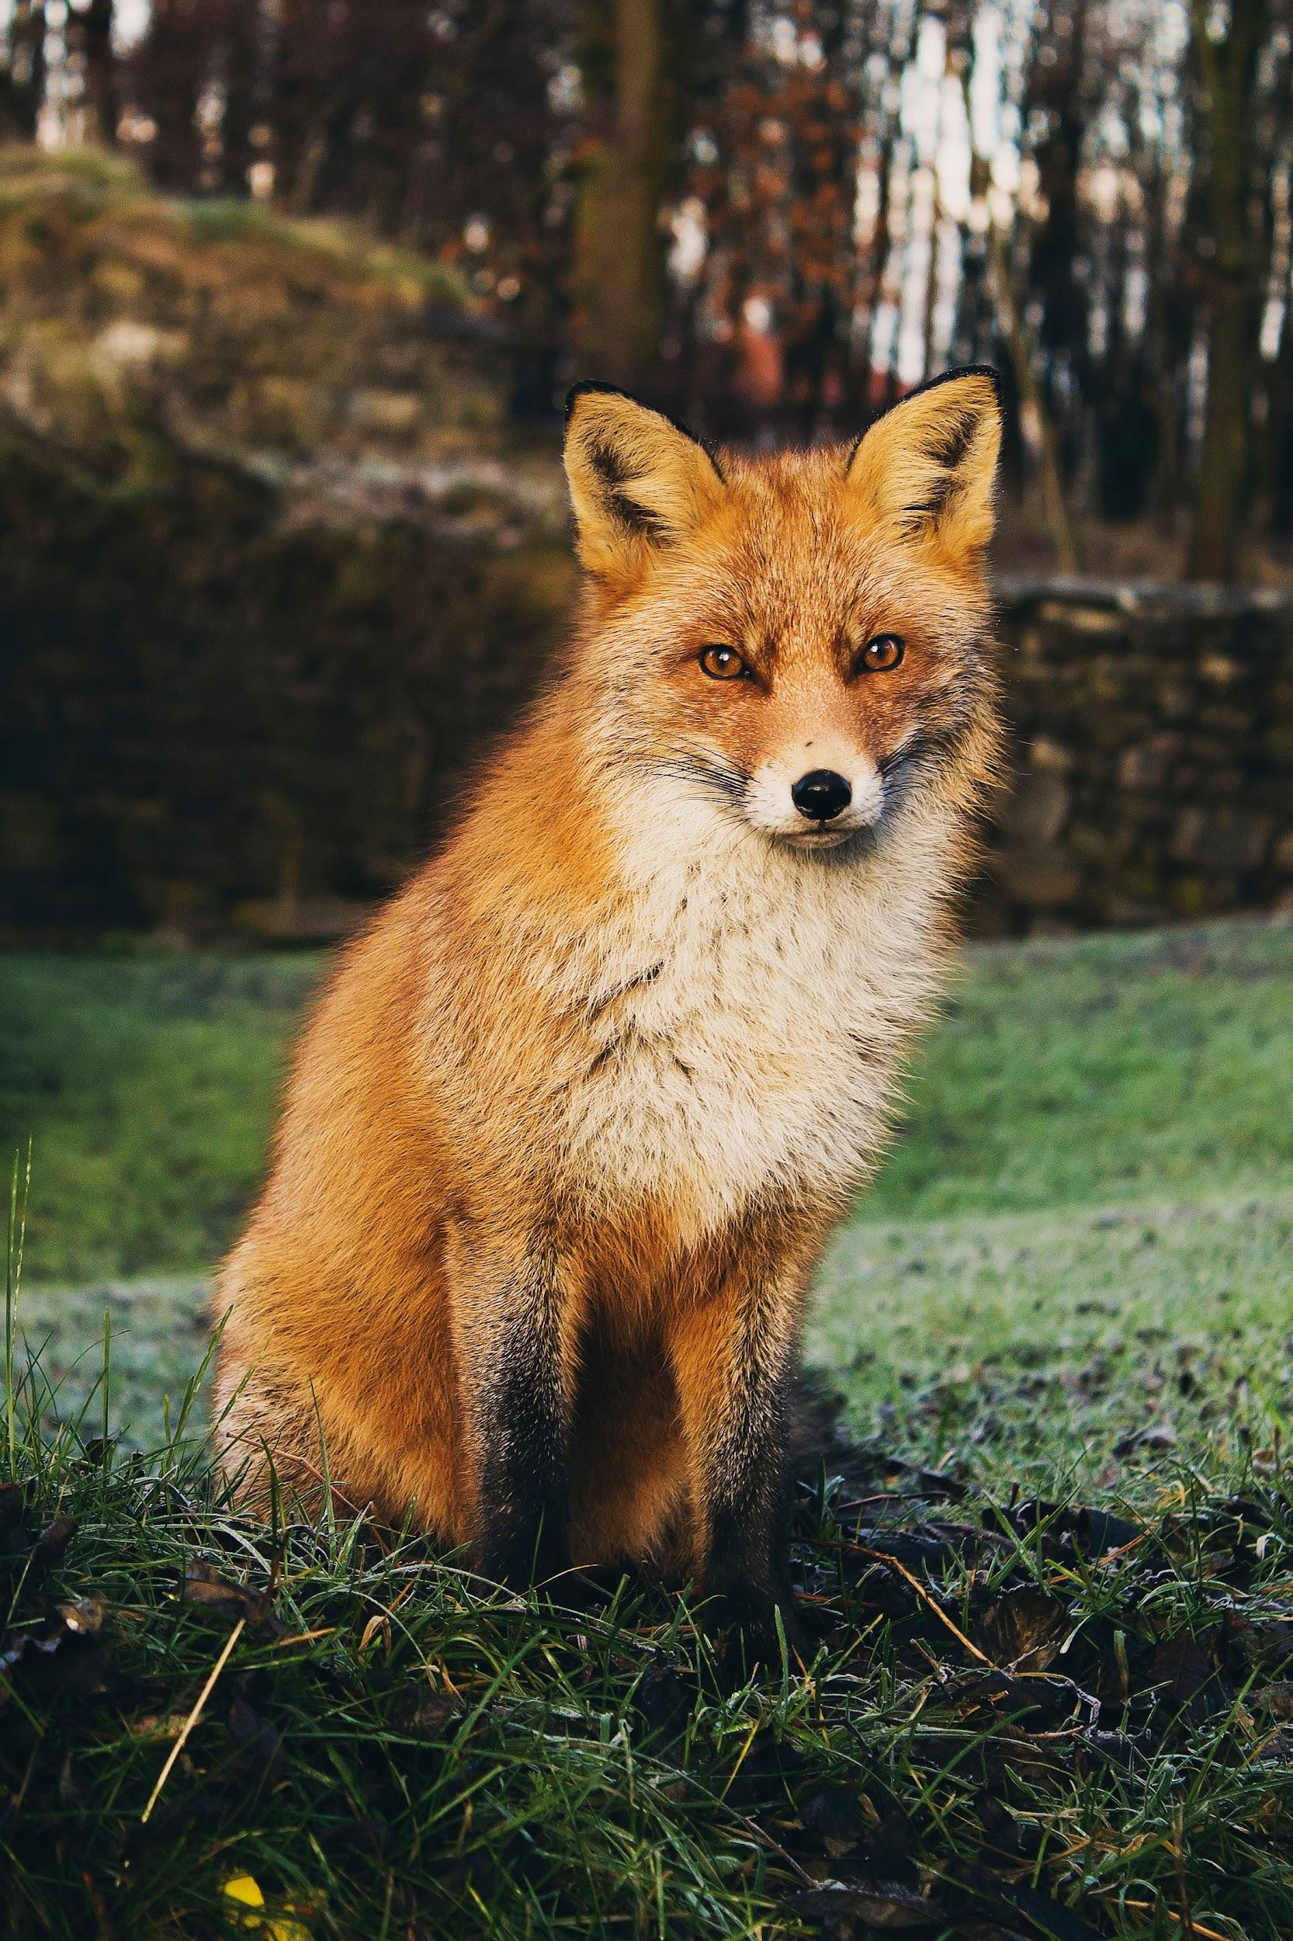
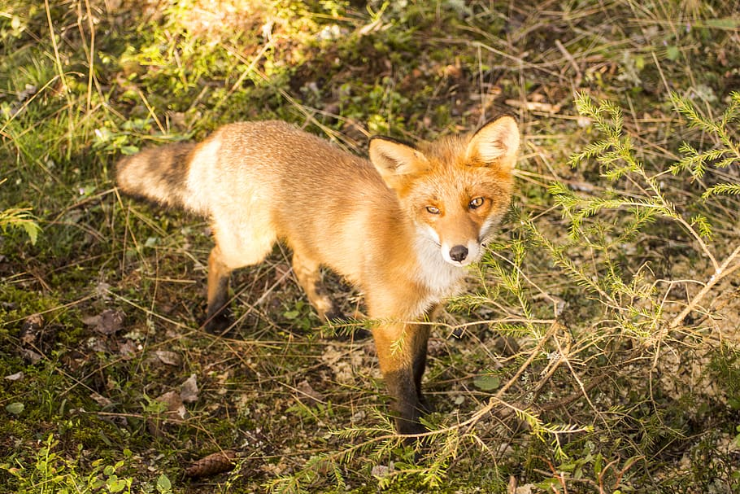
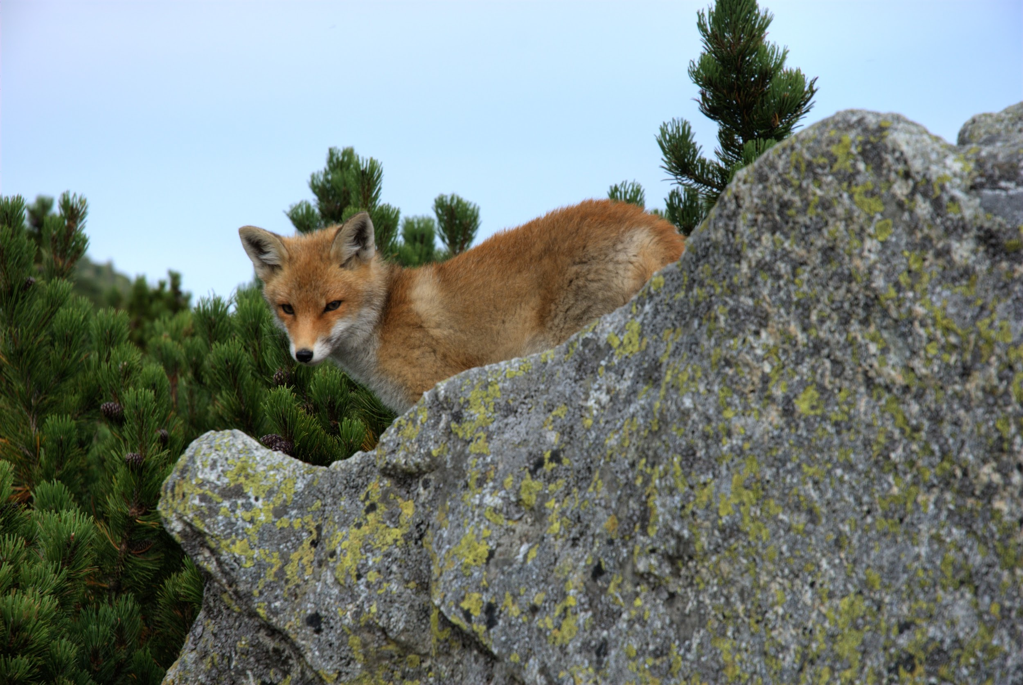
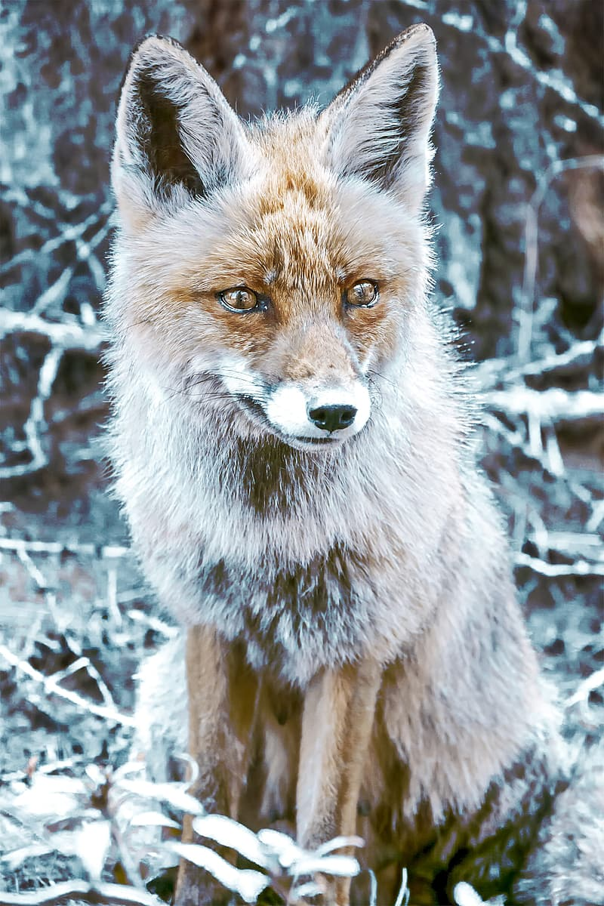
What ecosystem does the Red Fox live in?
Red foxes live around the world in many diverse habitats including forests, grasslands, mountains, and deserts. They also adapt well to human environments such as farms, suburban areas, and large communities.
Notes:
1 Background Color
1 Title (or write the question)
1 Pictures
1 Include Transitions
1 Answering question using complete sentences (multiple sentences if needed to fully explain your answer)
1 Accuracy of information
6

Slide 4
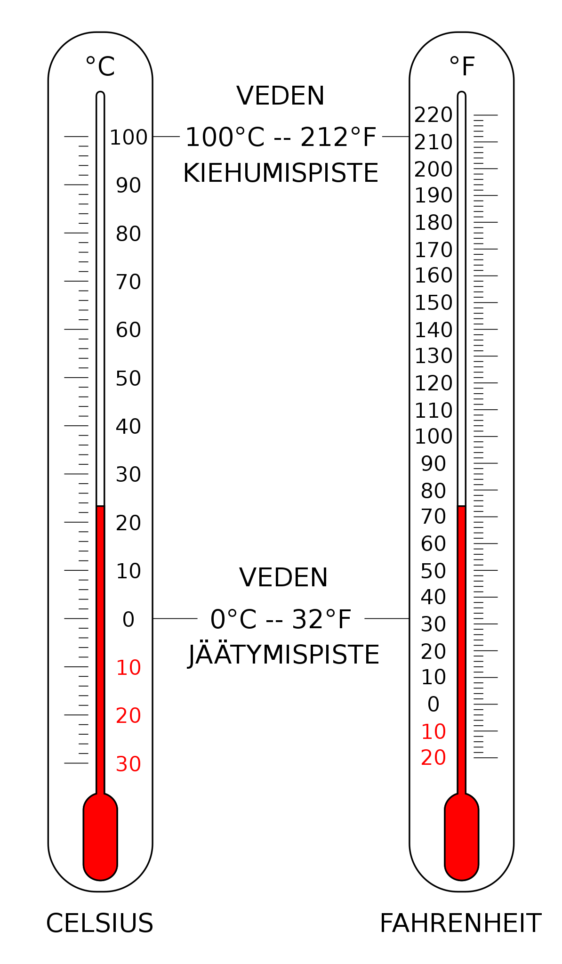
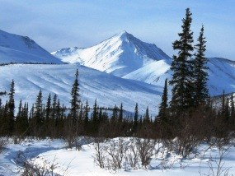
What is it like in the ecosystem?
Since they could live in different areas, The coldest that they could be in is -58°F -Only some could do -70°F
Notes:
1 Background Color
1 Title (or write the question)
1 Pictures
1 Include Transitions
0 Answering question using complete sentences (multiple sentences if needed to fully explain your answer)
1 Accuracy of information
5
…areas there is a broad range of temperatures. The coldest temperature they can live in is typically -58….. However, some have been found living in -70……

Slide 5
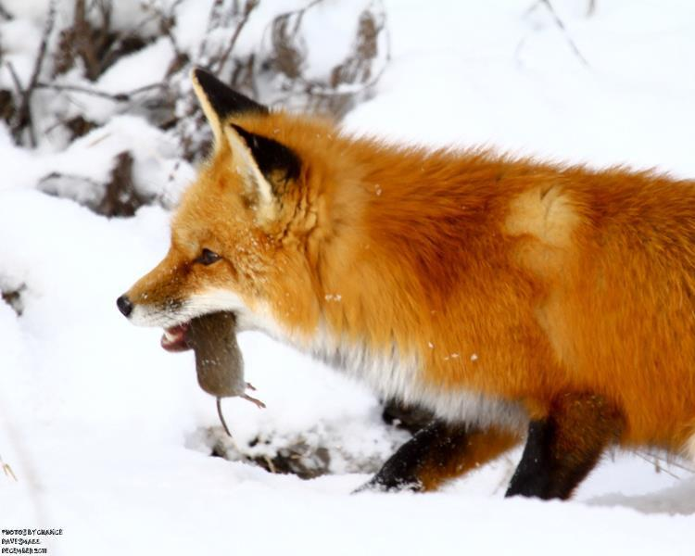
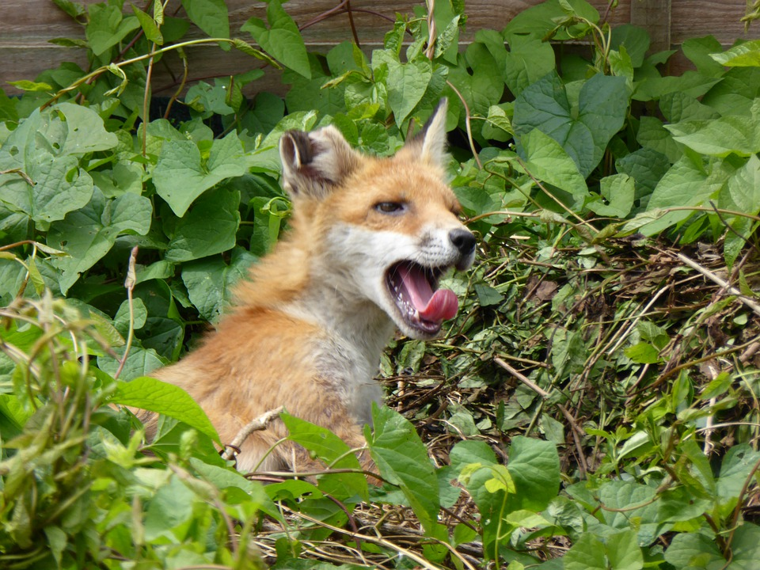
What type of consumer is a Red Fox?
This red fox is a consumer so, they are omnivores.
Notes:
1 Background Color
1 Title (or write the question)
1 Pictures
1 Include Transitions
0 Answering question using complete sentences (multiple sentences if needed to fully explain your answer)
1 Accuracy of information
5
…is a consumer, as they are omnivores.

Slide 6
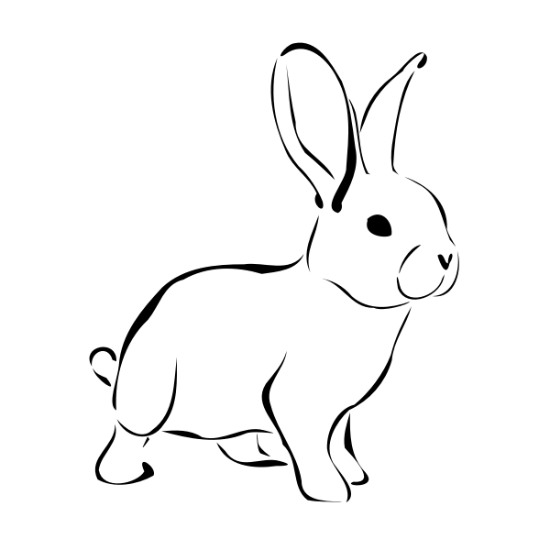
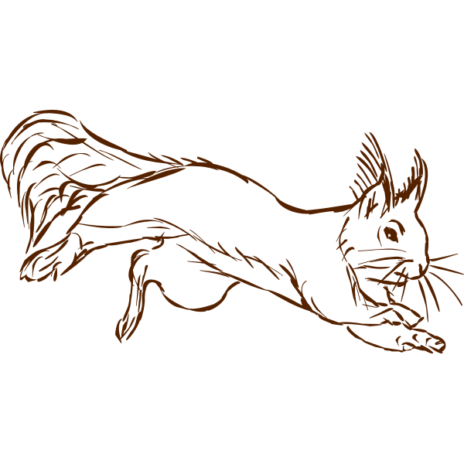
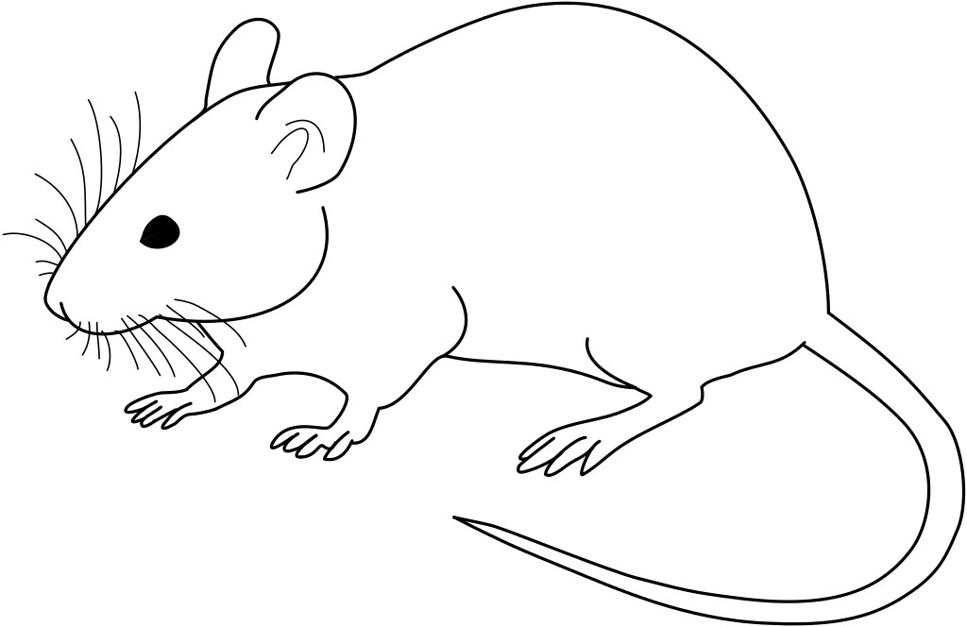

What foods do Red Foxes typically eat?
Red foxes eat small animals like voles, rats, mice, rabbits, squirrel, birds, and hares. This is about 50% of their diet.
Their favorite food is wild apples.
Notes:
1 Background Color
1 Title (or write the question)
1 Pictures
1 Include Transitions
0 Answering question using complete sentences (multiple sentences if needed to fully explain your answer)
1 Accuracy of information
5
..diet. However, their favorite….

Slide 7
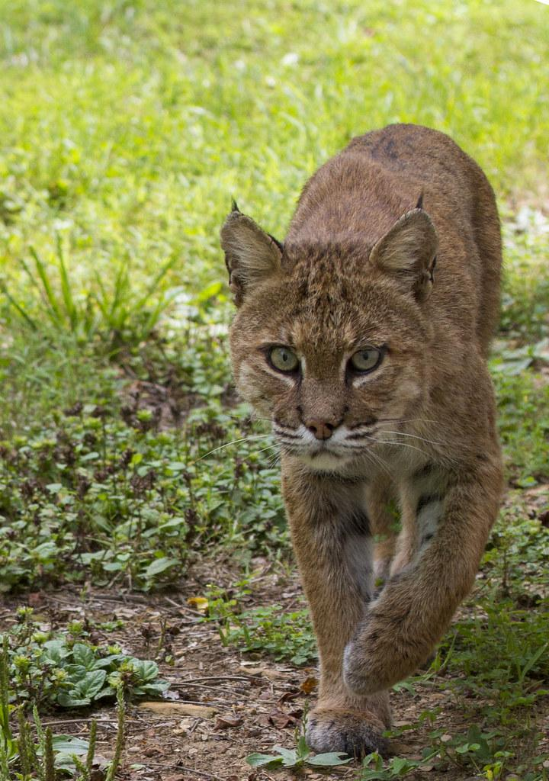
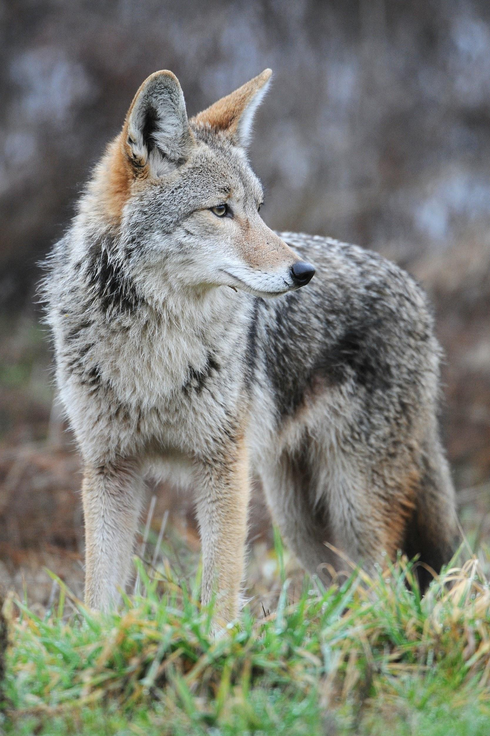
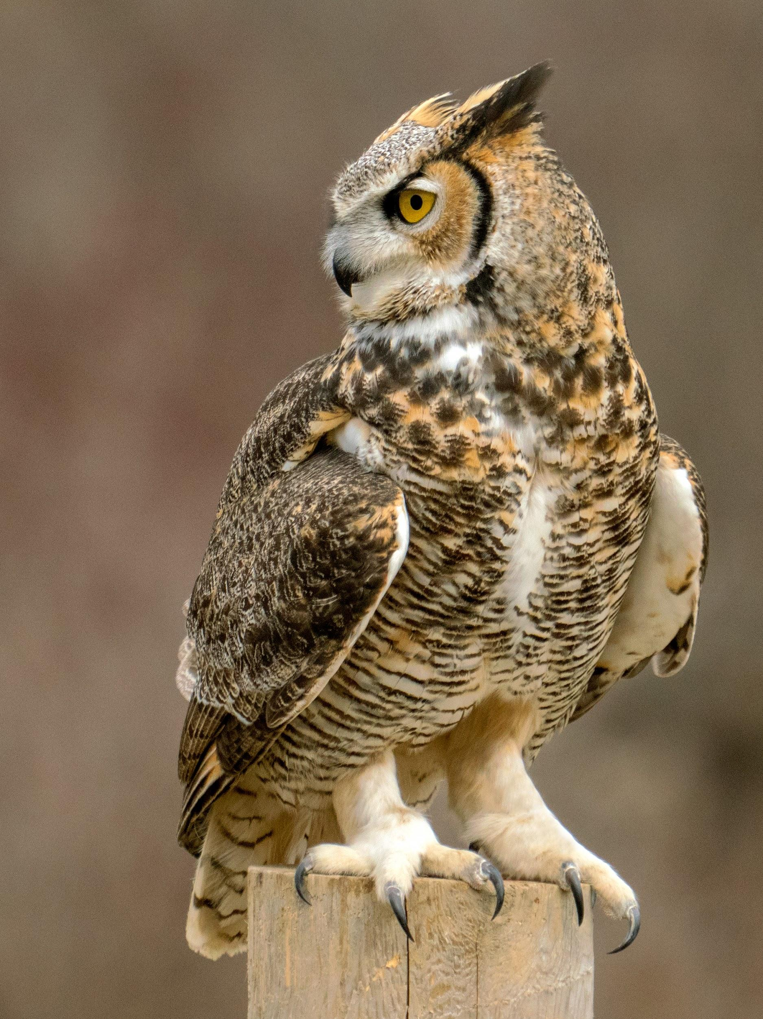
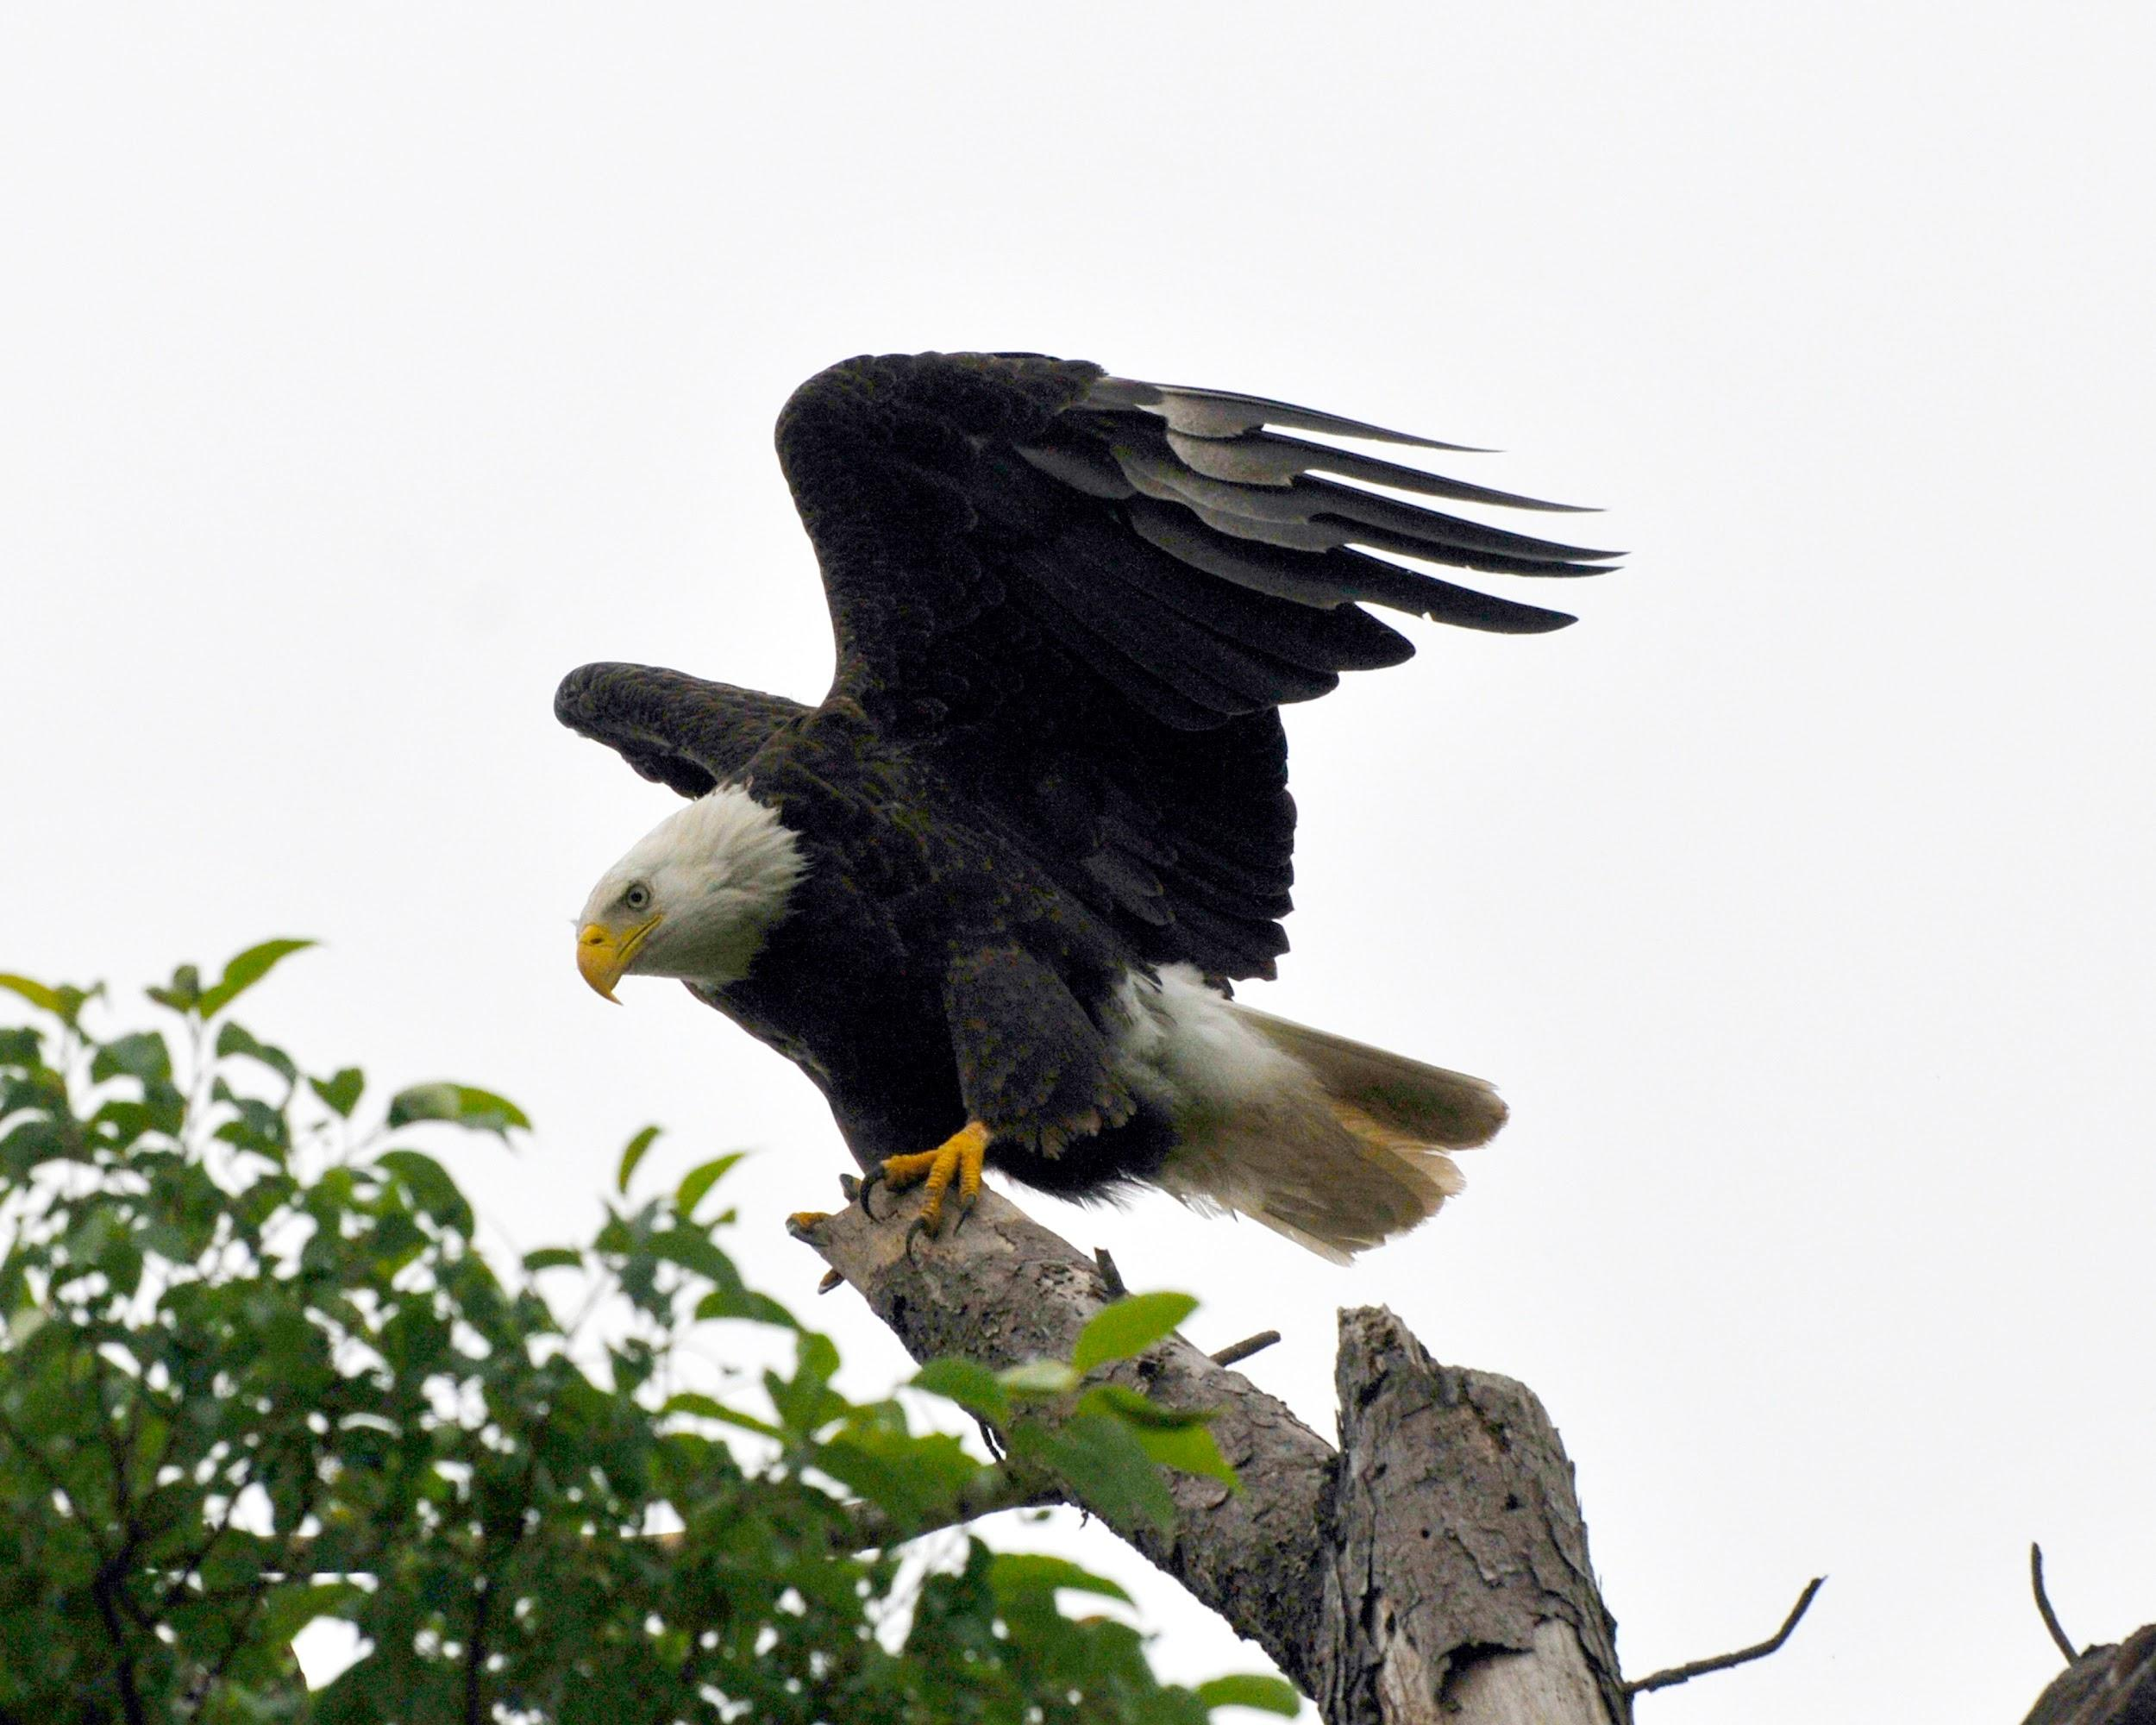
Does the Red Fox have any predators?
Red Foxes do have predators which are, coyotes, eagles, great horned owls, bobcats, and mountain lions.
Notes:
1 Background Color
1 Title (or write the question)
1 Pictures
1 Include Transitions
0 Answering question using complete sentences (multiple sentences if needed to fully explain your answer)
1 Accuracy of information
6

Slide 8
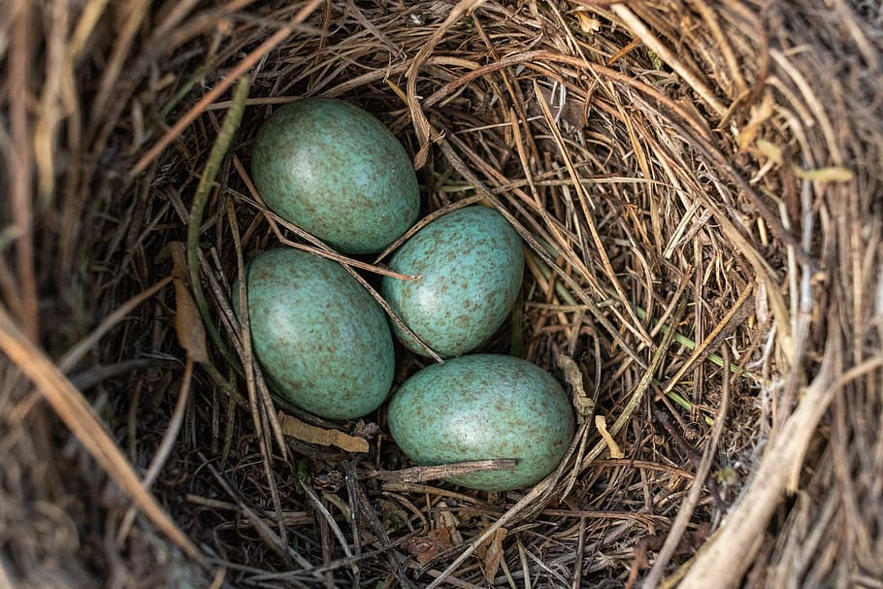
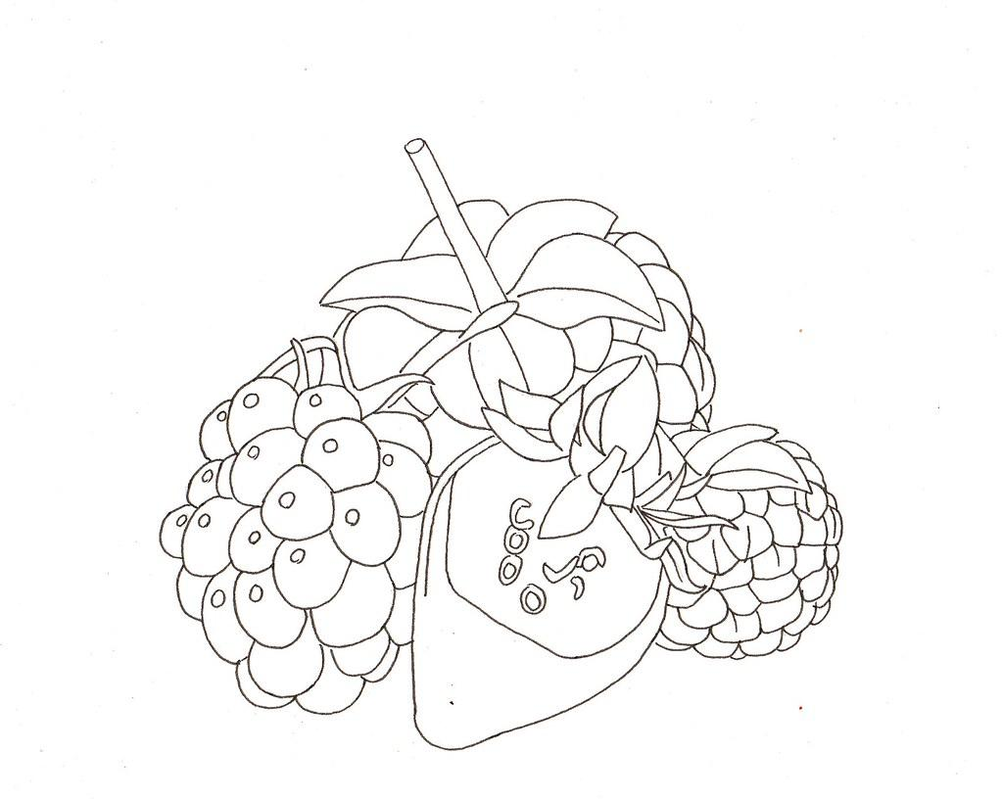
The typical food chain
Their food chain is definitely berries, fruits, seeds, and eggs.
Notes:
1 Background Color
1 Title (or write the question)
1 Pictures
1 Include Transitions
0 Answering question using complete sentences (multiple sentences if needed to fully explain your answer)
0 Accuracy of information
4
The Typical Food Chain (since its the title and not a sentence)
This is not a food chain. A food chan shows what their pray eats, what they eat, and what eats them.

Slide 9
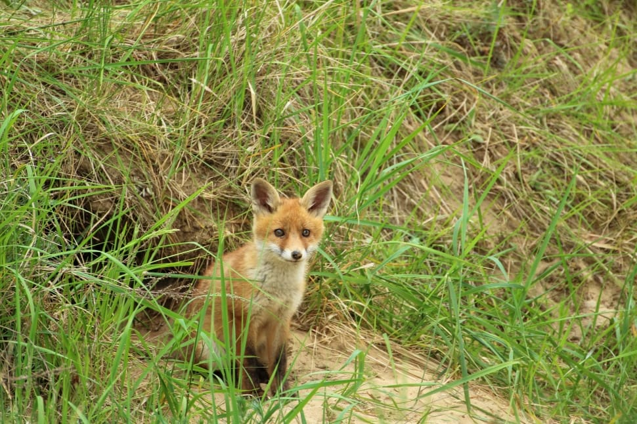
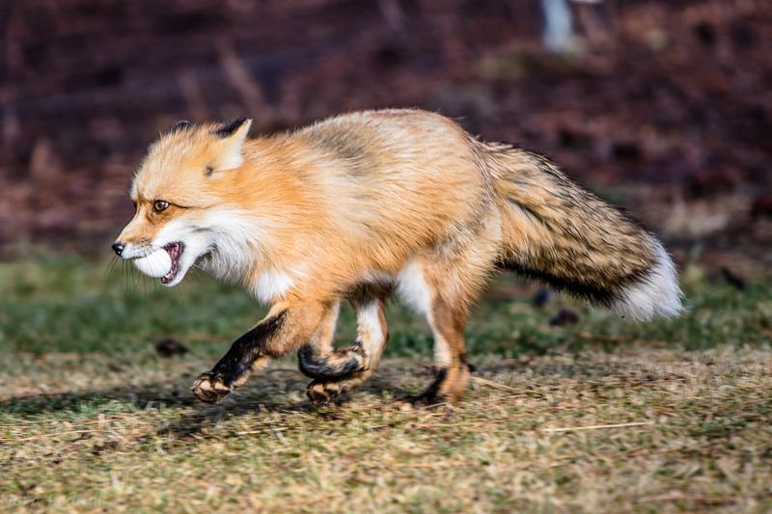
Adaptations to survive
Red foxes can run up to 30 miles per hour.
Long legs/slim body
Camouflage
Thick coat of fur
Notes:
1 Background Color
1 Title (or write the question)
1 Pictures
1 Include Transitions
0 Answering question using complete sentences (multiple sentences if needed to fully explain your answer)
1 Accuracy of information
5
Adaptations To Survive
Please use complete sentences in the paragraph.

Slide 10
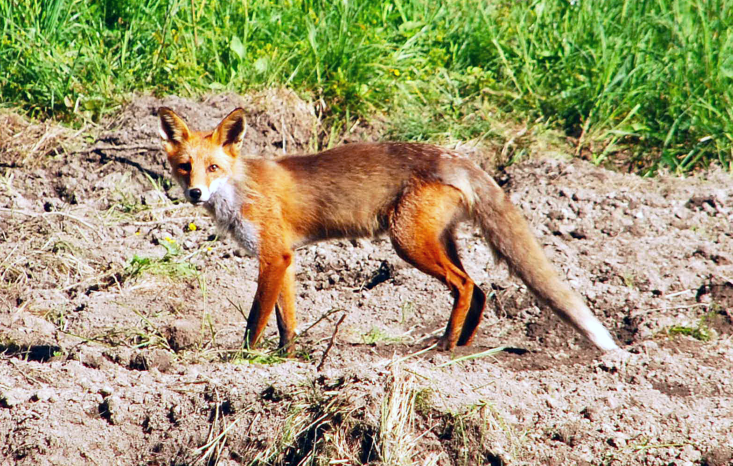
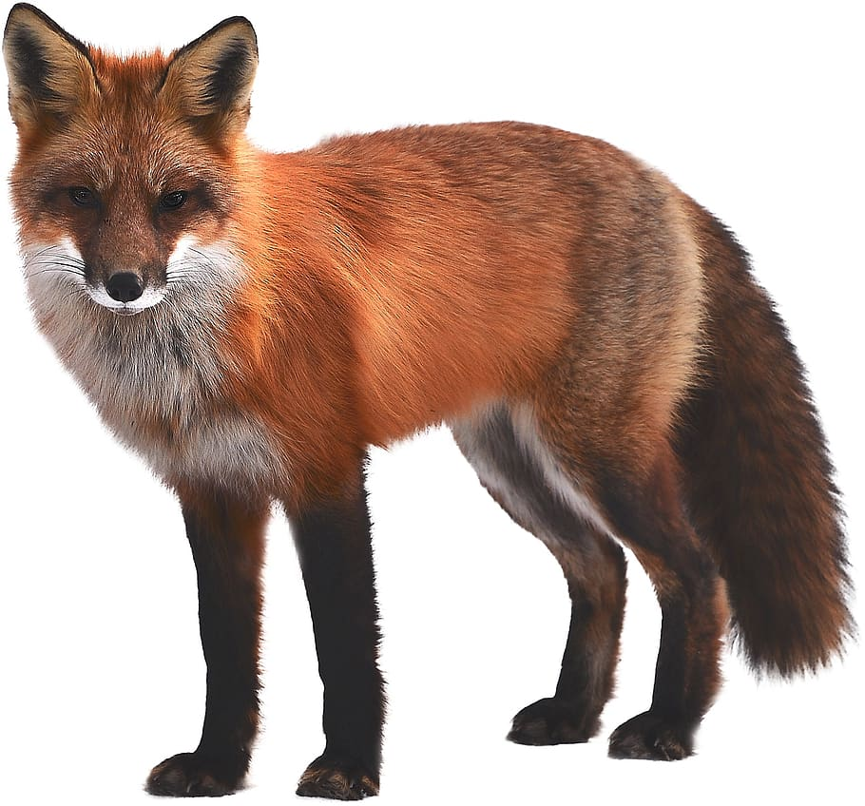
What does it look like?
The Red Fox is 14-20 inches or could also be 15 inches in length (Depends on the tail)
The weight range for a red fox is 6, 15 to 20 pounds (could depend on size/length)
Notes:
1 Background Color
1 Title (or write the question)
1 Pictures
1 Include Transitions
0 Answering question using complete sentences (multiple sentences if needed to fully explain your answer)
0 Accuracy of information
4
Delete or could be also 15 inches. This information is inaccurate .
18 – 35 in.
Adult, Without Tail

Slide 11
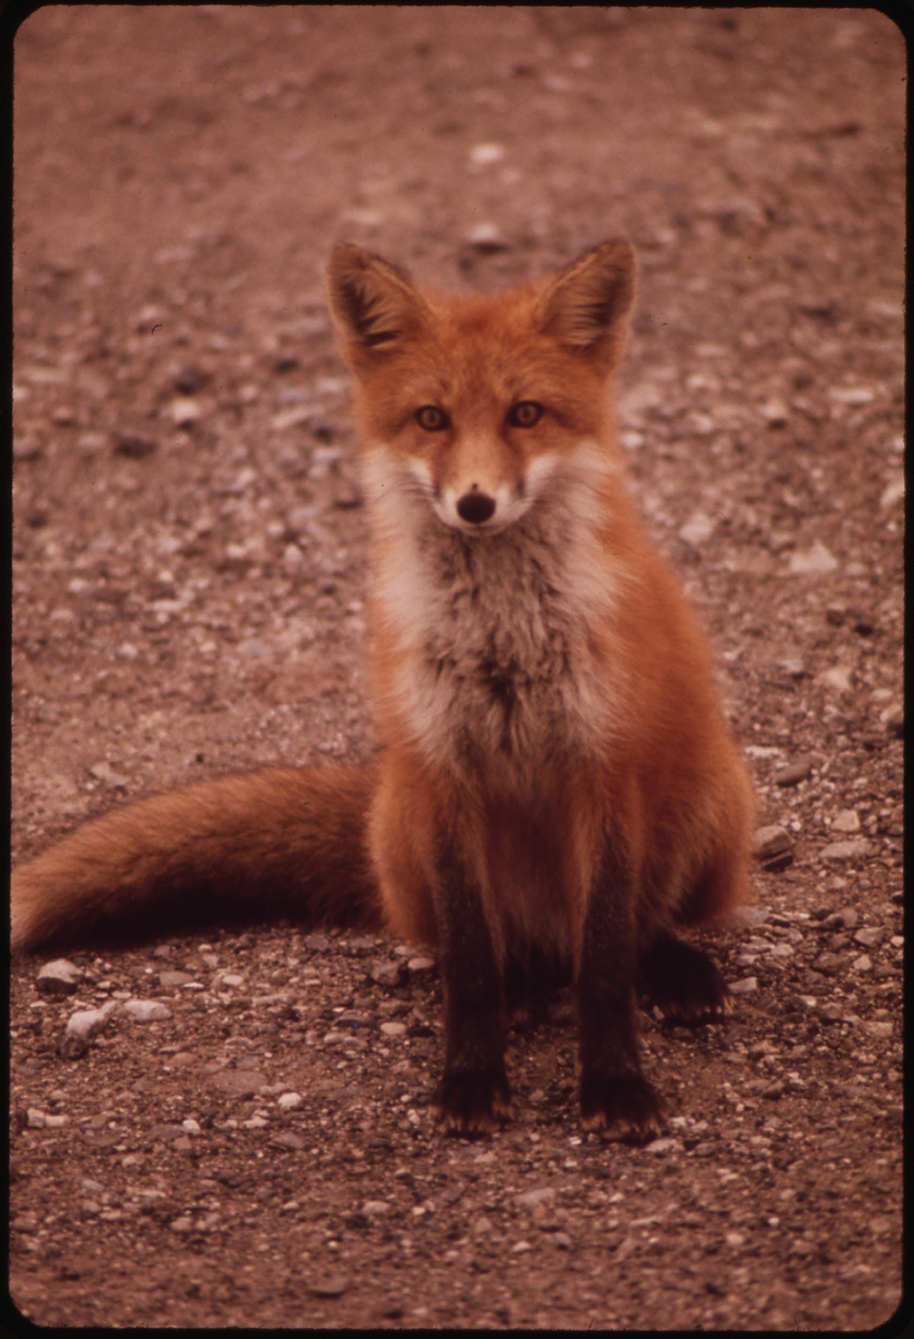
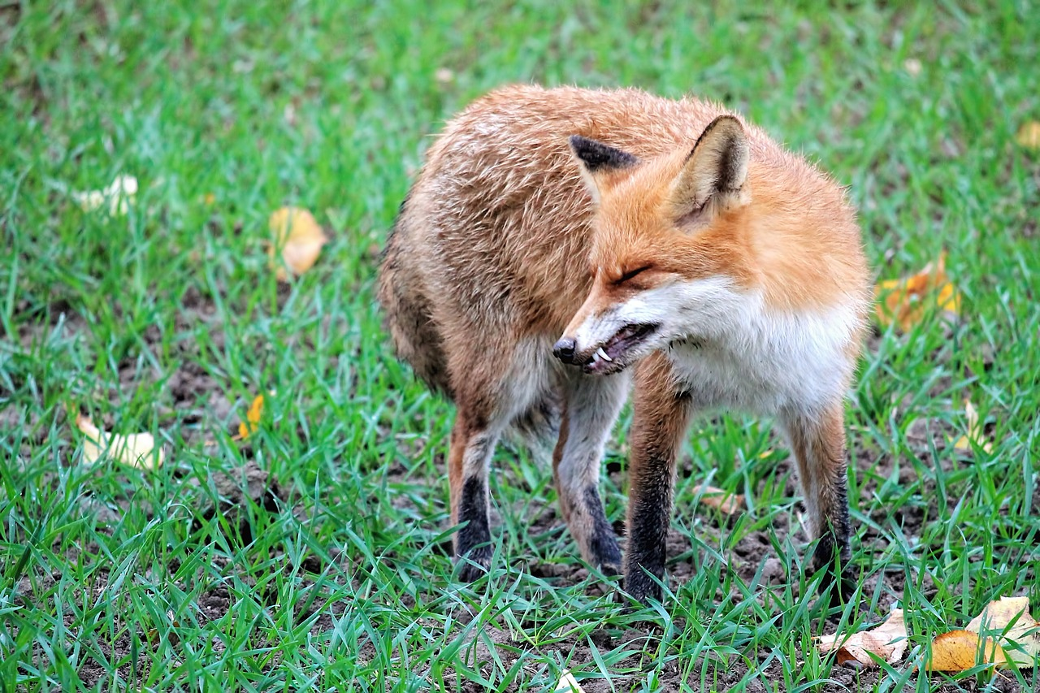
Do male and females weigh the same?
No they dont, males can weigh between 10-12 pounds
The female can weigh between 9-10
Notes:
1 Background Color
1 Title (or write the question)
1 Pictures
1 Include Transitions
0 Answering question using complete sentences (multiple sentences if needed to fully explain your answer)
0 Accuracy of information
5
..don’t or do not. Period after pounds… the word pounds is missing after 9-10. Every sentence ends with punctuation.

Slide 12
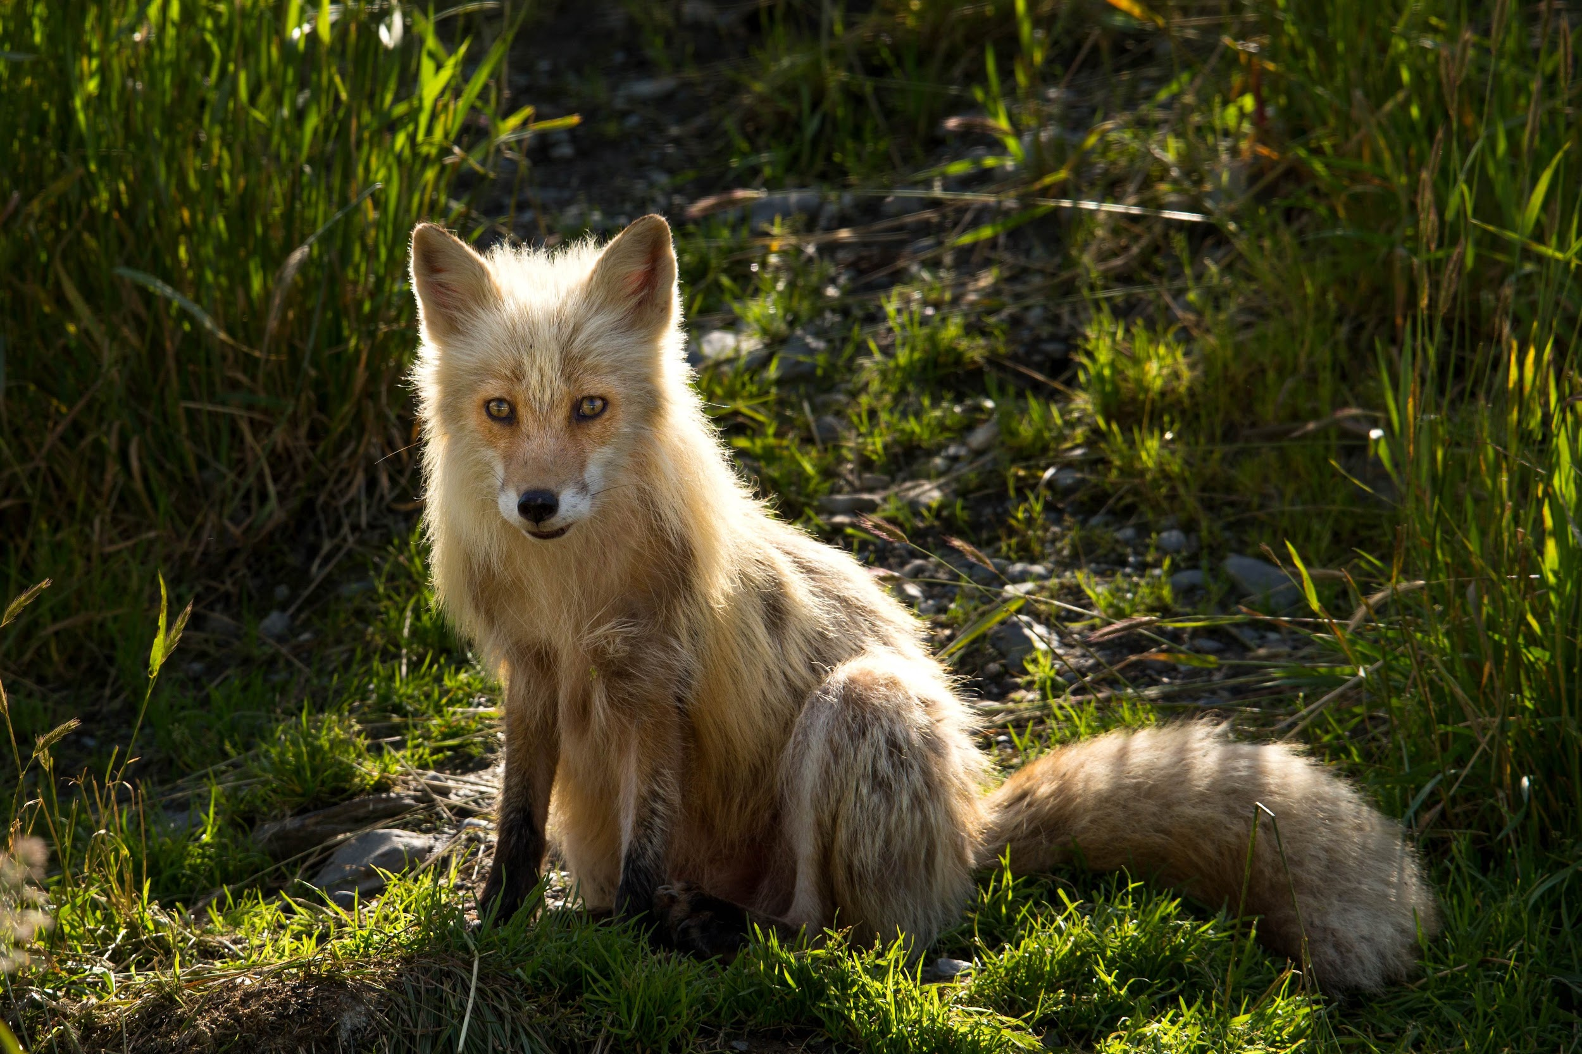
What's the lifespan?
The lifespan of a red fox is 3-4 years in the wild
Notes:
1 Background Color
1 Title (or write the question)
1 Pictures
1 Include Transitions
0 Answering question using complete sentences (multiple sentences if needed to fully explain your answer)
0 Accuracy of information
5
Every sentence ends with punctuation.

Slide 13
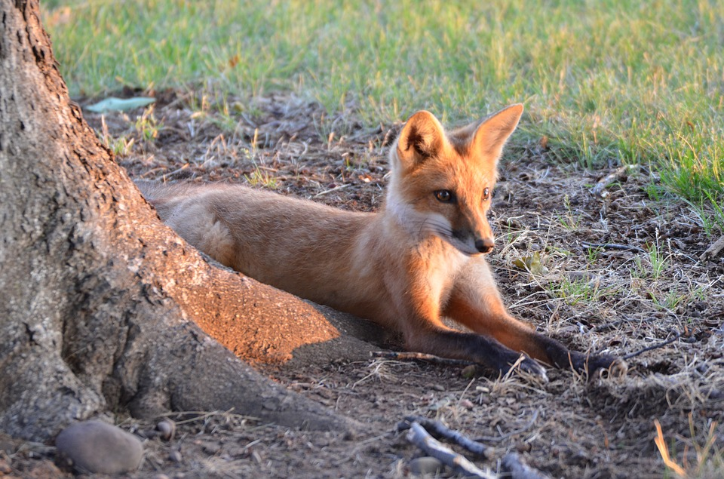
8 facts
Their forepaws have an extra toe
The females are called vixens
They have really good hearing
They don't make good house pets
When they are afraid, they grin
They choose one mate to be with for the rest of their life
There are 45 subspecies of a red fox
They could be found in about 80 countries
Notes:
1 Background Color
1 Title (or write the question)
1 Pictures
1 Include Transitions
0 Answering question using complete sentences (multiple sentences if needed to fully explain your answer)
0 Accuracy of information
5
Every sentence ends with punctuation.

Slide 14
Sources
https://www.treehugger.com/surprising-facts-about-the-red-fox-4864544
https://www.wildlifeonline.me.uk/animals/article/red-fox-longevity
https://forum.americanexpedition.us/red-fox-facts-information-and-photos
https://www.nwf.org/educational-resources/wildlife-guide/mammals/red-fox
Notes:
1 Background Color
1 Title (or write the question)
1 Pictures
1 Include Transitions
0 Answering question using complete sentences (multiple sentences if needed to fully explain your answer)
0 Accuracy of information
5
Either make them all hyperlinked or none of them. Stay with on font color.

