Slide 1
Crows
By Maira Khan
Notes:
1 Background Color
1 Title (or write the question)
1 Pictures
1 Include Transitions
1 Answering question using complete sentences (multiple sentences if needed to fully explain your answer)
1 Accuracy of information
6

Slide 2
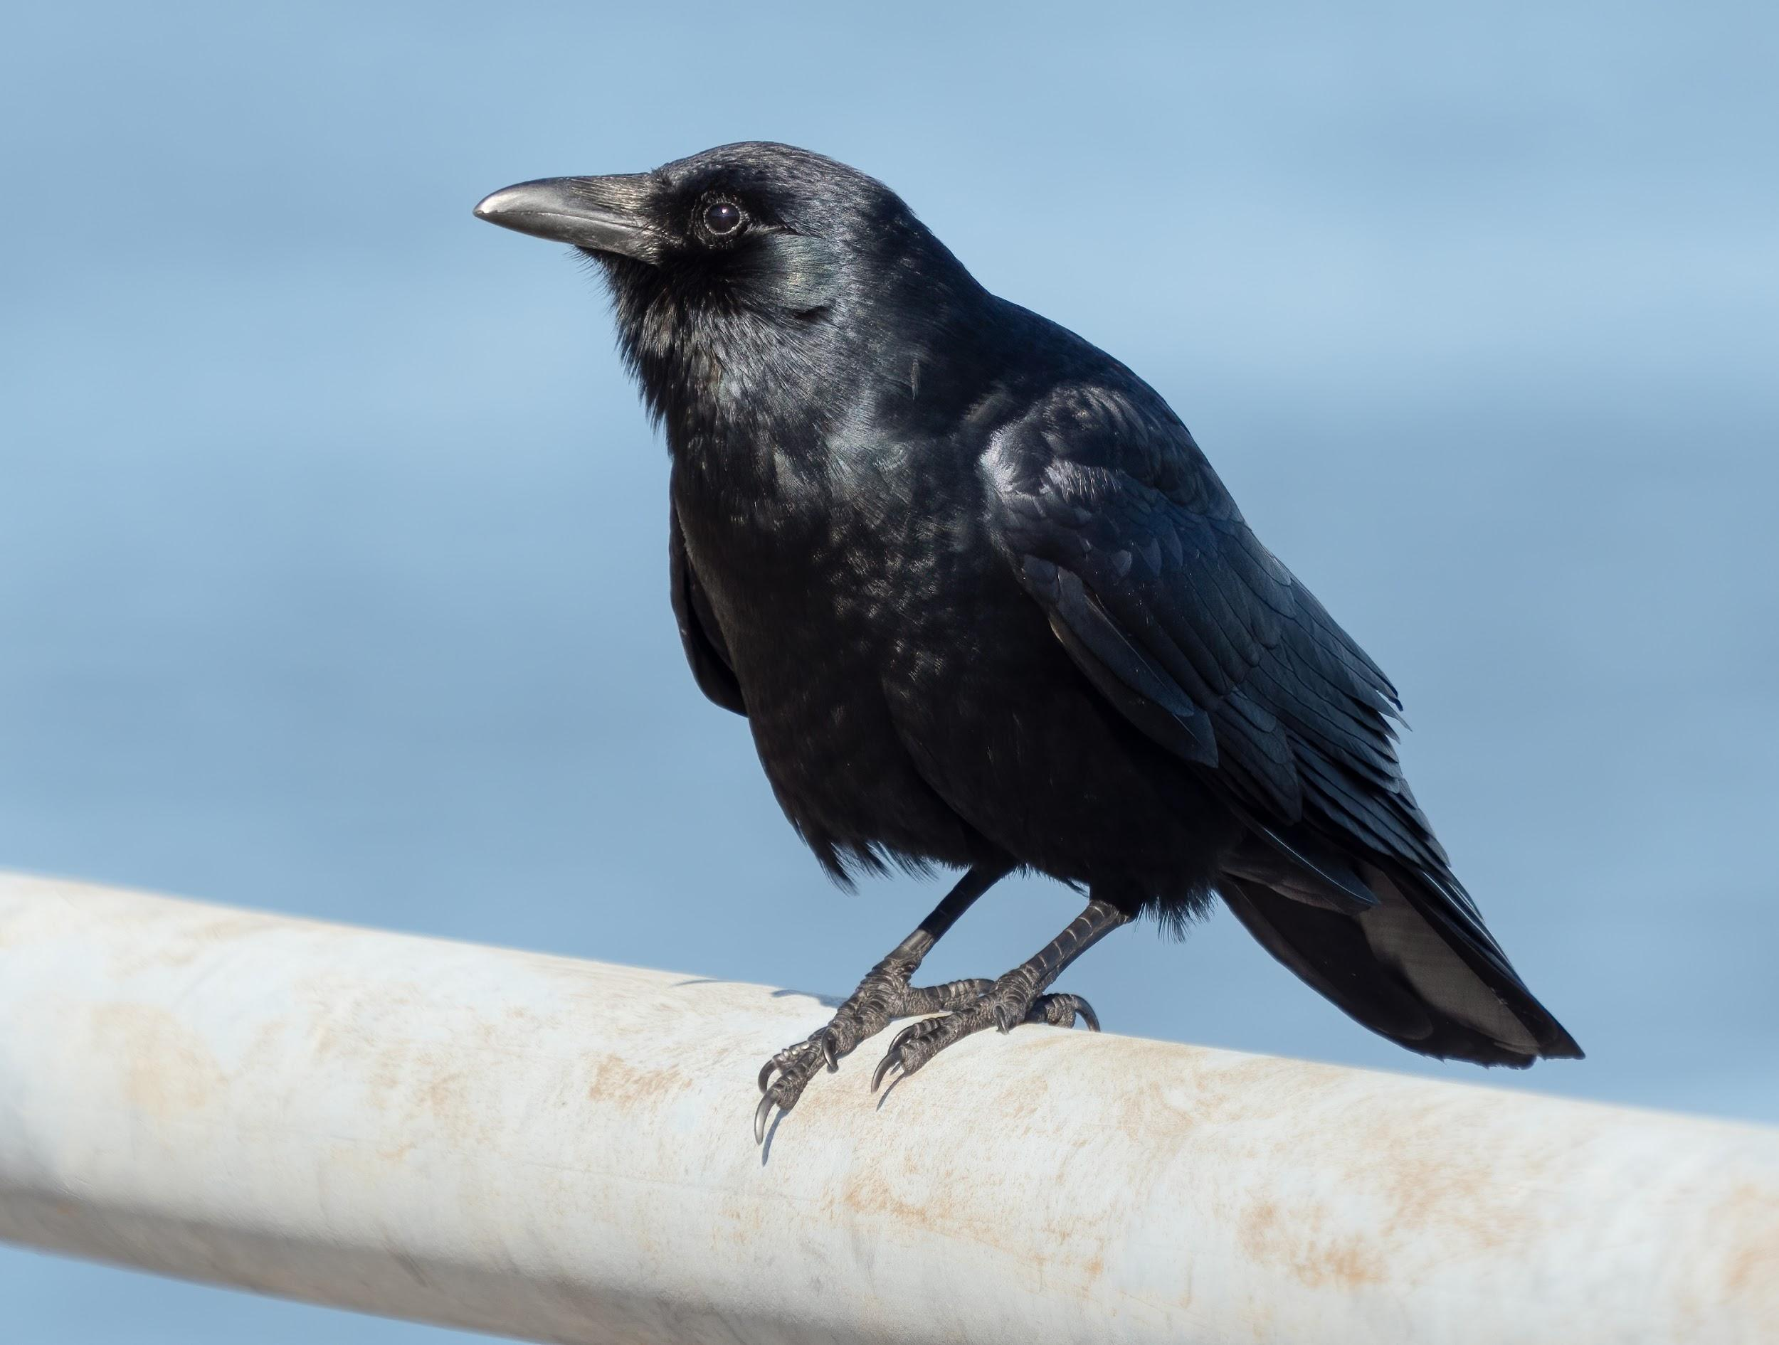
Where did crows originate from?
The Crows originated from The Palaearctic in the Miocene from where they dispersed to North America and around the world.
Source: Biomedcenteral.com
Fact 1: Crows are extremely intelligent creatures, they are known for their brilliant communication skills.
Notes:
1 Background Color
1 Title (or write the question)
1 Pictures
1 Include Transitions
0 Answering question using complete sentences (multiple sentences if needed to fully explain your answer)
1 Accuracy of information
5
Please remove the indent before “the”... also please place your facts on its own pages as well as your sources.

Slide 3
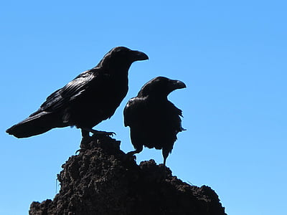
What ecosystem do crows live in?
Crows live in the grassland areas, they are the ideal areas for crows to forage their food.
Source: Animaldiversity.org
Fact 2: American crows will use nearby woodlots and forest edges for breeding and roosting.
Notes:
1 Background Color
1 Title (or write the question)
1 Pictures
1 Include Transitions
0 Answering question using complete sentences (multiple sentences if needed to fully explain your answer)
1 Accuracy of information
5
Please remove the indent before “the”... also

Slide 4
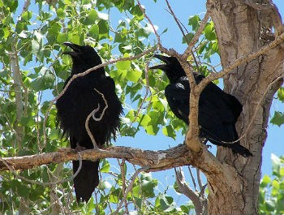
What is it like in a crows ecosystem?
They are common sights in treetops,
fields and roadsides. Crows mostly
feed on the ground and will most
likely eat anything. The weather is quite
humid in a crows habitat, quiet and peaceful.
Source: Allaboutbirds.org
Fact 3: Crows use only one of it’s eye at a time because of its monocular vision is more efficient than its binocular vision.
Notes:
1 Background Color
1 Title (or write the question)
1 Pictures
1 Include Transitions
0 Answering question using complete sentences (multiple sentences if needed to fully explain your answer)
1 Accuracy of information
5
please place your facts on its own pages as well as your sources.
…in treetops, fields, and roadsides. … in a crow’s habitat. The habitat is also quiet and peaceful.

Slide 5
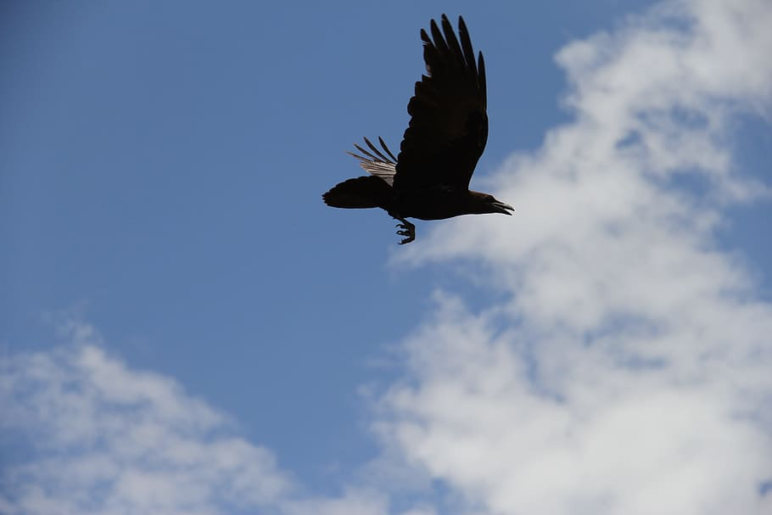
What type of consumer is a crow?
A crow is a scavenger type of consumer, they mostly feed on dead animals or leftovers.
Source: Onboces.org
Fact 4: Crows are often seen in darkened weather.
Notes:
1 Background Color
1 Title (or write the question)
1 Pictures
1 Include Transitions
0 Answering question using complete sentences (multiple sentences if needed to fully explain your answer)
1 Accuracy of information
5
please place your facts on its own pages as well as your sources.

Slide 6
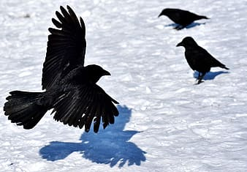
What specific food do crows usually eat?
Crows will most likely feed on dead animals, but, they do also eat fruits, seeds, fish, mammals, bird eggs, mollusks and insects.
Source: Abcbirds.org
Fact 5: Crows are extremely resourceful creatures, they are only primates, and they use and make tools.
Notes:
1 Background Color
1 Title (or write the question)
1 Pictures
1 Include Transitions
0 Answering question using complete sentences (multiple sentences if needed to fully explain your answer)
1 Accuracy of information
5
Please remove the indent before “Crows”... also please place your facts on its own pages as well as your sources.

Slide 7
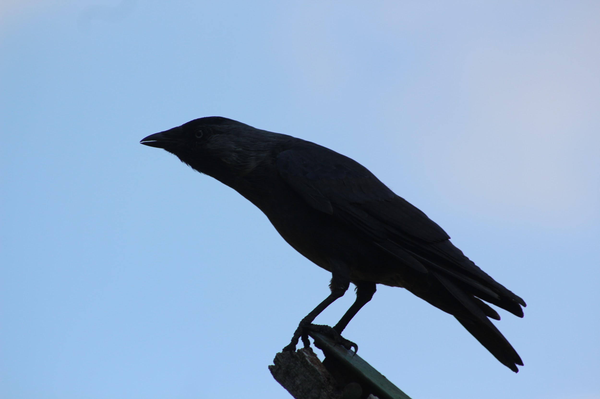
Do crows have any predators?
The main enemies and predators of a crow include: hawks, racoons, eagles, owls, squirrels, and humans.
Source: Pestpointers.com
Fact 6: Crows symbolize, adaptability, cleverness, cunningness, and intelligence.
Notes:
1 Background Color
1 Title (or write the question)
1 Pictures
1 Include Transitions
0 Answering question using complete sentences (multiple sentences if needed to fully explain your answer)
1 Accuracy of information
5
please place your facts on its own pages as well as your sources.

Slide 8
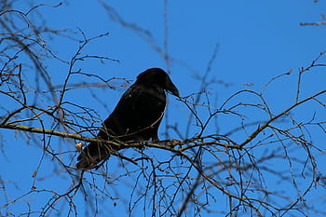
What is the typical food chain for crows?
The food chain of an American crow are, insects, worms, larvae, grains, nuts, fruits, eggs, and nestlings from other birds. The food chain of an Pied crow are, seeds, peanuts, fruits, eggs, carrion, lizards, and garbage.
Source: Bioexplorer.com
Fact 7: The latin name for crow is Corvus.
Notes:
1 Background Color
1 Title (or write the question)
1 Pictures
1 Include Transitions
0 Answering question using complete sentences (multiple sentences if needed to fully explain your answer)
0 Accuracy of information
4
This is not a food chain. A food chain would show that a worm eats , then a crow eats a worm, a cat eats a crow…. Etc. ... also please place your facts on its own pages as well as your sources.

Slide 9
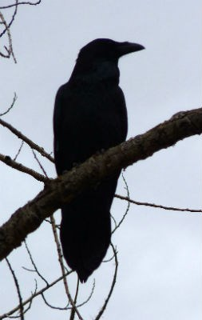
Do crows have specific adaptations to help it survive?
Crows adapt in many ways, especially in survival, the crow has a large, strong, and curved bill which helps it grasp onto prey and be able to eat many kinds of food.
Source: Bioweb.com
Fact 8:
Crows have large forebrains, an adaptation to life in a challenging environment.
Notes:
1 Background Color
1 Title (or write the question)
1 Pictures
1 Include Transitions
0 Answering question using complete sentences (multiple sentences if needed to fully explain your answer)
1 Accuracy of information
5
please place your facts on its own pages as well as your sources.

Slide 10

What do crows look like?
Crows are large birds, with long legs, and heavy straight bills, they are entirely black in color. They have distinct feathers on their upper backs with an opalescent quality. In height the crow measures around 17.5 inches, in weight crows weigh about 0.7 to 1.4 Ibs.
Source: Crittercontrol.com
Fact 9: Crows could be considered one of the most intelligent animals in the world, due to their adaptability and cunningness.
Notes:
1 Background Color
1 Title (or write the question)
1 Pictures
1 Include Transitions
0 Answering question using complete sentences (multiple sentences if needed to fully explain your answer)
1 Accuracy of information
5
Pplease place your facts on its own pages as well as your sources.

Slide 11
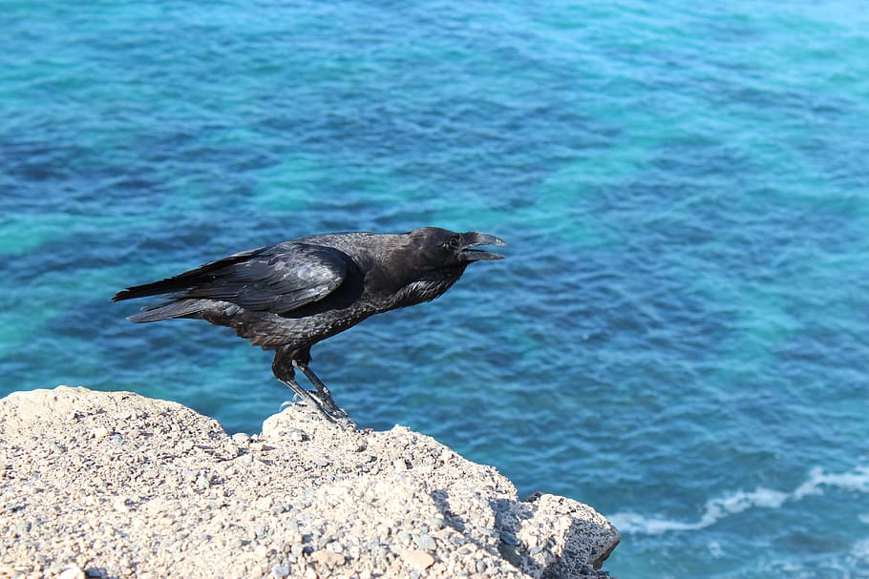
Male and Female crows
The male and female crows look identical, however, the male crow is just a few inches larger than the female crow.
Source: swnewsmedia.com
Fact 10:
The crow originates from the family Corvidae.
Notes:
1 Background Color
1 Title (or write the question)
1 Pictures
1 Include Transitions
0 Answering question using complete sentences (multiple sentences if needed to fully explain your answer)
1 Accuracy of information
5
please place your facts on its own pages as well as your sources.
Since the title is not a sentence use capital letters. Male And Female Crows..

Slide 12
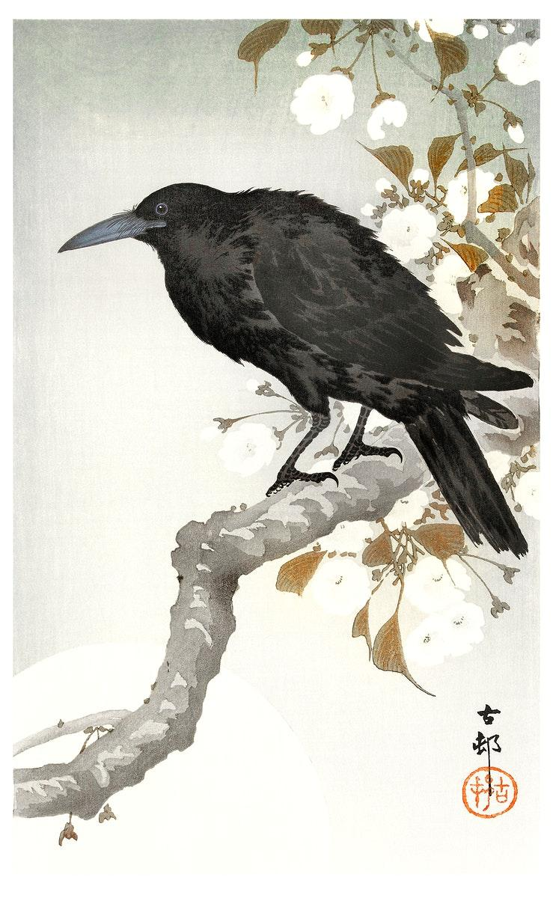
A crows life span
The average crow can live up to 7 - 8 years if not 10 - 15.
Source: Wikpedia.org
Fact 11: A crow never forgets a human face, especially a mean on.
Notes:
1 Background Color
1 Title (or write the question)
1 Pictures
1 Include Transitions
0 Answering question using complete sentences (multiple sentences if needed to fully explain your answer)
1 Accuracy of information
5
please place your facts on its own pages as well as your sources.
The title is not a sentence so… A Crows Lifespan Lifespan is oneword.

Slide 13
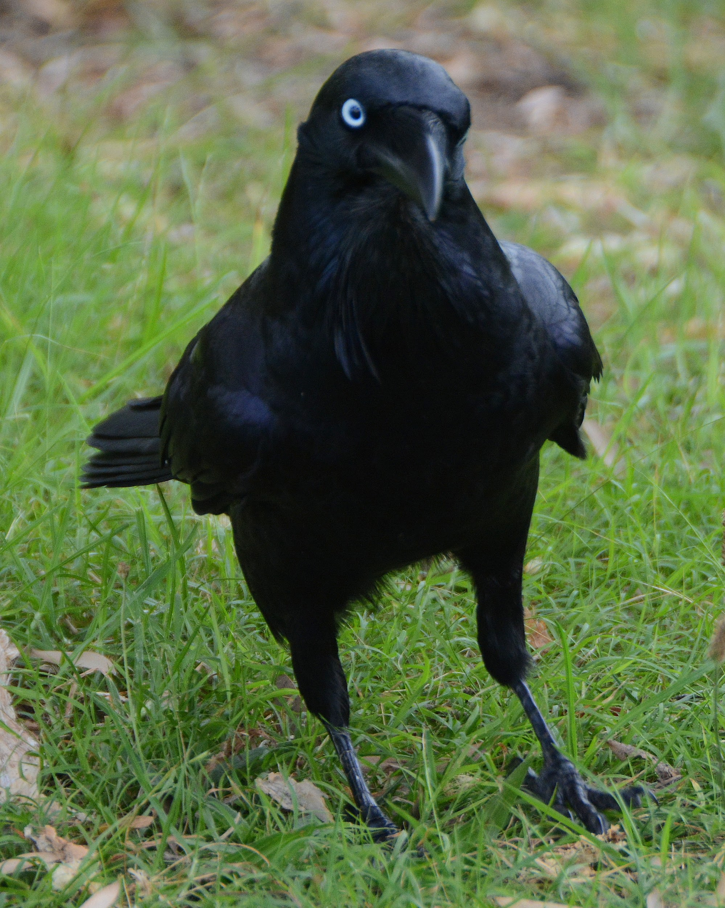
Crow facts
1: There are many species of the crow, such as the Fish Crow, Northwestern Crow, and the Tamaulipa Crow.
2: Crows can often be confused with Raves, due to their similar appearances, to distinguish these too, the crow has a smaller and much narrow beak than the common Raven.
Source: Audbon.org
Notes:
You are missing two slides for a total of 12 points deducted for that alone.

Slide 14
Crow facts
3: Crows and Ravens are both part of the same genus, The Corvus, there are more than 40 different species in the genus.
4: Research shows that crows often hold funerals, or “wakes” when a crow finds a dead corpse it will send an alert others in the area.
Source: Audbod.org

