Slide 1
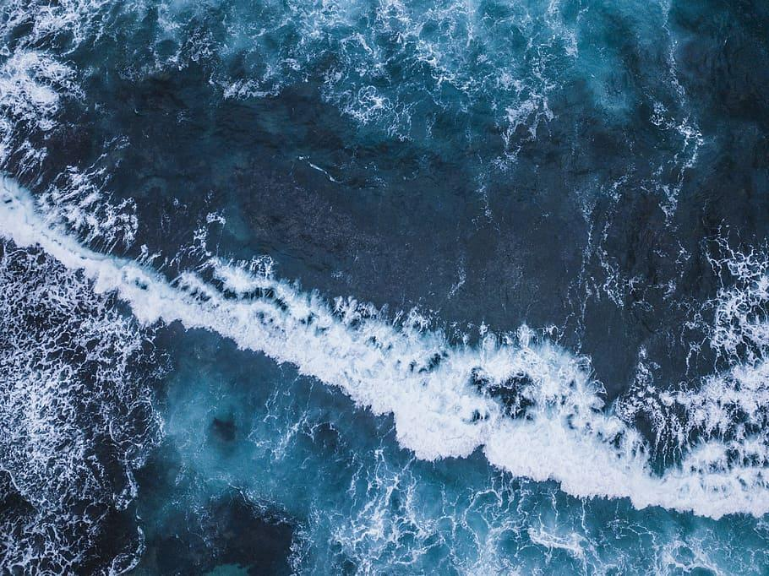
Creature Project
By Olivia Renfrow
Notes:
1 Background Color
1 Title (or write the question)
1 Pictures
1 Include Transitions
1 Answering question using complete sentences (multiple sentences if needed to fully explain your answer)
1 Accuracy of information
6

Slide 2
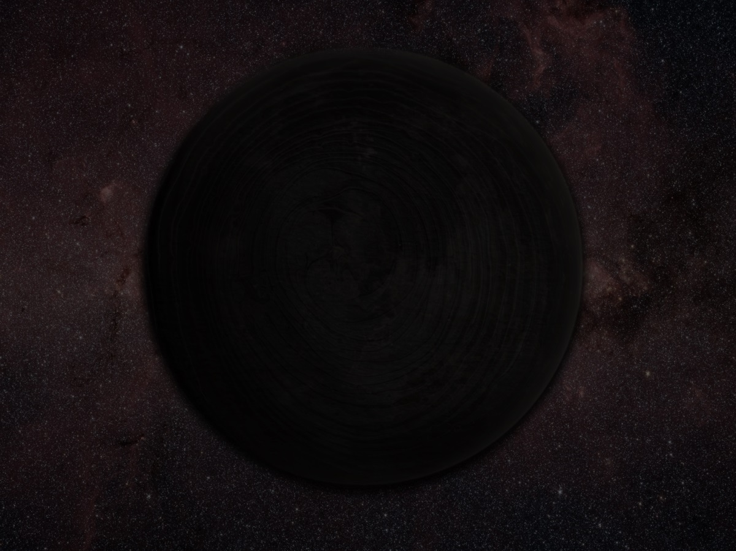
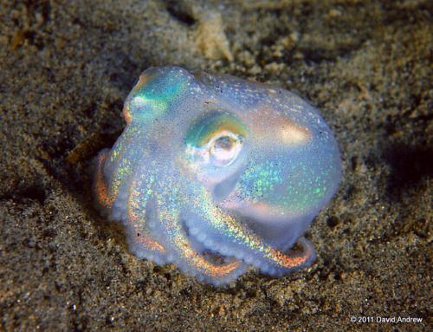
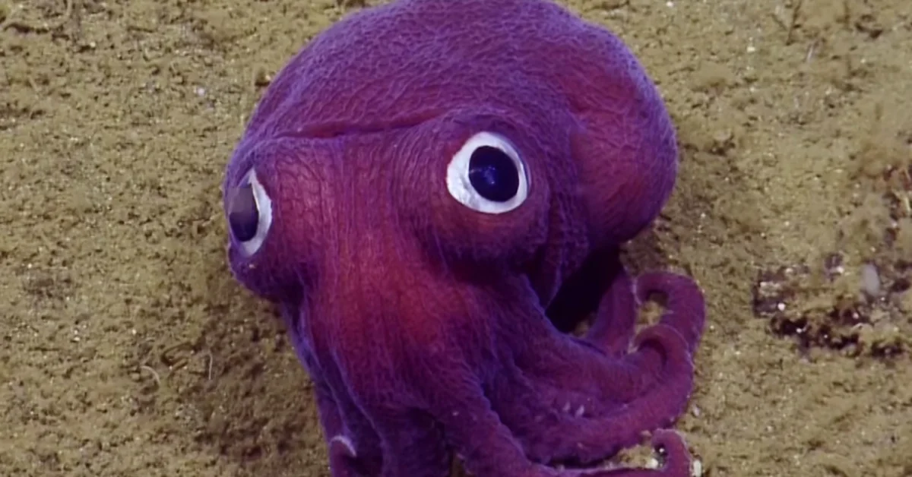
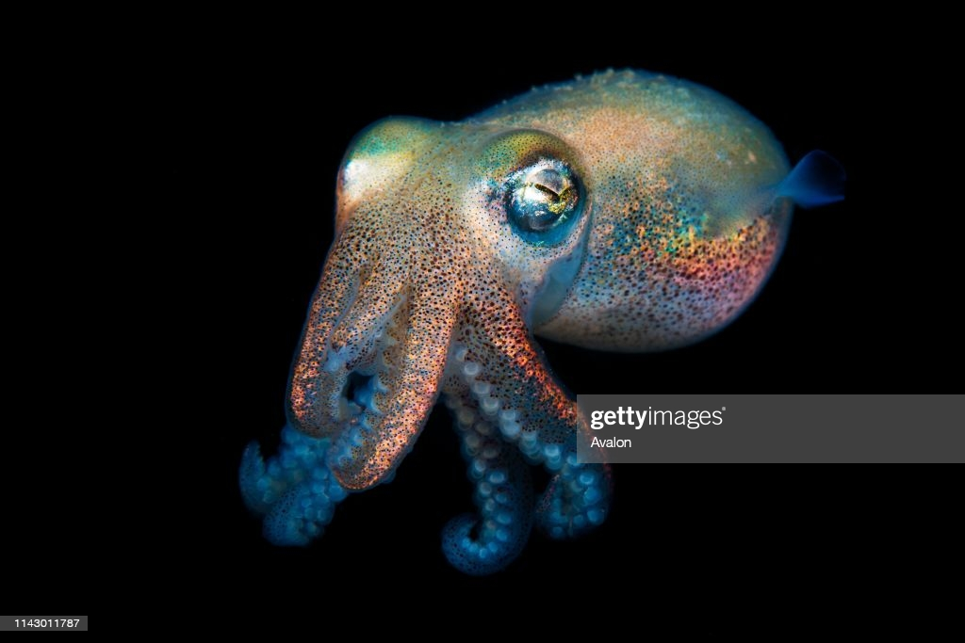
Rossia Pacifica
Notes:
1 Background Color
1 Title (or write the question)
1 Pictures
1 Include Transitions
1 Answering question using complete sentences (multiple sentences if needed to fully explain your answer)
1 Accuracy of information
6

Slide 3
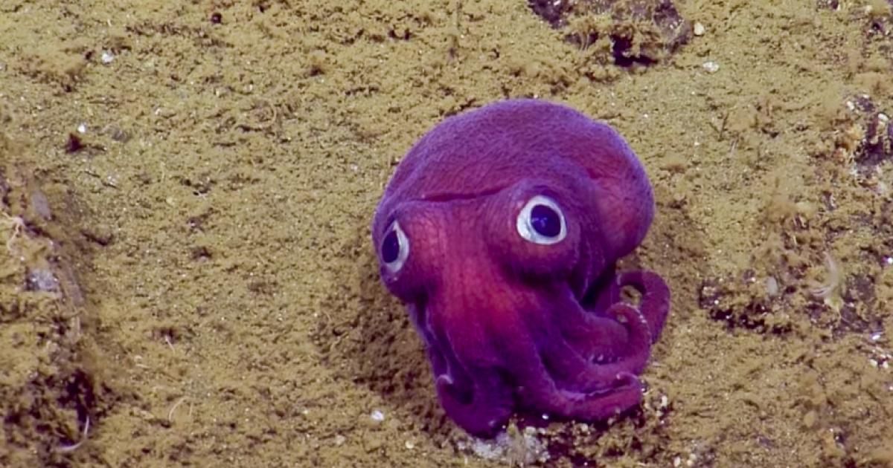
What is a Rossia pacifica?
Rossia pacifica, also known as the stubby squid, is a species of bobtail squid. It usually occurs in winter on sandy slopes away from strong currents in moderately shallow water. In summer it moves to deeper water where it breeds.
https://youtu.be/lEhYJEQmExE
.wikipedia.org/wiki/Rossia_pacifica
Notes:
1 Background Color
1 Title (or write the question)
0 Pictures
1 Include Transitions
0 Answering question using complete sentences (multiple sentences if needed to fully explain your answer)
1 Accuracy of information
4
Place a question mark on the title… ….It usually can be seen in winter…… Please put all site references on the last page. This slide has no picture.

Slide 4
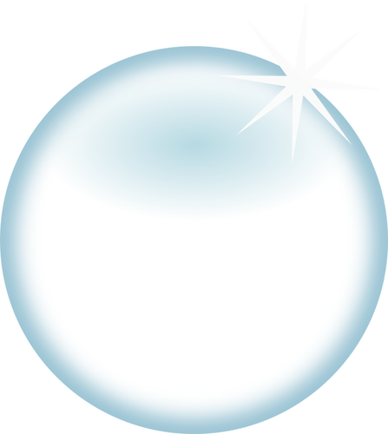
Where do Rossia pacificas come from?
Rossia pacifica come from the northern Pacific Ocean and can be found in the waters between Japan and Southern California.
This is also their ecosystem.
picture
https://marinesanctuary.org/
Notes:
1 Background Color
1 Title (or write the question)
0 Pictures
1 Include Transitions
0 Answering question using complete sentences (multiple sentences if needed to fully explain your answer)
1 Accuracy of information
4
Please put all site references on the last page. This slide has no picture.

Slide 5

What is their ecosystem like?
Average sea surface temperature along the North pacific coast (NPC) can range in the winter from 45-61°F (7.2-16.1°C) and in the summer months 64°F-74°F (17.8-23.3°C).
North Pacific Coast has some very humid months, and slightly dry months in the opposite season.
picture
https://championtraveler.com/
Notes:
1 Background Color
1 Title (or write the question)
0 Pictures
1 Include Transitions
0 Answering question using complete sentences (multiple sentences if needed to fully explain your answer)
1 Accuracy of information
4
To use NPC you have to first write North Pacific Ocean (NPC) then you can use NPC after that. Please put all site references on the last page. This slide has no picture.

Slide 6
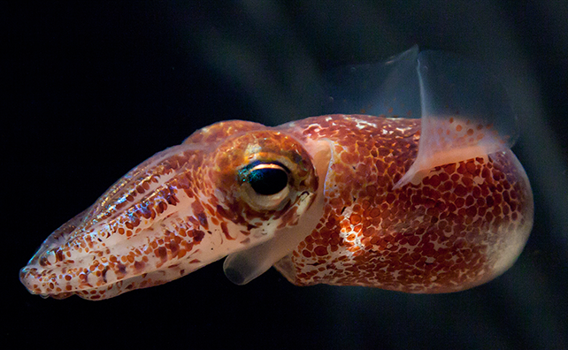
What type of a consumer is it?
A Rossia Pacifica is highly adapted for raptorial feeding and a carnivorous diet.
https://animaldiversity.org/accounts/Rossia_pacifica
Notes:
1 Background Color
1 Title (or write the question)
1 Pictures
1 Include Transitions
0 Answering question using complete sentences (multiple sentences if needed to fully explain your answer)
1 Accuracy of information
5
Please put all site references on the last page.

Slide 7
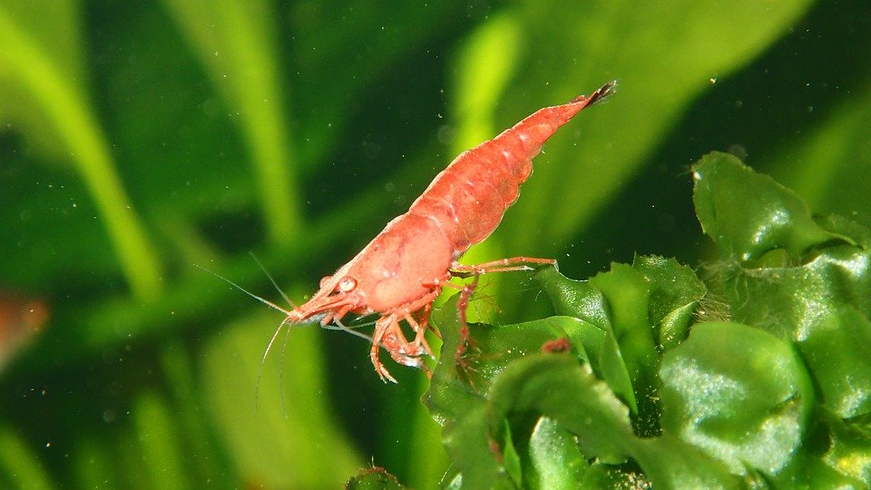

What does a Rossia Pacifica eat?
They inhabit shrimp beds; over 80% of their diet consists of shrimp, although, crabs, mysids, small fishes, and cephalopods are also eaten.
Notes:
1 Background Color
1 Title (or write the question)
1 Pictures
1 Include Transitions
0 Answering question using complete sentences (multiple sentences if needed to fully explain your answer)
1 Accuracy of information
5
Put a comma after although.

Slide 8
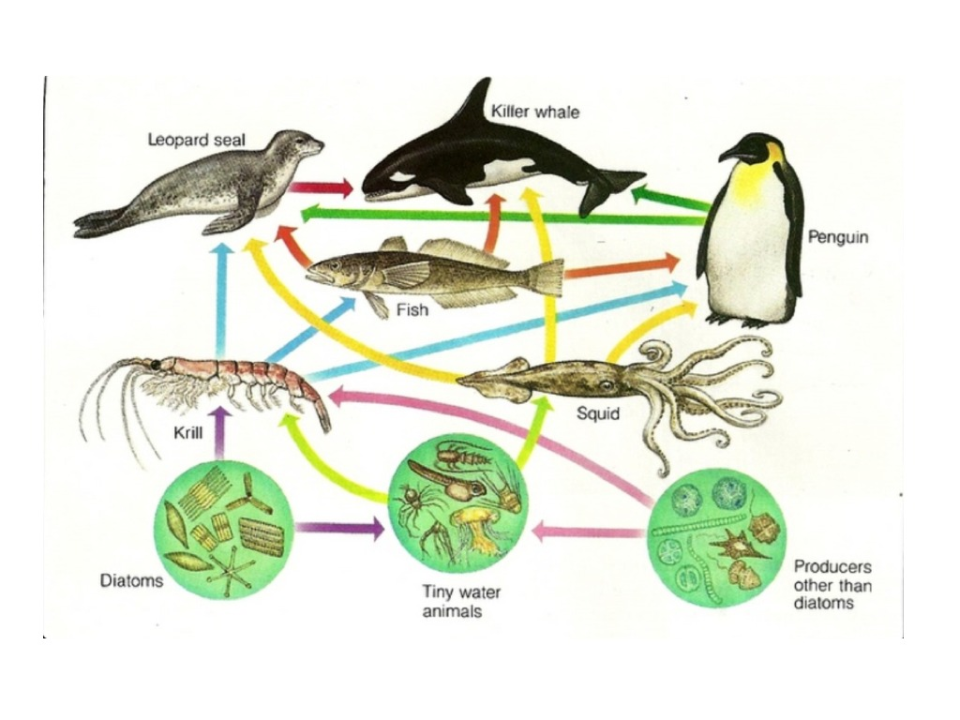
What predators does it have?
Food Chain :p
Rossia pacifica are eaten by almost any kind of predator imaginable, but their main predators are penguins, seals, sharks, whales such as the sperm whale, and humans.
Notes:
1 Background Color
1 Title (or write the question)
1 Pictures
1 Include Transitions
0 Answering question using complete sentences (multiple sentences if needed to fully explain your answer)
1 Accuracy of information
5
Unbolden the three, or bolden them all. Capitalize Food Chain.

Slide 9
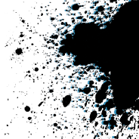
How do they protect themselves?
To protect themselves, rossia pacifica, let out a black ink that darkens and clouds the water making it difficult for predators to see them. Once these marine animals release their dark cloud of ink, they use their arms and siphon to propel themselves away from danger.
picture
Notes:
1 Background Color
1 Title (or write the question)
0 Pictures
1 Include Transitions
0 Answering question using complete sentences (multiple sentences if needed to fully explain your answer)
1 Accuracy of information
4
Delete the space before To… put a comma after Rossia pacifica,,, Either bolden the entire paragraph or remove the bold. This slide has no picture.

Slide 10

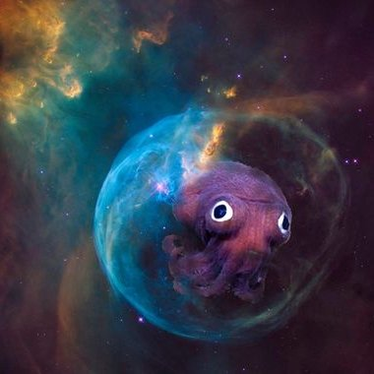
How big are they?
At maturity, these googly-eyed creatures grow to about six cm long and, as both male and female die after mating, they live for only two years.
Notes:
1 Background Color
1 Title (or write the question)
1 Pictures
1 Include Transitions
1 Answering question using complete sentences (multiple sentences if needed to fully explain your answer)
1 Accuracy of information
6

Slide 11
FACTS!!!
Did you know…
Living in sandy or muddy habitats ranging from 60 to 4,260 feet deep, but are most commonly found at a depth of about 3,000 feet.
Despite looking like an octopus and being called a squid, it's actually neither — it's most closely related to the cuttlefish.
You wouldn't be alone if you thought the octopus and squid were the same animals. ... They are cousins—both part of the group cephalopoda—a group of marine mollusks that include squid, octopus, nautilus, and snails.
Squid have three hearts: two branchial hearts and one systemic heart. The branchial hearts pump blood to the gills, where oxygen is taken up. Blood then flows to the systemic heart, where it is pumped to the rest of the body. The systemic heart is made of three chambers: a lower ventricle and two upper auricles.
Notes:
1 Background Color
1 Title (or write the question)
1 Pictures
1 Include Transitions
0 Answering question using complete sentences (multiple sentences if needed to fully explain your answer)
1 Accuracy of information
5
Every sentence starts with a capital and ends with punctuation.

Slide 12
in addition to the central brain, each of 8 arms has a mini-brain that allows it to act independently.
Most squid have 8 arms and two longer tentacles, but some squids have 10 arms.
Many squids that live in deep water have bioluminescent organs that show through their skin.
Biologists estimate that there are as many as 500 species of squid.
Squid swim faster than any other invertebrate.
FACTS!!!
Notes:
Extra slide not scored. \
Every sentence should begin with a capital letter and end with punctuation marks.

Slide 13

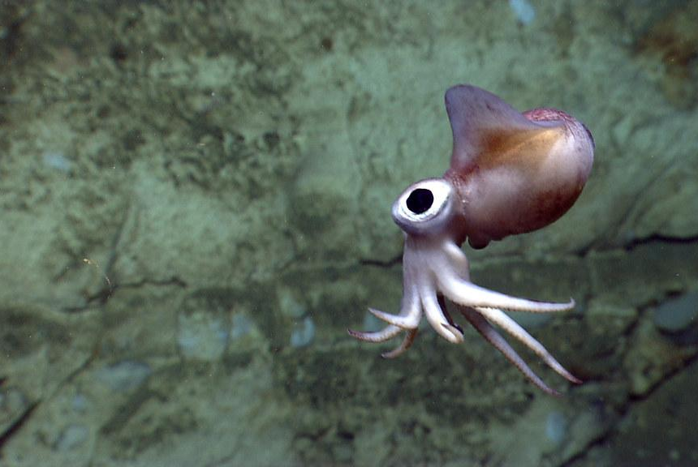
Websites used?
https://championtraveler.com/
https://marinesanctuary.org/
wikipedia.org/wiki/Rossia_pacifica
Notes:
6
This is where all those references go..

Slide 14

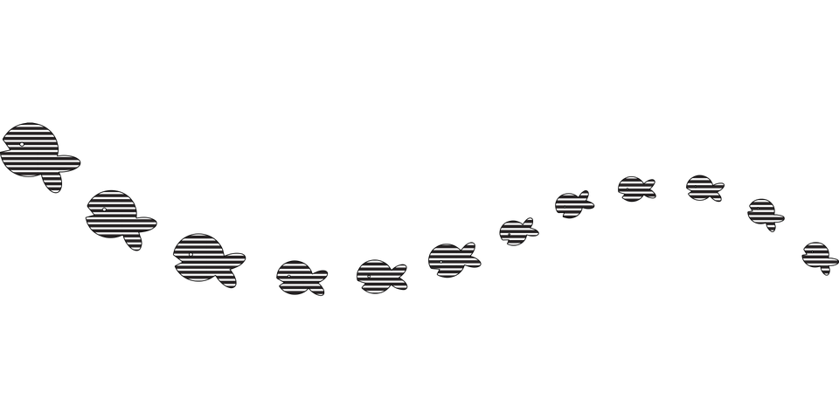
BYE!!!!
Notes:
Added slide… unscored..
You seem to be missing one slide.. I think the difference between male and female.

