Slide 1
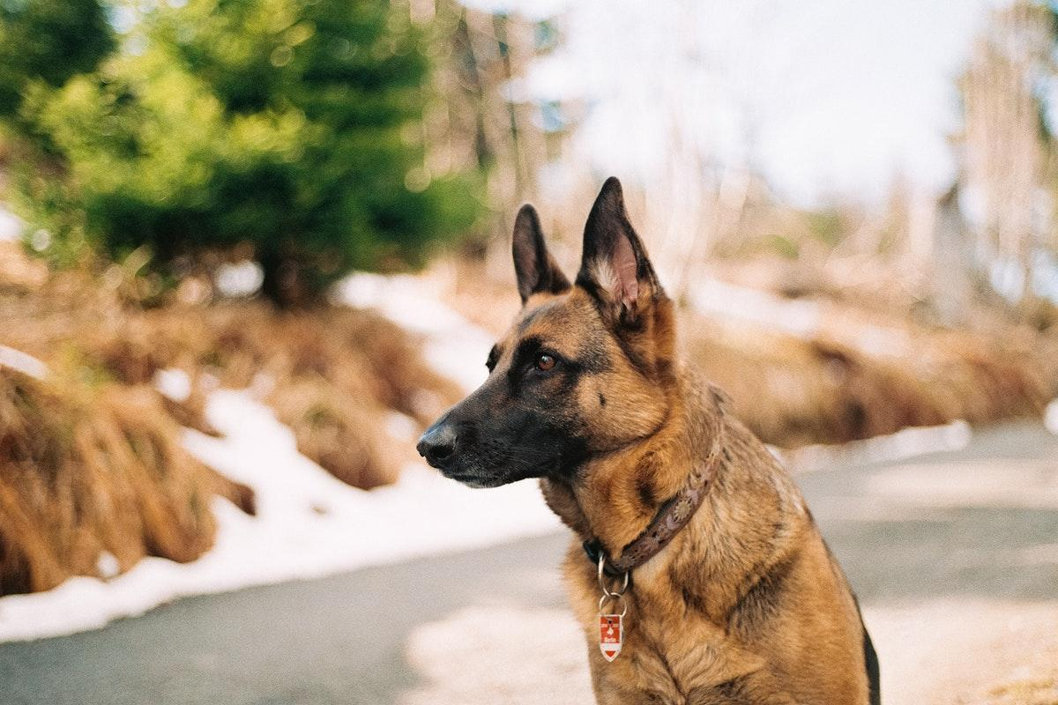
German shepherd
Notes:
1 Background Color
1 Title (or write the question)
1 Pictures
1 Include Transitions
1 Answering question using complete sentences (multiple sentences if needed to fully explain your answer)
1 Accuracy of information
6

Slide 2
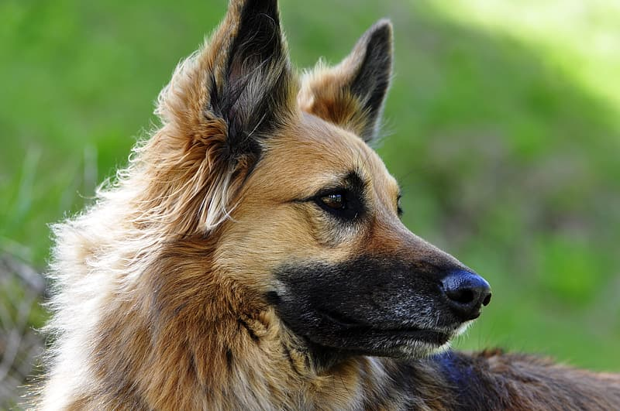
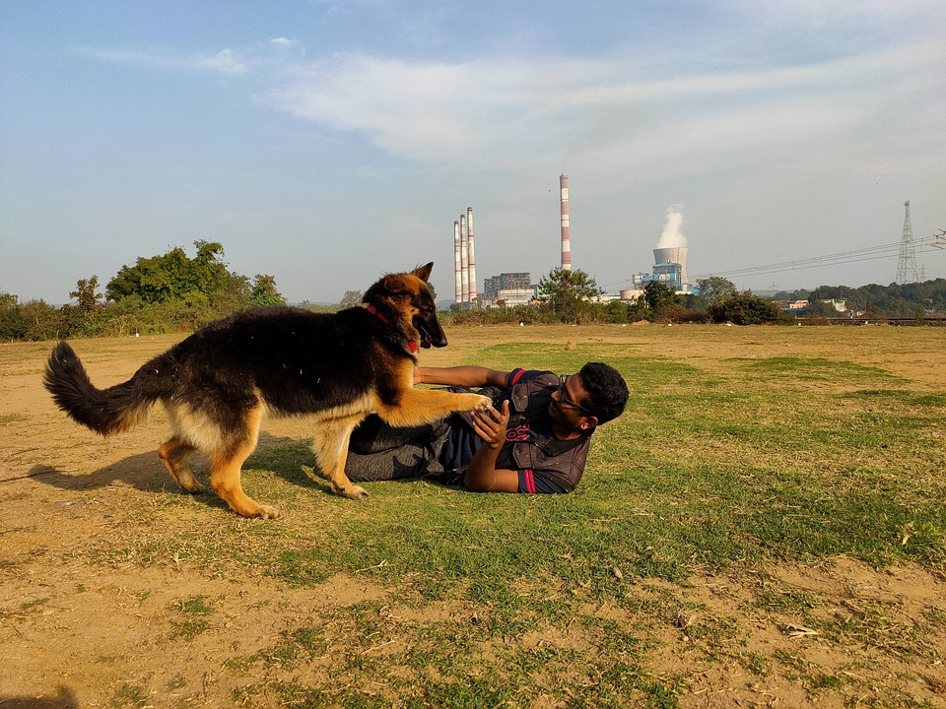
Where do german shepherds come from?
German shepherds usually come from germany.
Notes:
1 Background Color
1 Title (or write the question)
1 Pictures
1 Include Transitions
1 Answering question using complete sentences (multiple sentences if needed to fully explain your answer)
1 Accuracy of information
6

Slide 3
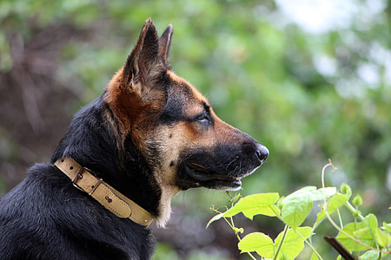
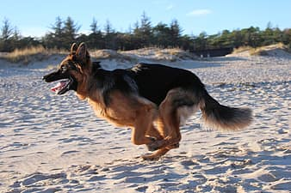
What ecosystem do German Shepherds live in?
The German Shepherd can live outdoors in cool or temperate climates, but also enjoy living indoors too.
Notes:
1 Background Color
1 Title (or write the question)
1 Pictures
1 Include Transitions
0 Answering question using complete sentences (multiple sentences if needed to fully explain your answer)
1 Accuracy of information
5
, but enjoy living indoors….

Slide 4
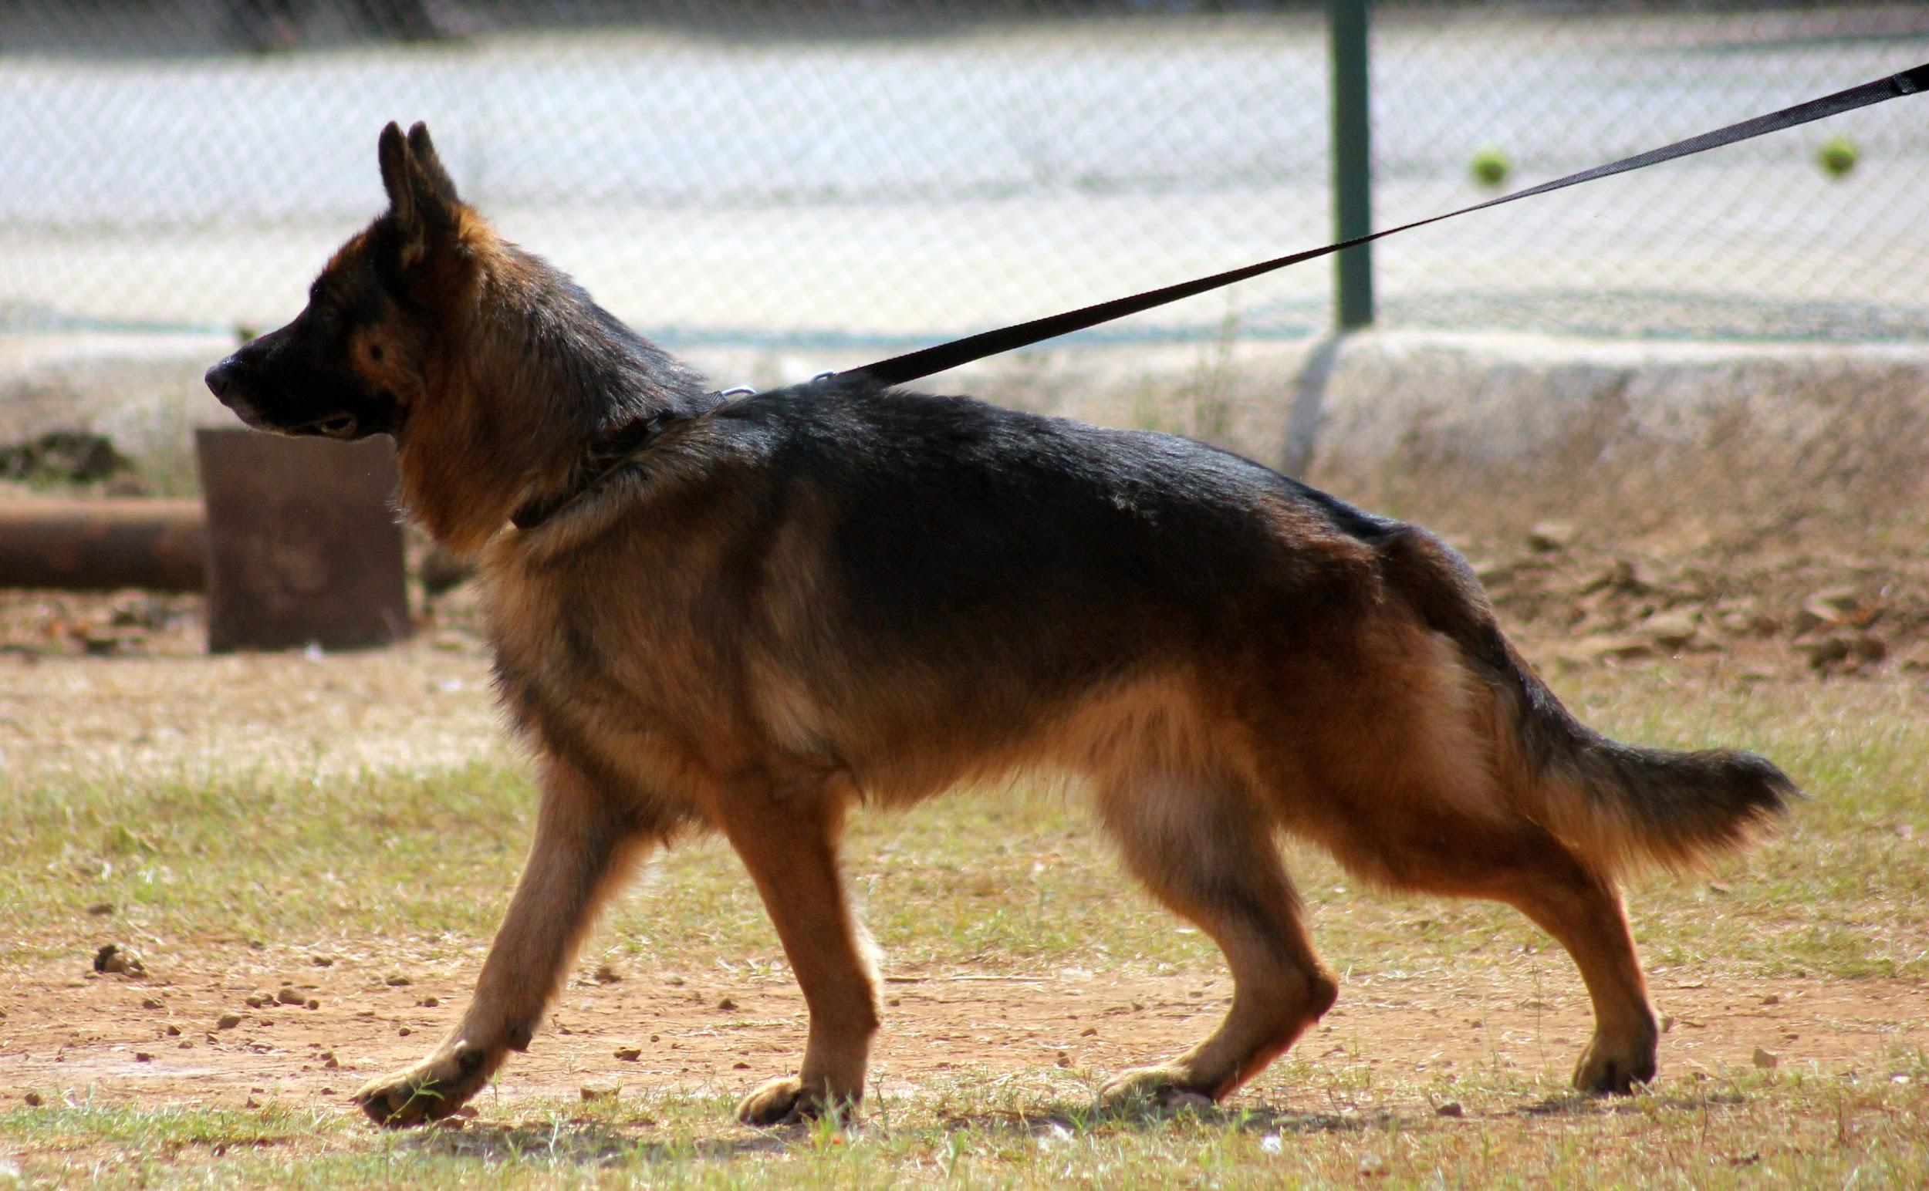
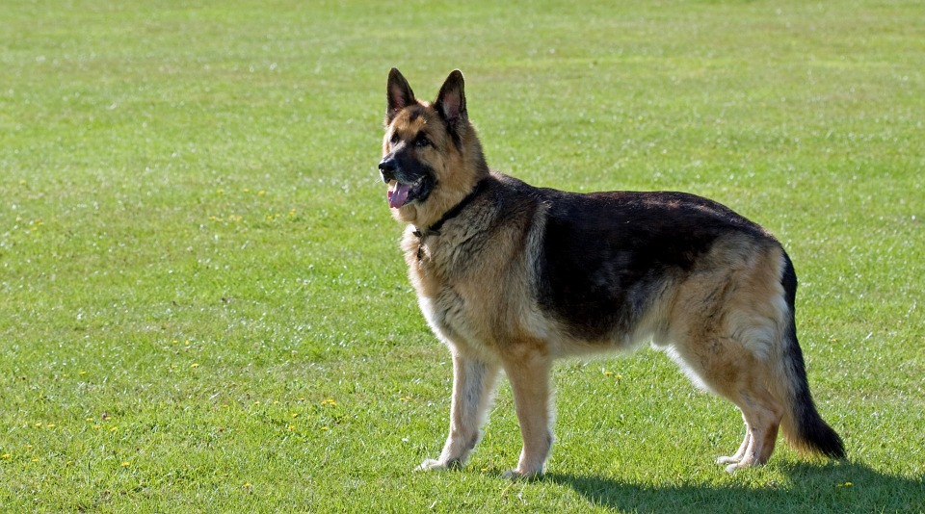
What do German shepherds like as temperature?
German shepherds like their temperature at the low 30c.
Notes:
1 Background Color
1 Title (or write the question)
1 Pictures
1 Include Transitions
0 Answering question using complete sentences (multiple sentences if needed to fully explain your answer)
0 Accuracy of information
4
…like their temperature.. Seems kind of a low temperature for them,, or do you mean 30 deg C.

Slide 5
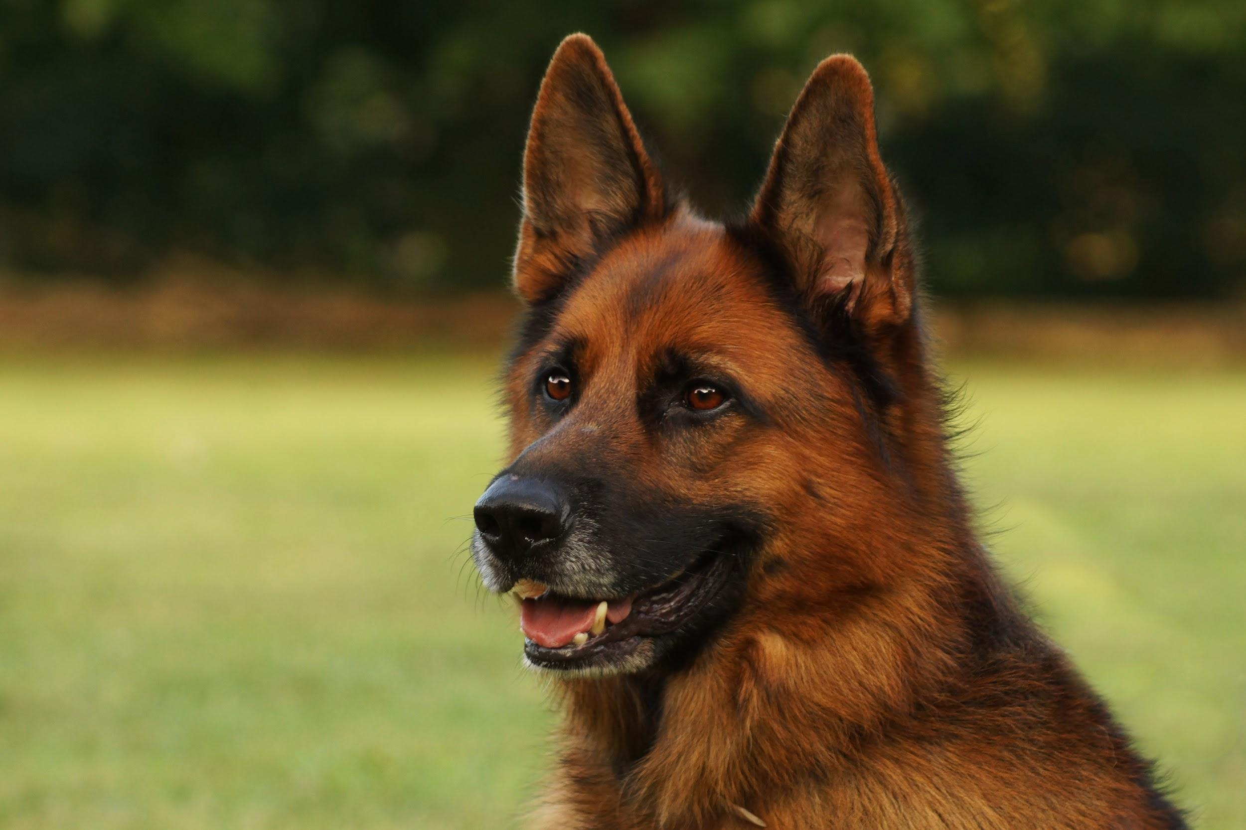
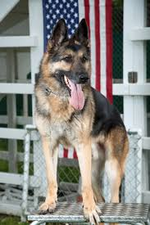
What kind of consumers are german shepherds?
German Shepherds are Omnivores.
Notes:
1 Background Color
1 Title (or write the question)
1 Pictures
1 Include Transitions
0 Answering question using complete sentences (multiple sentences if needed to fully explain your answer)
1 Accuracy of information
5
Title …….German shepherds?
Paragraph…. German shepherds are omnivores.

Slide 6
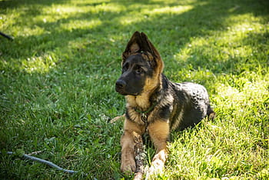
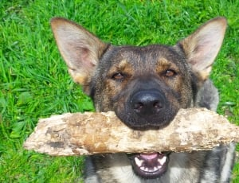
What food do German Shepherds eat?
German Shepards appetite is beef, lamb, and chicken.
Notes:
1 Background Color
1 Title (or write the question)
1 Pictures
1 Include Transitions
0 Answering question using complete sentences (multiple sentences if needed to fully explain your answer)
1 Accuracy of information
5
German shepherds…. .. have an appetite for beef, …….

Slide 7
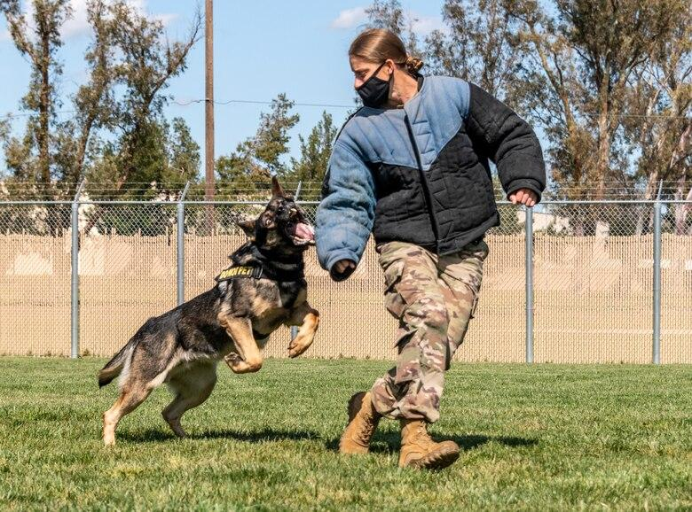
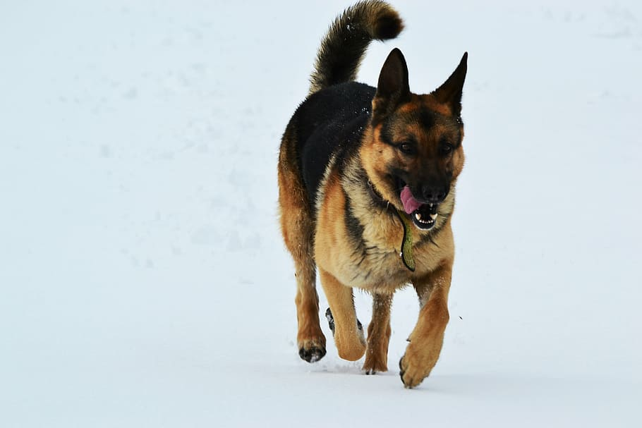
Do German Shepherds have any predators?
German Shepherds do have predators they are lions, coyotes, and bears.
Notes:
1 Background Color
1 Title (or write the question)
1 Pictures
1 Include Transitions
1 Answering question using complete sentences (multiple sentences if needed to fully explain your answer)
1 Accuracy of information
6

Slide 8
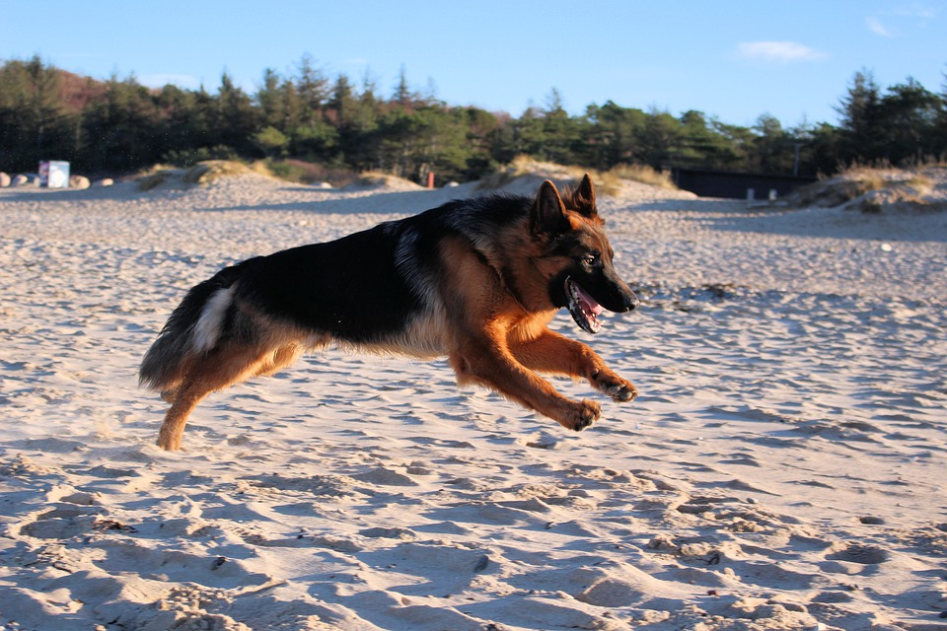
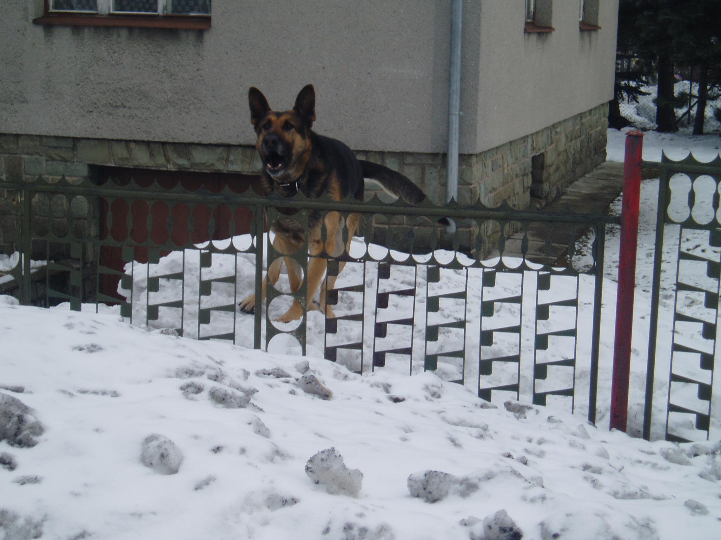
what is a typical food chain for german shepherds
They do not have a food chain. Mr. Perez says this is ok.
Notes:
1 Background Color
1 Title (or write the question)
1 Pictures
1 Include Transitions
0 Answering question using complete sentences (multiple sentences if needed to fully explain your answer)
0 Accuracy of information
4
What is a typical…..German shepherds?
German shepherds definitely have a food chain.

Slide 9
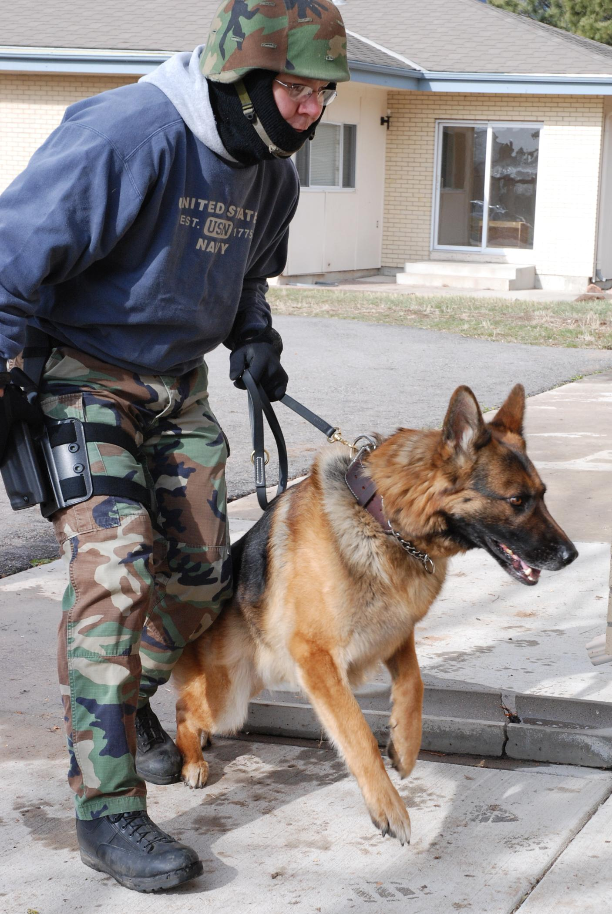
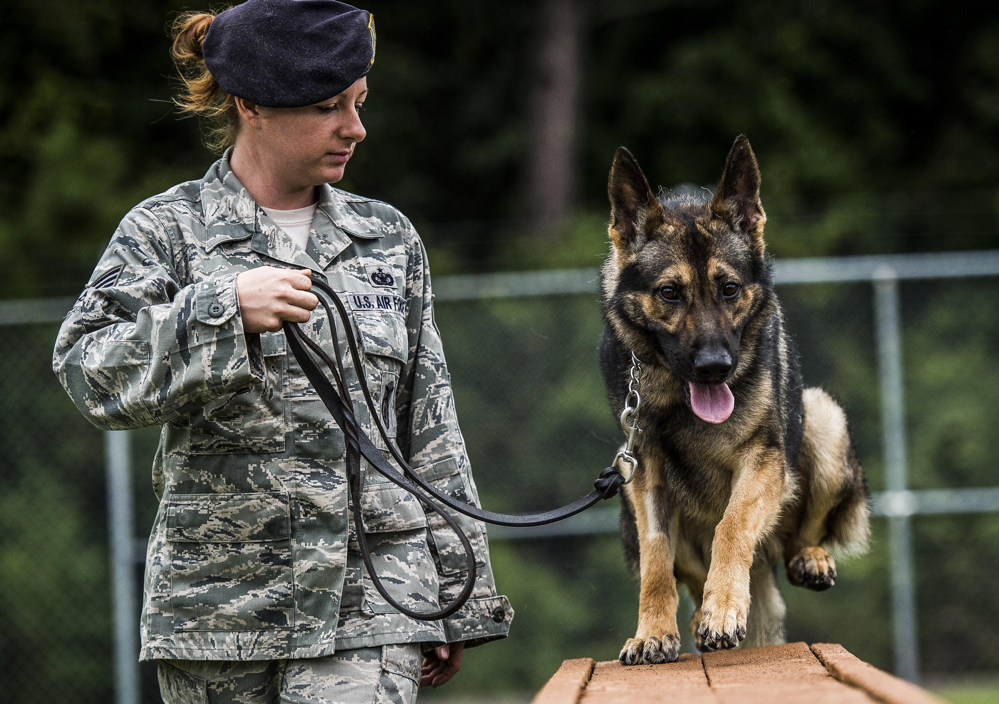
What adaptations do German Shepherds have?
German shepherds are intelligent and hardworking k9 dogs they also have great hearing
Notes:
1 Background Color
1 Title (or write the question)
1 Pictures
1 Include Transitions
1 Answering question using complete sentences (multiple sentences if needed to fully explain your answer)
0 Accuracy of information
5
What about their hearing, sense of smell, their ability to become attached to people?

Slide 10
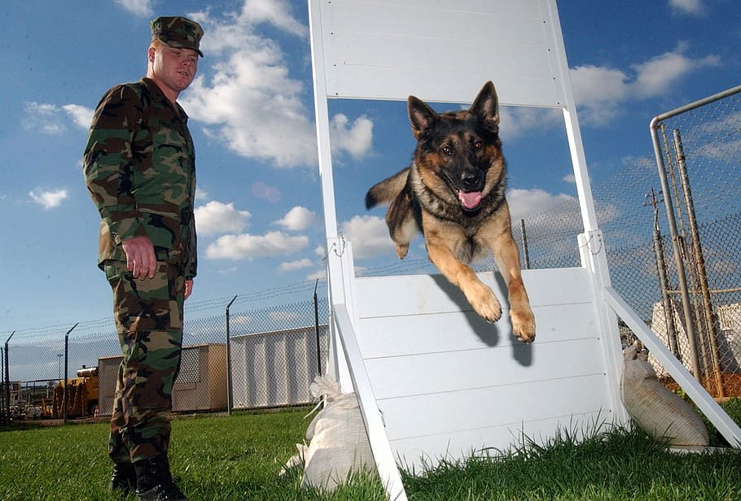
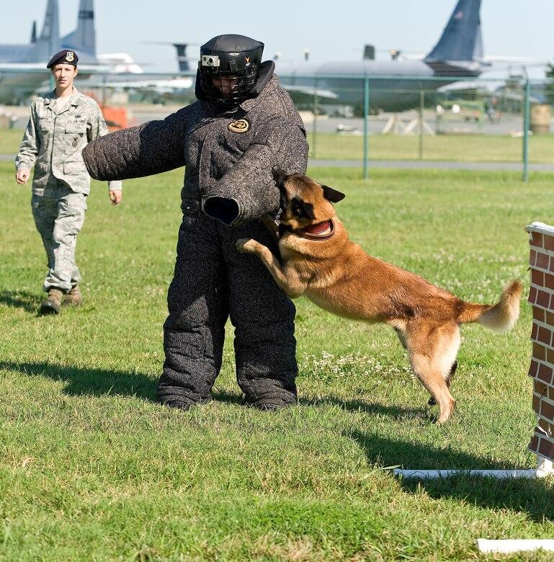
What does a german shepherd look like, how much does it weigh, and how tall is it?
Color- black with a little gold
Weight - males weigh around 66 to 88 and female weigh around 49 to 71
Height - The males height is about 24 to 26in, the females height is about 22 to 24
Notes:
1 Background Color
1 Title (or write the question)
1 Pictures
1 Include Transitions
0 Answering question using complete sentences (multiple sentences if needed to fully explain your answer)
1 Accuracy of information
5
German shepherd…
All sentences begin with a capital letter and end with punctuation.

Slide 11
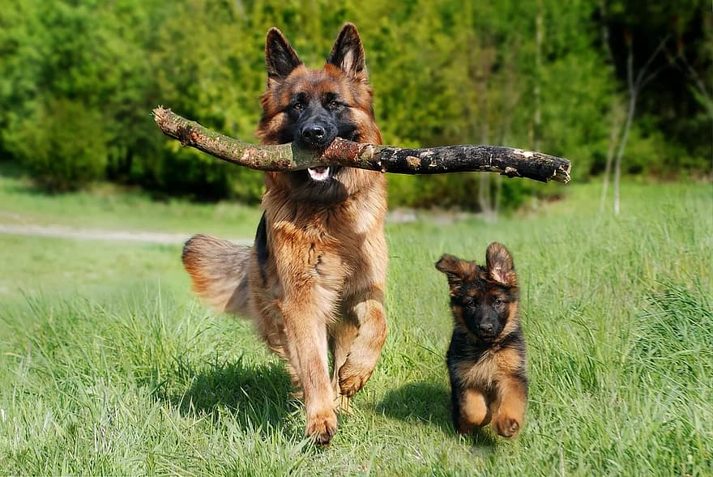
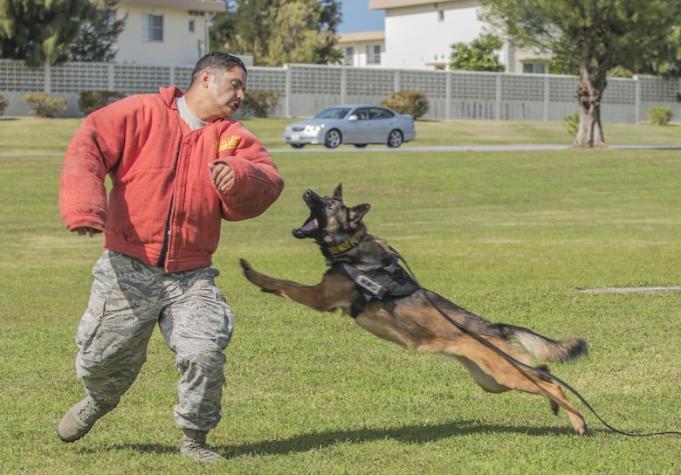
Do German Shepherds females and males weigh the sam and do they have the same height
No they both weigh differently.
Notes:
1 Background Color
1 Title (or write the question)
1 Pictures
1 Include Transitions
0 Answering question using complete sentences (multiple sentences if needed to fully explain your answer)
0 Accuracy of information
4
….weigh the same, and do they…. Height?
Please be more specific in the ways they differ.

Slide 12
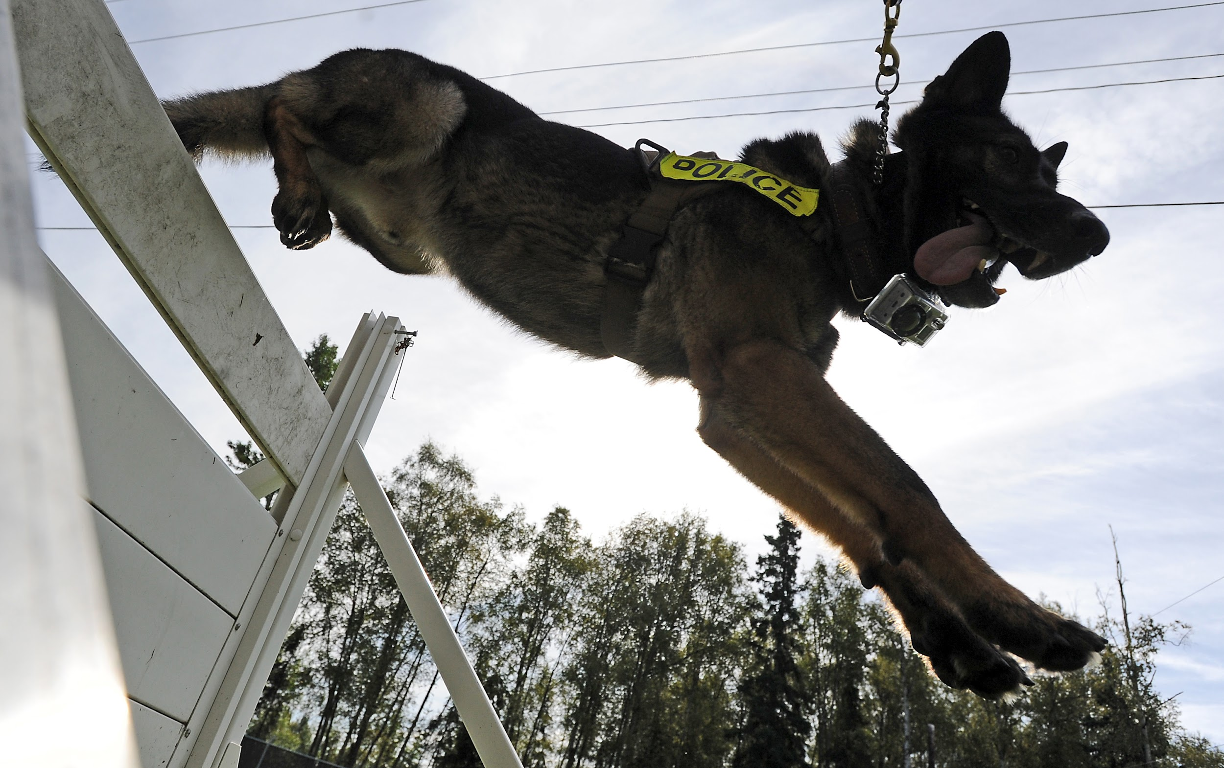
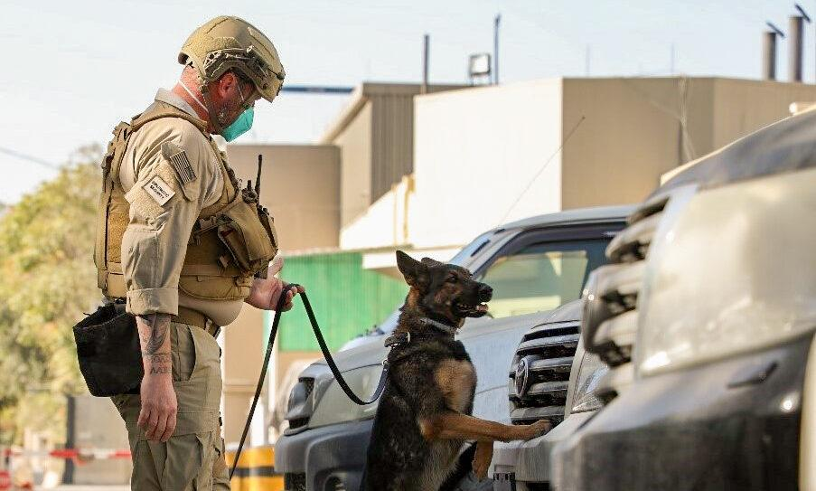
What is the lifespan of a german shepherd
The lifespan of a German shepherd is about 9-13 years
Notes:
1 Background Color
1 Title (or write the question)
1 Pictures
1 Include Transitions
0 Answering question using complete sentences (multiple sentences if needed to fully explain your answer)
1 Accuracy of information
5
German shepherd….

Slide 13
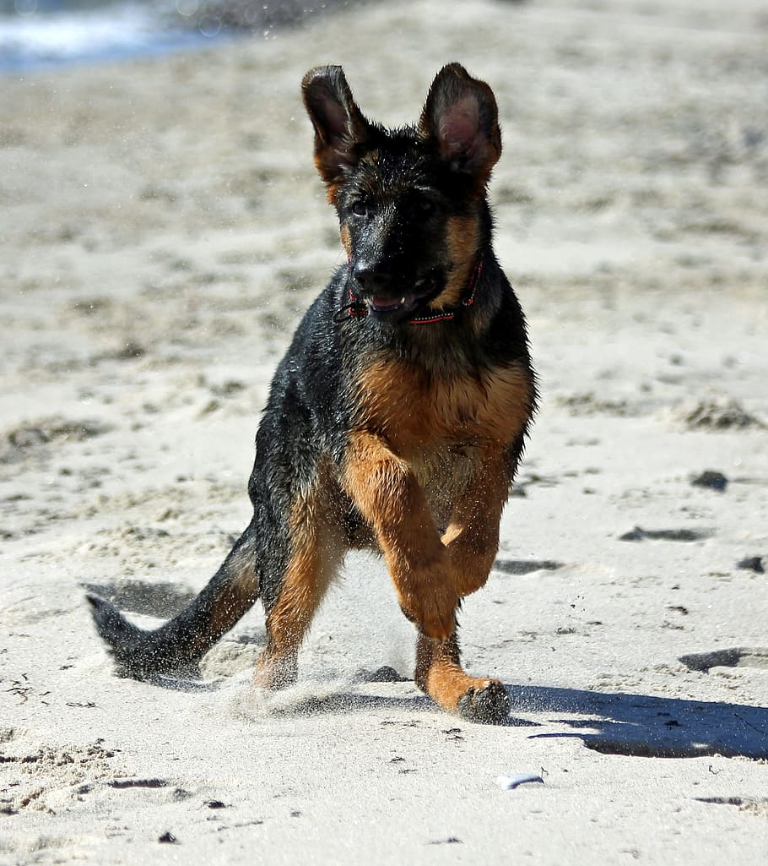
Here are 8 facts about German shepherds!!
German Shepherds will explore everything with their noses
GSDs are incredibly smart
German Shepherd Dogs are protective of their loved ones
GSDs provide constant companionship
German Shepherds are known as a mouthy breed
German Shepherds shed
ranking of most popular dogs.
Powerful Bite.
Notes:
1 Background Color
1 Title (or write the question)
1 Pictures
1 Include Transitions
0 Answering question using complete sentences (multiple sentences if needed to fully explain your answer)
1 Accuracy of information
5
On the first line say.. German Shepherd Dogs (GSD) will… this will make it ok to use GSD. Please make #7 have the same font and style as the rest..
All sentences begin with a capital letter and end with punctuation.

Slide 14
Sources
https://dogadvisorycouncil.com › how-long-do-german
https://www.pawlicy.com › blog › german-shepherd-gr
https://www.geliebteshepherds.com › colors-of-a-germa
Notes:
6

