Slide 1
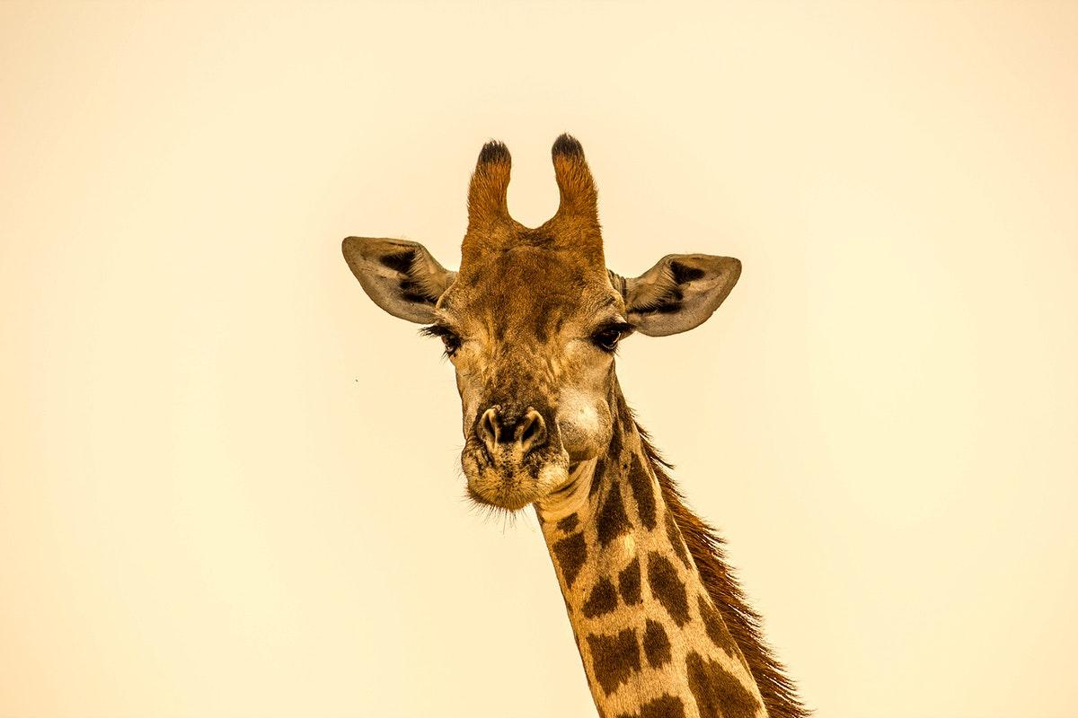
Creature Project
By Savannah Hughes
The Northern Giraffe
Notes:
1 Background Color
1 Title (or write the question)
1 Pictures
1 Include Transitions
1 Answering question using complete sentences (multiple sentences if needed to fully explain your answer)
1 Accuracy of information
6

Slide 2
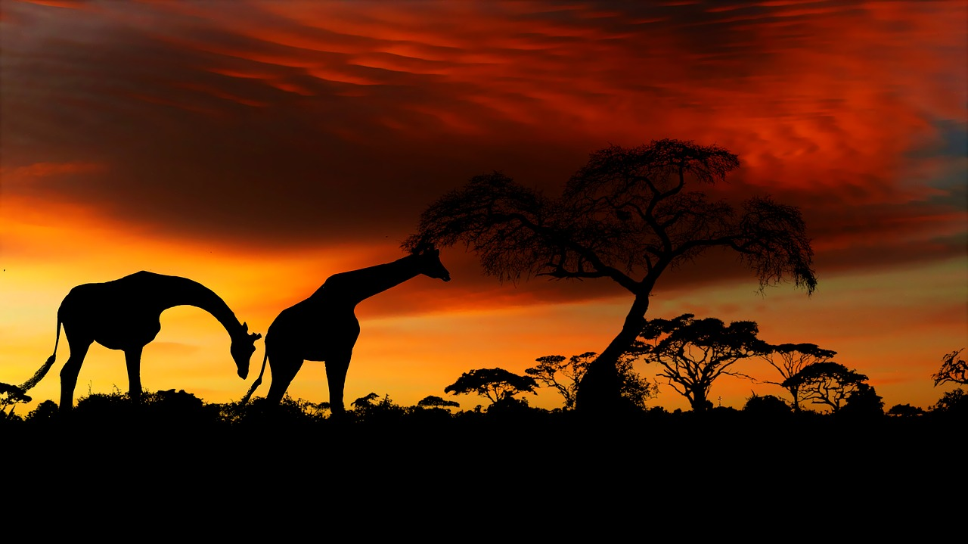
History of the Northern giraffe
The Northern giraffe can be found in East Africa. In places such as the Savannahs, Shrublands, and Woodlands.
Notes:
1 Background Color
1 Title (or write the question)
1 Pictures
1 Include Transitions
0 Answering question using complete sentences (multiple sentences if needed to fully explain your answer)
1 Accuracy of information
5
Since the title is not a sentence capitalize Northern Giraffe. If it were a sentence then it would be Northern giraffe. Since the list is not specific places they can be lowercase.

Slide 3
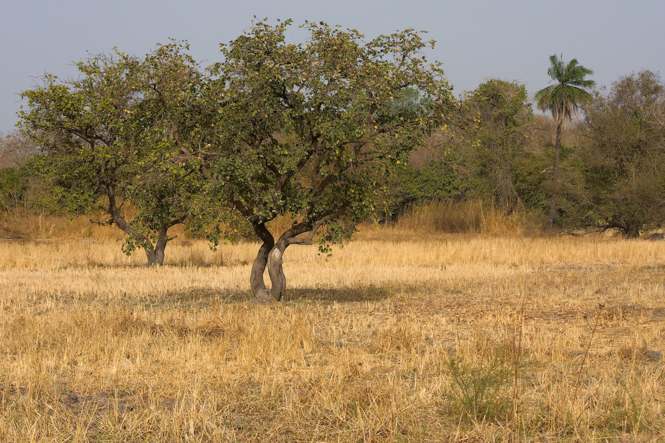
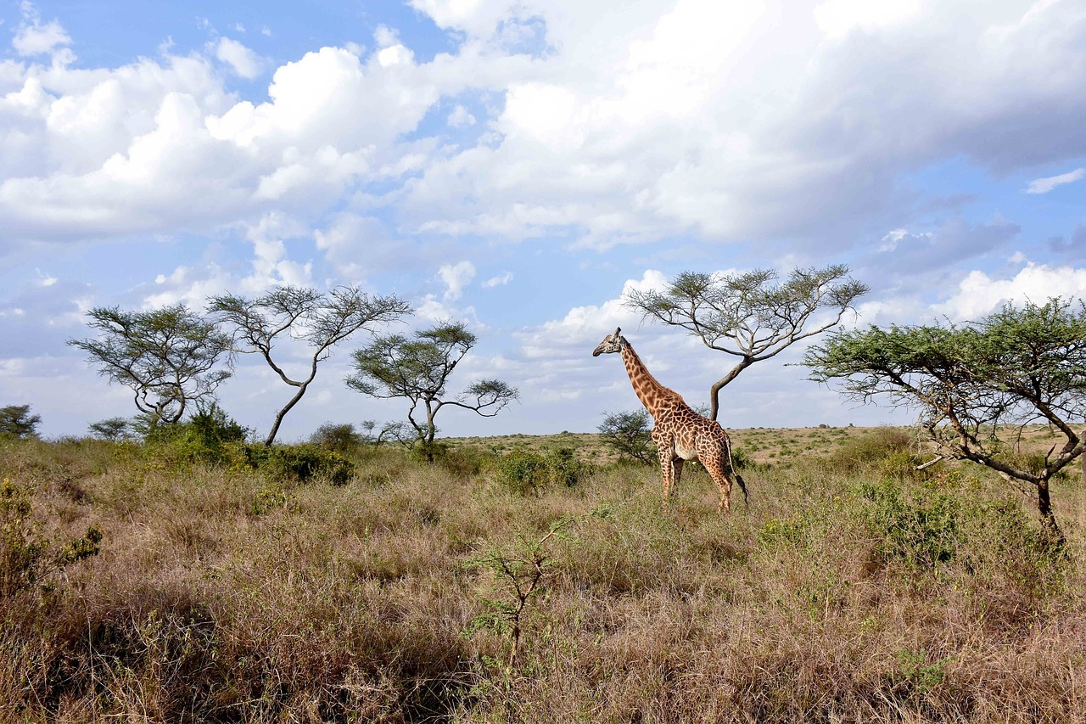
Northern Giraffes Ecosystem
The Northern Giraffes ecosystem is grasslands and open plains.
Notes:
1 Background Color
1 Title (or write the question)
1 Pictures
1 Include Transitions
1 Answering question using complete sentences (multiple sentences if needed to fully explain your answer)
1 Accuracy of information
6

Slide 4
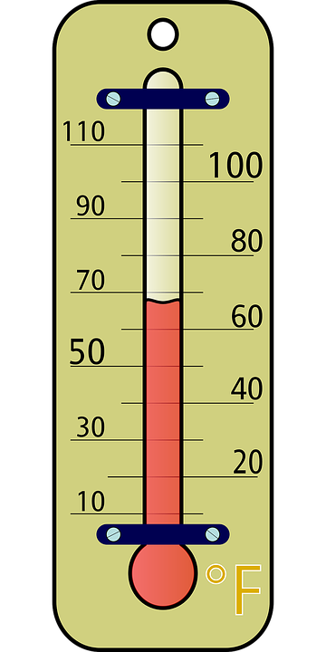
What is the ecosystem like?
The ecosystem in which a Northern giraffe lives in, will dip the temperature to 70 degrees in the dry season. In rainy seasons it can reach mid 80s.
Notes:
1 Background Color
1 Title (or write the question)
1 Pictures
1 Include Transitions
0 Answering question using complete sentences (multiple sentences if needed to fully explain your answer)
1 Accuracy of information
5
…it can reach the mid 80s.

Slide 5
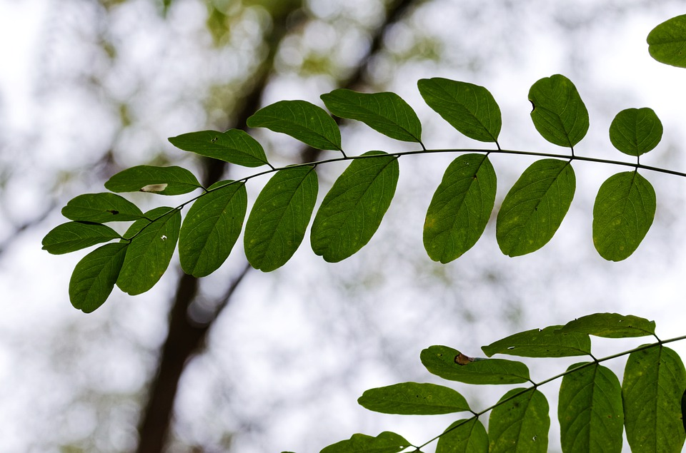
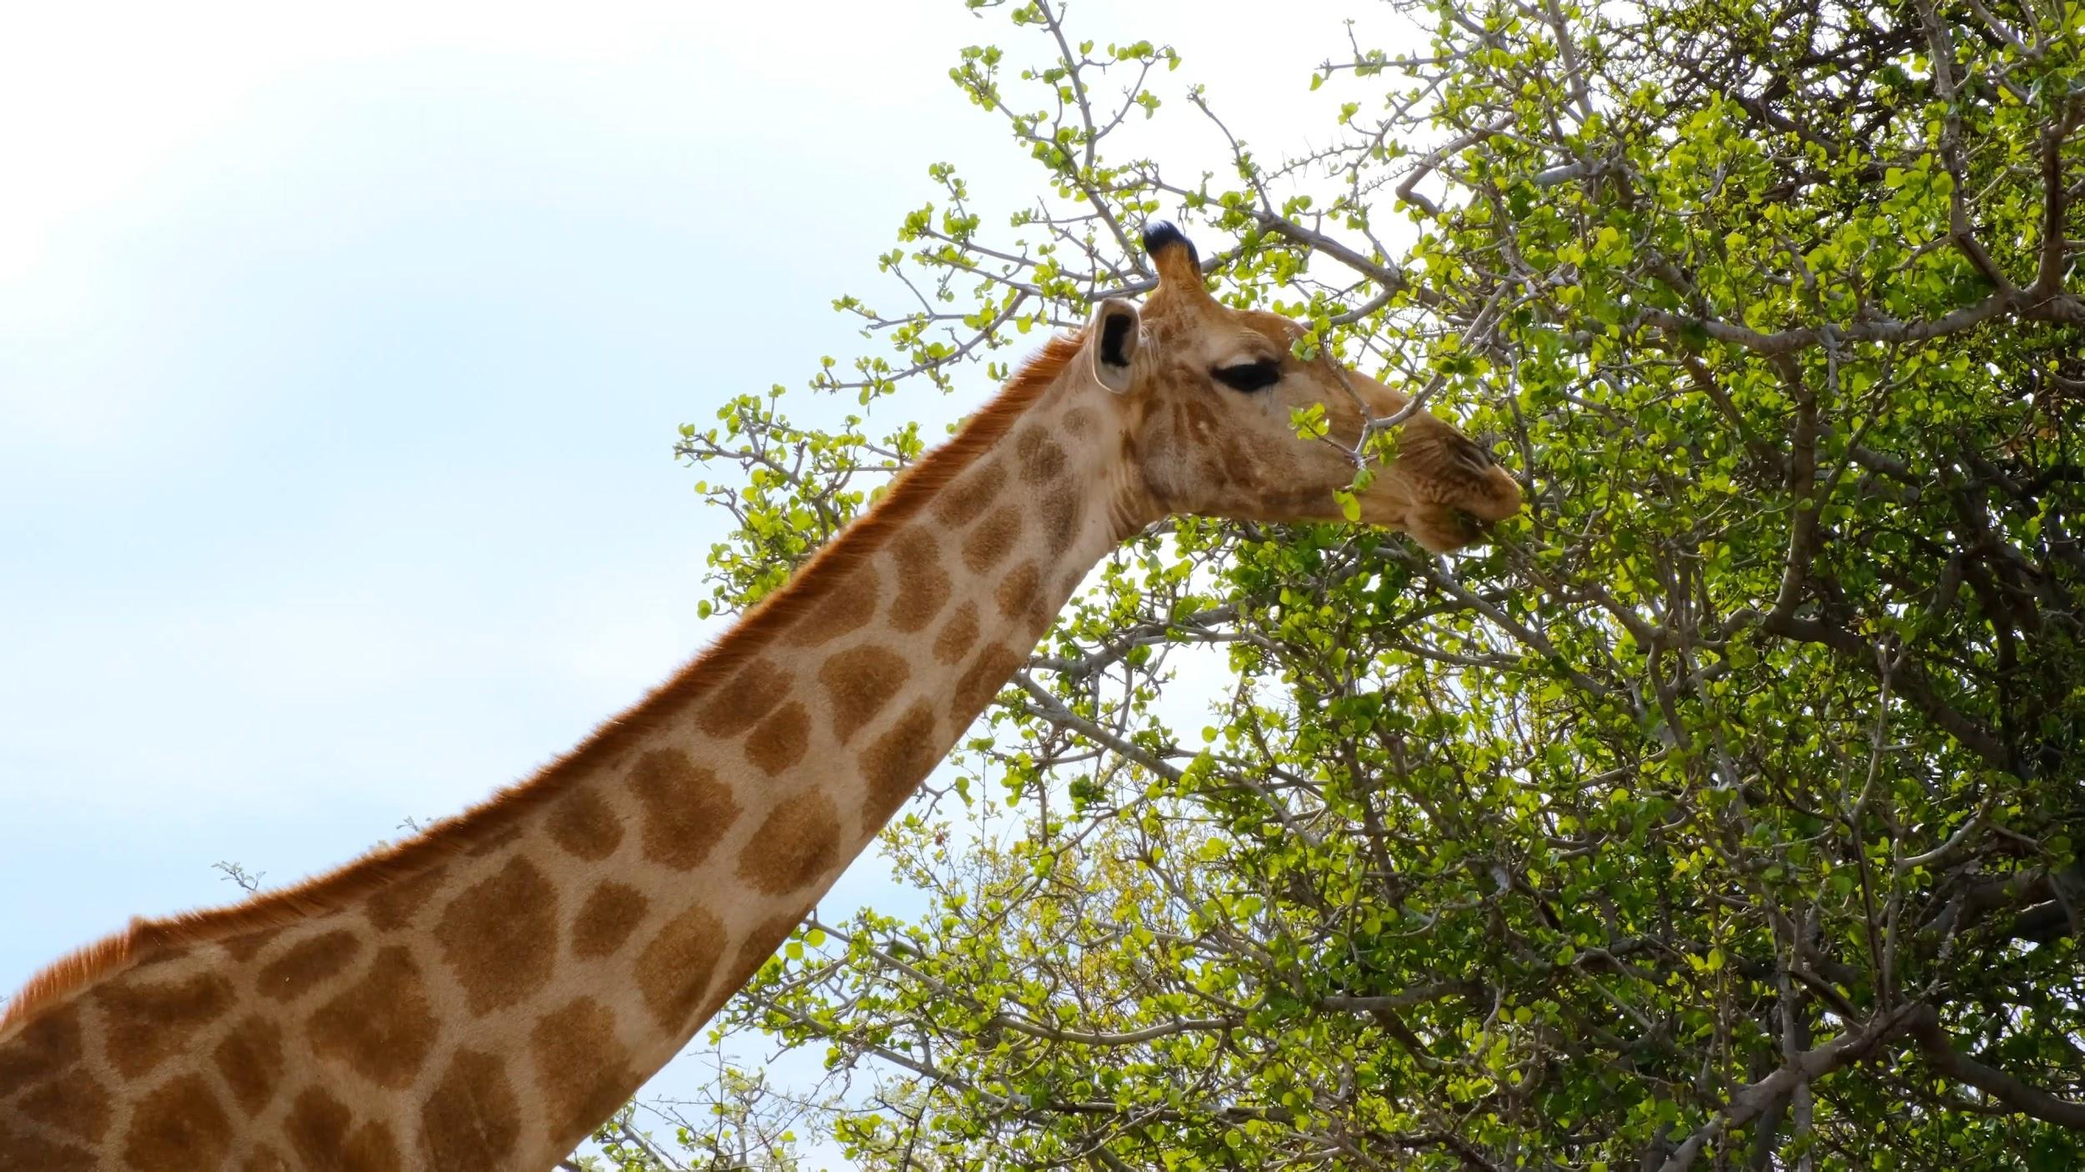
What type of consumer?
Herbivore. Northern giraffes are herbivores, which means they only eat plants.
Notes:
1 Background Color
1 Title (or write the question)
1 Pictures
1 Include Transitions
1 Answering question using complete sentences (multiple sentences if needed to fully explain your answer)
1 Accuracy of information
6

Slide 6
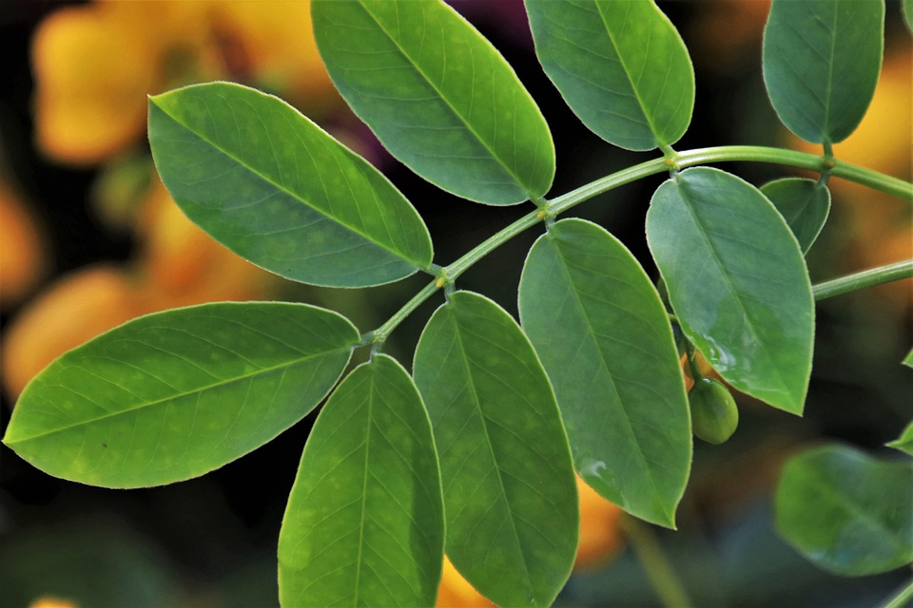
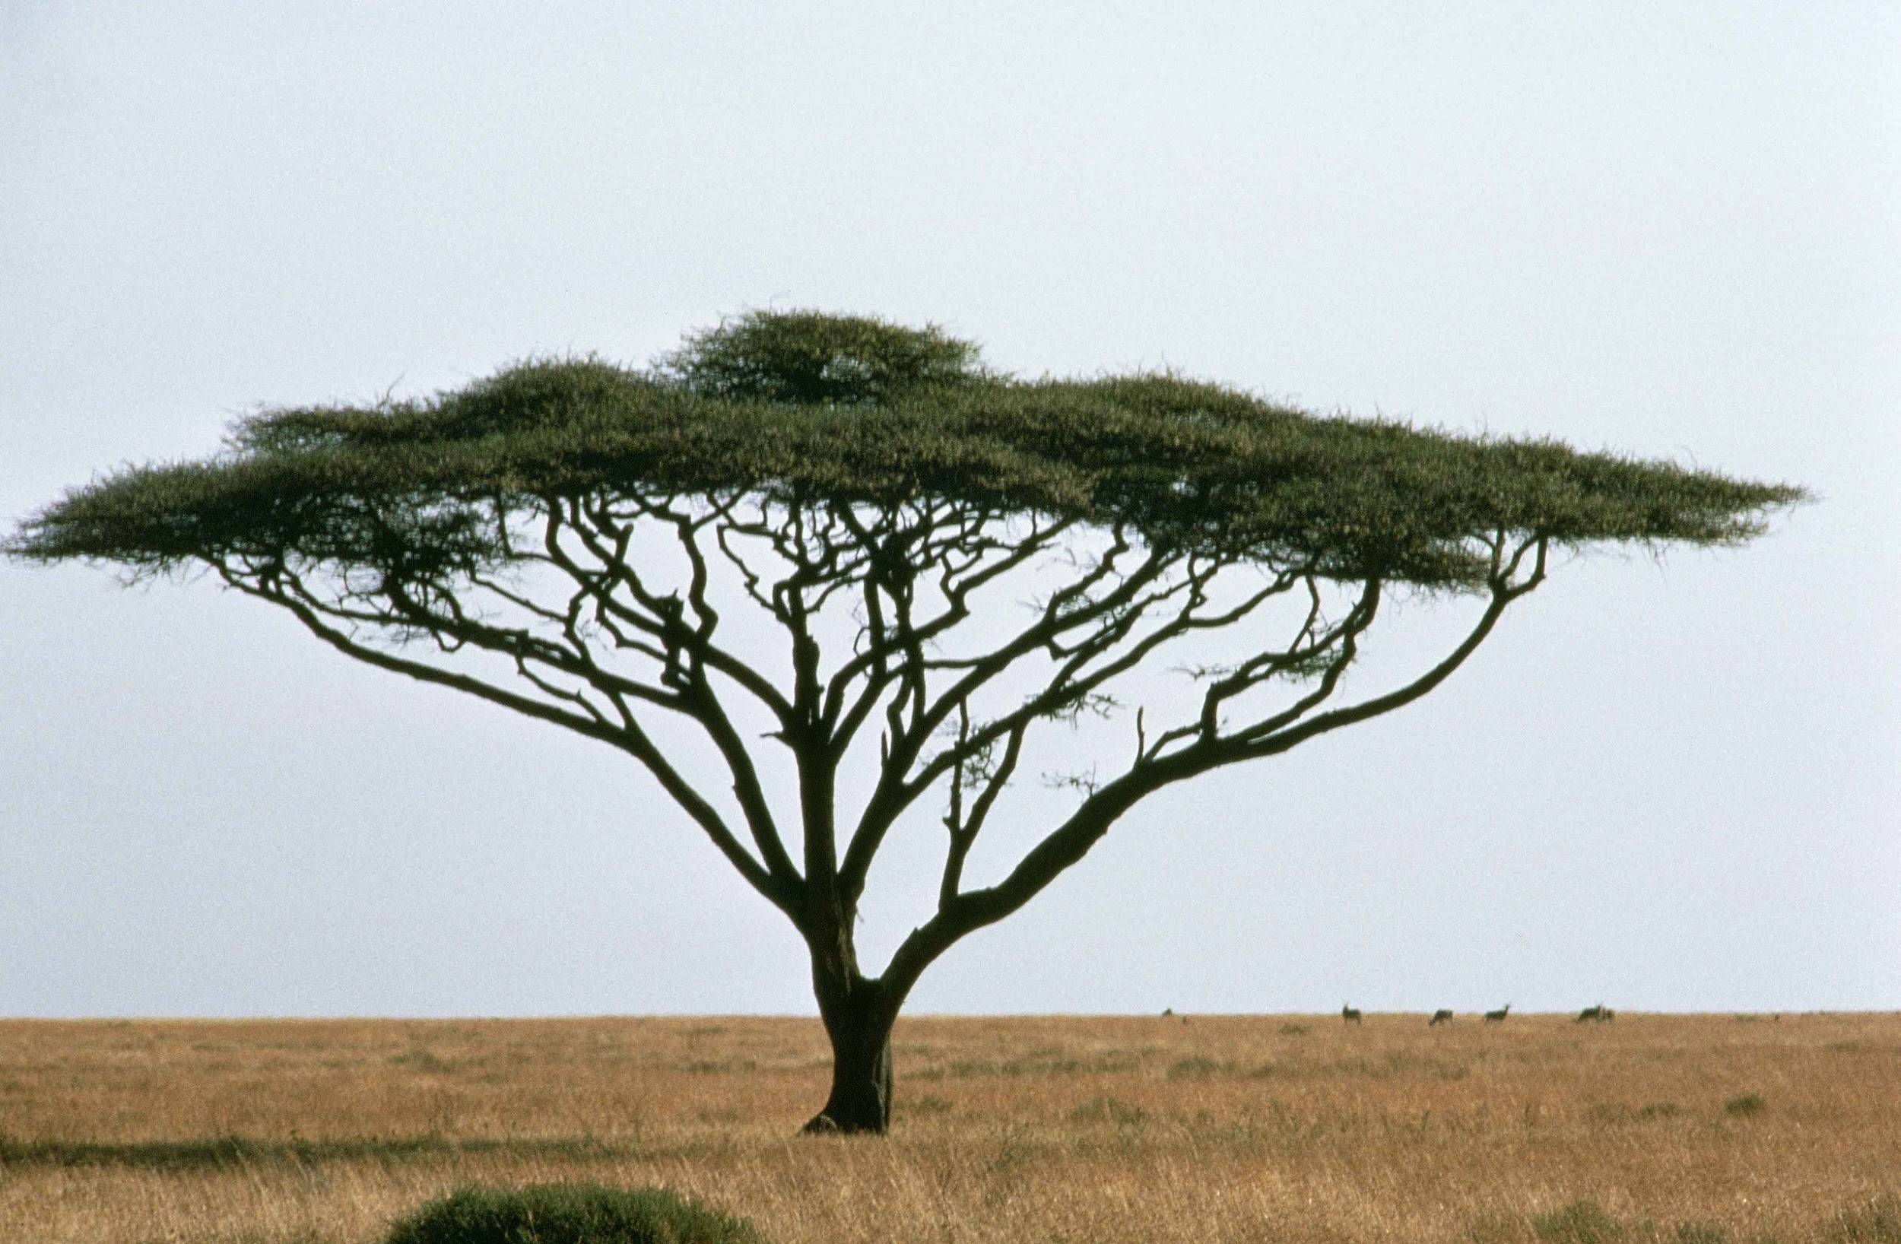
What do they eat?
Northern giraffes eat a specific leaf called an Acacia leaf.
Which comes off of an Acacia tree.
Notes:
1 Background Color
1 Title (or write the question)
1 Pictures
1 Include Transitions
0 Answering question using complete sentences (multiple sentences if needed to fully explain your answer)
1 Accuracy of information
5
Which comes off on Acacia tree. Is not a complete sentence.

Slide 7
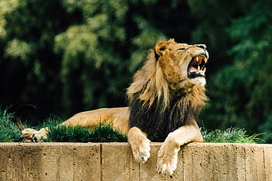
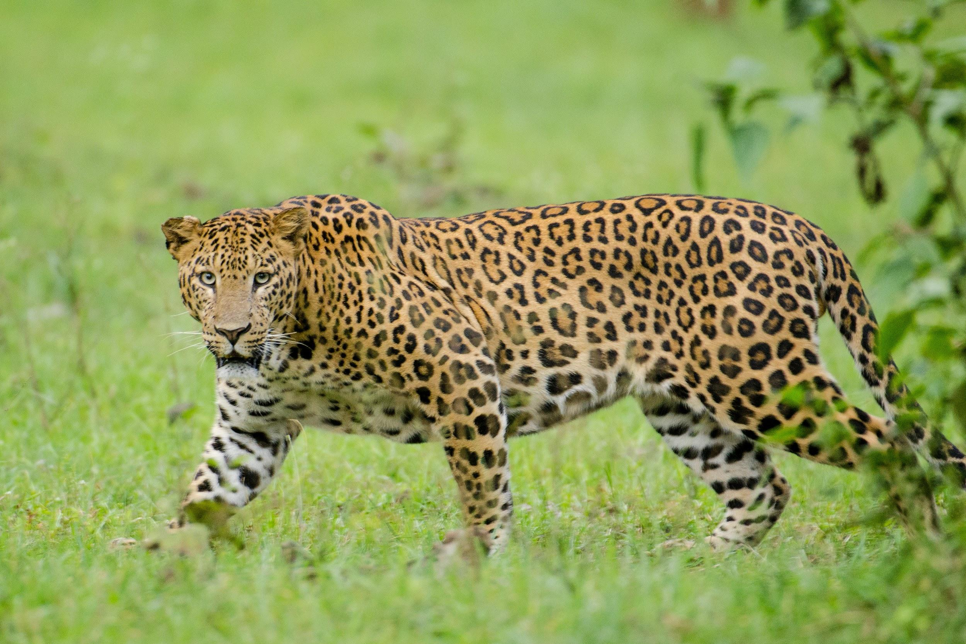
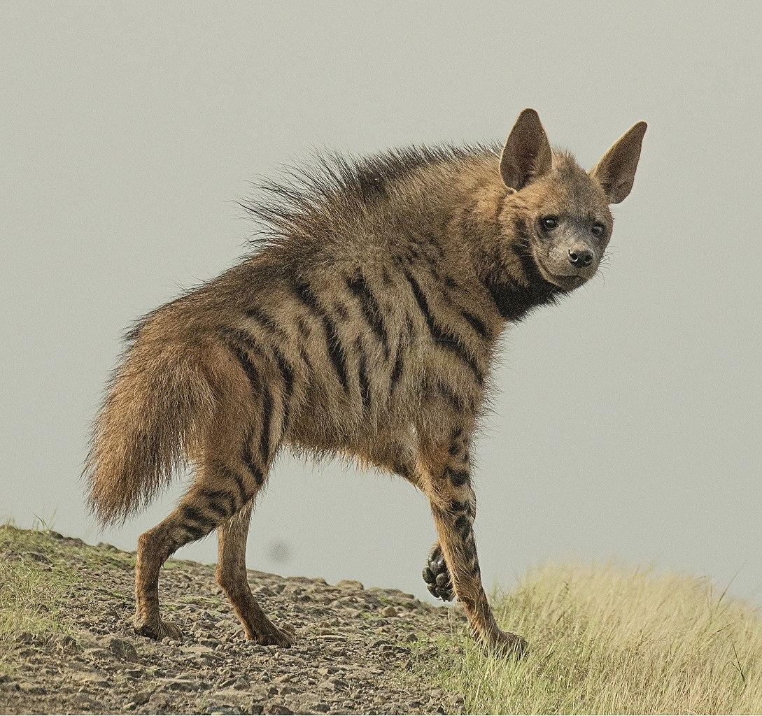
Do they have predators?
Northern giraffes do have predators, although the adults rarely get attacked. Lions, Hyenas, and leopards will attack the young vulnerable giraffes.
Notes:
1 Background Color
1 Title (or write the question)
1 Pictures
1 Include Transitions
0 Answering question using complete sentences (multiple sentences if needed to fully explain your answer)
1 Accuracy of information
5
…predators, although, the adults… Lions, hyenas, and leopards…

Slide 8
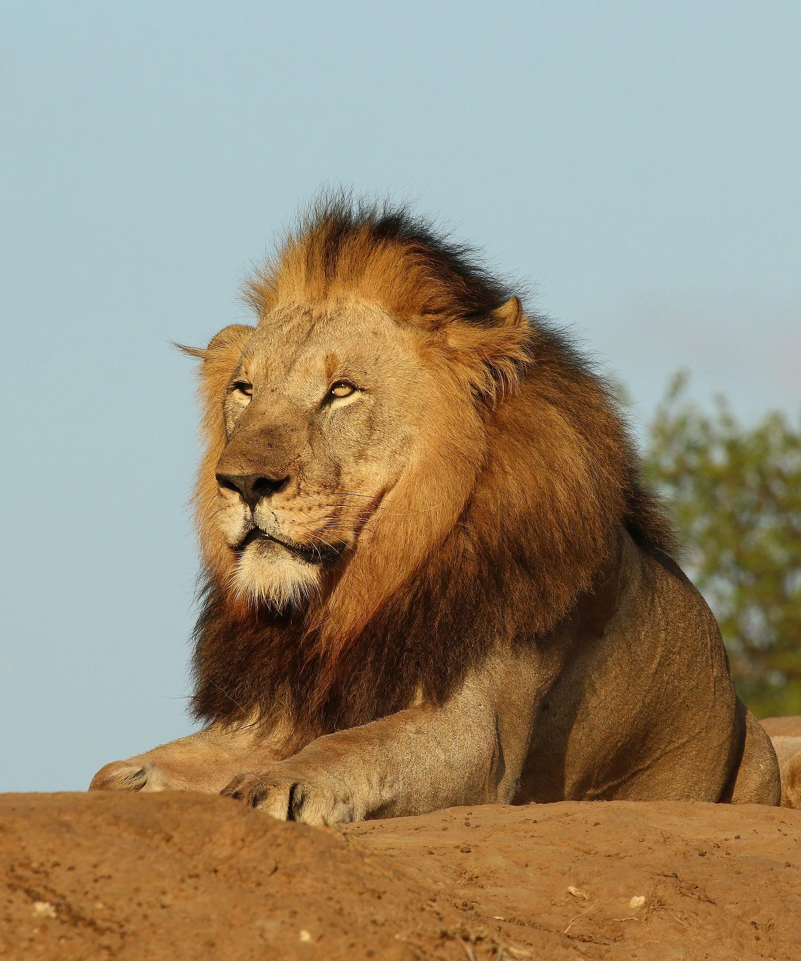
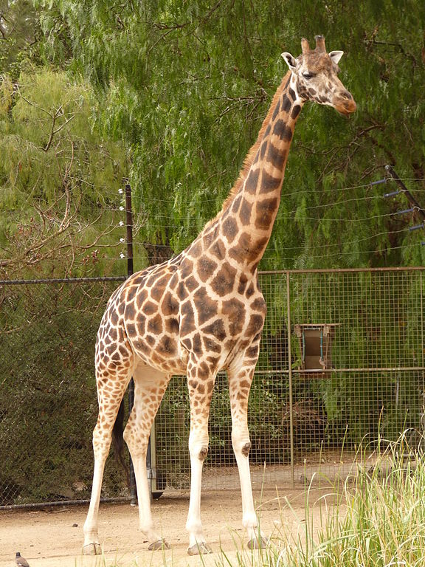




The food chain
Leaf consumes rain
Giraffe consumes leaf
Hyenas hunts giraffes
Lions hunts hyenas
Notes:
1 Background Color
1 Title (or write the question)
1 Pictures
1 Include Transitions
0 Answering question using complete sentences (multiple sentences if needed to fully explain your answer)
1 Accuracy of information
5
The Food Chain… since it is not a sentence but is the title.

Slide 9
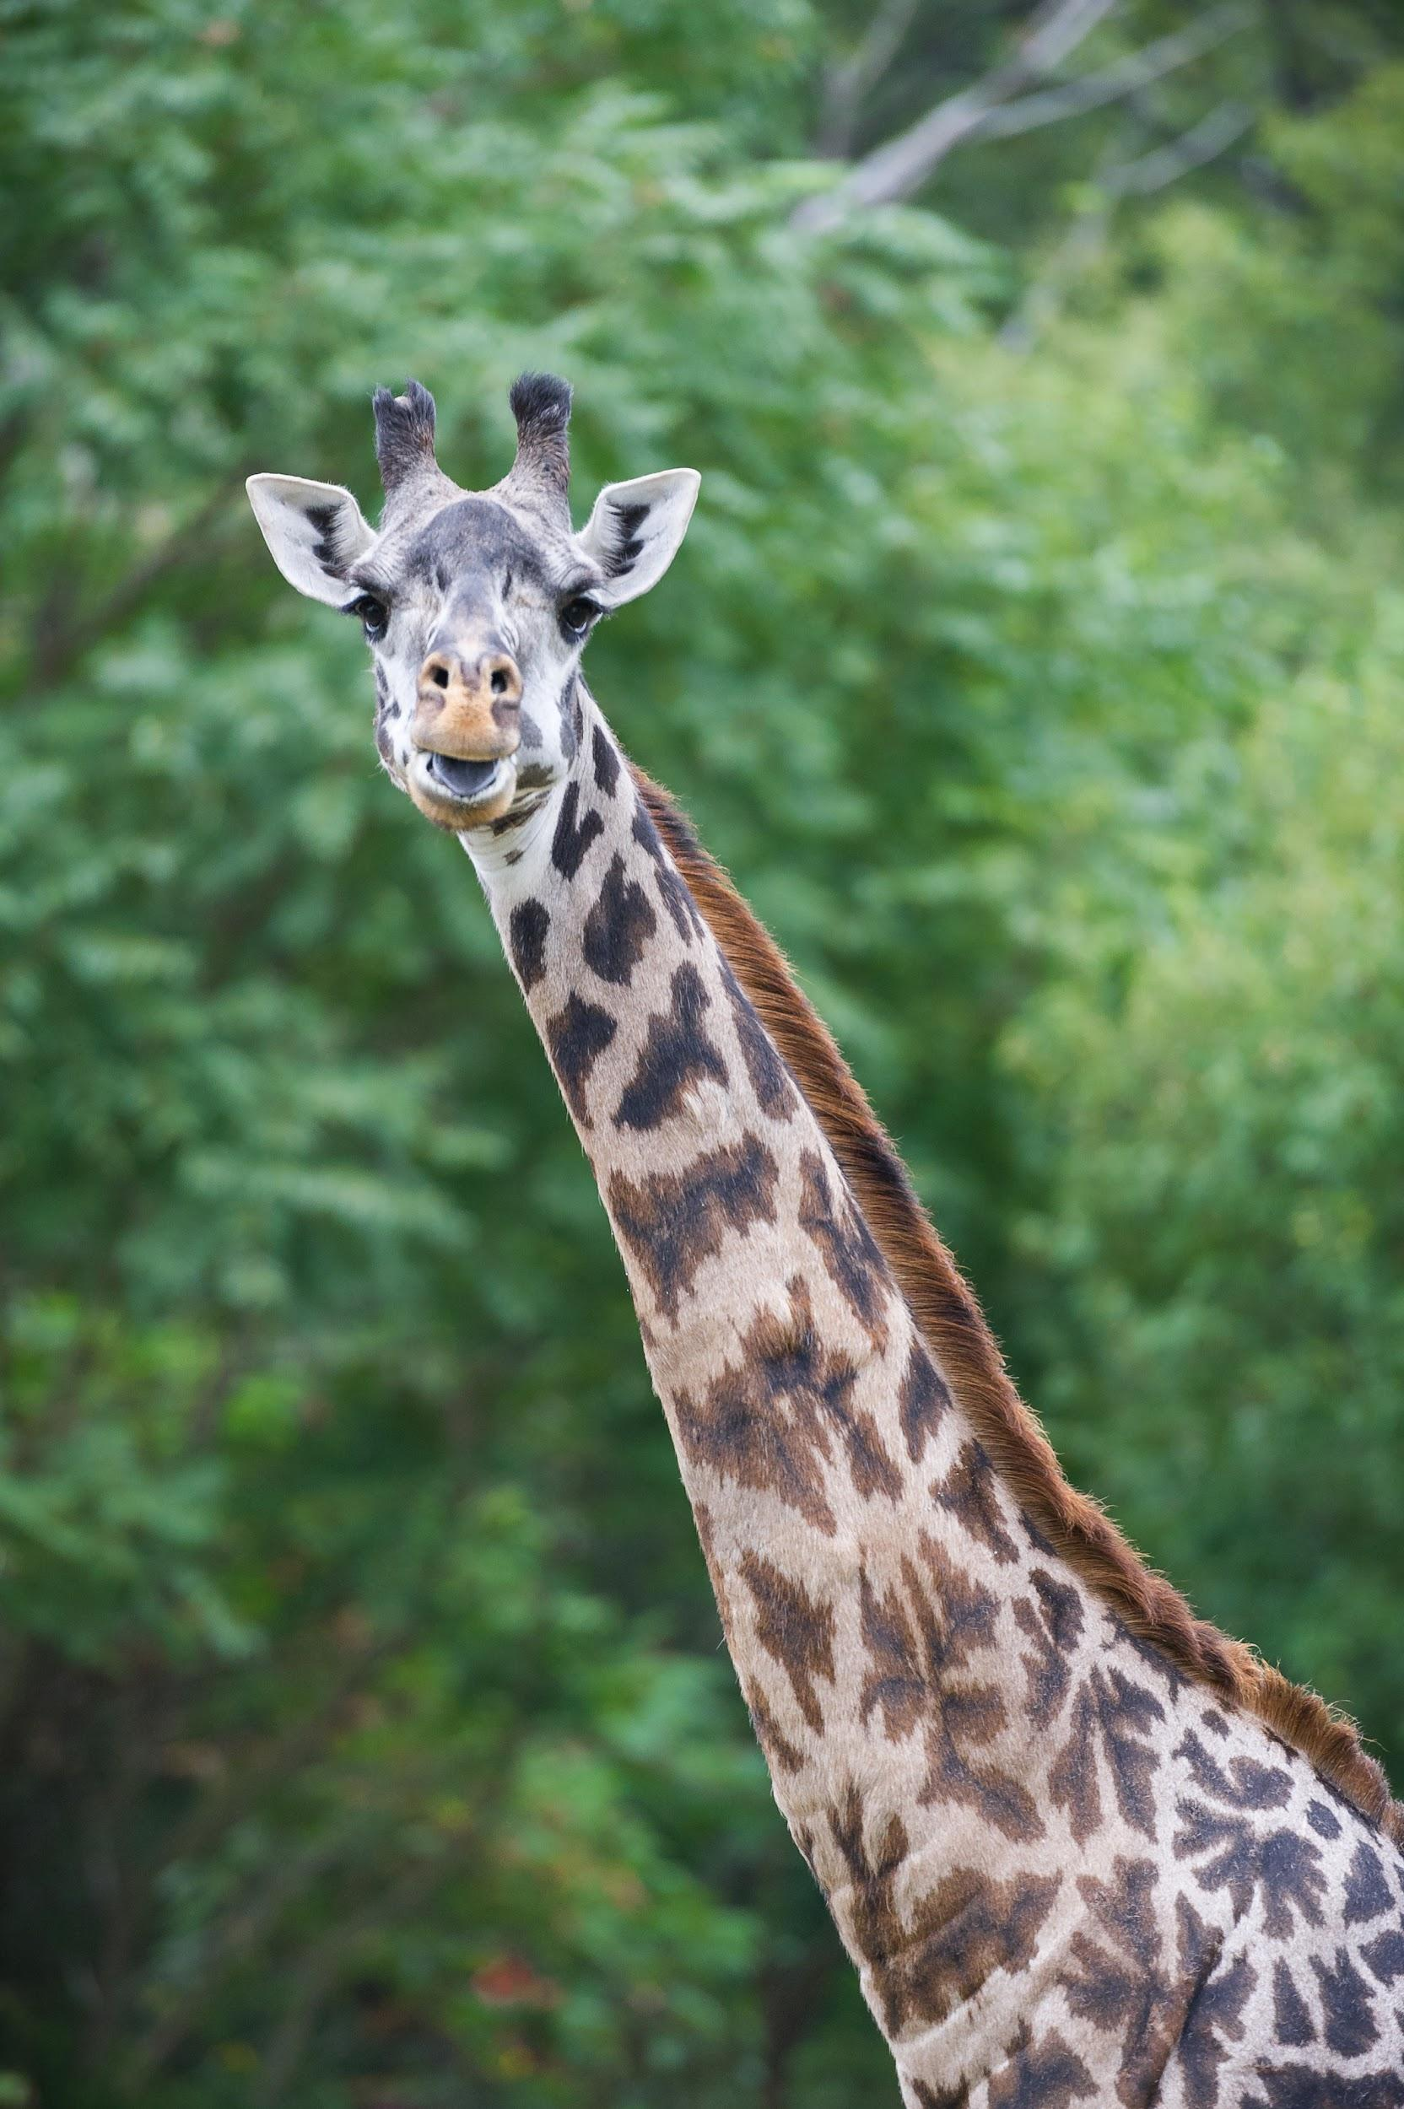
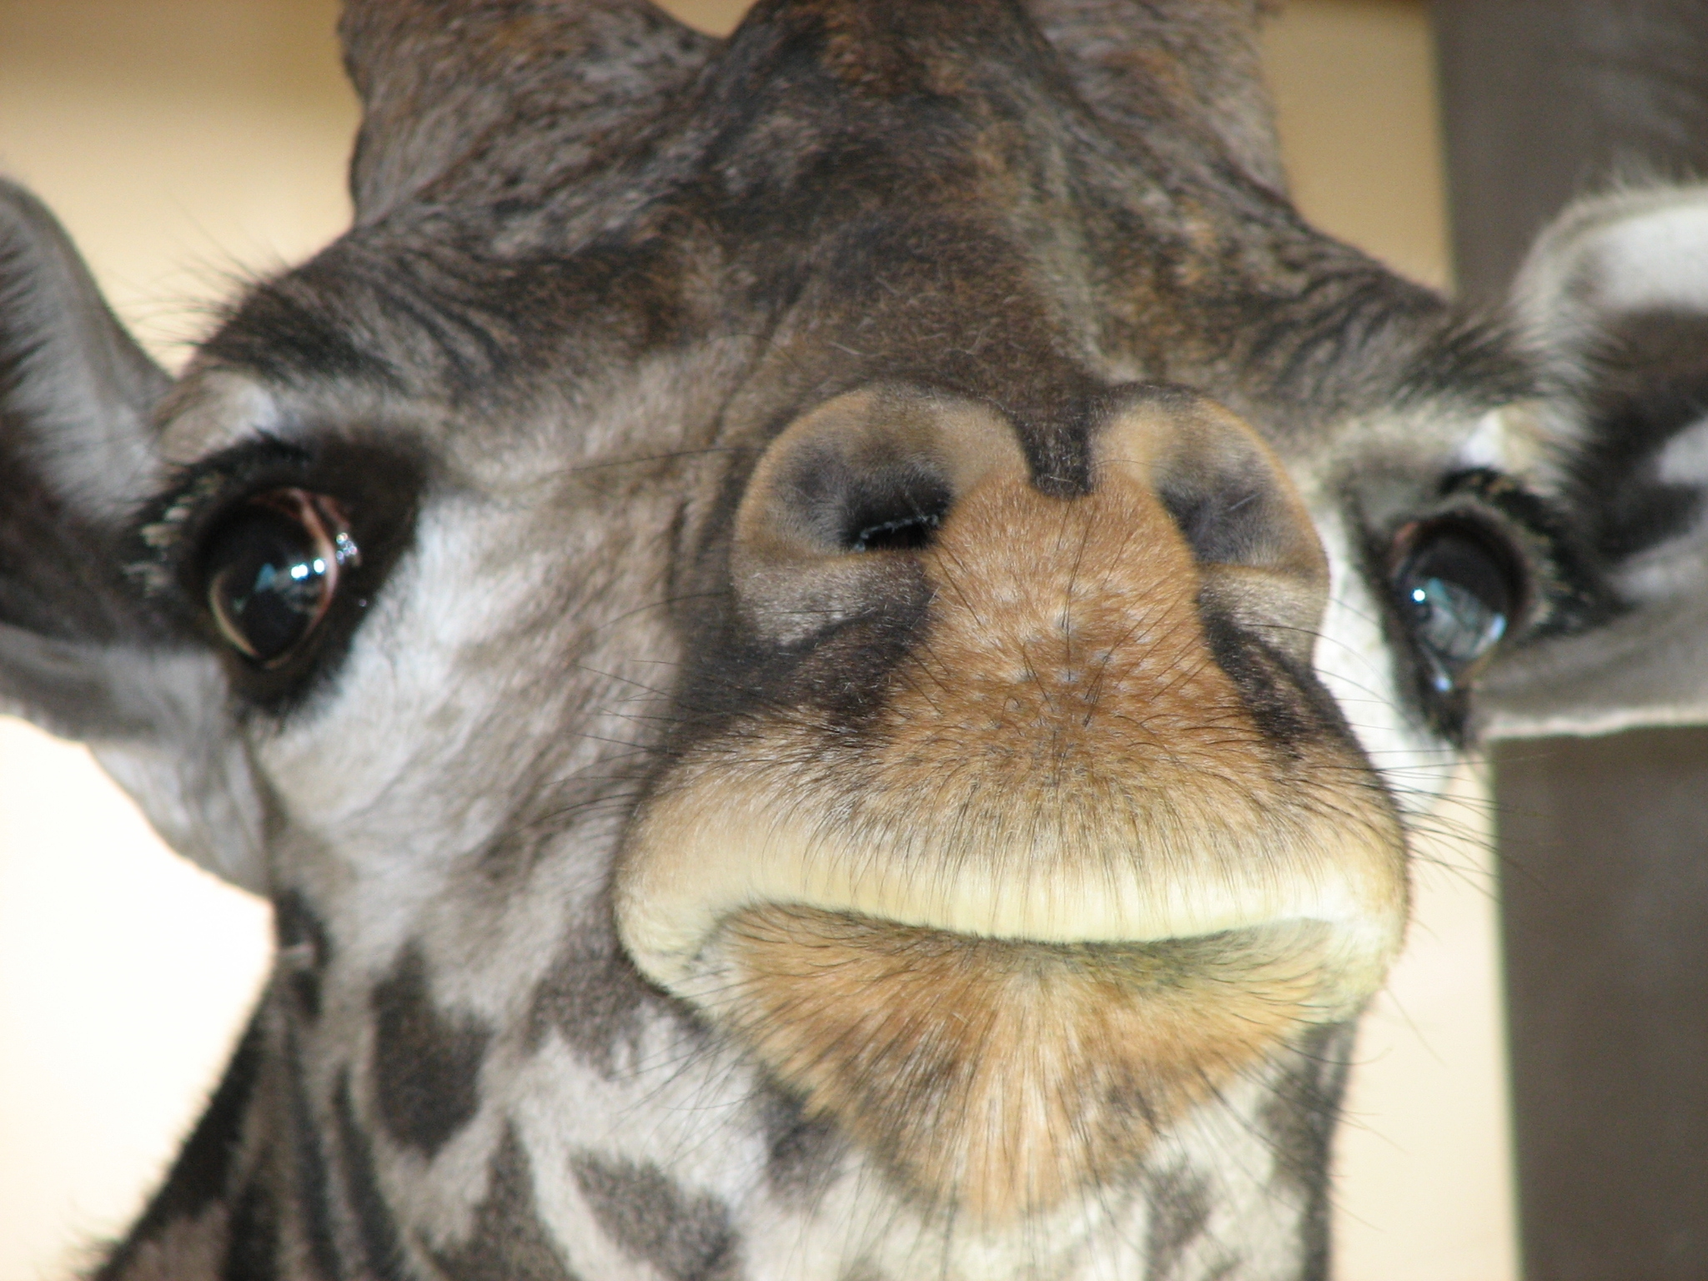
Adaptations to survive
Giraffes use their very long necks to eat leaves on high trees, and also to keep track of predators.
Notes:
1 Background Color
1 Title (or write the question)
1 Pictures
1 Include Transitions
0 Answering question using complete sentences (multiple sentences if needed to fully explain your answer)
1 Accuracy of information
5
TAdaptations To Survive… since it is not a sentence but is the title.

Slide 10
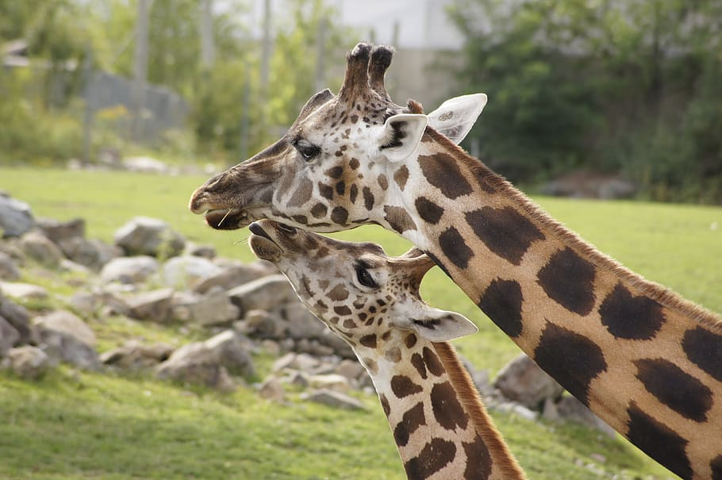
Appearance
The average female Northern giraffe weighs about 1,500 pounds and can grow up to 14 feet tall.
The average male Northern giraffe weighs about 3,000 pounds and can grow up to 18 feet tall.
Notes:
1 Background Color
1 Title (or write the question)
1 Pictures
1 Include Transitions
1 Answering question using complete sentences (multiple sentences if needed to fully explain your answer)
1 Accuracy of information
6

Slide 11
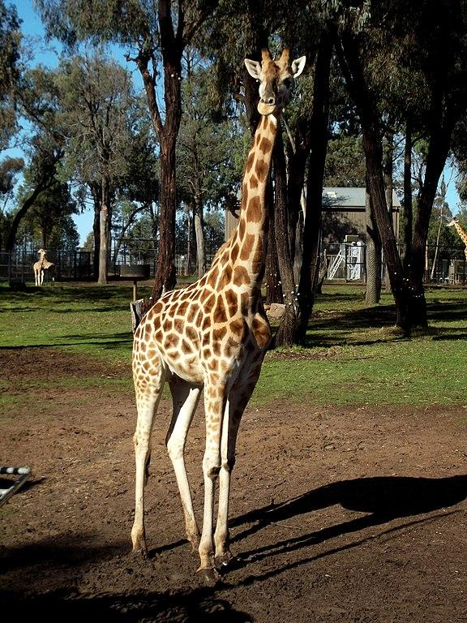
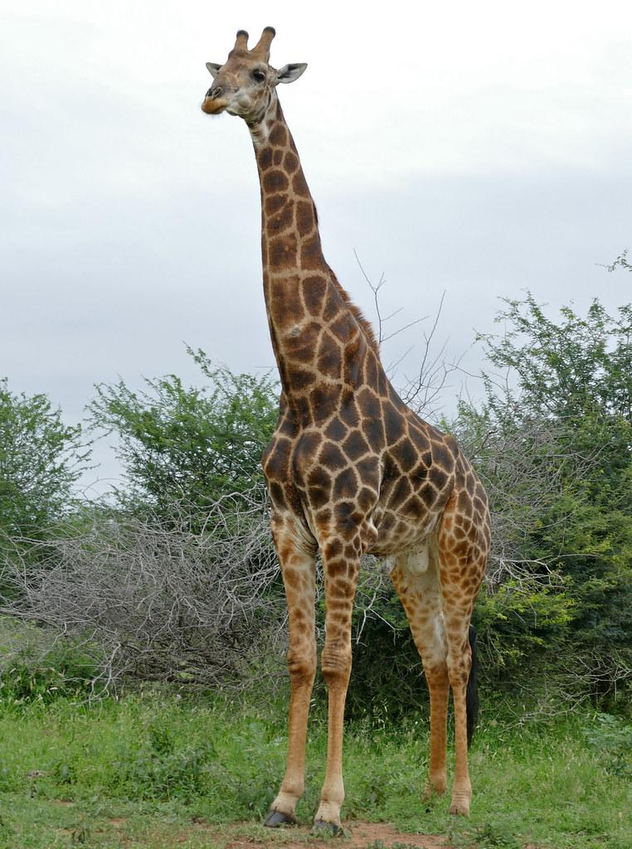
Male and Female
Female
Male
Male and female giraffes are much different in weight and size. The female tends to be lighter and smaller while the males are much heavier and bigger.
Notes:
1 Background Color
1 Title (or write the question)
1 Pictures
1 Include Transitions
1 Answering question using complete sentences (multiple sentences if needed to fully explain your answer)
1 Accuracy of information
6

Slide 12
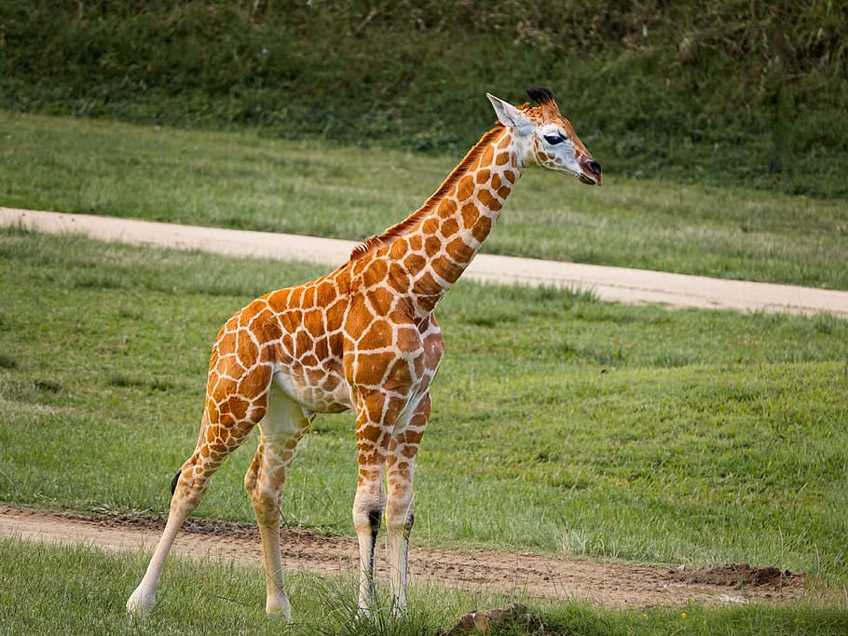
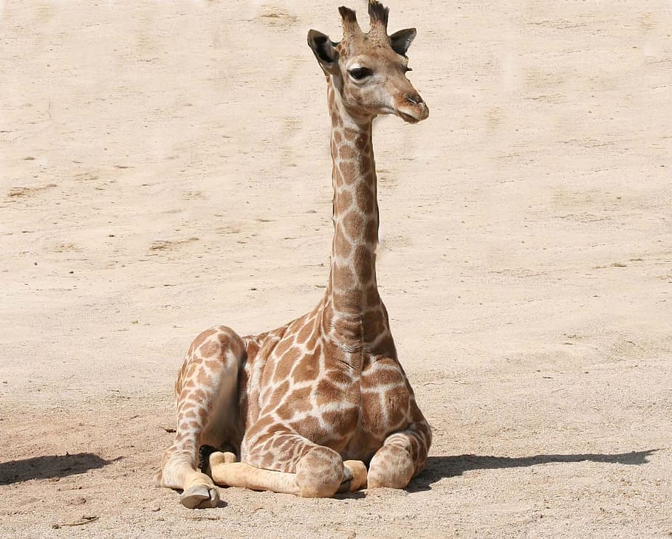
Giraffes lifespan
The average giraffe can live up to 26 years in the wild and slightly longer in captivity.
Notes:
1 Background Color
1 Title (or write the question)
1 Pictures
1 Include Transitions
0 Answering question using complete sentences (multiple sentences if needed to fully explain your answer)
1 Accuracy of information
5
Giraffes Lifespan since it is not a sentence but is the title.

Slide 13
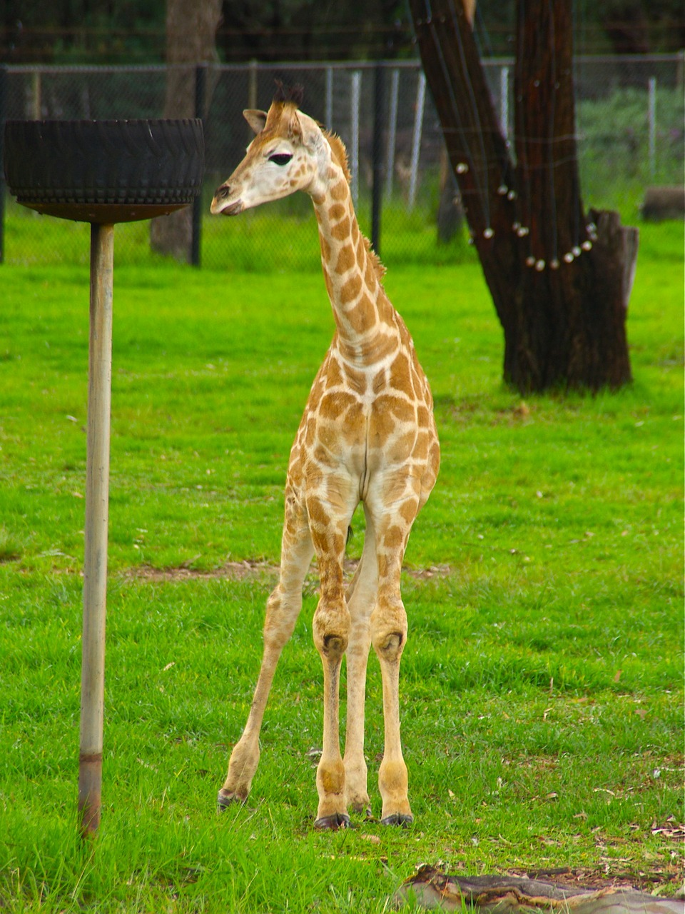
Interesting facts pt. 1
1. After local extinctions in various areas, giraffes are very endangered.
2. A giraffe's neck is too short to reach the ground.
3. Giraffes sleep and give birth standing up.
4. Giraffes have hearts that are 2 feet long.
Notes:
1 Background Color
1 Title (or write the question)
1 Pictures
1 Include Transitions
0 Answering question using complete sentences (multiple sentences if needed to fully explain your answer)
1 Accuracy of information
5
Interesting Facts since it is not a sentence but is the title.

Slide 14
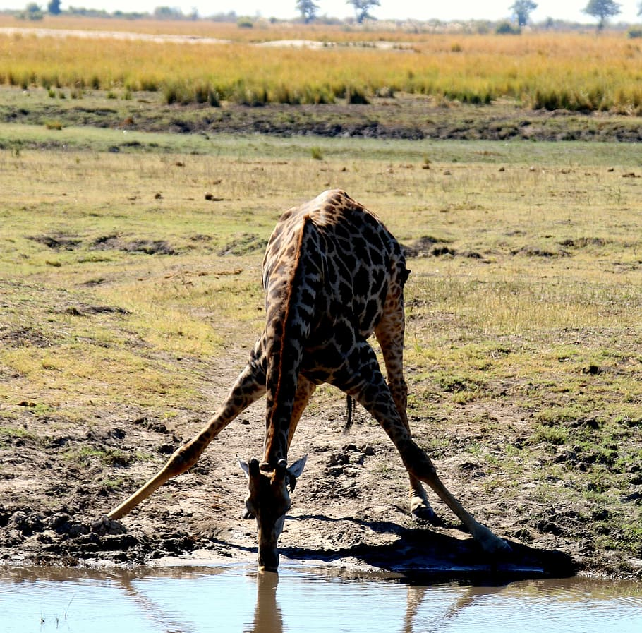
Interesting facts pt. 2
1. Female giraffes are called cows.
2. Giraffes eat up to 100 pounds of leaves every week.
3. Giraffes tongues can be 21 inches long!!
4. This is how giraffes drink water —->
Notes:
Not scored extra slide. Please put a period after water.

Slide 15

Sources
Wikipedia
www.britannica.com
www.pbs.org
www.dosomthing.org
Notes:
1 Background Color
1 Title (or write the question)
1 Pictures
1 Include Transitions
0 Answering question using complete sentences (multiple sentences if needed to fully explain your answer)
1 Accuracy of information
5
Please make them all hyperlinks or none of them

